Slide 1
Packaging & Deployment at KIT
24.04.2026
E. Blomley – Spring EPICS collaboration meeting 2026

Slide 2




Software Stack
EPICS: 2012
Ubuntu: ~ 2014
Salt: ~ 2016
GitLab CI: ~ 2020

Slide 3

Packaging – Ubuntu LTS & Debian Packages
Ubuntu Core Packages
Basic rule (since 2016?): .deb .deb .deb .deb
Use it as “whitelist” filter
External Software/Libraries
Python Modules
EPICS

Slide 4
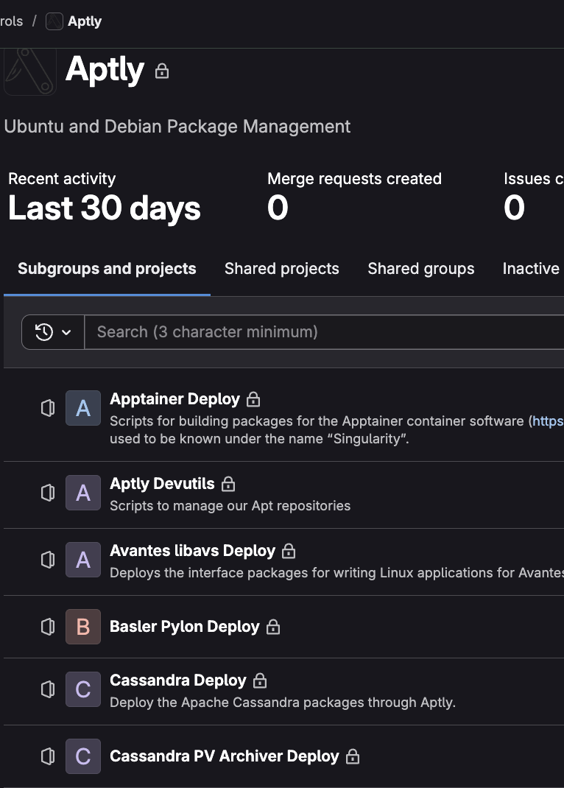
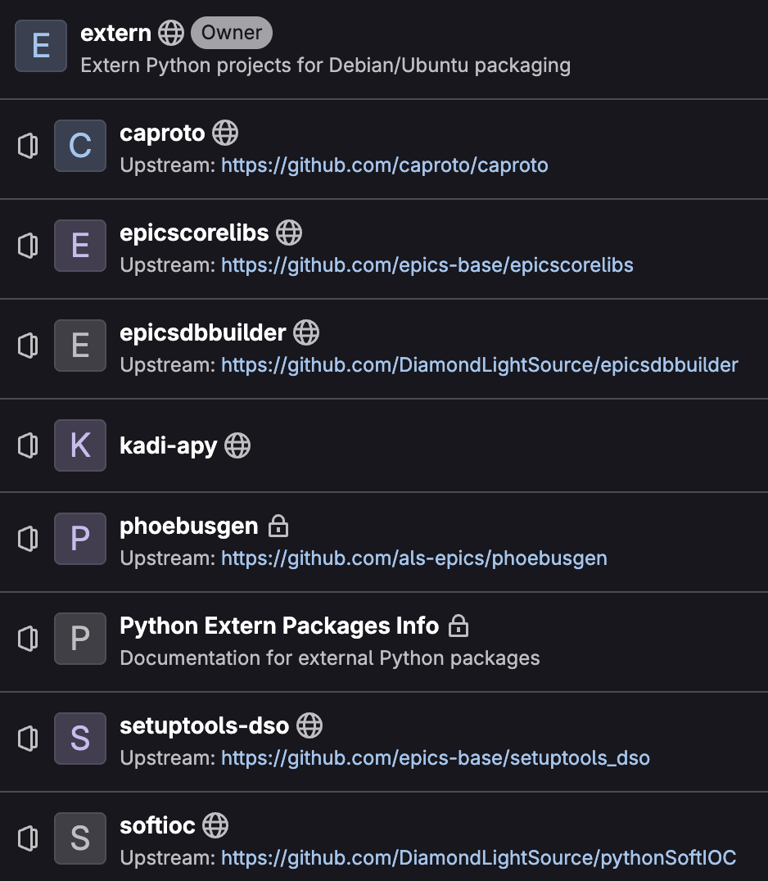
External Libraries & Python
Allow all Ubuntu Python packages
Bundle fixed set of core EPICS related libraries
Mirror or host external .deb
Build .deb via CI

Slide 5
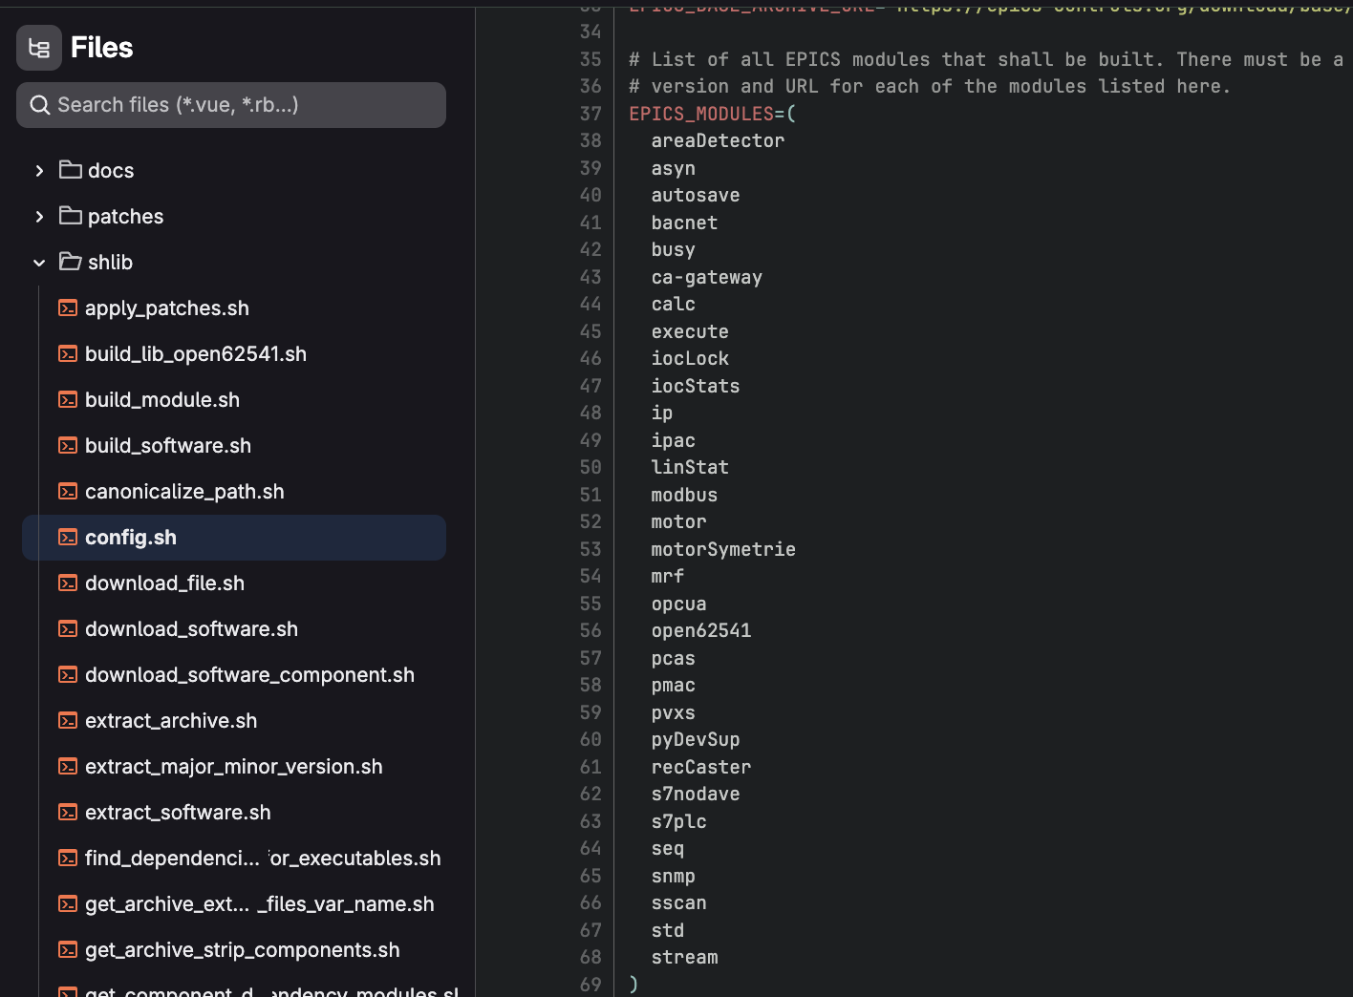
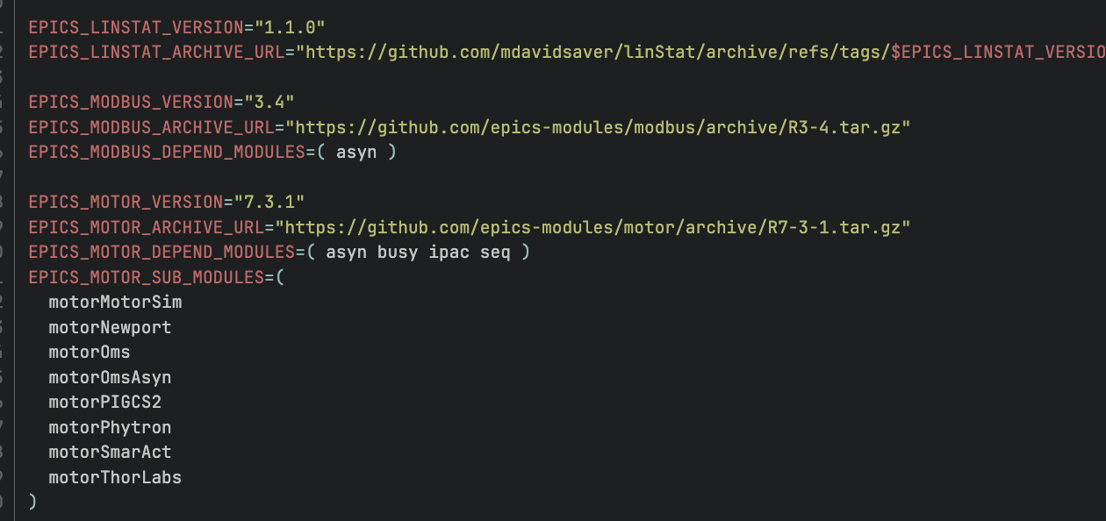
EPICS Packaging
Package EPICS to Debian
BUT: do not follow Debian rules
/opt/epics/base-<version>
/opt/epics/modules/<xyz>
/opt/epics/extensions/<abc>
https://gitlab.kit.edu/kit/ibpt/controls/epics/distribution/epics-build-tool

Slide 6
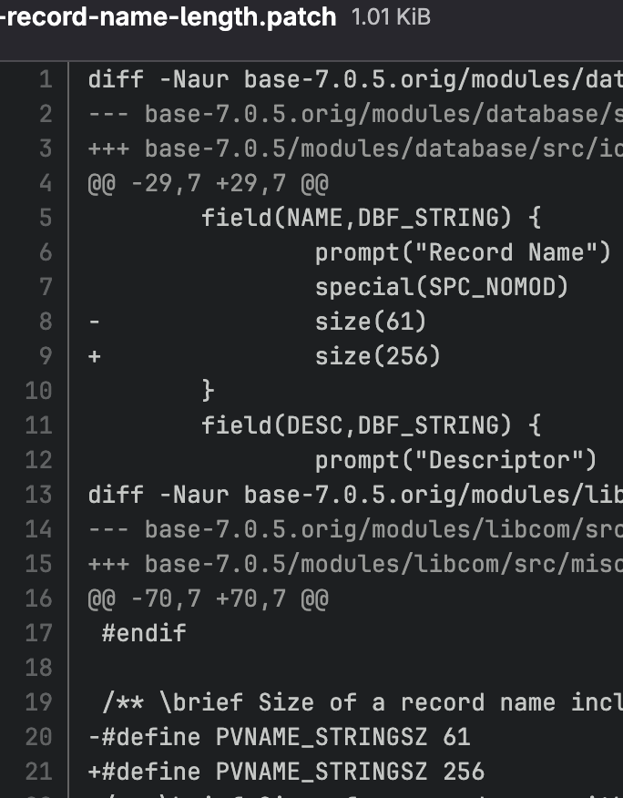
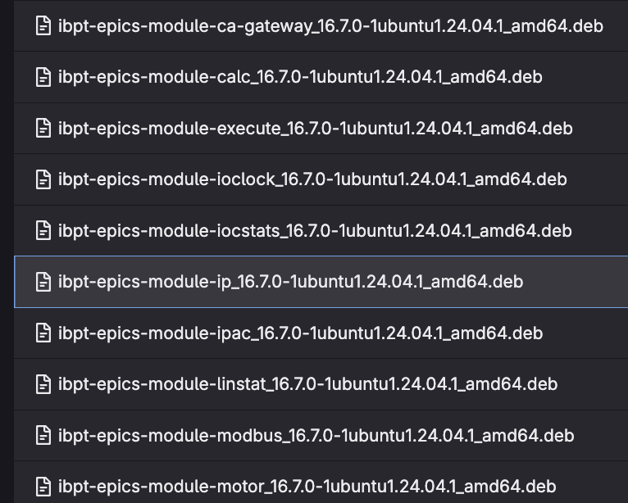
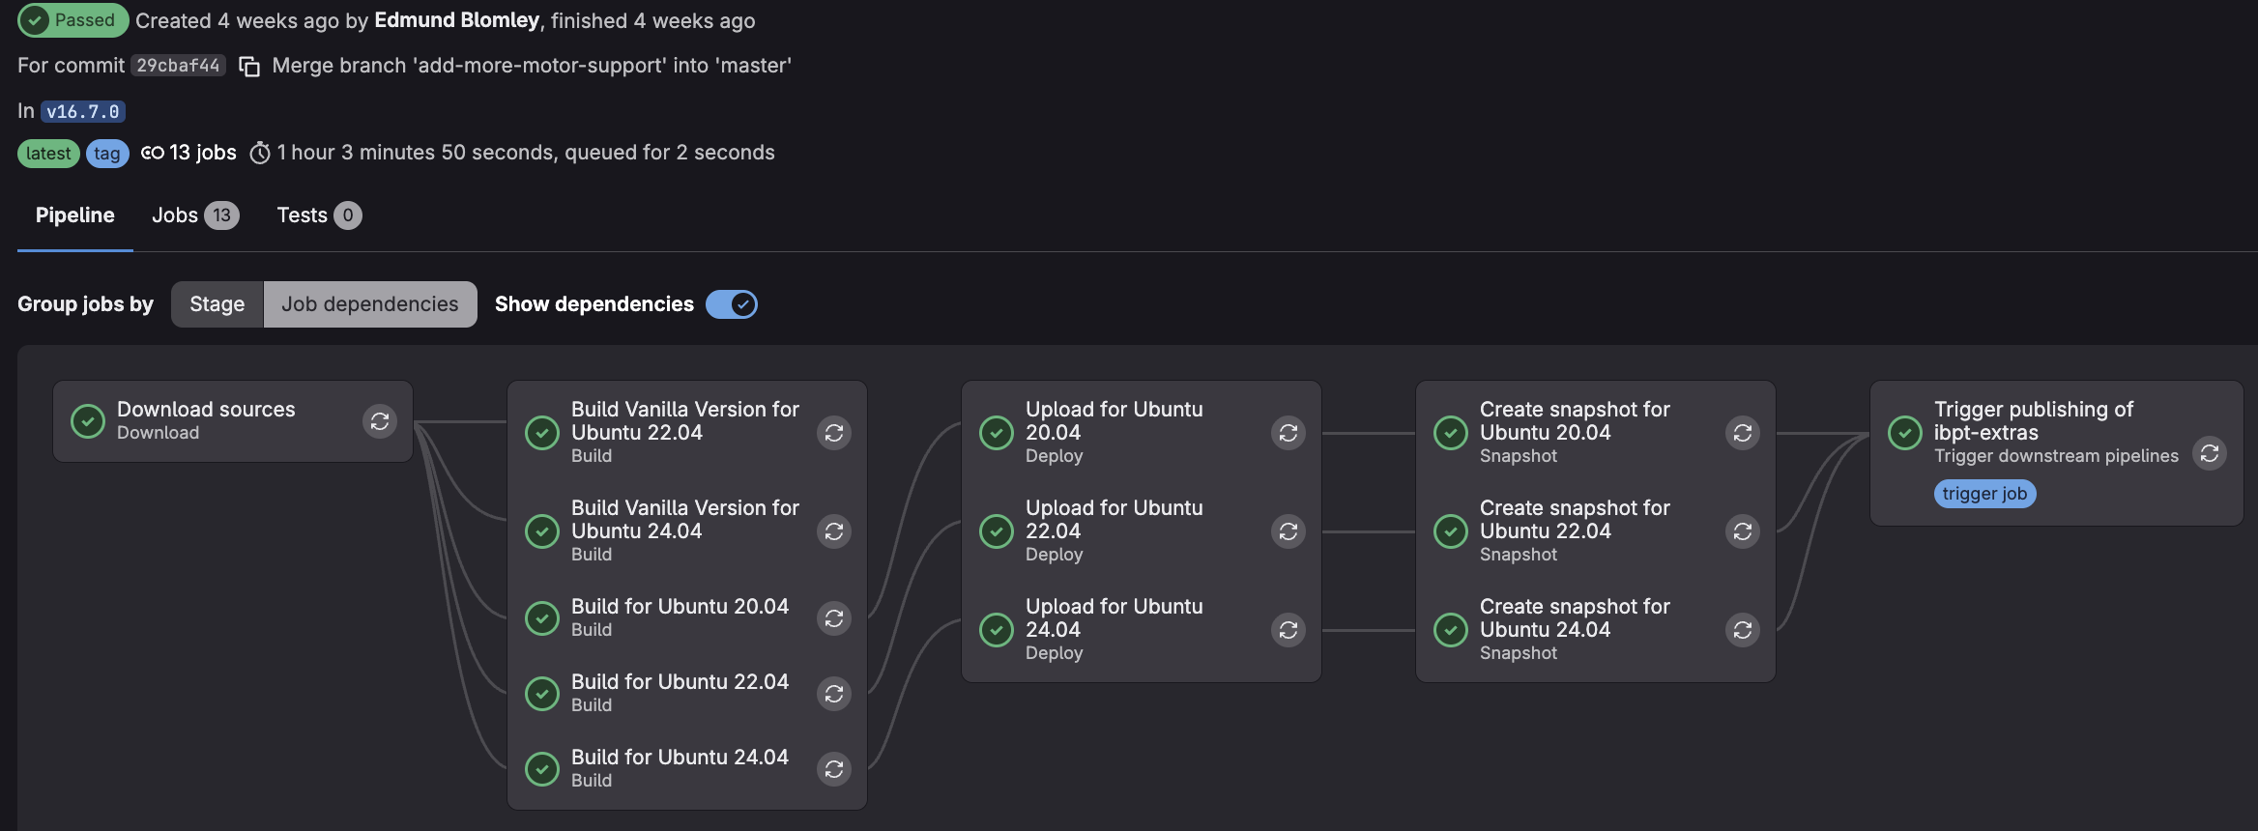
Build CI
Sources (mostly GitHub)
Build (& Bug) Patches
“Vanila” EPICS
Internal Modules
IBPT (*) Patches
IBPT EPICS
Patch & Vanilla split since 2025
Publish to public webserver missing
*Institute for Beam Physics & Technology (IBPT) as part of Karlsruhe Institute of Technology (KIT)

Slide 7
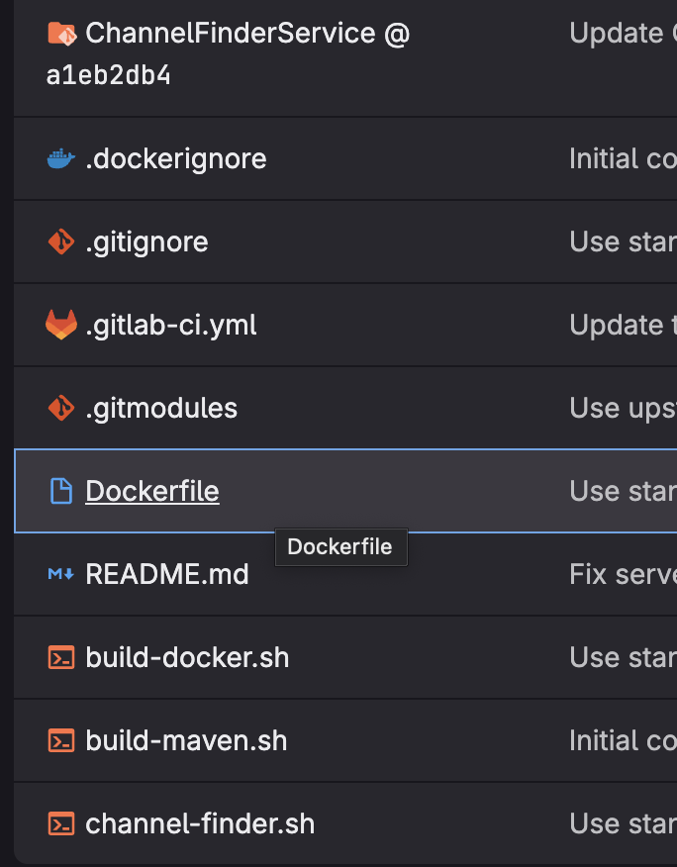
From Zero to EPICS….
IF you run Ubuntu LTS (no other requirements):
< 15 minutes from 0 EPICS to working OPC-UA PLC communication
Tested in a photovoltaics lab
BUT: only solves the EPICS problem
Services are NOT .deb packages
Deployed as Docker services via Salt

Slide 8
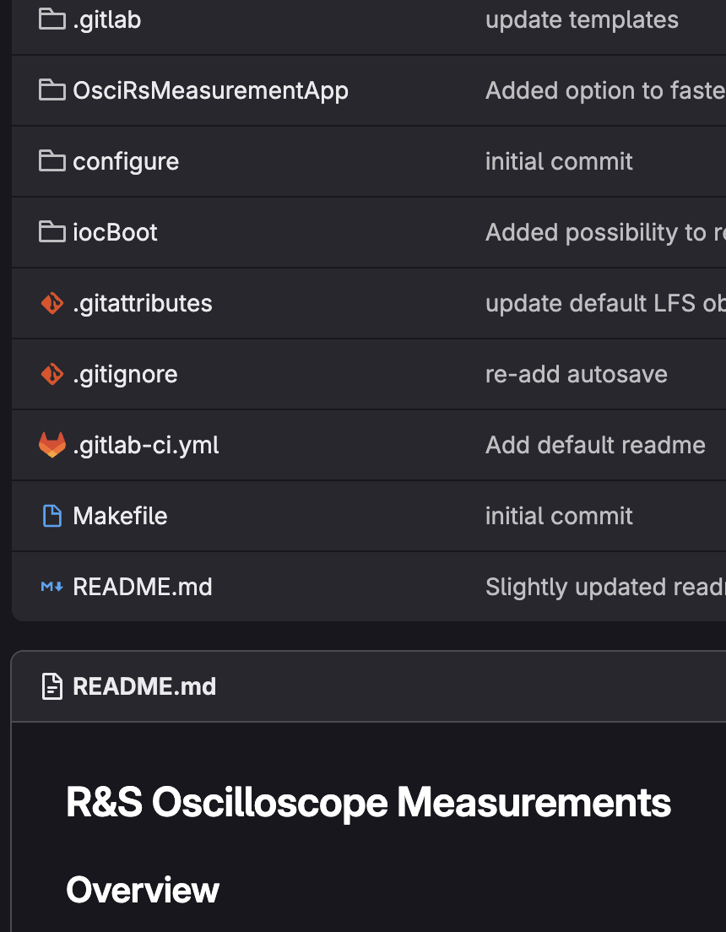
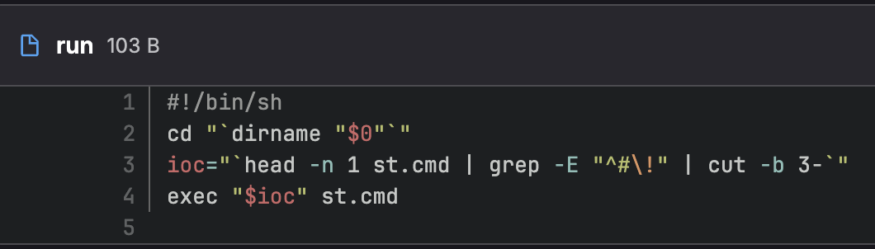
IOC Management
GitLab Project Template
.gitignore
.gitattributes
.gitlab-ci.yml
README.md template
makeBaseApp.pl
+ run executable
Manually set up modules
CI only for README.md publication
After meeting:
Add db->markdown list
Add db->markdown visual
Add tree-sitter based lintings
Add build + run stage with shell output parsing
~200 – 300 IOC GitLab projects
?!?
Base & module version upgrades painful….
Require module?
IOC structure which is just .db .st ?

Slide 9
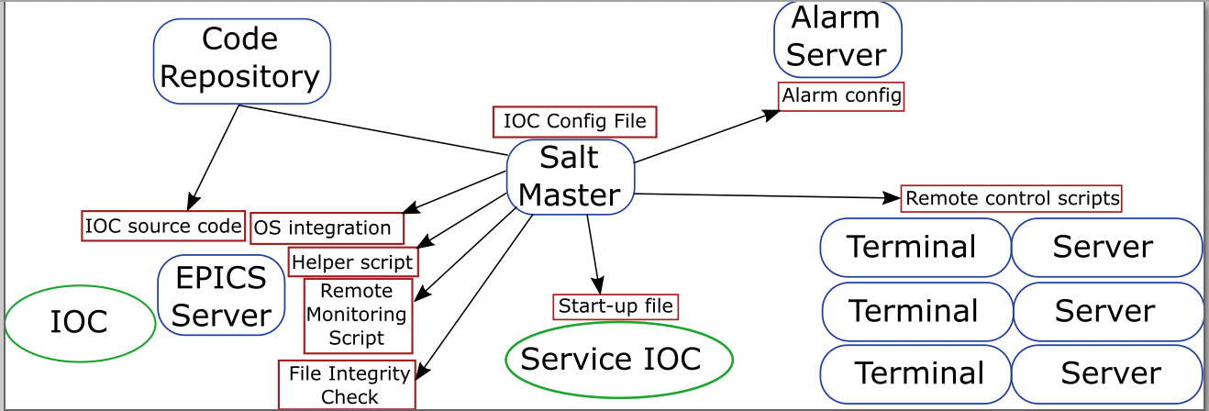
IOC Deployment
[…]
beam-info:
service-name: Beam Info
description: Current,energy,lifetime,dump status
dir-name: beam-info
host: acc-pc-epics01.anka-acc.kit.edu
[…]
camera-url:
autostart: False
service-name: URL Cameras
description: Controls URL cameras via AreaDetector
dir-name: camera-areadetector
host: acc-pc-cam01.anka-acc.kit.edu
[…]
Salt: Single Source of Truth
All configured IOC instances
Which Gitlab project to which host
Additional configuration options
Host has ibpt-epics-base & ibpt-epics-modules-all installed
Automated via Salt
Target host:
Clone IOC
Build
Systemd config
Local launch script
Monitoring scripts
Global:
Alarm server
Remote control scripts

Slide 10
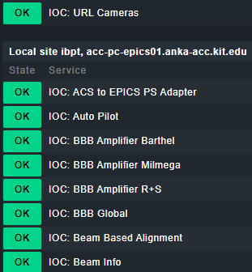
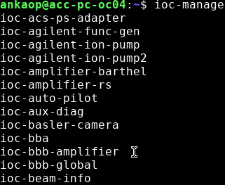
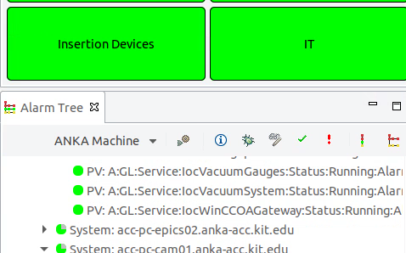
IOC Management
IOCs run in screen sessions wrapped in systemd processes
System logging: Elastic -> Kibana stack
KARA runs 150-160 IOC instances
Terminal – independent of host
Salt injects xml config for alarm server
Salt creates local script for IT monitoring integration (CheckMK)

Slide 11
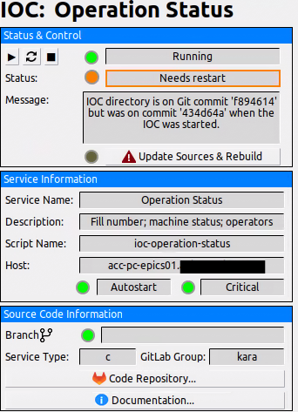
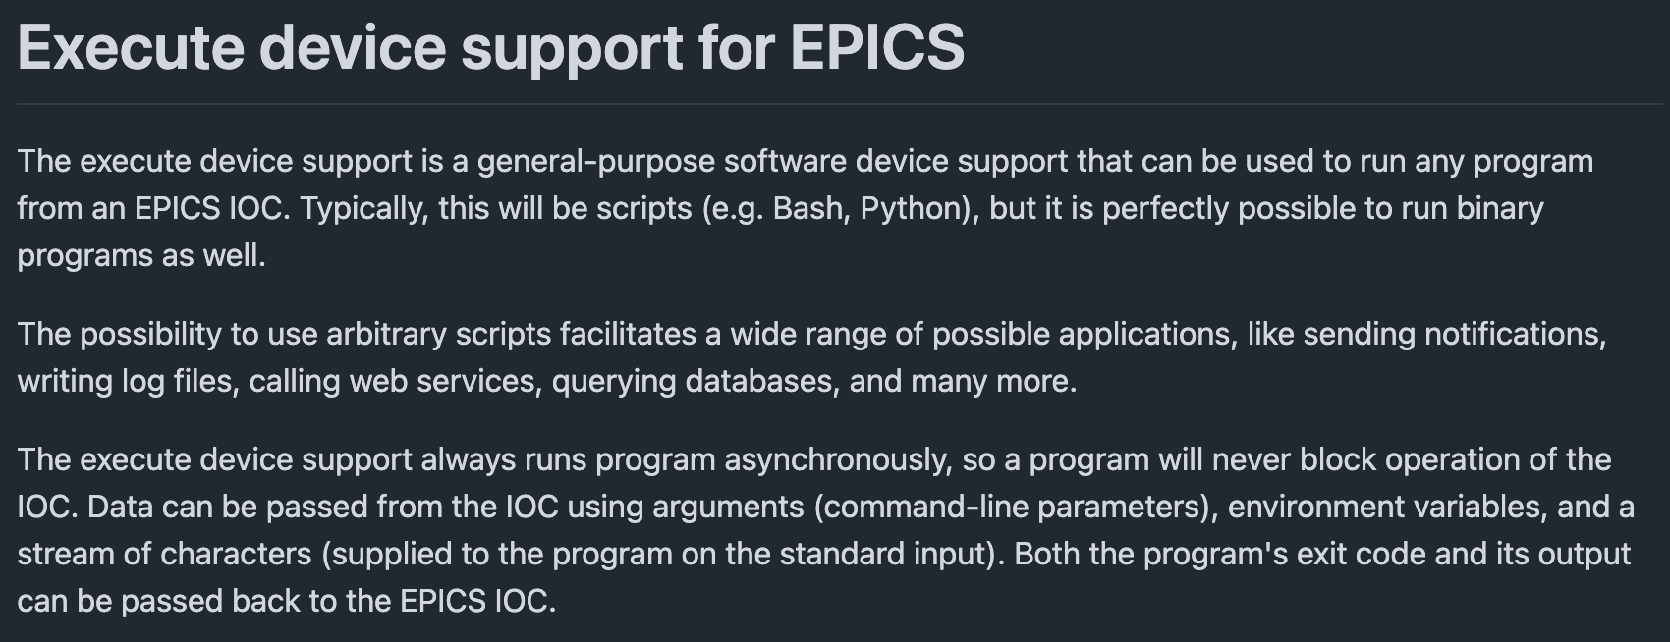
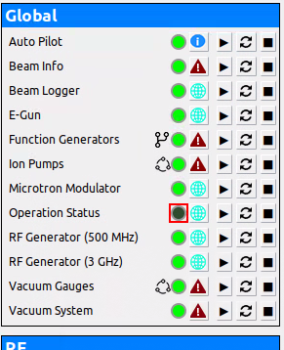
IOC to Manage IOCs
IOC status and basic IOC control via EPICS with panel integration
Inject st.cmd file via Salt to Service IOC
Linstat for every IOC service
https://github.com/KIT-IBPT/epics-execute

Slide 12
















Honorable Mention: Phoebus
Git Projects
Back-End Services
ChannelFinder Upstream
Phoebus Upstream
Git submodule
automatic deployment
ChannelFinder Product
KIT Phoebus Product
KIT Phoebus Launcher
Configurations
Panels
Phoebus Server Cluster
Launcher
Auto Update
Developer
File Storage
Streamed panels
User

Slide 13
Honorable Mention: Embedded Systems, Backups and monitoring
Central IT provides VEEAM for backups and CHECK_MK for IT monitoring
We only backup data drives
No EPICS server, terminals, salt master, …
Use distributed CephFS file cluster for autosave
Embedded systems hardly managed/automated
~80-90 embedded systems vs 150-200 IOCs
Basic idea: VM to manage embedded systems via SSH (backup and configuration)

Slide 14

Operations Schedule creates Opportunities
2026-01
2026-07
2027-01
2 months shutdown
1+ year shutdown
New laser plasma accelerator
Commissioning
Opportunity to rethink packaging, deployment & managing
Also: interest in self-contained EPICS setup for labs

Slide 15
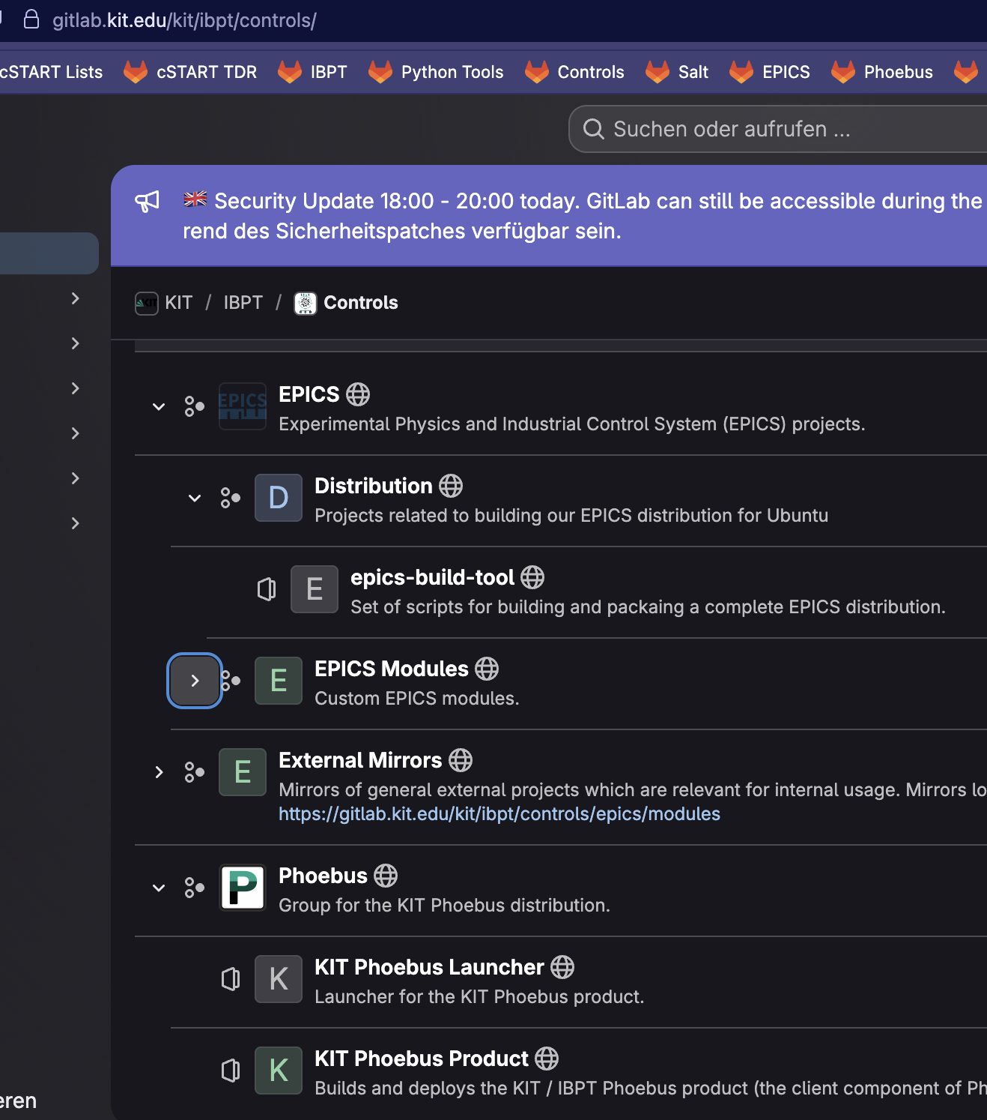
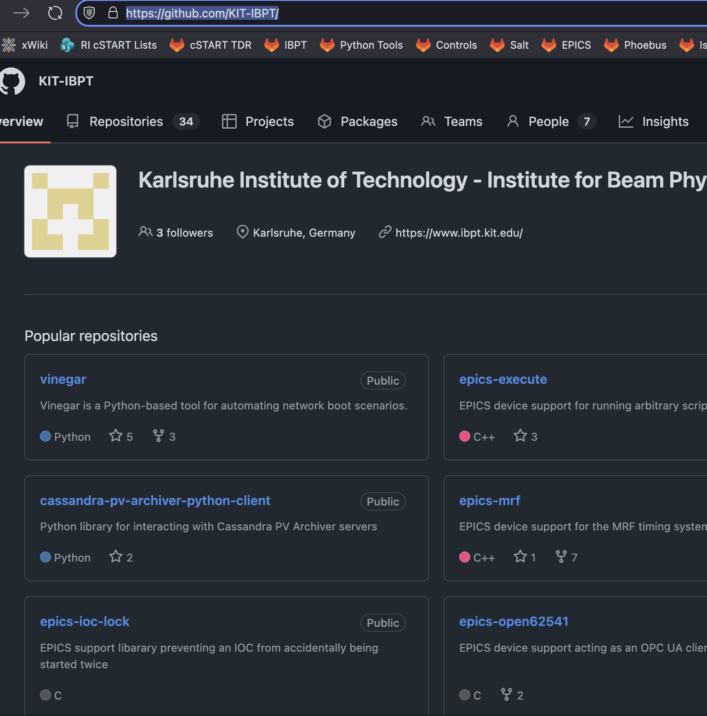
Resources
https://gitlab.kit.edu/kit/ibpt/controls/
https://github.com/KIT-IBPT/

