Slide 1
APS BEAMLINE IOC deployment
April 24, 2026
Nick Marks
Control Systems Engineer
Beamline Controls & Data Acquisition Group

Slide 2
Division of labor
Information Technology Group
Beamline Controls Group
~15 members
Manage network infrastructure, NFS, Linux workstations and beamline machines
15 members
EPICS support and IOC development
Manage EPICS deployments

Slide 3
NFS
Managed by IT group
Each sector has a Linux VM: sNdserv (where N=1-35)
Certain accounts have access to /APSmaster which is where we deploy software.
  cron job runs nightly to rsync /APSmaster to /APSshare mounts at each sector: /net/sNdserv/APSshare

Slide 4
Software deployment
We deploy
  EPICS Base
  synApps
  Other: display managers, scripts, etc.
Compiled for all our supported operating systems

Slide 5
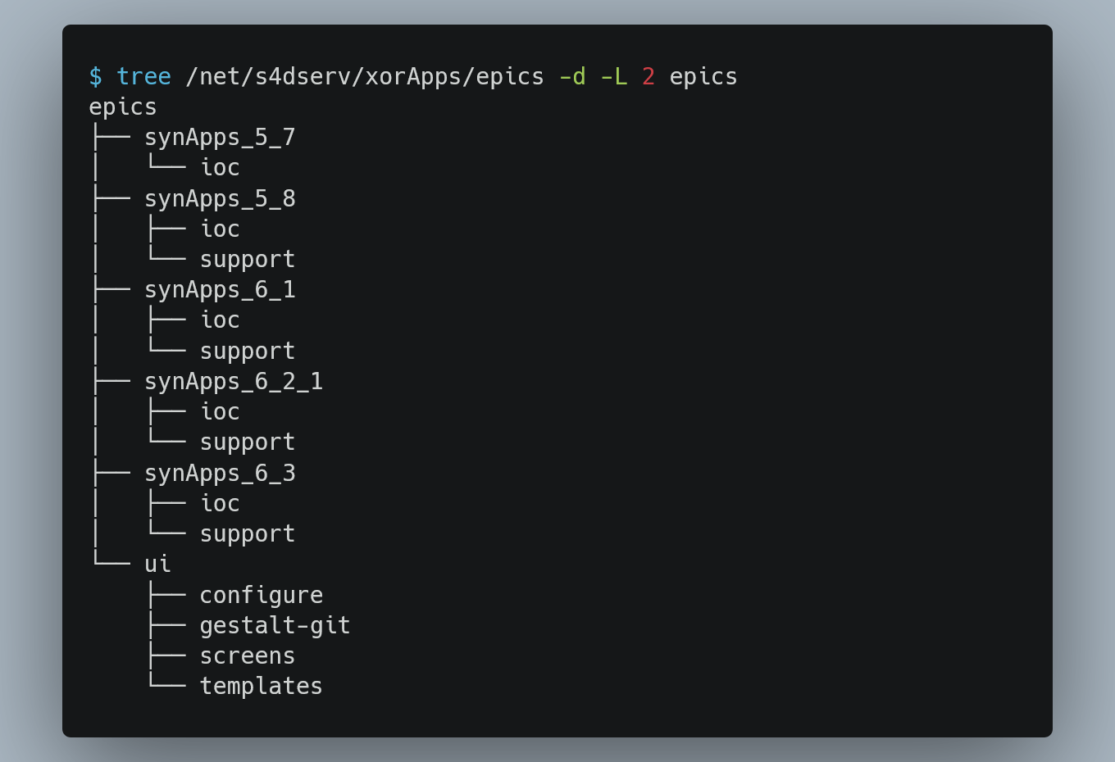
Example Beamline deployment
Organized by synApps version

Slide 6
Example Beamline deployment
Organized by synApps version
  ioc/: IOC applications. Default use compiled synApps on /APSshare

Slide 7
Example Beamline deployment
Organized by synApps version
  ioc/: IOC applications. Default use compiled synApps on /APSshare
  support/: Local support or patches not included in APSshare synApps

Slide 8
Example Beamline deployment
Organized by synApps version
  ioc/: IOC applications. Default use compiled synApps on /APSshare
  support/: Local support or patches not included in APSshare synApps
ui/: Display manager files

Slide 9
Example Beamline deployment
Organized by synApps version
  ioc/: IOC applications. Default use compiled synApps on /APSshare
  support/: Local support or patches not included in APSshare synApps
ui/: Display manager files

Slide 10
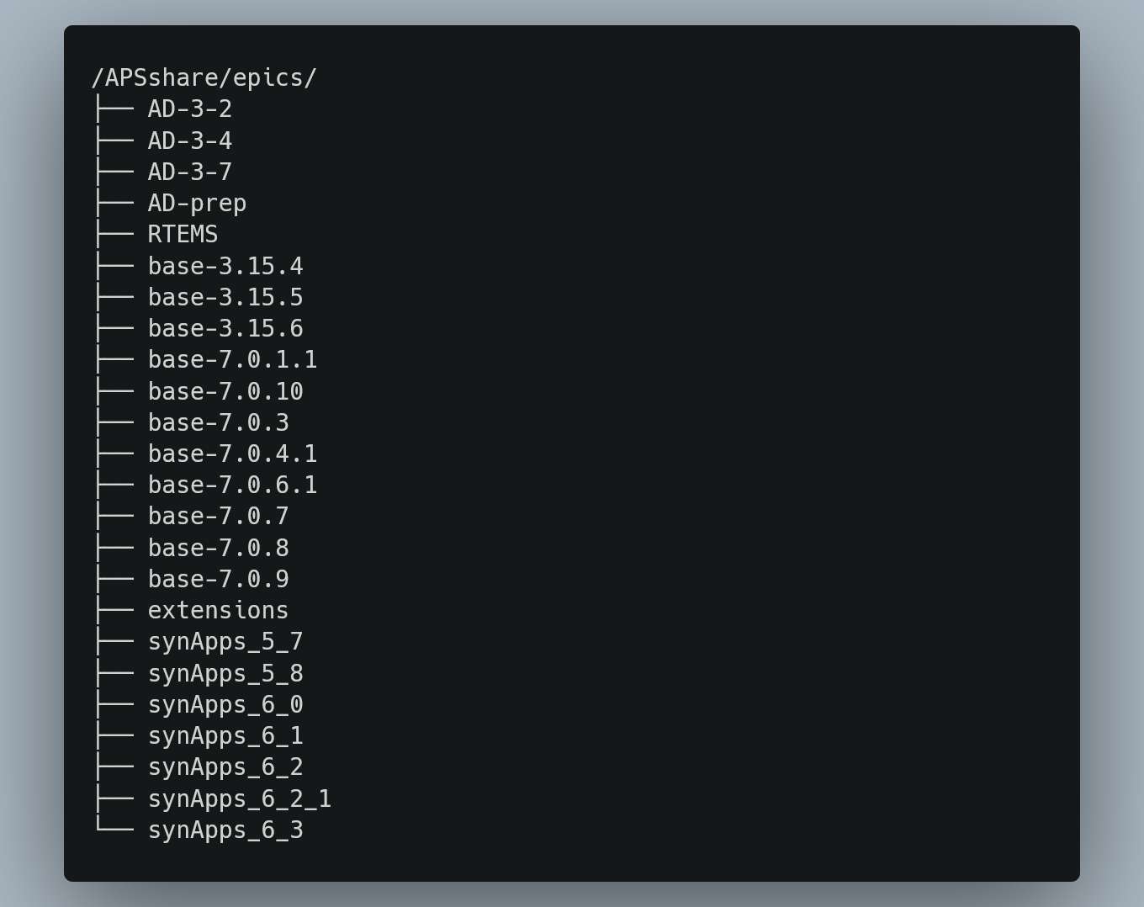
Details
Deploying a new synApps release

Slide 11
Details
Deploying a new synApps release
  assemble_synApps.pl script

Slide 12
Details
Deploying a new synApps release
  assemble_synApps.pl script
  Deploy to /APSmaster, synced the next day /APSshare at each sector

Slide 13
Details
Deploying a new synApps release
  assemble_synApps.pl script
  Deploy to /APSmaster, synced the next day /APSshare at each sector
IOCs updates typically coincide with synApps releases

Slide 14
Details
Deploying a new synApps release
  assemble_synApps.pl script
  Deploy to /APSmaster, synced the next day /APSshare at each sector
IOCs updates typically coincide with synApps releases
  In practice, many IOCs (especially VME) are not updated until something breaks

Slide 15
How you handle testing your infrastructure
How you handle embedded devices
How your administration team and IOC development team collaborate
The size / composition of your system administration team
How you monitor your installation and handle alerts
How you handle backups and recoveries
How you handle technical support
How you manage EPICS dependencies
  Do you ensure every deployment deploys the same version of every support module?
  Or do you let developer choose their own version?
Do you update deployed software regularly?
  If so, what's the process? How much time does it take for the team?
  If not, how do you handle installing older software?

