Slide 1
ISIS Controls
Packaging and Deployment
Ivan Finch
Saclay, Paris
Friday 24 April 2026
Notes:
Make it clear we are not a unified controls team, that Freddie’s team exists and is “Experiment Controls”. I’m only talking about the source / accelerators side of ISIS.

Slide 2
Docker and Docker Swarm
ISIS / STFC / UKRI use Microsoft software but we deploy onto Linux systems. Development via Docker, WSL, or (in the past) Linux desktops. Since we developed and tested in containers it was a natural step for us to deploy containers.
Chose Docker Swarm over Kubernetes:
  Both support failover which is our primary requirement for reliability.
  Kubernetes has more features but much more complexity. Our setup is static, so the extra features provide few benefits.
  Docker Swarms simplicity is its main virtue!
We have production Swarm of three servers / nodes, and a development Swarm of three nodes. Our Infrastructure team plans to move from bare metal server to VMs.
Portainer web interface used to manage Swarms.
Use of PVA Gateways to make PVs inside Swarm visible outside and vice versa. Use of docker_gwbridge to bridge into internal Swarm node networks allow this to work.

Slide 3
Docker Compose
services:
epics-soft-timers-bus:
image: epics-ioc-base-dynamic:main
hostname: epics-soft-timers-bus
environment:
- DEVICE_NAME=timers-bus
- ENGINEER=ISIS Controls
- LOCATION=R80 Server room
- PREFIX="GLOBAL:CNTRL:TIMERS:BUSFIX"
- IOCNAME="IOC"
- PLCNAME="PLC"
deploy:
mode: replicated
replicas: 1
tty: true
networks:
- controls
A Docker Compose file defines a collection of images to deploy as services / running containers.
A Docker Compose file may be run on a local machine for testing or, with some minor additions, as a configuration for a Docker Swarm deployment. In Swarm the collection of containers associated with a single docker compose file is called a Stack. We keep our compose files in a git repository and they are pulled via the Portainer web interface.
Swarm specific

Slide 4

GitLab CI/CD
GitLab
Use STFC GitLab (free version of GitLab) internally hosted by STFC SCD for our repos.
Use GitLab for continuous integration (CI) and continuous deployment (CD)
CI/CD Runners on our development swarm, using docker-in-docker.
Three stages for build and deployment via CI/CD:
Build IOC image from push to repo
Push image to Harbor image registry
Webhook triggers deployment of new image to stack

Slide 5
Pushing Configuration Change to a Single IOC
We quickly determined that it was unsatisfactory to build the configuration of an IOC into the image, and that we wanted trigger an IOC to restart with a new configuration when the configuration changed.
Aqeel AlShafei developed a solution:
When a container starts it has the environment variables DEVICE_NAME and CONFIG_URL
It pulls its configuration from an Nginx webserver which serves zipped directories from our epics-configs repository
When a configuration (e.g. single .db file) is changed the CI/CD associated with epics-configs detect the change and uses a webhook to trigger the restart of the associated container.

Slide 6
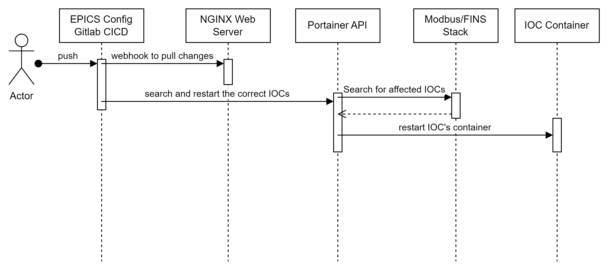
Deployment Pipeline – Gitlab CICD

Slide 7
Docker Swarm and GitLab CI/CD
We use similar processes for the deployment of other key services, e.g.
pvecho – our bridge between our old control system and EPICS
p4p – we have some “unconventional” IOCs
We also make use of other features of Docker Swarm:
Secrets – for passing containers information that should not be shared or in repos, such as certificates or passwords
NFS Mounts – useful for persistent data or some configurations. (Volume mounts do not work as expected across nodes in the swarm.)

Slide 8
Future Improvements and Potential Issues
We do not yet have a common EPICS Base base image. Each developer creates their own image from scratch including all standard and specific modules.
Currently an IOCs image, docker compose files, CI/CD pipeline, and configuration are spread across three repos. Consolidate these down to one for IOC image and one for all configuration.
Portainer may wish to drop support for Docker Swarm.

