Slide 1

Motorization at CEA
Alexis Gaget IRFU / DIS /LDiSC

Slide 2
10 years ago
1

Slide 3
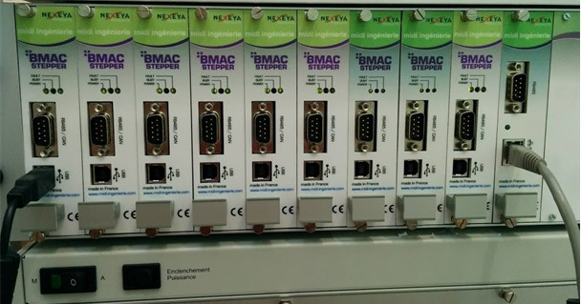
Choice (more than) 10 years ago
S3 (spiral2) / beam blockers insertion
  No coder because of X
  Potentiometer used as position coder
  BMAC controller
    Issue with analog inputs correlated to ambiant temperature ☹
    Recently, we discover issue with broadcast packet.
    Streamdevice
Fact is, we still need to integrate them

Slide 4
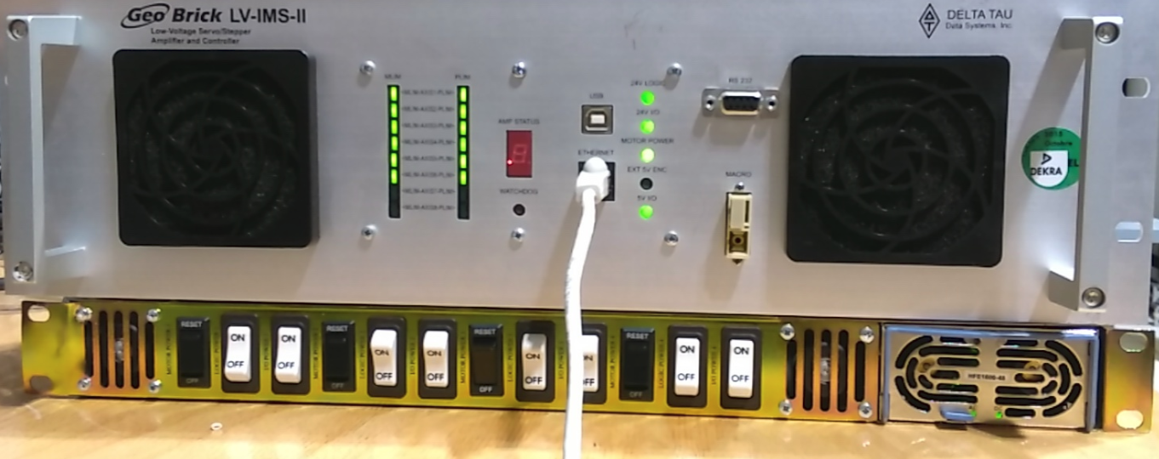
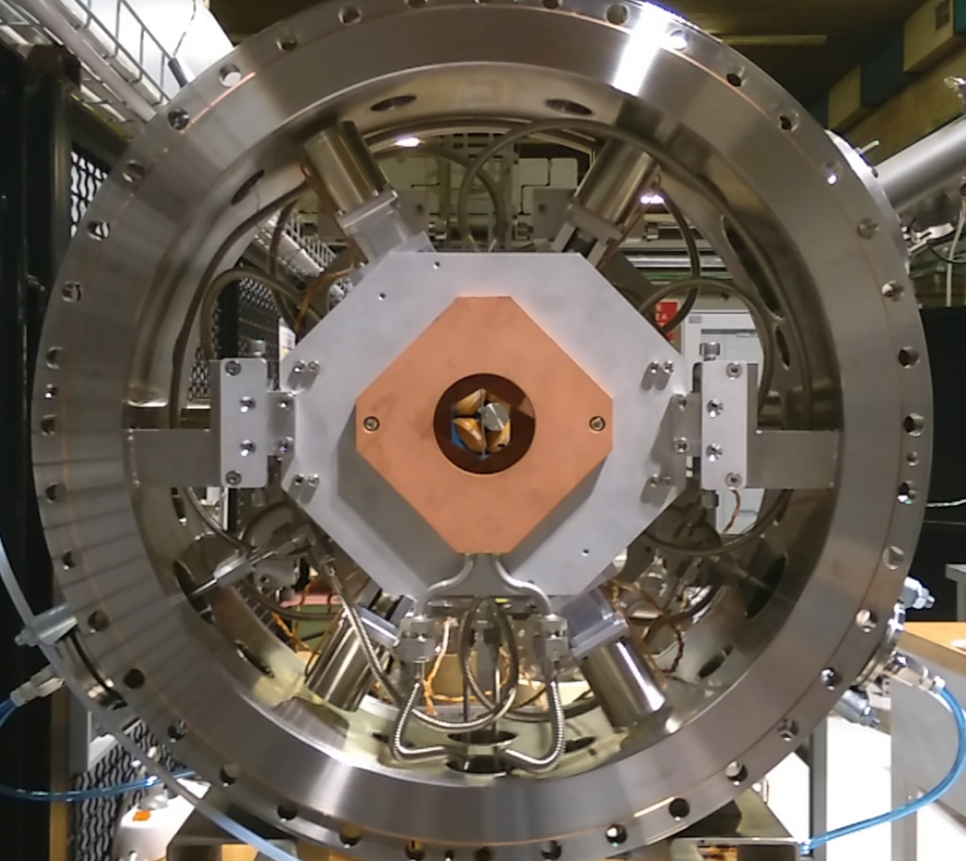
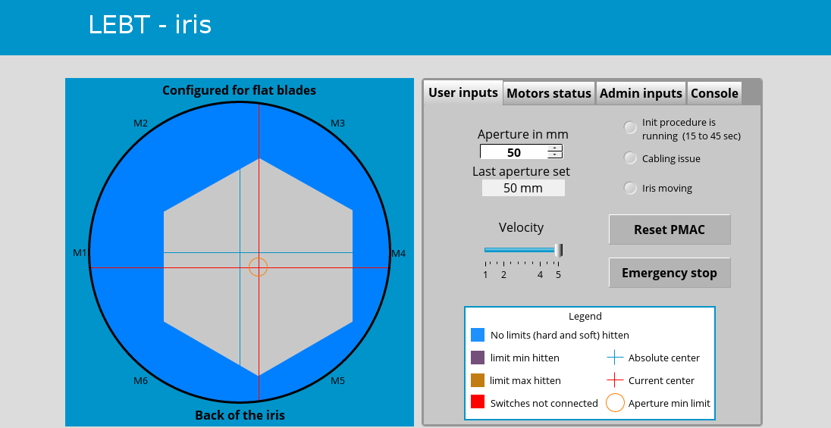
Choice (more than) 10 years ago
ESS Injector (catania):
  Iris LEBT
  Geobrick controller (since replaced with Beckhoff solution I think ?)
  1 traumatized ex-interns that develop FPGA now.
  Streamdevice

Slide 5
5 years ago
2

Slide 6
SARAF motorization
SARAF Injector
  Motorization already existing:
    Motor Stepper
    Potentiometer as position feedback for some motors
    Some with not position feedback at all
    Some with just insertion from hardware limit to another.

Slide 7
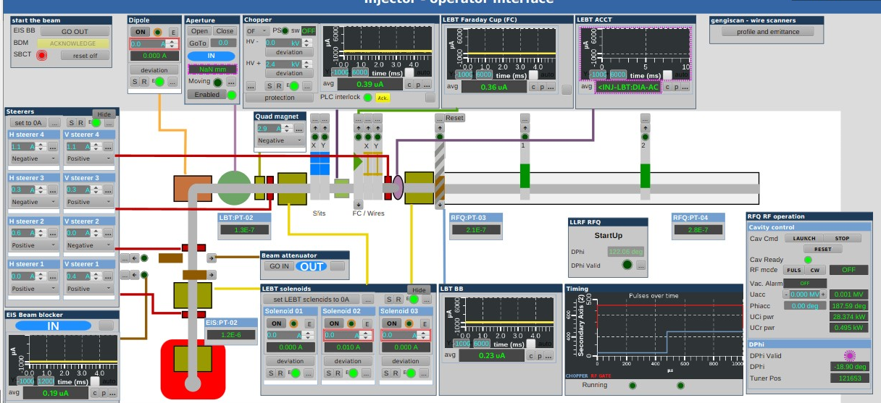
x1 Faraday Cup
x2 WireScanners
x1 Beam Blocker
x2 Plungers
x1 aperture
x2 Slits

Slide 8
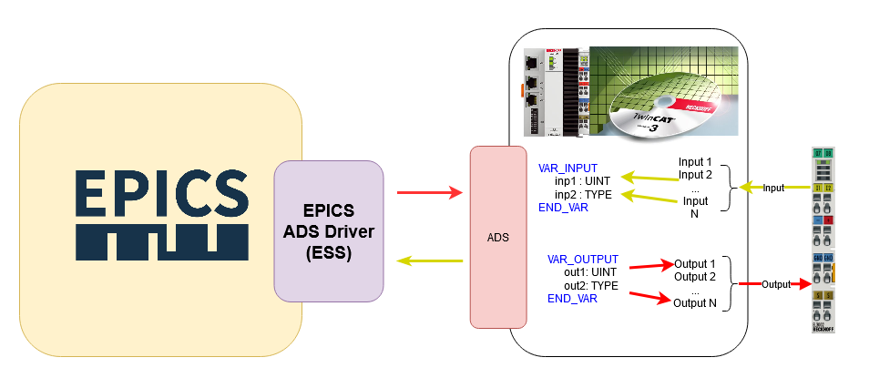
SARAF motorization
SARAF Injector
  We were already using Beckhoff module for I/O with Modbus coupler EK9000
  -> Time to discover Beckhoff driver
  Motor Stepper without coder
    EL7041-0052
    Try to control it with the EK9000 coupler => No conclusive results
    Finally using CX9020 as a CPU.
    Twincat-ads driver (https://github.com/epics-modules/twincat-ads )
      See Torsten workshop yesterday for more information, it is now demystified.

Slide 9
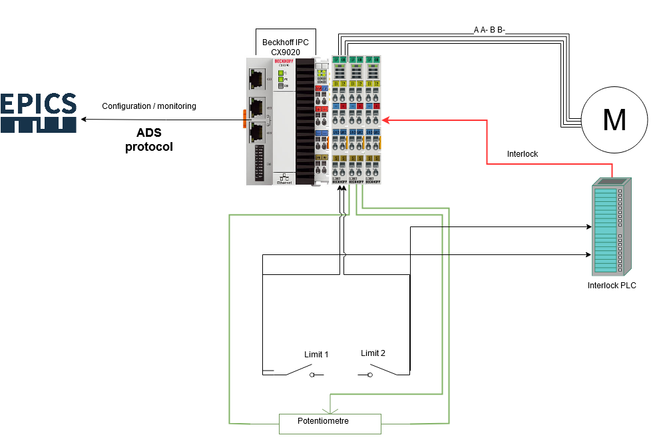
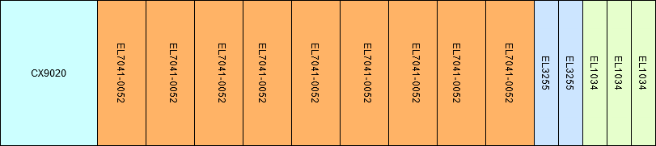
SARAF motorization
SARAF Injector
  9 motors
    x9 EL7041-0052 (with no encoder interface)
    x2 EL3255 10 channels analog input, potentiometer
    x3 EL1034 for hardware limits
Integrated limits integrated in EL7041 behaviour was not compatible to our need. If you touch limit it disabled the driver and motor can’t move anymore… but I want to move in the opposite direction.

Slide 10
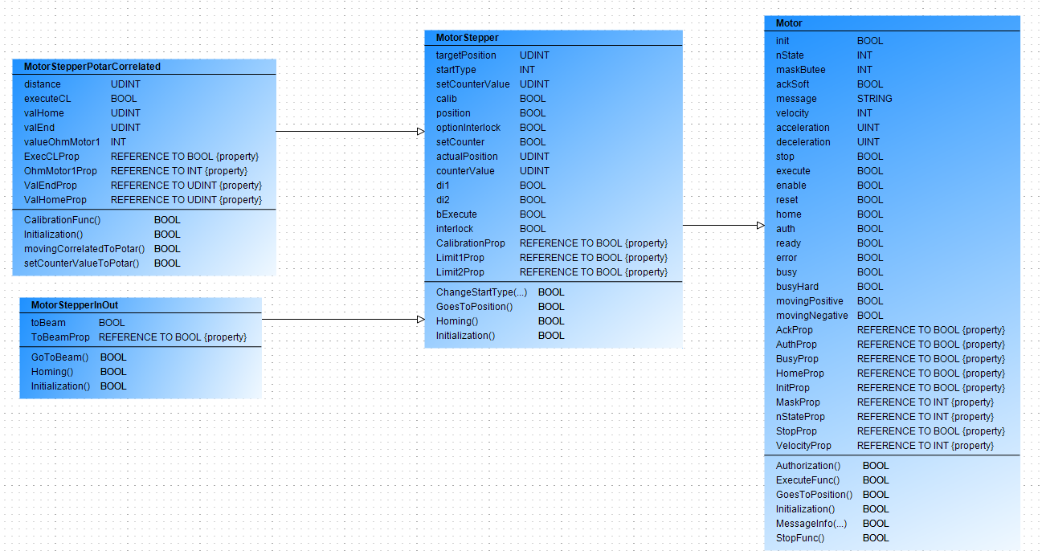
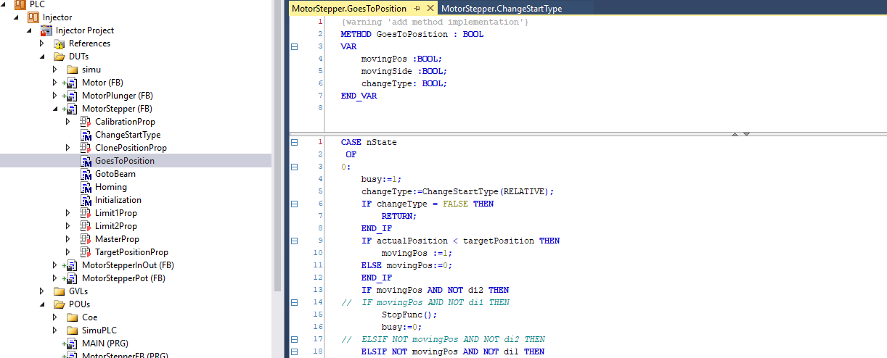
SARAF motorization
SARAF Injector
  No automatic possibility of axes creation with TwinCAT so we needed to build our own code
  Structured Text (ST) code -> EPICS DB library
    Motor
    MotorStepper
    MotorStepperPotarCorrelated
    MotorStepperInOut
  ST code object developer compatible.

Slide 11
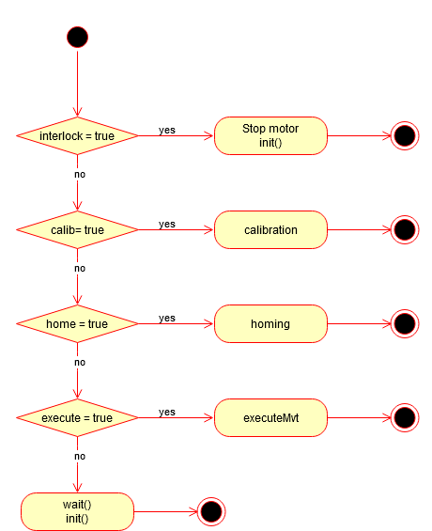
SARAF motorization
SARAF Injector
  Calibration: goes to limit 1 and limit 2 to calibrate reference position, distance between limits ...etc
  Home: goes to limit
  Execute movement according to potentiometer indication.

Slide 12
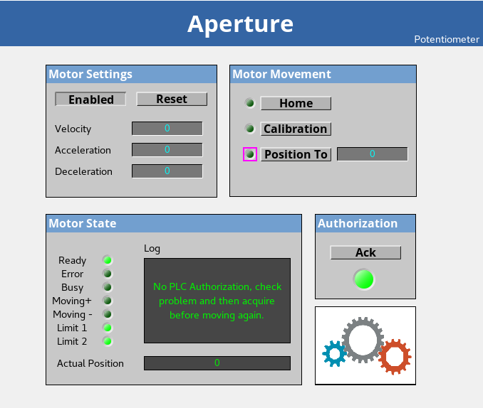
SARAF motorization
SARAF Injector

Slide 13
SARAF motorization
SARAF Mebt
  Soreq team take over and use our code and seems happy with it.

Slide 14
Now
2

Slide 15
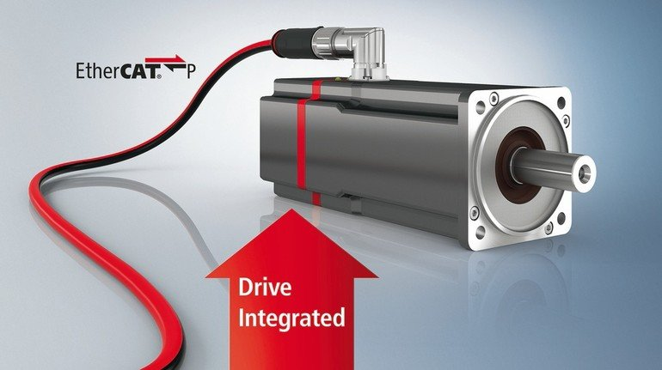
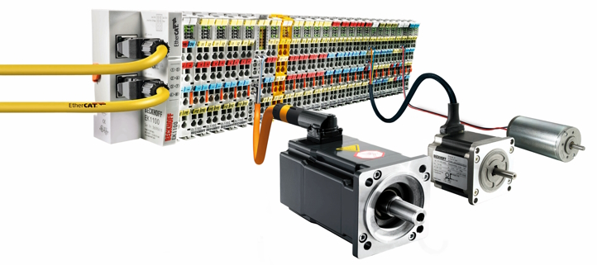
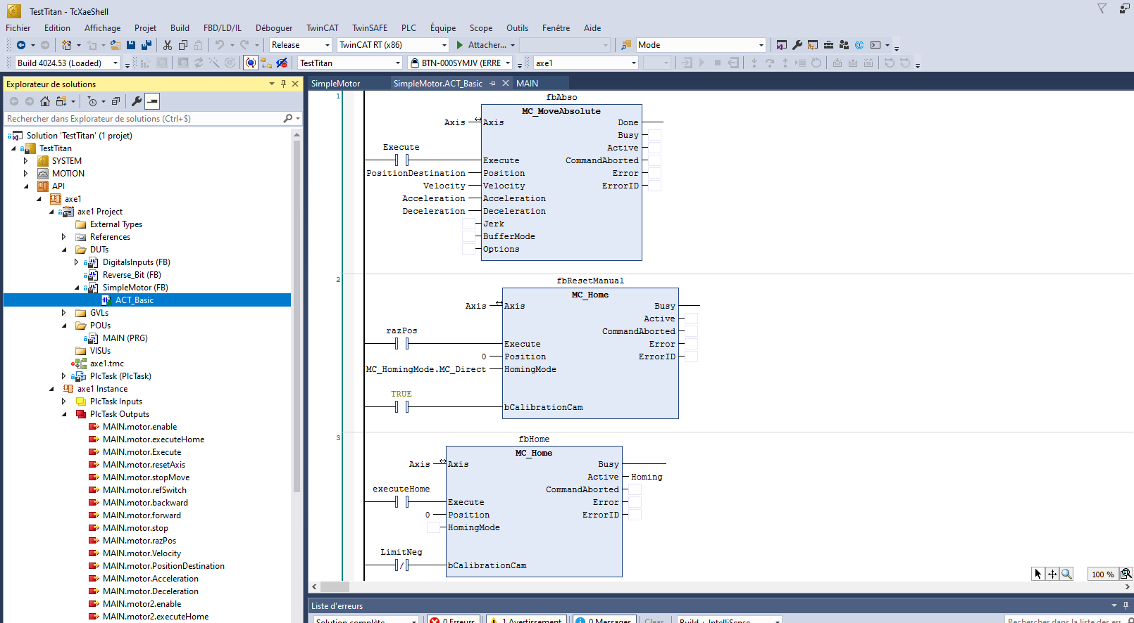
Titan project
Titan motorization
  Slits
  Iris
  EMU
  …
Standardized platform
Motorization: Beckhoff (the whole chain: CPU,Driver, wires, motors and development environment TwinCAT)
  IPC Beckhoff CX5110-9020+ Driver ServoMotor EL7221-9014 + Motor AL8121-0F21
  IPC C6930 + driver AX5201 + Motor AL8011

Slide 16
Titan project
Servomotors an overkill ? Maybe but
Generic translator mechanism design integrates it (translator designed by CEA diagnostic team)
works very well all the time
Great precision, measured at 0,01 cm
Easy to plug
Easy to program in TwinCAT
Engineer hours is more expensive than the cost of equipments !!
so no hesitation.

Slide 17
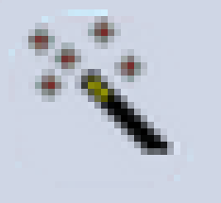
Titan project
💕💕
💕
Titan motorization
  Use of the Servo motor so we can use automatic detection and NC Axis
  Axis can be used with TC_MC2 library. Standard library based on PLCopen specification for Motion Control (plcopen.org)
  We have developed a specific library “EPICS_Motion” in ladder, associated with EPICS template files
    Why Ladder ? Because I want PLC guys to use it and they don’t know dev.

Slide 18
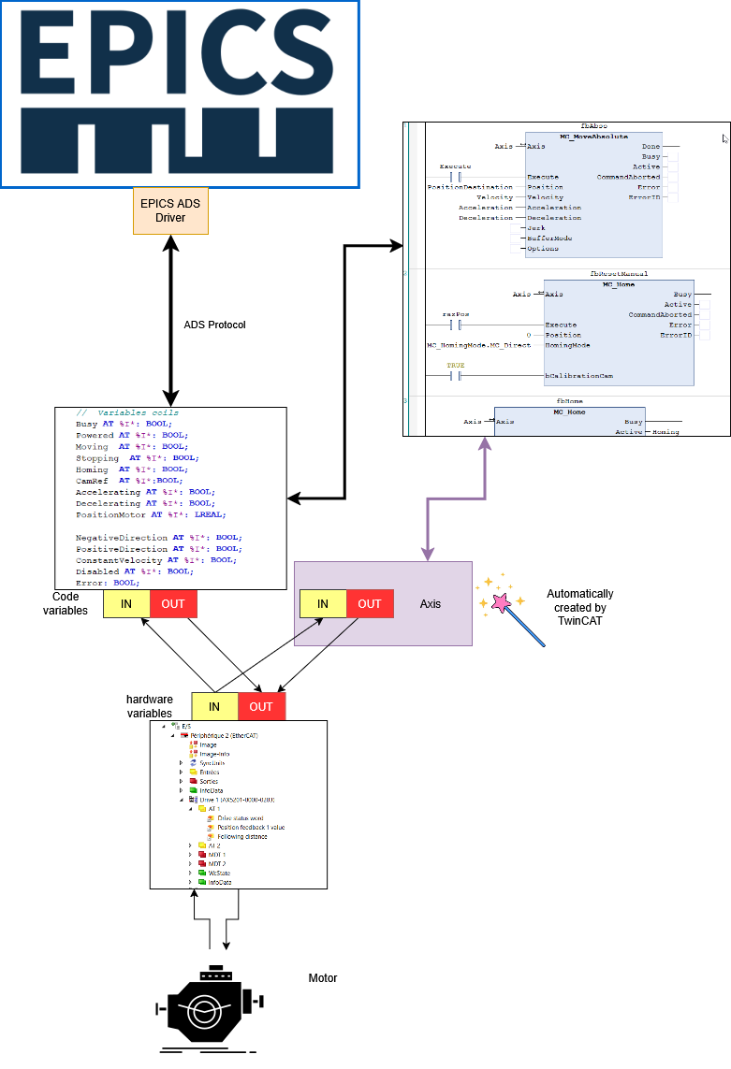
Titan project
Titan motorization

Slide 19
Titan project
Titan motorization
Automatically detected and created

Slide 20
Titan project
Titan motorization
This created once and for all (for most of our use cases) with already existing standard function

Slide 21
Titan project
Titan motorization
This created and maintained by Torsten
(and everyone else)

Slide 22
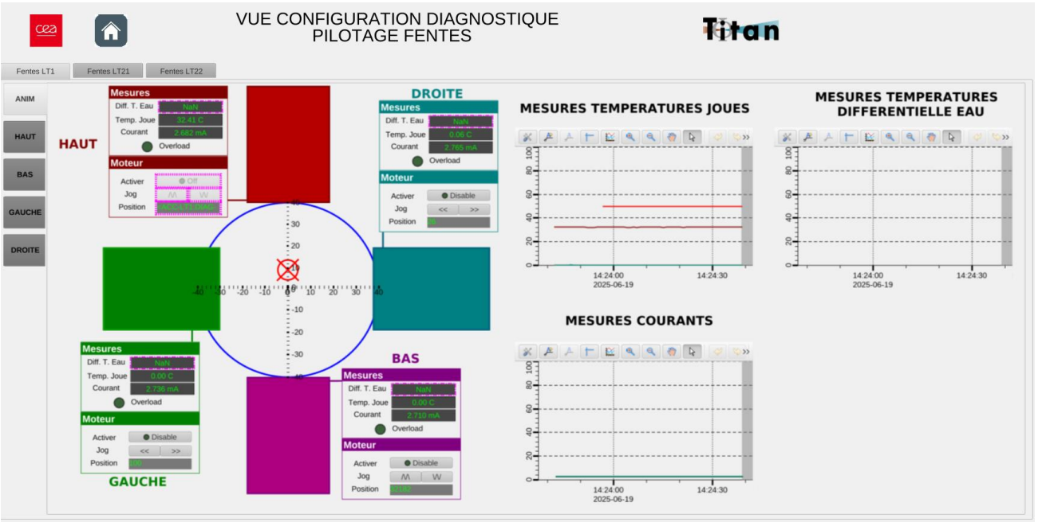
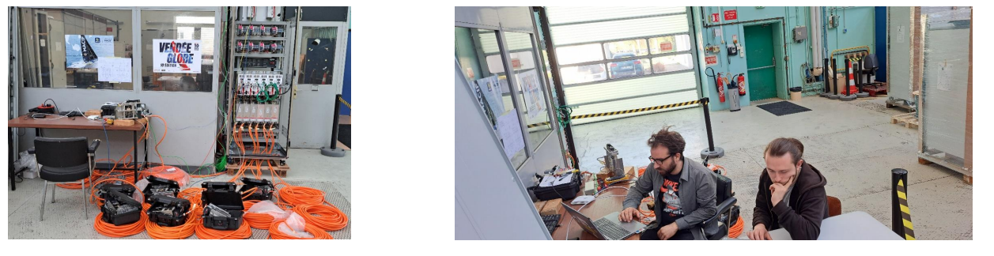
Titan project
Titan motorization
Slits
  12 motorizations

Slide 23
Close Future
3

Slide 24
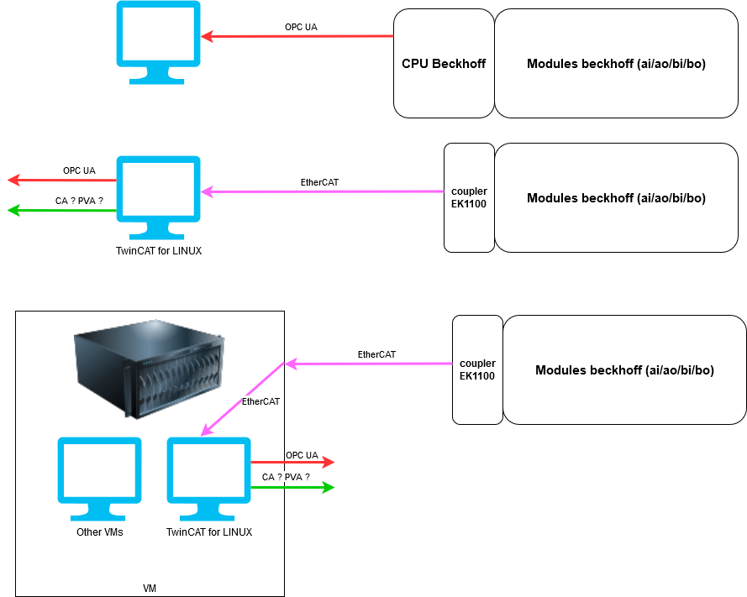

Future
ADS/
  Beckhoff Linux : https://www.beckhoff.com/fr-fr/products/product-news/linux-r/
    CX9240 (demonstration) Arm linux
      IOC can now run on Beckhoff CPU (probably already possible on Windows server but …)
    ISO of x64 Linux available
      TwinCAT runtime can possibly run onto other CPU
      TwinCAT runtime can run on VM
        Quick test on Virtual Box: IOC was running, didn’t test yet with hardware.
        Server IOC Proxmox : TBT
CA / PVA
ADS/
ADS/

Slide 25


Merci
CEA SACLAY
alexis.gaget@cea.fr

