Slide 1
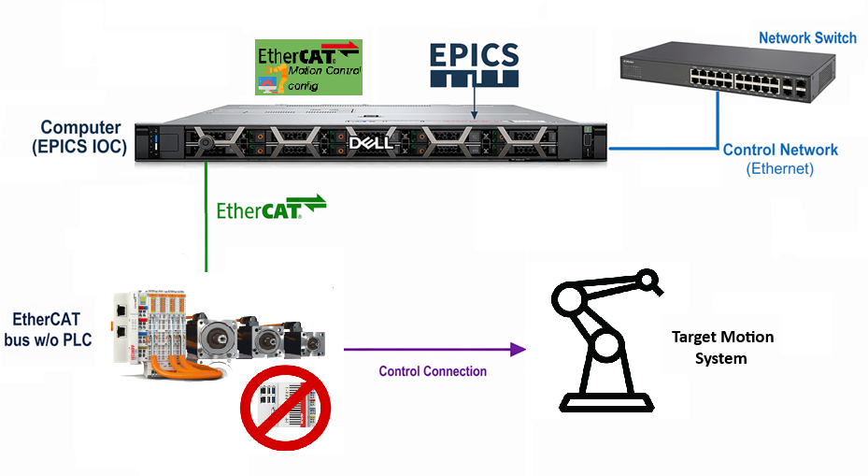
CLS – Motion System Architecture
  IOC-host:
    Debian 13
    Ethercat IgH kernel module (installed as deb)
    EPICS ecmc+ecmccfg (built using require)
    NO TwinCAT
    E-CAT bus:
      E-CAT coupler (EK1100)
      Motors drivers/ encoders / DIO / AIO modules
    Target:
      replace all VME motion systems
      Except Safety Systems
    Current:
      2 systems in use
      2 in commissioning stage
  Questions: augusto.Horita@lightsource.ca

Slide 2
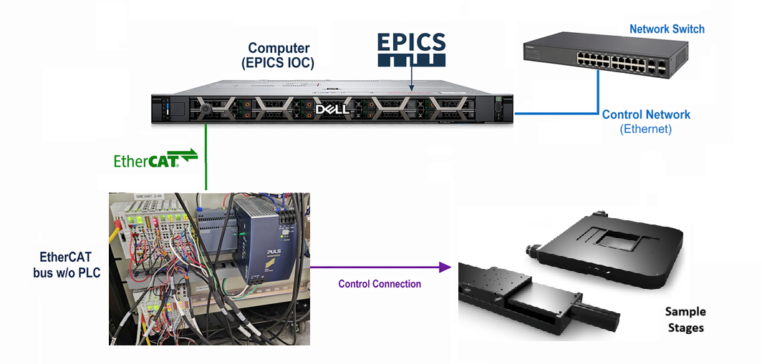

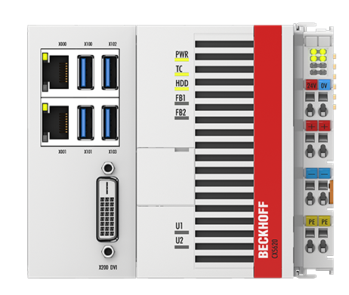
CLS – Motion control example 1
Control system for Sample Stages
ECAT master is the IOC computer
System composed by:
  Servo motors
  Limit Switches
Kinematics Logic at IOC (ecmccfg)
System is in use
  Questions: augusto.Horita@lightsource.ca

Slide 3
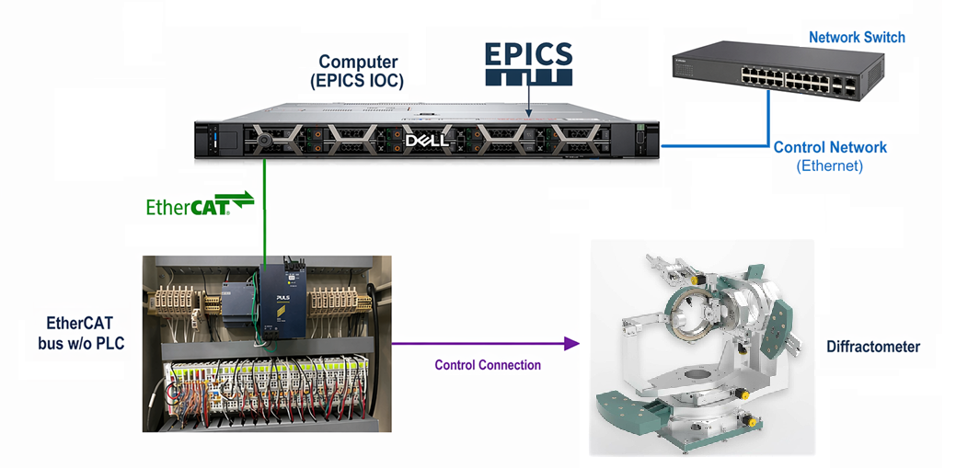
CLS – Motion control example 2
Control system for Huber Diffractometer
ECAT master is the IOC computer
System composed by:
  Stepper motors
  Limit Switches
  BISS encoders
Kinematics Logic at IOC (ecmccfg)
System is on final commissioning tests
  Questions: augusto.Horita@lightsource.ca

