Slide 1
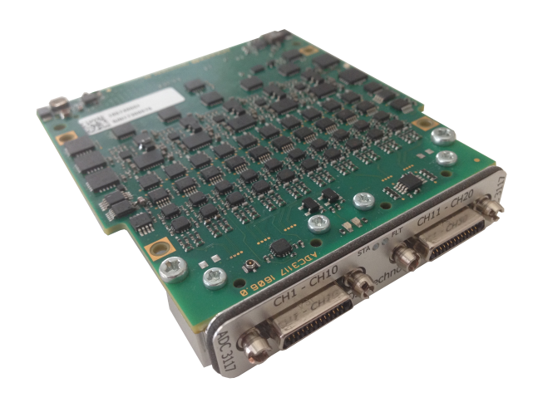
CEA Saclay MTCA platform EPICS meeting: MTCA workshop

Slide 2
Agenda
11:00-11:10 CEA MTCA.4 platform Françoise Gougnaud CEA Saclay
11:10-11:40 How to become a MTCA expert in 30 minutes? Antony Besseau EMG2
11:40-11:55 IOxOS AMC development environment-FPGA-based applications Victor Nadot CEA
11:55-12:15 Key elements for an easy start with MTCA? Antony Besseau EMG2
12:15-12:30 Discussion, questions…

Slide 3
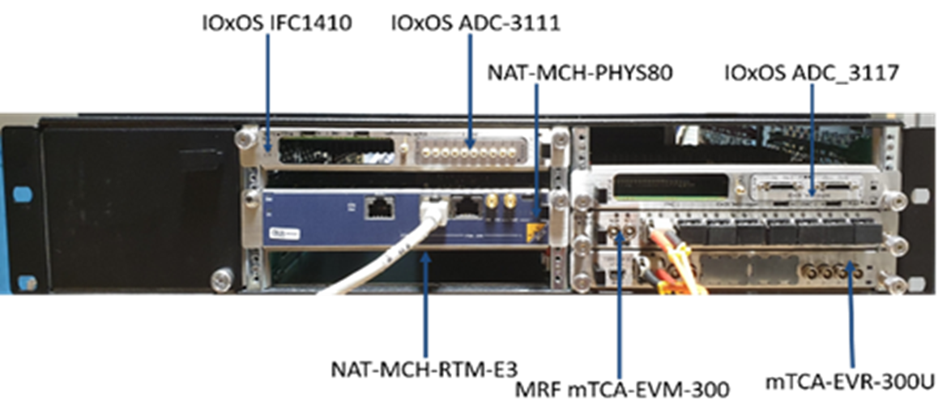
HW MTCA platform
This platform is based on the very compact NATIVE-R2 crate with a common core on each crate:
NAT-MCH-PHYS80 board (80-port PCIe Gen3 switch) combined with
Rear Transition Module CPU: RTM-COMex-E3 then RTM-COMex-Ce16
A set of IOxOS boards was also added (ADC-3117, ADC-3111, DIO-3118)
MRF boards for the Timing System
Entire satisfaction

Slide 4
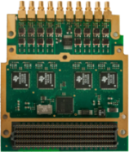
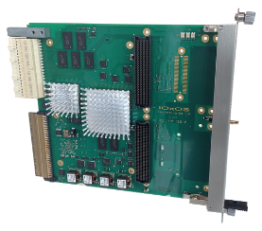
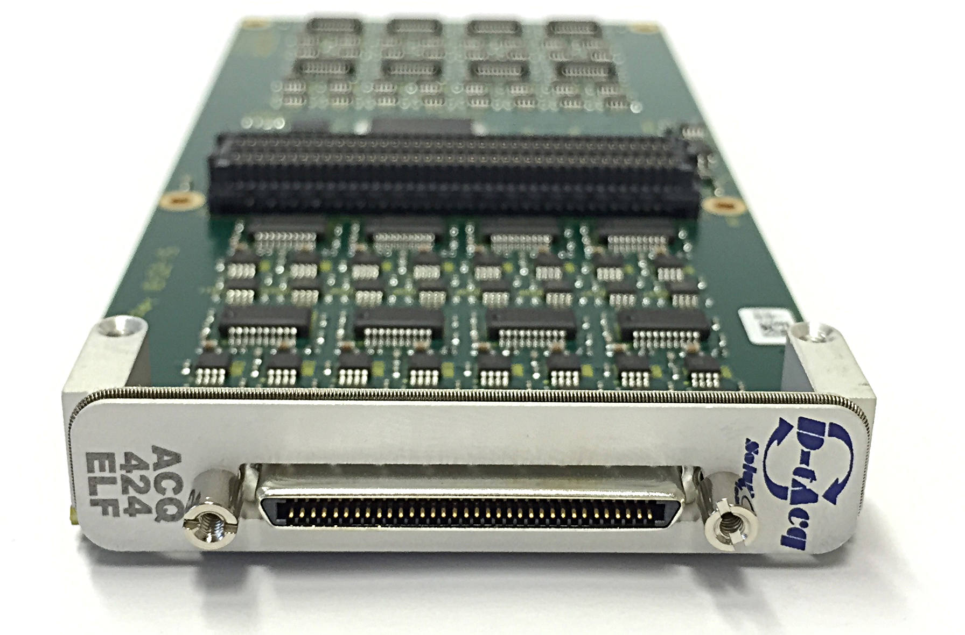
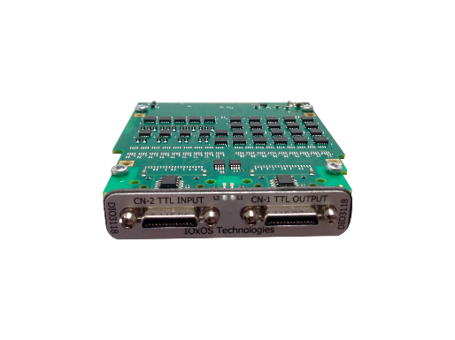
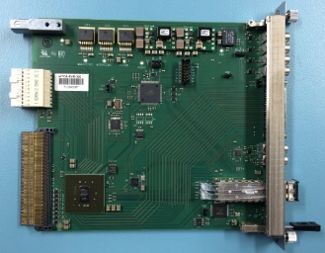
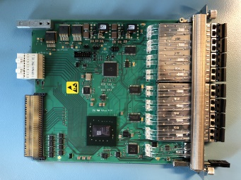
CEA Saclay MTCA COTS solutions
Requirements of Devices | Sampling/monitoring frequency range | COTS solutions
Fast acquisition | 5 MS/s up to 250 MS/s 8 ADCs | IOxOS AMC IFC-1410 & FMC ADC-3111
Semi-fast acquisition | 50 KS/s up to 5 MS/s 20 ADCs | IoxOS AMC IFC-1410 & FMC ADC-3117 MTCA.4 D-Tacq 424ELF
Digital Input/output | 16 inputs and 16 outputs | IOxOS AMC IFC-1410 & FMC DIO-3118
Timing Sytem Event generator |  | MRF mTCA-EVM-300
Timing Sytem Event receiver |  | MRF mTCA-EVR-300U
Neutron sensitive Beam Loss Monitors
Saclay EPICS driver
Faraday cups , ACCTs, DCCTs, Allison EMUs, …
Saclay EPICS drivers
Sem-grids, Harps
Saclay EPICS driver
Event generators generate events at the repetition frequency and transfer events to all receivers
Event receivers analyse the events and generate the requested signal
Communication through Optical Fibre
Community EPICS driver
EVG and fanout

Slide 5
Migration to MTCA in 2018
Up and running on the Saraf-Linac project
with EPICS 3.15.9 – CA
Integration has started on the Titan project
with EPICS 7- CA and transition to PVA

Slide 6
Questions
NAT evolution in a near future compared with these current NAT boards
Which CPU?
Which MCH?
Costing

