Slide 1

oac-tree
Operations, Automation and Control using behavior trees
Gennady Pospelov Walter Van Herck

Slide 2
Overview
Framework overview
Behavior trees
oac-tree GUI
Example patterns
Future plans
Links

Slide 3
Framework overview
oac-tree is a C++ framework for the execution of control procedures, based on behavior tree semantics
oac-tree consists of a base library and plugins that extend the base functionality
oac-tree-gui is a Qt/C++ GUI to create, edit and run procedures

Slide 4
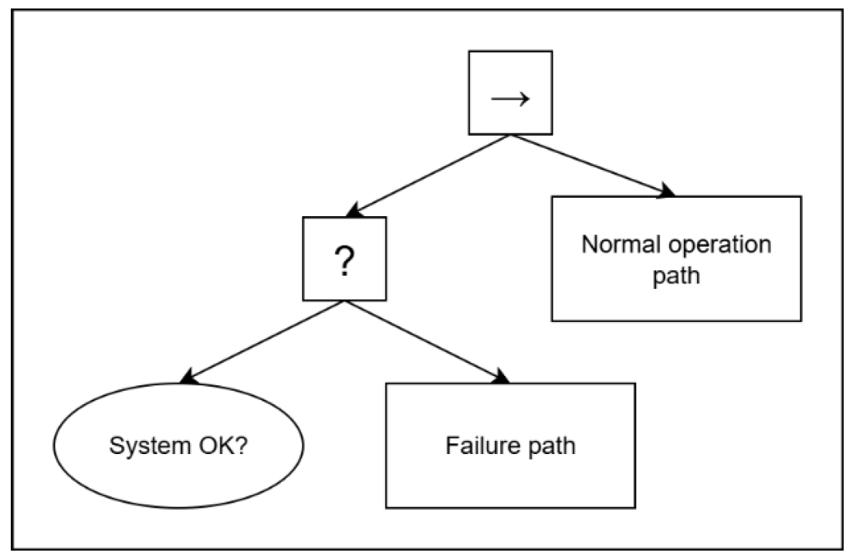
Behavior trees: instruction trees
Control flow nodes:
Have child node(s)
Report all possible instruction statuses: success, failure or running
Condition node:
No child nodes
Immediately report success or failure
Action nodes:
No child nodes
Can report all statuses

Slide 5
Behavior trees: control flow
Sequence with memory
tick
failure
running
*
tick
success
tick
failure
running
system ok?
Action 1
Action 2

Slide 6
Behavior trees: control flow
ReactiveSequence
tick
failure
running
tick
success
tick
failure
running
system ok?
Action 1
Action 2

Slide 7
oac-tree: base instructions
Sequence/ReactiveSequence: succeeds if all child nodes succeed (AND)
Fallback/ReactiveFallback: succeeds if one child node succeeds (OR)
ParallelSequence: custom success conditions (e.g. success on 2 child nodes’ success)
(User)Choice: only execute child nodes marked by user or workspace variable
Inverter: single child; invert success – failure
Repeat: single child; repeat child node execution
Listen: single child; trigger child node on update of workspace variable(s)
*
*
?
?

Slide 8
oac-tree: base actions
Wait: return success after optional timeout
Fail: return failure after optional timeout
Copy: copy (subfield of) variable to (subfield of) variable
Equal, GreaterThan, GreaterThanOrEqual, LessThan, LessThanOrEqual: compare two variables (or fields thereof)
Input: allow user to set variable

Slide 9
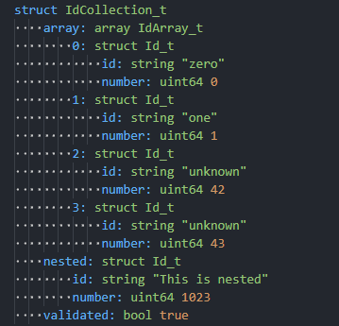
oac-tree: variables
Each procedure contains a workspace with a flat list of named, threadsafe variables that can be accessed by all instructions in the procedure
Variables have a common API, where you read/write (subfields of) an AnyValue:
Local: in-memory storage of AnyValue
File: JSON encoded storage of AnyValue in a file

Slide 10
oac-tree-epics
Instructions:
ChannelAccessRead/ChannelAccessWrite: read/write ChannelAccess PV
PvAccessRead/PvAccessWrite: read/write PvAccess PV
Variables:
ChannelAccessClient: connects to ChannelAccess PV
PvAccessClient: connects to PvAccess PV
PvAccessServer: publishes a variable over PvAccess
PvAccessEncodedClient/PvAccessEncodedServer: same, but with encoded payload over PvAccess to support dynamic types and scalars

Slide 11
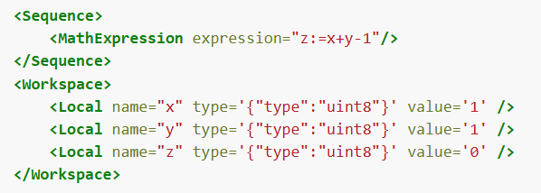
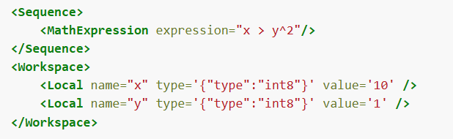
oac-tree-mathexpr
MathExpression instruction:

Slide 12
oac-tree GUI

Slide 13
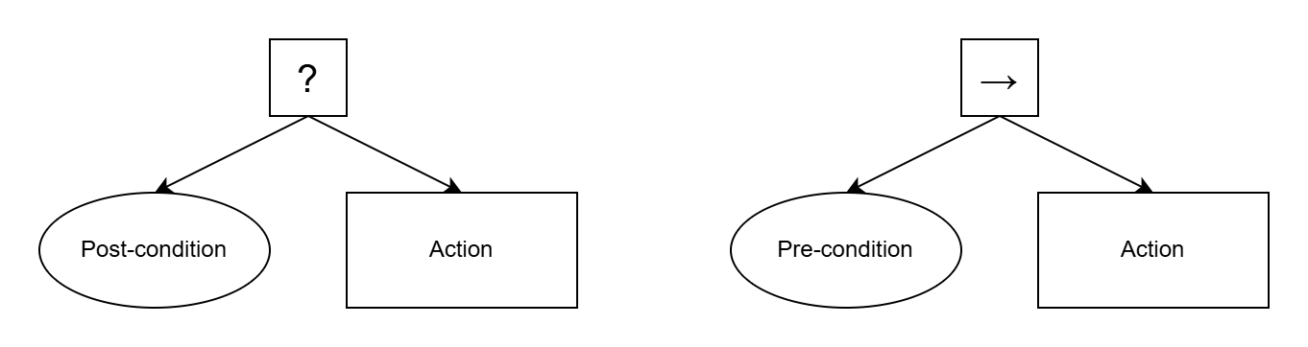
Example patterns: building blocks
Fallback
Sequence

Slide 14
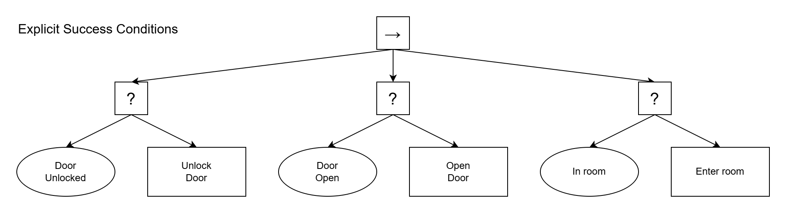
Example patterns

Slide 15
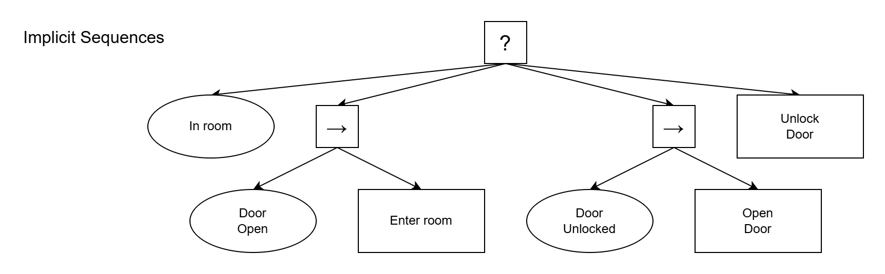
Example patterns

Slide 16
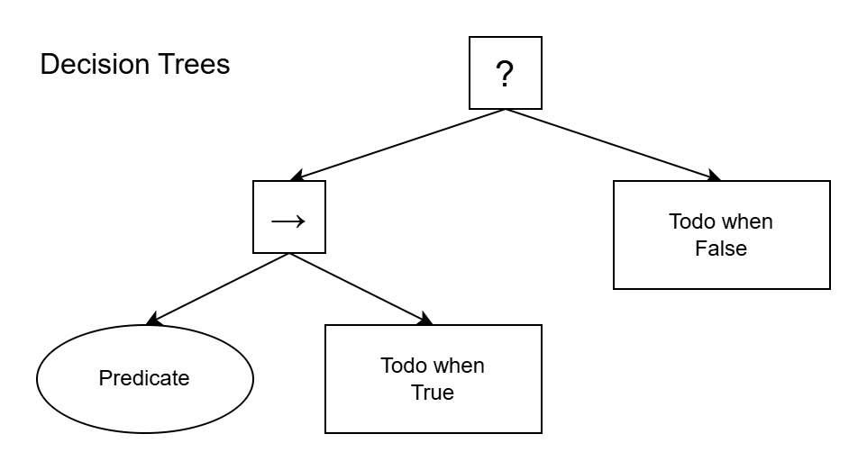
Example patterns

Slide 17
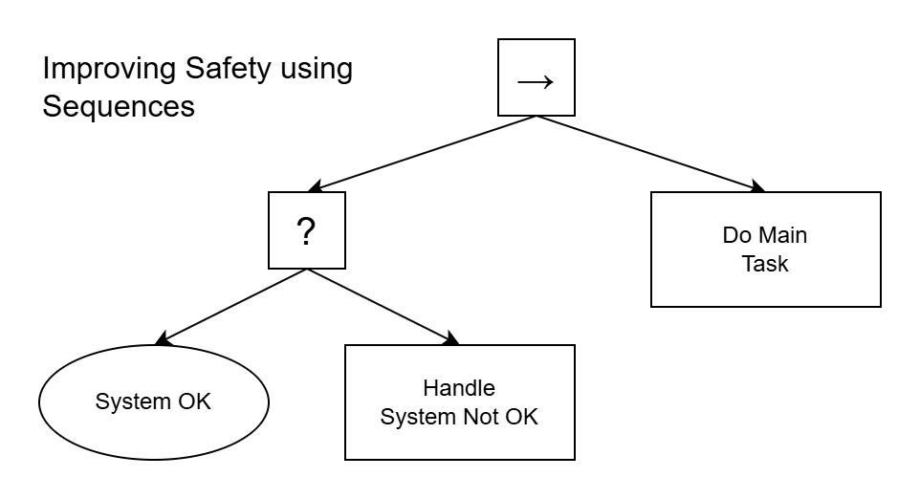
Example patterns

Slide 18
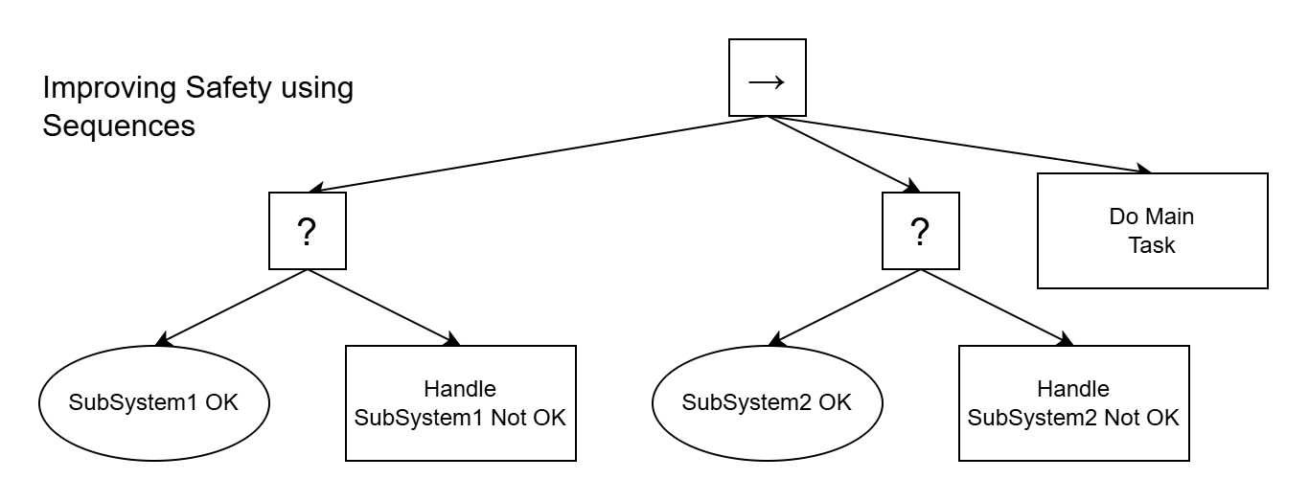
Example patterns

Slide 19
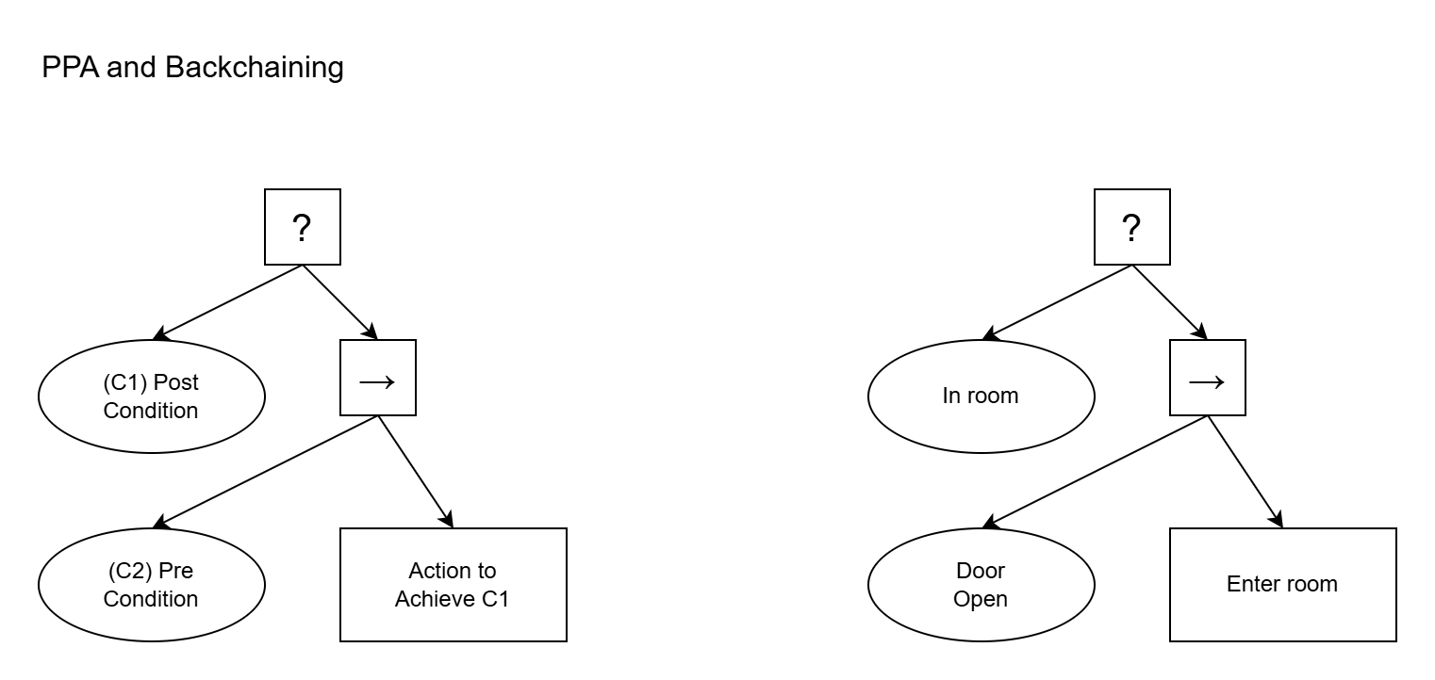
Example patterns

Slide 20
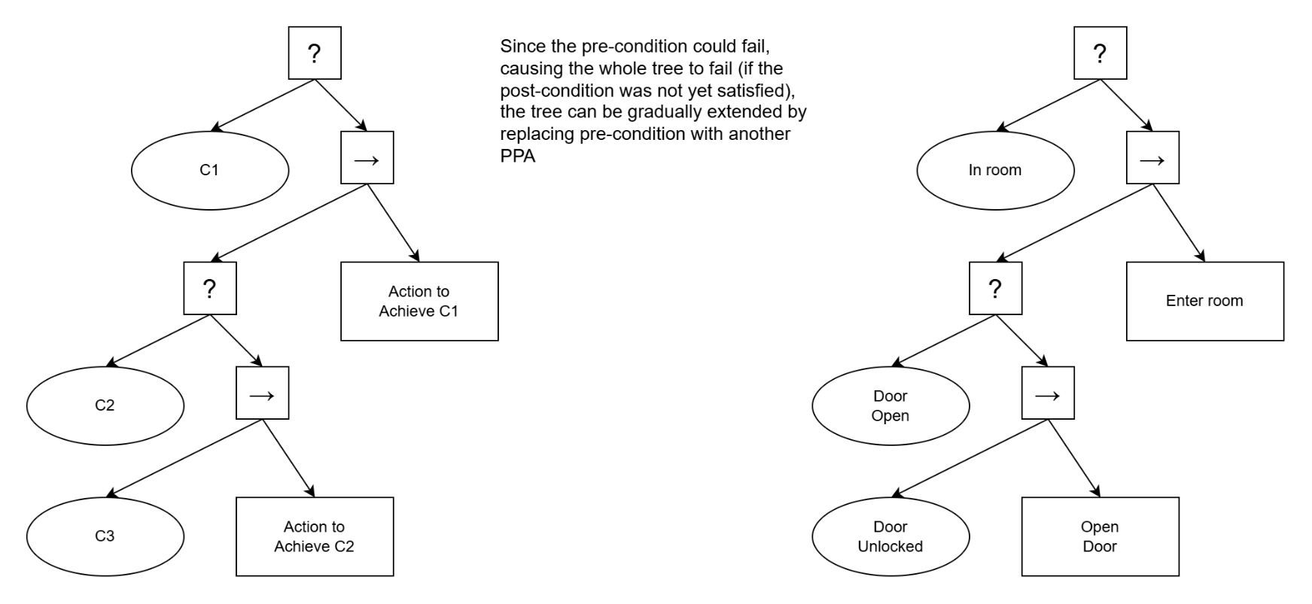
Example patterns
PPA

Slide 21
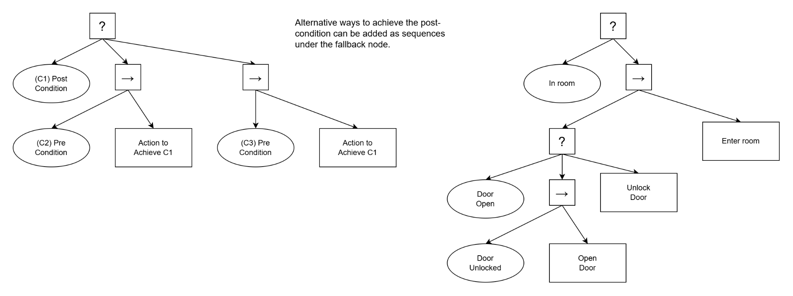
Example patterns

Slide 22
Future plans
Improve GUI: functionality and user experience (see e.g. Task Monitor during demo)
Expose oac-tree-server using WebSockets and create web client application
Containerized deployment of procedures

Slide 23
Links
Source code https://github.com/oac-tree
Documentation https://oac-tree.github.io/oac-tree-docs Behavior trees in robotics and AI
Training material: https://github.com/oac-tree/oac-tree-training https://github.com/epics-training/training-vm
Support: mailto:Walter.Vanherck@iter.org mailto:Gennady.Pospelov@iter.org

