Slide 1


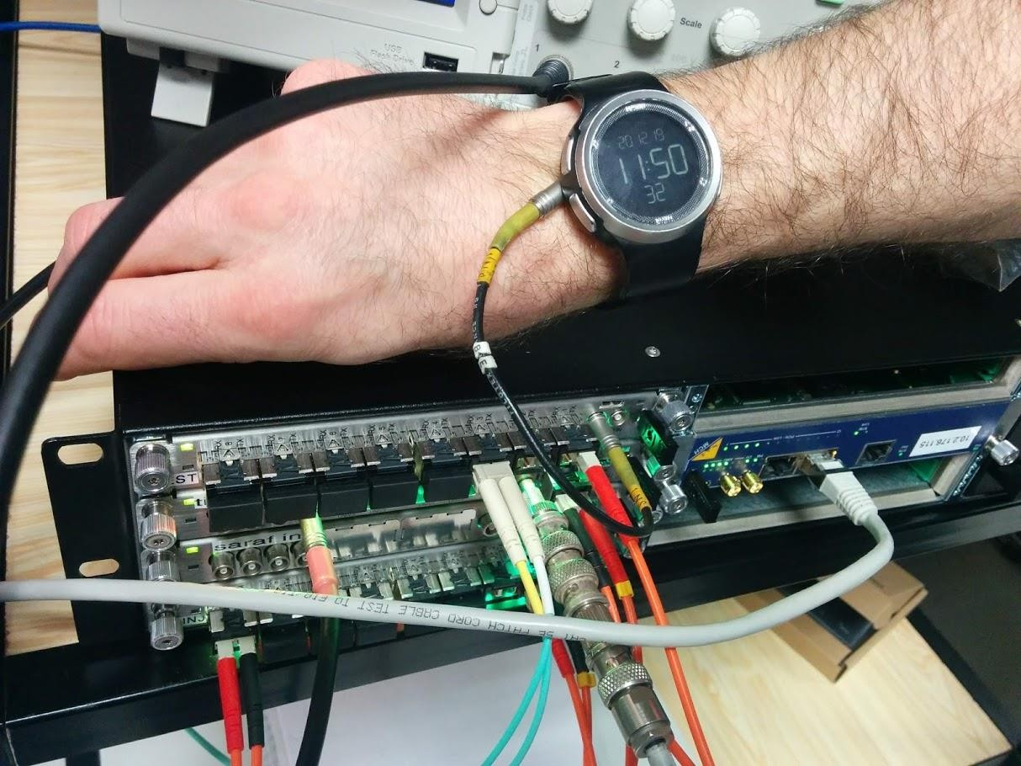

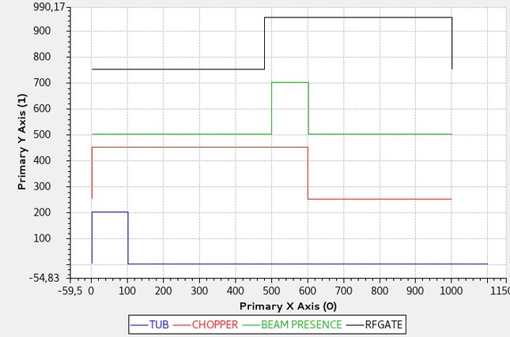
MRF Timing system appliqué à la synchronisation et à la protection machine de SARAF
Alexis Gaget IRFU / DIS /LDiSC

Slide 2
What is MRF timing system?
1

Slide 3
What is MRF Timing system ?
Micro-Research Finland Oy
Founded in 1985
Timing System development initiated in 1999 by the design of the timing system for SLS (Swiss Light Source)
References:
SLS, Paul-Scherrer Institute, Switzerland
Diamond Light Source Ltd., U.K.
ASP, Australia
BEPCII, Insitute for High Energy Physics, Beijing, China
LCLS, Stanford Linear Accelerator Center, USA
SNS, Oak Ridge National Laboratory, USA
SSRF, Shanghai, China
Elettra, Trieste, Italy
ESS, Sweden
ALBA, Spain
And others...
Documentation : https://mrftiming.readthedocs.io/en/latest/hardware/mrfEventRef.html
Official website : https://www.mrf.fi

Slide 4








Standard architecture
UTC via NTP
1PPS
10MHz
GPS
Master Event Generator (EVG) generates a continuous data stream
The (accelerator) synchronization frequency will be fed into the master event generator and used as the system clock.
Event receivers synchronize to that clock and
receive the data stream
Fanout system distributes the signal downstream (and concentrates signals upstream)
RF Master Oscillator
^{f}rf
Master Event Generator
Fanout/ concentrator
Optical fiber (connector sfp tx/rx)
Event receiver
Event receiver
fanout
Event receiver
Event receiver
Event receiver
Event receiver
Event receiver
Event receiver
Equipement 1

Slide 5








In (optical) wire protocol
11,3ns
…
EVENT CODE
DATA
0-255
(some are reserved, check on MRF Documentation)
16-bit “frame” repeating at event clock
frequency, e.g., 88 MHz
Each frame contains an 8-bit event code and 8 bits for datas.

Slide 6
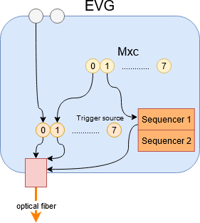
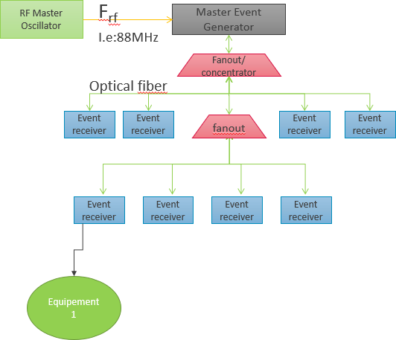
Understand the Event Generator (EVG)
Event Generator (EVG) is responsible of creating and sending out timing events to an array of Event
Receivers.
3 different ways
Software events (triggered by the software)
Trigger events x8 (trig one event)
Sequencer x2 (sequence of events)
…
Mxc : Programmable Multiplexed counter

Slide 7
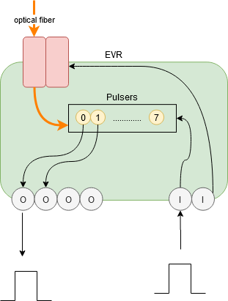
Understand the Event Receiver (EVR)
“Decode timing events and signals from an optical event stream transmitted by an Event Generator.”
Since generation “300”, EVRs can generate events itself :
Sequencer
software
Output can be configured to react to a reception of a specific event code :
Trigger (pulse of a specified width and delay)
Set High or Low
At the opposite Input can be configured to sent event upstream or locally

Slide 8
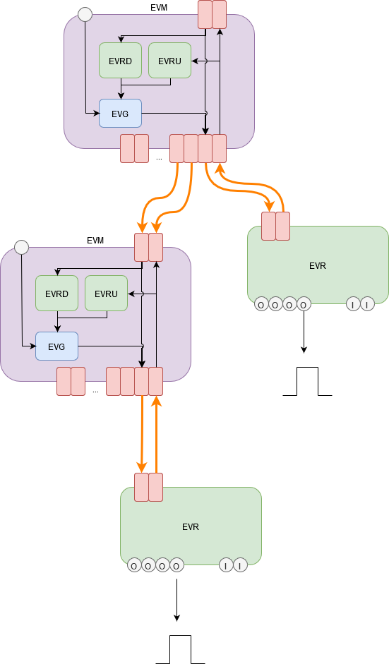


Timestamping
EVG produces event 125 (reserved) at 1Hz
Configured to have the timestamps from the « Sys Clk » meaning the
date of the CPU executing the IOC.
Internally the Clock provider of the EVR IOC is defined by the the mrf driver.
EVRs update their PV « $(EVR):Time-I » that can be used as reference for other PVs
E.g :
Individual events counter can also be used as time reference for those events.
EVRs can be use as NTP Server. For less critical PVs for example.

Slide 9
Delay compensation
“Delay compensation is achieved in measuring the propagation delay of events from the delay compensation master EVM through the distribution network up to the Event Receivers. At the last stage the EVR is aware of the delay through the network and adjusts an internal FIFO depth to match a programmed target delay value.”
EVM Fanout have to be well configured as fanout
15 minutes to stabilize
WARNING : delay compensation impacts upstream propagation time.

Slide 10
Various cases
4

Slide 11
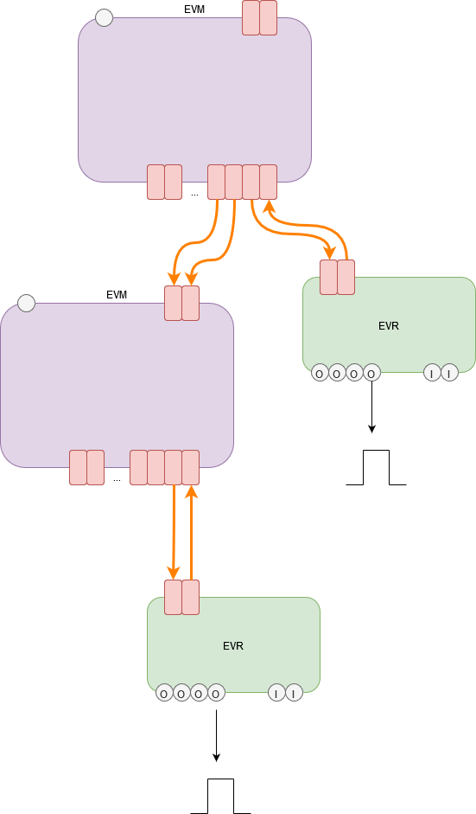
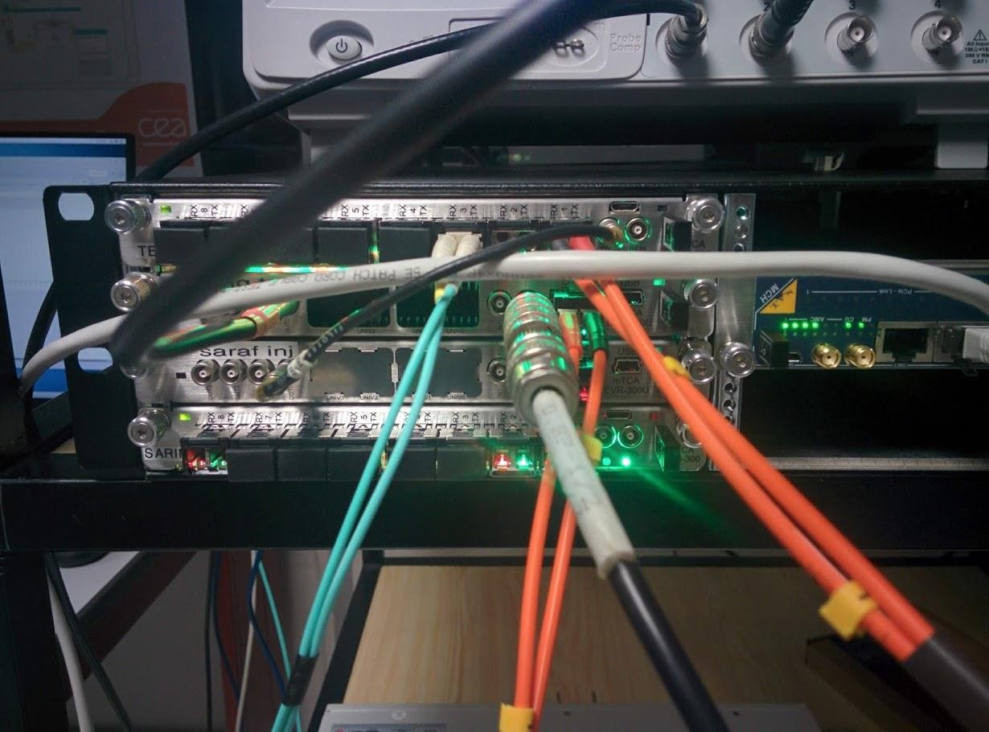
Standard installation
Imagine a test stand with the following installation :
MTCA EVM 300 x2 : One master to rull them all, the other to be a simple fanout
MTCA EVR 300U x2
Master EVM
EVM
Fanout

Slide 12

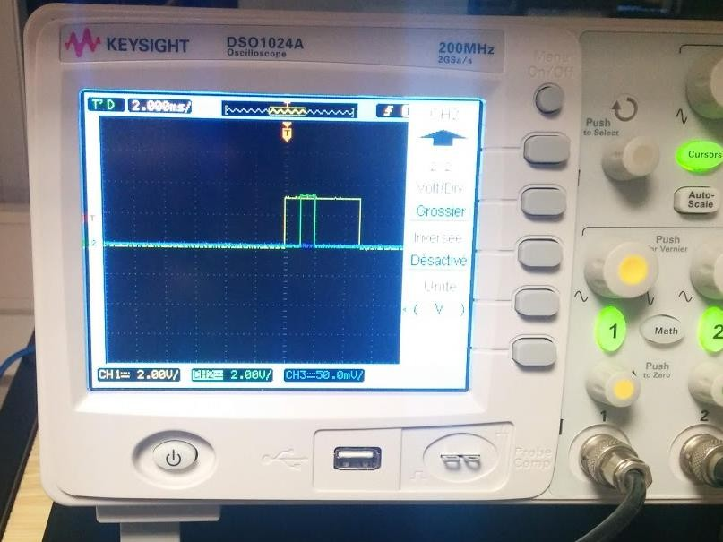
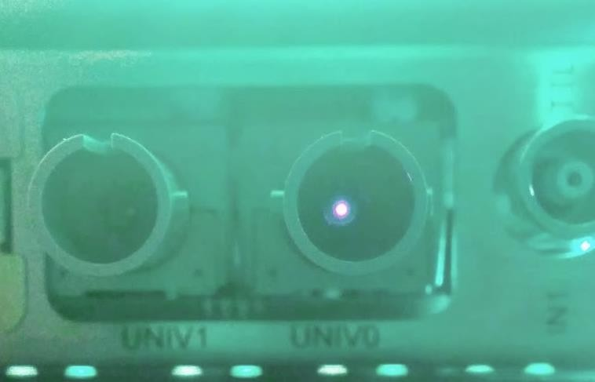
Standard case
EVG produce Event #14 at 1Hz from internal clock.
EVM Fanout transmit Event #14 to the following EVR
EVRs receive Event #14 and produced the associated pulse to the defined front panel output
Front Panel Universe Optical Fiber
(i.e Magnetron)
Front Panel TTL

Slide 13


Upstream case
A signal is received on input of an EVR
The signal is configured to send and event upstream.
The EVRU (for Upstream) received the event, and like any other EVR it is configured through its pulser to send a signal.
The signal is received by the EVG that send an event downstream

Slide 14
MRF and EPICS
5

Slide 15
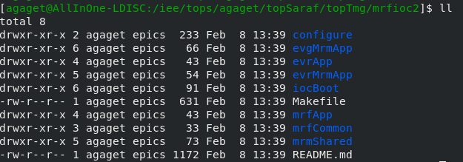
Register for each card are generic from card to card
Each App develop many common functionalities
A card is a substitutions file that have been filled by its I/O
Mtca-evm300.substitutions
Mtca-evr300u.substitutions
10/02/2023

Slide 16
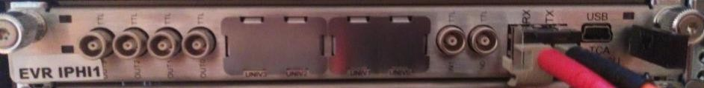
Substitutions files example (MTCA EVR300U)
#[...]
file "evrin.db"
{pattern
{IN, INTRIG, INCODE, OBJ, DESC}
{"$(SYS){$(D)-In:0}" , "$(SYS){$(D)-In:0}Trig:", "$(SYS){$(D)-In:0}Code:", "$(EVR):FPIn0", "IN0 (TTL)"}
{"$(SYS){$(D)-In:1}" , "$(SYS){$(D)-In:1}Trig:", "$(SYS){$(D)-In:1}Code:", "$(EVR):FPIn1", "IN1 (TTL)"}
{"$(SYS){$(D)-Univ:0}", "$(SYS){$(D)-Univ:0}Trig:", "$(SYS){$(D)-Univ:0}Code:", "$(EVR):FPUniv0", "Univ0 (TTL)"}
{"$(SYS){$(D)-Univ:1}", "$(SYS){$(D)-Univ:1}Trig:", "$(SYS){$(D)-Univ:1}Code:", "$(EVR):FPUniv1", "Univ1 (TTL)"}
{"$(SYS){$(D)-Univ:2}", "$(SYS){$(D)-Univ:2}Trig:", "$(SYS){$(D)-Univ:2}Code:", "$(EVR):FPUniv2", "Univ2 (TTL)"}
{"$(SYS){$(D)-Univ:3}", "$(SYS){$(D)-Univ:3}Trig:", "$(SYS){$(D)-Univ:3}Code:", "$(EVR):FPUniv3", "Univ3 (TTL)"}
#[...]
file "mrmevrout.db"
{pattern
{ON, ONSRC, OBJ, DESC}
{"$(SYS){$(D)-Out:Int}", "$(SYS){$(D)-Out:Int}Src:", "$(EVR):Int", "Internal"}
{"$(SYS){$(D)-Out:FP0}", "$(SYS){$(D)-Out:FP0}Src:", "$(EVR):FrontOut0", "OUT0 (TTL)"}
{"$(SYS){$(D)-Out:FP1}", "$(SYS){$(D)-Out:FP1}Src:", "$(EVR):FrontOut1", "OUT1 (TTL)"}
{"$(SYS){$(D)-Out:FP2}", "$(SYS){$(D)-Out:FP2}Src:", "$(EVR):FrontOut2", "OUT2 (TTL)"}
{"$(SYS){$(D)-Out:FP3}", "$(SYS){$(D)-Out:FP3}Src:", "$(EVR):FrontOut3", "OUT3 (TTL)"}
# default to tri-state for IFB and backplane lines pattern
{ON, ONSRC, OBJ, DESC, DEFAULT}
{"$(SYS){$(D)-Out:FPUV0}", "$(SYS){$(D)-Out:FPUV0}Src:", "$(EVR):FrontUnivOut0", "UNIV0", 61}
{"$(SYS){$(D)-Out:FPUV1}", "$(SYS){$(D)-Out:FPUV1}Src:", "$(EVR):FrontUnivOut1", "UNIV1", 61}
{"$(SYS){$(D)-Out:FPUV2}", "$(SYS){$(D)-Out:FPUV2}Src:", "$(EVR):FrontUnivOut2", "UNIV2", 61}
{"$(SYS){$(D)-Out:FPUV3}", "$(SYS){$(D)-Out:FPUV3}Src:", "$(EVR):FrontUnivOut3", "UNIV3", 61}
{"$(SYS){$(D)-Out:Back0}", "$(SYS){$(D)-Out:Back0}Src:", "$(EVR):Backplane0", "RX17 (0)", 61}
{"$(SYS){$(D)-Out:Back1}", "$(SYS){$(D)-Out:Back1}Src:", "$(EVR):Backplane1", "TX17 (1)", 61}
{"$(SYS){$(D)-Out:Back2}", "$(SYS){$(D)-Out:Back2}Src:", "$(EVR):Backplane2", "RX18 (2)", 61}
{"$(SYS){$(D)-Out:Back3}", "$(SYS){$(D)-Out:Back3}Src:", "$(EVR):Backplane3", "TX18 (3)", 61} #[...]
10/02/2023

Slide 17
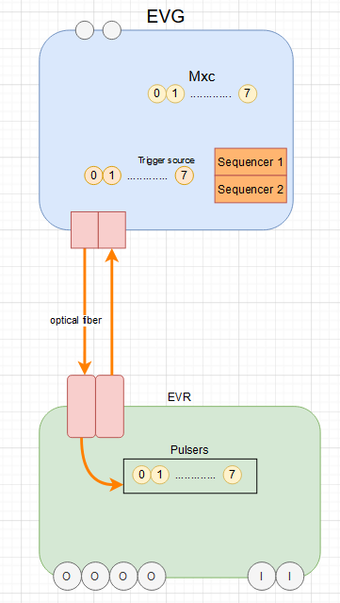
Startup file
# Configure card
mrmEvrSetupPCI("EVR-MTCA", "0a:00.0") mrmEvgSetupPCI("EVM-MTCA", "0c:00.0")
dbLoadRecords("evm-mtca-300.db","SYS=LABO,D=EVM,EVG=EVM-MTCA , FRF=88,FEVT=88") dbLoadRecords("evr-mtca-300u.db","SYS=LABO,D=EVR, EVR=EVR-MTCA , FRF=88,FEVT=88")
############ EVM ##################
#Set the clock from External reference dbpf LABO-EVM:EvtClk-RFFreq-SP 176
dbpf LABO-EVM:EvtClk-RFDiv-SP 2
dbpf LABO-EVM:EvtClk-Source-Sel "RF (Ext)"
#At1Hz
dbpf LABO-EVM:Mxc0-Frequency-SP 1
#Trigger source 0, send event 1 downstream dbpf LABO-EVM:TrigEvt0-TrigSrc-Sel "Mxc0" dbpf LABO-EVM:TrigEvt0-EvtCode-SP 1
############ EVR ##################
#Receiving Event 1, pulser 0 generate a trig of 1000000us and 50us delay. dbpf LABO-EVR:DlyGen0-Evt-Trig0-SP 1
dbpf LABO-EVR:DlyGen0-Width-SP 100000
dbpf LABO-EVR:DlyGen0-Delay-SP 50
#If receiving event 13, put the pulser 0 to low immediatly dbpf LABO-EVR:DlyGen0-Evt-Reset0-SP 13
#The output Front Panel 0 (FP0) is connected to Pulser 0 behaviour dbpf LABO-EVR:OutFP0-Src-Pulse-SP "Pulser 0"
MRF is just configuration
1Hz
Event 1
Width 100000us Delay 50us
10/02/2023

Slide 18
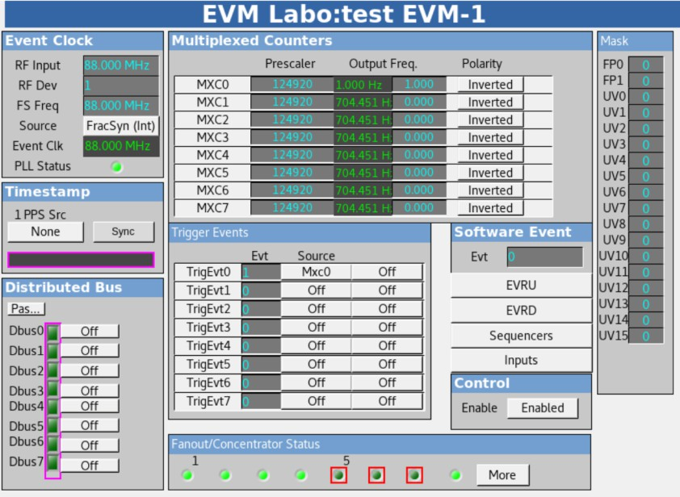
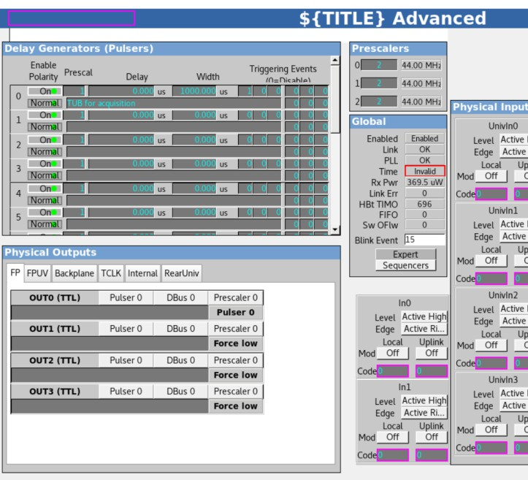
10/02/2023
33

Slide 19
SARAF
5

Slide 20
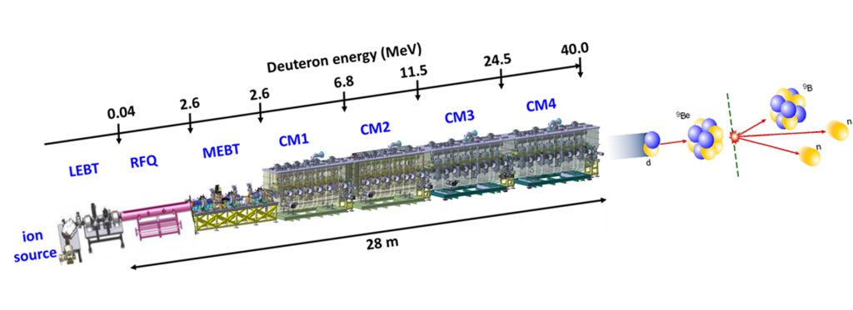
SARAF Accelerator
04

Slide 21
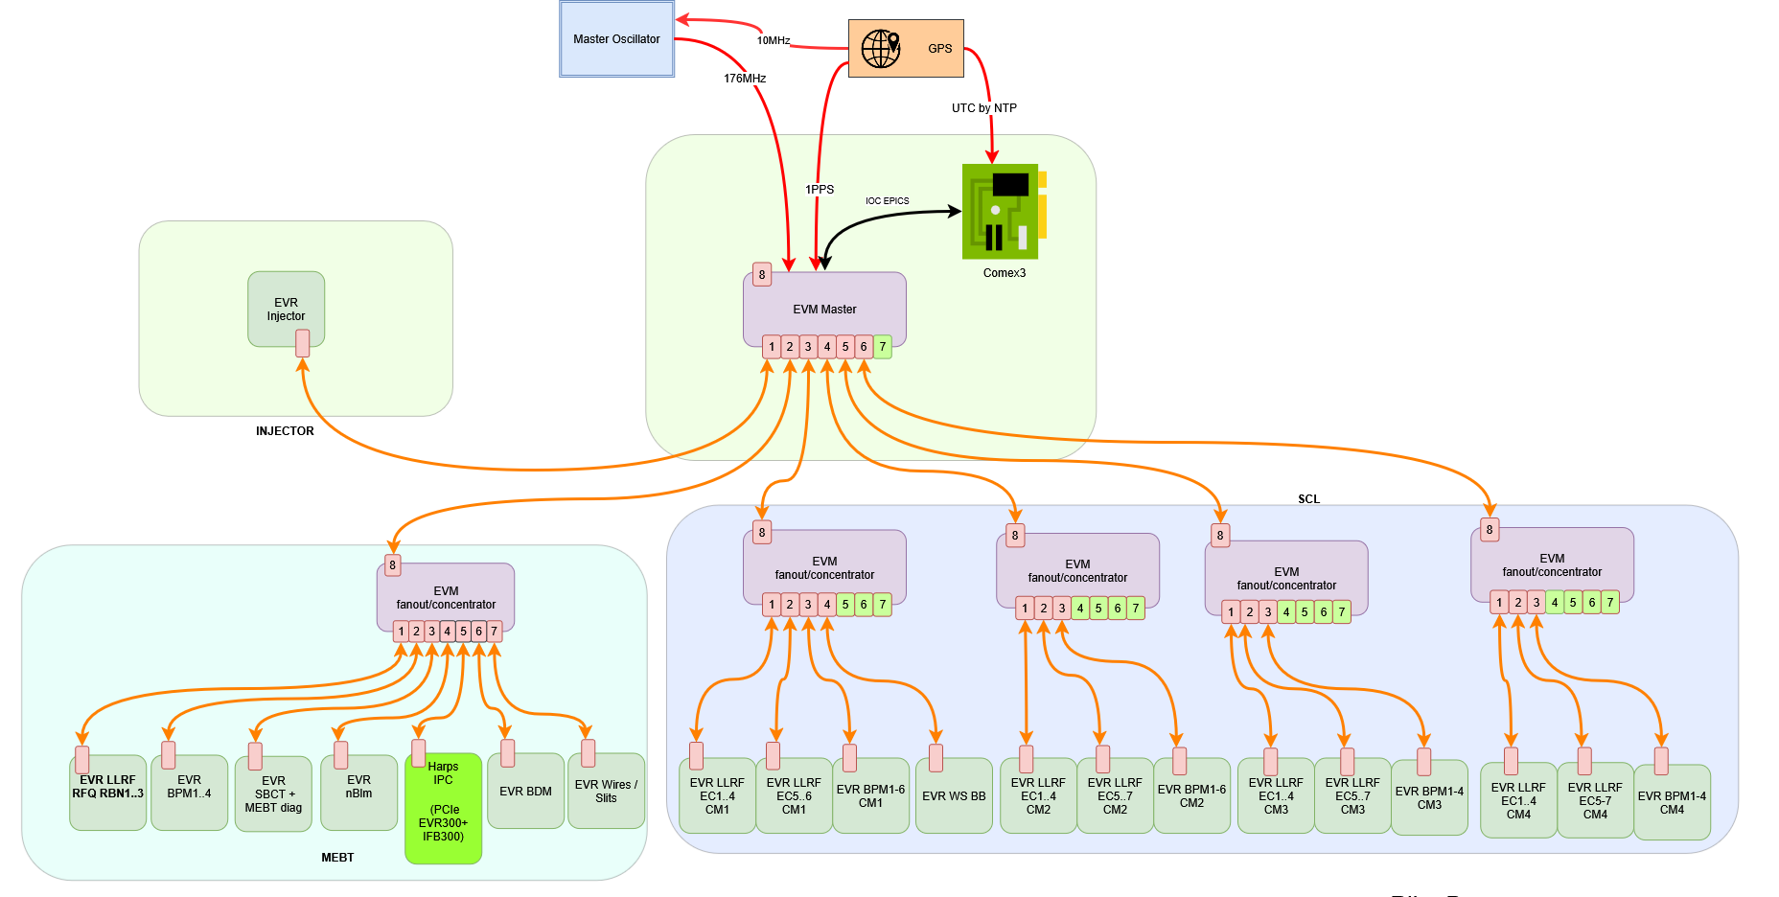
Topology
10/02/2023

Slide 22
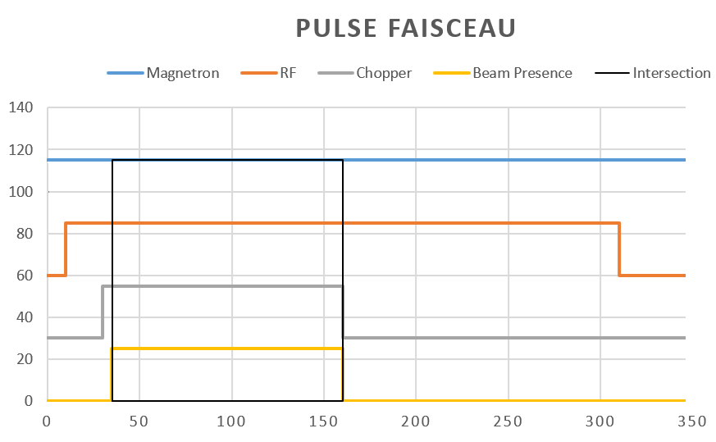
Pulse Generation
Produced by EVM sequencer

Slide 23
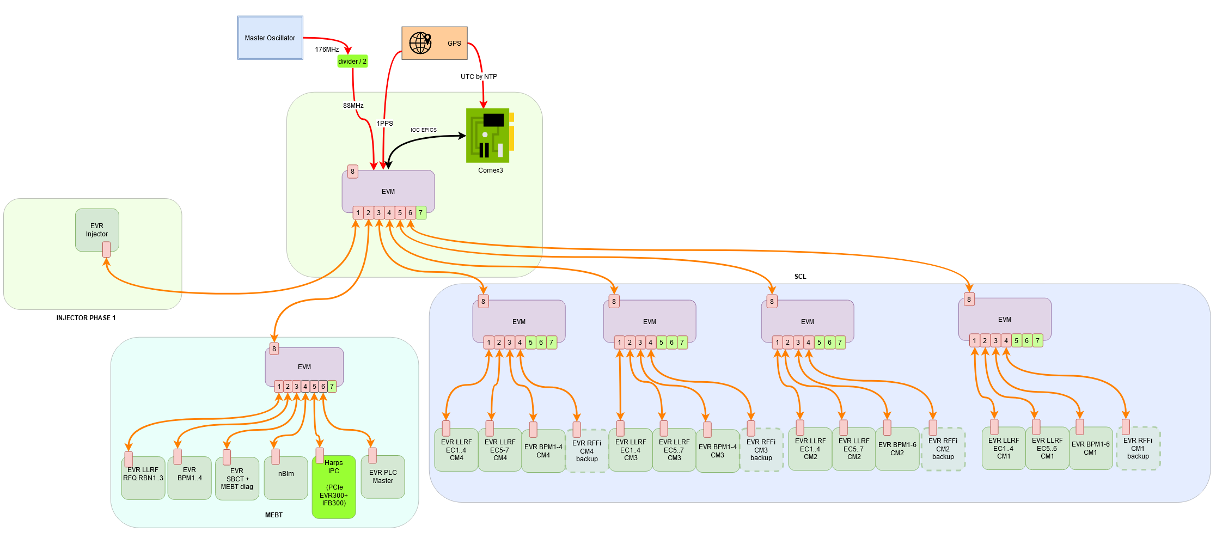
Machine Protection System
Propagation time to chopper according to previous tab is 1400ns + lenght of OF
It will also respect that in case of HEBT with 2 floors EVM. According to the test it will be 1740ns.
MPS
Each of those EVRs are part of the MPS.
EVR Injector is the one that will cut, chopper and magnetron
EVR BDM is the link with the PLC BDM, ask to shut the beam will come from there
EVRs LLRF, will cut RF and ask to shut the beam
EVR SBCT and BPM will ask to shut the beam
EVR Injector
EVM
EVM
10/02/2023

Slide 24
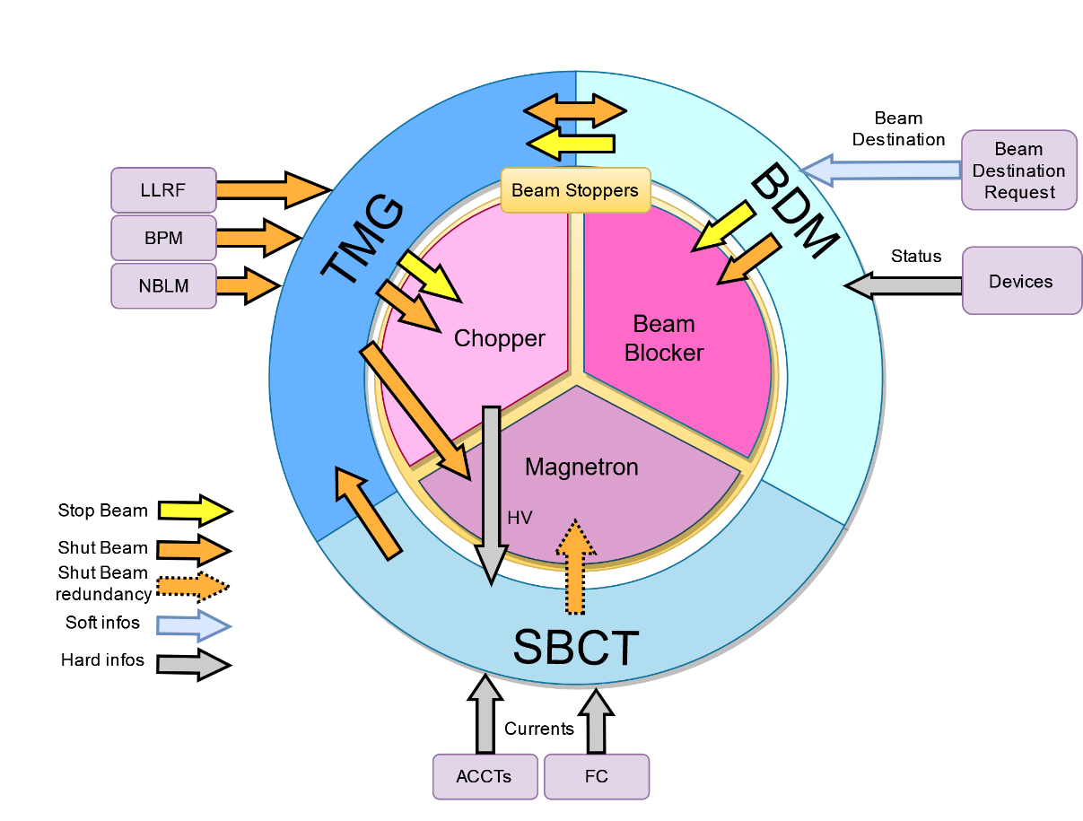
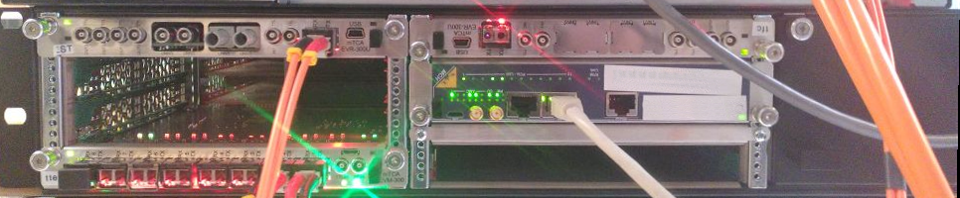
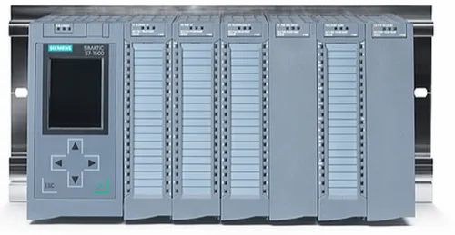
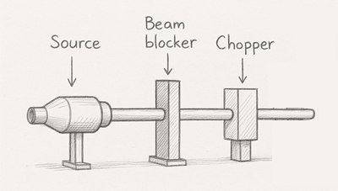

Machine Protection System
Beam destination master (BDM) controls that conditions to get the beam to a destination are checked. Linked to all PLC all along the accelerator through Profinet
Timing (TMG) is the heart of the MPS creating or shutting the beam pulse through chopper and magnetron and being the messenger of the shutbeam event
Section Beam Current Transmission is checking current of the beam all along the accelerator and compare them.

Slide 25
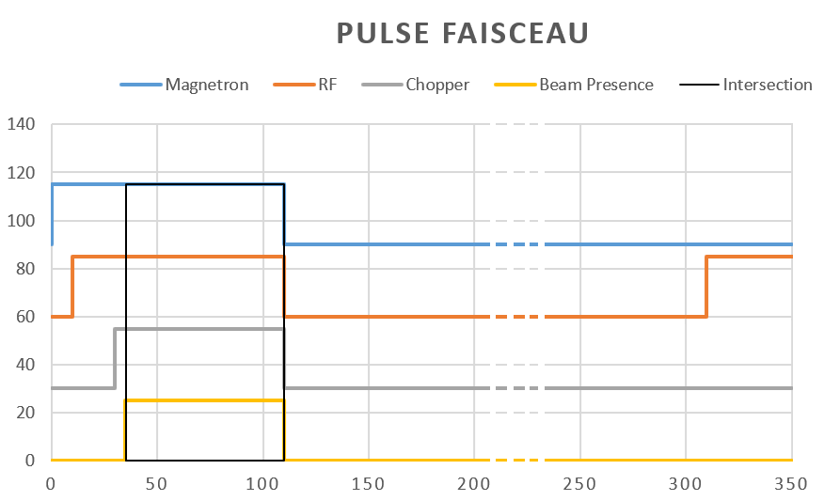
Machine Protection System
During a shutbeam
All the pulses are immediatly interrupted
Sequence continue, but Beam Presence and Chopper pulses are masked

Slide 26
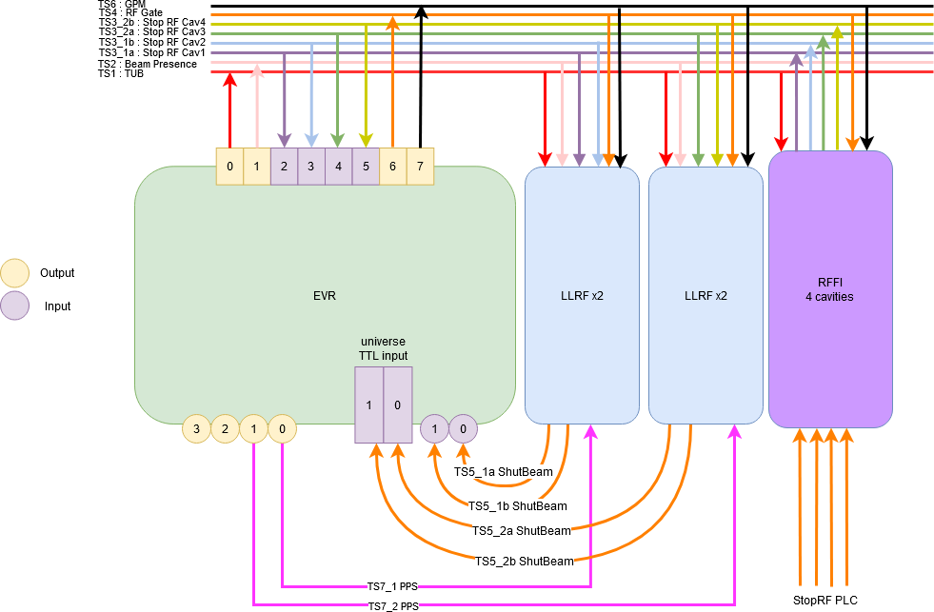
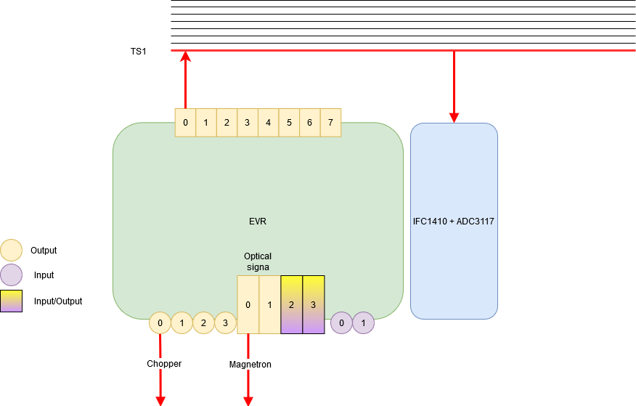
Some EVR examples
Example from SARAF for 2 LLRF cards (4 LLRF) and for the injector
EVR Injector
EVR LLRF

Slide 27
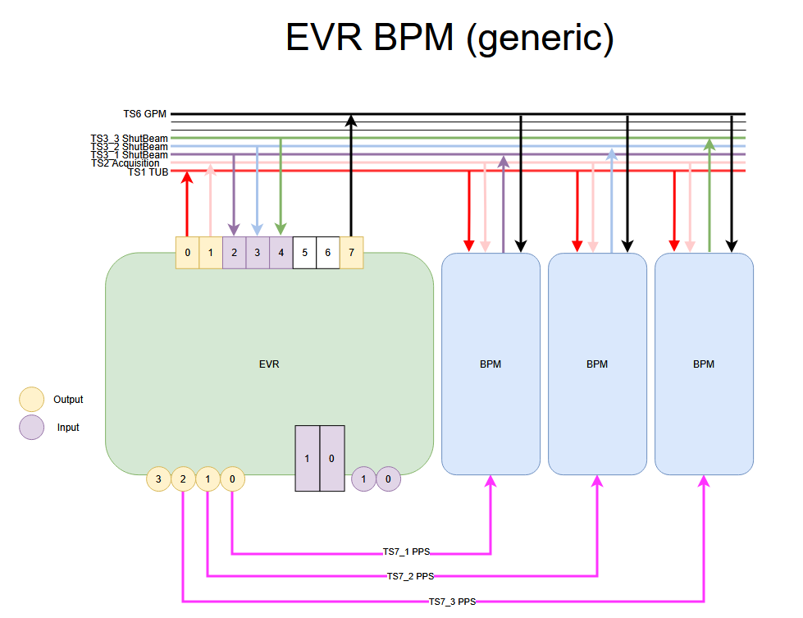
Some EVR examples
EVR BPM
EVR LLRF

Slide 28
Check the optical fiber network
Each element knows if TX is ok, not RX
Each RX is the TX of another element
We check that each EVR connection to EVM is OK.

Slide 29
Check the optical fiber network
Each element knows if TX is ok, not RX
Each RX is the TX of another element
We check that each EVR connection to EVM is OK.
Need to know exact position of the EVR on which EVM Fanout

Slide 30
How to check network optical fiber
Topology ID, MRF Timing System
EVM Master ID = 0
Each leaf behind get id from id from its fanout mother + the position of OF on its Fanout mother.
ID = 0
ID = 1
ID = (id from my mother)(id of the opfical fiber where I’m plugged)
EVM MEBT Fanout = (EVM Master)(position 2)
= 02
EVR nBlm= (EVM MEBT Fanout)(position 4)
= 24
ID = 3
ID = 2
ID = 21
ID = 23
ID = 31
ID = 22
ID = 24

Slide 31
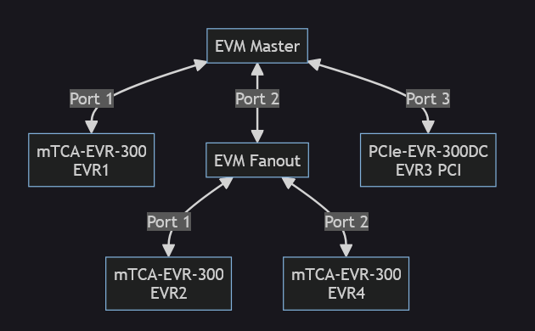
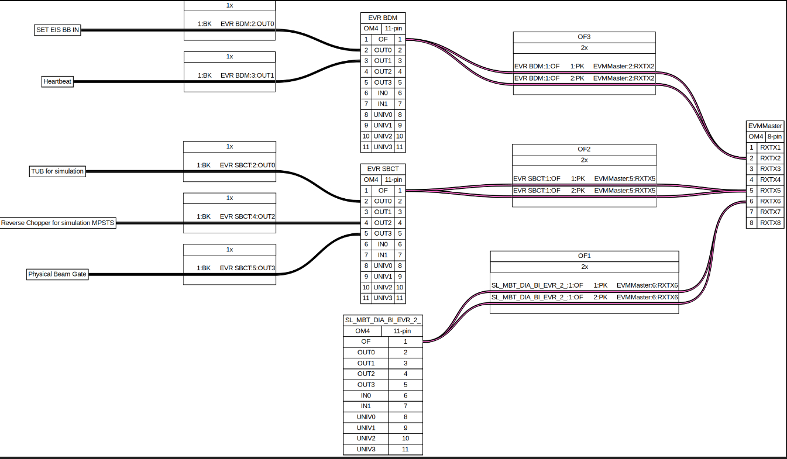
How to check network optical fiber
Script Artist (Advanced Representation of MRF TIming System Topology )
This script takes a file in input with the EPICS Prefix used to control every EVMs and EVRs of your system. It results a graph representing your timing topology and to which port each EVRs is connected to EVMs.
mermaid
wireviz

Slide 32
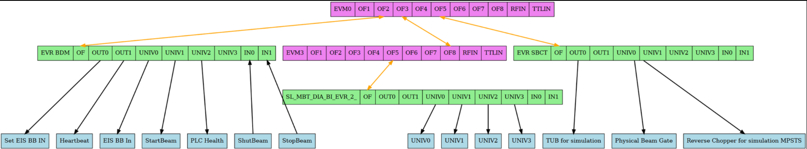
How to check network optical fiber
Script Artist (Advanced Representation of MRF TIming System Topology )
This script takes a file in input with the EPICS Prefix used to control every EVMs and EVRs of your system. It results a mermaid graph representing your timing topology and to which port each EVRs is connected to EVMs.
graphviz

Slide 33

Conclusion
MRF in MPS mode gives great satisfaction for the commissioning of the MEBT of SARAF for now.
Soon tested for the first cryomodule.
Perspective
MRF will be used for Titan accelerator in Saclay (MPS not included this time)
MRF +MPS architecture proposed for pre-project for ICONE accelerator

Slide 34


Merci
CEA SACLAY
alexis.gaget@cea.fr

