Slide 1

StreamDevice Introduction
Dirk Zimoch :: Paul Scherrer Institut
EPICS Collaboration Meeting April 2026

Slide 2
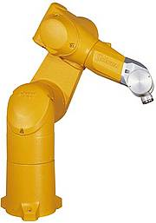
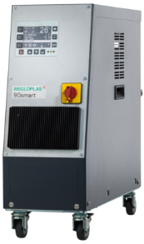
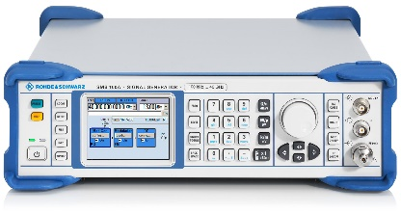
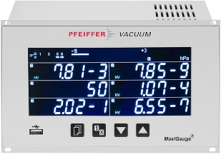
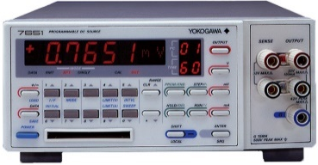
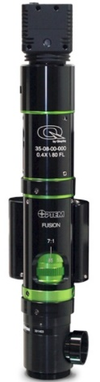
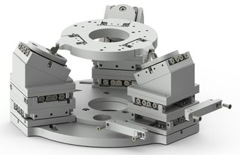
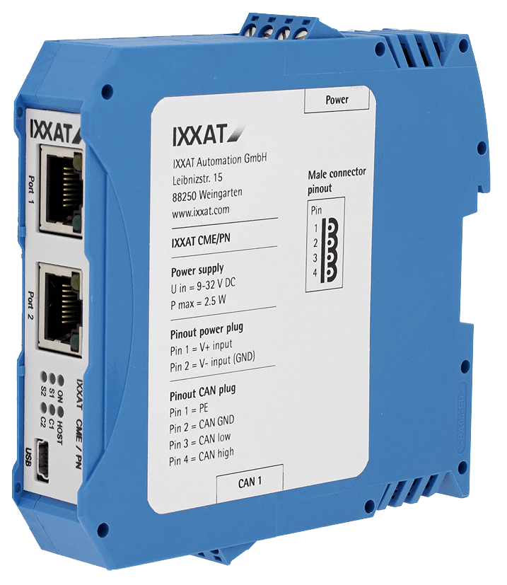
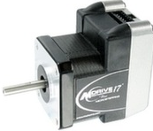
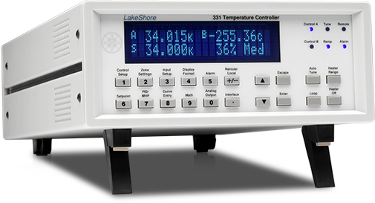
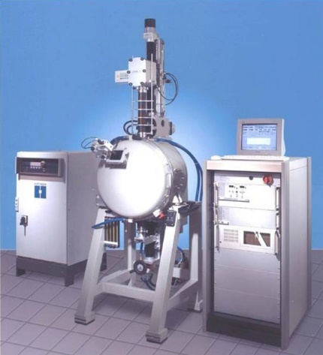
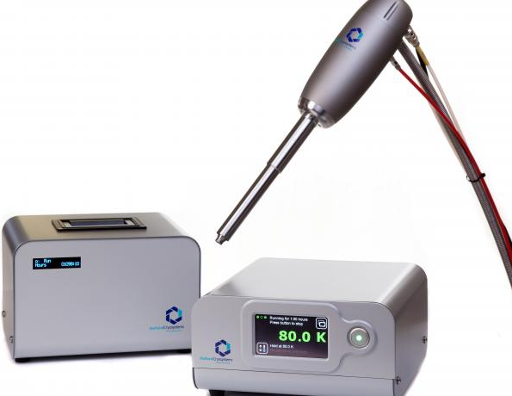
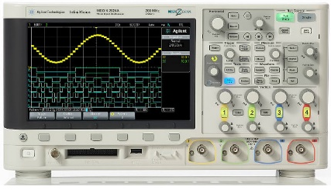
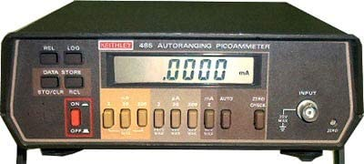
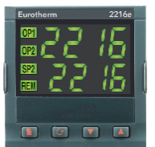
What is StreamDevice?
One generic EPICS driver for many different devices

Slide 3
How can a Device Driver be Generic?
Separate similarities from differences
What do many devices have in common?
What is different between those devices?
Command strings
Human readable Text
Fixed size (binary) “telegrams”
Command sets
Command words
Terminators
Limited set of buses
Serial (RS232, RS485, USB)
GPIB
Ethernet (TCP, UDP)
Value encoding
Formatting
Position in the command
Programming
Configuration

Slide 4
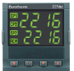
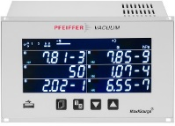
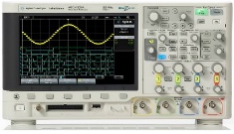
StreamDevice Architecture
Record
database
(templates)
ai
bo
stringout
...
waveform
StreamDevice
This is already done
%f
…
%b
Protocol
file
%{…}
Modular design allows to plug in new functionality
%<…>
%/…/
This is what you need to do
asynDriver
This is already done
serial
Startup
script
TCP
GPIB

Slide 5
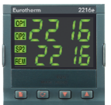
StreamDevice and asynDriver
Does StreamDevice replace asynDriver?
  No. In fact it uses asynDriver to talk to the hardware.
  To be exact: It uses the asynOctet interface.
But doesn’t asynDriver already come with device support?
  Yes, but for string-based devices only stringin, stringout and char waveform.
https://github.com/epics-modules/asyn
StreamDevice does the string formatting and parsing
and asynDriver does the hardware access.
https://github.com/paulscherrerinstitute/StreamDevice
Example:
3.1415
(double)
StreamDevice
"SET 3.14\r\n"
(string)
ao
VAL=3.1415
asynDriver
RS232
"SET %.2f\r\n"

Slide 6
Example: Read a Device in 3 Easy Steps
Read Kelvin temperature #1 from a LakeShore 218 via RS232
  Command: "KRDG? 1" CR LF
  Reply: "+273.15" CR LF
Configure serial port in startup script
      drvAsynSerialPortConfigure LakeShore1 /dev/ttyS0
      asynSetOption LakeShore1 0, baud 9600
      asynSetOption LakeShore1 0, …
Write a protocol file, e.g. file LS218.prot
      Terminator = CR LF;
      temp_K_1 {
      out "KRDG? 1";
      in "%f";
      }
Write a record connecting to protocol file, protocol, and port
      record (ai, "$(DEVICE):TEMP1") {
      field (DTYP, "stream")
      field (INP, "@LS218.prot temp_K_1 LakeShore1")
      field (EGU, "K")
      field (PREC, "2")
      }

Slide 7
Protocol Files
Comment:
# until end of line
Have one file for each device type
  Best name it after device type
Set some global configuration of
communication properties
Write one protocol for each
function/command of device
Use out and in commands
send and receive strings
Format/parse values with format
converters like %f.
  Format converters work on
  implicit variables, typically
  VAL or RVAL fields.
  You can redirect to other fields
  or even other records
See: https://paulscherrerinstitute.github.io/StreamDevice/protocol.html
#LakeShore 218
Terminator = CR LF;
ReplyTimeout = 1000; #ms
ReadTimeout = 100; #ms
reset {
out "*RST"; #no reply
wait 2000;
}
# read in Kelvin
temp_K_1 {
out "KRDG? 1";
in "%f";
}
# read in Celsius
temp_C_1 {
out "CRDG? 1";
in "%f";
}
Configuration
variables
Protocol
needs unique
name within
file
write constant
string
read and parse
reply string
if used by an
ai record
%f sets .VAL

Slide 8
Strings in StreamDevice
Only difference:
no need to escape
the other quote type
Strings can be single or double quoted.
  "That's a string"
  'This one too'
Strings can be written in chunks, with or without comma
  "This is", ' one'
  " big" ' string'
Non-printable characters can be written in many ways:
hex, oct, or dec number, escape sequence, symbolic name
  0x0a 012 10 "\x0a" "\012" "\10" "\n" LF NL
  0x00 0 "\x00" "\0" NUL
Alternatives can be freely mixed
  0x1b "00", 'PR3' CR
See: https://paulscherrerinstitute.github.io/StreamDevice/protocol.html#str
This is the way to
break long strings
into multiple lines.
For a list of symbolic names
and escape sequences
see the documentation.

Slide 9
Formats as Known From printf/scanf
Standard formats
  %f, %e, %E, %g, %G, %d, %i, %x, %o, %s, %c, %[…]
  standard flags %0 -+# to modify format and %* to skip input
  new flags %? for optional input and %= for input comparison
  but no type modifiers like %hi or %lf
Additional formats and features
  %b (bit strings like "10010001")
  %r (raw machine format numbers)
  %{…|…|…} (enumerations)
  %<…> (checksums)
  %/…/ (regular expressions)
Variable is implicit, usually VAL or RVAL field
  Depends on converter type and record type
  Can be redirected like %(EGU)s or %(record)f
See: https://paulscherrerinstitute.github.io/StreamDevice/formats.html
These are just some examples.
More formats can be added.
"redirection"
is explained later

Slide 10
Protocol Parameters
Passing parameters from record to protocol can save typing.
Example: LakeShore218 has 8 temperatures
Terminator = CR LF;
temp_K_1 {out "KRDG? 1"; in "%f";}
temp_K_2 {out "KRDG? 2"; in "%f";}
temp_K_3 {out "KRDG? 3"; in "%f";}
temp_K_4 {out "KRDG? 4"; in "%f";}
temp_K_5 {out "KRDG? 5"; in "%f";}
temp_K_6 {out "KRDG? 6"; in "%f";}
temp_K_7 {out "KRDG? 7"; in "%f";}
temp_K_8 {out "KRDG? 8"; in "%f";}
Terminator = CR LF;
temp_K {out "KRDG? \$1"; in "%f";}
Use parameter instead:
"\$1" is 1st parameter
Pass value
for 1st parameter
record(ai,"$(DEVICE):TEMP2") {
field(DTYP,"stream")
field(INP,"@LS218.prot temp_K_2 $(PORT)")
field(EGU,"K")
field(PREC,"2")
}
record(ai,"$(DEVICE):TEMP2") {
field(DTYP,"stream")
field(INP,"@LS218.prot temp_K(2) $(PORT)")
field(EGU,"K")
field(PREC,"2")
}
Up to 9 parameters
possible.

Slide 11
Redirections
Normally format converters choose field automatically
  VAL or RVAL, depending on format data type
  Scaling (ASLO, AOFF) and smoothing (SMOO) are supported
But sometimes other fields or even other records are needed
  e.g. when one message contains more than one value.
Examples:
  Write value and units: out "%f %(EGU)s";
  Read status and value: in "%(otherrecord)d,%f";
Other records must be on the same IOC.
Use parameters to avoid full record names in protocols.
  Like "%(\$1)d" or "%(\$1:STATUS)d"
If no field is given
.VAL is assumed
pass full
record name
as parameter
pass only part of
record name as
parameter

Slide 12
Redirection Example
Example: "position?" request gives reply with 6 coordinates.
"position( 1.2 , 2.1234, 23.12 ,-2.312 ,-12.33 ,24.4321)"
record (ai,"$(DEV):POS-X") {
field (DTYP,"stream")
field (INP, "@$(PROT) pos($(DEV)) $(PORT)")
field (EGU, "mm")
field (PREC,"2")
field (SCAN,"5 second")
field (FLNK,"…")
}
record (ai,$(DEV):POS-Y) {
field (EGU, "mm")
field (PREC,"2")
}
…
record (ai,$(DEV):POS-RZ) {
field (EGU, "deg")
field (PREC,"3")
}
pos { out "position?";
in "position(%f\_,"
"%(\$1:POS-Y)f\_,"
"%(\$1:POS-Z)f\_,"
"%(\$1:POS-RX)f\_,"
"%(\$1:POS-RY)f\_,"
"%(\$1:POS-RZ)f\_)";}
When FLNK is processed,
the other records have
already got their values.
Spaces around numbers:
%f accepts leading whitespace.
Any amount of trailing whitespace is consumed by \_.
These records have
SCAN="Passive" and
DTYP="Soft Channel"
When redirecting
to .RVAL use
DTYP="Raw Soft Channel"
Redirecting to other records uses dbPutField()
and thus process the target if
the field (here .VAL) is PP

Slide 13
Complex Protocol: Pfeiffer MaxiGauge
InTerminator = CR LF;
# no OutTerminator because of ENQ
pressure {
out ESC "0\$1"
"PR\$2" CR;
in ACK;
out ENQ;
in "%(\$3:STATUS)d,%f";
}
Send device address (on RS485)
ESC (=0x1b) "aa"
  aa is address 00, 01, …
Send pressure read command:
"PRn" CR
  n is sensor number 1 … 6
Each command is
acknowledged with
ACK (=0x06) CR LF
After acknowledge
request value with
ENQ (=0x05)
Receive status
and pressure:
"0,1.234E-5" CR LF
address
sensor
redirect status
to other record
pass address, sensor
and device name
as 3 parameters
record (ai,"$(D):PRESSURE") {
field (DTYP,"stream")
field (INP, "@Maxi.prot pressure($(A),$(S),$(D)) $(B)")
}
record (mbbi,"$(D):STATUS") {
field (ZRST,"OK")
field (ONST,"Unterrange")
field (TWST,"Overrange")
…
}

Slide 14
Enum Format: %{…|…|…}
Translates integers to enumerated strings and back
Example1: Device can be switched with "STOP" and "GO".
Example2: Device may run forward or backward with different speeds (e.g. 1 or 5 mm/s) and reports this as "<<", "<", "=", ">", or ">>".
See: https://paulscherrerinstitute.github.io/StreamDevice/formats.html#enum
record (bo,"$(DEV):SWITCH") {
field (DTYP,"stream")
field (OUT, "@XXX.proto switch $(PORT)")
field (ZNAM,"off")
field (ONAM,"on")
}
record (longin,"$(DEV):SPEED") {
field (DTYP,"stream")
field (INP, "@XXX.proto speed $(PORT)")
field (EGU, "mm/s")
}
0 = "STOP"
1 = "GO"
%#{ allows
assignments:
"<<" = -5
"<" = -1
"=" = 0
">" = 1
">>" = 5
switch {
out "%{STOP|GO}";
}
speed {
out "DIR?";
in "DIR=%#{<<=-5|<=-1|\=|>>=5|>=1}"
}
Escape any literal
| or } or = or \
in enum strings as
\| or \} or \= or \\
>> before > to
avoid wrong match
Input not matching any string raises INVALID/CALC alarm

Slide 15
Binary Protocols (aka “Telegrams”)
Example: Send/receive 5 bytes telegrams:
  Address, command, 2 bytes value (little endian), xor-checksum
  Confirmation is the same with bit 8 set in command byte
Use %r to send integers in “raw” machine code format
details on %r see next slide
Protocol does not use Terminators but has fixed size messages and checksums.
set_value {
MaxInput=5;
out $1 0x04 "%#.2r%<xor>";
in $1 0x84 "%=#.2r%<xor>";
}
get_value {
MaxInput=5;
out $1 0x44 0x00 0x00 "%<xor>";
in $1 0xc4 "%2r%<xor>";
}
pass address
as parameter 1
(no \ outside quotes)
Add checksum
%= checks reply value
Test checksum
local configurations
per protocol
(overwrite globals)

Slide 16
Raw values: %r and %R
Output format: %<flag><width>.<precision>r
  flag #: little endian (default is big endian)
  width: number of bytes printed (sign extended, default 1)
  precision: number of bytes taken from variable (default 1)
Example: value = 0xdeadbeef
  out "%2r"; 0xff 0xef 1 byte sign extended to 2
  out "%.2r"; 0xbe 0xef 2 bytes
  out "%#.4r"; 0xef 0xbe 0xad 0xde 4 bytes little endian
  out "%#4.2r"; 0xef 0xbe 0xff 0xff 2 bytes sign extended to 4
Input format: %<flag><width>r
  width: number of bytes to read
  flag #: little endian
  flag 0: zero extend to long (default is sign extend)
%4R is float and %8R is double
See: https://paulscherrerinstitute.github.io/StreamDevice/formats.html#raw
Pitfall !
sorry for the mess
out "%.2r"
versus
in "%2r"

Slide 17
Checksums: %<…>
Many types of checksums supported
  sum, xor, crc (8,16,32 bit), adler32, …
Output: checksum is appended to output
Input: checksum is compared with input
Range selection: %<start>.<end><checksum>
  start: number of bytes to skip from beginning of string (default 0)
  end: number of bytes to skip just before %<...> (default 0)
Example: out "Example string%3.2<xor>";
Flag %0<…> switches to hex digits instead of raw bytes
Flag %#<…> switches to little endian for multi-byte checksums
See: https://paulscherrerinstitute.github.io/StreamDevice/formats.html#chksum

Slide 18
Regular expressions: %/…/
Regular expressions allow very powerful string parsing
  either to read the string itself
  or to find data that comes after some string
Example: Read title of a web-page.
drvAsynIPPortConfigure "web","epics.web.psi.ch:80”
See: https://paulscherrerinstitute.github.io/StreamDevice/formats.html#regex
don't complain that we don't parse the whole page
%/…/ ignores all input before the match if the expression does not start with ^
OutTerminator = LF;
ExtraInput = ignore;
title {
out "GET http://\$1";
in "%.1/(?im)<title>(.*?)<\/title>/";
disconnect;
}
(?im): case insensitive
multi-line match.
These are Perl compatible regular expressions (PCRE) which are more powerful than Posix or GNU regex.
.1: get 1st
sub expression,
here: (.*?)
escape the /
web server disconnects
after sending a page
and so do we
record (stringin, "$(DEV):TITLE") {
field (DTYP,"stream")
field (INP, "@web.prot title(epics.web.psi.ch) web")
}

Slide 19
Regular expression substitutions: %#/…/…/
Regular expression substitutions let you re-write input or output strings
  Use before other formats in input or after normal formats in output, e.g.:
  in "%#/(<?=[+-]) +(?=[0-9])//%f"
  first removes all spaces between signs and numbers, then parses as float.
More Examples:
%#/_/ / replaces all underscores with spaces
%#/:// removes all : characters. (0b:19:35:31:34 becomes 0b19353134)
%#/..\B/&:/ inserts : after every second character which is not at the end
of a word. (0b19353134 becomes 0b:19:35:31:34)
%#/\\/\// replaces all \ with / (\dir\file becomes /dir/file)
%#+-10.2/ab/X/ replaces the string ab with X maximal 2 times
in the last 10 characters. (abcabcabcabc becomes abcXcXcabc)
%#/([^+-])*([+-])/\2\1/ moves a postfix sign to the front.
(1.23- becomes -1.23)ß
%#-2/.*/\U0/ converts the previous 2 characters to upper case.
See: https://paulscherrerinstitute.github.io/StreamDevice/formats.html#regsub

Slide 20
Asynchronous input: I/O Intr
Some devices send unsolicited data
Example: Temperature sensor sends periodically: "+27.3 C" CR LF
Asynchronous records have SCAN "I/O Intr"
Asynchronous protocols typically have only an in command.
Any input from that device is checked.
  Including input going to other protocols
  Record is processed whenever matching input is found.
  Non-matching input is silently ignored (no error).
record (ai,"$(DEVICE):TEMP") {
field (DTYP,"stream")
field (INP, "@$(PROT) temperature $(PORT)")
field (EGU, "C")
field (PREC,"1")
field (SCAN,"I/O Intr")
}
Terminator = CR LF;
temperature {
in "%f C";
}

Slide 21
I/O Intr vs. Redirection
Example: Read input line with two values x and y every second
record (ai,"$(D):x") {
field (SCAN,"1 second")
field (DTYP,"stream")
field (INP, "@XY.prot x $(PORT)")
}
record (ai,"$(D):y") {
field (SCAN, "I/O Intr")
field (DTYP, "stream")
field (INP, "@XY.prot y $(PORT)")
}
y is processed when x writes value to it
record (ai,"$(D):x") {
field (SCAN,"1 second")
field (DTYP,"stream")
field (INP, "@XY.prot x($(D)) $(PORT)")
}
record (ai,"$(D):y") {
field (SCAN, "Passive")
field (DTYP, "Soft Channel")
}
y is processed when anyone receives input
that matches
x {
out "xy?";
in "%f %(\$1:y)f";
}
x {
out "xy?";
in "%f %*f";
}
y {
in "%*f %f";
}
Redirection is more selective.
Only input from x goes to y.
Ignore
second value
redirect
second value
Be careful:
Any input with two numbers matches.
Ignore
first value

Slide 22
Error Handling
All errors set SEVR to INVALID
  STAT depends on error type
    Reply timeout: device does not reply (TIMEOUT)
    Read timeout: device stops sending unexpectedly (READ)
    Write timeout: writing is not possible (WRITE)
    Lock timeout: port is in use by other records (TIMEOUT)
    Mismatch: input does not match format string (CALC)
Errors abort the protocol
  but may trigger exception handlers
Errors are not propagated along redirections ☹
  Redirects before mismatch are processed normally
  Redirects after mismatch are not processed at all
  Only active record gets error status
Mismatch in "I/O Intr" records is silently ignored

Slide 23
Exception Handlers
Jump to different protocol if something goes wrong
  @mismatch, @replyTimeout, @readTimeout, @writeTimeout
Example: Device replies with value or error message
readValue {
out "value?";
in "%f";
@mismatch {
in "%(\$1:ErrorString)39c";
}
}
if input does not match "%f"
jump to @mismatch
If input does not match and the @mismatch handler starts with in, then the same input is parsed a second time.
reparse input
and redirect
Exception handlers can be defined before or inside normal protocol.
record (ai,"$(DEVICE):Value") {
field (DTYP,"stream")
field (INP, "@$(PROT) readValue($(DEVICE)) $(PORT)")
}
record (stringin,"$(DEVICE):ErrorString") {
}

Slide 24
Record Initialization
Output records can be initialized from hardware
  Initialization is formally handled as an exception: @init
getVolt {
out "VOLT?"; in "VOLT %f";
}
setVolt {
out "VOLT %.2f";
@init {getVolt;}
}
getFreq {
out "FREQ?"; in "FREQ %f MHZ";
}
setFreq {
out "FREQ %.6f MHZ";
@init {getFreq;}
}
record (ai,"$(D):ReadVoltage") {
field (DTYP,"stream")
field (INP, "@X.prot getVolt $(PORT)")
}
record (ao,$(D):SetVoltage") {
field (DTYP,"stream")
field (OUT, "@X.prot setVolt $(PORT)")
}
record (ai,"$(D):ReadFrequency") {
field (DTYP,"stream")
field (INP, "@X.prot getFreq $(PORT)")
}
record (ao,$(D):SetFrequency") {
field (DTYP,"stream")
field (OUT, "@X.prot setFreq $(PORT)")
}
reference other
protocol to insert
all its commands
@init is executed in iocInit before scans are started and at re-connects.

Slide 25
Arrays
For arrays the format is repeated for each element with optional separator string in between.
Example: "{10.2,345.3,23.3,10.0}"
Input
  reads max NELM elements
  at least one element must be found
  sets NORD to number of elements found
Output
  writes NORD elements
readArray {
Separator = ",";
in "{%f}";
}
record (aai,"$(DEVICE):Array") {
field (FTVL,"FLOAT")
field (NELM,"100")
field (DTYP,"stream")
field (INP, "@$(PROT) readArray $(PORT)")
}

Slide 26
Recommended Reading
StreamDevice documentation
    https://paulscherrerinstitute.github.io/StreamDevice
AsynDriver documentation:
    https://epics-modules.github.io/master/asyn
EPICS Documentation
    https://docs.epics-controls.org/projects/base/en/latest/index.html
    Record Reference
      https://docs.epics-controls.org/projects/base/en/latest/
      ComponentReference.html#record-type-definitions
Getting started with EPICS
  https://docs.epics-controls.org/en/latest/getting-started/EPICS_Intro.html

