Slide 2
The Controls Ecosystem (CE)
Managing IOCs at the European Spallation Source
PRESENTED BY Anders Lindh Olsson

Slide 3
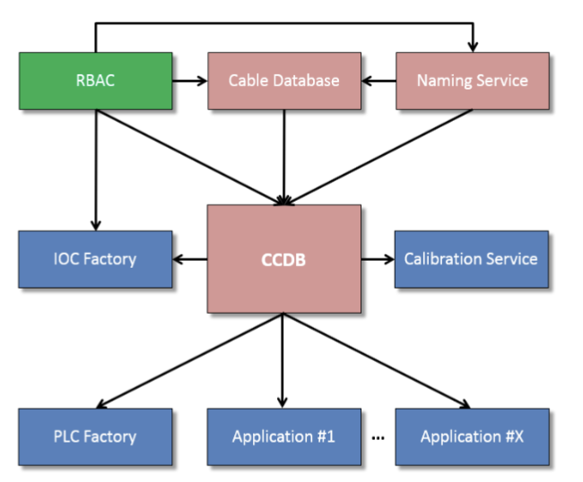
History
The CCDB ecosystem
“An IOC is failing, which hardware does it relate to?”
It was to answer this type of question that we created the CCDB ecosystem

Slide 4
History
The CCDB ecosystem (2)
The Controls Configuration Database (CCDB) was meant to host all relevant data about our control system
We built several other services around CCDB to be able to manage control system roles, control system hardware assets and cabling, and much more; in the end, we had a grand total of 5 separate applications
But…
We realised that we had built a system which did not suit our needs; it was difficult to use, to maintain, and to extend, and many of the functions within the ecosystem had been superseded by other ESS systems
So, we decided to take a step back and to act on this

Slide 5
Enter CCCE
Controls Configuration: Community Edition
We decided to build a replacement system following a few guiding principles
One of these principles was the efficiency of our control system engineers; the tool(s) should not only be useful for the long-term management of the site, but also for the individual developers – thus Community Edition
A project charter was written, and a development team was formed
We decided to call the replacement system the Controls Ecosystem (CE)

Slide 6
Project plan
Our approach
As the previous ecosystem was in production, we needed to replace its functions one by one, and we decided to start from the end of the toolchain in order to provide immediate value:
Deploy (e3) IOCs in a standardised, reproducible, and auditable manner
Monitor IOCs and the servers they are running on
Manage IOCs at scale
Monitor the control system
Once done, we would unify all functions
We would also need to replace our solutions for authentication and authorisation, deprecate old services, and more

Slide 7
The Controls Ecosystem (CE)
Core principles and key features
Be conservative about scope and leverage existing systems
Our software should be maintainable, intuitive, and reliable
Design for basic users while still allowing for advanced users (API first)
Nudge users towards better software practices

Slide 8
The Controls Ecosystem (CE)
Technologies
Most of our software was written in Java, so we decided to go for
PostgreSQL – Java – SpringBoot applications
TypeScript - React web interface(s) with MUI components
Ansible to deploy IOCs (as well as to orchestrate our servers)

Slide 9
The Controls Ecosystem (CE)
Deploying an IOC – a primer on e3
With e3, we have a standardised executable in a modified softIocPVA called iocsh, and further functionality is then (dynamically) loaded as e3 modules with the help of require – a variation of the module initially written by Dirk Zimoch for PSI
We have two different distribution methods used with e3:
Using shared builds, made available to all hosts using NFS
Downloading build artifacts using conda
We do, thus, not have any compilation step involved in the creation of an IOC
Find more information about e3 at https://e3.pages.esss.lu.se/, and see our IOC deployment ansible playbook at https://gitlab.esss.lu.se/ics-ansible-galaxy/ics-ans-ioc/

Slide 10
The Controls Ecosystem (CE)
Where we are today
We have a deployment service, a monitoring service, and a templating service in production
We are still using the old naming service, but are working on its replacement
We have deprecated one of the old services (IOC factory)
The remaining three will be deprecated Soon™️

Slide 11
The Controls Ecosystem (CE)
Integrations
Outside of the services that constitute the ecosystem, we use:
Ping (for authentication and authorisation)
GitLab (as devops platform)
AWX (as ansible task engine)
Netbox (for network and device configuration)
Prometheus (as monitoring system and time-series database)
ChannelFinder (as EPICS record directory service)
Grafana Loki (for log aggregation)
ENOVIA (“CHESS”; ESS’ product lifecycle manager)

Slide 12
Usage
Adoption and control system growth
We have gone from 0 IOCs deployed in a standardised manner in 2020 to
64 IOCs in February 2021
408 IOCs in June 2022
1 012 IOCs in June 2023
And then we started exporting also entity statistics in Prometheus…

Slide 13
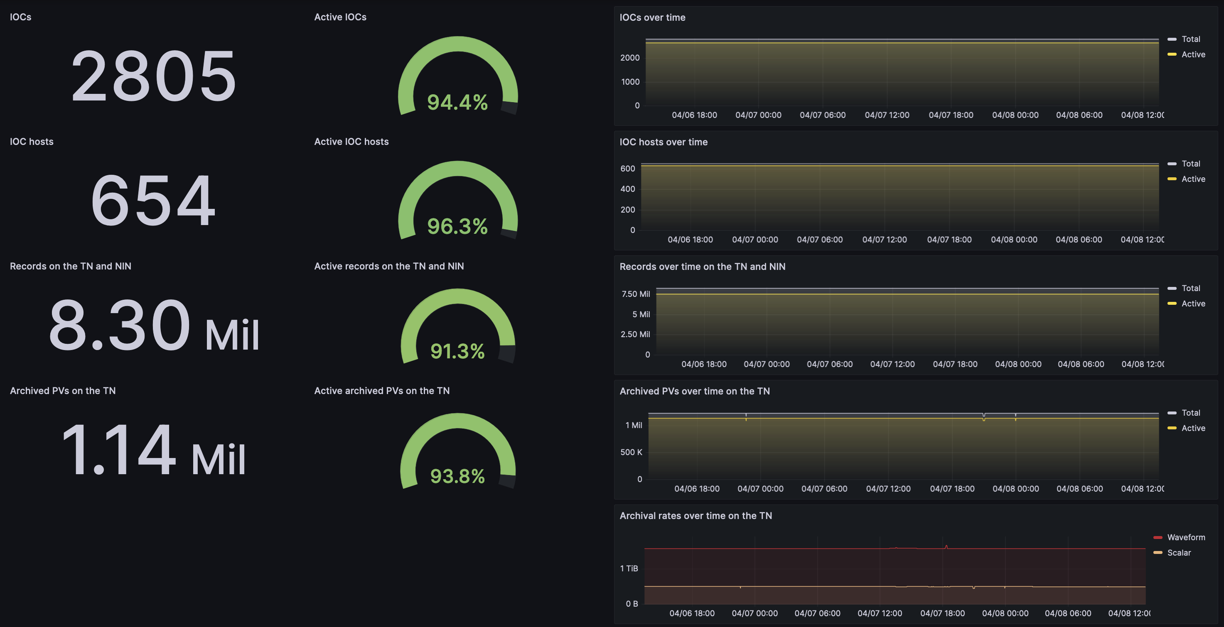
Usage
Today

Slide 14
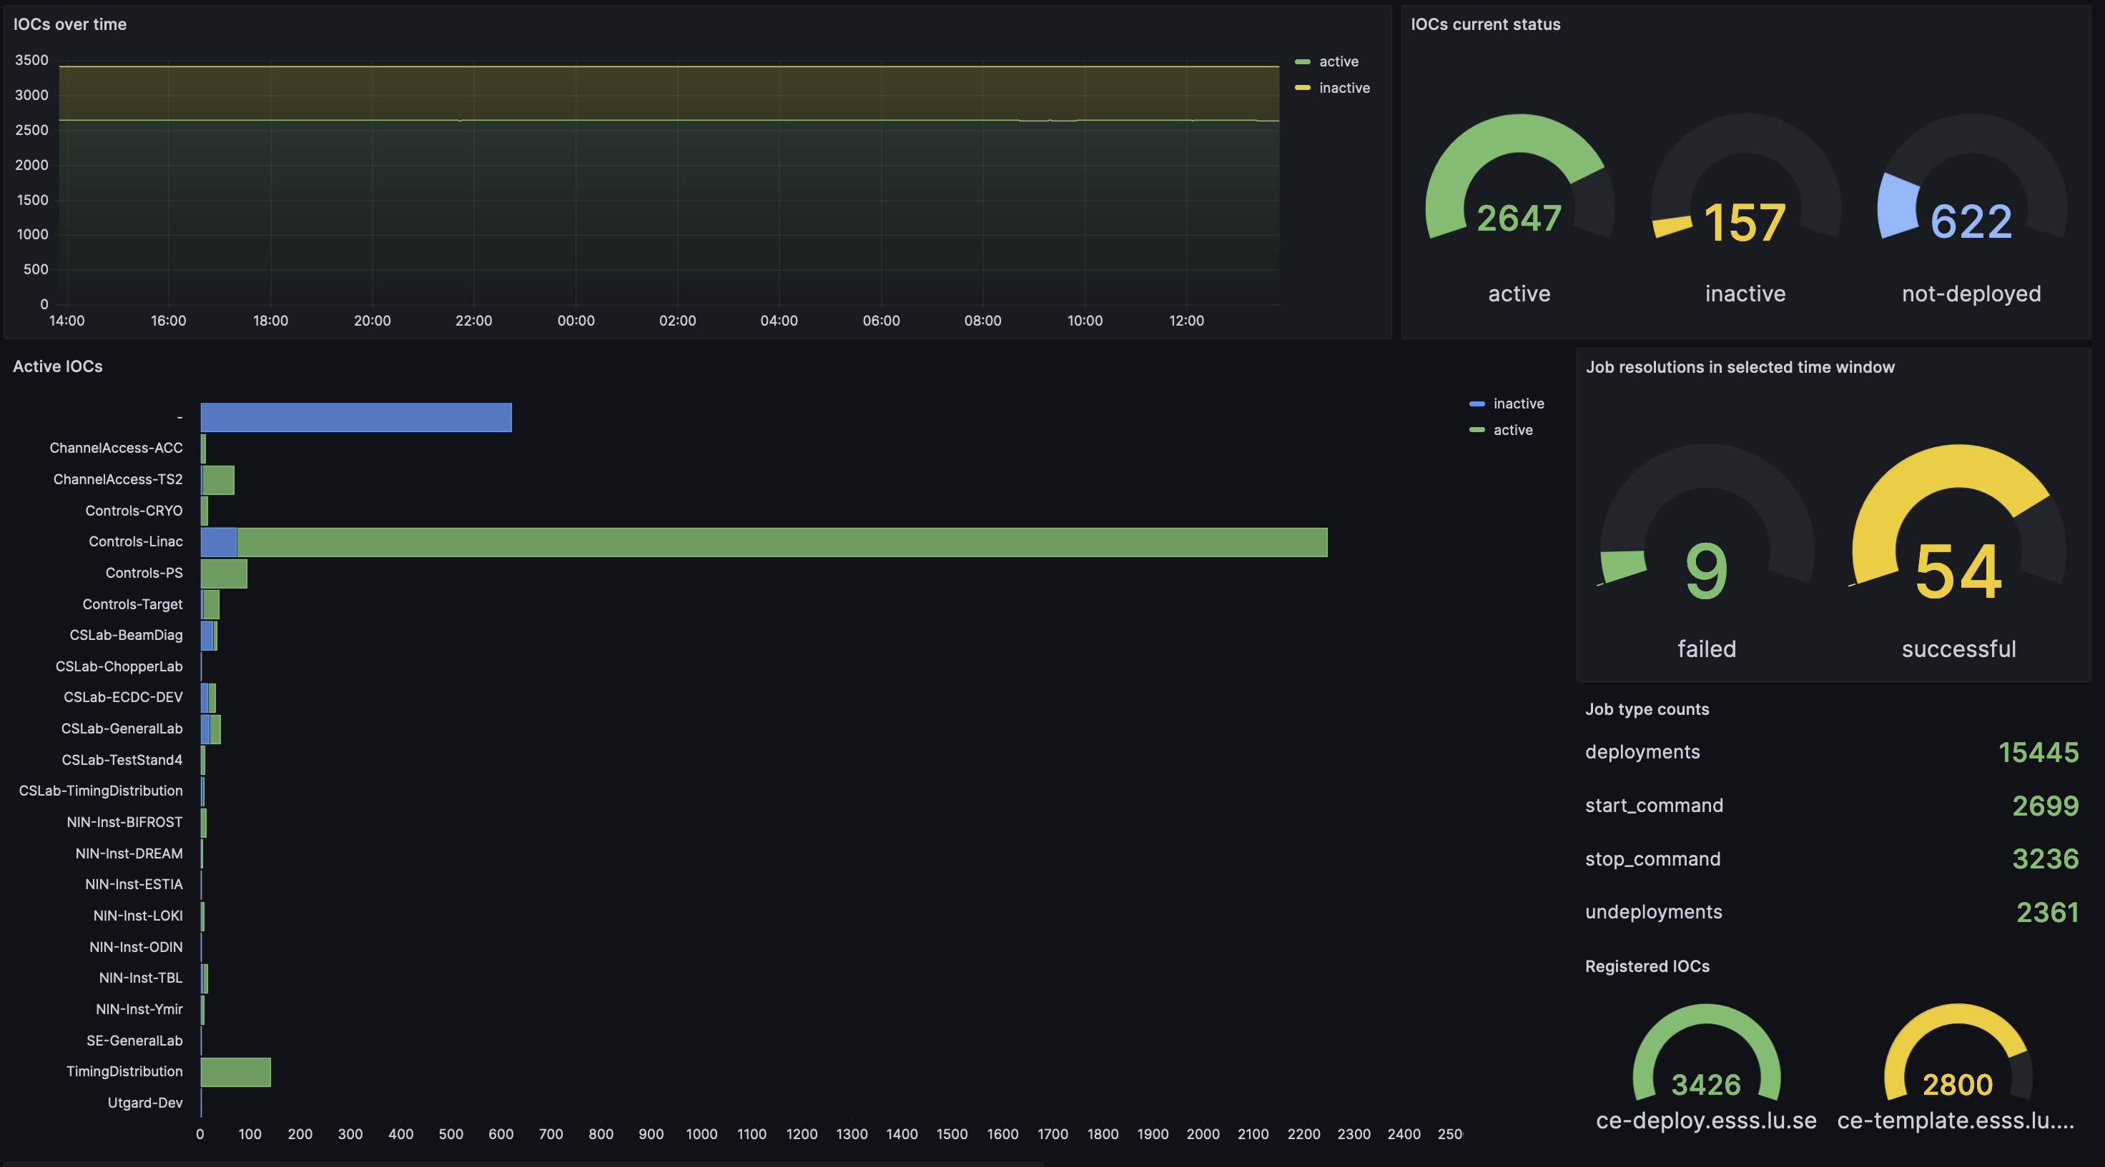
Usage
Today (2)

Slide 15
Capabilities
More numbers
We can deploy an individual IOC (of either type) in about 2.5-3 minutes
This amounts to about 200-300 IOCs in one day
We expect to soon be able to do this at least 5x as fast for larger batches
We could technically reinstate every IOC at ESS with the click of one button
We can update 100s of IOCs in minutes to 10s of minutes
We can display alarms on all entitites, e.g. to highlight
Invalid record names
High system load

Slide 16
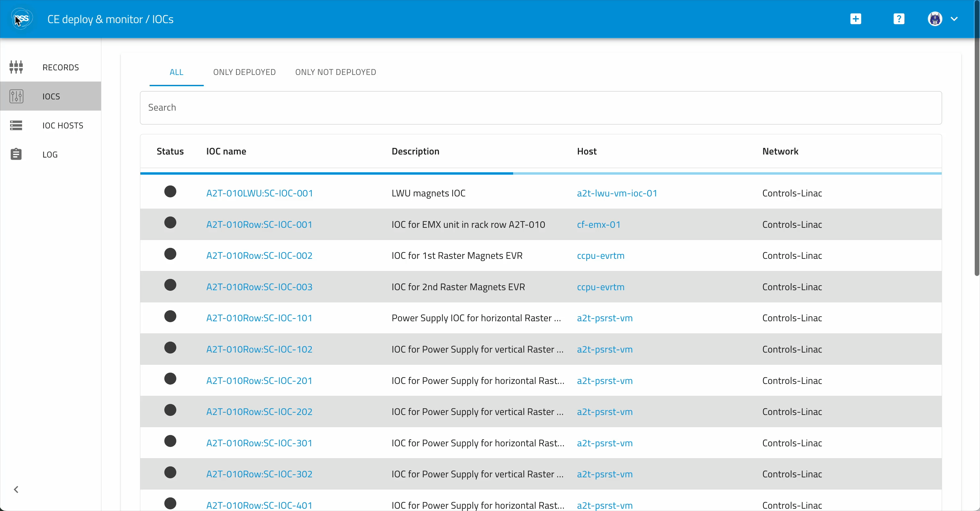
CE deploy & monitor
Navigation demo

Slide 17
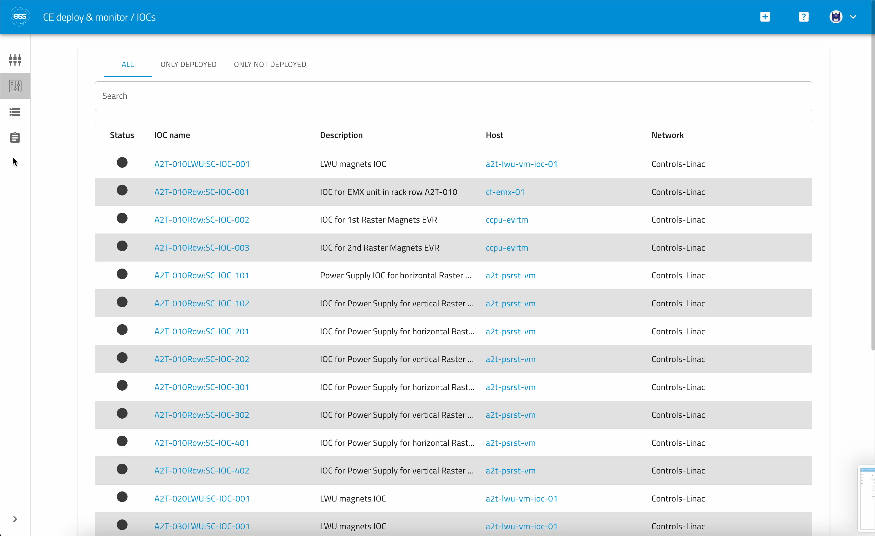
CE deploy & monitor
Deployment demo

Slide 18
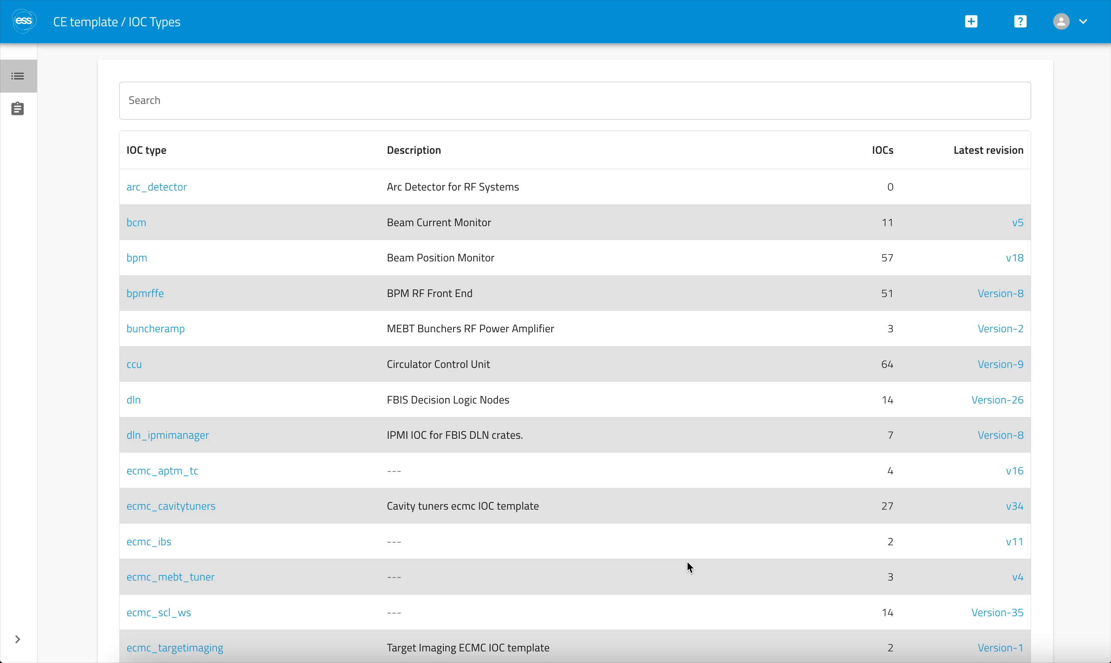
CE template
Generation demo

Slide 19
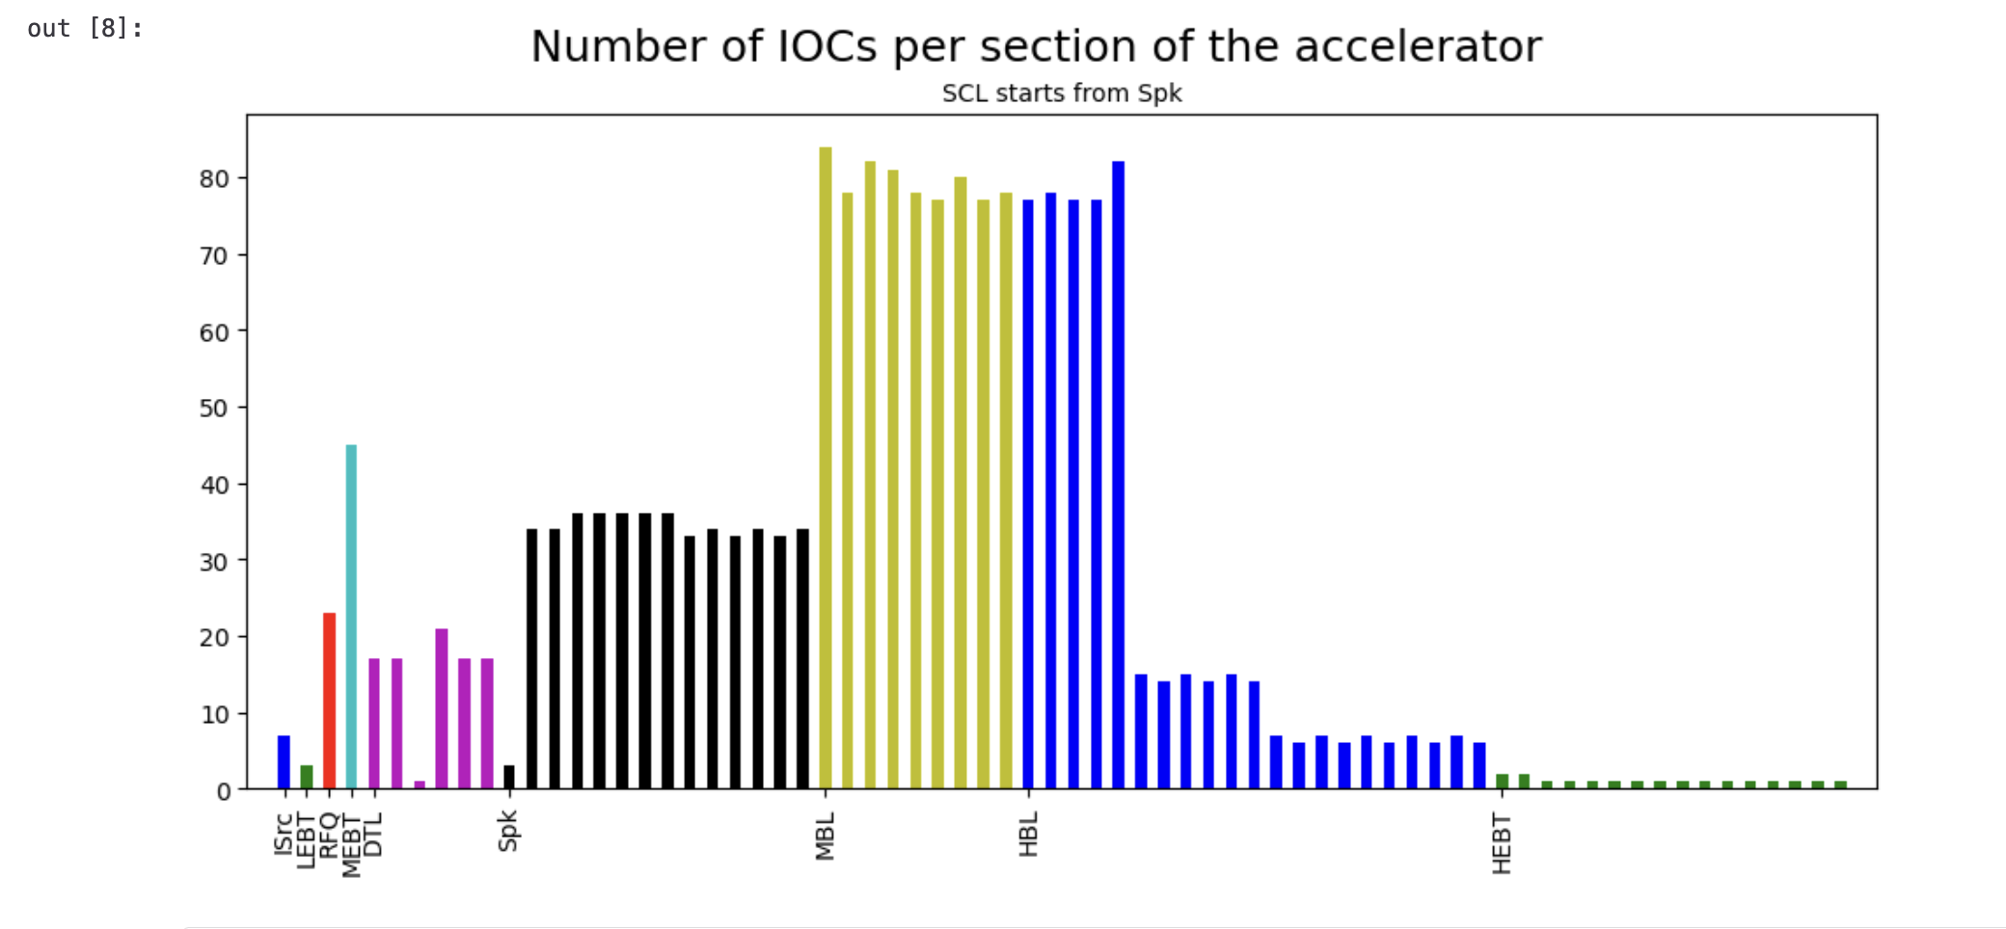
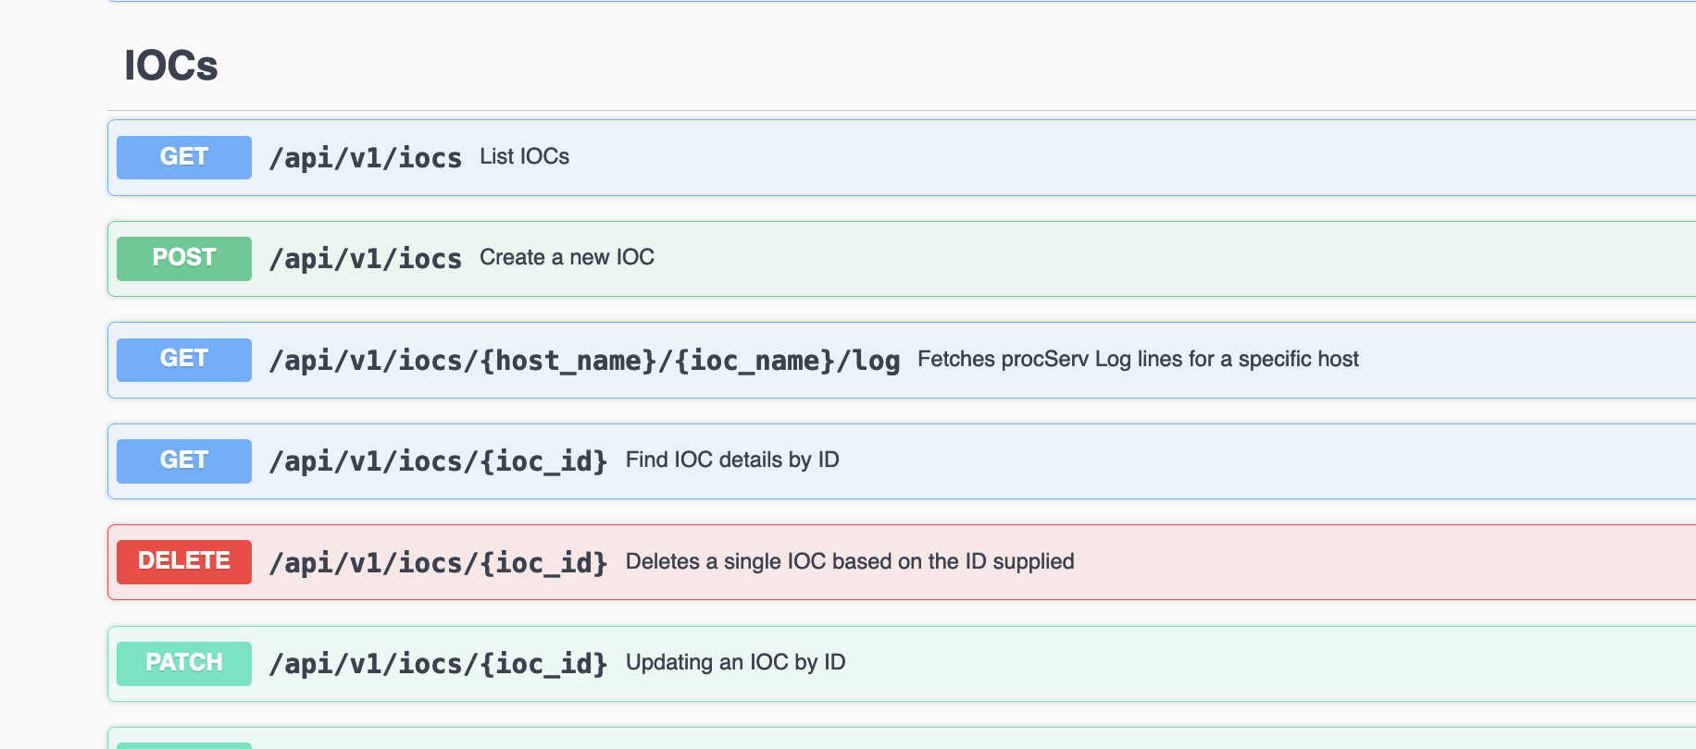
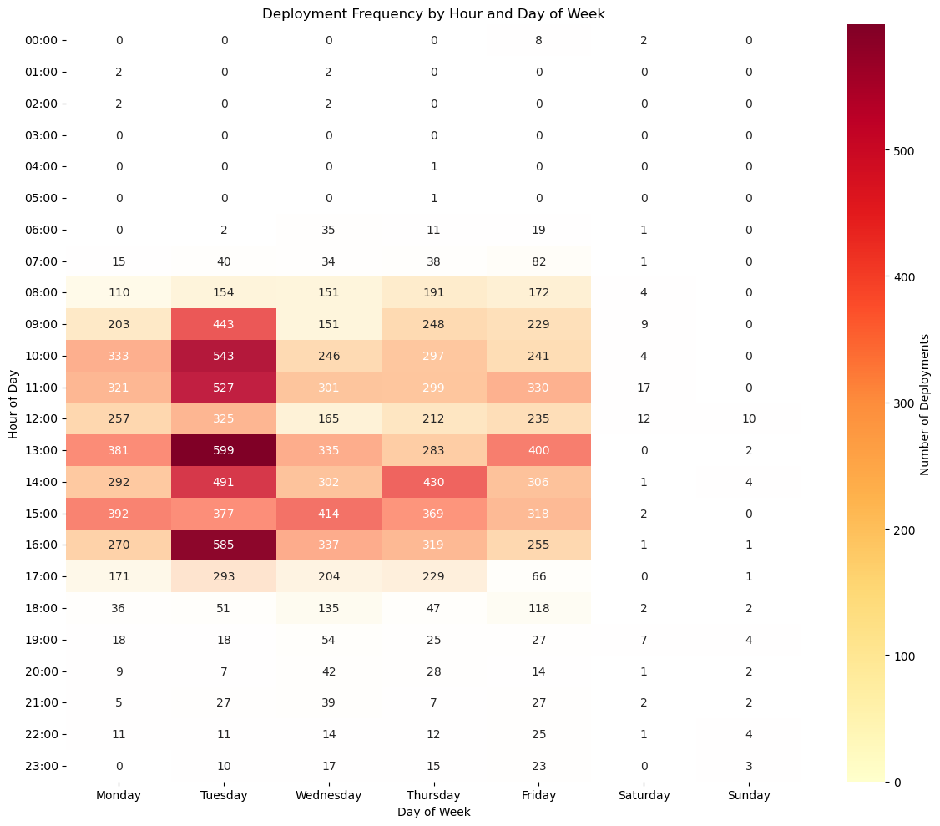
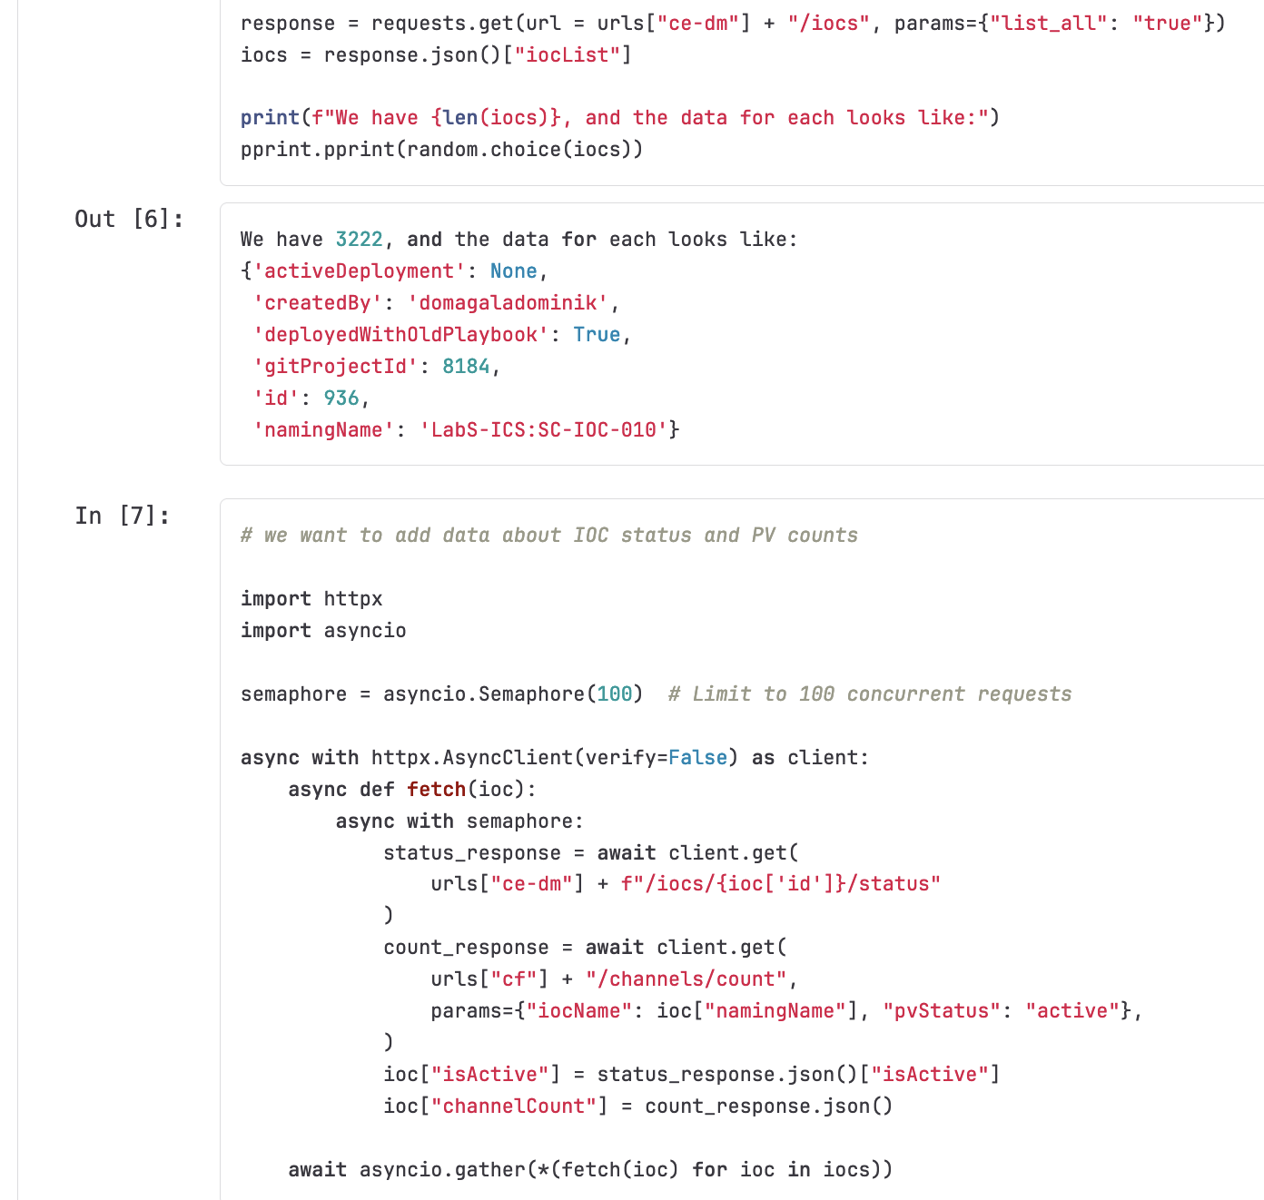
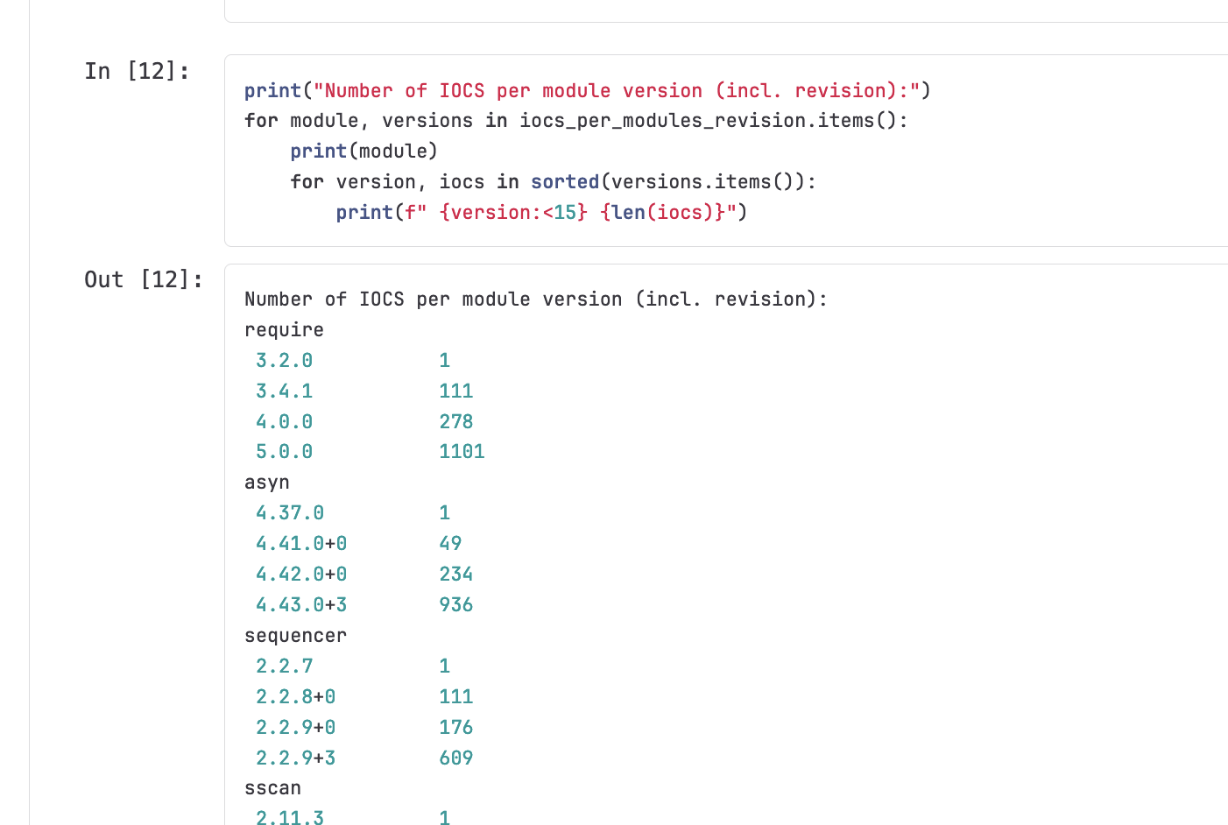
The REST API
Enabling further analysis

Slide 20
Summary
To wrap things up
We still have a few challenges in front of us:
Deploying IOCs for diskless systems
Unifying our services into a monolithic application
…and we will want to add a few more quality-of-life features, to help navigate the masses of objects
But!
We have an IOC management system which we believe can support the scale of the facility’s control system
We think we have set ourselves up well for the (eco)system going into a support & maintenance phase

Slide 21
Tack!
Questions?
Anders.lindholsson@ess.eu

Slide 22
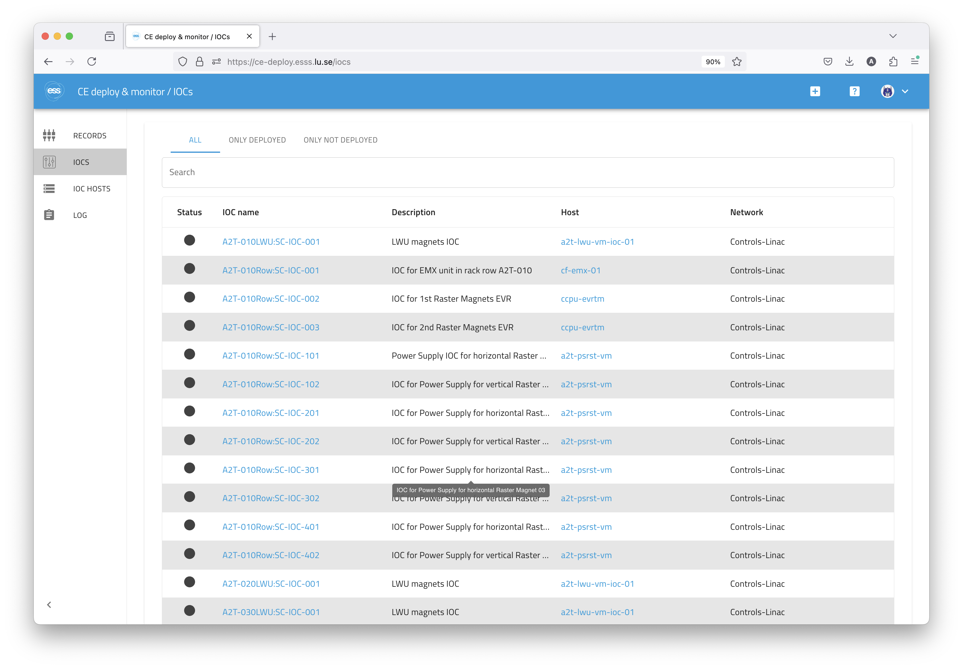
CE deploy & monitor
Browsing IOCs

Slide 23
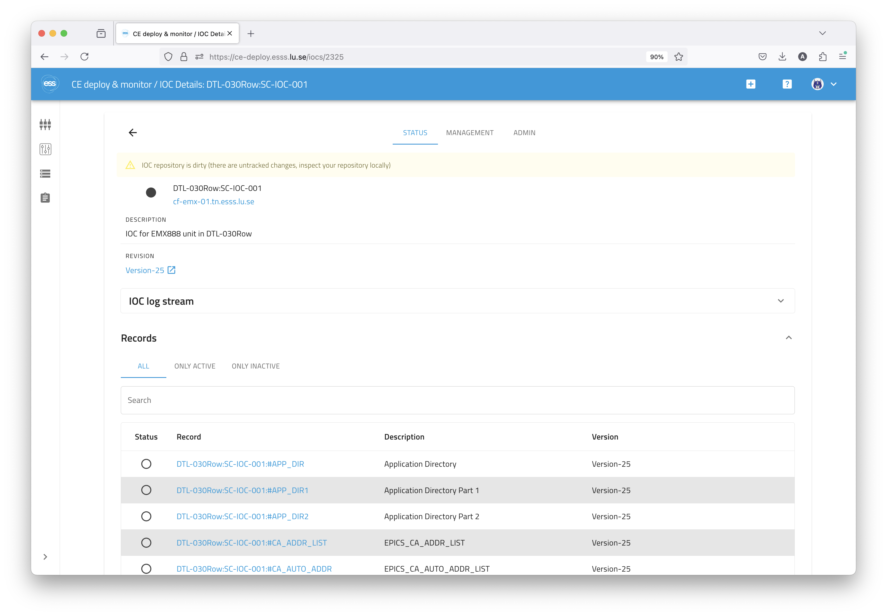
CE deploy & monitor
Inspecting an IOC

Slide 24
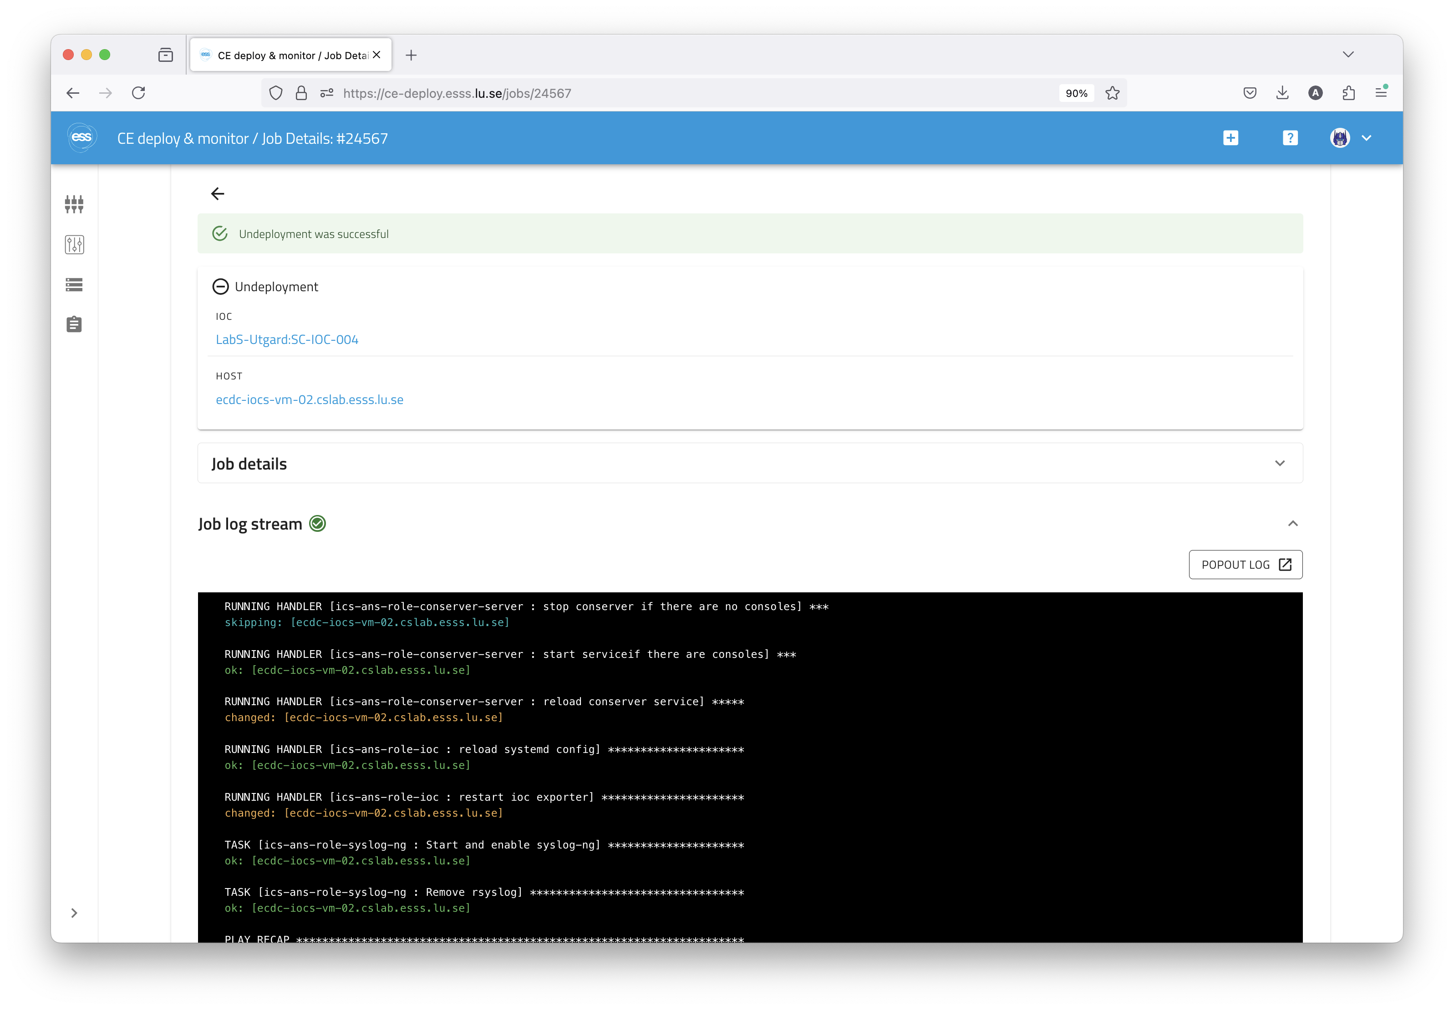
CE deploy & monitor
Deploying an IOC

Slide 25
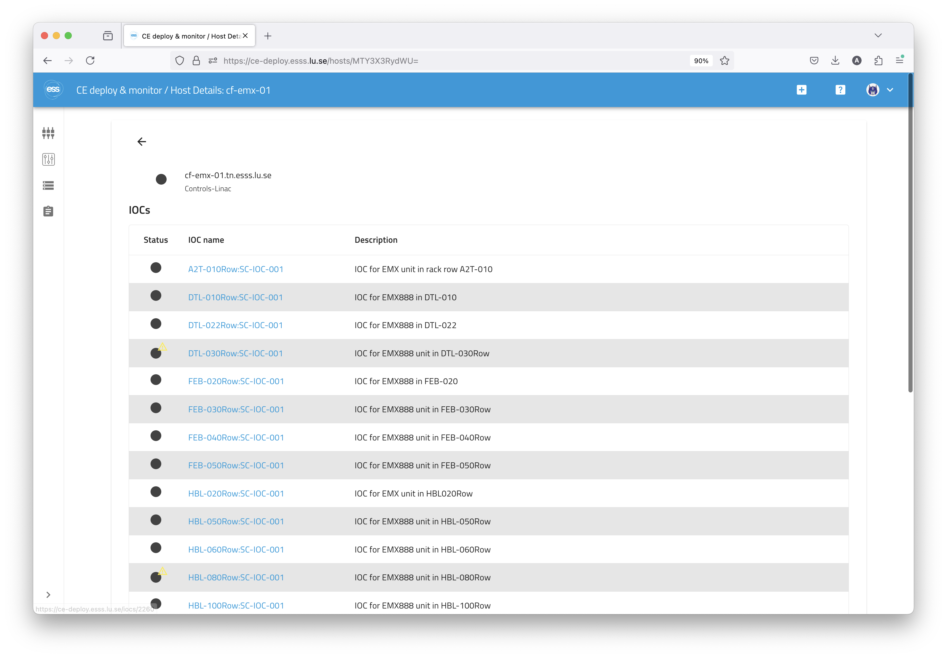
CE deploy & monitor
Inspecting an IOC host

Slide 26
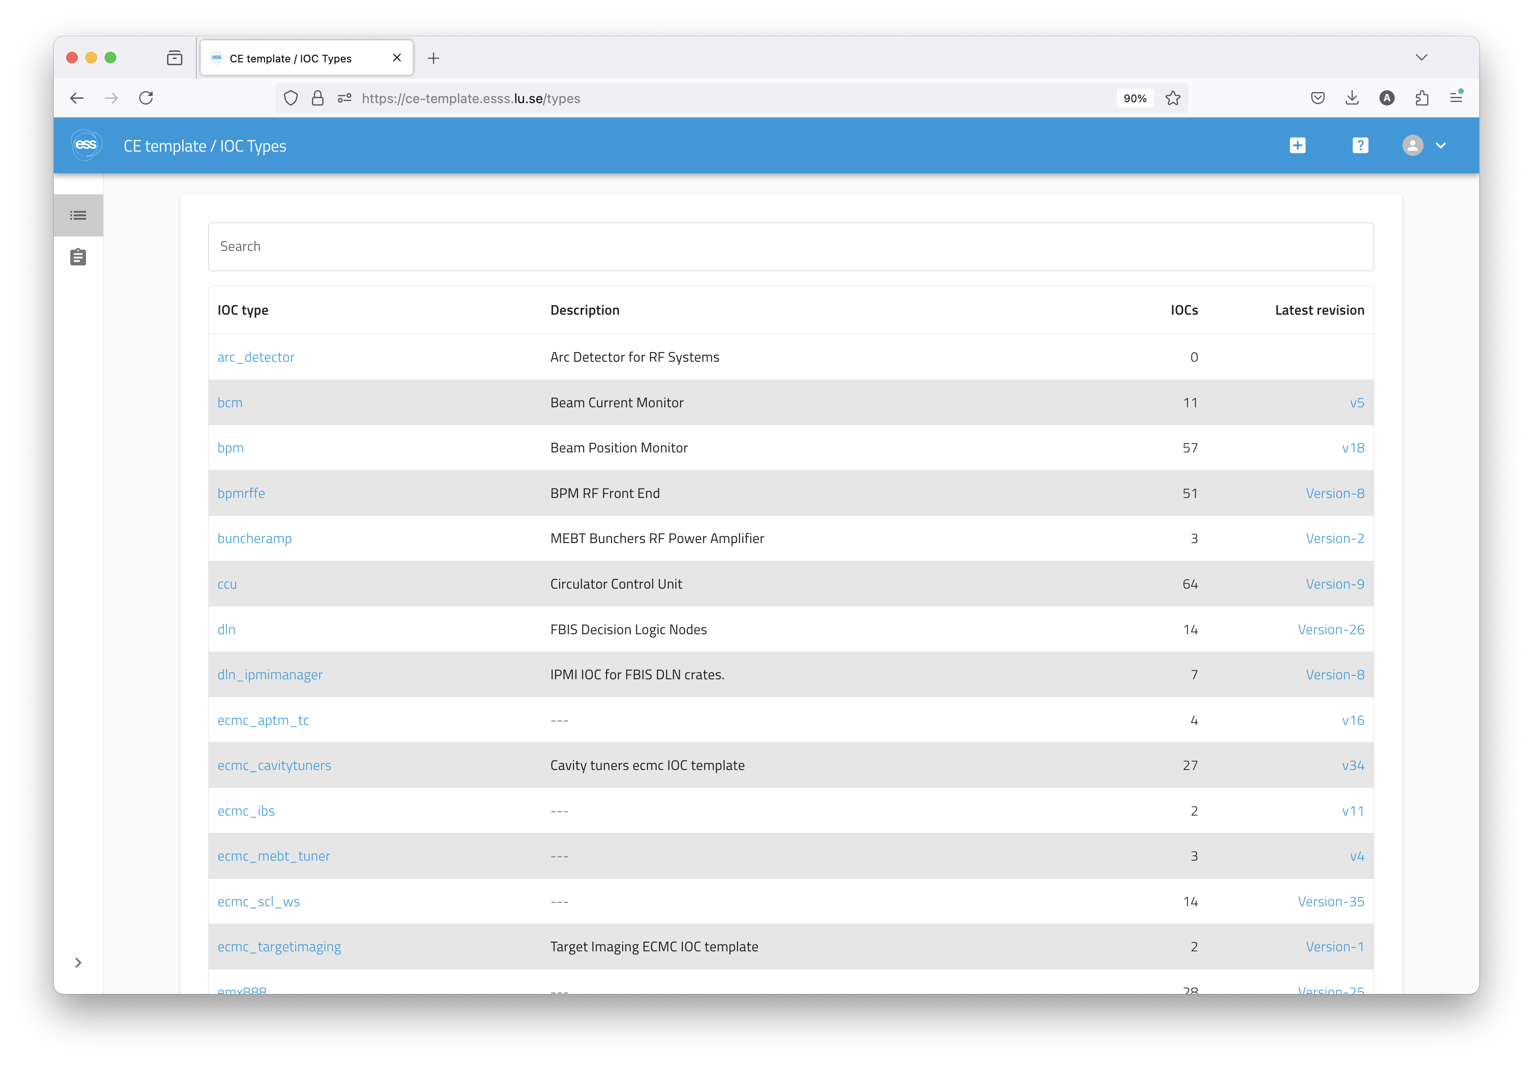
CE template
Browsing IOC types

Slide 27
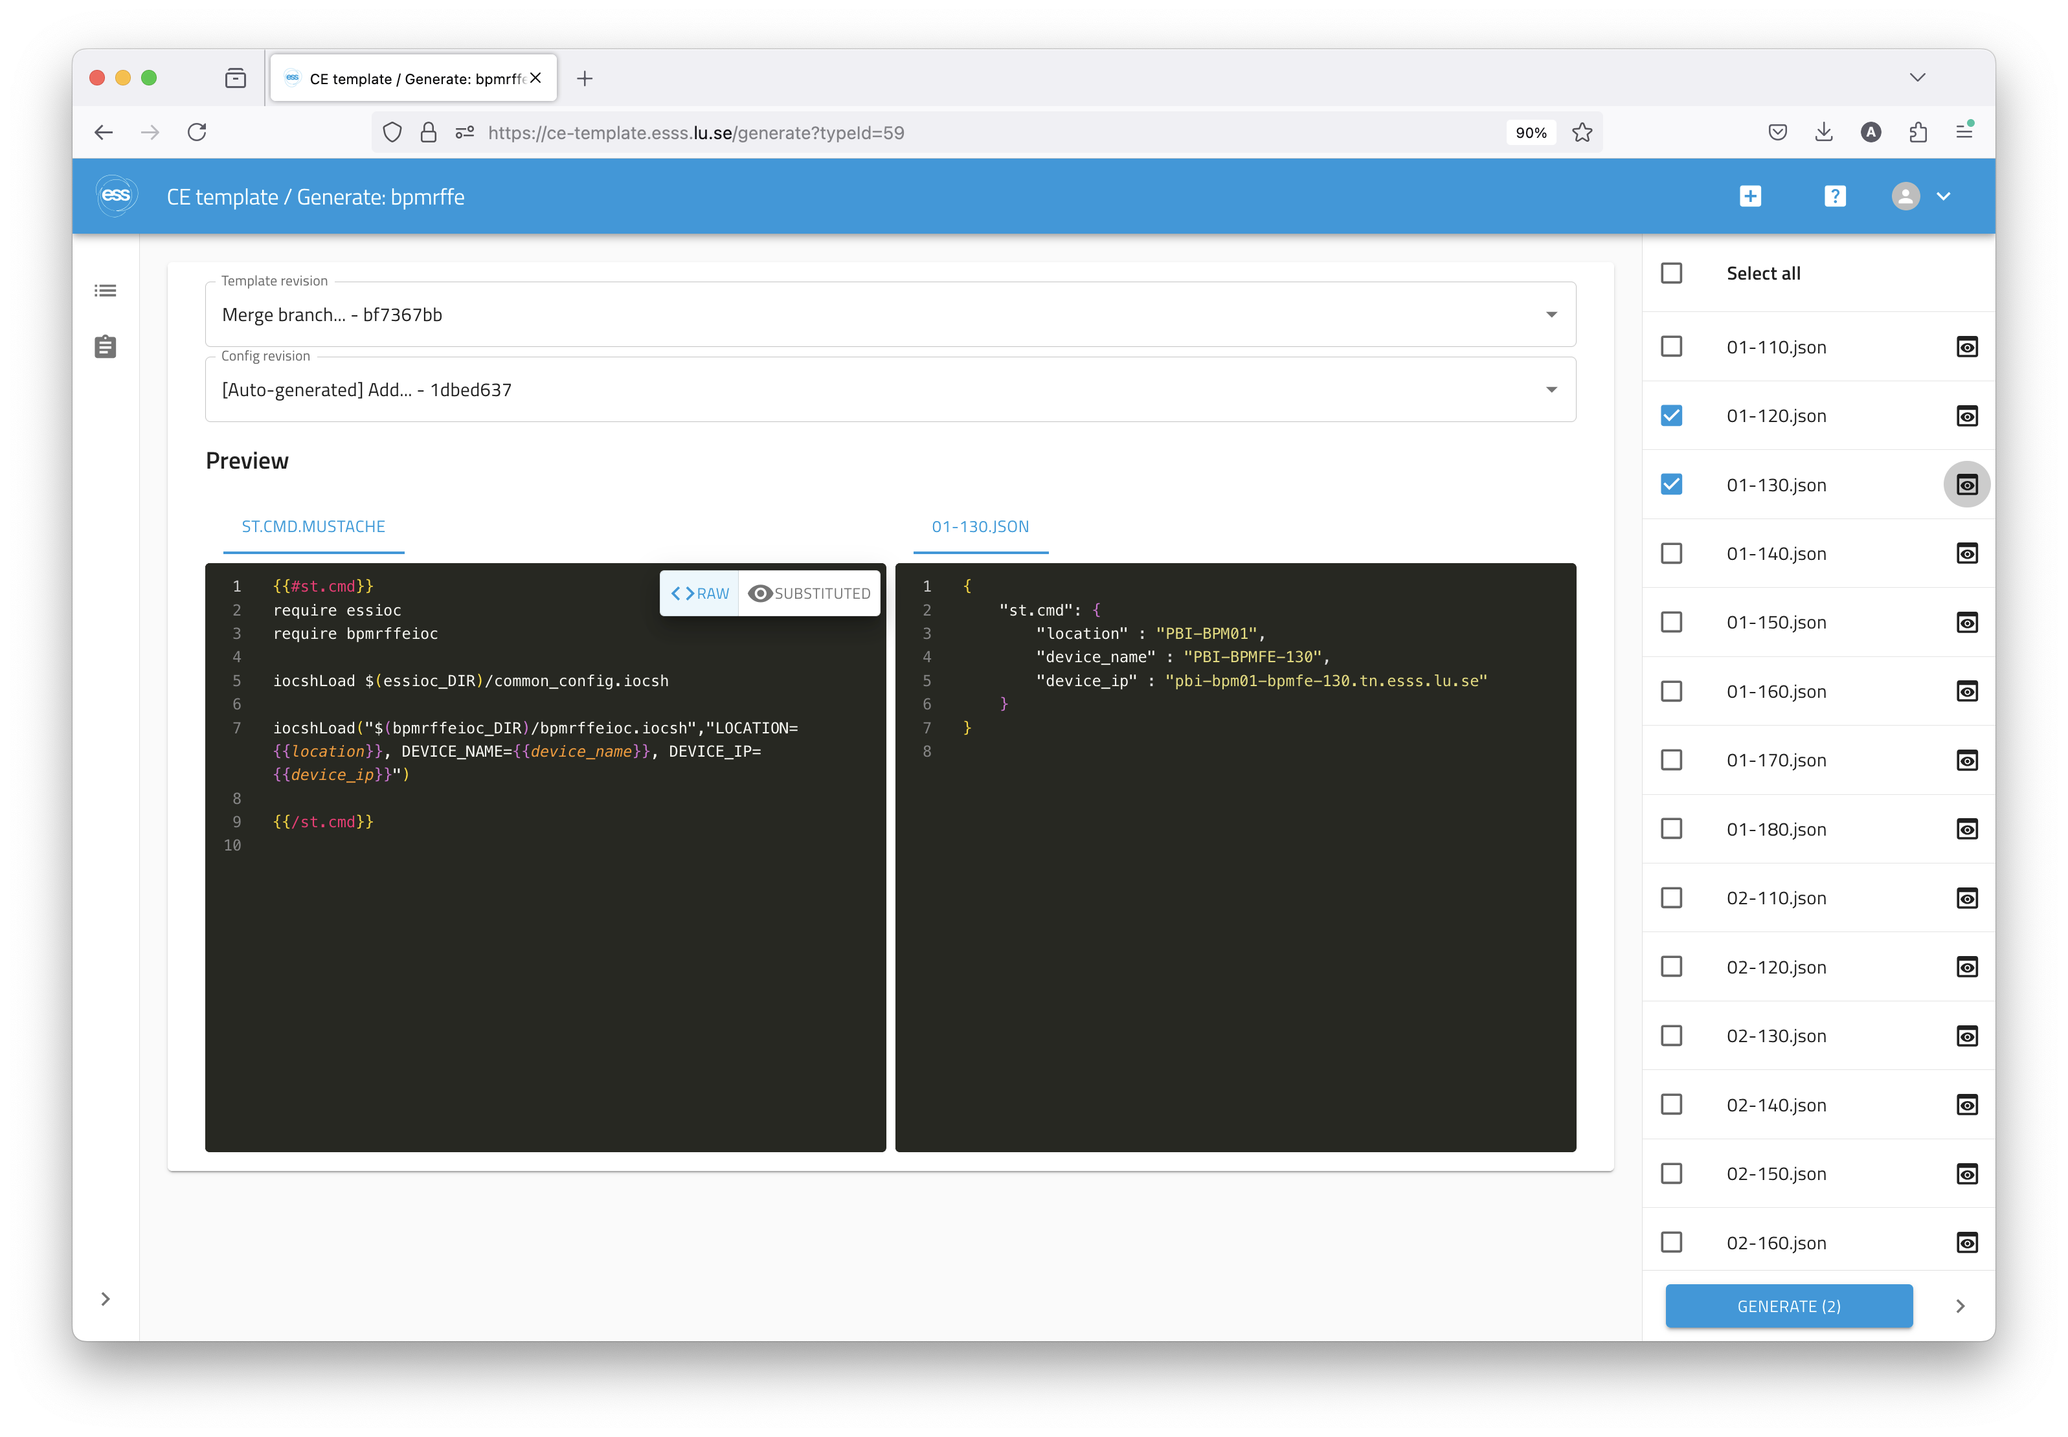
CE template
Generating new revisions for an IOC type

