Slide 1

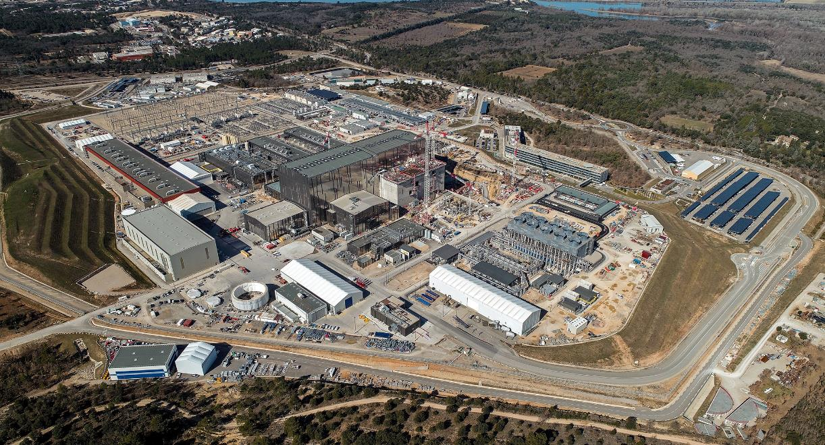
Web Tools at ITER
Web Tools at ITER
Overview for the GUI Web Workshop
Denis Stepanov, ITER Organization
On behalf of the ITER Controls Team
EPICS Collaboration Meeting, 20-24 April 2026, ENS Paris-Saclay, France
Denis Stepanov, ITER Organization
On behalf of the ITER Controls Team
EPICS Collaboration Meeting, 20-24 April 2026, ENS Paris-Saclay, France

Slide 2
General Status
Web Applications are actively used for system description, monitoring and data processing. Use for controls is limited
There is no central design or policy. Applications are usually made “bottom up”, when there is strong demand from users
Mix of third-party apps and home-made apps
Some apps are only available from Intranet, some (many) are from Internet, using Microsoft cloud authentication + 2FA
Always connected to central user directories (AD or LDAP with full sync)
(shown further are only a subset, some others could be inadvertently omitted)
(build environment Web is entirely omitted: Jenkins / Bugzilla / Jira / SVN / Git Bitbucket / SonarQube / Artifactory / Red Hat Satellite, …)
Disclaimer: as the systems are often under construction or commissioning, the metrics shown may be incorrect, incomplete or require further explanation.

Slide 3
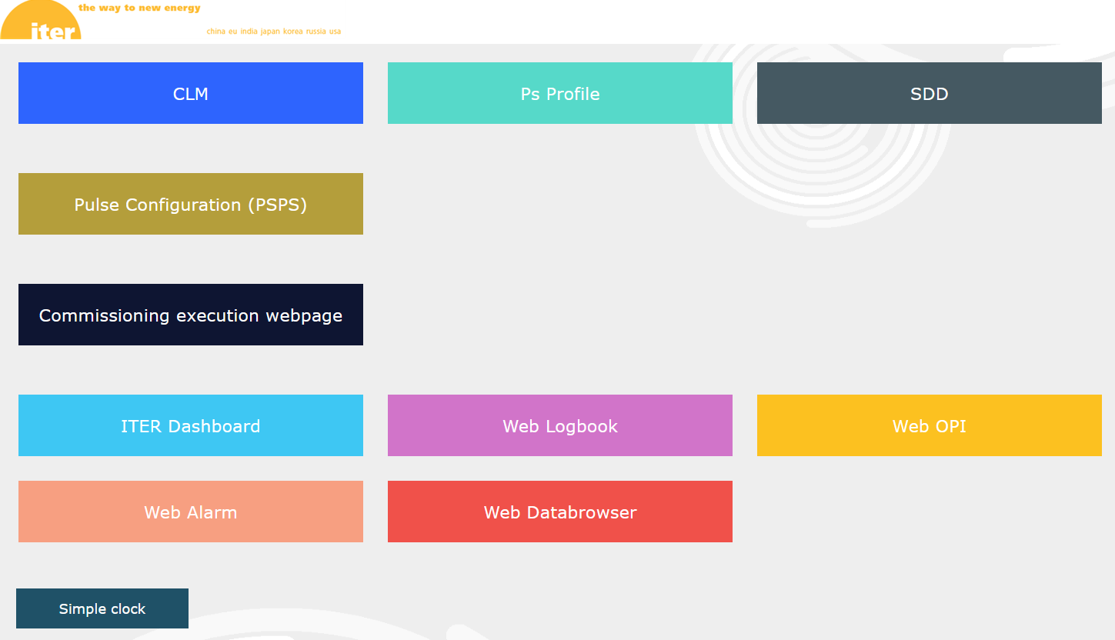
The launchpad

Slide 4
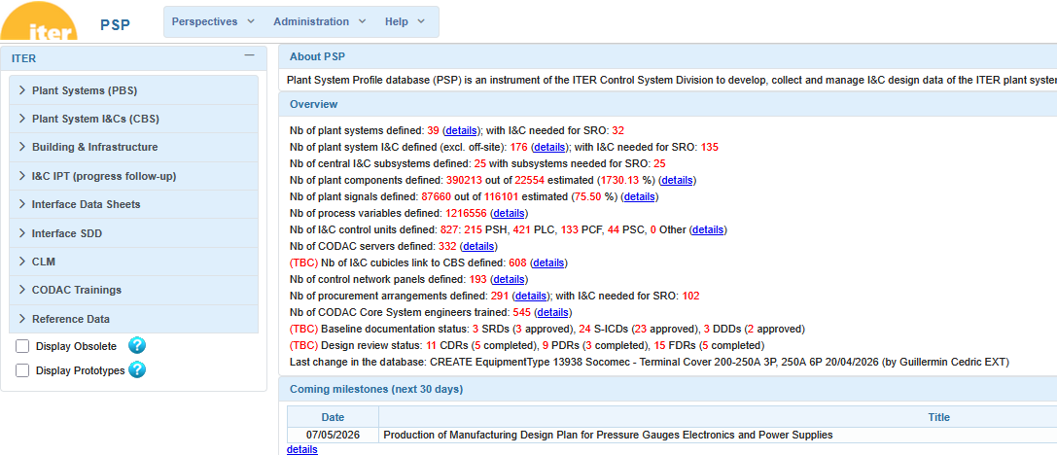
PSP – structured records of the I&C design. Support for interface document generation

Slide 5
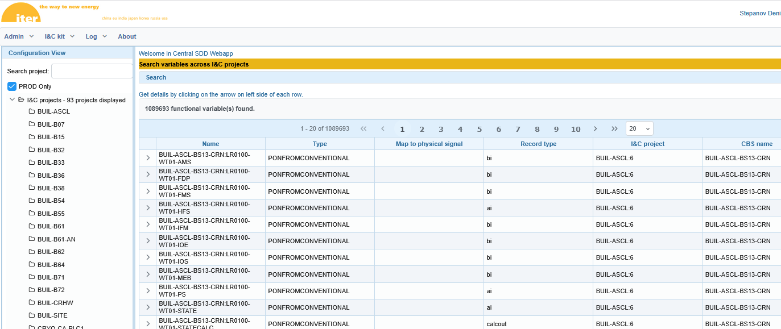
SDD – static configuration of the production projects (including full configuration of EPICS IOCs)

Slide 6
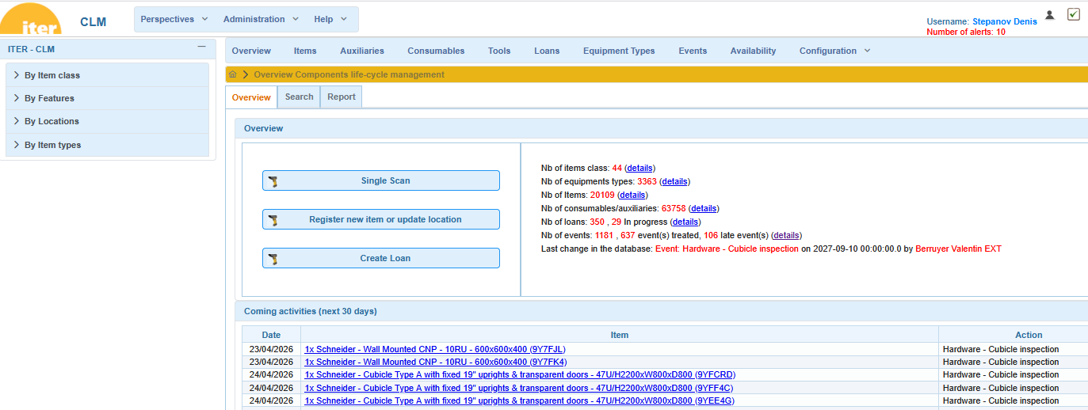
CLM – I&C equipment inventory down to maintainable items. Support for warehouse scanners and RFID.

Slide 7
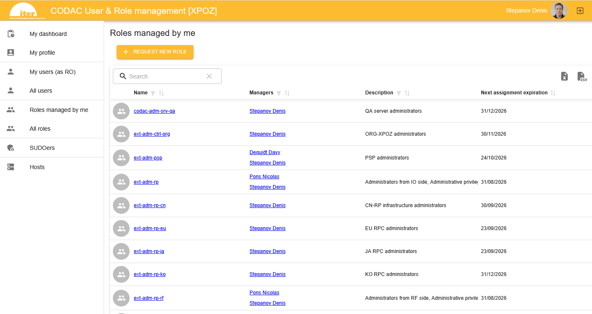
Role Management – Managing user rights in the control system

Slide 8
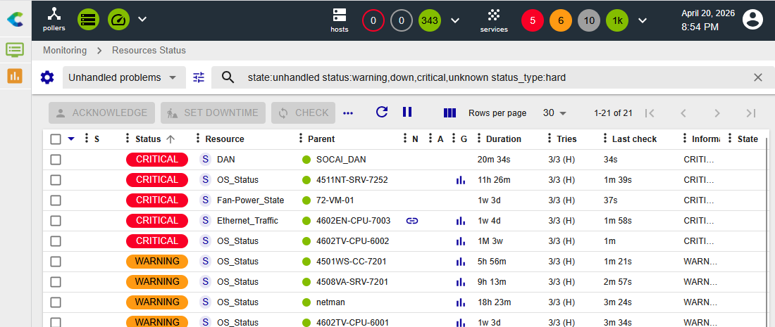
Centreon – Nagios-type control system monitoring with email / SMS alerts.

Slide 9
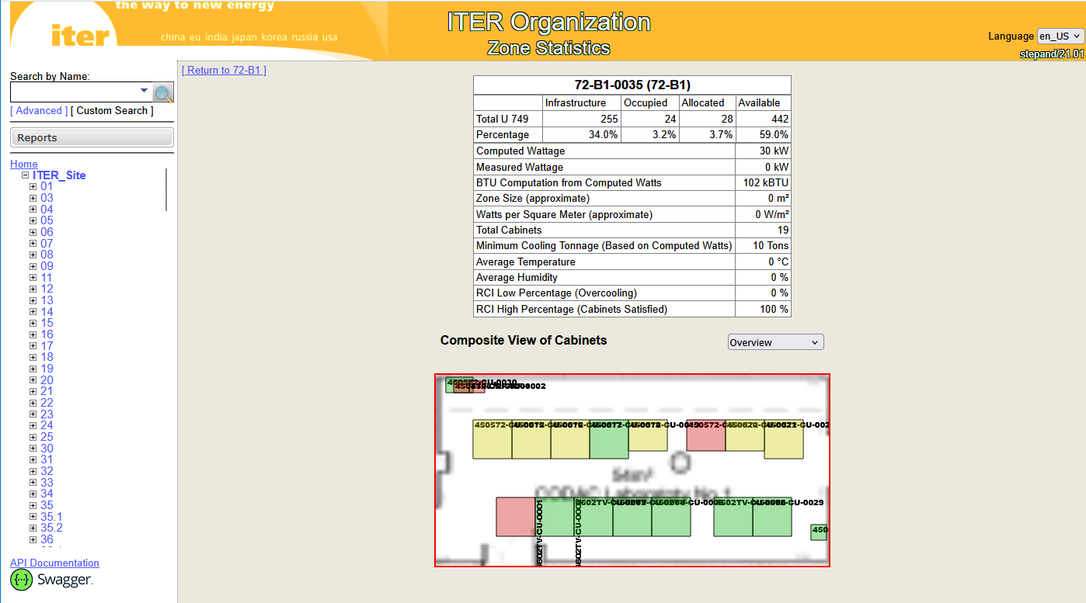
OpenDCIM – detailed layouts of server rooms and I&C cubicles

Slide 10
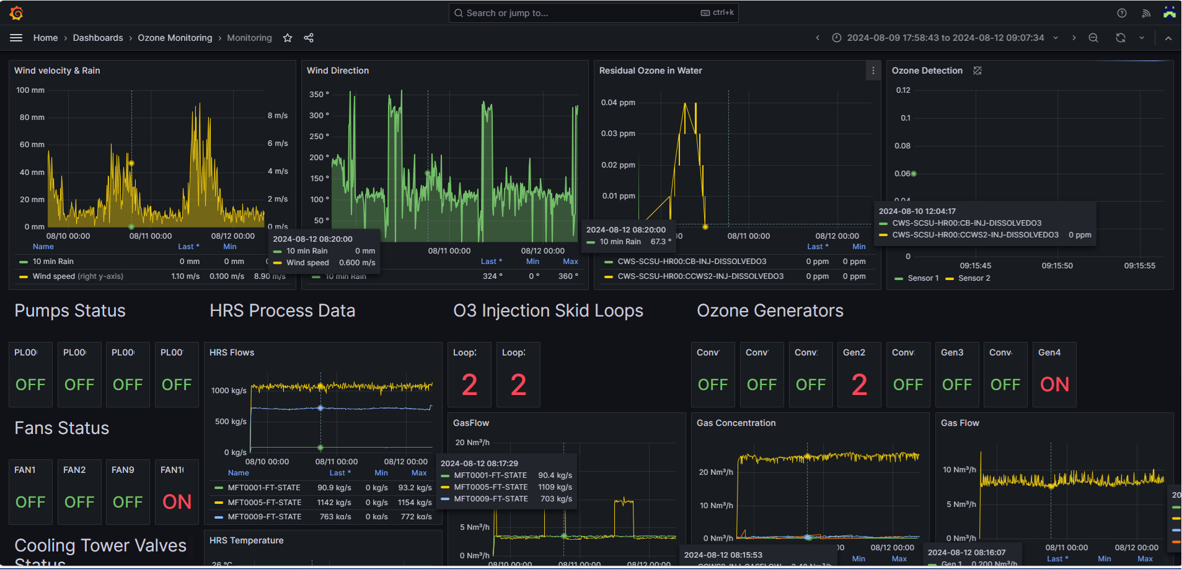
Grafana – system dashboards of all sorts. Plugin to the live and archived data

Slide 11
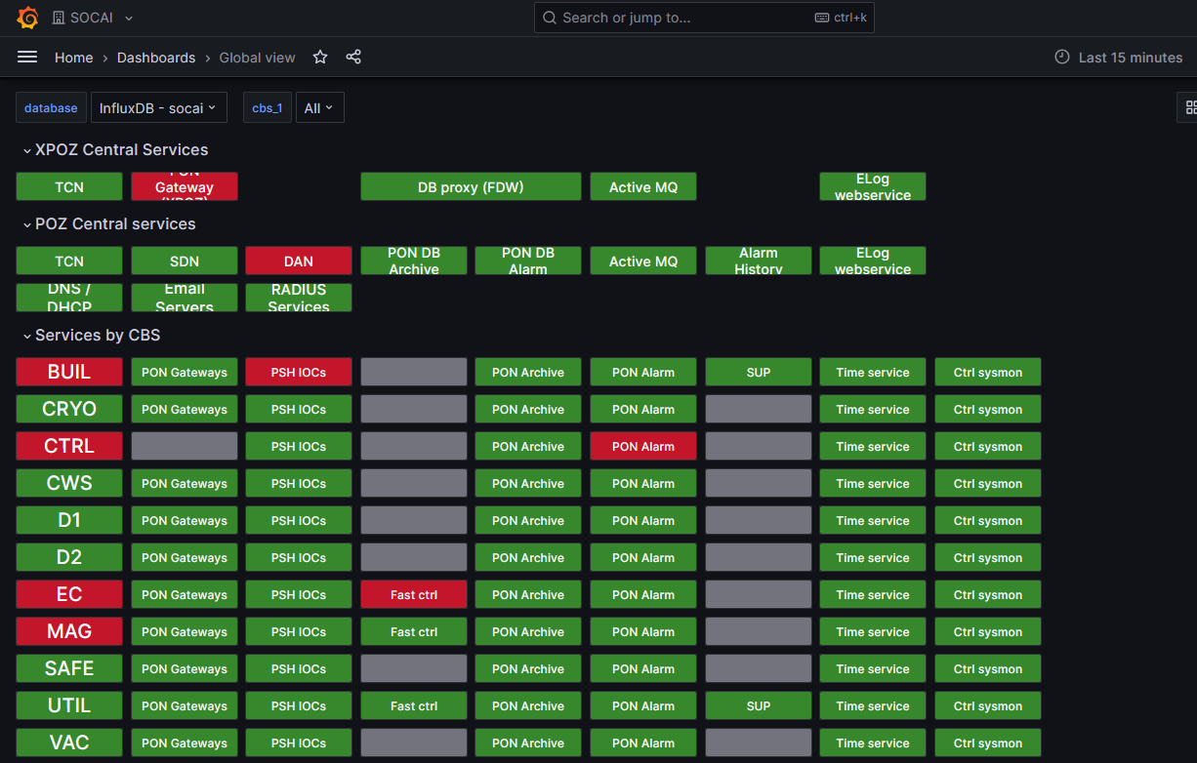
SOCAI – Control system services status (Grafana-based)

Slide 12
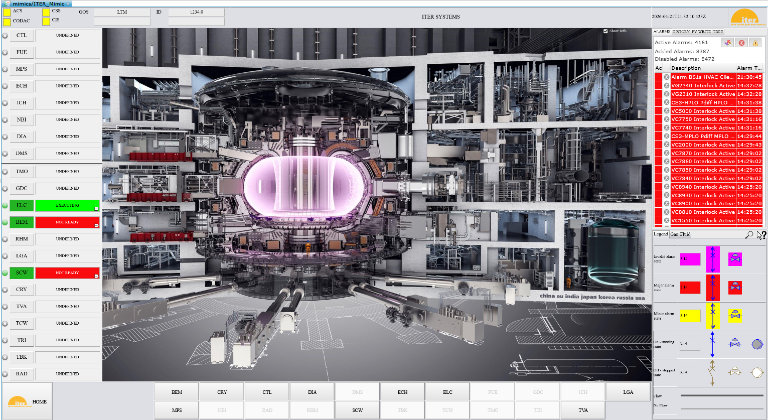
Web OPI (CS-Studio)

Slide 13
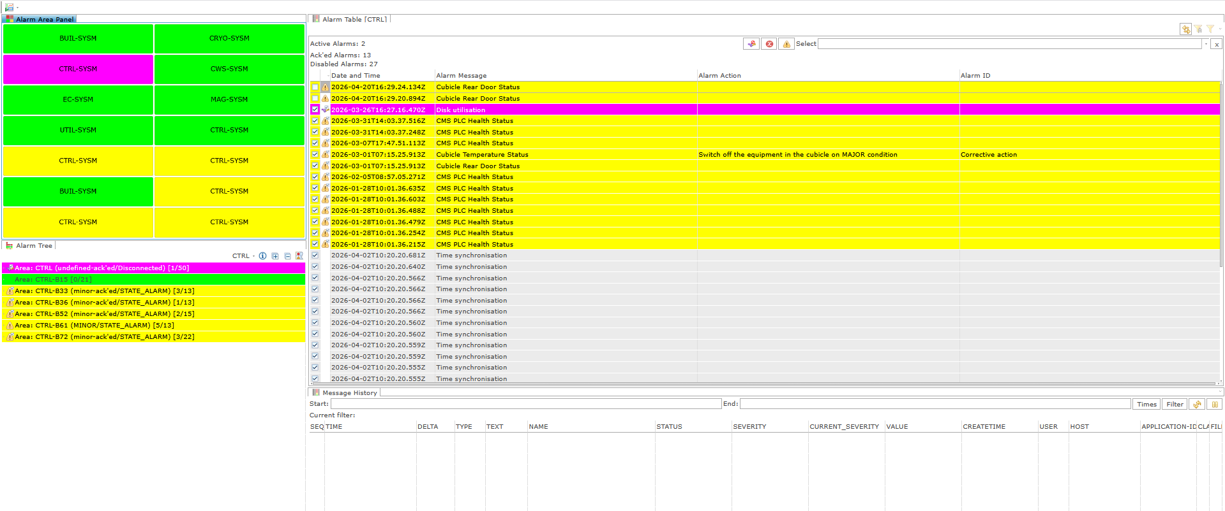
Web Alarms (CS-Studio)

Slide 14
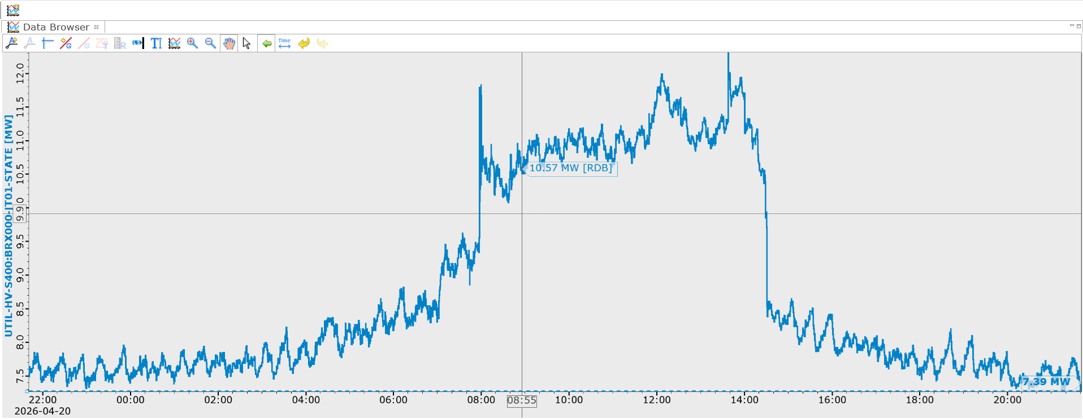
Web Data Browser (CS-Studio)

Slide 15
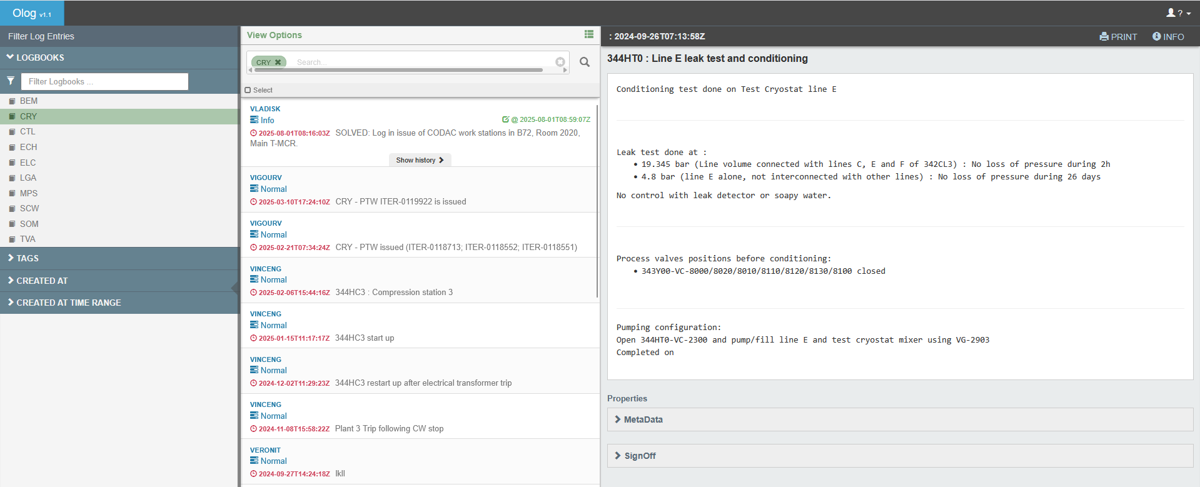
Web Logbook (CS-Studio)

Slide 16
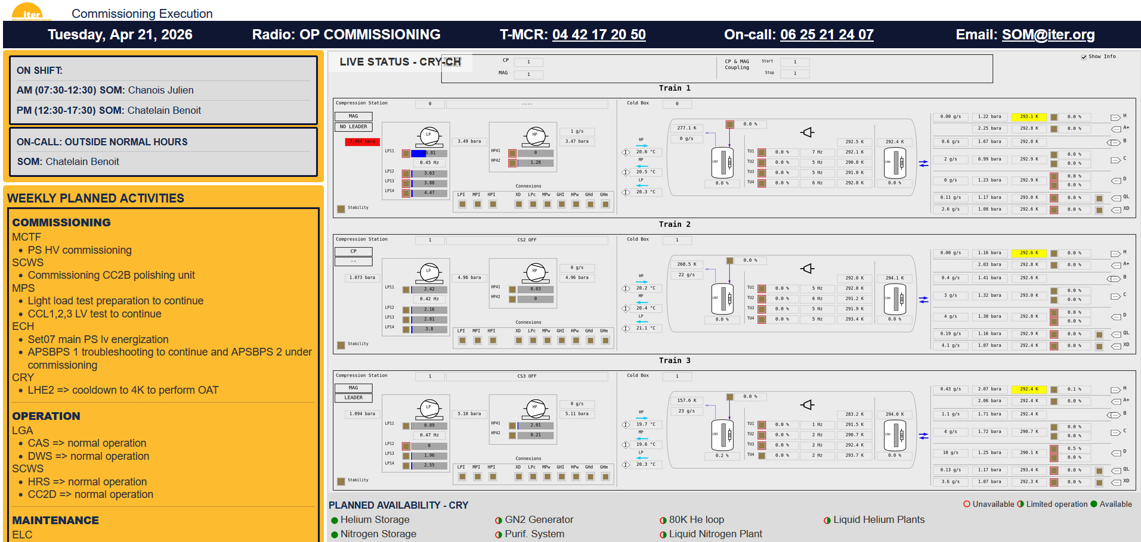
COC – Commissioning and Operation Coordination (Confluence-based)

Slide 17
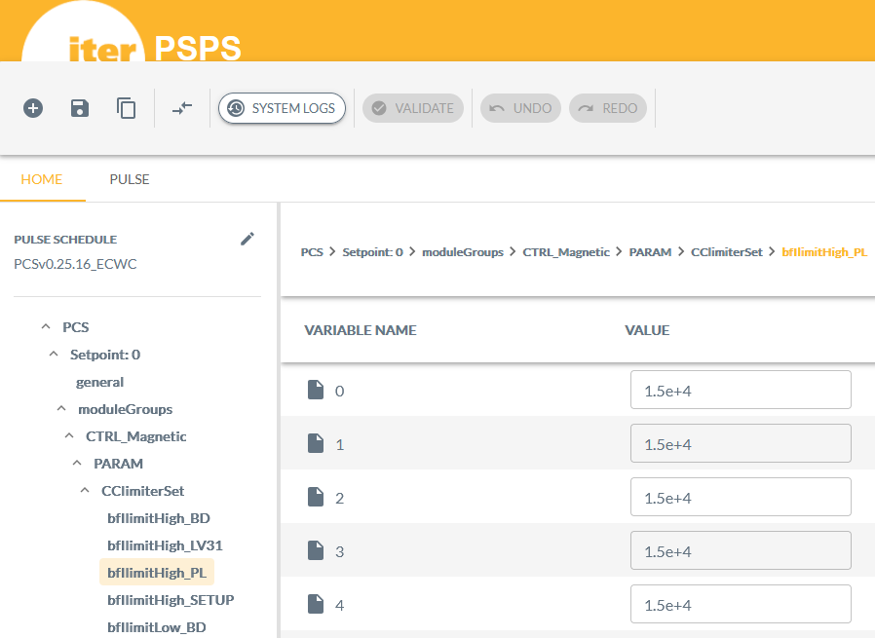
PSPS – pulse schedule preparation system

Slide 18
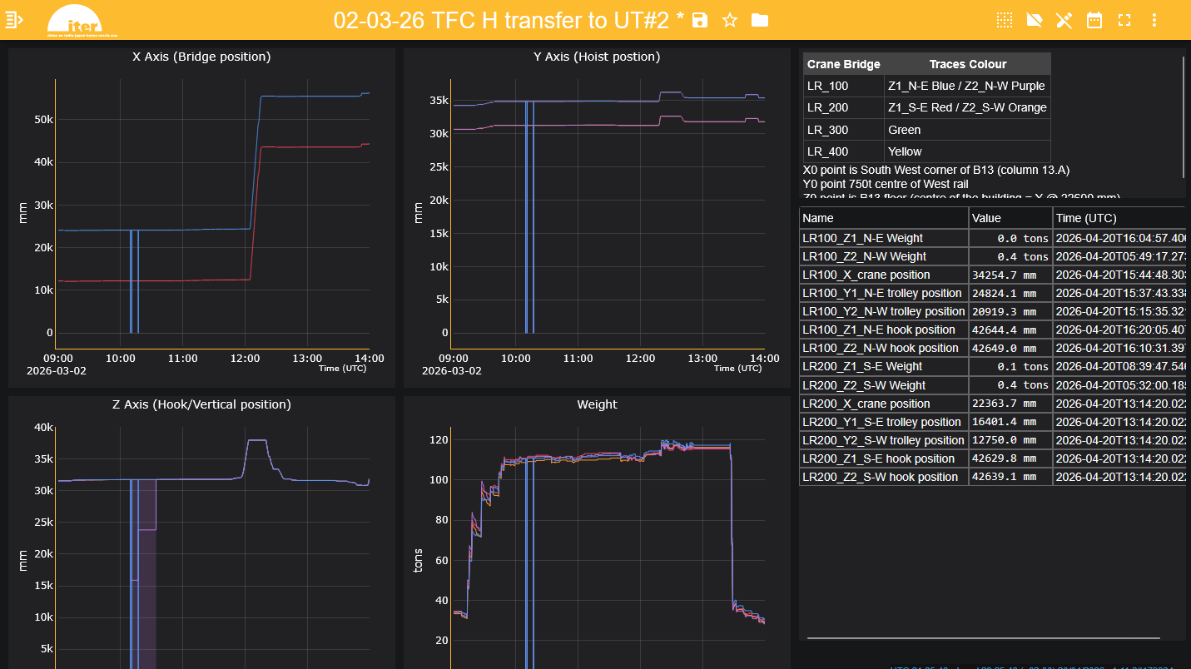
ITER Dashboard – user-defined dashboards for live and archived plant variables

Slide 19
Zoom on the ITER Dashboard
A sort of web-based Data Browser with rich plotting capabilities (crosshairs, stacked plots, …)
Exists since 2020, reported on the same year in EPICS meeting https://indico.fhi-berlin.mpg.de/event/52/contributions/584/
Seamless support for live and archived data
Optimized to display very long graphs (like a year-long graph sampled at 1 Hz)
All configs and dashboards are stored on the server, no user-side configuration
URL-encoded dashboard configs; support for dashboard construction from URL
Support for mobile devices
Well-versed with EPICS (PV database from the control system, support for alarm severity display, …)

Slide 20
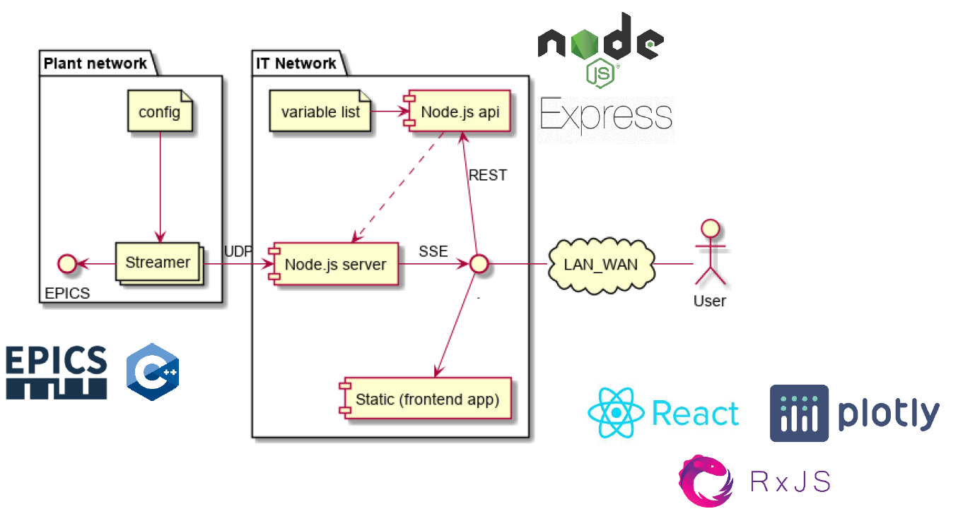
ITER Dashboard Architecture

Slide 21
DEMO

Slide 22
Dashboard Construction on the Fly from External Apps
https://controls.iter.org/dashboard/?variables=CRYO-CH-CB3-HESC:MT3600-AA-IN,CRYO-CH-CB3-HESC:VOL3600-XI,CRYO-CH-MM-CRST:HT1010-MV&types=table,plot&from=2024-10-29T08:00:00.000Z&to=2024-10-29T18:00:00.000Z&title=Liquid%20helium%20

Slide 23

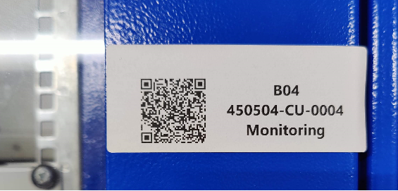
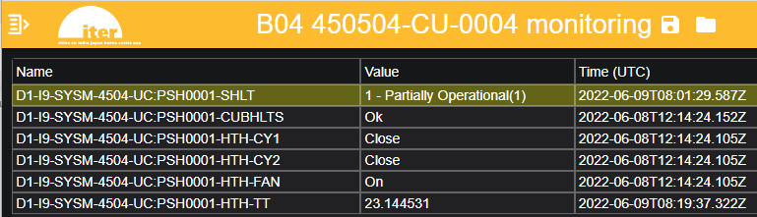
Ex: QR Codes
Smart glasses (PPE compatible)

