Slide 1
WEISS Web EPICS Interface & Synoptic Studio
A fully web-native suite for EPICS Operation Interfaces
Presented by André Favoto

Slide 2
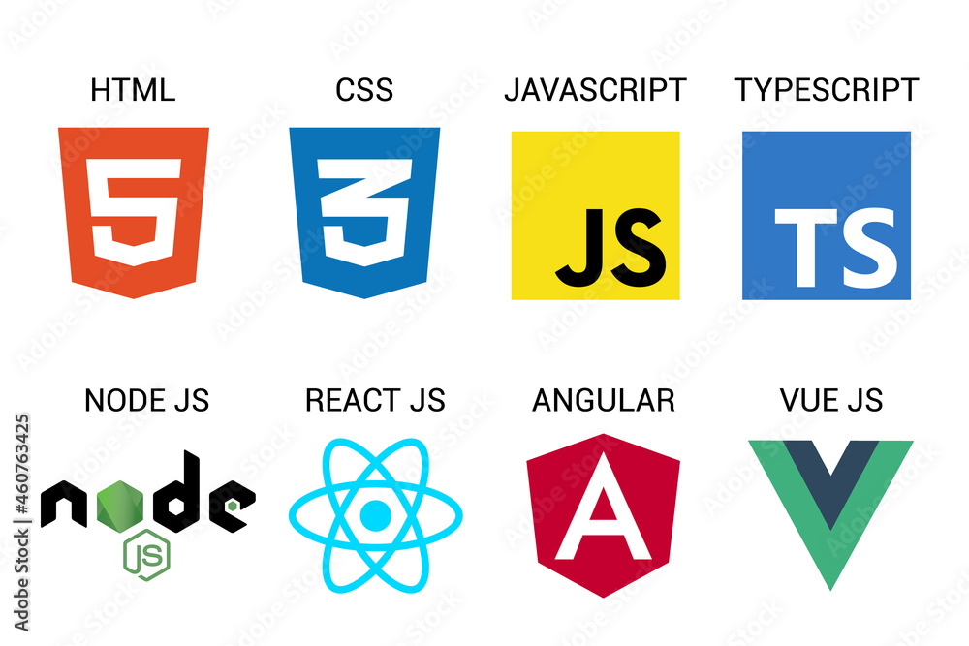
Why use (modern) web?
Client-side rendering
Ease of access
Still keeping things safe!
Built for scale
Global ecosystem
HUGE community!
Tool integration friendly
Exciting future ahead:
E.g. https://www.webgpu.com/ (theme for another discussion…)
https://github.com/weiss-controls/weiss

Slide 3
What does WEISS offer?
And what is new about it?
https://github.com/weiss-controls/weiss

Slide 4
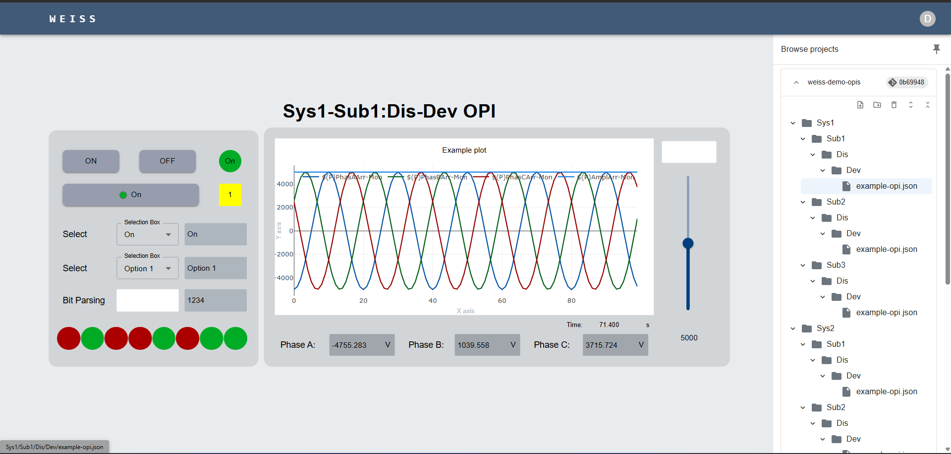
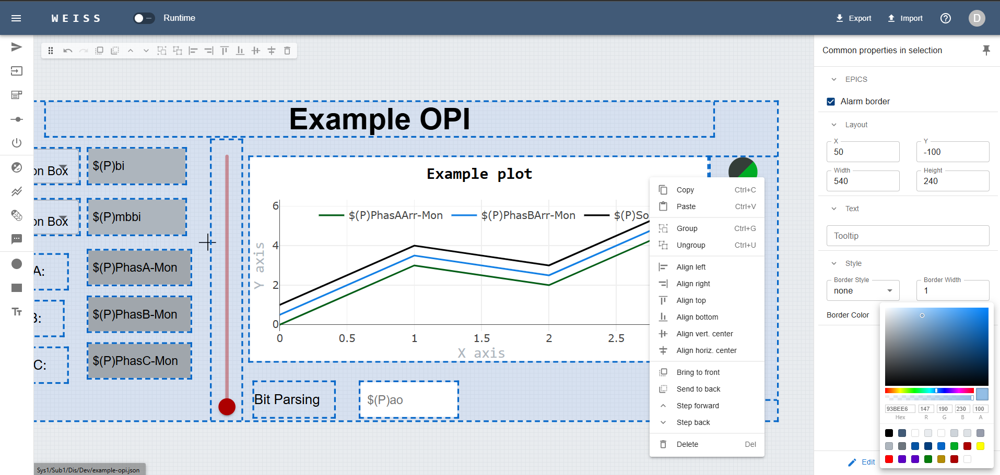
WEISS Features
Everything done from browser. No intermediary tools needed.
- Design - Commit - Deploy - Rollback
Operation environment (deployed snapshot)
Development environment (staging changes)
https://github.com/weiss-controls/weiss

Slide 5
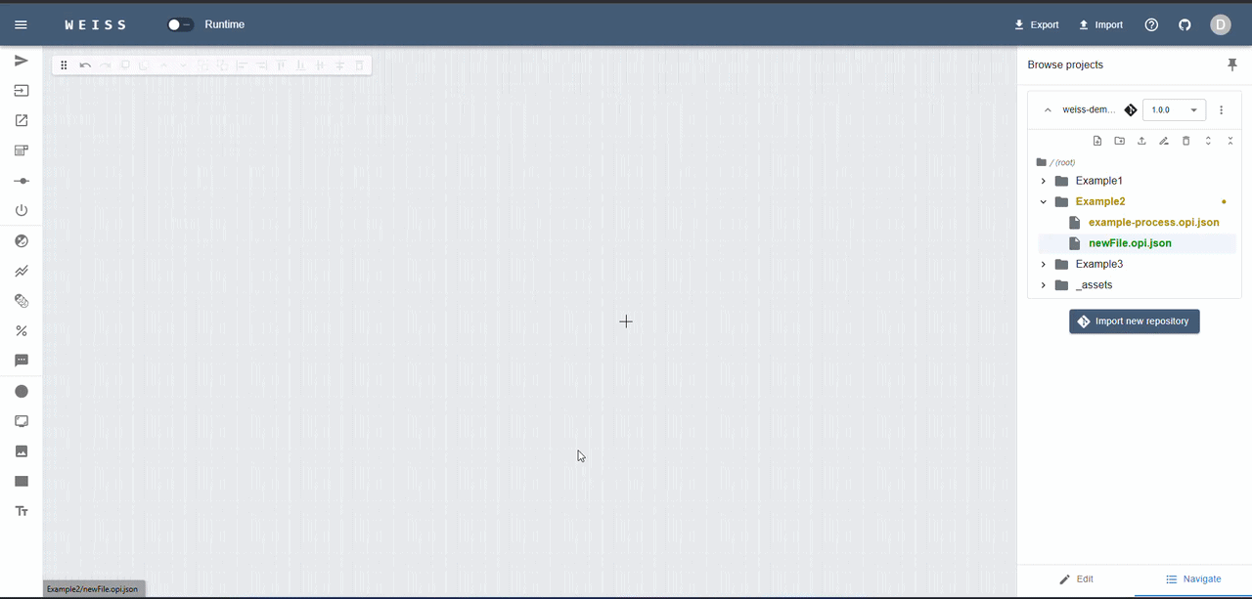
WEISS Features
No need to know web programming
Everything is drag and drop. Raw files are plain JSON.
https://github.com/weiss-controls/weiss

Slide 6
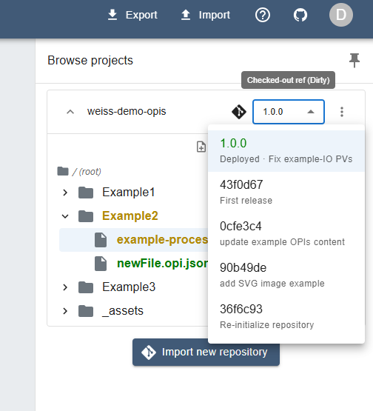
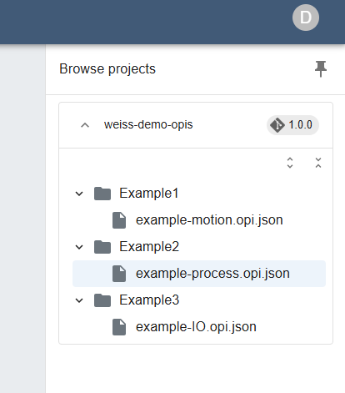
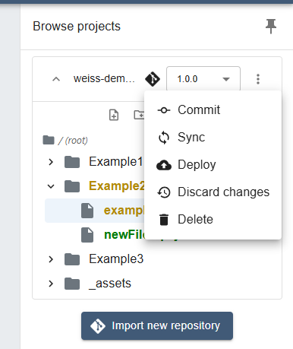
WEISS Features
Native integration with Git & Deployment model
Developer’s view
Reuse your infra:
Repos are cloned via “import” action + URL. No self-hosting.
Operator’s view
https://github.com/weiss-controls/weiss-demo-opis
https://github.com/weiss-controls/weiss

Slide 7
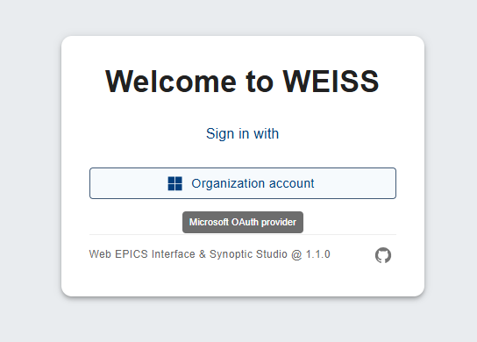
WEISS Features
Easy integration with organization credentials:
- Work in progress to include more OAuth2 providers

Slide 8

WEISS Features
Live demonstration
Not today, Murphy!!!

Slide 9
Wrap up
You can reproduce (almost) everything shown here in the live demo app:
https://demo.weiss-controls.org
Except for creating commits – those are disabled there. Let’s not get ahead of ourselves...
The available PVs are provided by the demo IOCs.
Source code: https://github.com/weiss-controls/weiss/
Documentation: https://docs.weiss-controls.org/
Planned features: https://github.com/orgs/weiss-controls/projects/1

