Slide 1
Web GUI Workshop
EPICS Meeting Workshop
23/04/2026
1

Slide 2
Workshop 1 : Views
WEISS
DAEDALUS
DBWR and CSLib comparison
Web Viewer
Workshop 2 : Tool
Web Tools at ITER
CE (ESS)
PVInfo (++svgviewer and OlogWeb)
Alarm Web

Slide 3
Views
1

Slide 4
WEISS
Demo by André Favoto
Slides in Indico
https://demo.weiss-controls.org/
Talk

Slide 5
DAEDALUS
Demo by Oliver Copping
https://github.com/DiamondLightSource/daedalus/
Talk

Slide 6
DBWR and CSLib comparison
Demo by Loic Caouen (Thanks to Antoine Choquetfor the help !)
CS Lib
DBWR
Différences between both solutions
Button : CSLib missing « open display » function
Input : CSLib missing alarm border
Scripts : CSLib is a POC at the moment
Tooltip : DBWR yes but only pvname

Slide 7
DBWR & CSLib architecture
Client
Services
EPICS Core
DBWR
PVWS
EPICS PV
Daedalus
CSLib

Slide 8
WEB VIEWER
Web client using DBWR and used at CEA to view OPIs and Archive Appliance
Demo by Loïc Caouën
Talk

Slide 9
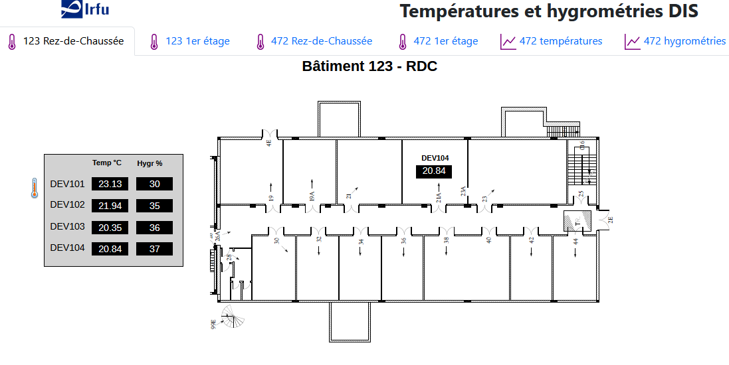
WEB VIEWER
Old version (simple tabs)

Slide 10
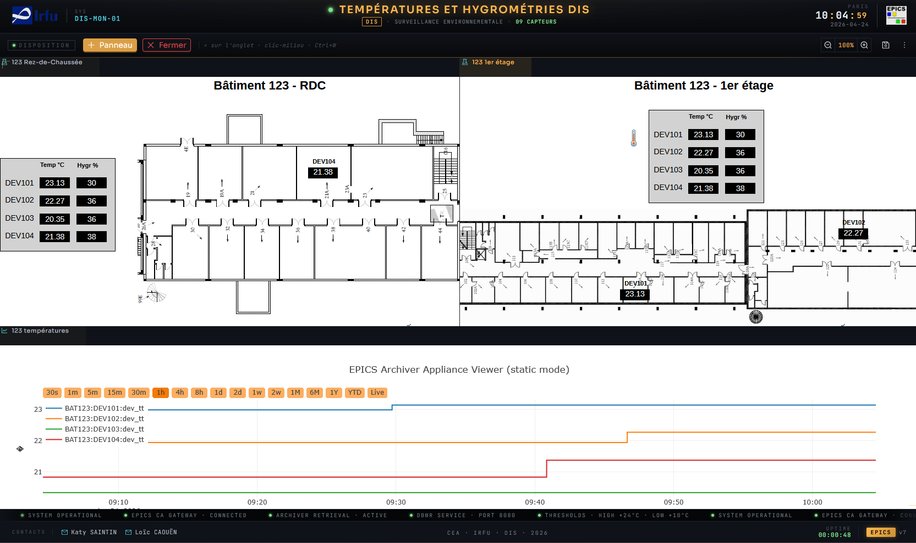
WEB VIEWER
New version : Full customisation

Slide 11
Tools
2

Slide 12
ITER Web Tools
Demo by Denis Stepanov
Slides in Indico
Talk

Slide 13
CE (ESS)
Demo by Anders Olsson
Slides in Indico
Talk

Slide 14
PVINFO
Demo by Loïc Caouën but developped by Tynan Ford
https://github.com/ChannelFinder/pvinfo
Talk

Slide 15
PVINFO Architecture
Client
Services
EPICS Core
Channel Finder
RecCeiver
Phoebus Alarm-logger
Phoebus Olog
PVInfo
Archive Appliance
EPICS PV
With RecCaster
PVWS

Slide 16
ALARM WEB
Demo by Loïc Caouën
Not available yet on Github
Talk

Slide 17
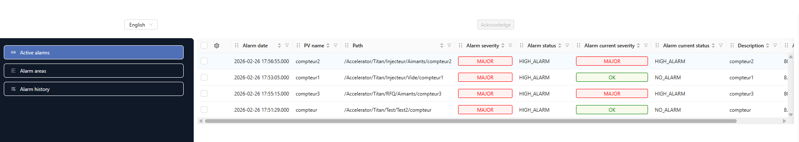
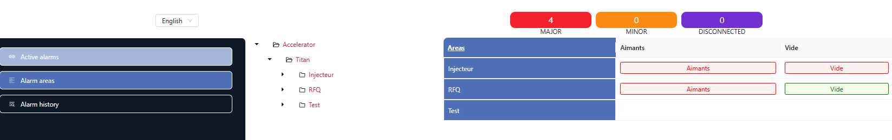
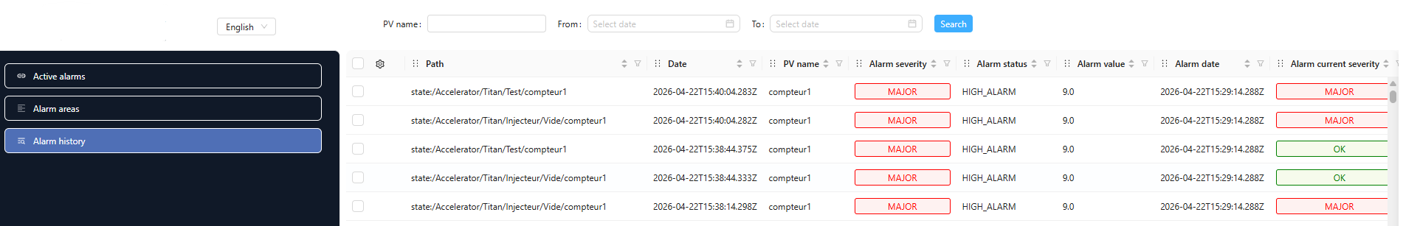
ALARM WEB

Slide 18
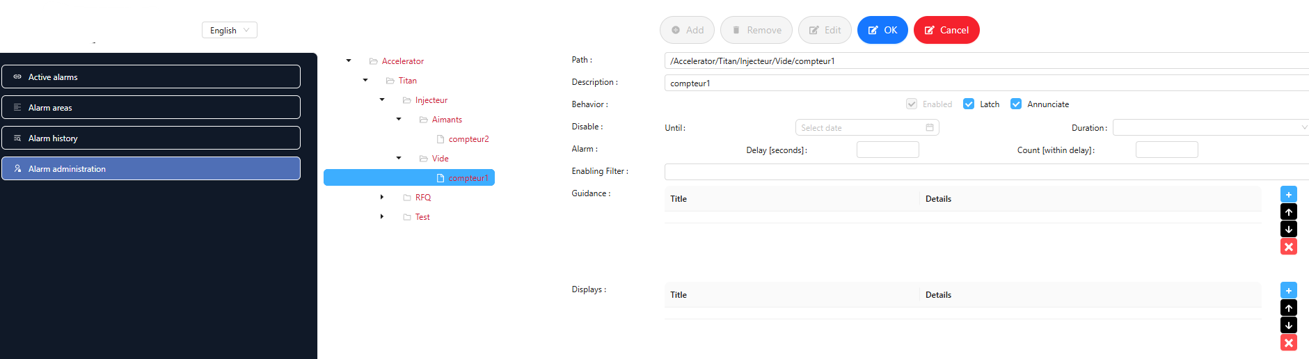
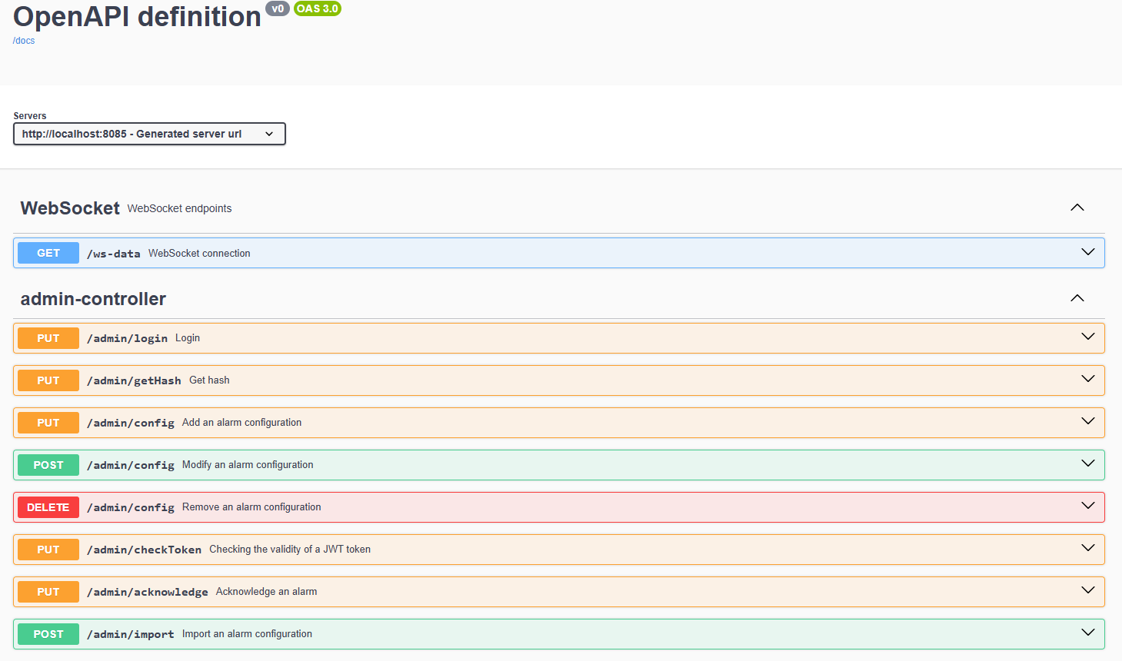
ALARM WEB

