Slide 1
ecmc:
Open-source EPICS-based motion control on EtherCAT
Anders Sandström
Saclay, 23 April 2026

Slide 2
Agenda
01
Introduction/Overview
04
Custom logic: PLC & scripting
What’s ecmc
Different ways to add custom functionality
02
Motion
05
Extending ecmc
Axis configuration
Add functionality with plugins
03
Diagnostics
06
Get started
Panels / tools
Repositories, manual, community
ECMC · EPICS Collaboration Meeting 2026, Saclay
Agenda
2 / 23

Slide 3
Introduction
Open-source motion control & DAQ framework, tightly integrated in EPICS
At PSI
What it is
An open-source EPICS module that turns EtherCAT hardware into motion axes and I/O, also supporting soft-PLC scripting, plugin API.
770+
axes in production
(SLS,HIPA, SwissFEL)
Motion: positioning, jogging, homing, referencing, interlocks, latching
Synchronisation: axis-to-axis, external source, kinematics, PVT
DAQ: analog ≤100 kHz, digital ≤1 MHz (hardware-limited)
Soft-PLC: scriptable real-time logic, user plugins in C/C++
Standard EPICS: Motor Record, PVs, Channel Access, pvAccess
190+
ecmc IOCs
(motion + DAQ)
ECMC · EPICS Collaboration Meeting 2026, Saclay
What ECMC is
3 / 23

Slide 4
Overview: Comparison of two approaches
Both approaches are valid — the choice depends on your control system and workflow
Typical vendor-integrated stack
Open EPICS-native stack
Client / GUI layer
Client / GUI layer
caQtDM, Python scripts, CSS-PHOEBUS
caQtDM, Python scripts, CSS-PHOEBUS
EPICS IOC
EPICS IOC layer
Config PVs, records
Motor Record, PVs, asynDriver, Channel Access
Open architecture
ADS bridge, OPC-UA, ..
vs.
Protocol translation
ECMC real-time core
TwinCAT runtime
RT loop, Axis objects, trajectory gen, PLC logic
Vendor runtime, Windows, TC/BSD, or Linux
IgH EtherCAT master
TwinCAT project
Cyclic comms, distributed clocks, slave config
IDE-edited, per-deployment
EtherCAT hardware
EtherCAT hardware
Drives, encoders, I/O modules, sensors, actuators
Drives, encoders, I/O modules, sensors, actuators
ECMC · EPICS Collaboration Meeting 2026, Saclay
4 / 23

Slide 5
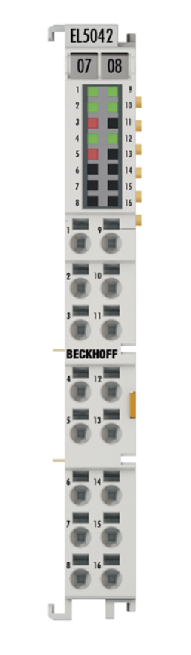
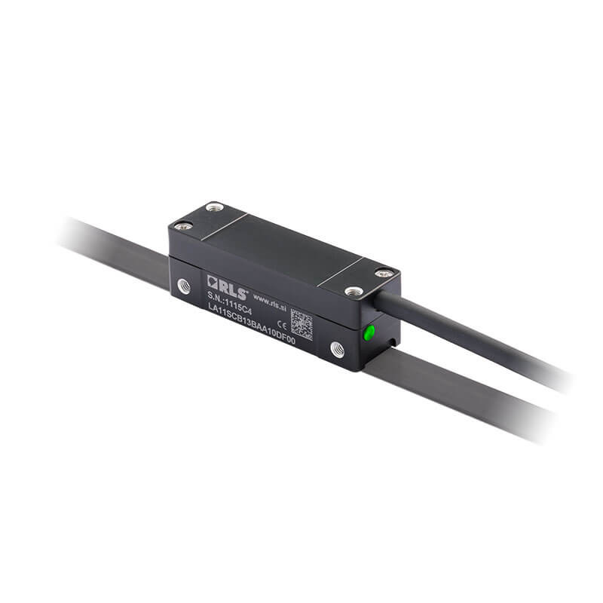
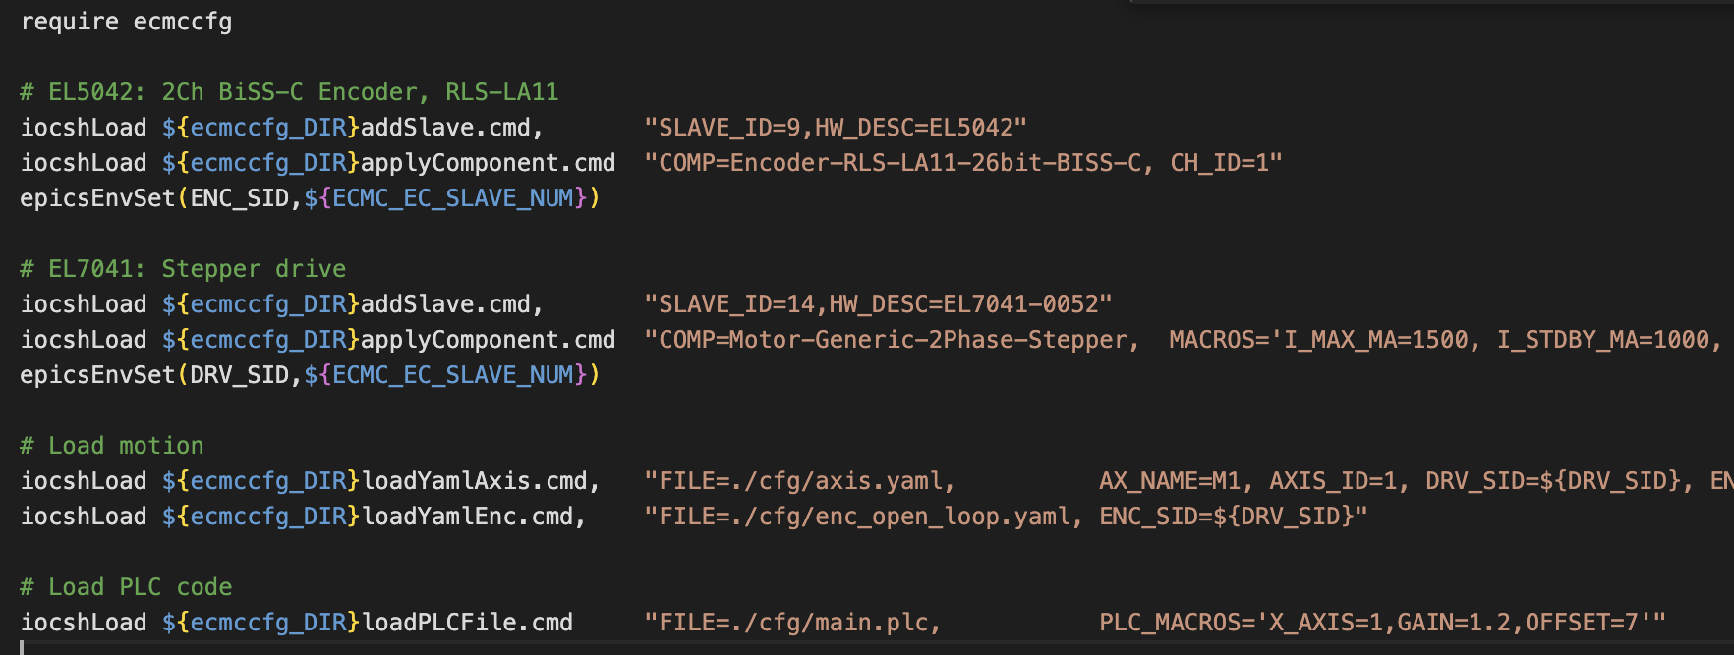
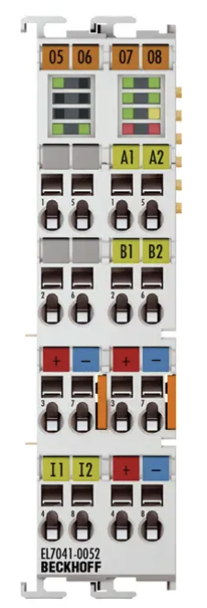
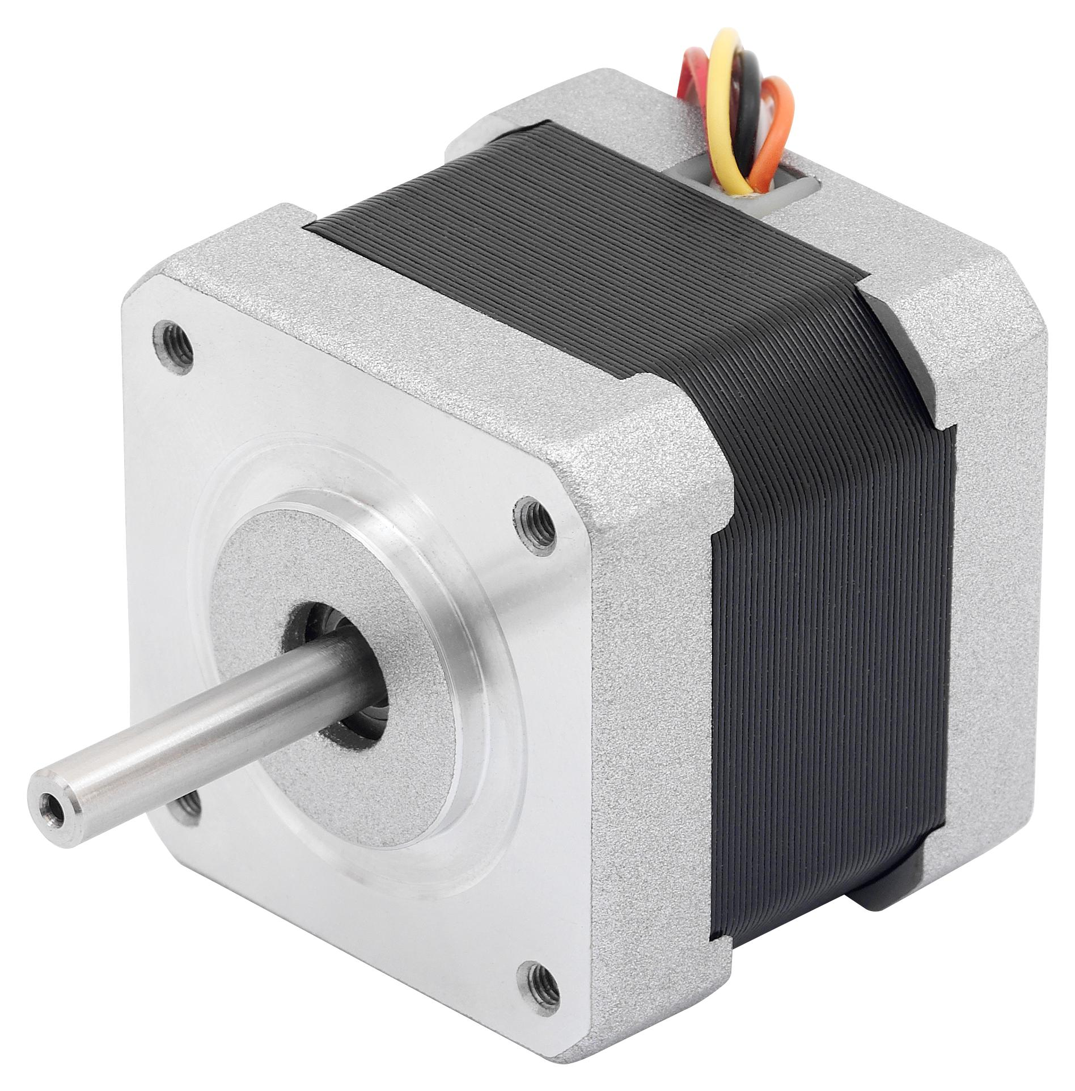
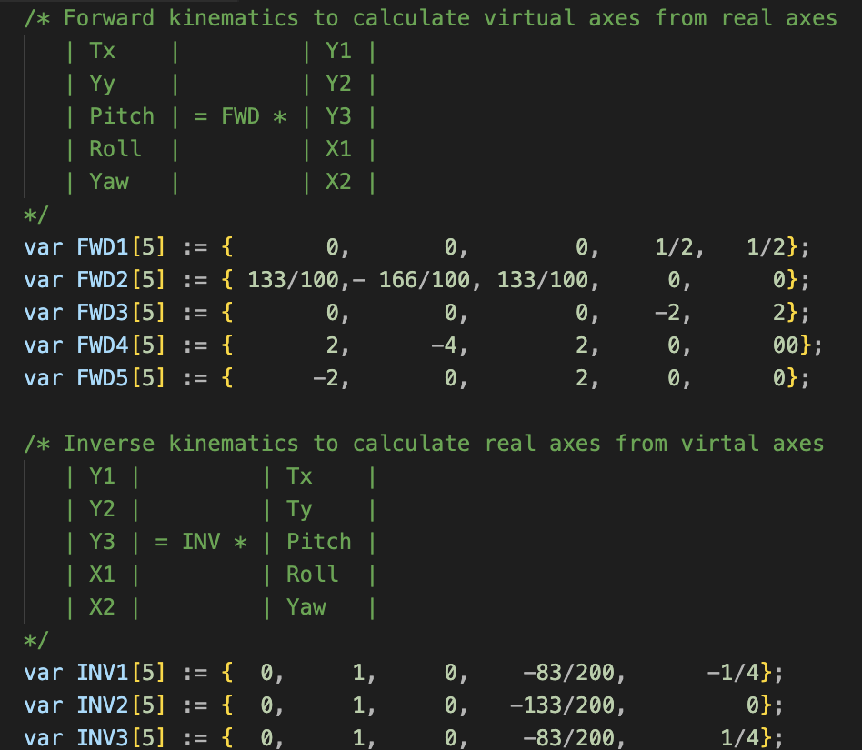
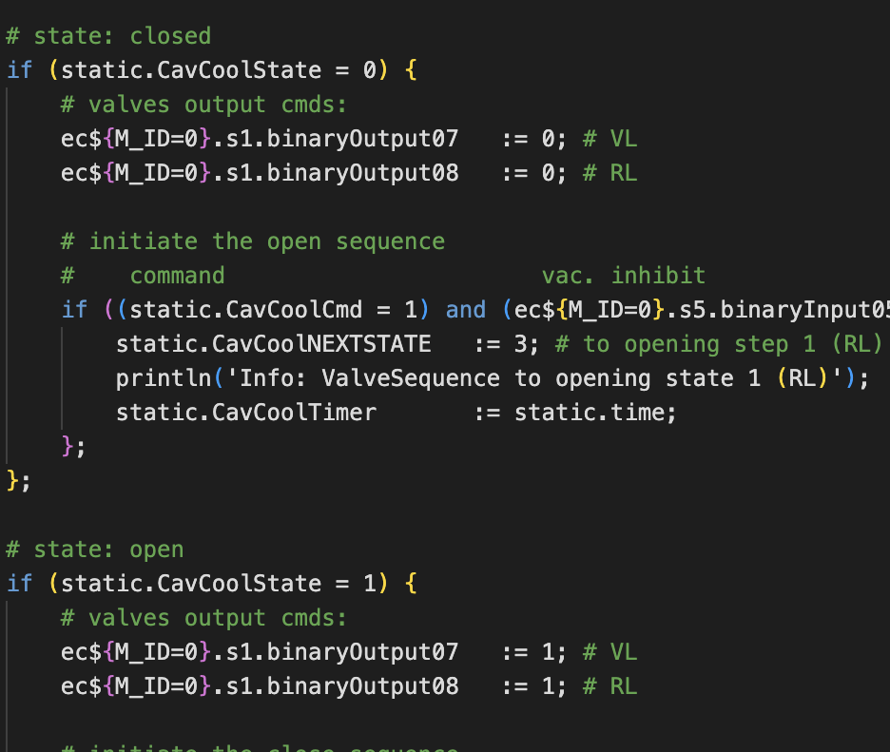
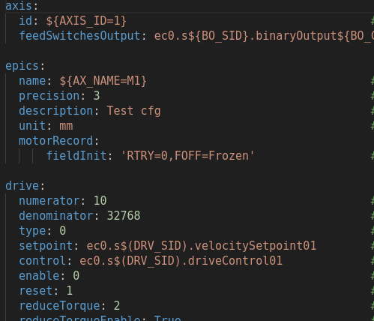
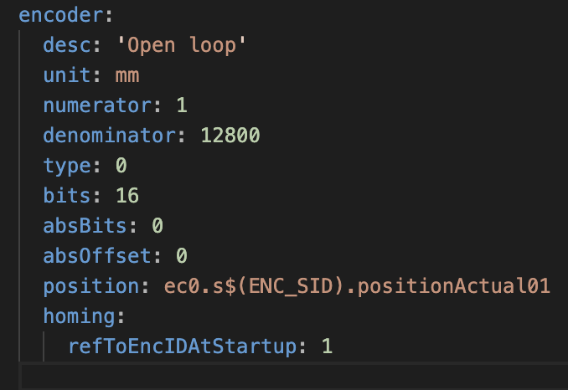
Configuration
Everything is linked from the startup file
ECMC · EPICS Collaboration Meeting 2026, Saclay
5 / 23

Slide 6
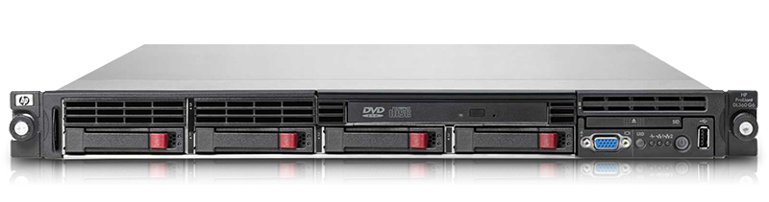

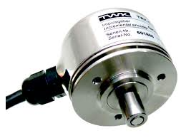
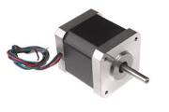
Motion: Control Loops: CSP, CSV, CST
CSP
Cyclic Sync. Position
CSV
Cyclic Sync. Velocity
CST
Cyclic Sync. Torque
- Trajectory gen.
- No control
-Trajectory gen.
-Position cont.
-Trajectory gen.
-Position cont.
-Velocity cont.
ecmc controller
Act. position
Position setp.
Act. position
Velocity setp.
Act. position
Torque setp.
Servos
Some Steppers
SmarAct (EtherCAT)
Analog position drives
Most common:
Servos
Steppers
Analog velocity drives
Servos
Hardware
Control:
Pos.
Velo.
Torque
Control:
Velo.
Torque
Control:
Torque
Components
Controller: No loops needed
Drive: All control loops
Controller: Position loop
Drive: Velocity and current loop
Controller: Position, velocity loop
Drive: Current loop
ECMC · EPICS Collaboration Meeting 2026, Saclay
6 / 23

Slide 7
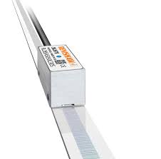
Motion: Control Loops: CSP-PC, Dual Position Loop
CSP-PC-Mode
Cyclic Sync. Position with Dual Position loop
- Trajectory gen.
- Position control
Special case:
Servos
Some steppers (EL7062, currently a bug in CSV)
Analog position drives
Controller
Act. position
Act. position
Position setp.
Hardware
Control:
Pos.
Velo.
Torque
Components
Controller: No loops needed
Drive: All control loops
ECMC · EPICS Collaboration Meeting 2026, Saclay
7 / 23

Slide 8
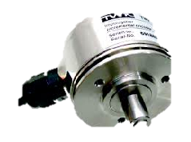
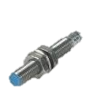
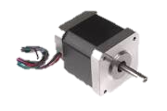
Motion
Axis Object
Axis
PLC (optional)
EtherCAT master
Hardware
Field
Custom logic
EcEntry
Encoder
EcEntry
EcEntry
ax1enc.actpos:=(ax5.enc.actpos+ec0.s14.analogInput01)/2;
ax3.traj.setpos:=ax4.traj.setpos*5;
ax1.mon.ilockbwd:=ax2.mon.lowlim and ec1.s12.binaryInput03;
Trajectory
EcEntry
Monitor
EcEntry
EcEntry
ax1.ctrl.kp:= abs(ax1.enc.actpos - ax1.traj.setpos) * static.kp;
ax3.drv.enable:=1;
PID cntrl.
Virtual Axis
EcEntry
Drive
EcEntry
EcEntry
ECMC · EPICS Collaboration Meeting 2026, Saclay
Motion
8 / 23

Slide 9
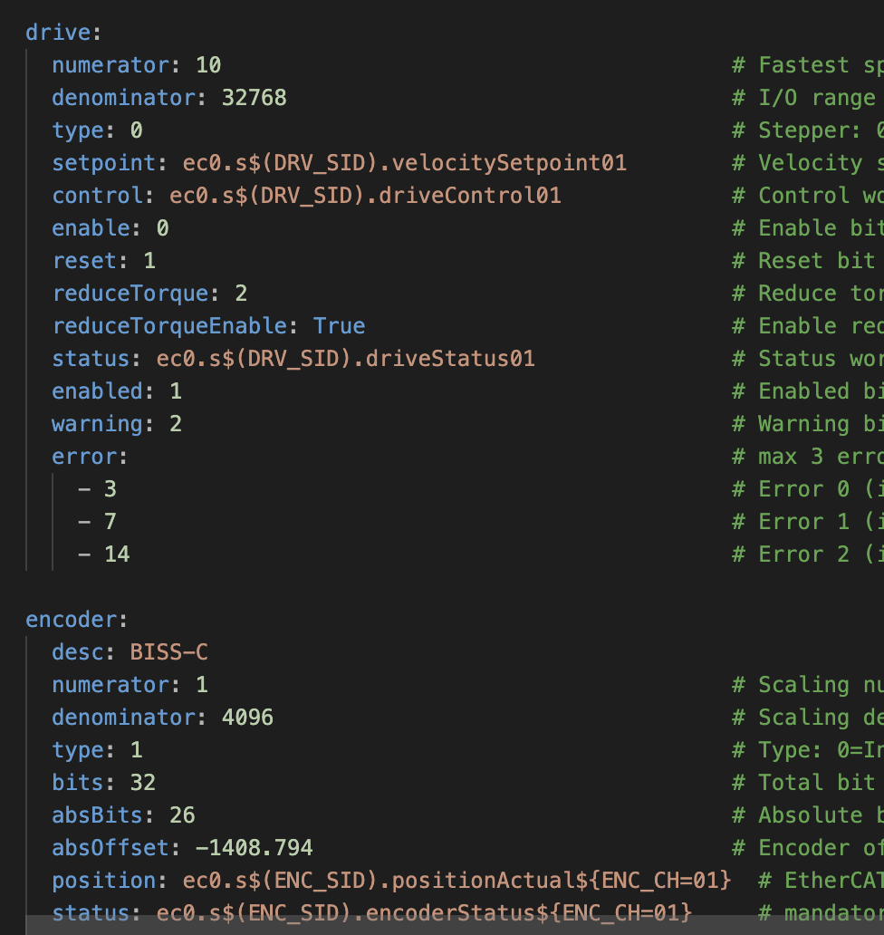
Motion: Configuration
Yaml config for the objects
Axis
  CSV, CSP..
  General, name, auto enable/disable
Encoder
  Hardware link for actual position input, Scalings
Trajectory
  Default velo, acc, jerk
  Traj type
Monitoring
  Hardware links for limits, following error, max velo,..
Controller
  PID, Clamping, deadbands,…
Drive
  Hardware links to drive , Scalings, …
ecmc PLC exprtk code
ECMC · EPICS Collaboration Meeting 2026, Saclay
Motion
9 / 23

Slide 10
Synchronized axes: kinematics + state machine
Virtual masters drive physical slaves — one command, coordinated motion
Example: slit system
State machine guarantees consistency
Gap
Centre
IDLE
Waits for command. Routes to MASTERS or SLAVES.
MASTERS (virtual)
MASTERS
Enables all axes · sets trajectory source to PLC for slaves · executes command · handles interlocks.
Axis-PLC kinematics · axis_kin_2DoF.plc_inc
SLAVES
Direct command on physical axis · waits · returns to IDLE.
Left blade
Right blade
SLAVES (physical)
RESET
Resets errors across the group · returns to IDLE.
ECMC · EPICS Collaboration Meeting 2026, Saclay
Synchronized axes
10 / 23

Slide 11
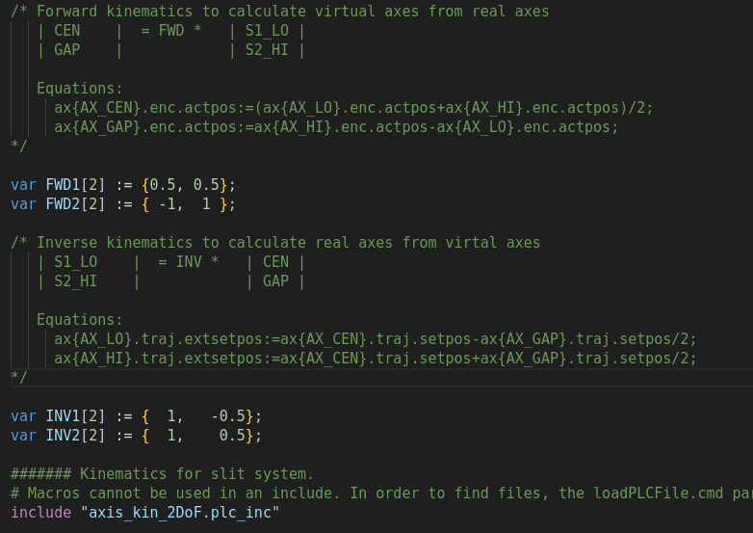
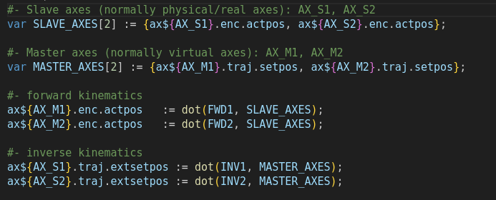
Synchronized axes: kinematics
Application PLC-code
Generic 2DoF kinematics
axis_kin_2DoF.plc_inc
https://github.com/paulscherrerinstitute/ecmccfg/tree/master/plc_lib
ECMC · EPICS Collaboration Meeting 2026, Saclay
Synchronized axes
11 / 23

Slide 12
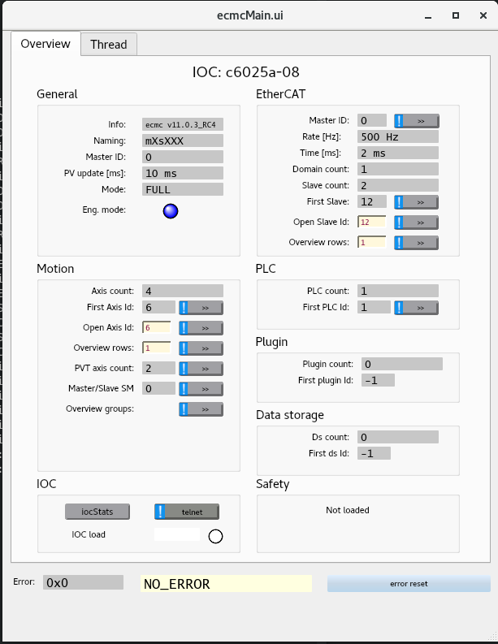
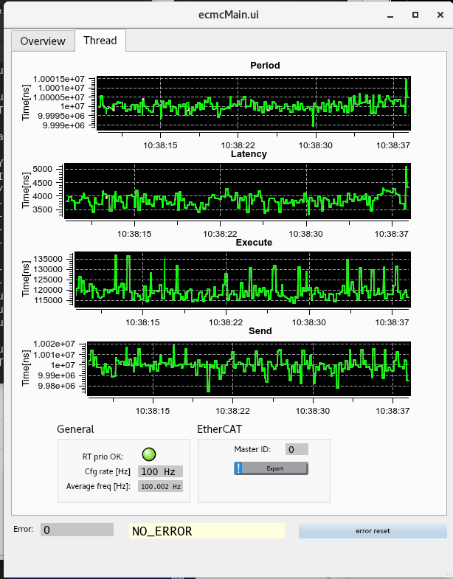
Diagnostics
Overview panel (dynamic)
ecmcMain.ui: Access (almost) entire ecmc system:
  caqtdm –macro ”IOC=<IOC>” ecmcMain.ui
ECMC · EPICS Collaboration Meeting 2026, Saclay
12 / 23

Slide 13
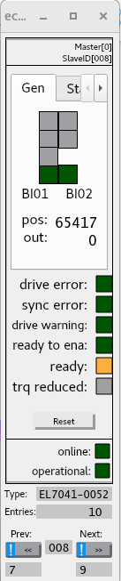
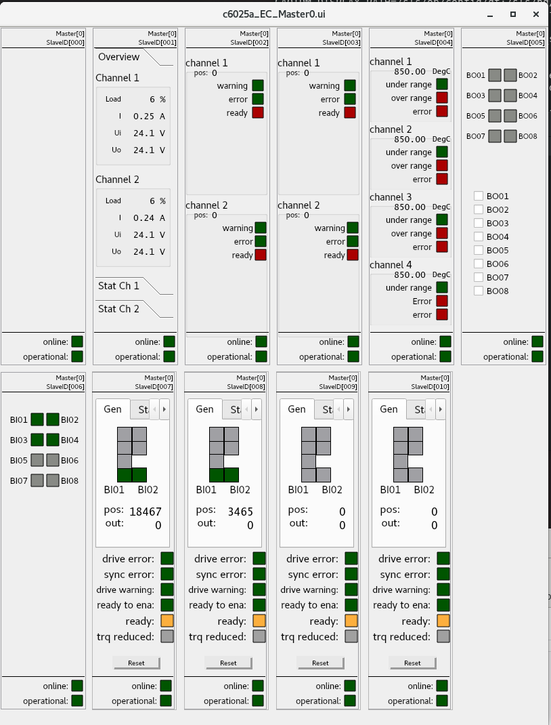
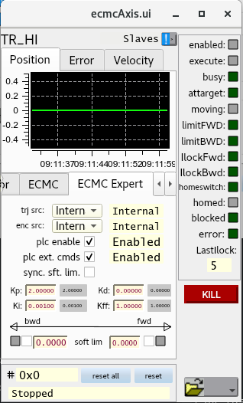
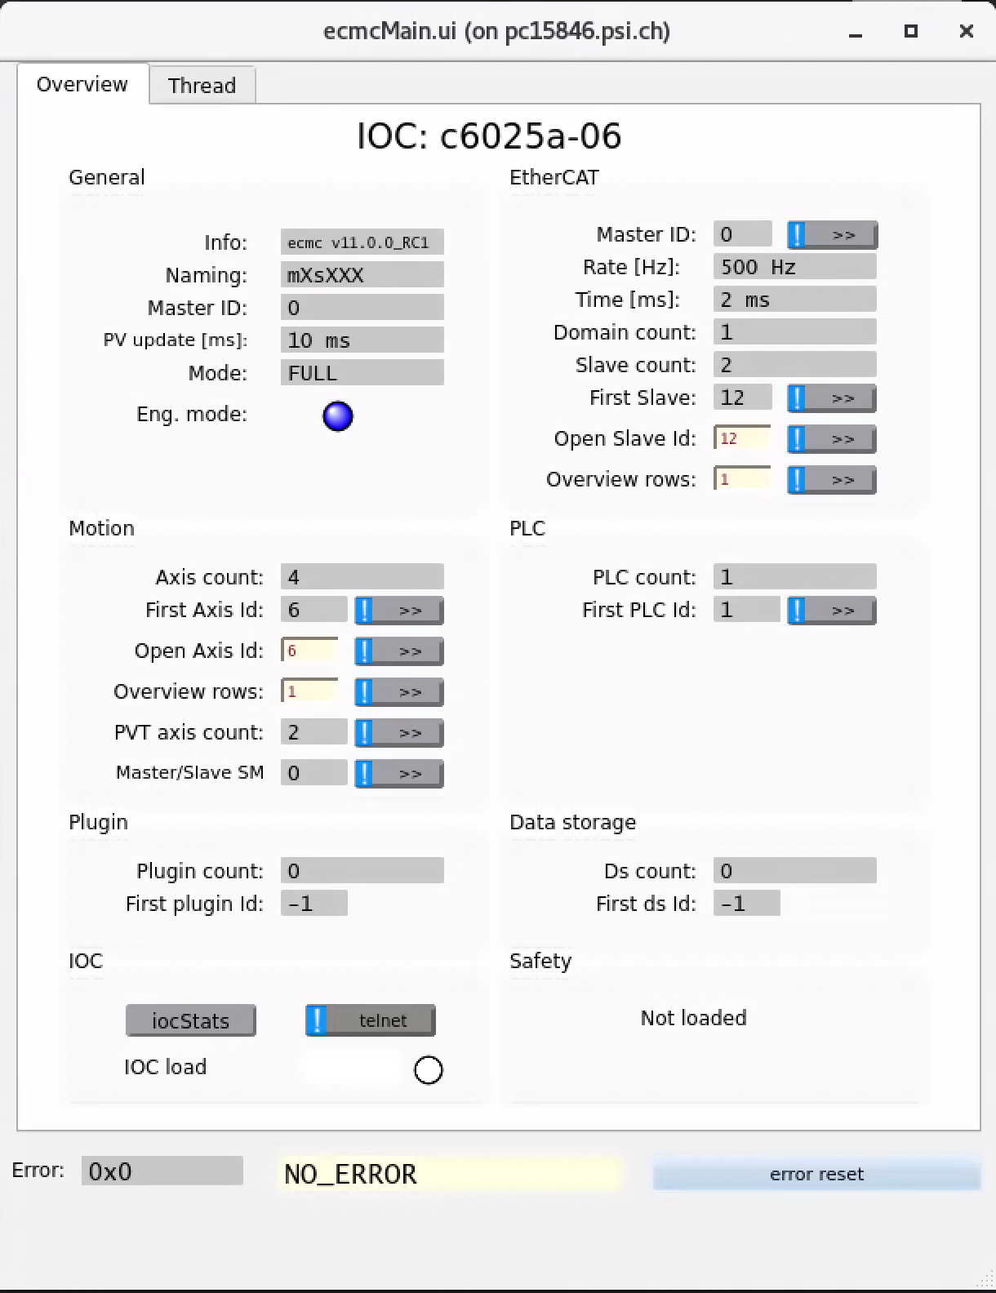
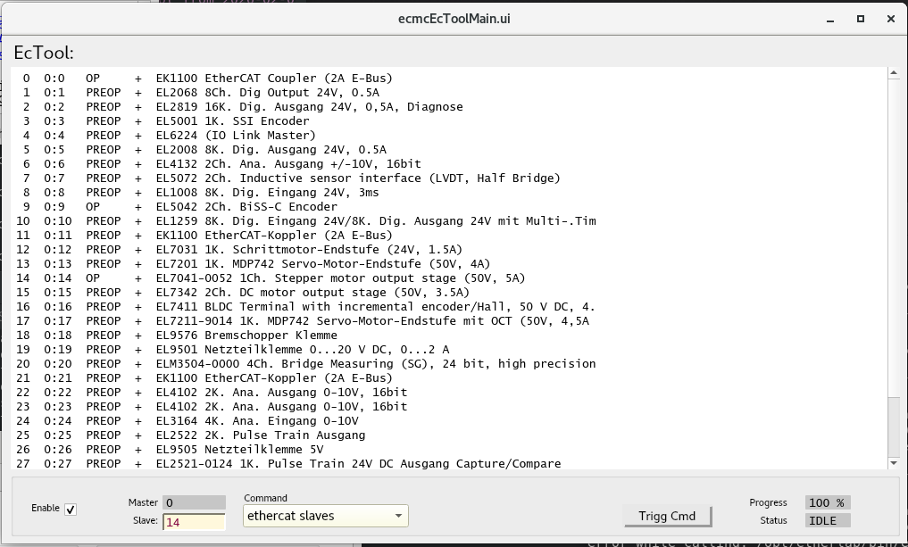
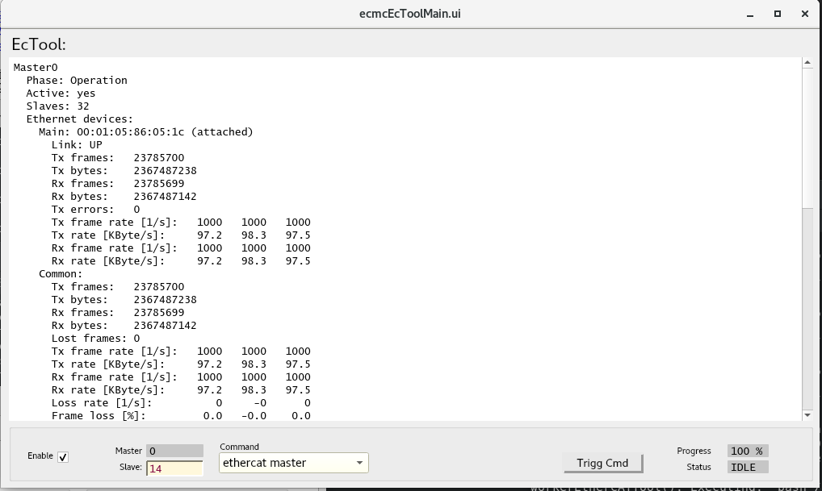
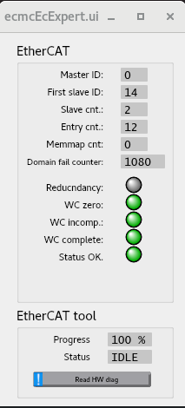
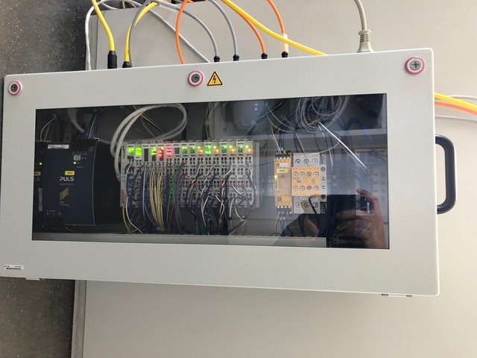
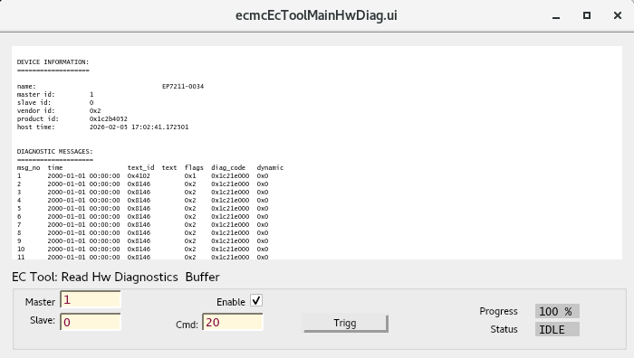
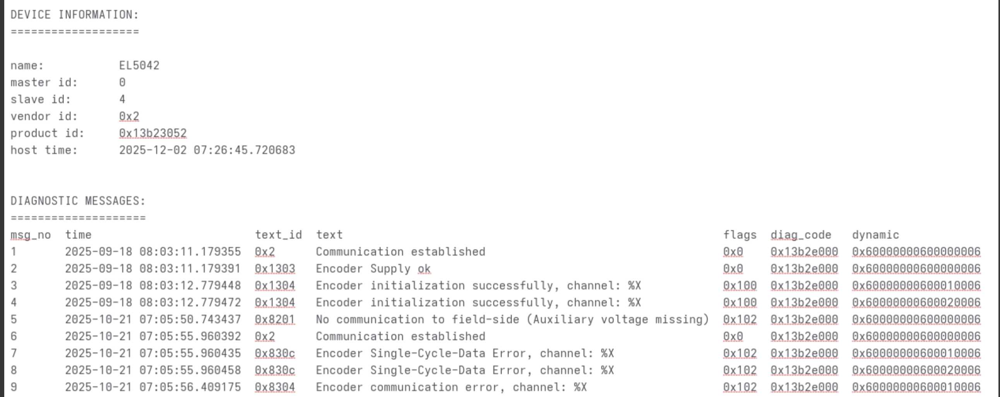
Diagnostics
Hardware: “Dynamic” panels
ECMC · EPICS Collaboration Meeting 2026, Saclay
Diagnostics
13 / 23

Slide 14
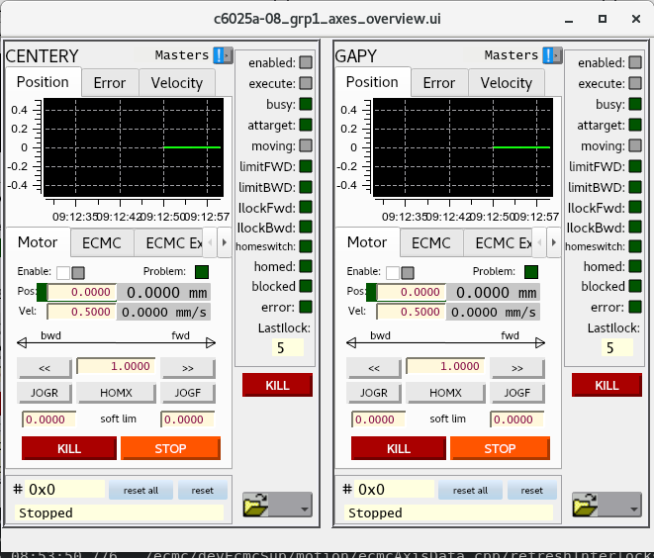
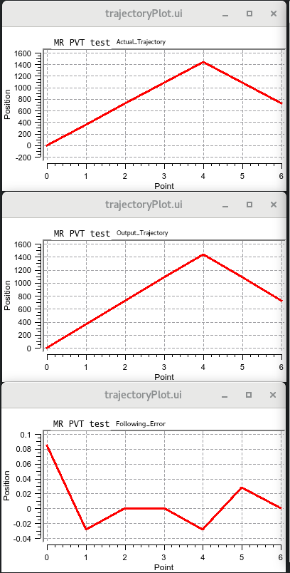
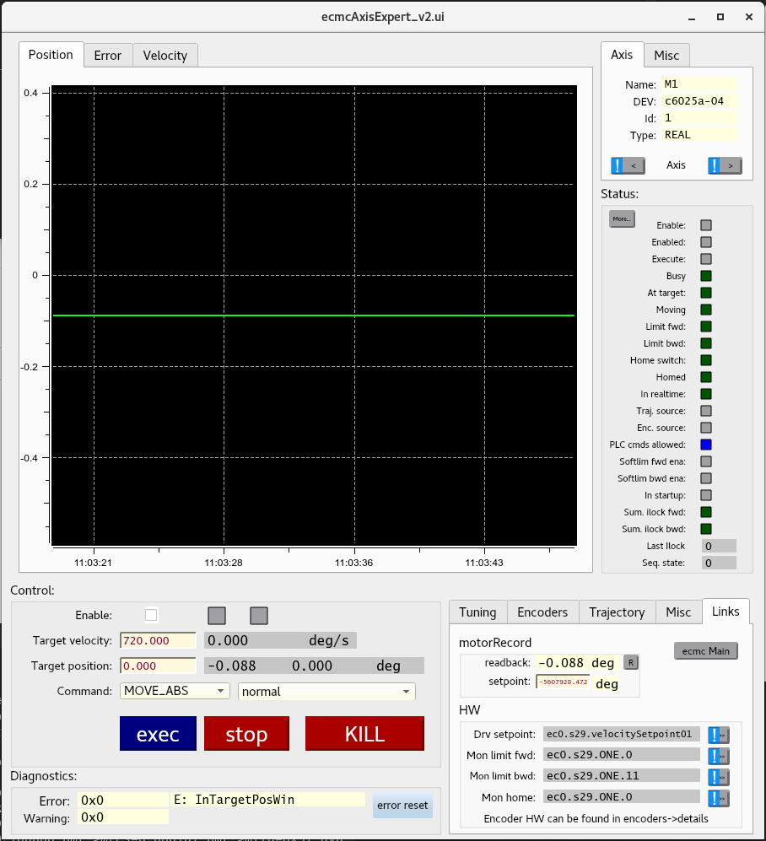
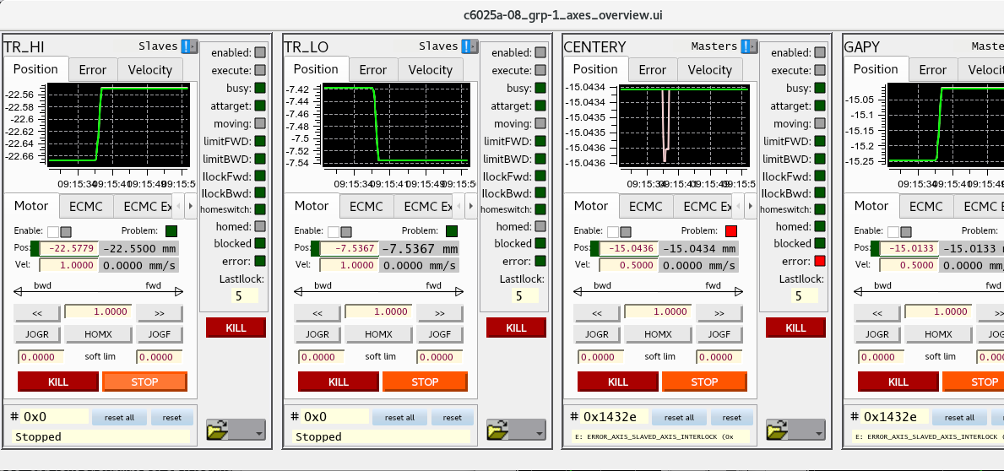
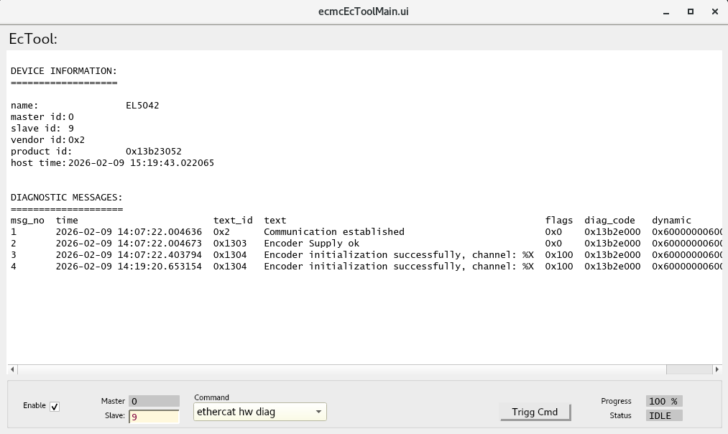
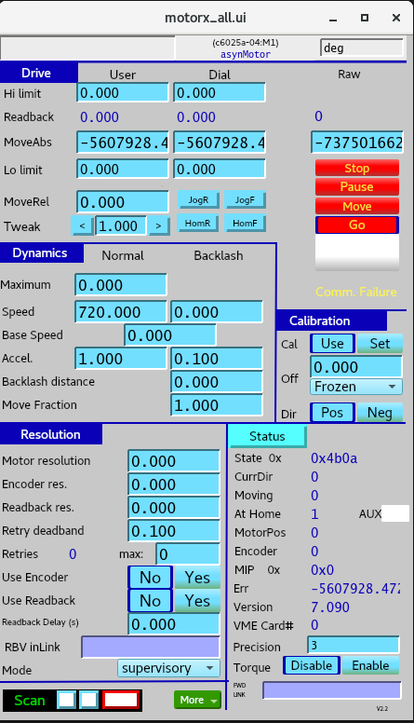
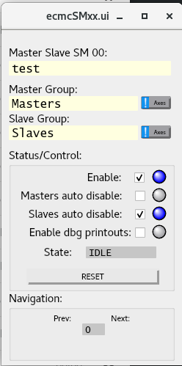
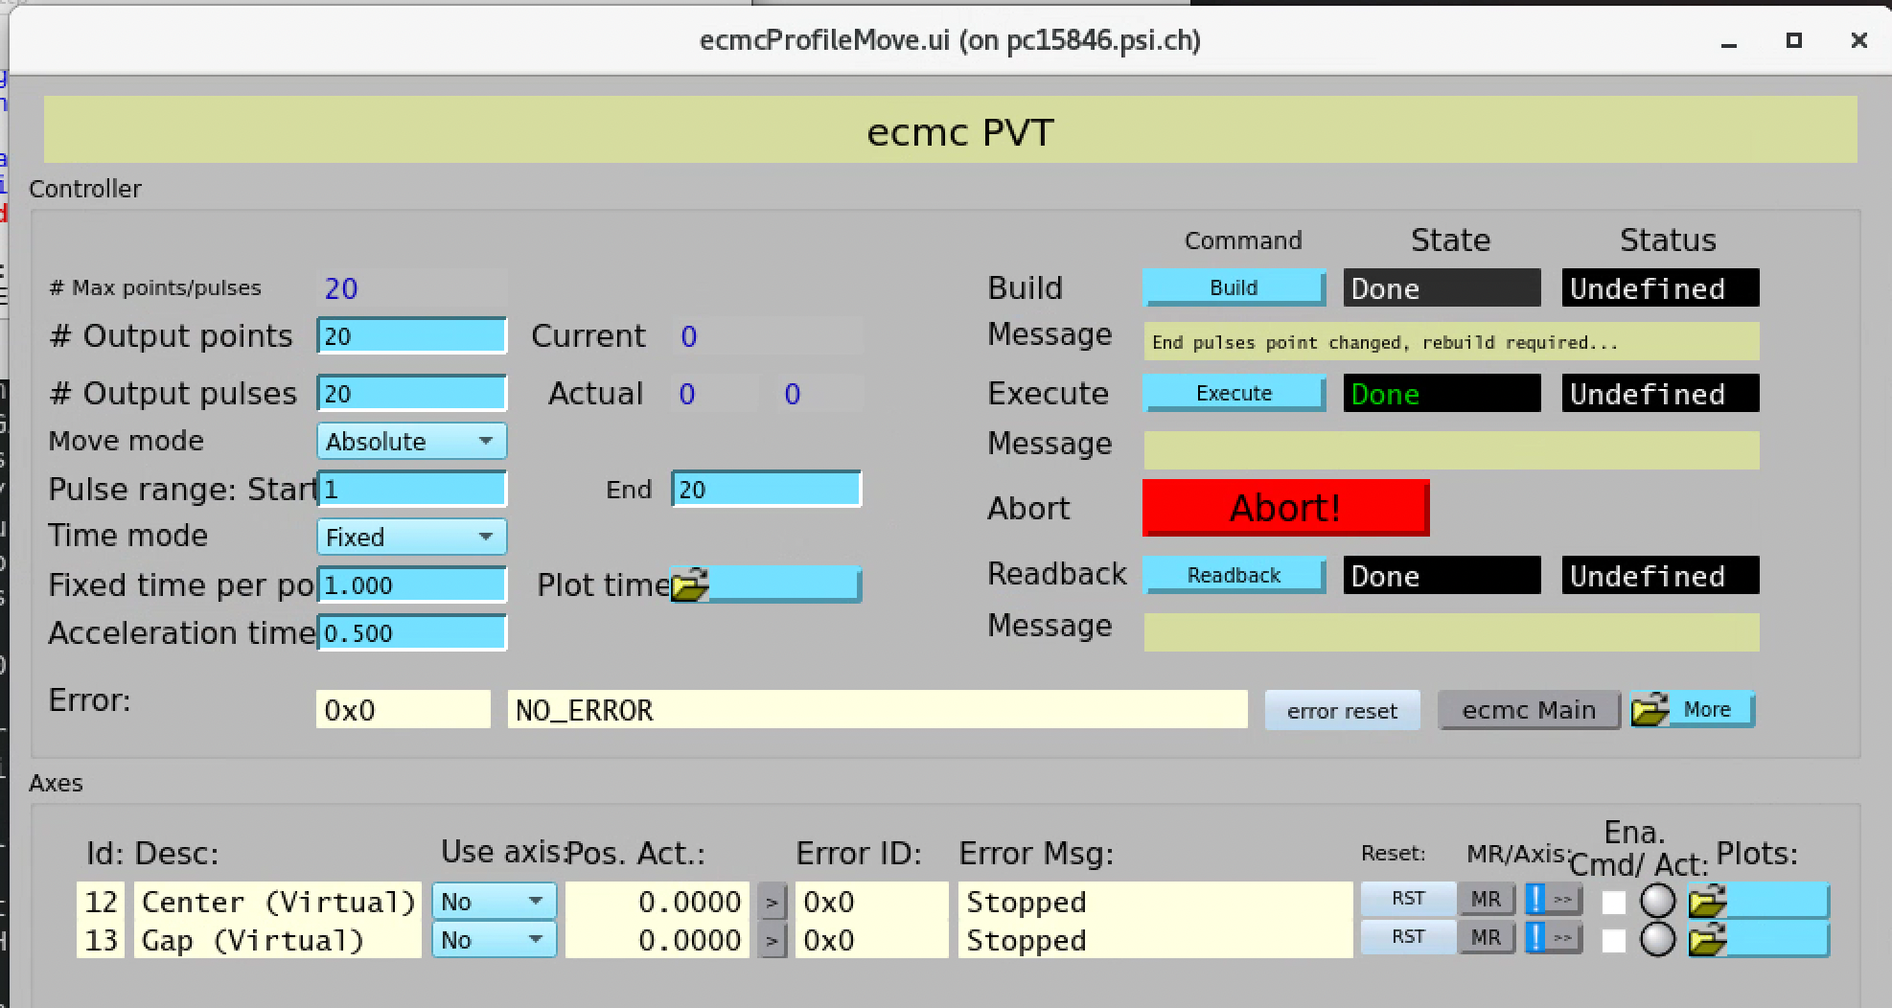
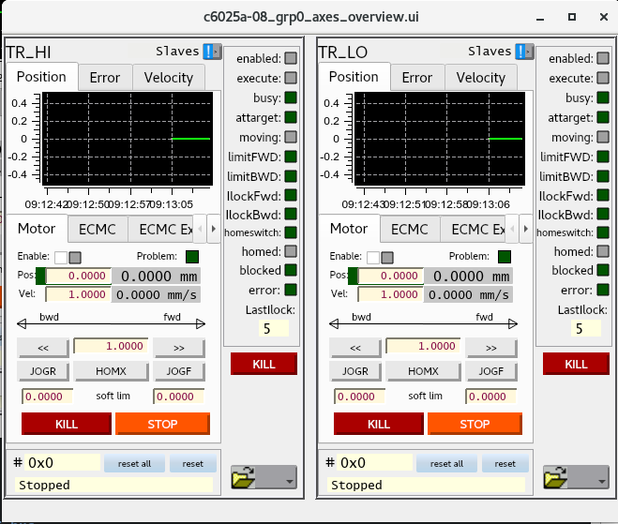
Diagnostics
Motion
ECMC · EPICS Collaboration Meeting 2026, Saclay
Diagnostics
14 / 23

Slide 15
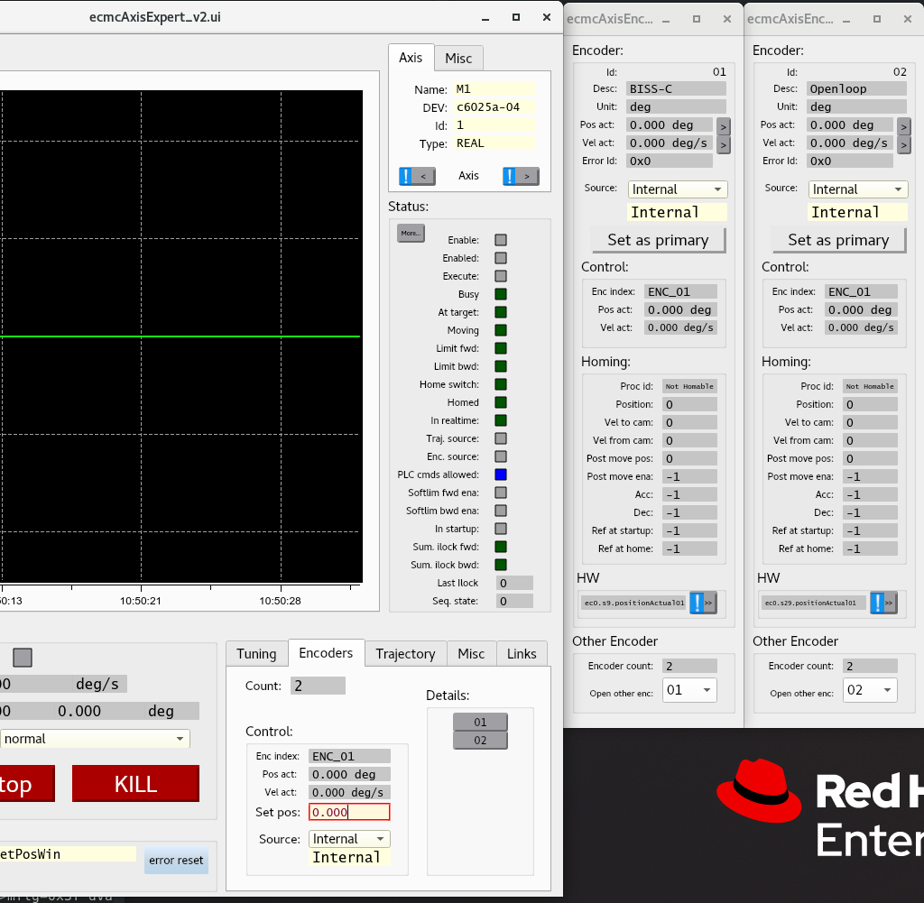
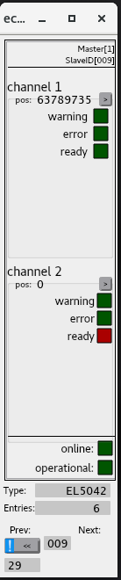
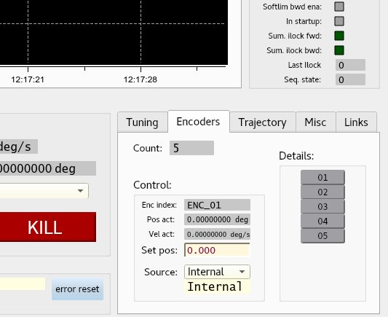
  Openloop
Open/closed loop
  BISS
Motion
Closed loop
Open loop (steppers)
ECMC · EPICS Collaboration Meeting 2026, Saclay
Diagnostics
15 / 23

Slide 16
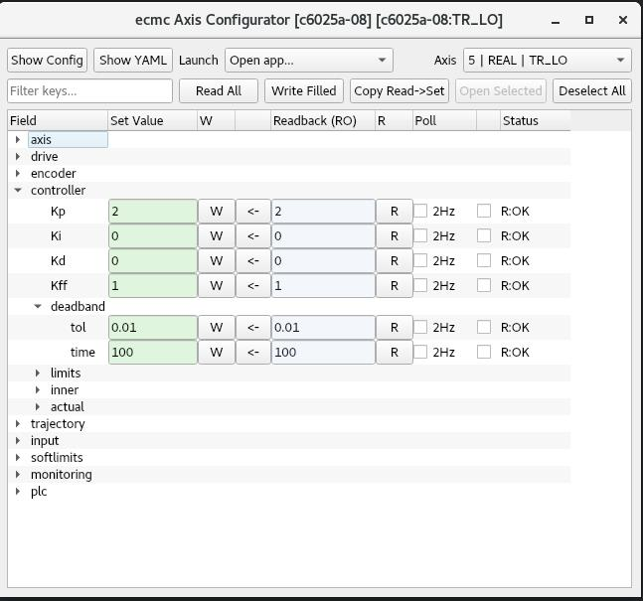
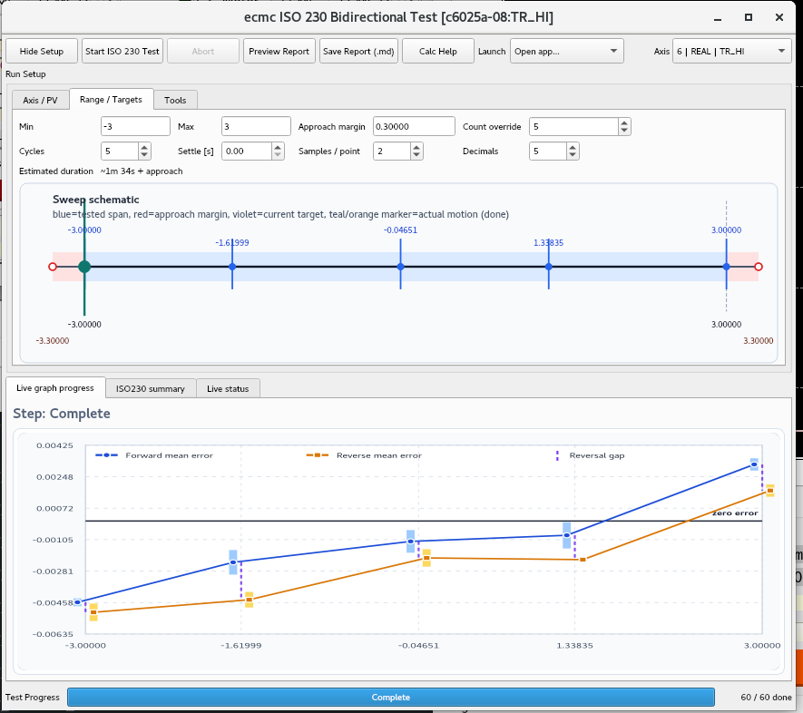
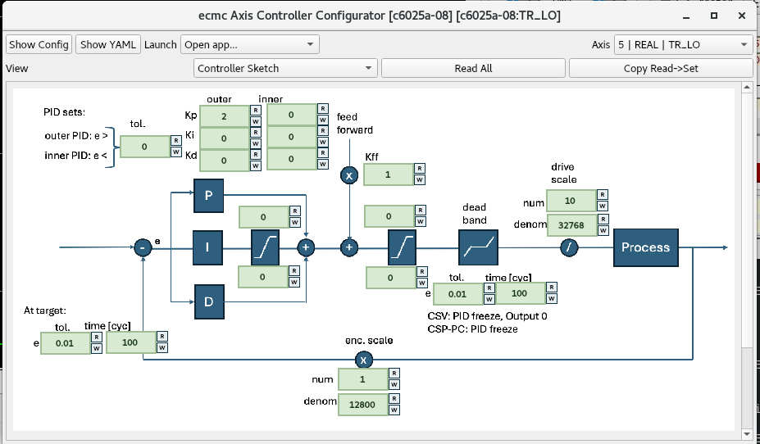
Tools
ECMC · EPICS Collaboration Meeting 2026, Saclay
Diagnostics
16 / 23

Slide 17
Soft-PLC: scriptable real-time logic
A PLC object runs in-sync with the RT loop — custom interlocks, kinematics, math
Classic ecmc PLC: exprtk based ECMC syntax
  Access all PVs of all axes, I/O, and EtherCAT entries by name
  Kinematics
  Expose PLC variables as EPICS PVs
  Motion Library (MC_*), many utility functions and variables
Plugins:
  Integration of c/c++ modules
Next ecmc release:
  Direct C++ (cpp-logic). An extension to the existing plugin concept
  IEC 61131-3 Structured Text (ecmc_plugin_strucpp) trough strucpp*
Usecases:
Control tasks
Kinematics — mirror, slit, …
Sequences, state machines
Custom homing
ECMC · EPICS Collaboration Meeting 2026, Saclay
Soft PLC
17 / 23s

Slide 18
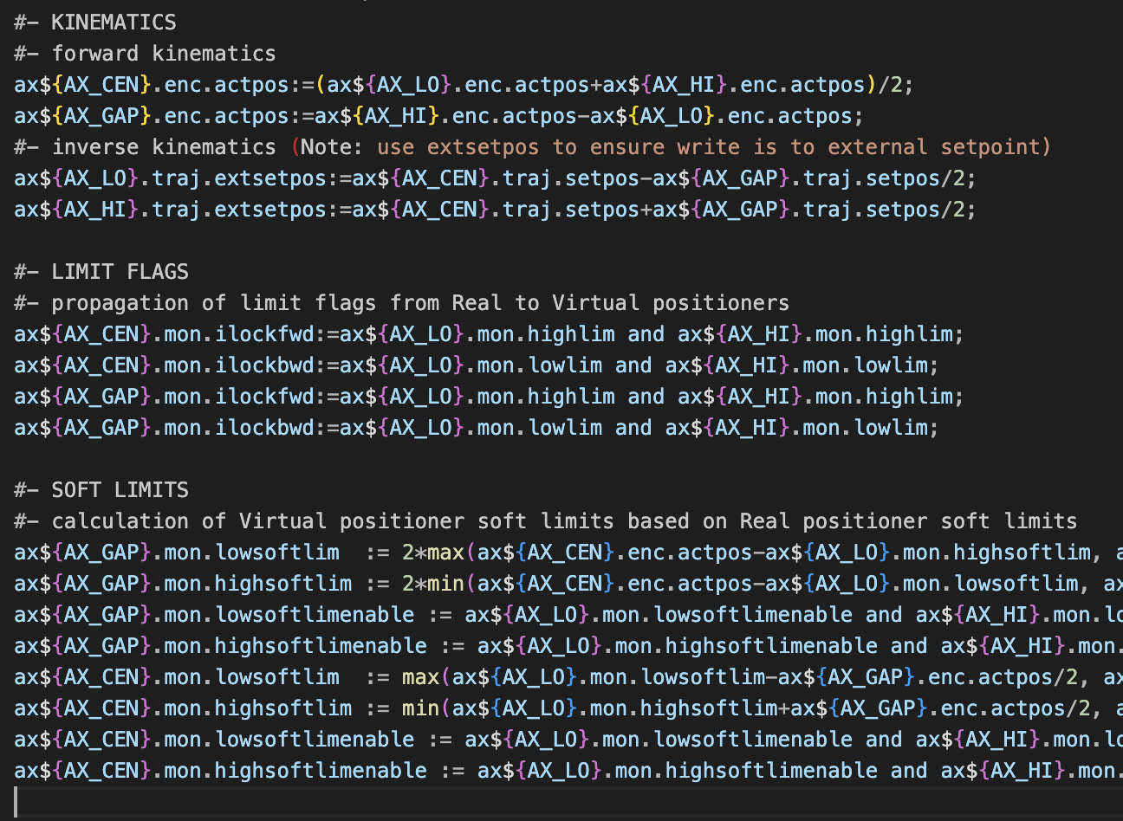
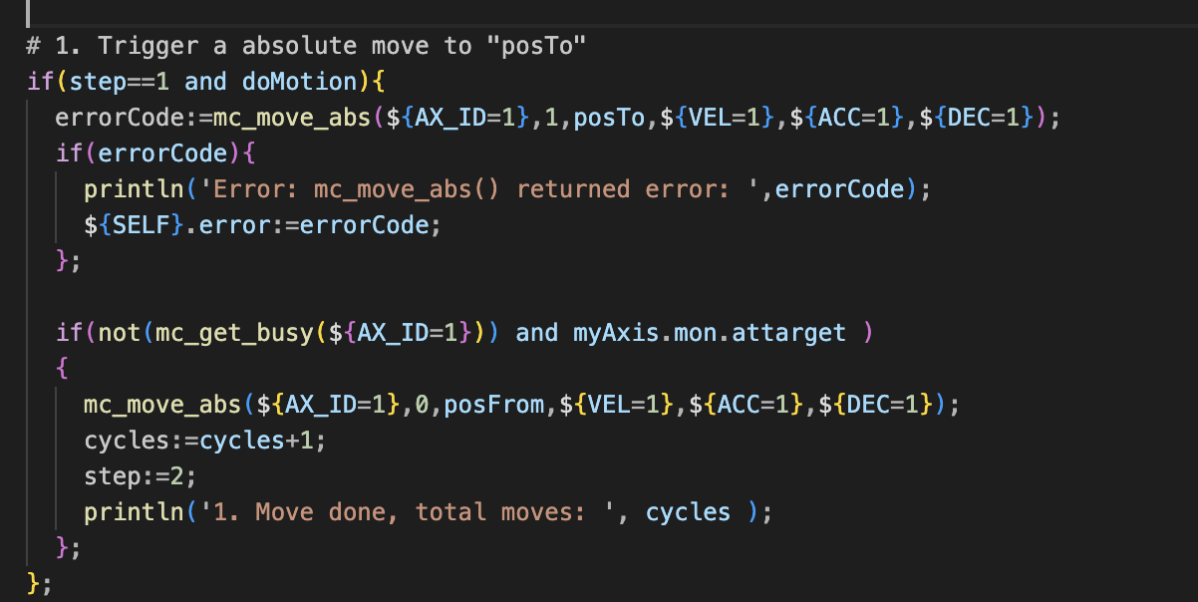
Soft-PLC: scriptable real-time logic, exprtk
A PLC object runs in-sync with the RT loop — custom interlocks, kinematics, math
variables (total 70)
  generic: 3
  ethercat: 2
  motion: 49
  plc: 9
  data storage: 7
functions (total 110):
  ethercat: 29
  master 2 master: 6
  motion: 30
  motion group: 27
  data storage: 15
  lookup tables: 1
  misc: 2
ECMC · EPICS Collaboration Meeting 2026, Saclay
18 / 23

Slide 19
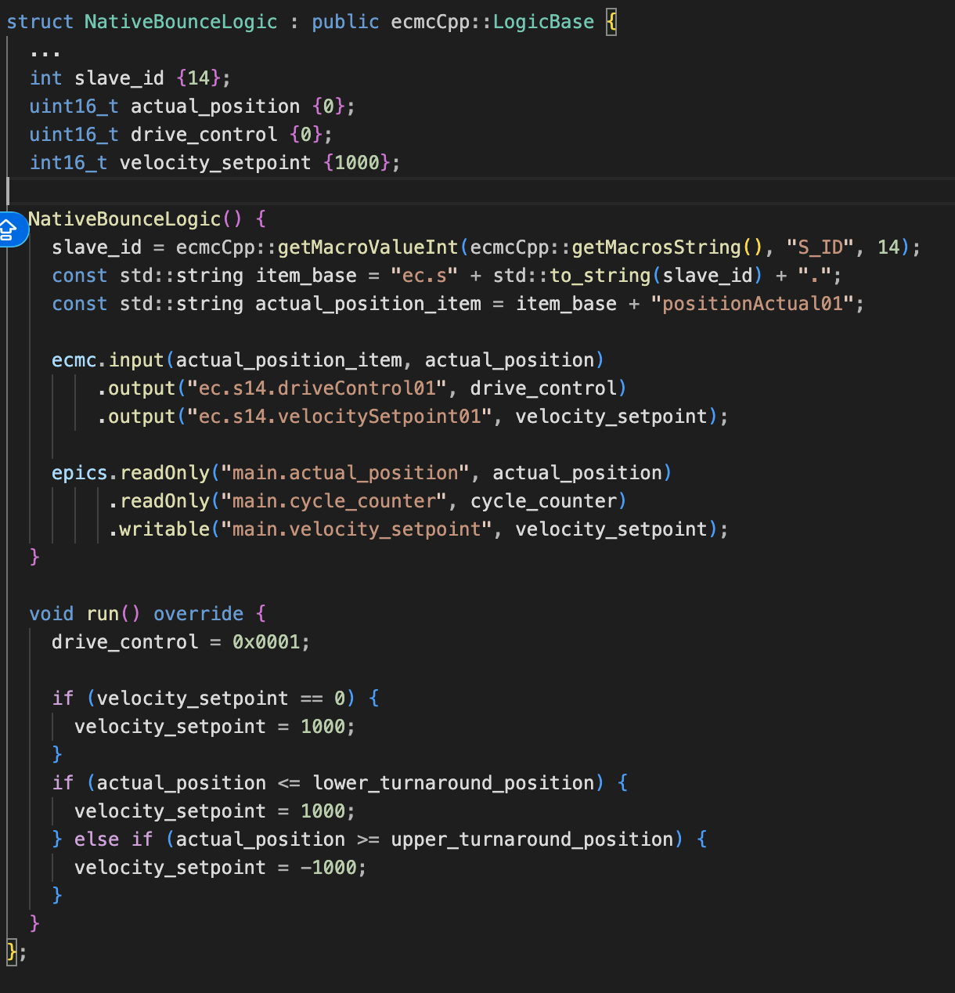
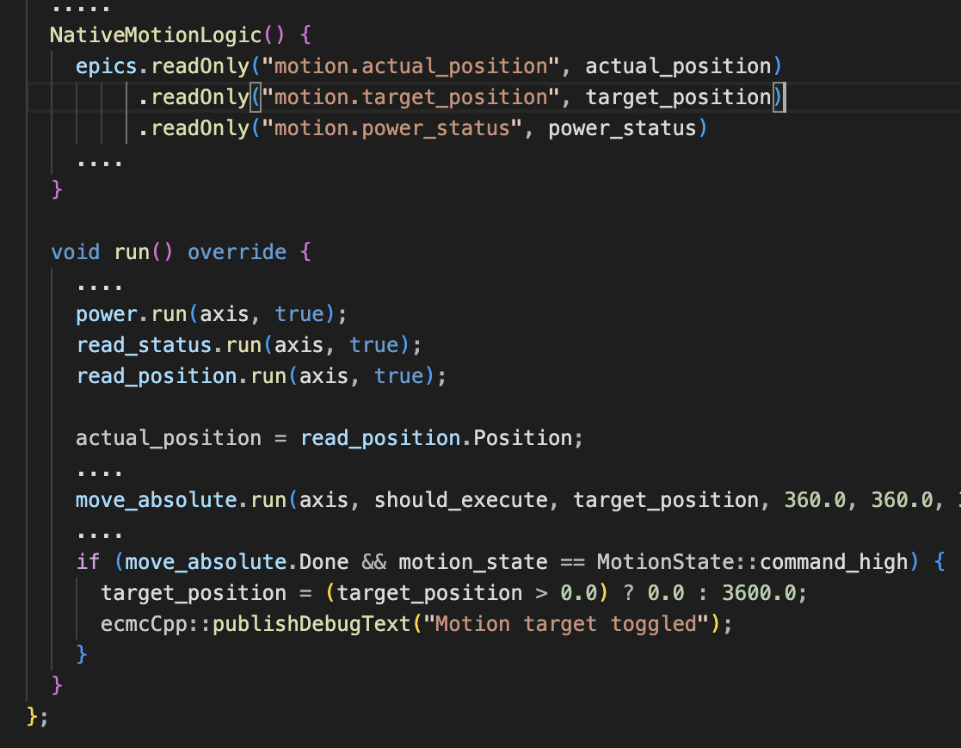
Soft-PLC: scriptable real-time logic, C++
C++, minimal examples
Next Release
ECMC · EPICS Collaboration Meeting 2026, Saclay
Ecosystem
19 / 23

Slide 20

Soft-PLC: scriptable real-time logic, Structured Text (strucpp*)
A PLC object runs in-sync with the RT loop — custom interlocks, kinematics, math. Plugin needed ecmc_plugin_strucpp and strucpp
Next Release
ECMC · EPICS Collaboration Meeting 2026, Saclay
Ecosystem
20 / 23

Slide 21

Plugin architecture
Extend functionality without modifying ecmc
ecmc_plugin_daq
ecmc_plugin_socketcan
Waveform data acquisition with timestamps
SocketCAN / CANopen bridge
ecmc_plugin_scope
ecmc_plugin_safety
Low-level scope for DC-enabled slaves
Interface to Pilz motion-safety box (PSI specific)
ecmc_plugin_grbl
ecmc_plugin_raspi
GRBL G-code / CNC interpreter
wiringPi — GPIO
ecmc_plugin_fft
ecmc_plugin_strucpp
FFT on live EtherCAT signals (via kissfft)
IEC 61131-3 Structured Text PLC execution
Plugin API is minimal — a handful of callbacks.
ECMC · EPICS Collaboration Meeting 2026, Saclay
Plugins
21 / 23

Slide 22

How to get started
Every link below is public — no sign-up, no NDA
epics-modules/ecmc
ecmccfg manual
Core module — RT loop, axis objects, commands, APIs
Online docs, knowledge base, best-practice examples
github.com/epics-modules/ecmc
paulscherrerinstitute.github.io/ecmccfg/manual
paulscherrerinstitute/ecmccfg
ECMC plugins
Configuration framework — YAML, Jinja2, loader scripts
DAQ · Structured Text · C++ · G-code · FFT · PVA · scope · CAN · safety
github.com/paulscherrerinstitute/ecmccfg
github.com/paulscherrerinstitute (search: ecmc_plugin)
paulscherrerinstitute/ecmccomp
IgH EtherCAT Master
Component library — motors, encoders
The underlying open-source EtherCAT master
github.com/paulscherrerinstitute/ecmccomp
etherlab.org
First try?
Clone ecmccfg → look at the examples in examples/PSI/best_practice/
ECMC · EPICS Collaboration Meeting 2026, Saclay
Get started
22 / 23

Slide 23

Thanks to:
Felix Maier
Alvin Acerbo
Xiaoqiang Wang
Luka Debenjak
https://git.psi.ch/motion/ecmc_plugin_grbl
ECMC · EPICS Collaboration Meeting 2026, Saclay
Get started
23 / 23

