Slide 1

Spring EPICS collaboration meeting 2026
Information point
Paul Lotrus
22/04/26

Slide 2

Information
  Badge
    Phone numbers
    Red Point: You do not wish to appear in any official event media
    Green ticket: You have chosen the vegetarian menu at the Gala diner
    Visit : Name of the visit and color point
    Give back the badge

Slide 3
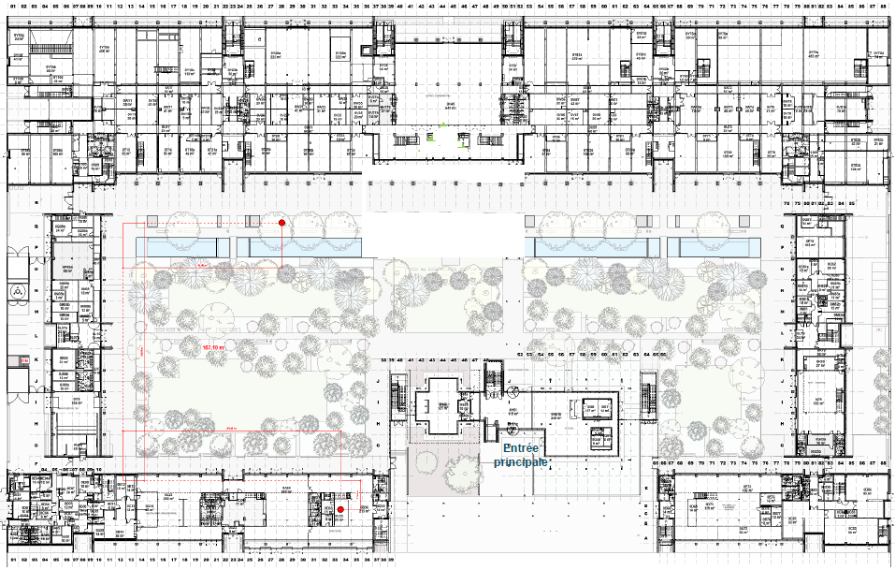
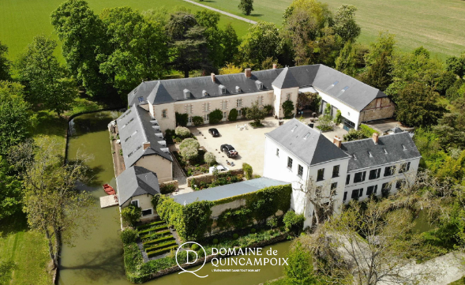

Social event: Gala diner on Wednesday
Bus departure
Ground floor
  Domaine de Quincampoix
    2 buses at 17h45 at the Hall Emmy Noether (ground floor)
    Return by bus in 2 locations: One bus at ENS (here), one bus at Massy-Palaiseau train station
  Vegetarian menu: You should have a green paper in your badge

Slide 4
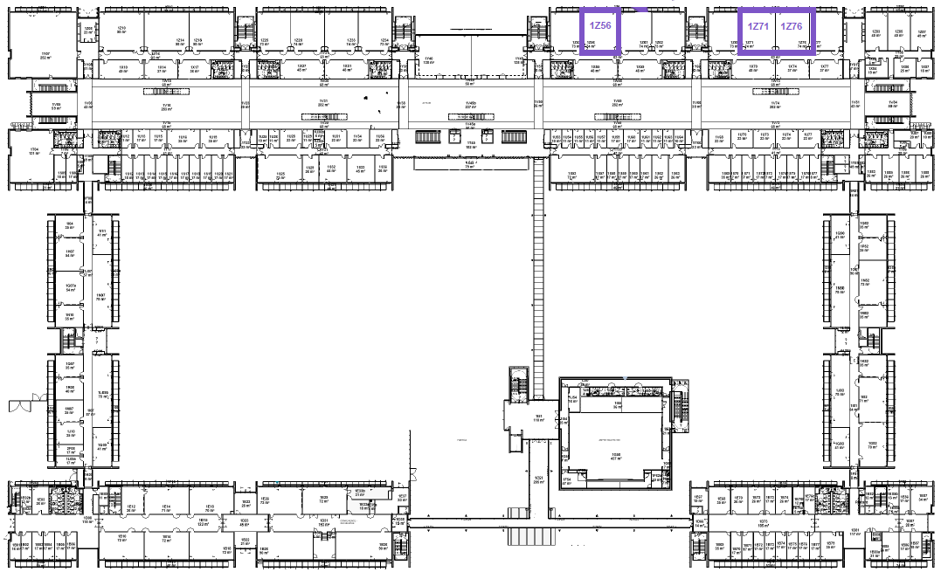
Workshops: 1st floor
Gradinée room (60 seats)
Thursday, Friday
Gradinée room (60 seats)
Thursday, Friday

Slide 5
Trainings and workshops
  Start at 9h00
  Some sessions have an agenda, look at the website
  Depending on the workshop, you may need to download a Virtual Machine which will contains all the EPICS environment or configure a Github codespace
  Please, go on the description of the workshop session in the Timetable – detailed view (https://indico.in2p3.fr/event/37441/timetable/#20260423.detailed)
  Github code space for the session Introduction to EPICS, just need a Github account (Thursday 9h00)
  Same VM will be used for the sessions:
    StreamDevice (Thursday 11h00)
    EPICS 7 (Thursday 10h00)
    OPC UA Security (Thursday 13h30)
    oac-tree (Friday 9h00)
  A VM for the session Phoebus GUI and services workshop (Thursday 13h30)

Slide 6
Visit on Friday afternoon
Visit bus departure
Ground floor
  Departure by bus at 13h50 from ENS (lunch exit)
  Return by bus at ENS
  Synergium visit (full):
    You MUST have your passport
    You MUST stay with your group
    2 groups of 10
    Duration: 2h
  SOLEIL (full):
    Take your Id just in case
    Duration 2h30
  Maison de la simulation (Universe simulation):
    Duration : 2h

Slide 7
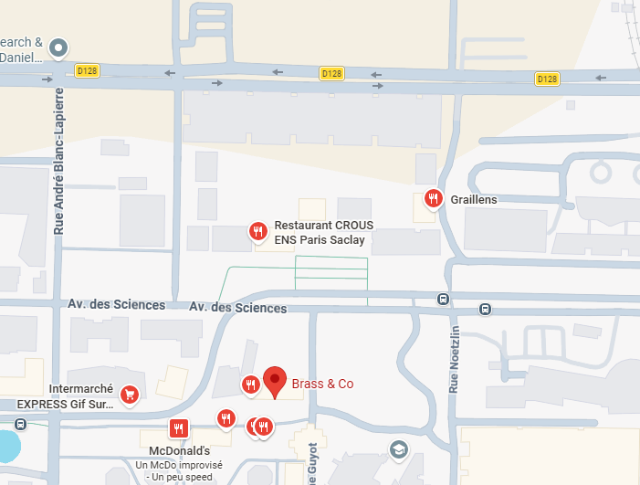


Social event: Farewell drink on Friday after visit
  Farewell drink on Friday night at “Brass & Co” bar nearby (at your expense) at around 17h30

Slide 8
Thanks
  EPICS Council
  All the speakers

