Slide 1


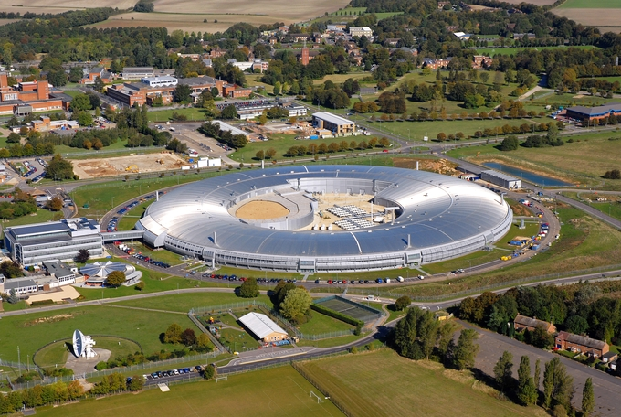
The Control of X-ray Deformable Mirrors
Andy Foster
Observatory Sciences Ltd & The Diamond Optics Group

Slide 2
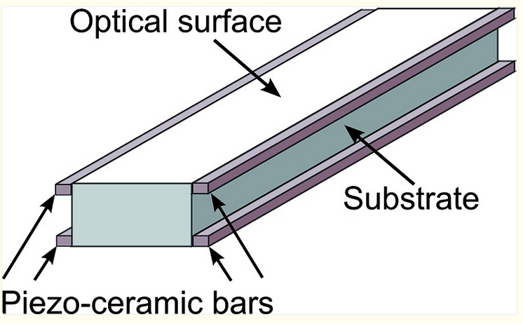

Introduction & Motivation
Original, older Bimorph Power Supplies, suffered from poor RS-232 communication, locks-ups and EPICS screens going white (disconnecting) while a command executes
A particular problem was in the commissioning of a mirror when scripts, continually setting voltages and examining the response on the beam shape and size were left running overnight – only to find they’d failed 45 minutes after the scientist had gone home…
Piezo-electric, deformable “bimorph” mirrors are used to focus X-rays at many synchrotrons and XFELS
Electrodes

Slide 3


The beamline scientists weren’t happy…
Why can’t I see what’s happening on the screen?!?
Why does this keep
locking-up?
Why does it take so long to apply large voltages?
I want to commission my mirror much quicker… We’re wasting beamtime!

Slide 4

One night, over drinks, a plan was hatched…
I’ve found a new power supply!
What about EPICS support?
That’s what the software guys are for…

Slide 5
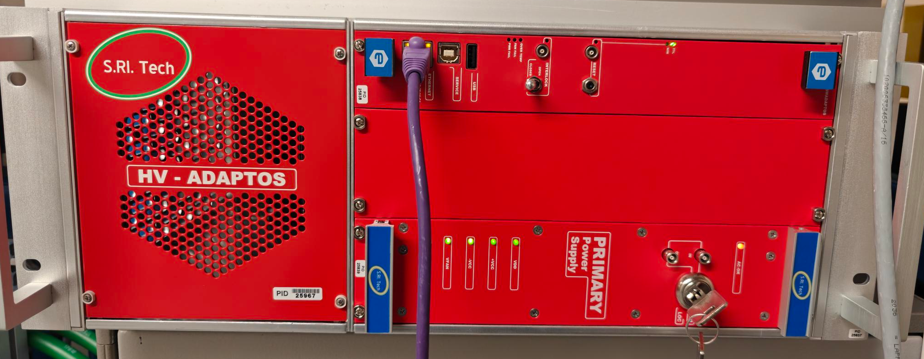
New Programmable HV Power Supply
HV-ADAPTOS from CAEN (based on earlier Elettra model)
Hardware is from CAEN, the software is from S.RI.Tech (excellent support from Matteo Fusco & Riccardo Signorato)
Programmable voltages (speed & shape of voltage impulse)

Slide 6
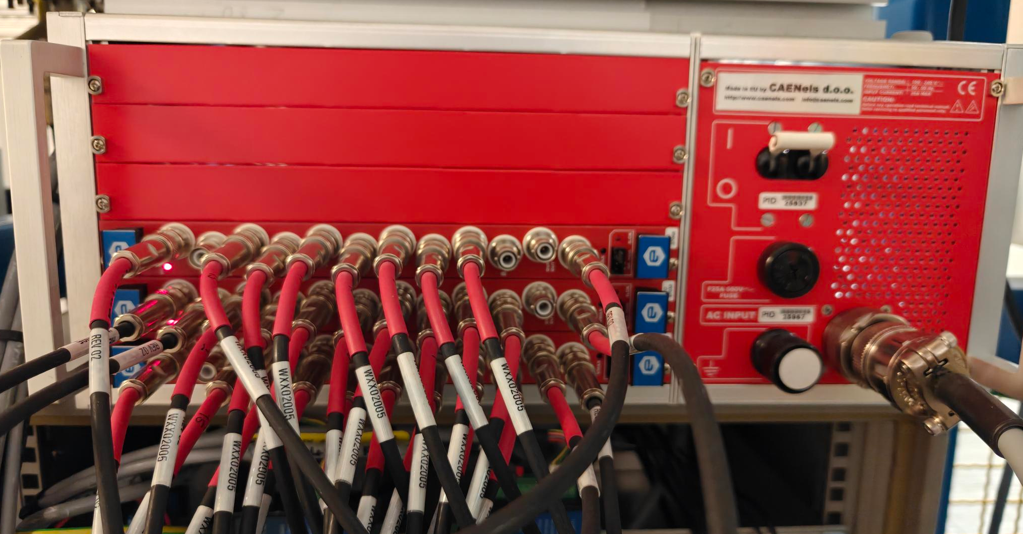
HV Adaptos PSU Back
8-channels per amplifier card, possible 6 cards

Slide 7
HV-Adaptos Power Supply
Channels can be configured into groups (mirrors) e.g. 16-channels, 8-channels etc
Ubuntu Linux system underneath, but limited access for the facility
Special Admin privileges to be able to set:
  Maximum slew rate (typically more than 100V/s, cf. 10V/s previous PSU)
  Maximum voltage between neighbouring bimorph electrodes (500V)
  Maximum absolute voltage (+/-1500V)
But these parameters depend on, at least:
  The age of the mirror
  The way the mirror is mounted
Being too cavalier can end-up with a broken mirror!
Set once by an Optics expert and left

Slide 8
HV-Adaptos Power Supply
Originally, limited EPICS Support
On-board EPICS IOC – abandoned: “black-box”, didn’t do what we wanted
Instead, added a feature-rich TCP/IP interface which we can talk to from our own IOC’s
We have worked closely with Riccardo & Matteo to improve the TCP/IP interface and the reliability of the communication
Although the TCP/IP interface is simple ASCII commands like:
“GROUP0:VOUT%d:%f”
We opted to write an asynPortDriver instead of using streamDevice for two reasons:
  Initially there were some communication issues and we wanted to prove it was not at the EPICS level – easier to see what was going on in asynPortDriver code.
  It was a good learning exercise!

Slide 9
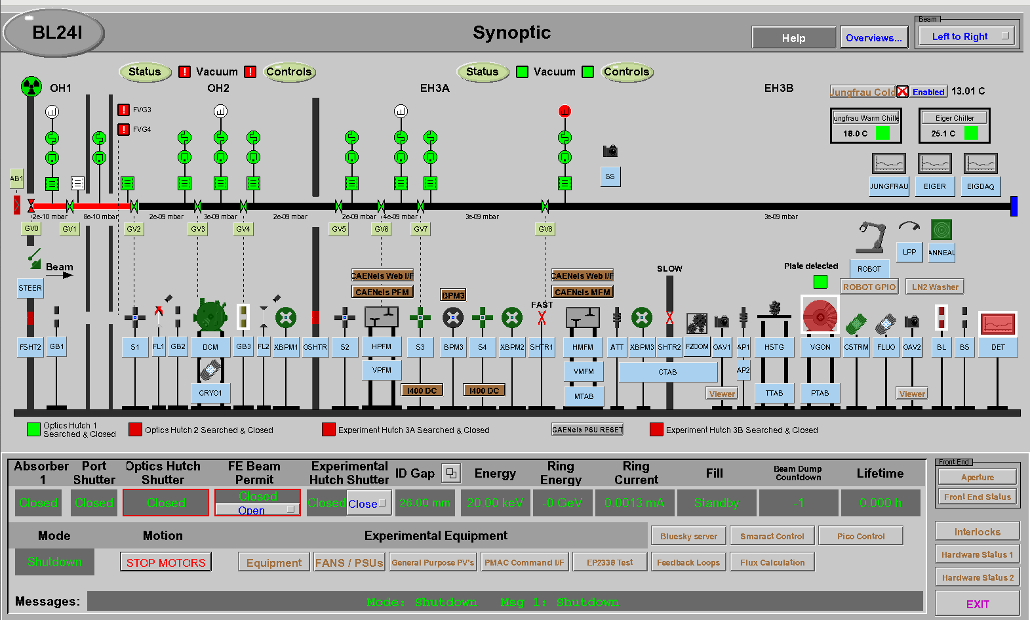
I24 Synoptic (Micro-Focus MX, 10um)
Pre-Focus Mirrors
Secondary Source
Micro-Focus Mirrors

Slide 10
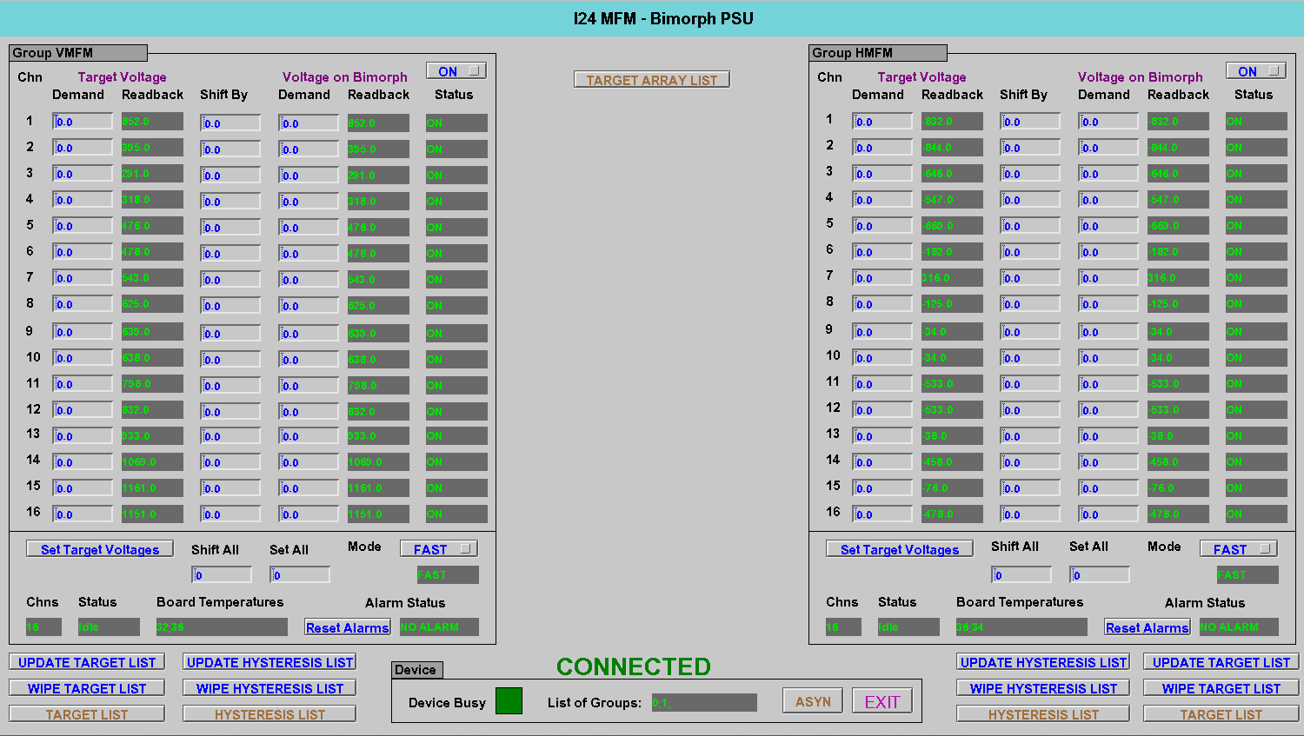
I24 Micro-Focus Control
Blue – writeable demand
Green – readback value

Slide 11
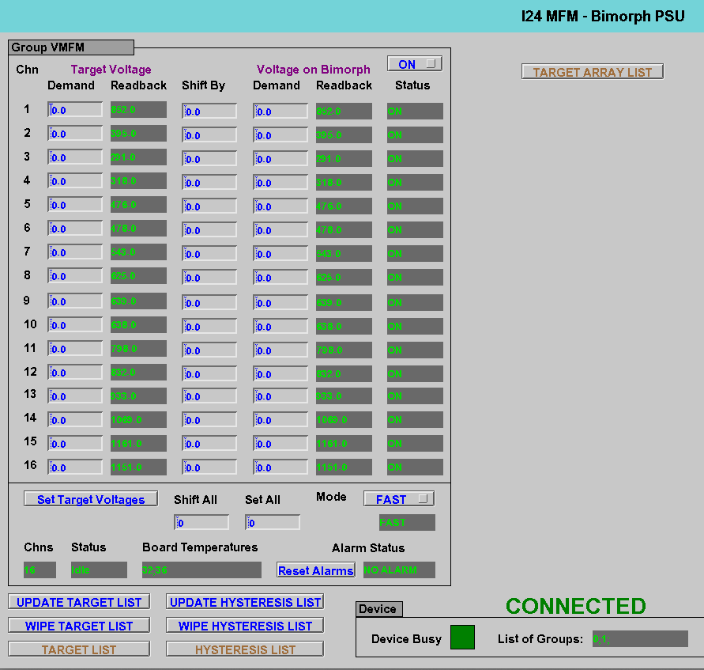
Zooming in…
Target Voltages are a staging post
These are the voltages on the outputs
Tells us if a mirror is busy
Tells us when the device is busy
Are we still talking to the power supply? Uses ASYN record .CNCT field

Slide 12
Device Busy PV
The asynPortDriver has a polling task (1 second)
One of its jobs is to read back the status of each mirror (group) and update the PV’s for the state of each mirror
A CALC record combines the two individual states to give us “Device Busy”
Using this PV is crucial in the way we drive the power supply
  We don’t want to flood the power supply with commands, while it is still busy
  If we do, commands are lost, voltage settings don’t happen
So, our client code must always look for: IDLE->BUSY->IDLE, after sending each command, and before sending the next command
Following this paradigm, the communication is rock solid and there are no disconnections

Slide 13
Back to commissioning…
What happens during commissioning?
  We set each voltage to a value and make a measurement of the beam off the mirror. This is done multiple times, to generate a response matrix.
  But that means for every set of voltages, we have to send 16 commands, per mirror, and wait IDLE->BUSY->IDLE for each one - still quite slow…
Wouldn’t it be better if we could send all 16 as an array?
  That’s where the Target Voltages come in!
  We can send the whole set of Target Voltages to the outputs with a single command (“Set Target Voltages” button on the interface)
  But, hold on, we still have to set each individual target voltage first, that’s 16-commands!!
At this point…

Slide 14

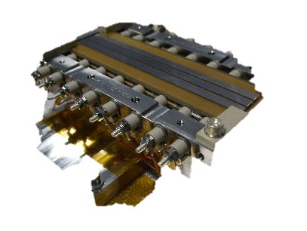
This thing is still too slow…
…can we make it go quicker?!?

Slide 15
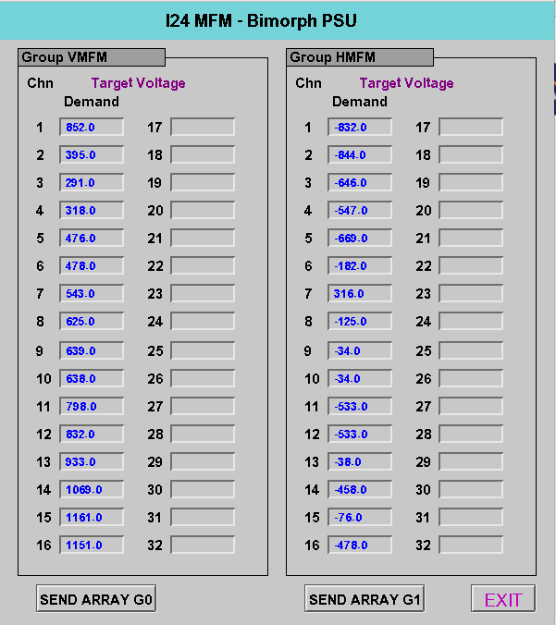
Target Array Command
The answer is, of course, YES!
We add another command, which allows us to set the target voltages as an array
We need another set of EPICS records to hold the values. Writing to these does not send a command to the device. They are just “soft” records
Use ca_put_callback() in the client code, to know when they are all written
Now send the new command!
Database logic formats the command and sends it the device

Slide 16
Timings…
Using the Target Array Command:
  500 sets of 32 random voltages on a single mirror: 250 minutes
Compared to setting output voltages individually:
  Running the same 500 sets of 32 voltages: 534 minutes
In continuous running, we have achieved more than 72 hours and never had a problem with lock-ups or communication. We stopped the script at that point.
Remember where we started from with the old power supplies…
  Failure after 45 minutes!

Slide 17
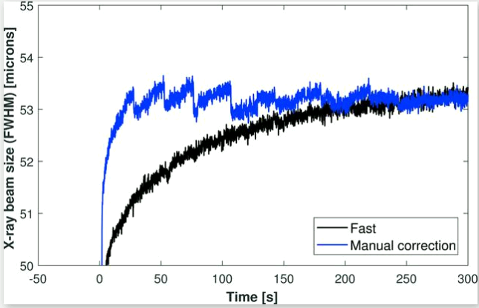
More Features
Piezo creep can be reliably predicted and automatically compensated
Hysteresis command
Apply larger target voltage
Then, automatically apply small voltage offsets as a time series afterwards
2-D X-ray beam size changed and stabilised in < 10 seconds!!
“Dynamic adaptive X-ray optics. Part II. High-speed piezoelectric bimorph deformable Kirkpatrick-Baez mirrors for rapid variation of the 2D size and shape of X-ray beams”, S.G. Alcock, I-T. Nistea, R. Signorato, R.L. Owen, D. Axford, J.P. Sutter, A.J. Foster, K. Sawhney. J. Synchrotron Radiat. 26, 45-51 (2019) https://doi.org/10.1107/S1600577518015965
Once we have our sets of commissioned voltages for various foci and beam shape
Up to 16 sets can be read from a JSON file and made available to EPICS through the “Update Target List” command.
These can be applied, at will, to change focus etc.

Slide 18
Acknowledgements
Dr Kawal Sawhney – Diamond, Head of Optics & Metrology
Dr Simon Alcock – Diamond, Principal Optics & Metrology Scientist
Dr John Sutter – Diamond, Senior Optics Scientist
Riccardo Signorato – S.RI. Tech (sri_tech@pec.it)
Matteo Fusco – CAEN, Software Engineer
Many Diamond Beamline Scientists… for their patience!

Slide 19

The End
Thanks for your attention!
Time to ride off into the sunset…

