Slide 1
Evaluating EPICS as a replacement for IBA’s SCADA Layer
EPICS collaboration meeting | Apr 20 – 24, 2026
Xavier Wilputte, Automation Expert

Slide 2
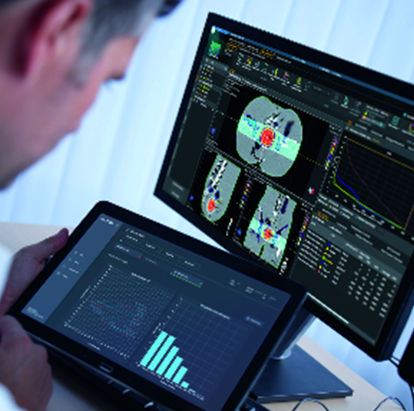
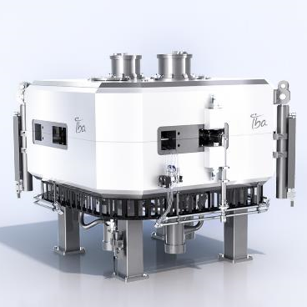
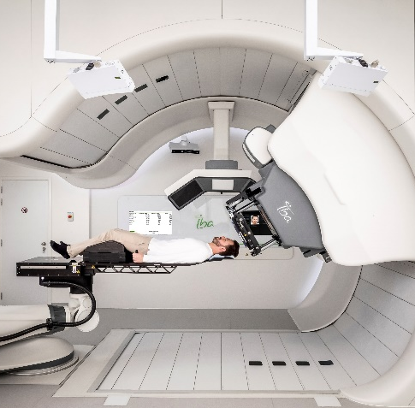
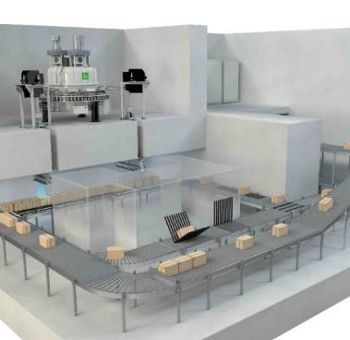
IBA – Global leader in particle beam technology
RADIOPHARMA
SOLUTIONS
DOSIMETRY
#1 Quality Assurance Solutions
10k+ customers
#1 Radioisotopes production
380+ accelerators sold
PROTON THERAPY
INDUSTRIAL
SOLUTIONS
#1 Proton Therapy Solutions
75+ systems sold
#1 E-Beam & X-ray Solutions
300+ accelerators sold
Strong Market & Innovation Synergies
https://www.iba-worldwide.com/

Slide 3

IBA – Control System
SCADA capabilities
5k to 30k PVs
1k to 10k Historized PVs
1Hz to 40Hz PV update
Up to 5 HMI concurrent sessions
RBAC & Audit trail
SCADA current pains
Proprietary, commercially licensed technology (VMWare, Windows, Aveva)
Tightly coupled to vendor toolchain & license model
Growing concerns: sustainability, cost & vendor lock-in
High-level software
SCADA

Slide 4




IBA – Our evaluation approach
Evaluation framework
Requirements
Candidates EVALUATION
Demonstrator
Categories
Weighted scoring
Regulations
Medical
Industrial
Cybersecurity
Quality attributes
24/7 availability
Auditability & Role base access
Maintanability and system remotely updatable
…
EPICS + Web-HMI framework
Open-source, royalty-free license
OPC-UA & pvAccess for PLC comms
Proven at large-scale facilities worldwide
A comprehensive overview
Residual uncertainties
Performances
Based for the IBA product impact analysis

Slide 5



IBA – What we are seeking?
Operational Experience
Know Limitations
Community & Collaboration
REX in similar context
Configuration
Long term support
Regulated env.
Cybersecurity hardening “secure by design”
Scalability challenges
Web-HMI capabilities
Support pathways
Contributing back if evaluation is positive

Slide 6


Contact
Xavier Wilputte
R&D Automation Expert
Xavier.Wilputte@iba-group.com
Marco Pitruzzella
R&D Automation Expert
Marco.Pitruzzella@iba-group.com

Slide 7

Protect, Enhance and Save Lives
Viggo Mommaerts, treated with Proton Therapy

