Slide 1
Squirrel
a new (to us) save-compare-restore architecture
By: Devan Agrawal

Slide 2
Motivation
Replace existing application: SCORE
  Java desktop application launched from OPIs
  Tied to Oracle database
    Requires licensing
    Relies on IT and Oracle technical support
    Schema ill-suited to our control system
      Fragmented snapshots
  Unwieldy enough that an operator created a separate restore UI
  Intermittently slow, difficult to debug, inflexible, etc
Investigate stack as a template for future controls apps
Notes:
RE stack: In particular, we may be able to reuse the redis cache to distribute PV values to services that don’t need to have their own EPICS connections

Slide 3
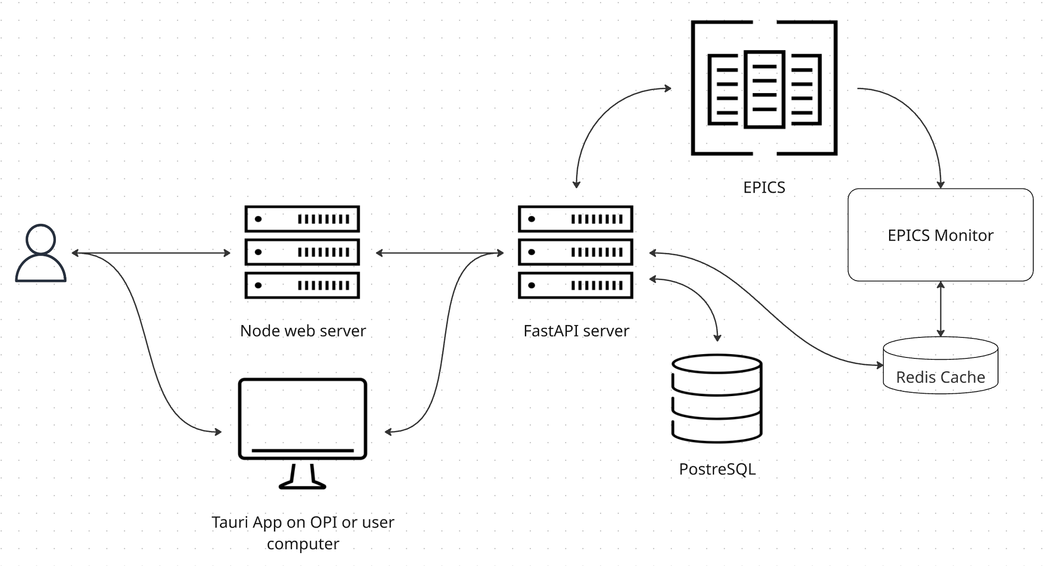
Architecture
React with Typescript
Node
FastAPI
Redis
PostgreSQL with SQLAlchemy
aioca & p4p
Tauri (to launch frontend as desktop app)
Docker Compose

Slide 4
Advantages
Faster to save / more responsive
  Each instance doesn’t have to make 40,000 EPICS calls per save or manage its own monitors
Backend API available to other tools
Cache data may be available to other tools
Users can manage the data
  e.g. PVs can be added and modified through the UI, rather than asking a database admin
Accessible without ssh
No Oracle!
Faster to develop
Better aesthetics (or at least more control)
Notes:
Saves in SCORE could take between 30 seconds and 30 minutes
Frontend-agnostic

Slide 5
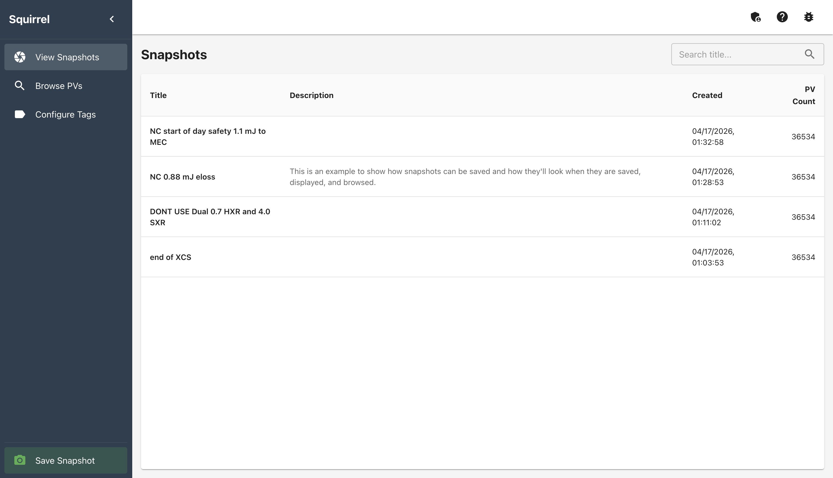
Image: List of Snapshots

Slide 6
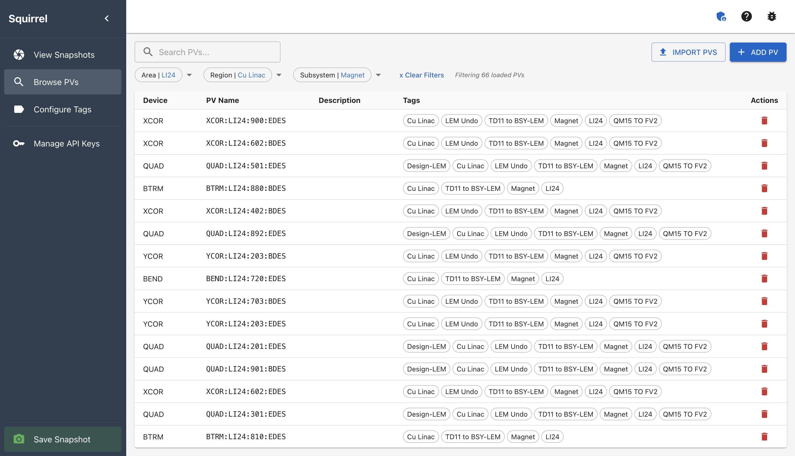
Image: Filtered List of PVs

Slide 7
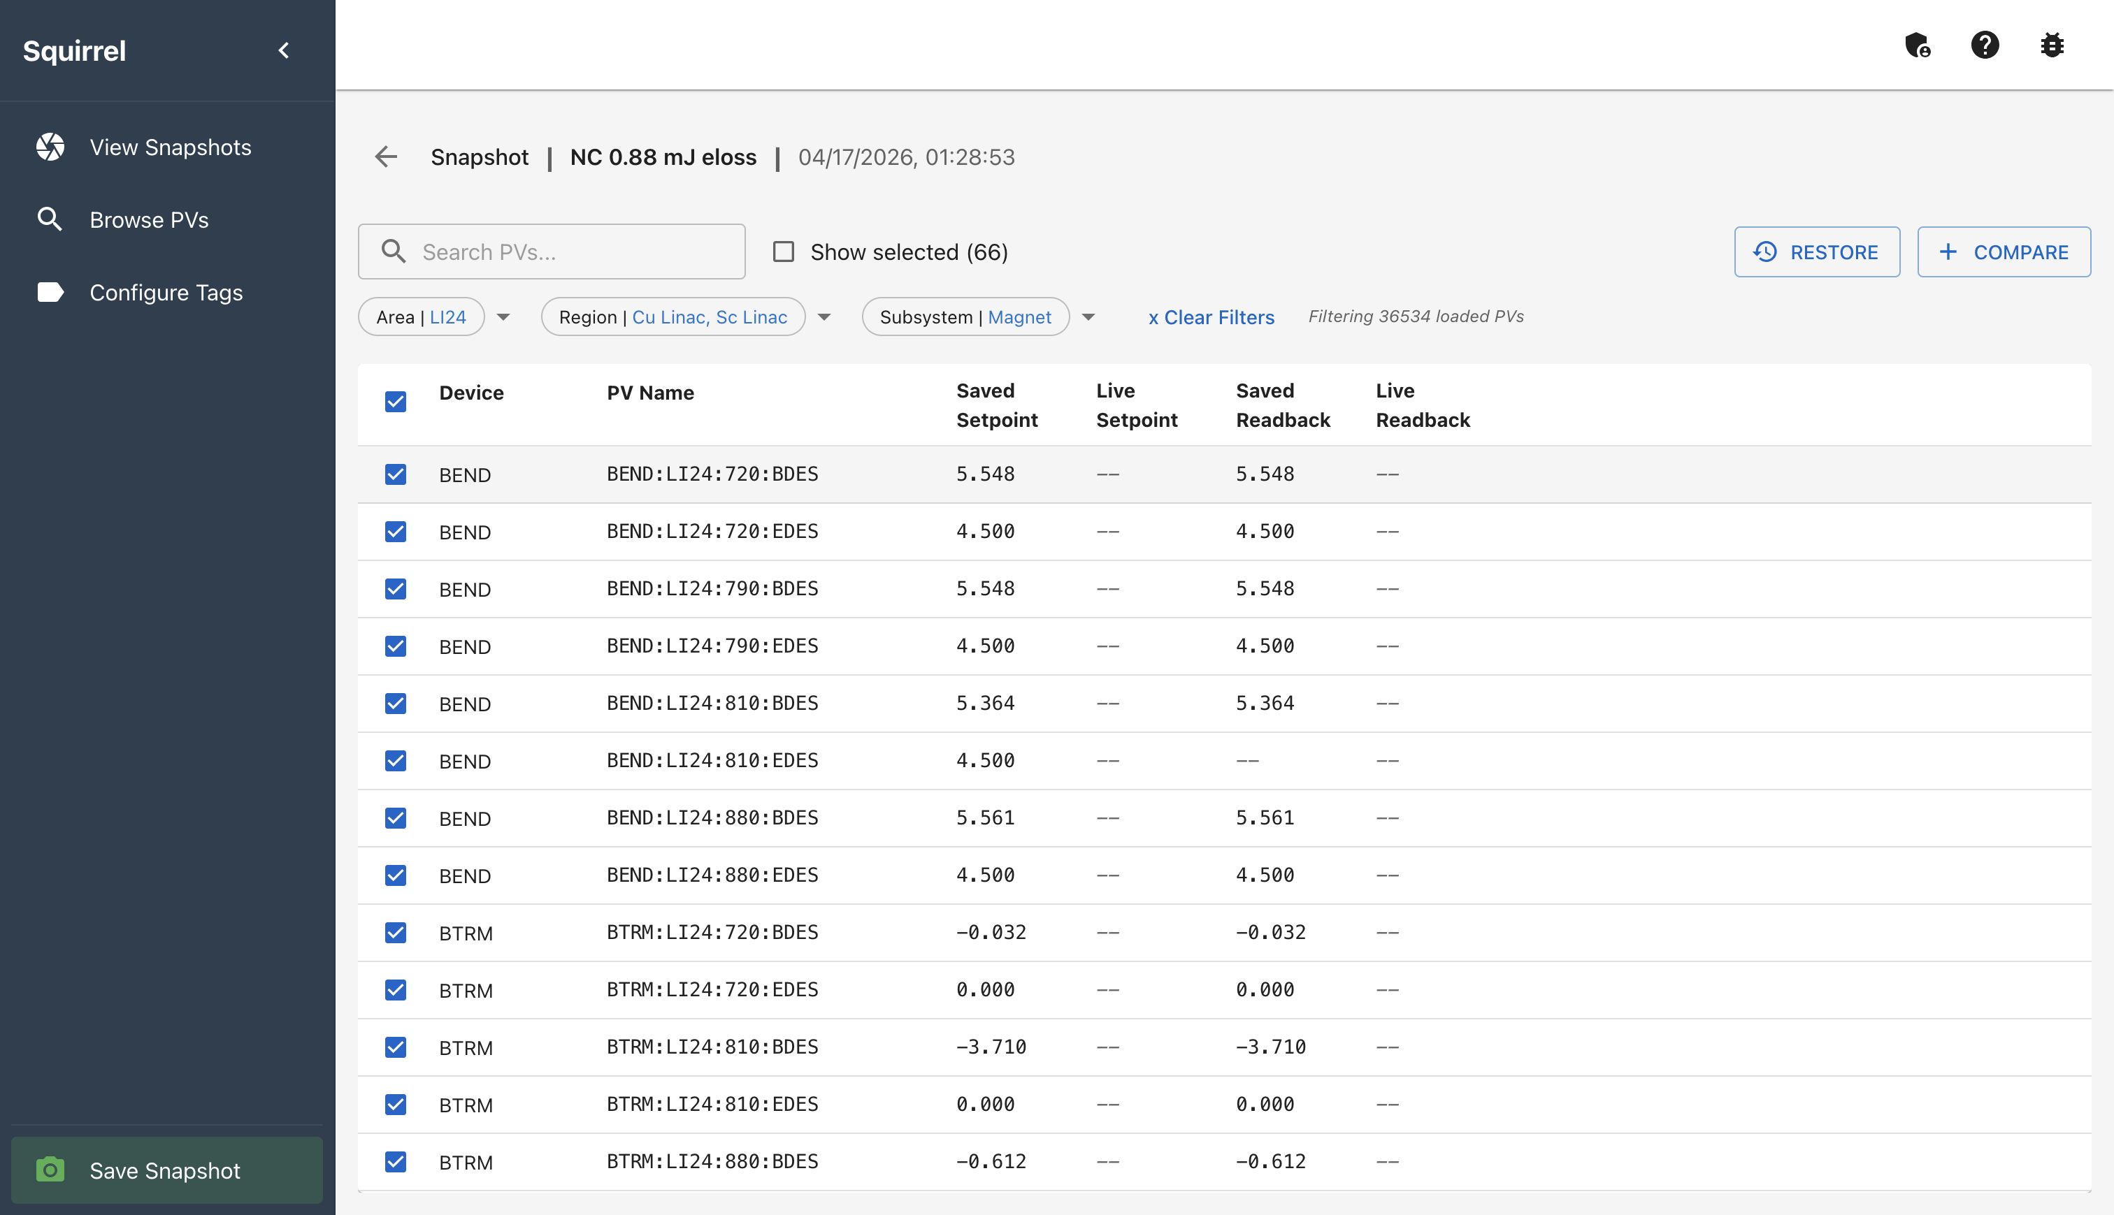
Image: Filtered List of PV Values in Snapshot

Slide 8
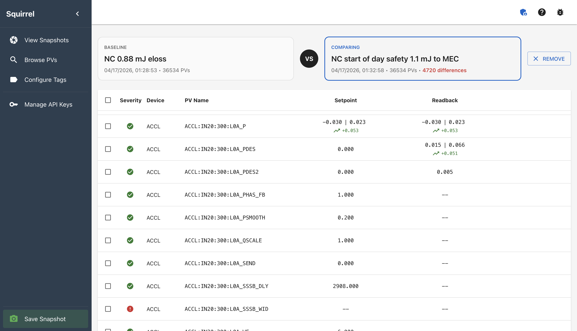
Image: Comparison of PV Values in Two Snapshots

Slide 9
Upcoming Goals
Features:
  Saved values for certain PVs shown in the table of snapshots
    e.g. total beam energy, peak current, energy loss
  Build snapshots on-demand using data from Archiver Appliance
  Container orchestration
Possible Features:
  Access control based on IP address
    Our operators don’t like logging in to things, so we may be able to whitelist OPIs
  Support for accessing multiple databases from one frontend
    May make it easier to manage multiple facilities within one deployment, like LCLS / LCLS-II
Deployments:
  Production deployment to NLCTA control room
    ~500 PVs in system
  Production deployment to LCLS / LCLS-II
    ~40,000 PVs in system
Notes:
Operators often include certain PV values in their titles; saving and displaying these automatically, and making them individually filterable, will be helpful.
Orchestration will help with resiliency when we have long-running deployments

Slide 10
Resources
Frontend: https://github.com/slaclab/react-squirrel
Backend: https://github.com/slaclab/react-squirrel-backend
My email: devagr@slac.stanford.edu
Notes:
We hope this tool will be useful outside of SLAC, so you’re interested in using it, or if you have any features or integrations to suggest, or any other feedback, please reach out (my email is listed here) or find me during the tea break or such.

