Slide 1
NICOS @ ESS An Experiment Control System on Top of EPICS
Vincent Hardion, on behalf of ECDC, ESS
Spring EPICS Collaboration Meeting 2026
April 20–24, 2026 · ENS Paris-Saclay, Gif-sur-Yvette, France
Notes:
ESS cold commissioning phase → transition to hot commissioning, then operations
Focus on instrument control experience, not detailed architecture
Joint perspective: ECDC + LOKI

Slide 2
Agenda
ESS Neutron Instruments
NICOS
NICOS Device with EPICS
Conclusion
April 2026

Slide 3
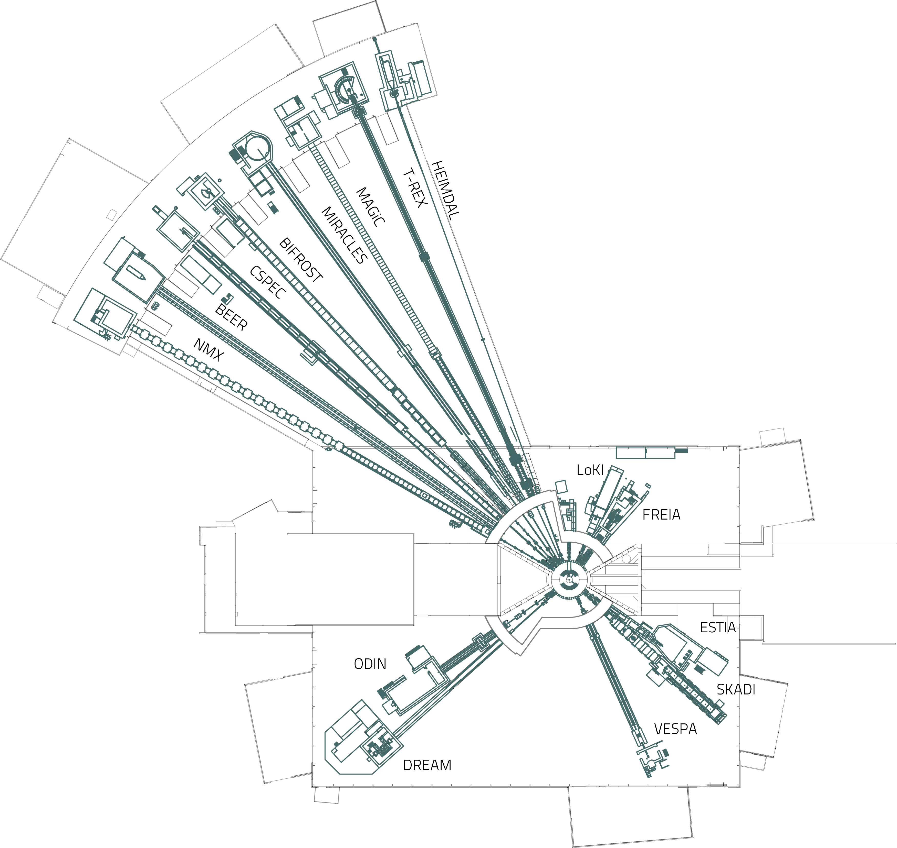
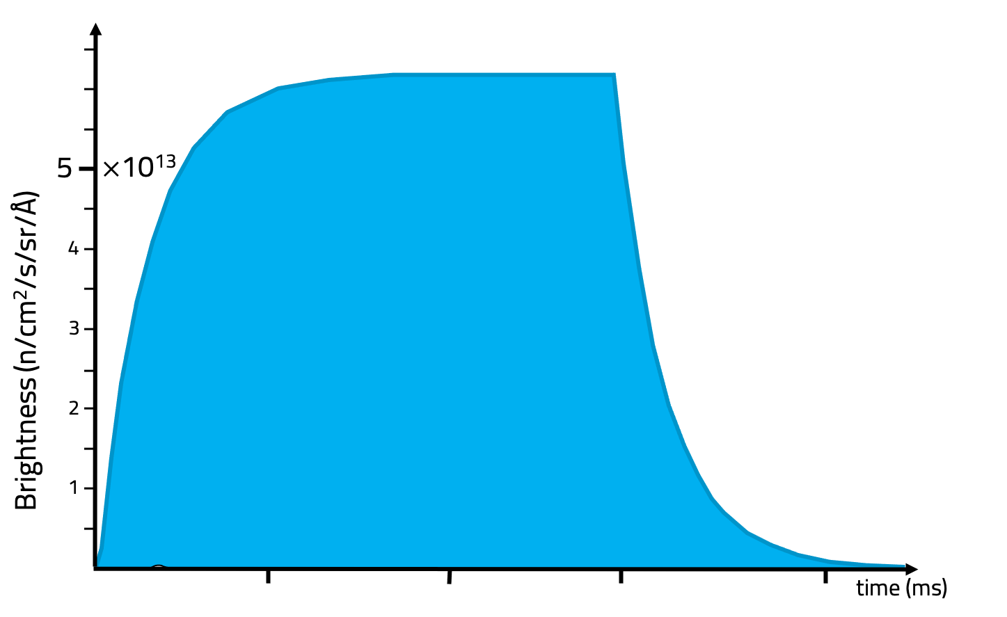
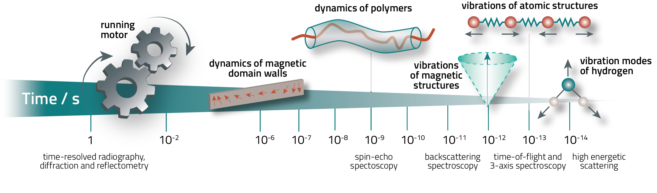
European Spallation Source
Neutron Instrumentation
16 Instruments with focus area:
Chemistry of Materials, Magnetic & Electronic Phenomena
Engineering Materials, Geosciences, Archeology & Heritage Conservation and Fast Neutron Applications
Life Science & Soft Condensed Matter
14 Hz Neutron Pulse => Time resolved
Long time structure => Time Of Flight
ESS Pulse shape
ESS Neutron Instruments map
Neutron Experiment with Time Resolved

Slide 4
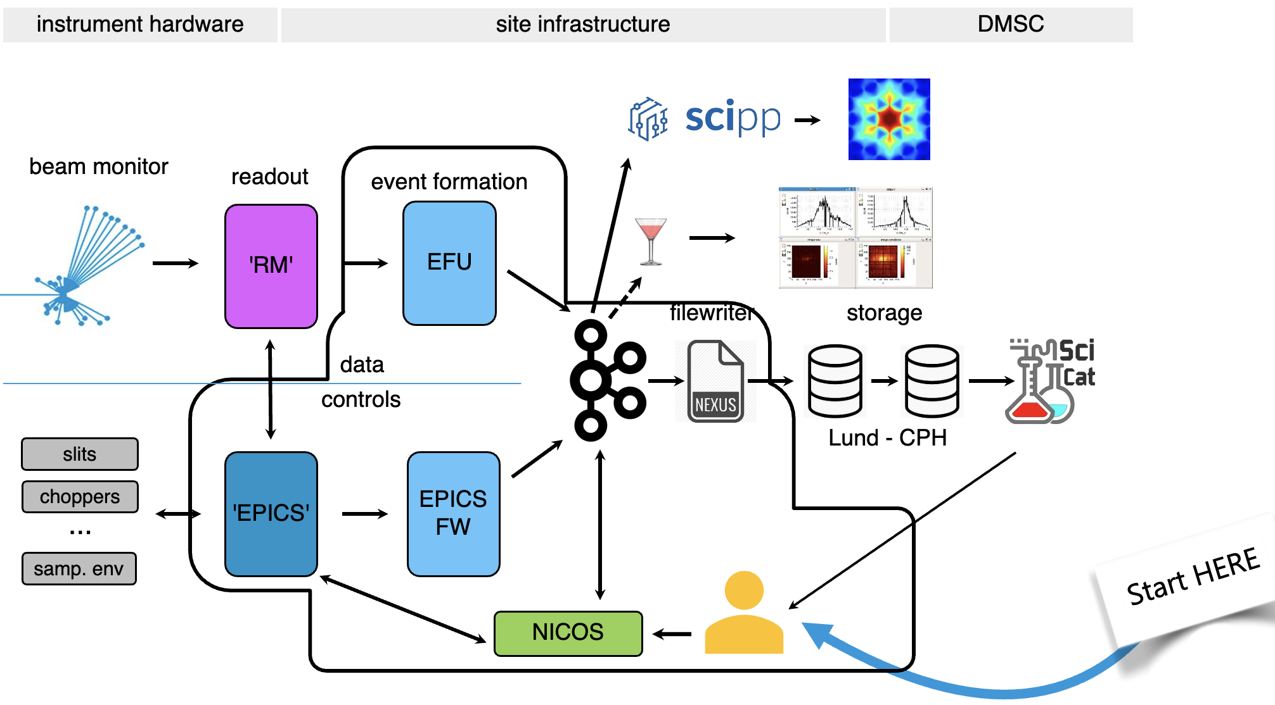


ECDC Scope
Experiment Control to orchestrate experiments and perform commissioning.​
Event Formation Unit (EFU), collecting data from the different instruments detectors and reducing data to the minimal user raw data​ ​
Data Collection: pipeline recording data and MetaData, ensuring compliance with NEXUS and SciCAT standards.​
ECDC Architecture

Slide 5
Experiment Control Requirement
The Gap Between IOCs and Scientists
Instrument Scientists needs
Technical Requirement
Scripted scan sequences
Live data views & plotting
Sample tracking & metadata
Proposal management
Multi-User
Remote Access
Sits on top of EPICS
Python based
Modular and possibility to opt-out of unnecessary feature
Plug-and-play sample environment
Server based

Slide 6
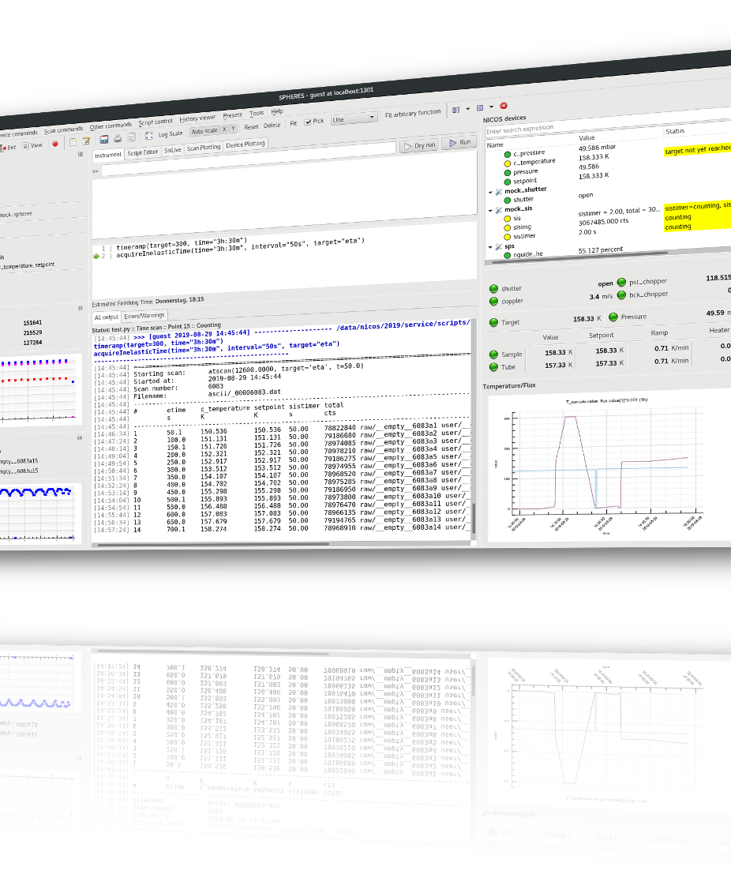
NICOS
An Integrated Experiment Control System

Slide 7

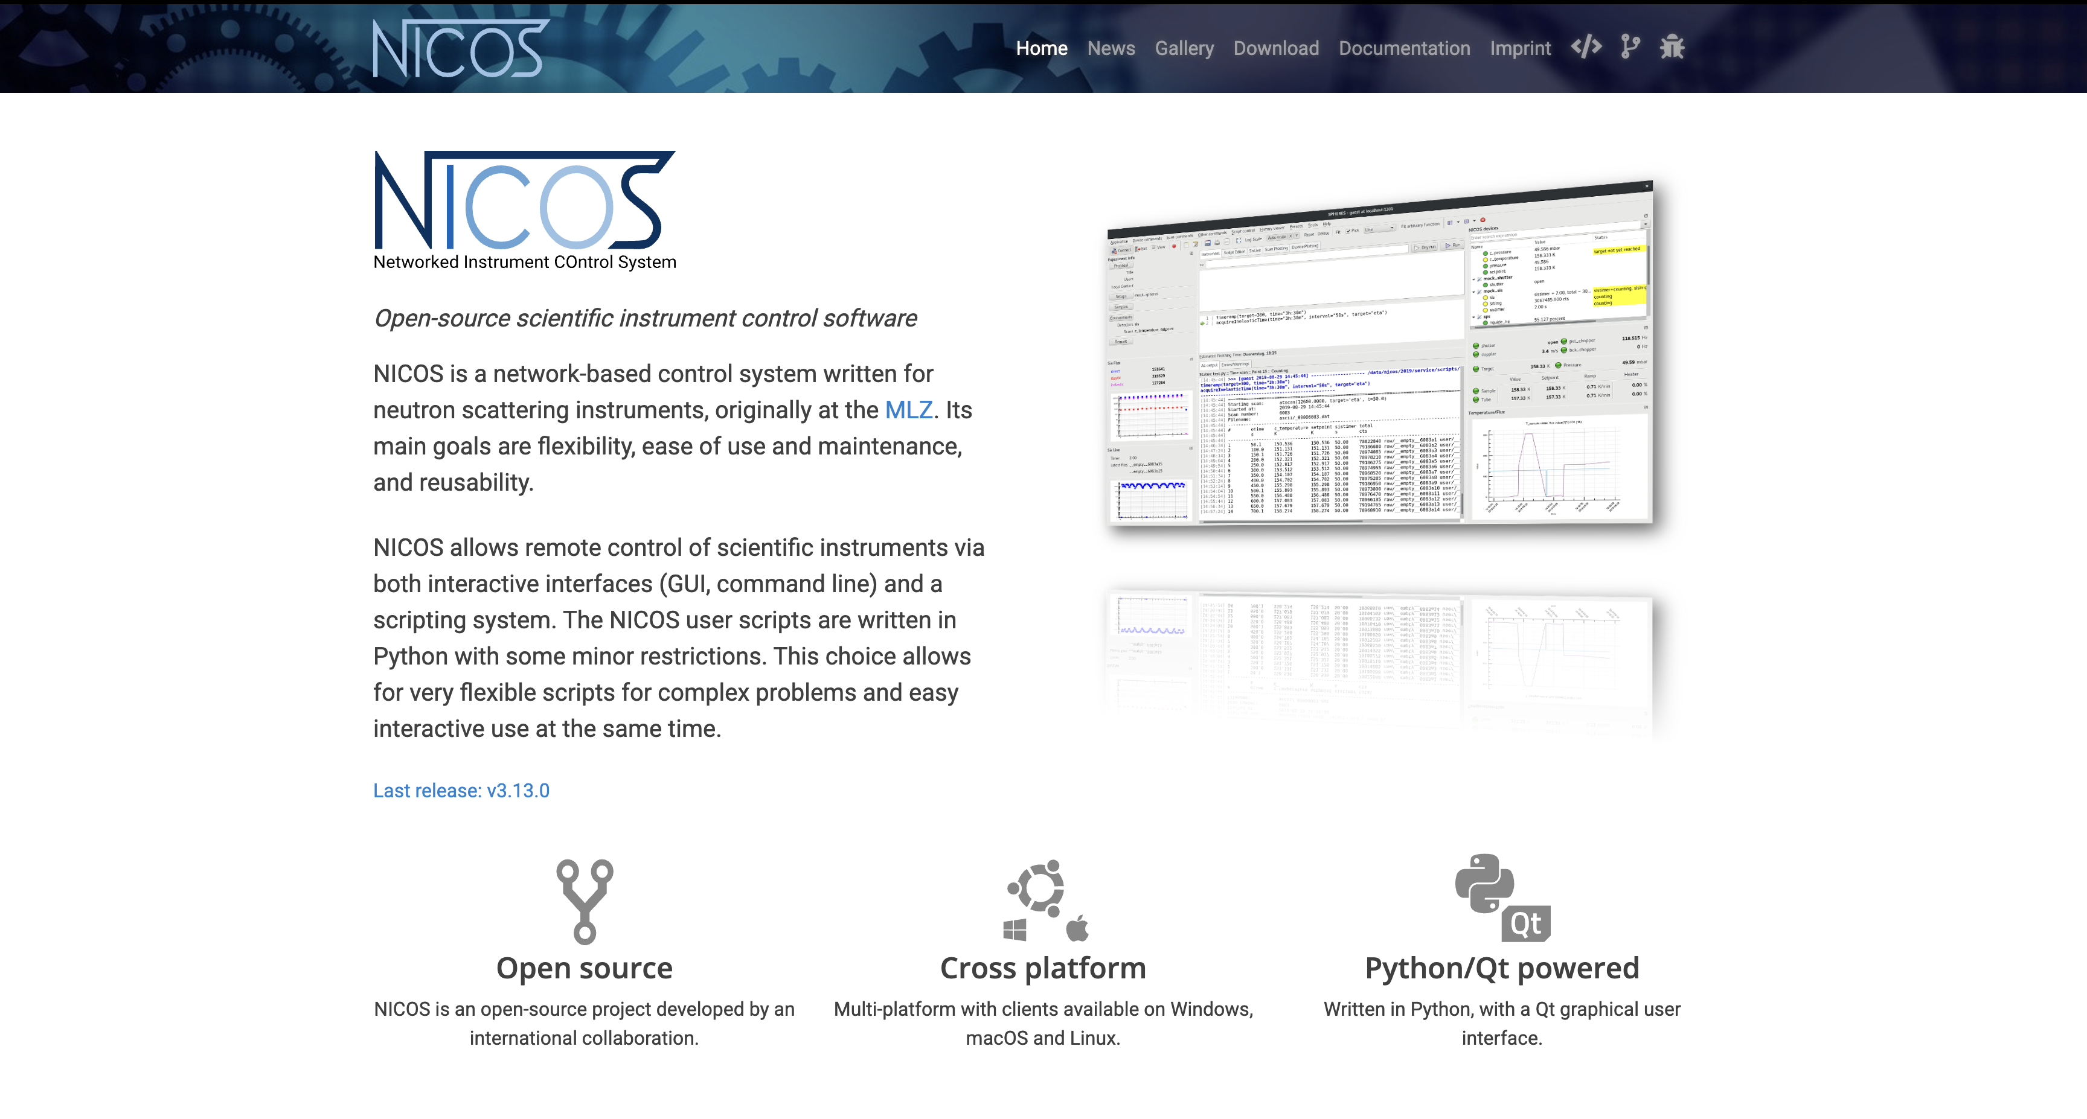
Visit https://nicos-controls.org/

Slide 8




What is NICOS?
Network Instrument COntrol System
Origin & Community:
Developed at FRM II / MLZ (Garching)
Active at: MLZ, ESS, PSI and more
Design goals:
User Friendly, Flexibility, and Reliability
Python scripting, Qt GUI, Daemon-based
Other facilities worldwide
LAHN (Laboratorio Argentino De Haces De Neutrones, Buenos Aires, Argentina)
Materials Growth & Measurement Laboratory at Charles University (Prague, Czech Republic)
ISIS (Didcot, UK)
Idaho National Lab (Idaho Falls, USA)
Neutron Radiography Facility (NRF) of Oregon State University (Corvallis, USA)
X-Ray Center of TU Wien (Vienna, Austria)

Slide 9
NICOS Stack
Simplified architecture
NICOS Desktop Qt Client
NICOS Server
Kafka
Electronic Logbook
Execution Daemon
Collector
Cache
Watchdog
Poller
EPICS
TANGO
SECoP
CARESS
5 / 15
Distributed: daemon + cache server + multiple GUI/script clients (TCP)

Slide 10
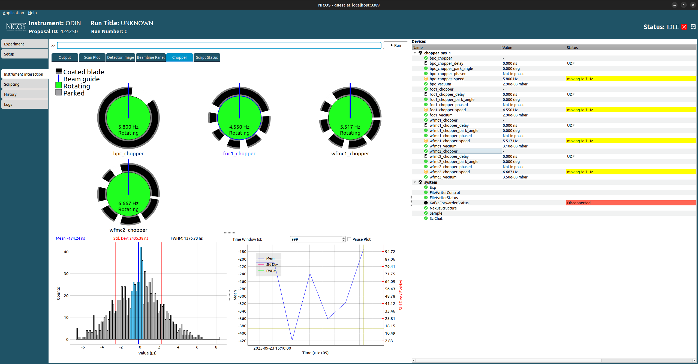
NICOS in Practice — Interface
Instrument information
Instrument status and emergency button
Applications: UI, CLI and Scripting, Sample management, Logbook, …
Settings: Proposal management, Instrument setup
Configurable multi-panel layout per instrument - Widget, Ploting, Imaging, …
Device tree, browse all connected devices and their live state
1
2
3
5
6
4
11 / 15

Slide 11
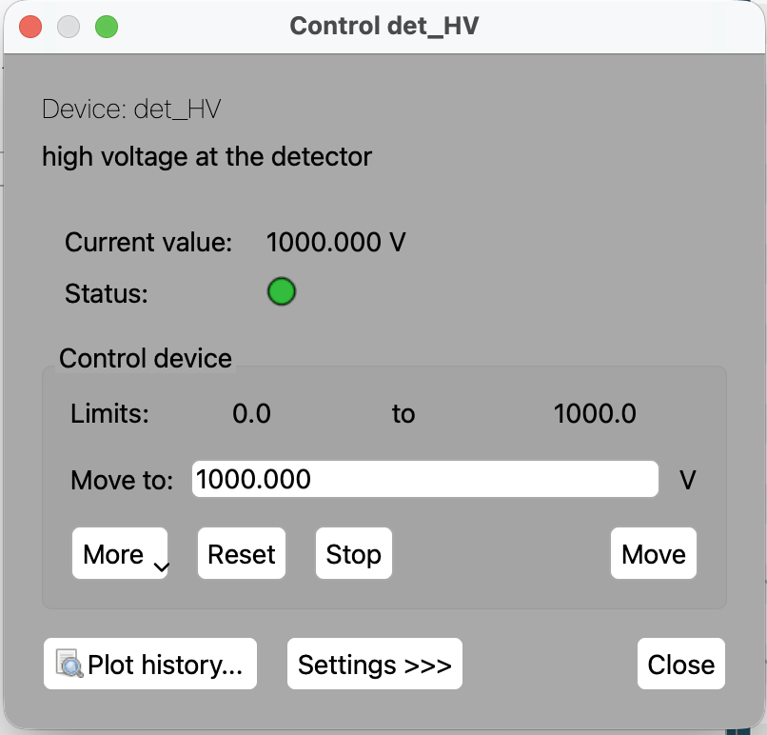
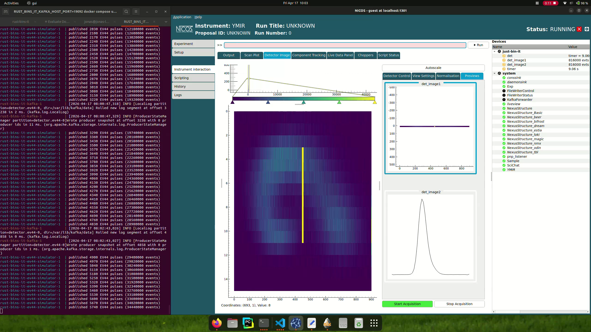
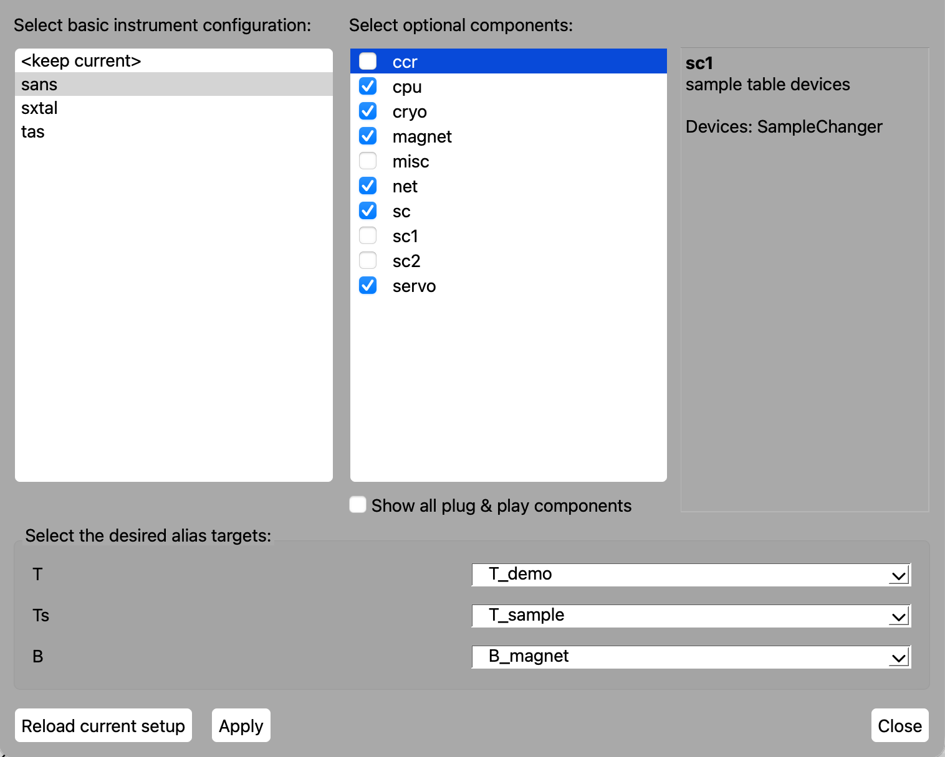
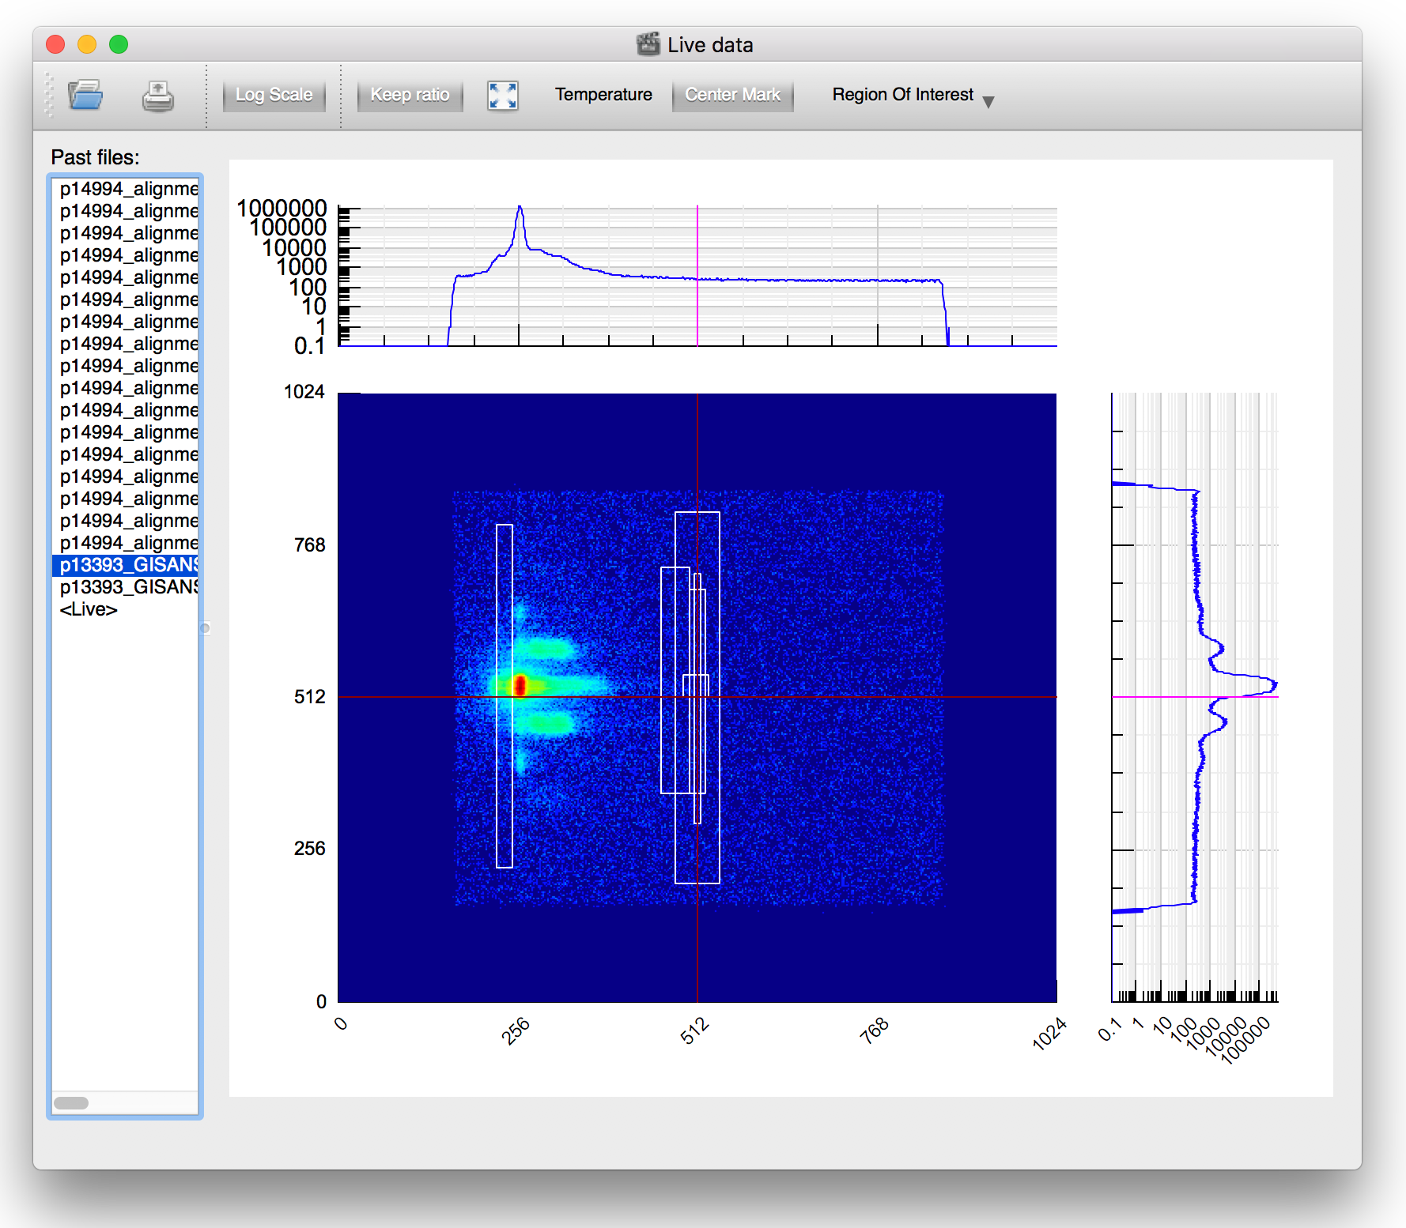
A Rich, Scientist-Facing GUI
Device Control
Live Plots
Set Up
Live readout, setpoints, alarm indicators for all connected devices
Real-time live view of the data acquisition
Possibility to load different set up depending on the hardware.

Slide 12
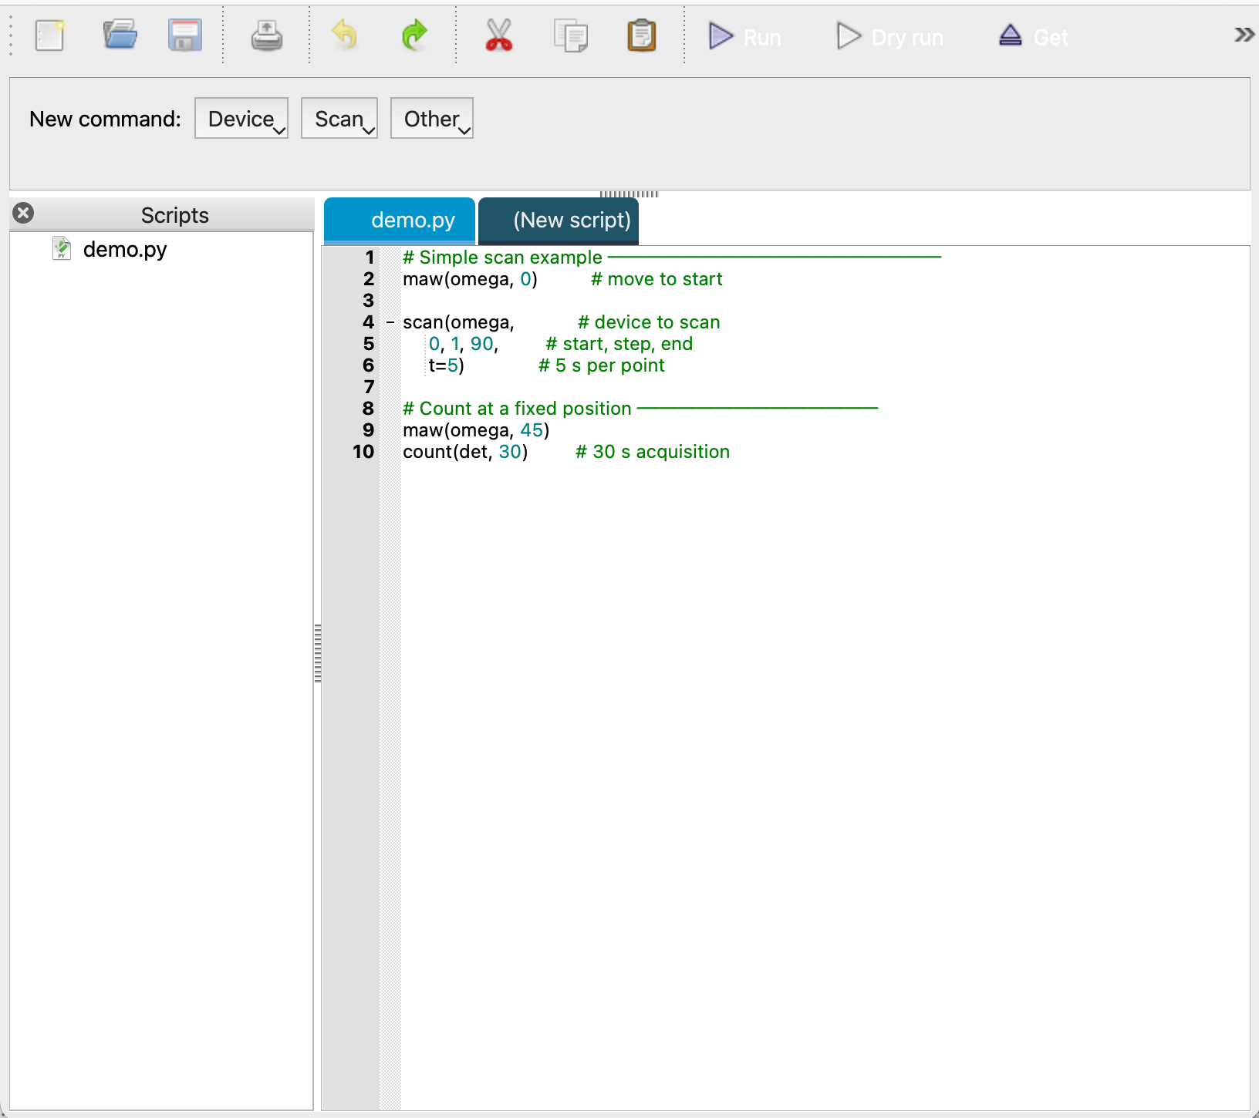
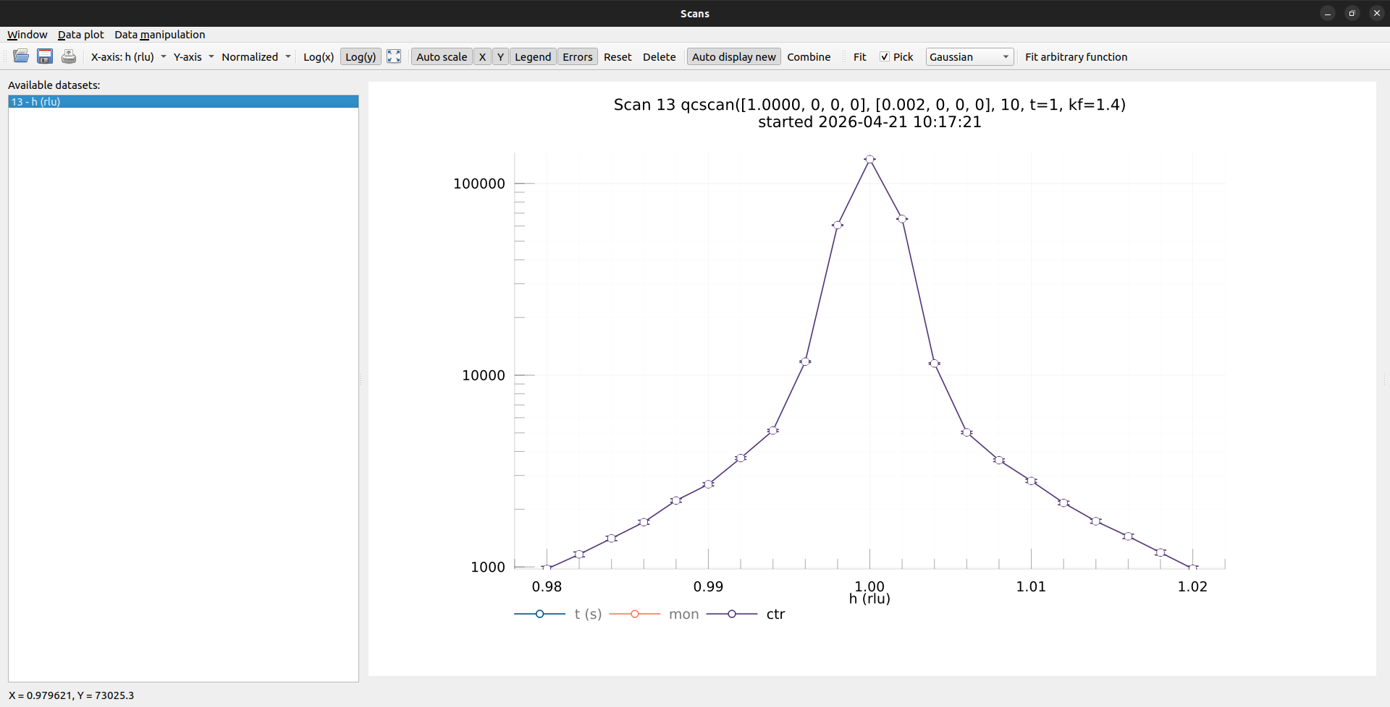
A Rich, Scientist-Facing GUI
Script Editor
Scan Control
HDF5/NeXus
Syntax highlighting, auto-complete, run/stop controls
Queue scripts; monitor execution progress
UI for scan control, management, and scan plotting
Every scan is recorded automatically in a
NeXus/HDF5 file
Template by configuration
Metadata captured at scan start
HDF5 File Template
'WONI:NXInstrument': {
'monochromator:NXcrystal': {
'wavelength': DeviceDataset('wavelength',
units=NXAttribute('angstrom', 'string')),
'rotation_angle': DeviceDataset('mtt'),
'd_spacing': DeviceAttribute('mono', 'dvalue'),
'type': ConstDataset('Si', 'string'),
}
}

Slide 13
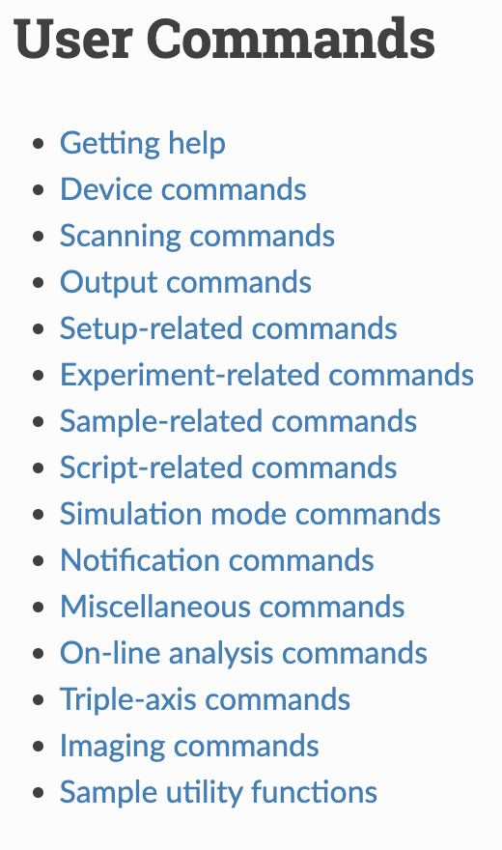
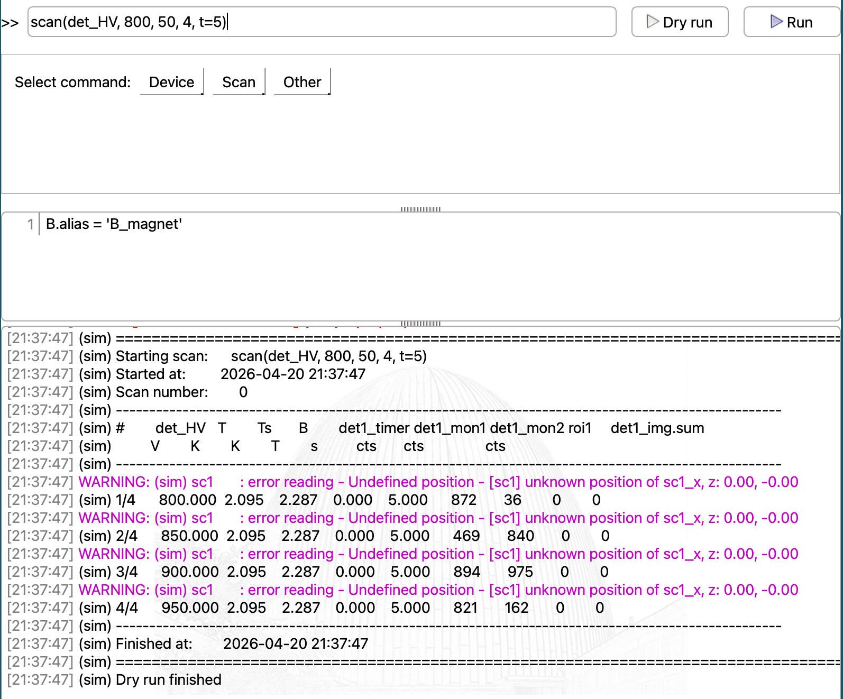
A Rich, Scientist-Facing GUI
CLI
Commands
ipython
Interactive Python prompt connected to instrument control system.
Tab completion on device names and commands
More than 100+ predefined commands
Accessing control and data from an ipython session: device value, parameters, live stream from detector, scan data
%load_ext nicos.clients.ipython.nicos %nicos /connect <host> <port> <user> <password>
var = %nicos /val <device>
var = %nicos /val <detname>_live
x, y, n = %nicos /val scandata

Slide 14
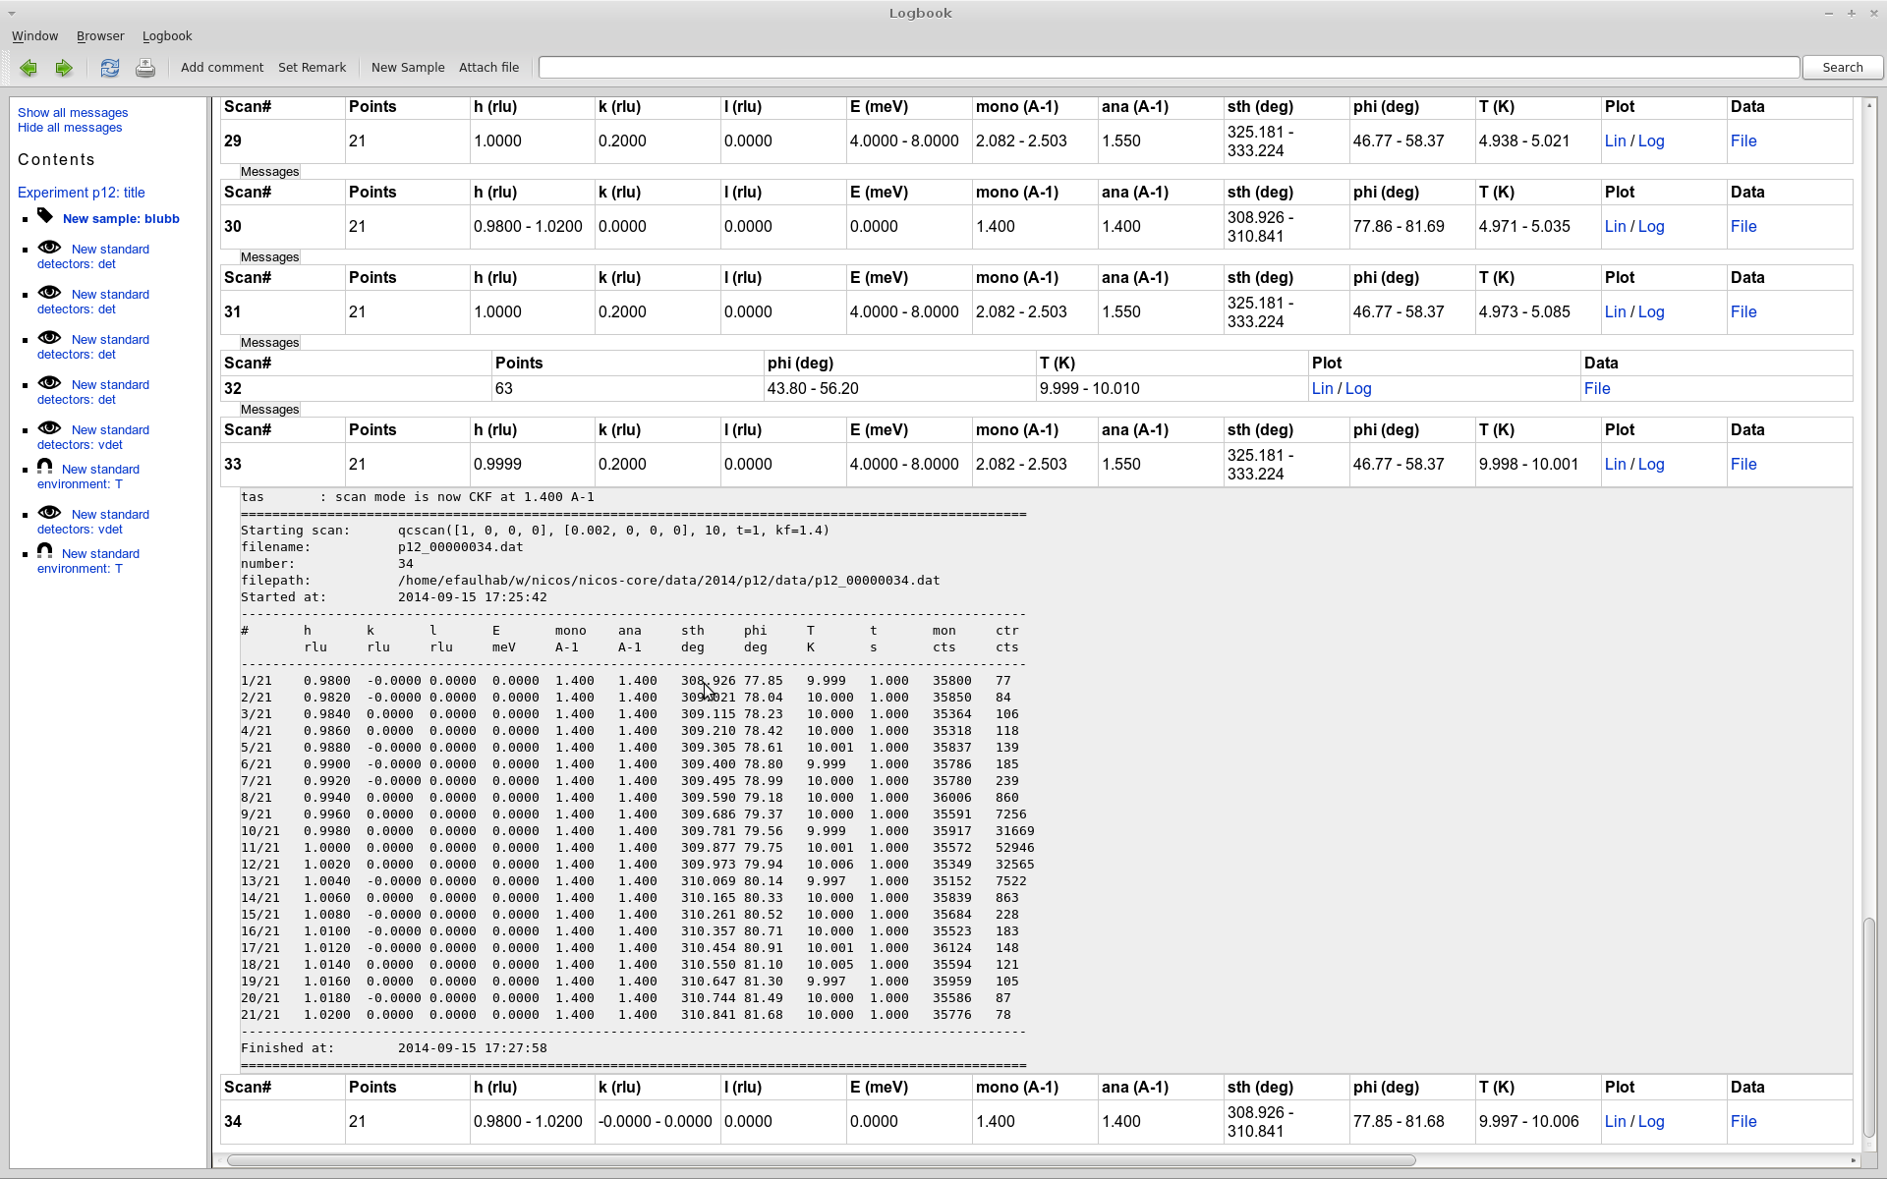
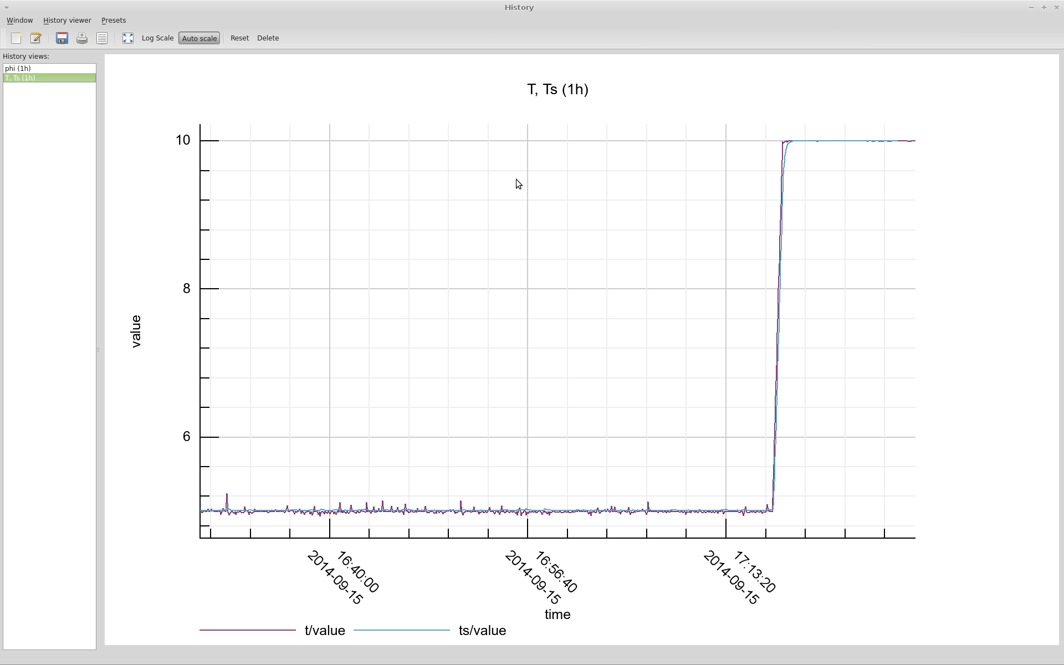
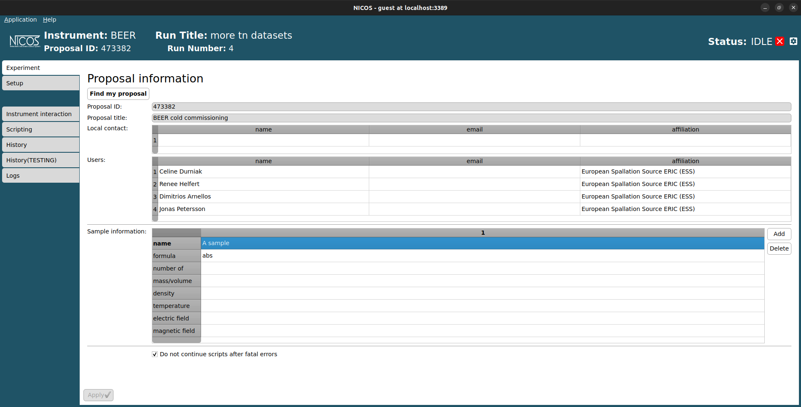
A Rich, Scientist-Facing GUI
Electronic logbook
Historic
Proposals and Sample management
User Experiment log, synchronised automatically with counting and measurement
Visualisation of history value of Device from the cache for the current session.
User session connected to the User proposal. Possibility to add meta data related to the samples used in experiment.

Slide 15

NICOS Device with EPICS

Slide 16
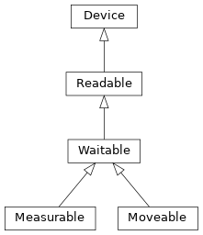
Writing a new device class
4 types of NICOS Devices
Device: the root of all NICOS devices
Use for: auxiliary objects, configuration holders, communication handlers (e.g. a serial bus, an EPICS connection pool)
Readable: a device you can read a value from
Use for: sensors, encoders, monitors, anything with a scalar readout but no setpoint
Measurable: a detector or counting device
Use for: detector arrays, single counters, time-of-flight detectors, anything driven by a count/time preset
Moveable: a device with a target you can drive to
Use for: motors, temperature controllers, slits, attenuators, anything with a setpoint

Slide 17
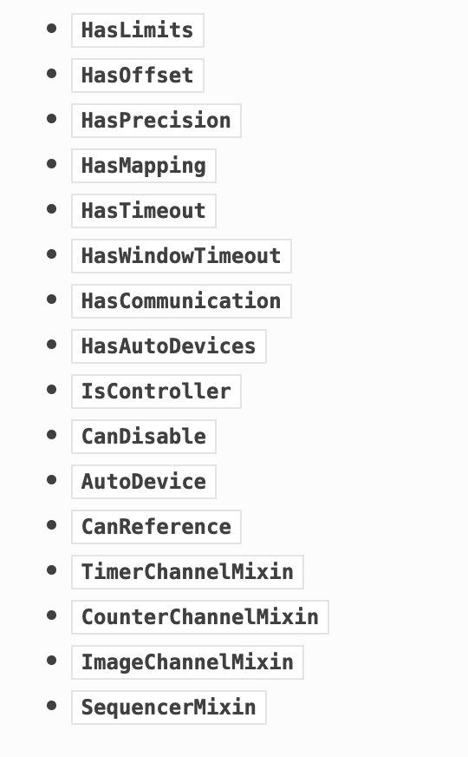
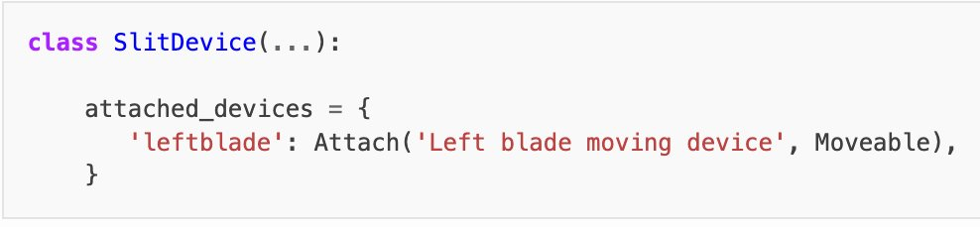
Writing a new device class
Mixins
Combined with base classes to add specific capabilities without rewriting logic.
For example:
HasLimits: enforces software userlimits and abslimits before any move
HasOffset: transparent user/hardware position shift via an offset parameter
HasMapping: maps named positions ("open", "closed") to raw hardware values
HasAutoDevices: auto-attaches child sub-devices (e.g. encoder alongside a motor)
IsController: manages ordered start/stop of a group of sub-devices
CanDisable: adds enable() / disable() without removing the device from the setup
Composite NICOS device example

Slide 18
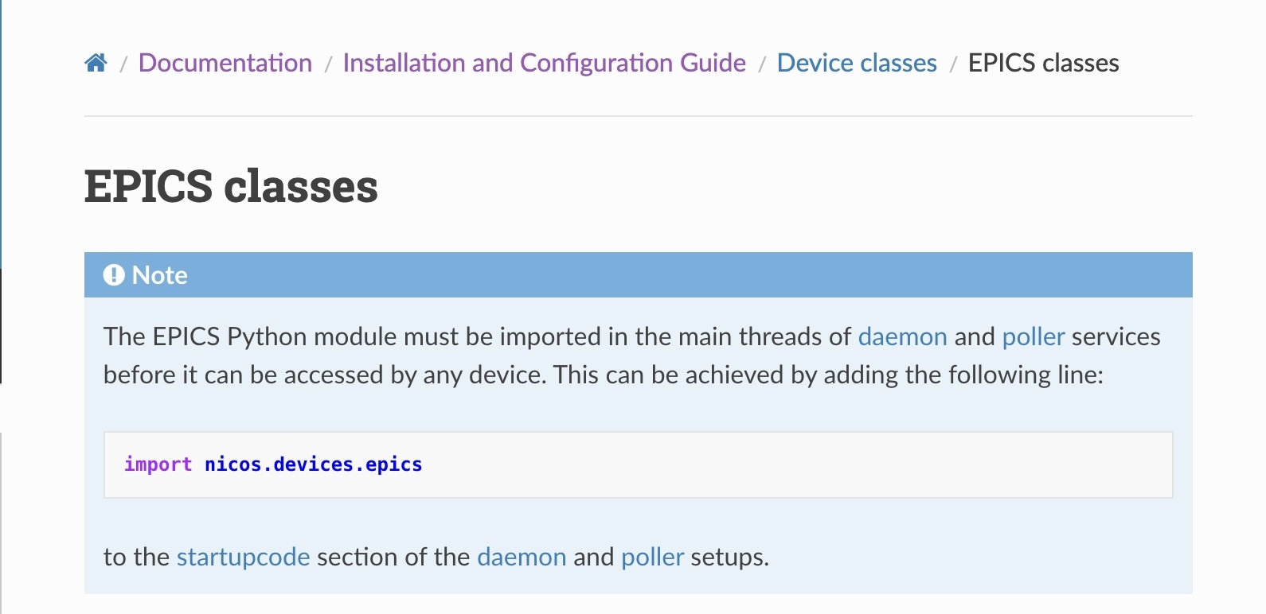
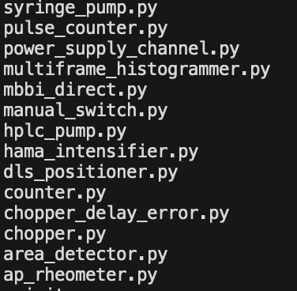
EPICS NICOS Devices
Currently supported
Predefined Device classes for EPICS:
EpicsMotor,
EpicsReadable,
EpicsStringReadable,
EpicsAnalogMoveable,
EpicsDigitalMoveable,
EpicsStringMoveable,
EpicsMappedReadable,
EpicsMappedMoveable,
EpicsManualMappedAnalogMoveable
Supports PVAccess (PVA) and Channel Access (CA)
Connection monitoring and automatic reconnect
NICOS mainly used to create high level composite devices.
NICOS EPICS Class documentation
ESS specific NICOS EpicsDevice

Slide 19
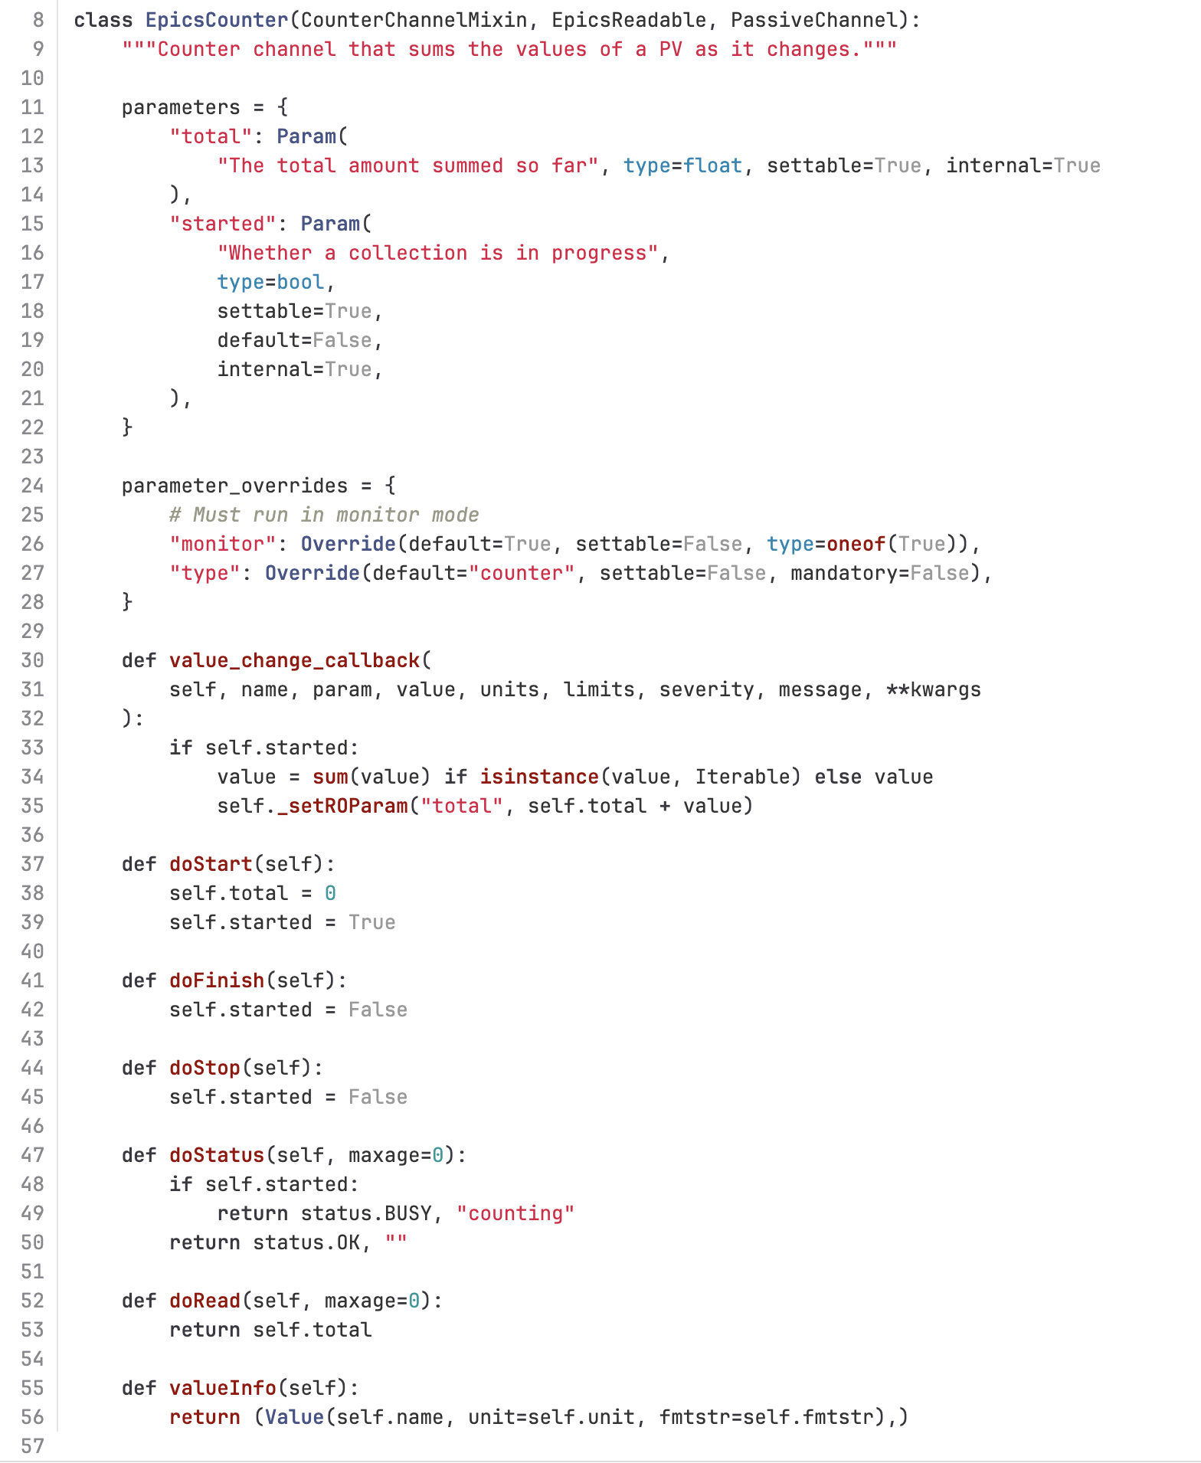
Writing a new device class
Code for a generic counter from any readeable PV
Key Points
Inherit from a base class and mixin
pick the right parent: Device, Readable, Moveable, HasLimits, Actuator, etc.
Declare parameters
use the parameters dict to define configuration values with type, default, and description:
Implement doRead()
returns the current value from hardware; called by read()
Implement doStart()
sends a trigger to hardwareto start acquisition
Optionally implement doStatus()
returns (status_code, message) so NICOS knows if the device is moving, idle, or in error
Register in a setup file — devices are instantiated in a Python setup dict, not in code:
Configuration of this generic counter
devices = dict(
protoncurr=device(
"nicos.devices.epics.EpicsCounterPassiveChannel",
description="Monitor for proton current",
type="monitor",
readpv="IOC:PROTON",
),
)

Slide 20
Conclusion

Slide 21
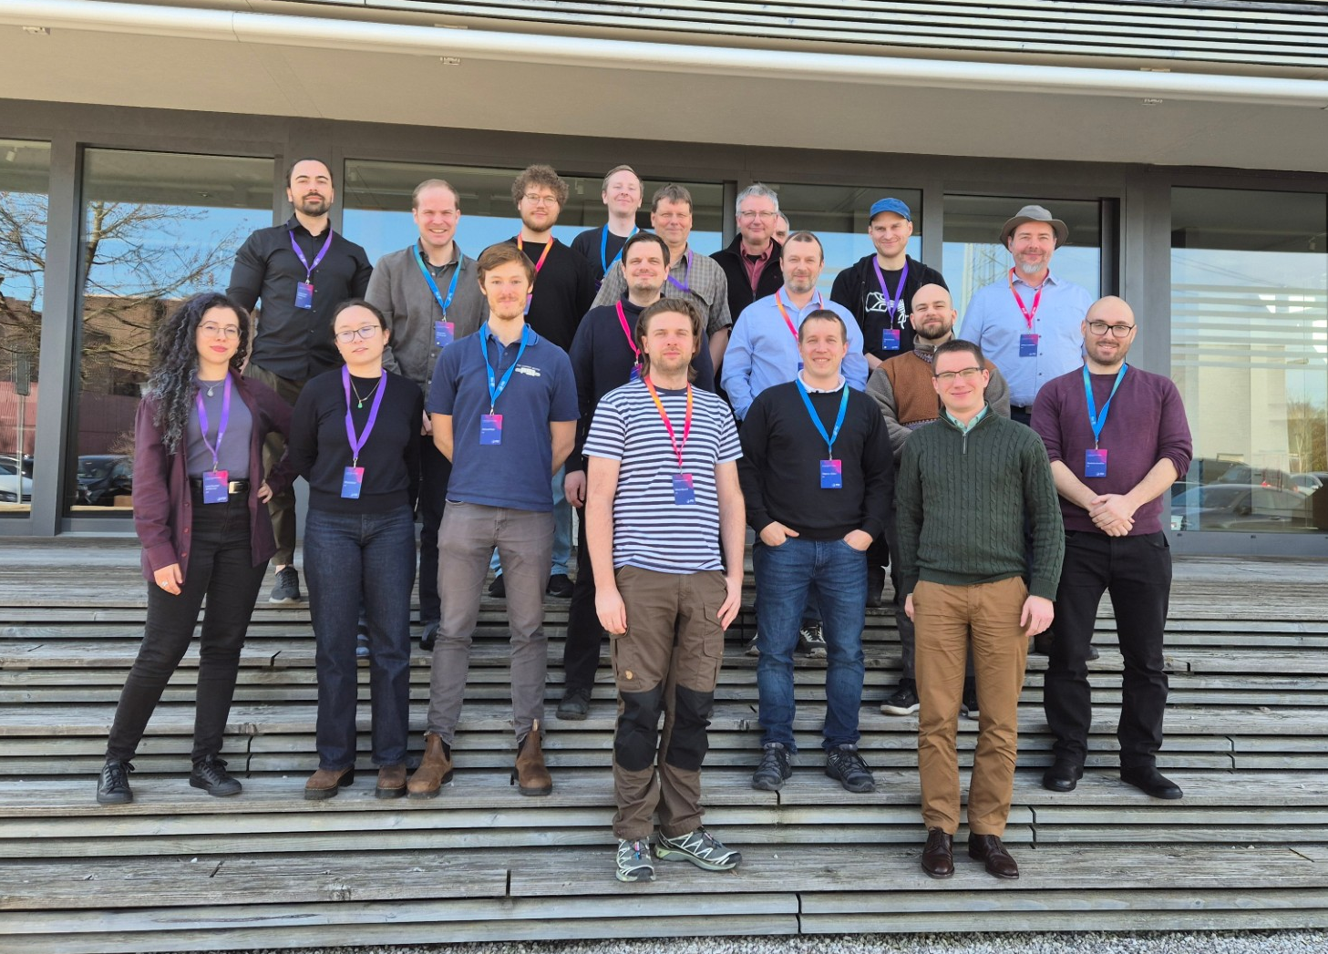
Conclusion & Invitation to Collaborate
ESS Neutron Instruments use NICOS as the main User Interface.
NICOS Proven at neutron facilities
Many feature toward Instrument Scientific usage
Easy to adapt
NICOS + EPICS: complementary
Try at nicos-controls.org
2nd NICOS collaboration meeting, PSI, March 2026

Slide 22
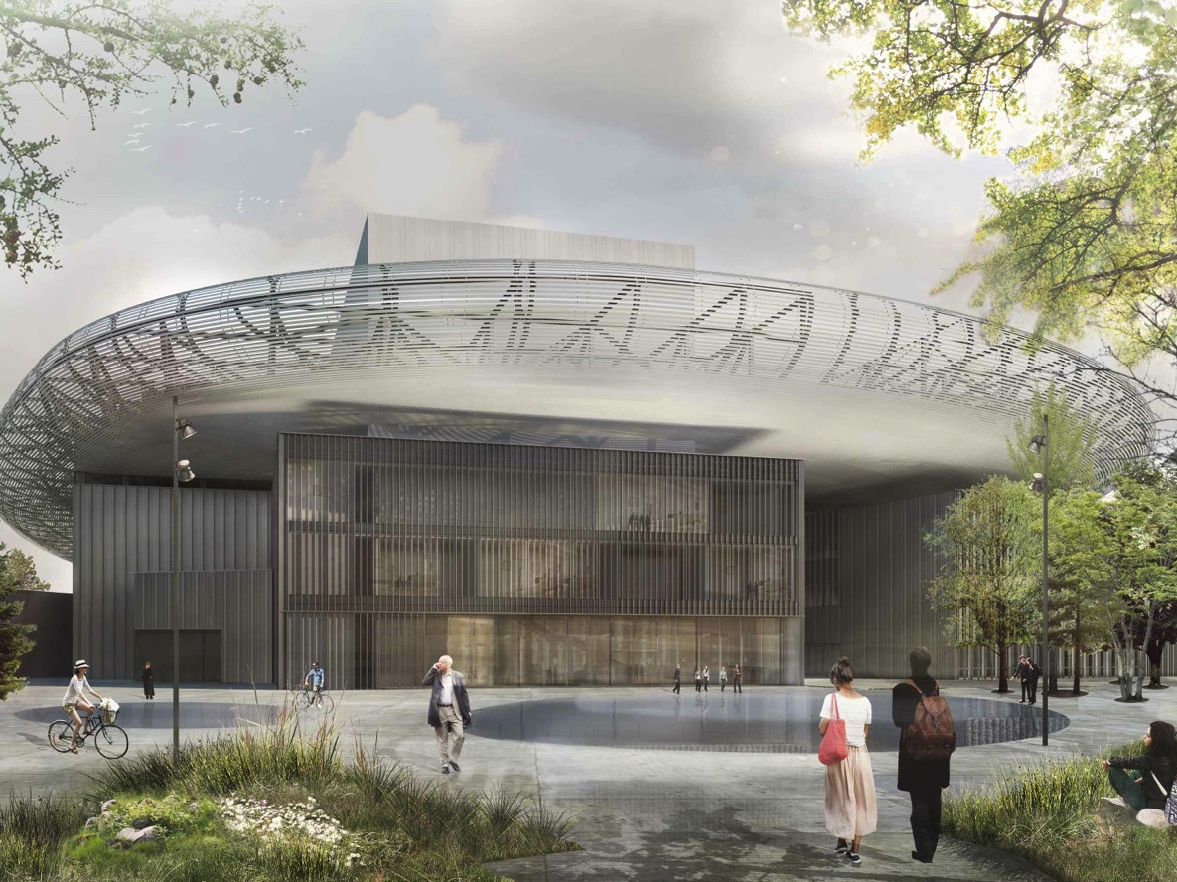
Question?
2026-04-21

