Slide 1
Bridging the Gap: Using EPICS in Self-Driving Materials Science Labs
Christian Kunkel
Theory Department

Slide 2
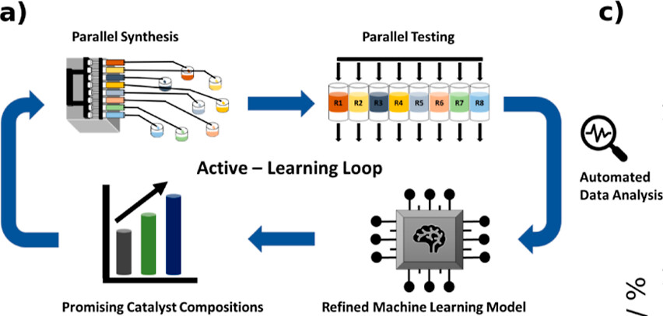
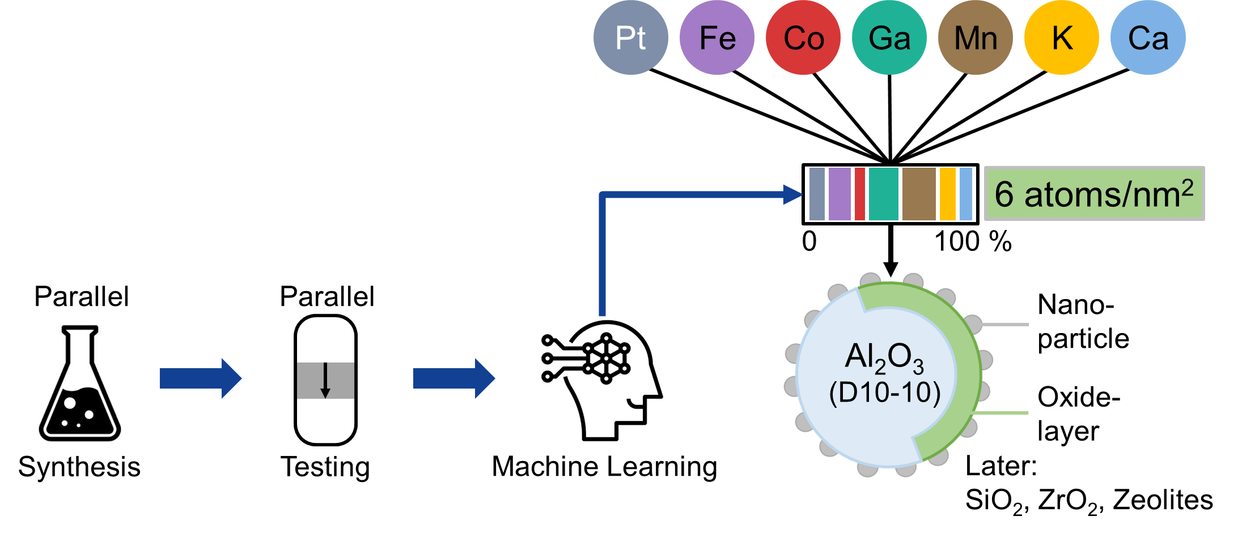
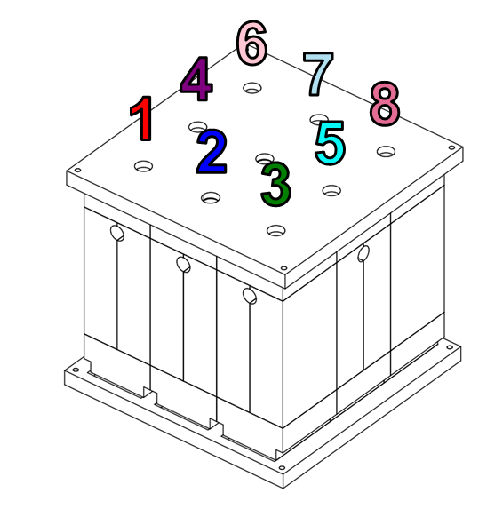
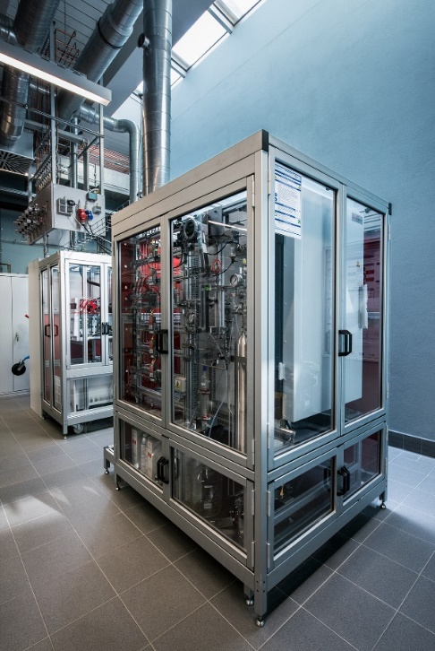
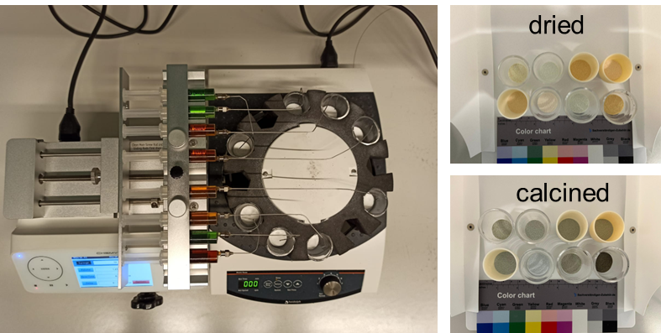
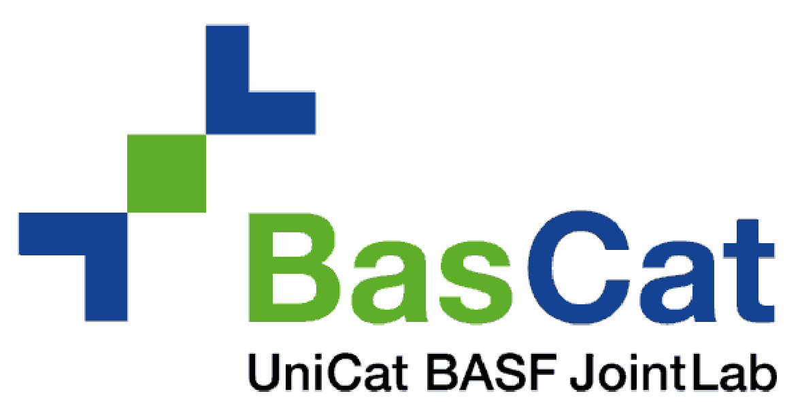

Closed loop materials discovery
8-fold reactor unit “Ikarus”
Incipient wetness impregnation
with automated syringe pump setup

Slide 3
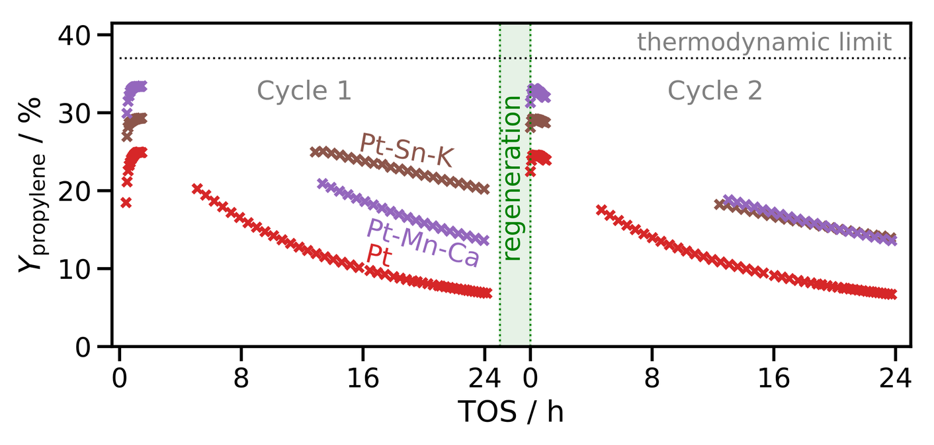
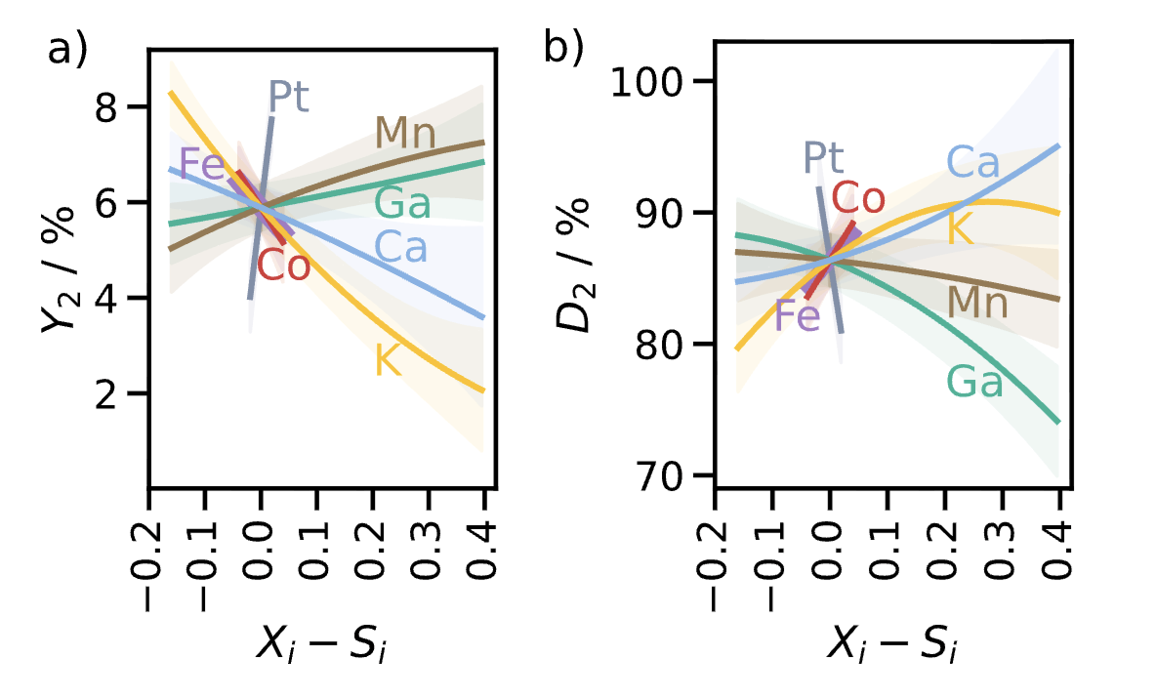
Closed loop materials discovery
After multiple iterations (in weeks): Competitive catalyst found
Experimental Design + Machine Learning drives rapid discovery.
Reality of materials science labs
One instrument = one computer
Vendor specific software
Ad-hoc scripts & manual settings
Local files & personal folders
Systematic elucidation of Promoter Effects
xc
Reference
xc
xc
Discovered

Slide 4
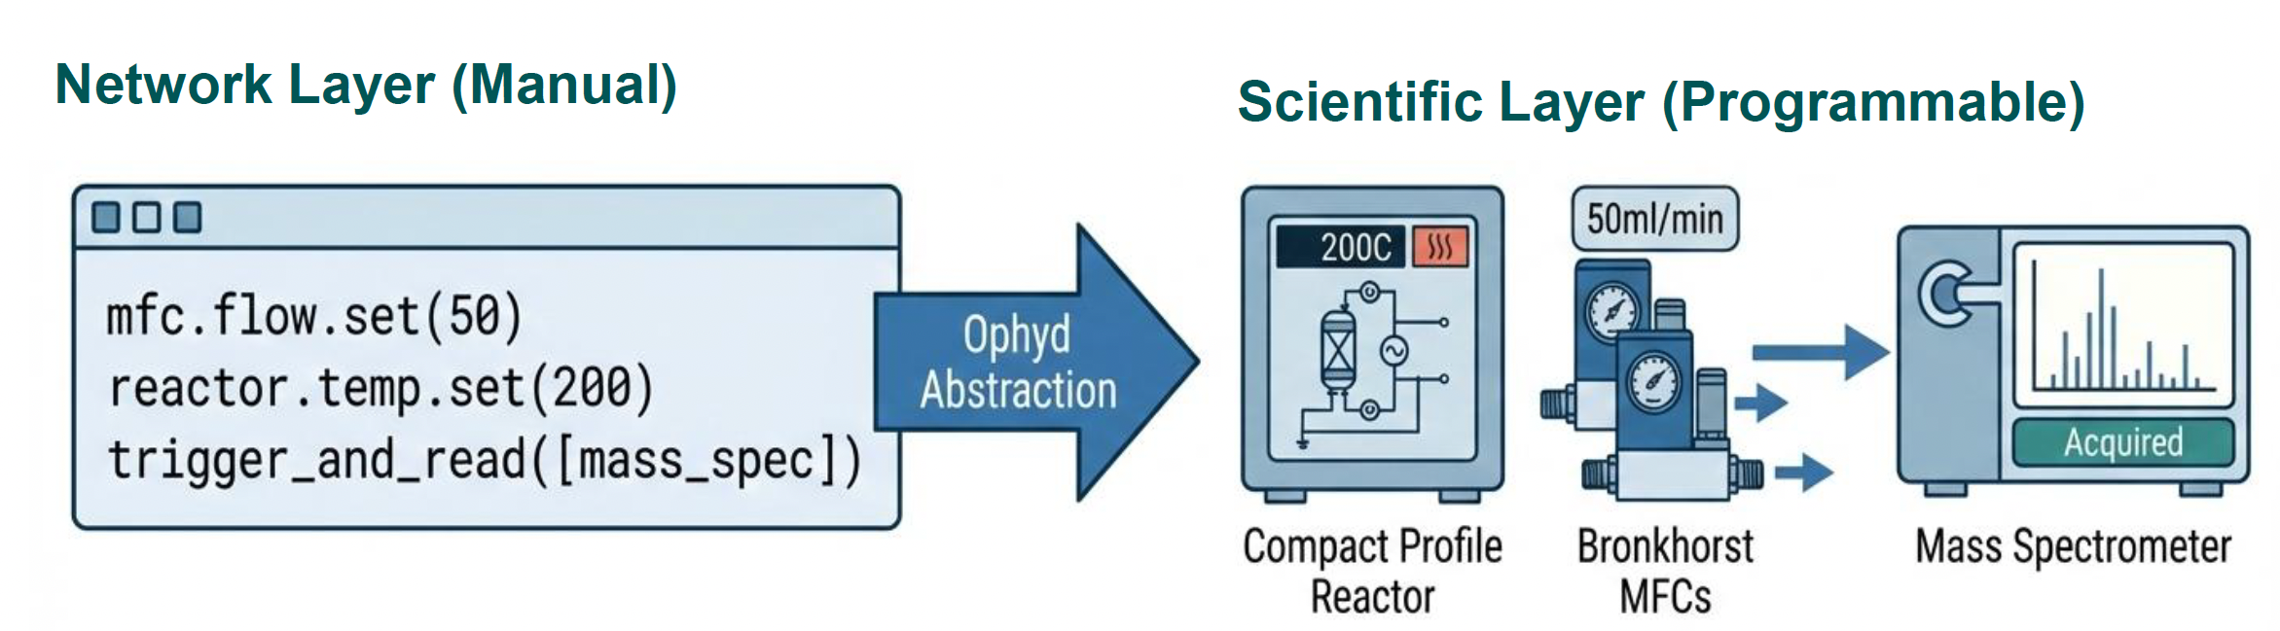
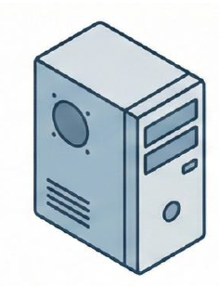
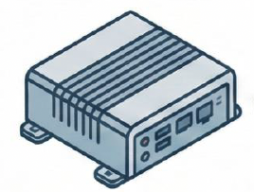
Digital Control & Automation of Catalysis Experiments
BasCat Laboratory case study by Jinyi Zhou, Heinz Junkes, Christoph Scheurer et al.
xc
xc
xc
OPC-DA Server for communication
Software components:
Bluesky: Orchestration engine
Ophyd: Hardware abstraction
Archiver: Continous logging
Datastore: Organized file storage
Catalog: Database for struct. metadata
serial connections
EPICS IOCs on Linux Gateway
EPICS IOCs Windows
Network Layer
Automated data generation for kinetic modeling (our algorithms)

Slide 5
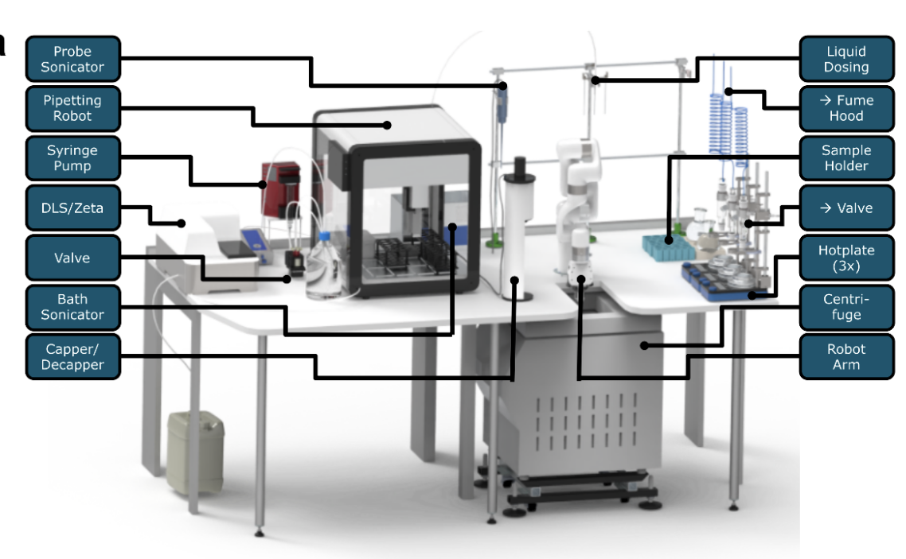
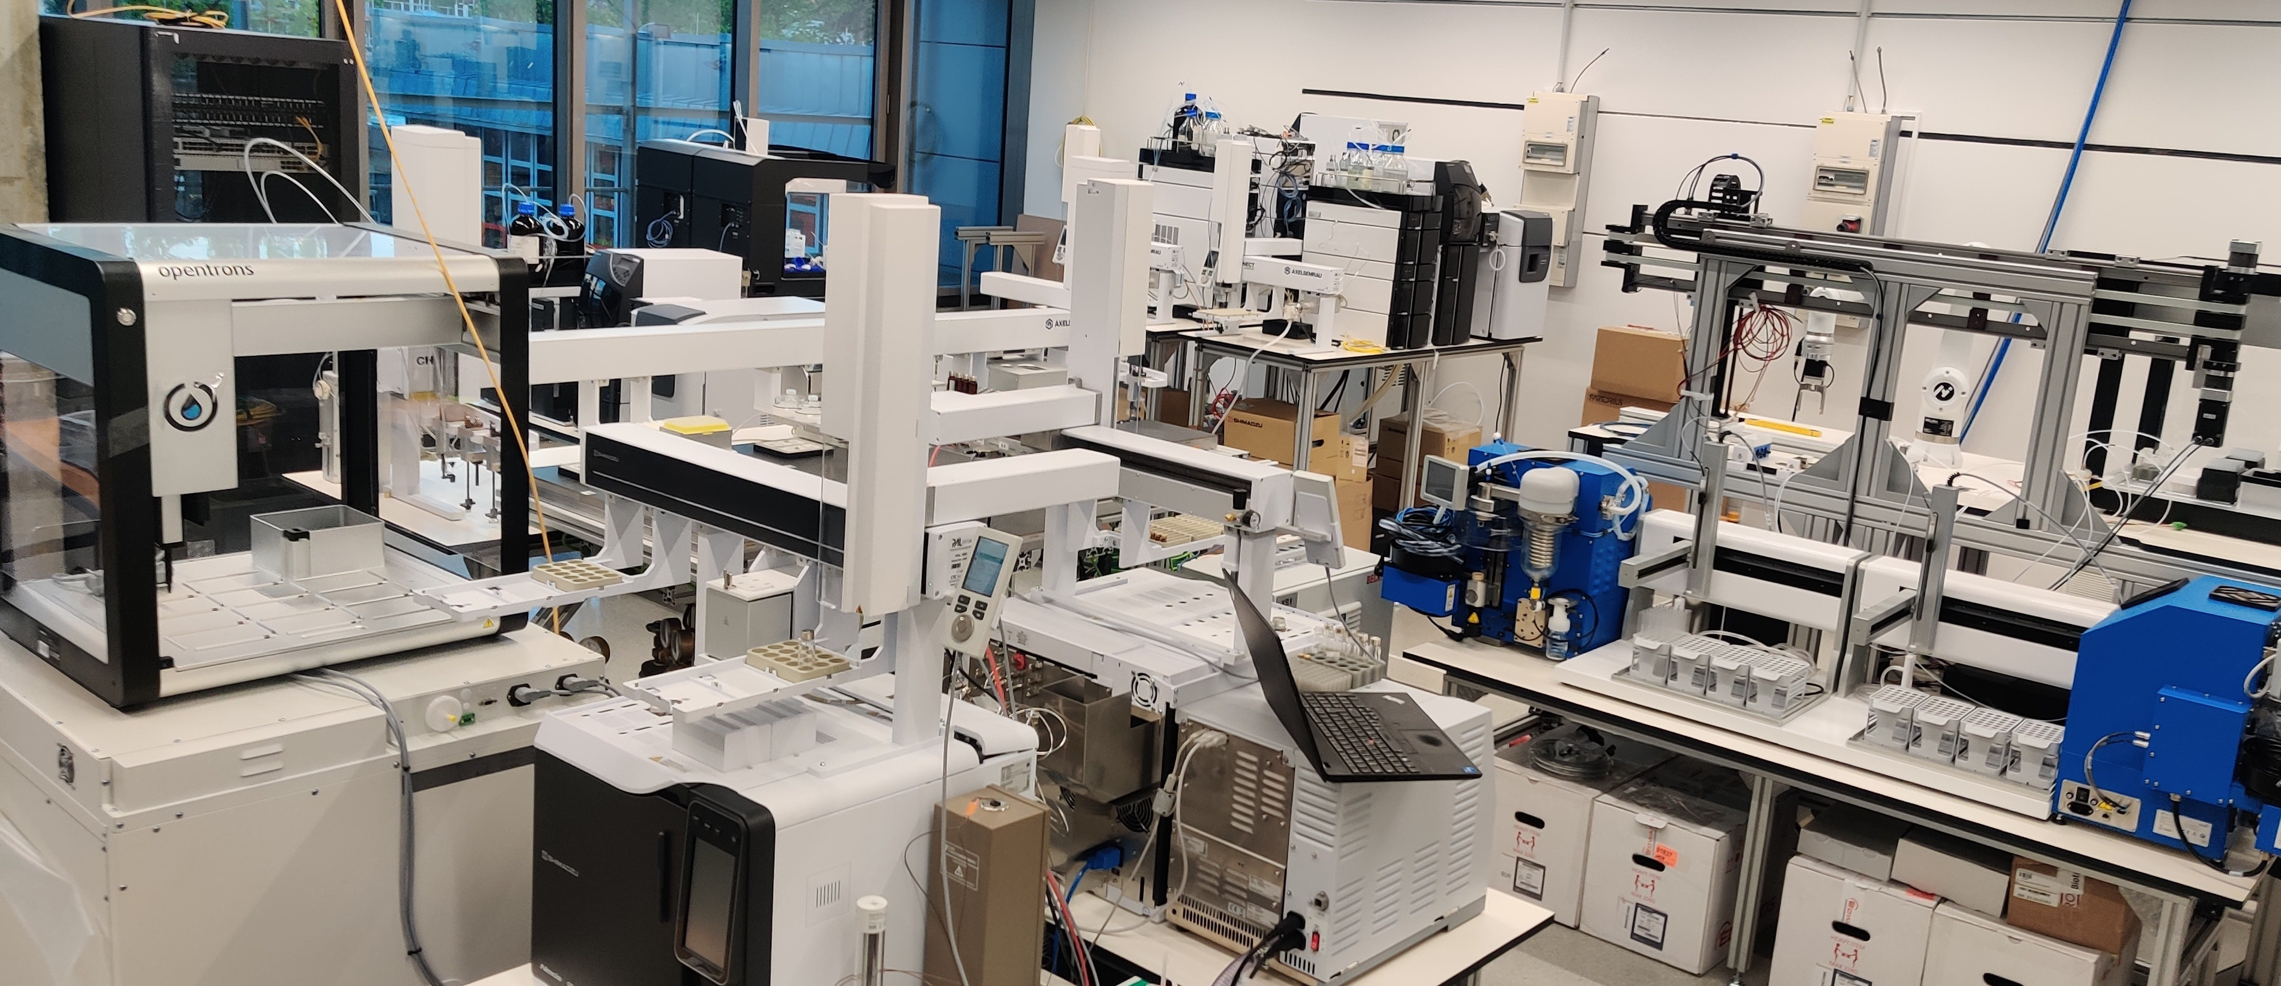
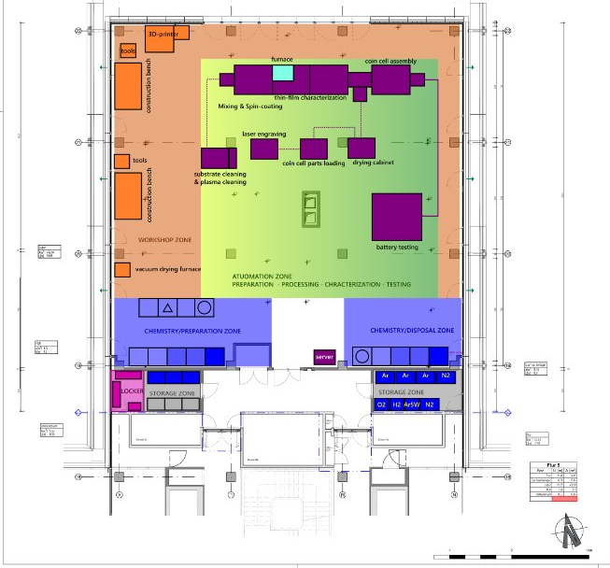
Self-driving materials laboratories (SDL)
combine automation, data infrastructure, and AI agents into closed-loop experimental processes.
emerge globally - from small platforms in existing labs to purpose-built laboratories.
Expt. station in Minerva @ BAM
ChemASAP @ KIT
MPG-TUM SolBat Center @ Munich
SDLs need interfaces & scheduling + orchestration of experiments across stations
→ benefit from mature, open, distributed EPICS tech. stack and its community
Blueprints (& GUIs + LLM-support) to lower entry barrier & enable rapid prototyping
(Competing platforms like SiLA 2, IvoryOS, Opentrons advertise low entry barriers)
(our initiative, under construction)

