Slide 1
Phoebus eco system update
Georg Weiss – ESS Kunal Shroff – EIC

Slide 2
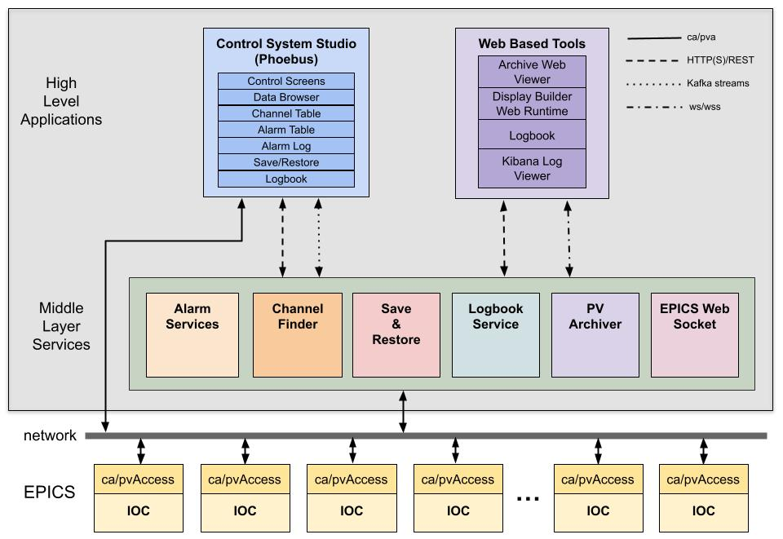



The Phoebus eco system

Slide 3
Releases 5.0.2 and 5.0.4
Contributors: Aquenos, BNL, CEA, CLS, Cosylab, CSNS, Diamond, ESS, High Voltage Engineering Europa, ISIS, LBNL, SBU, SNS, Thales Group
Number of commits: ~800.
Number of merged pull requests: ~200.
Full list: https://github.com/ControlSystemStudio/phoebus/releases

Slide 4
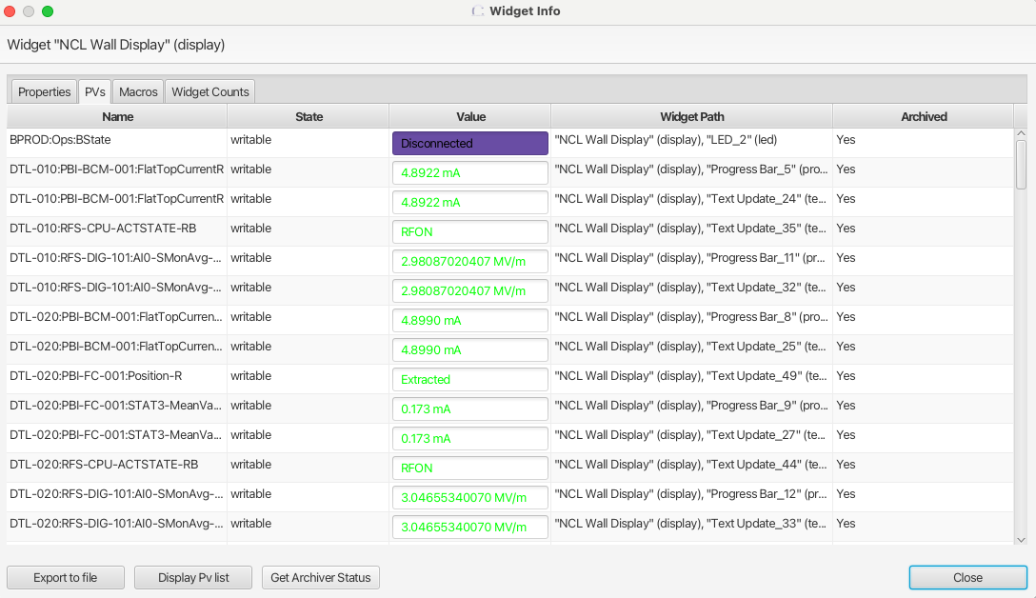
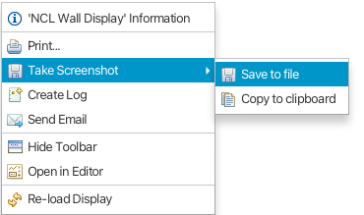
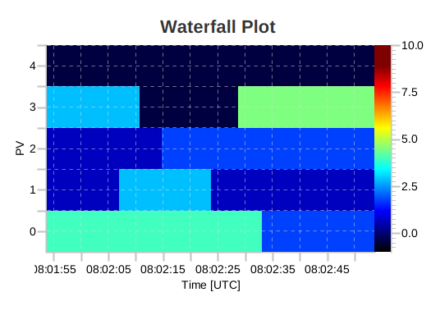
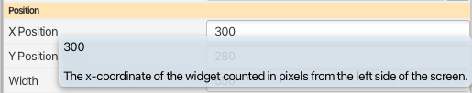
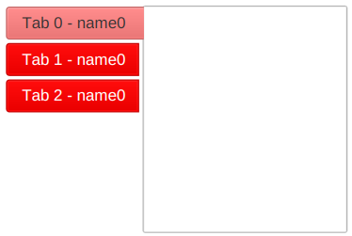
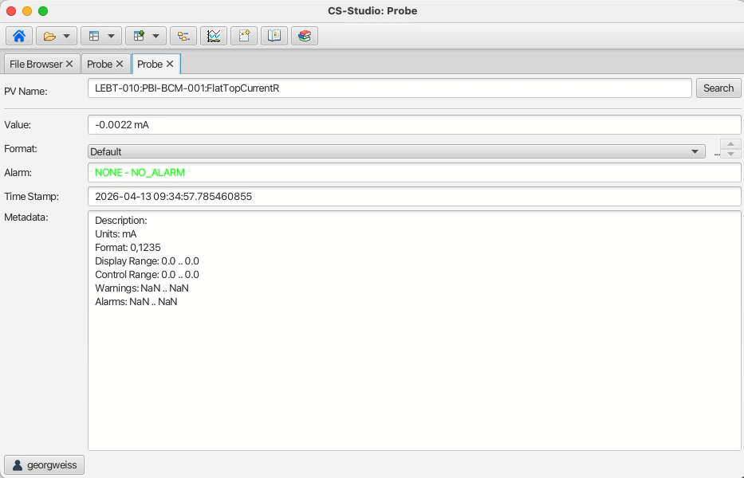
Display Builder
A default zoom factor for OPIs can be set in preferences file, e.g.on high resolution monitors, or for vision impaired users.
Access to archived status from widget info dialog.
Make symbols with transparent regions clickable.
Screen shot of OPI or Data Browser plot may be copied to system clipboard.
Tooltips for widget properties to clarify purpose/function.
New widget: waterfall plot.
Customizable tab title background color in Navigation Tabs widget.
Split or detach tabs using mouse gestures.

Slide 5
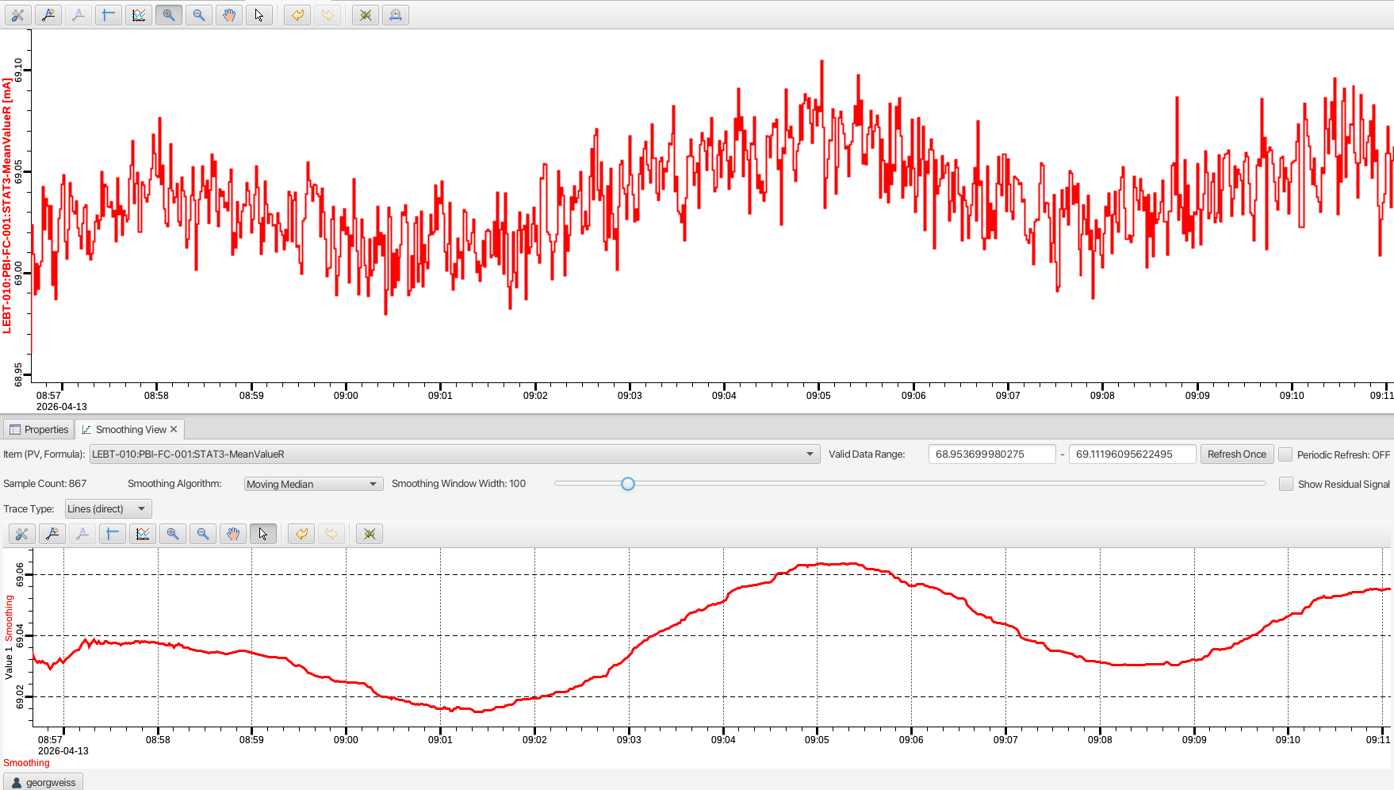
Data Browser
Data export to Excel file type.
Overlapping waveforms and smoothing, see ISIS meeting presentation.

Slide 6
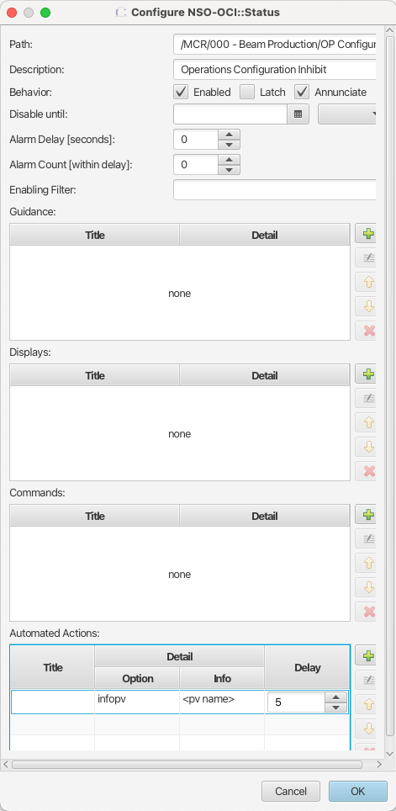
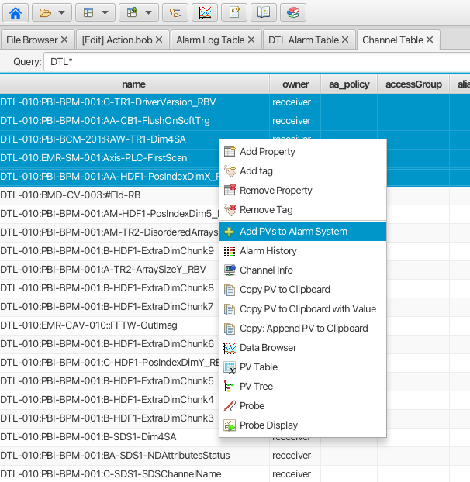
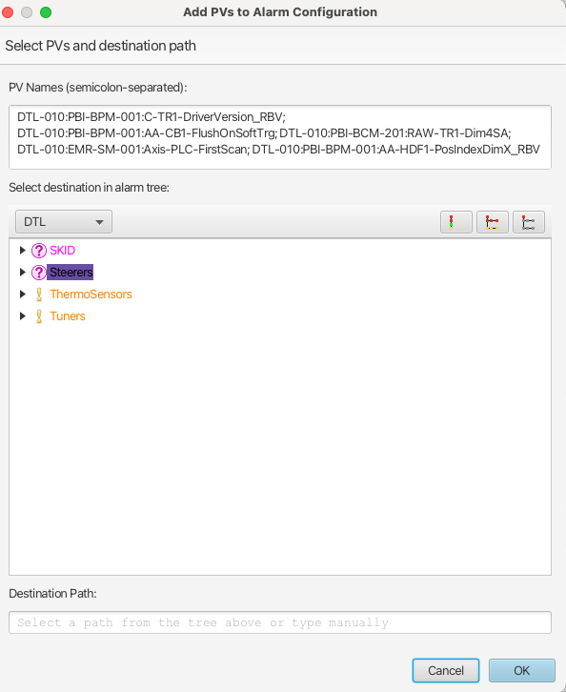
Alarms
Automated action: send alarm summary text to a user-defined PV.
Selections in Alarm Tree and Alarm Table preserved across alarm state changes.
Add PVs to alarm configuration from selection (e.g. in channel finder UI).

Slide 7
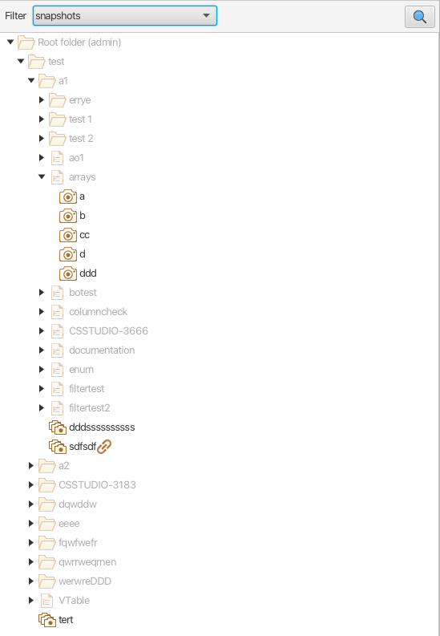
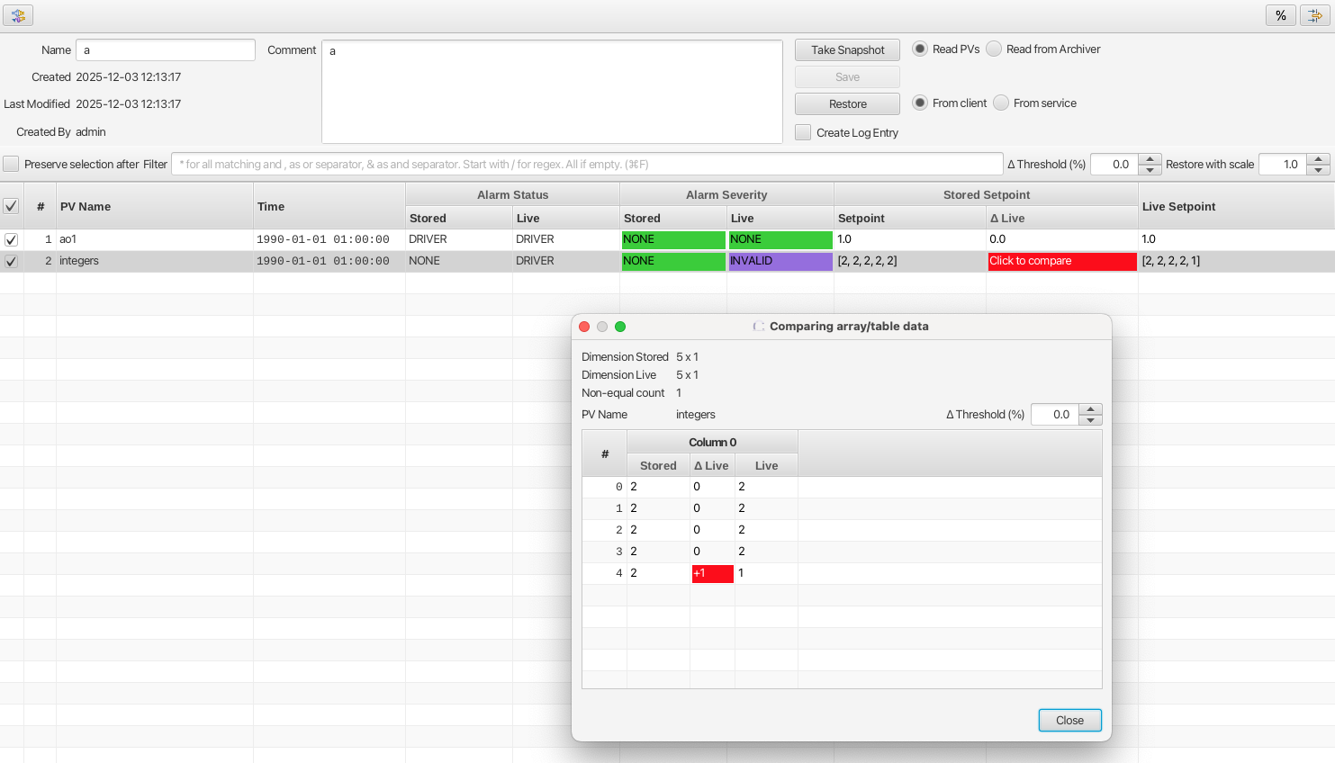
Save&restore
Comparison feature: in a configuration object, a tolerance can be defined per PV.
Main use case: is a (sub)system in the expected state as defined by a set of read-back values saved in a snapshot?
Use web sockets to update all connected clients on changes in data.
Automatically activate filters based on custom business logic.
Indicate that a snapshot is referenced in composite snapshot(s).
Element-wise comparison of array data.

Slide 8
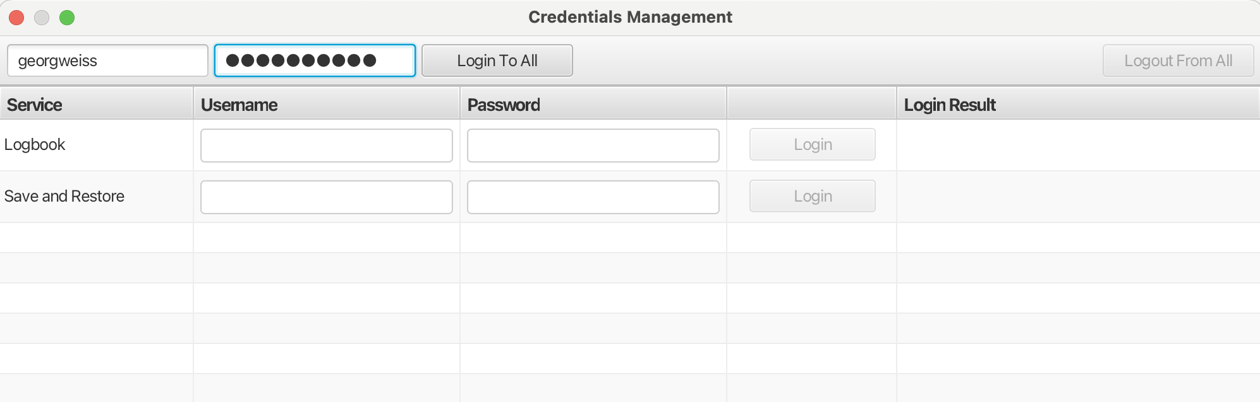
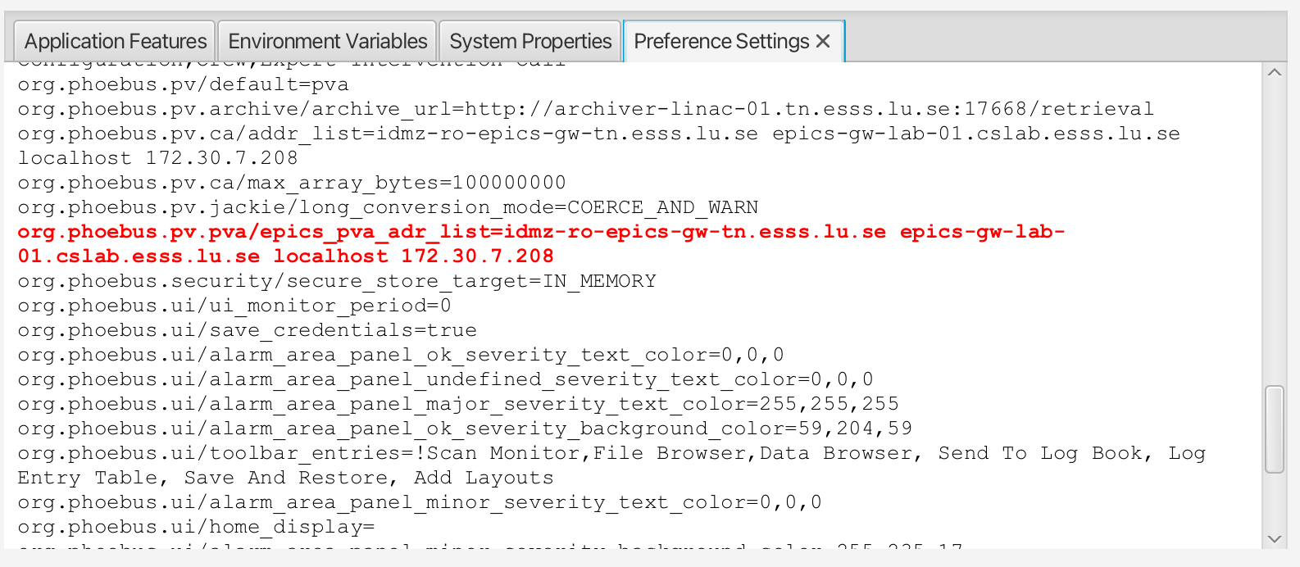
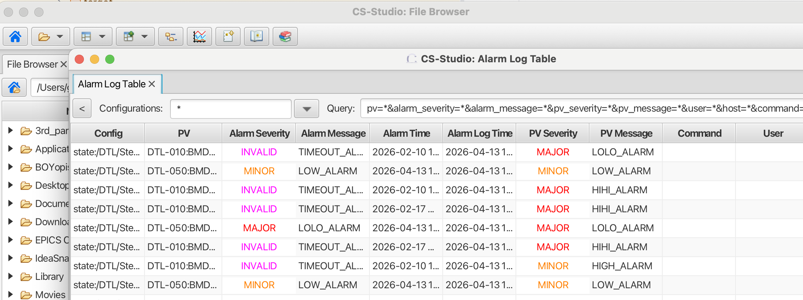
Miscellaneous
Support for pva over TLS.
Help content launched into native browser (instead of JavaFX webview).
Login to ”all” services.
Unknown – or misspelled – preferences highlighted in red.
Phoebus main window title includes name of active tab.
Updated dependency version of epicsCoreJava
New formula functions:
Array down-sampling with LTTB.
Reverse array elements.

Slide 9
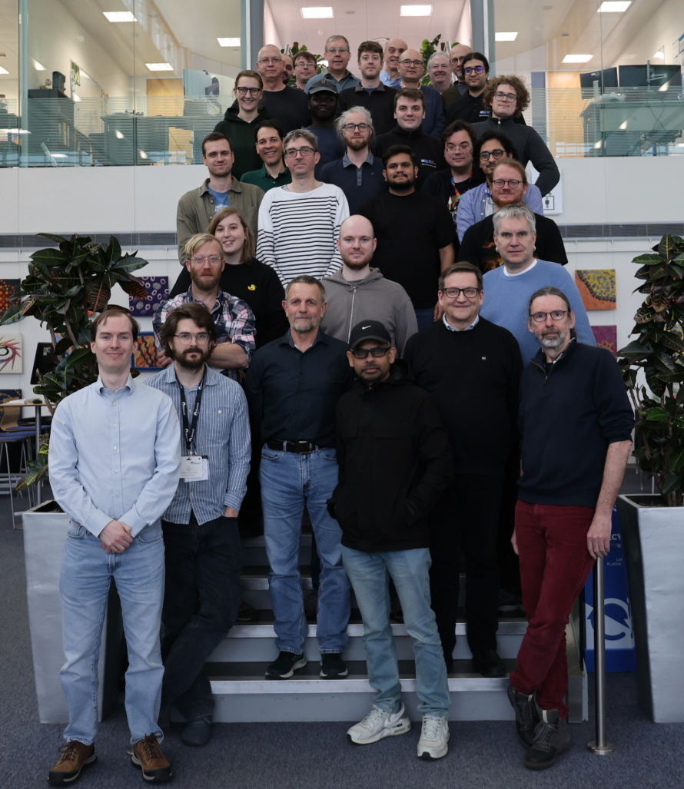
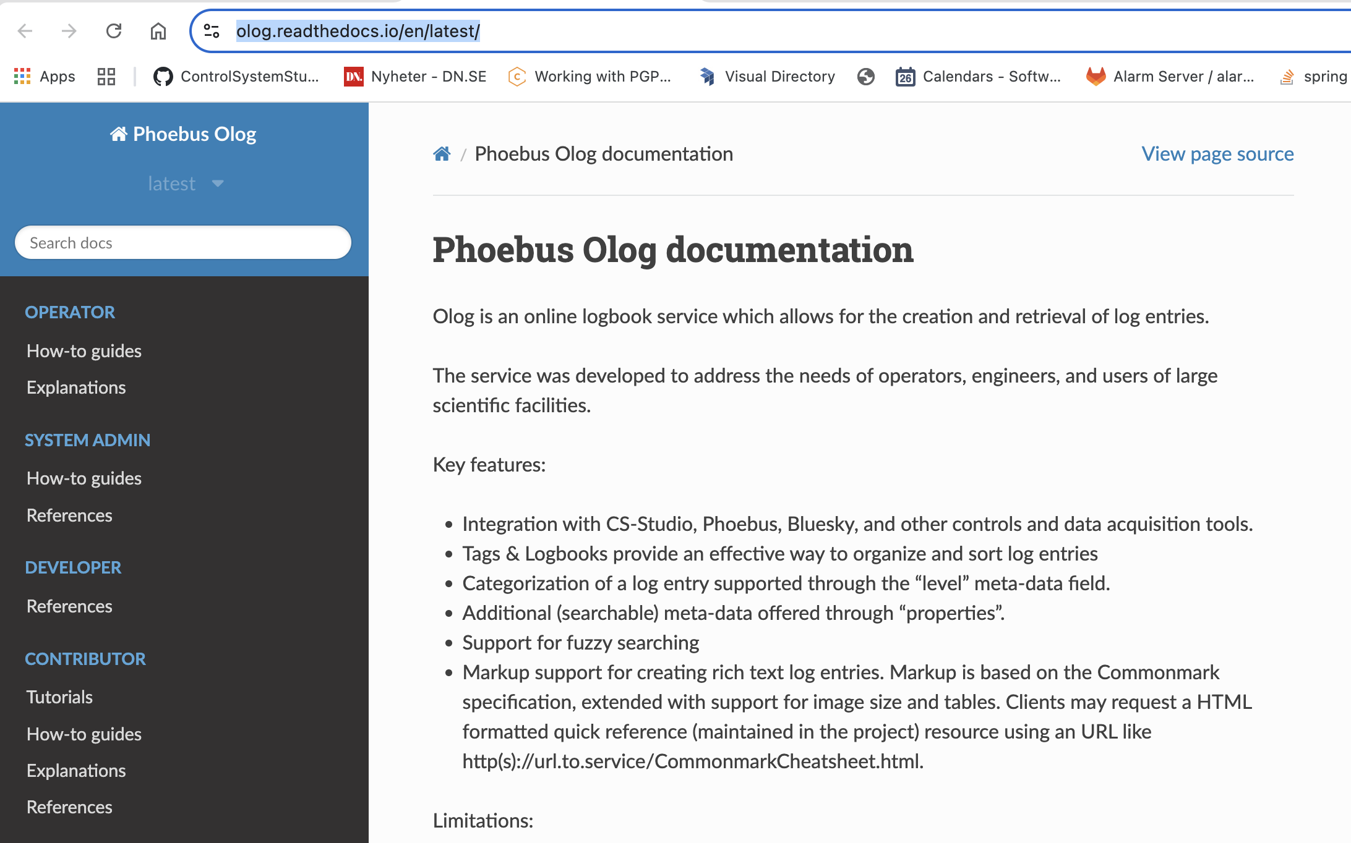
Codathon @ Diamond - highlights
Phoebus (and EPICS) developers gathered at Diamond Light Source, Feb 2026.
Improve documentation with respect to structure and content.
Customizable Kafka configuration parameters.
Create Kafka topics if needed on alarm server startup.
Services health endpoints.
Improved APIs for color management.

Slide 10
Work in progress
Update to Java 21 (major version 5 → 6).
Lightweight threads!
Update to Spring Boot 4.x for all services.
Multiple authentication providers for services (already available in Olog service).
OAuth2 for services.
Edit of Olog entries to support add/remove attachment(s).
“Simple search” in Olog.
Continued work on improving alarm configuration management.
Continued work on documentation improvements.
Health endpoints for services.
Brigde between health endpoints and EPICS.
Swagger integrated in all service documentation.
Continued work on docker.

Slide 11
Q&A

