Slide 1
Towards Secure EPICS at SNS Instruments
Spring EPICS collaboration meeting 2026
Klemen Vodopivec
Neutron Instrument Technologies Section Head

Slide 2
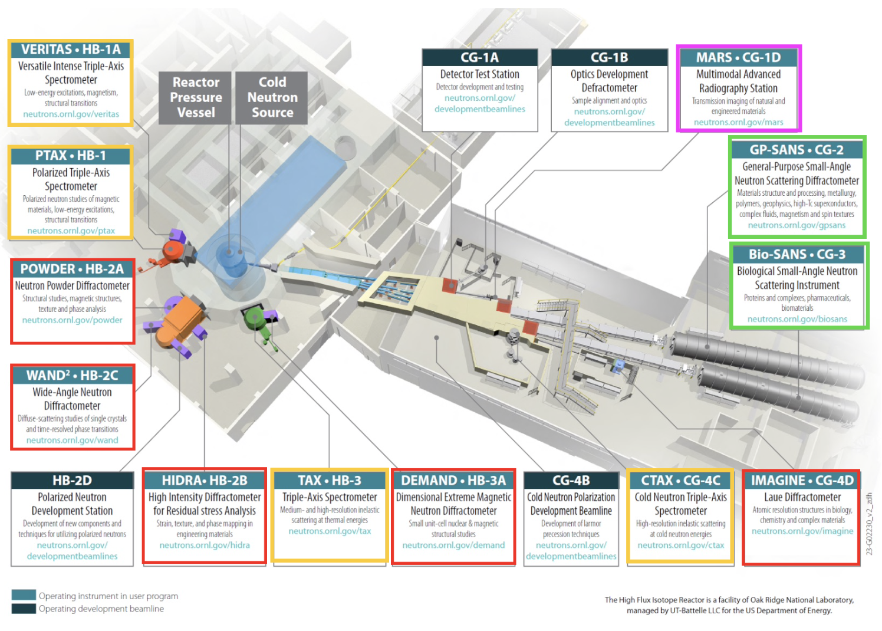
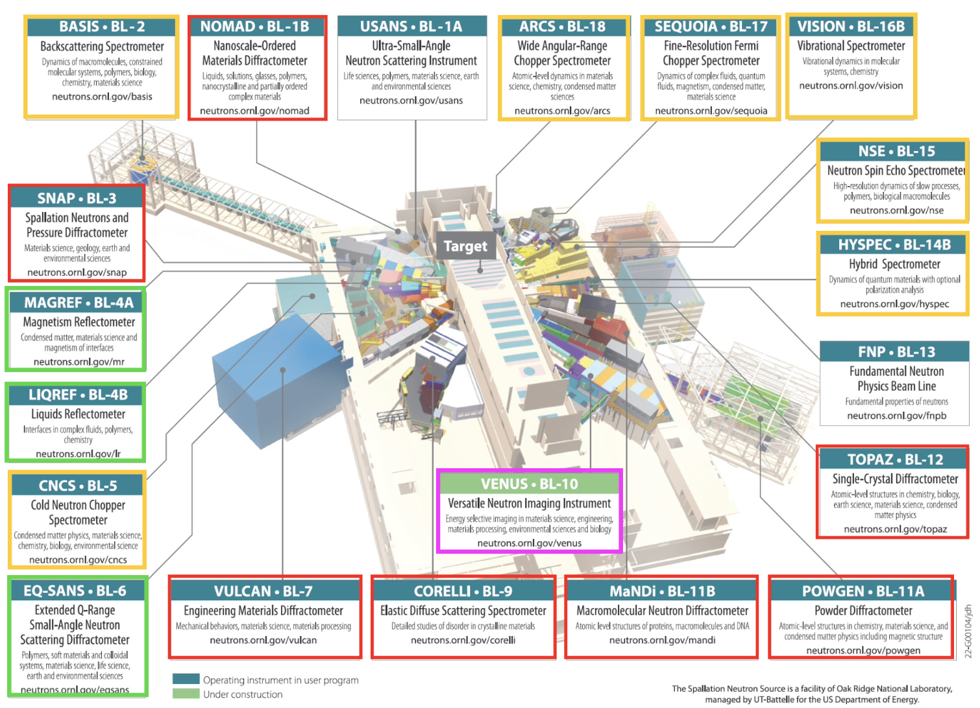
Neutron Instruments at SNS and HFIR
SNS (19 instruments)
HFIR (12 instruments)
Diffraction (elastic scattering) (12 instruments)
Spectroscopy (inelastic scattering) (11 instruments)
SANS & Reflectometry (elastic scattering) (5 instruments)
Neutron Imaging (2 instruments)

Slide 3
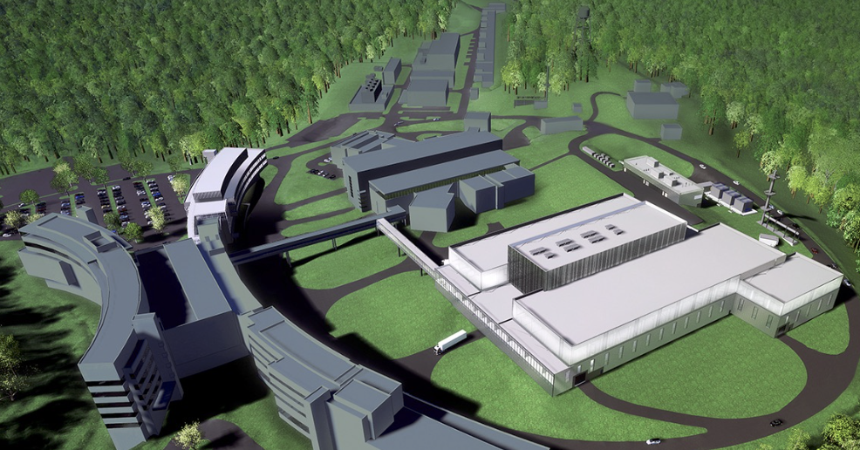
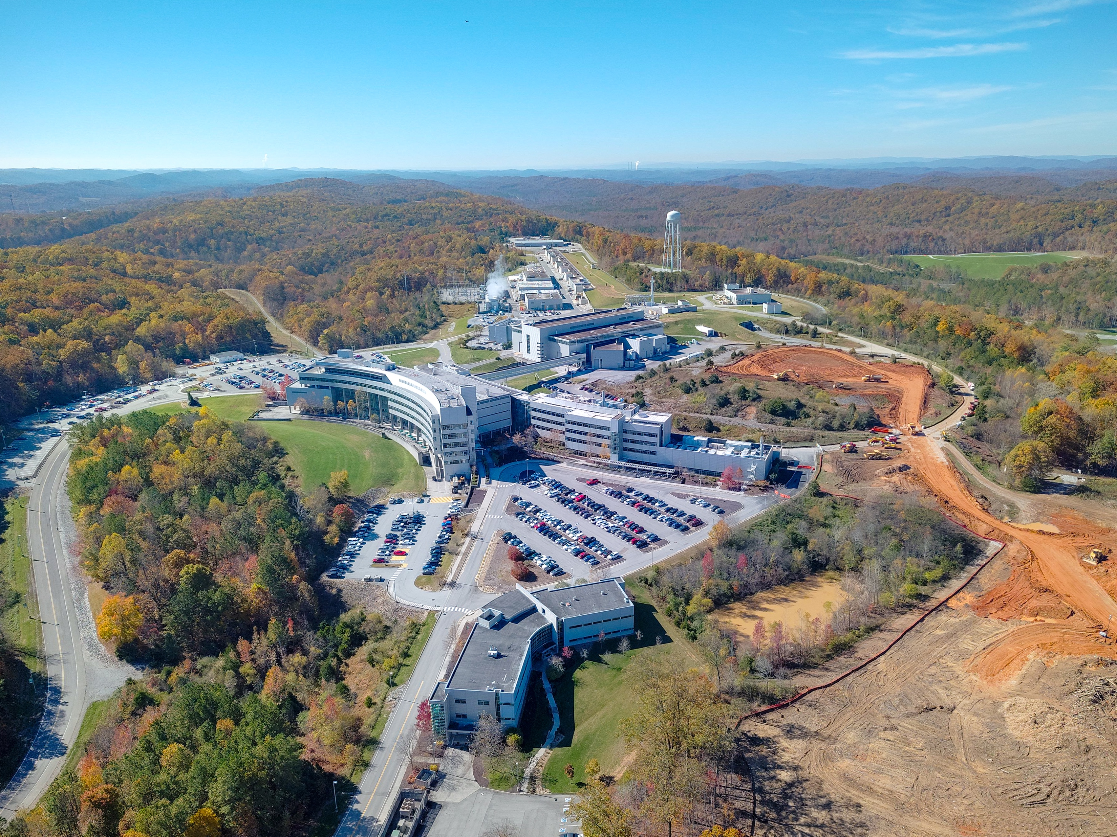
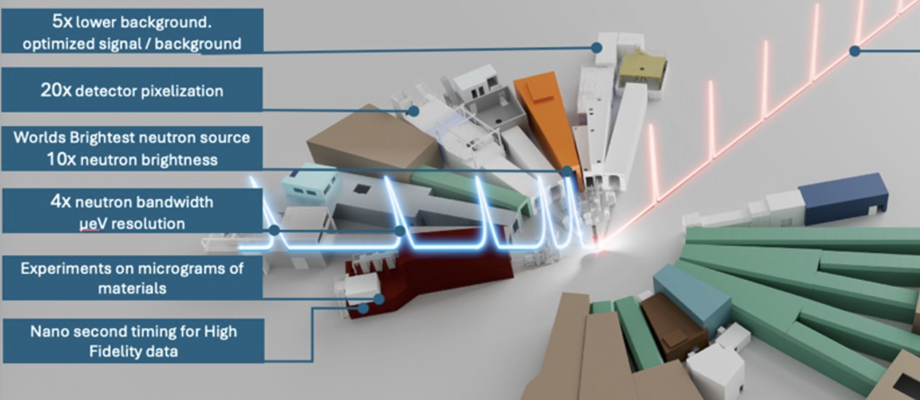
SNS Second Target Station – more Neutron Instruments
Aerial photo of SNS, November 2025

Slide 4
SNS & HFIR Instrument EPICS infrastructure
n
n
n
ADARA
Nexus
Isolated Network
Neutron Detector
PV Access
AreaDetector
Channel Access Gateway
User Interfaces
CS-Studio
Channel Access
User Interfaces
CS-Studio
Experiment Control
IOCs
Pcaspy
ScanServer
Sample Environment
IOCs
Remote Desktop
?
AI/ML

Slide 5
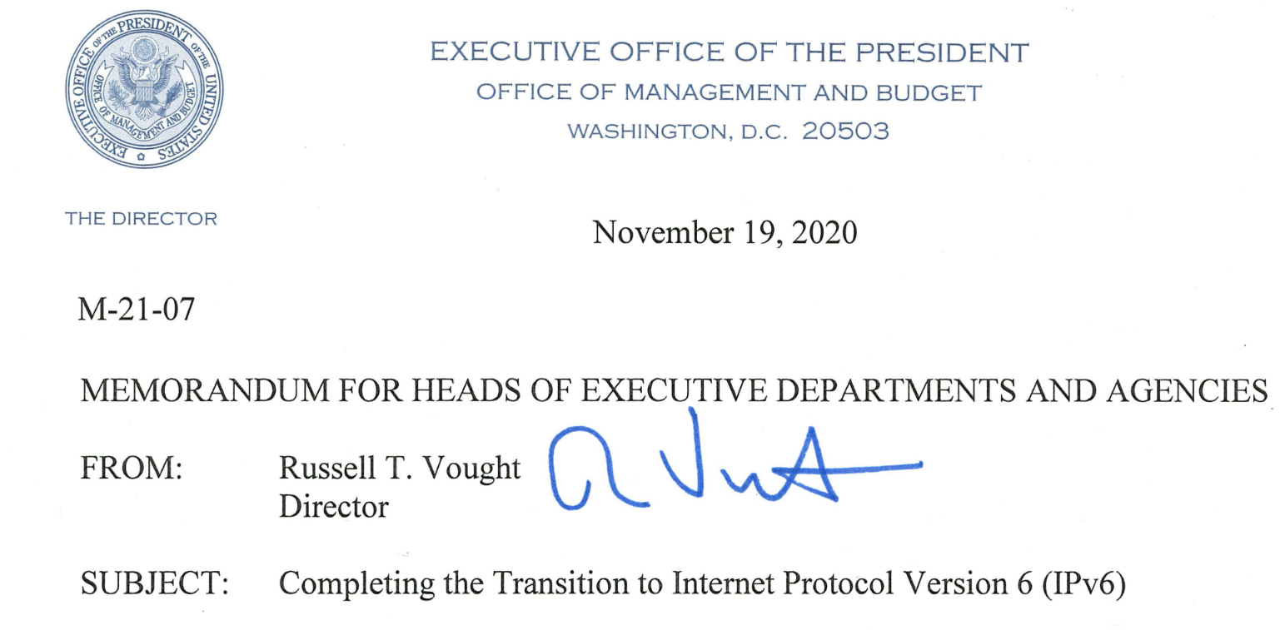
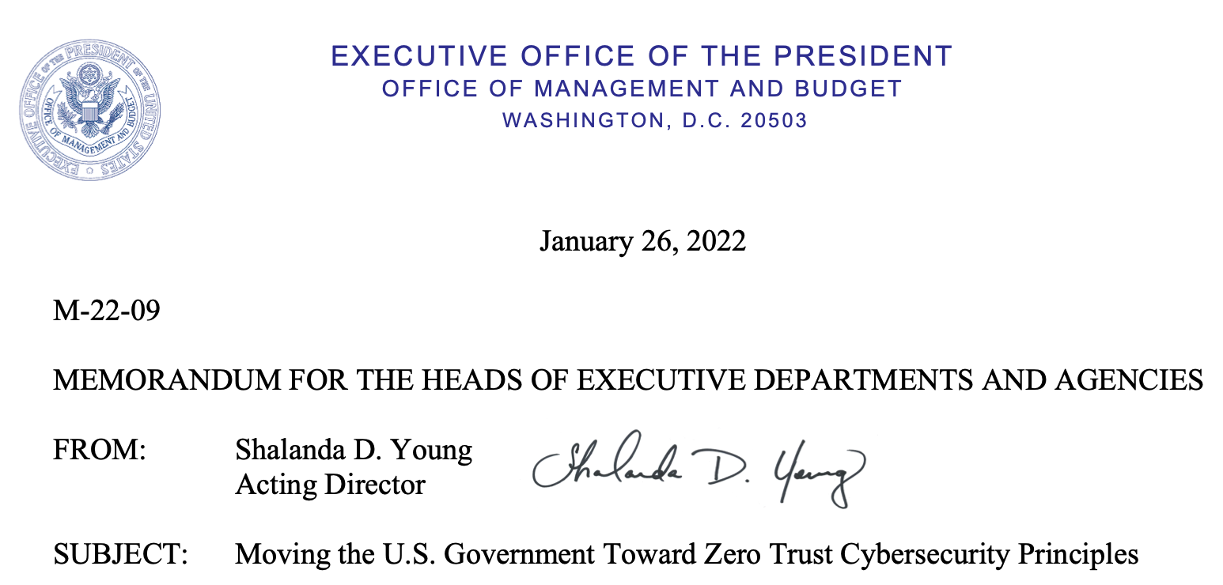
Increasing pressure from Cybersecurity
High visibility policies and requirements
Data Encryption
Audit Logs
Patched Software
Approved Devices
Managed Access Control
ZERO TRUST POLICY
No specific timeline, but can change instantly!

Slide 6
3-stage plan towards Secure EPICS
Enable PVA
Encryption
Cert-based Authorization
Already on EPICS 7.0.9
CA & PVA in parallel
CA for users, PVA for engineers
Add PVA gateway for improved performance
But expect challenges
Disable Channel Access
Encrypted PVA only internally and externally
Hopefully easy
Collaborate with community
Ensure compatibility with ORNL authentication scheme
External control for Remote Experiments and AI/ML
Do we still need PVA gateway?

Slide 7
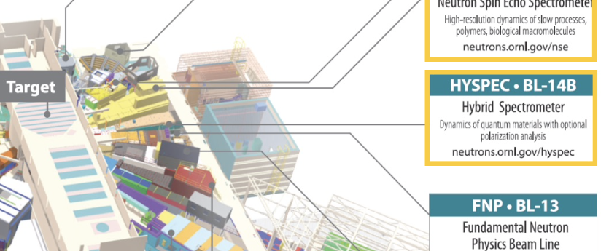
Stage 1 - Scope
Goal: Ability to turn CA off at the Instrument
All IOCs support CA and PVA simultaneously
Clients support CA and/or PVA
All functionality works the same over CA or PVA
No significant changes for the users or instrument staff
Prototype on 1 Instrument, plan for all
Iterate until the goal is achieved
Testing on production Instrument HYSPEC
Test and deploy/revert changes during outages only
Fix identified issues offline between outages
Don’t interfere with user program
Intermediate goal: Turn external CA off
PVA read-only gateway, no CA gateway
Extends the timeline with Cyber

Slide 8
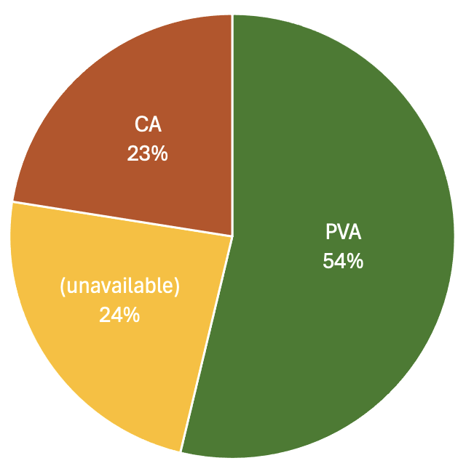
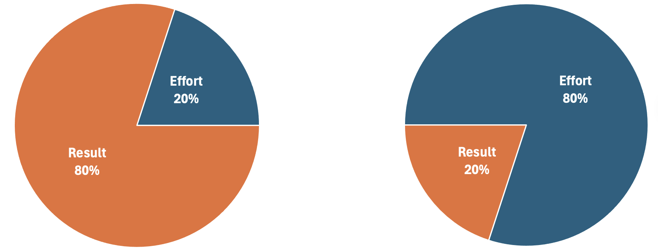
Stage 1 - Progress
41 “base” IOCs upgraded with PVXS
18 Sample Environment IOCs disabled
19 pcaspy IOCs
Implemented & tested pcaspy-pvxs wrapper
“Neutrons” data PV uses pvAccess & pvData
pvAccess & PVXS compatible in same IOC
CS-Studio client switched to pva
PV Access protocol lacks permission info
Upgraded 2 pcaspy IOCs to PyDevice
Record links still use Channel Access
Proxy CA PVs with PVAiFY
ADARA is C++ code that links ”base” API for CA
In 3 weeks
How long for the rest?

Slide 9
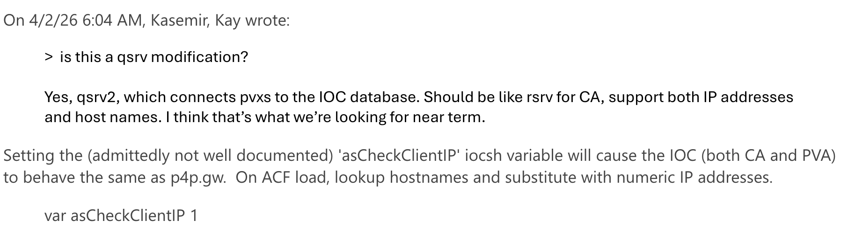
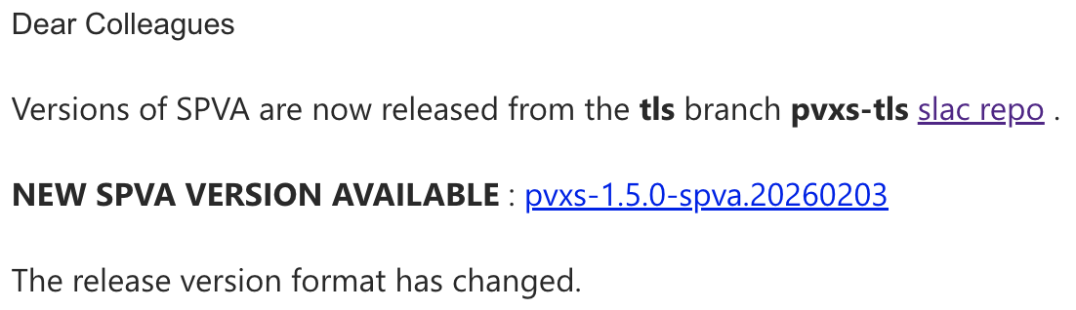
Stage 1 – Challenges (community related)
Under Control
Needs Work
qsrv ACF doesn’t resolve hostnames – but it does
Where to get Secure PVXS?
PVA lacks permission info
Proposal in CS-Studio https://github.com/ControlSystemStudio/phoebus/pull/3506
Inter-record links awkward syntax
What about CA/CPP address specifiers?
Do we need to encrypt search requests?
FTFM
©mdavidsaver
field(INP, {pva:{pv:"SomeForeignRecord"}})
2/3/2026

Slide 10
Stage 1 – Remaining Work
pcaspy IOCs to PyDevice
“Neutrons” structure to PVXS
PVA perms
ADARA PVA
PVA gateway
User ”pyepics” scripts
April 2026
Summer 2026
Winter 2027
Summer 2027

Slide 11
Thank You
For Your Attention
Credit goes to Kaz Gofron, Kay Kasemir, Alex Sobhani

