Slide 1
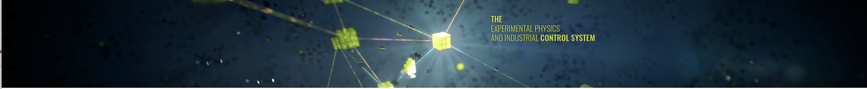
EPICS Council Report
Presented by Karen White on behalf of the EPICS Council
April 22, 2026

Slide 2
Collaboration Meetings
EPICS Collaboration Meetings
2026-1 Saclay, FR April 20-24, 2026
https://indico.in2p3.fr/event/37441/
2026-2
Hosted by CSNS at IHEP, Dongguan China 11/2-7, 2026
Notes:
In case of emergency follow instructions from an ORNL employee or PA announcements
Assembly points – Exit through the emergency exits near the stage or lobby front doors, assemble just past the flagpole
Your visitor badge allows you to be unescorted in this building (8600)
Please obey all safety postings – most relevant for the tours on Friday
While you are at ORNL, please do not take photographs of areas that indicate photography is forbidden
Our planned tour route allows photos at all locations

Slide 3
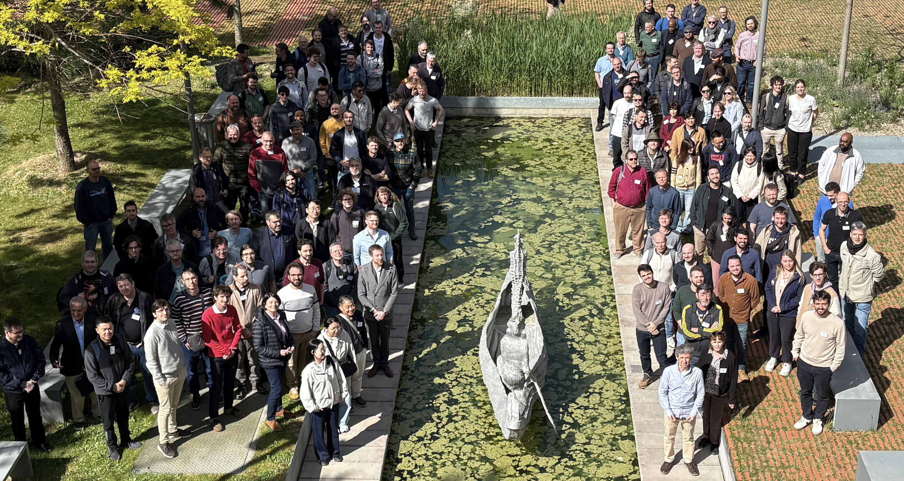

Spring EPICS Collaboration Meeting
Spring 2026
April 20-24, 2026
Hosted by CEA at Saclay
~160 participants
https://indico.in2p3.fr/event/37441/
Many thanks to our hosts for a well organized and productive meeting!
Notes:
In case of emergency follow instructions from an ORNL employee or PA announcements
Assembly points – Exit through the emergency exits near the stage or lobby front doors, assemble just past the flagpole
Your visitor badge allows you to be unescorted in this building (8600)
Please obey all safety postings – most relevant for the tours on Friday
While you are at ORNL, please do not take photographs of areas that indicate photography is forbidden
Our planned tour route allows photos at all locations

Slide 4
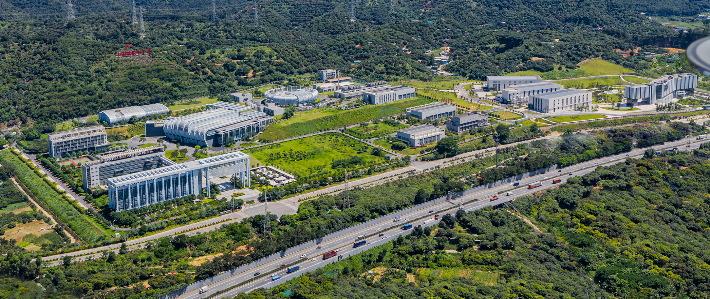
2026 Fall EPICS Collaboration Meeting
CSNS will host the 2026 Fall EPICS collaboration meeting from November 2nd to 6th, during the first week of November.
CSNS is an accelerator-based neutron source operated by the Institute of High Energy Physics under the Chinese Academy of Sciences.
POC: Yuliang Zhang zhangyl@ihep.ac.cn

Slide 5
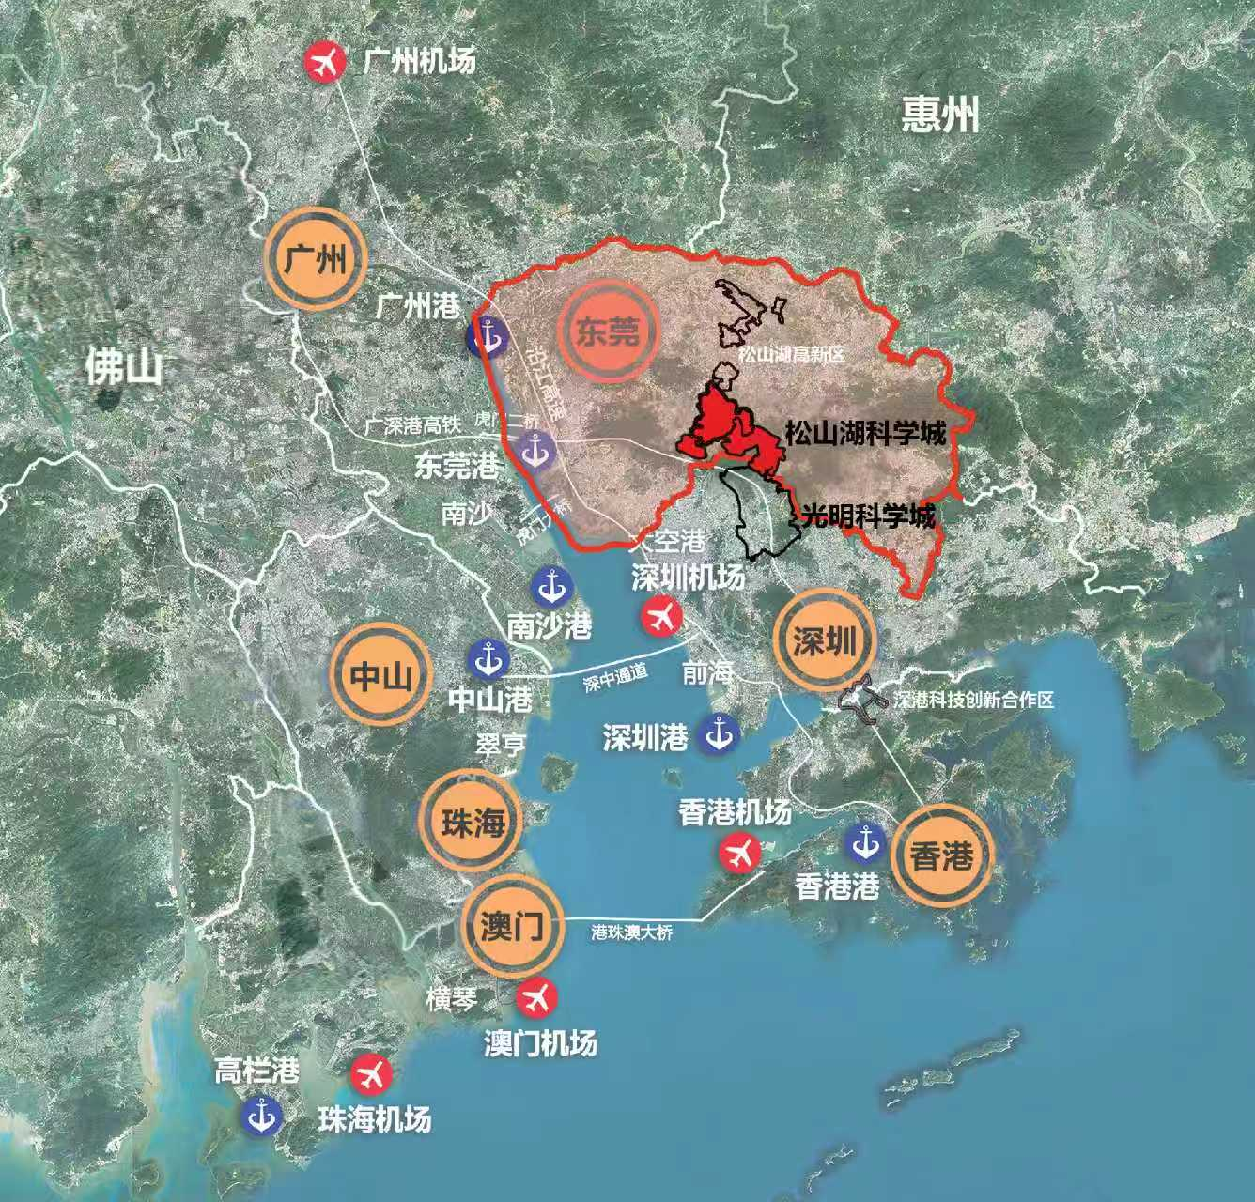
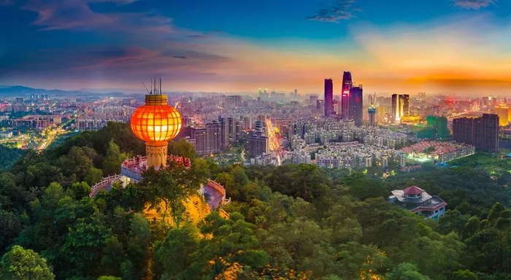
Location of CSNS
CSNS is located in Dongguan, a city in Guangdong Province, southern China.
Guangzhou
Dongguan
CSNS
Hong Kong
Macao

Slide 6
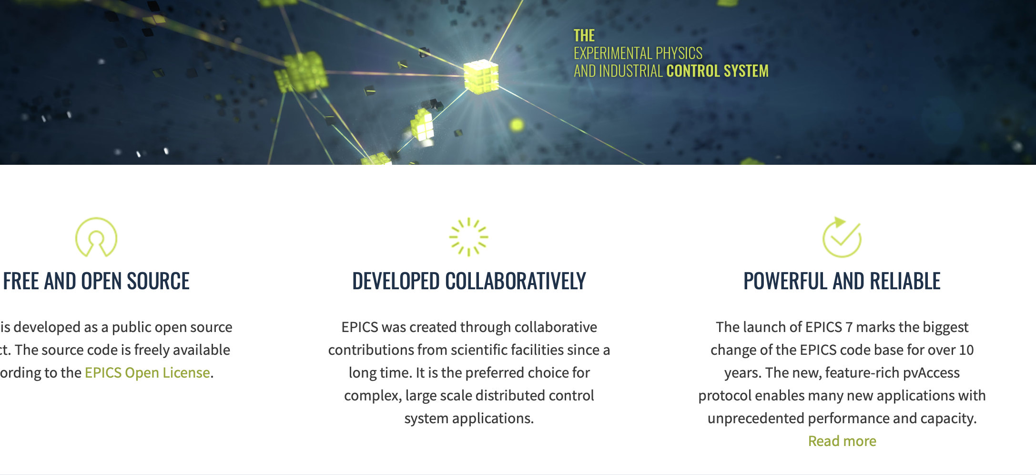
Codeathons Documentathons
Codeathon/Documentathon February 2026 at Diamond Light Source
Codeathon/Documentathon (EPICS and Phoebus) October 2026 at Brookhaven National Laboratory
Documentathon Spring 2027 at European Spallation Source
Notes:
In case of emergency follow instructions from an ORNL employee or PA announcements
Assembly points – Exit through the emergency exits near the stage or lobby front doors, assemble just past the flagpole
Your visitor badge allows you to be unescorted in this building (8600)
Please obey all safety postings – most relevant for the tours on Friday
While you are at ORNL, please do not take photographs of areas that indicate photography is forbidden
Our planned tour route allows photos at all locations

Slide 7
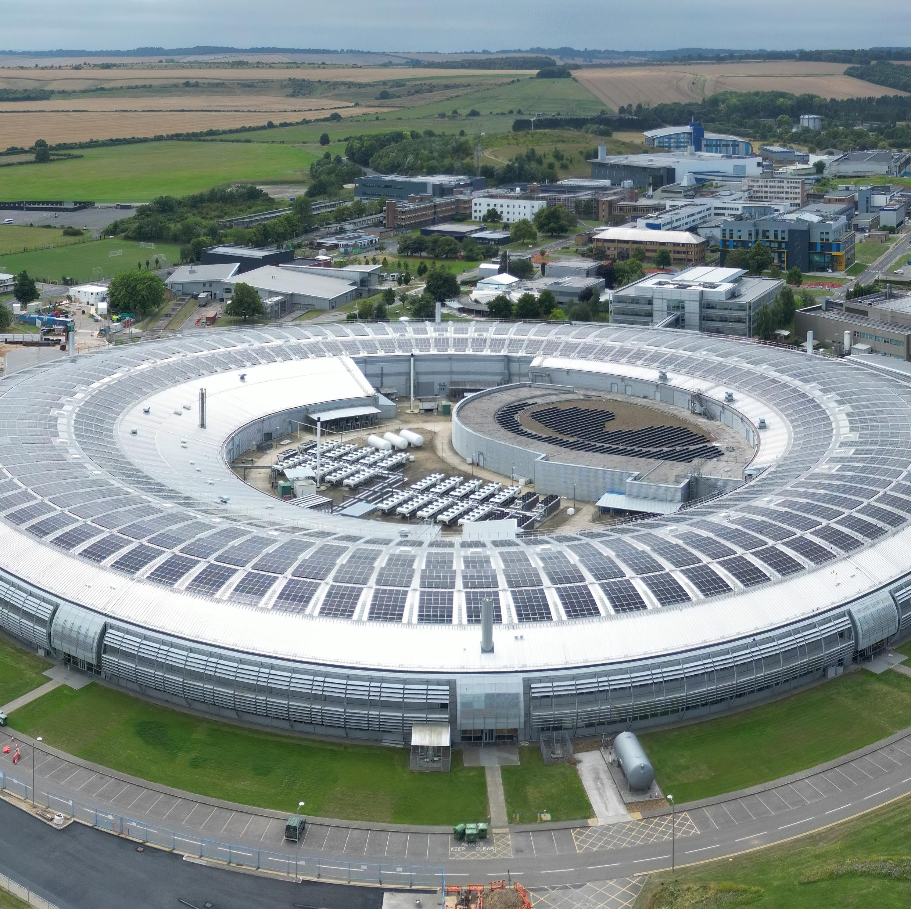
Codeathon 2026 at Diamond
Diamond is UK’s national synchrotron light source located in South Oxfordshire
23 to 27 Feb 2026
35 registered participants
18 institutions
Separation in two areas:
EPICS core developers and epics-base, lead by Andrew Johnson
Phoebus + services / documentation lead by Kunal Shroff
Codeathon slides from Ronaldo Mercado

Slide 8
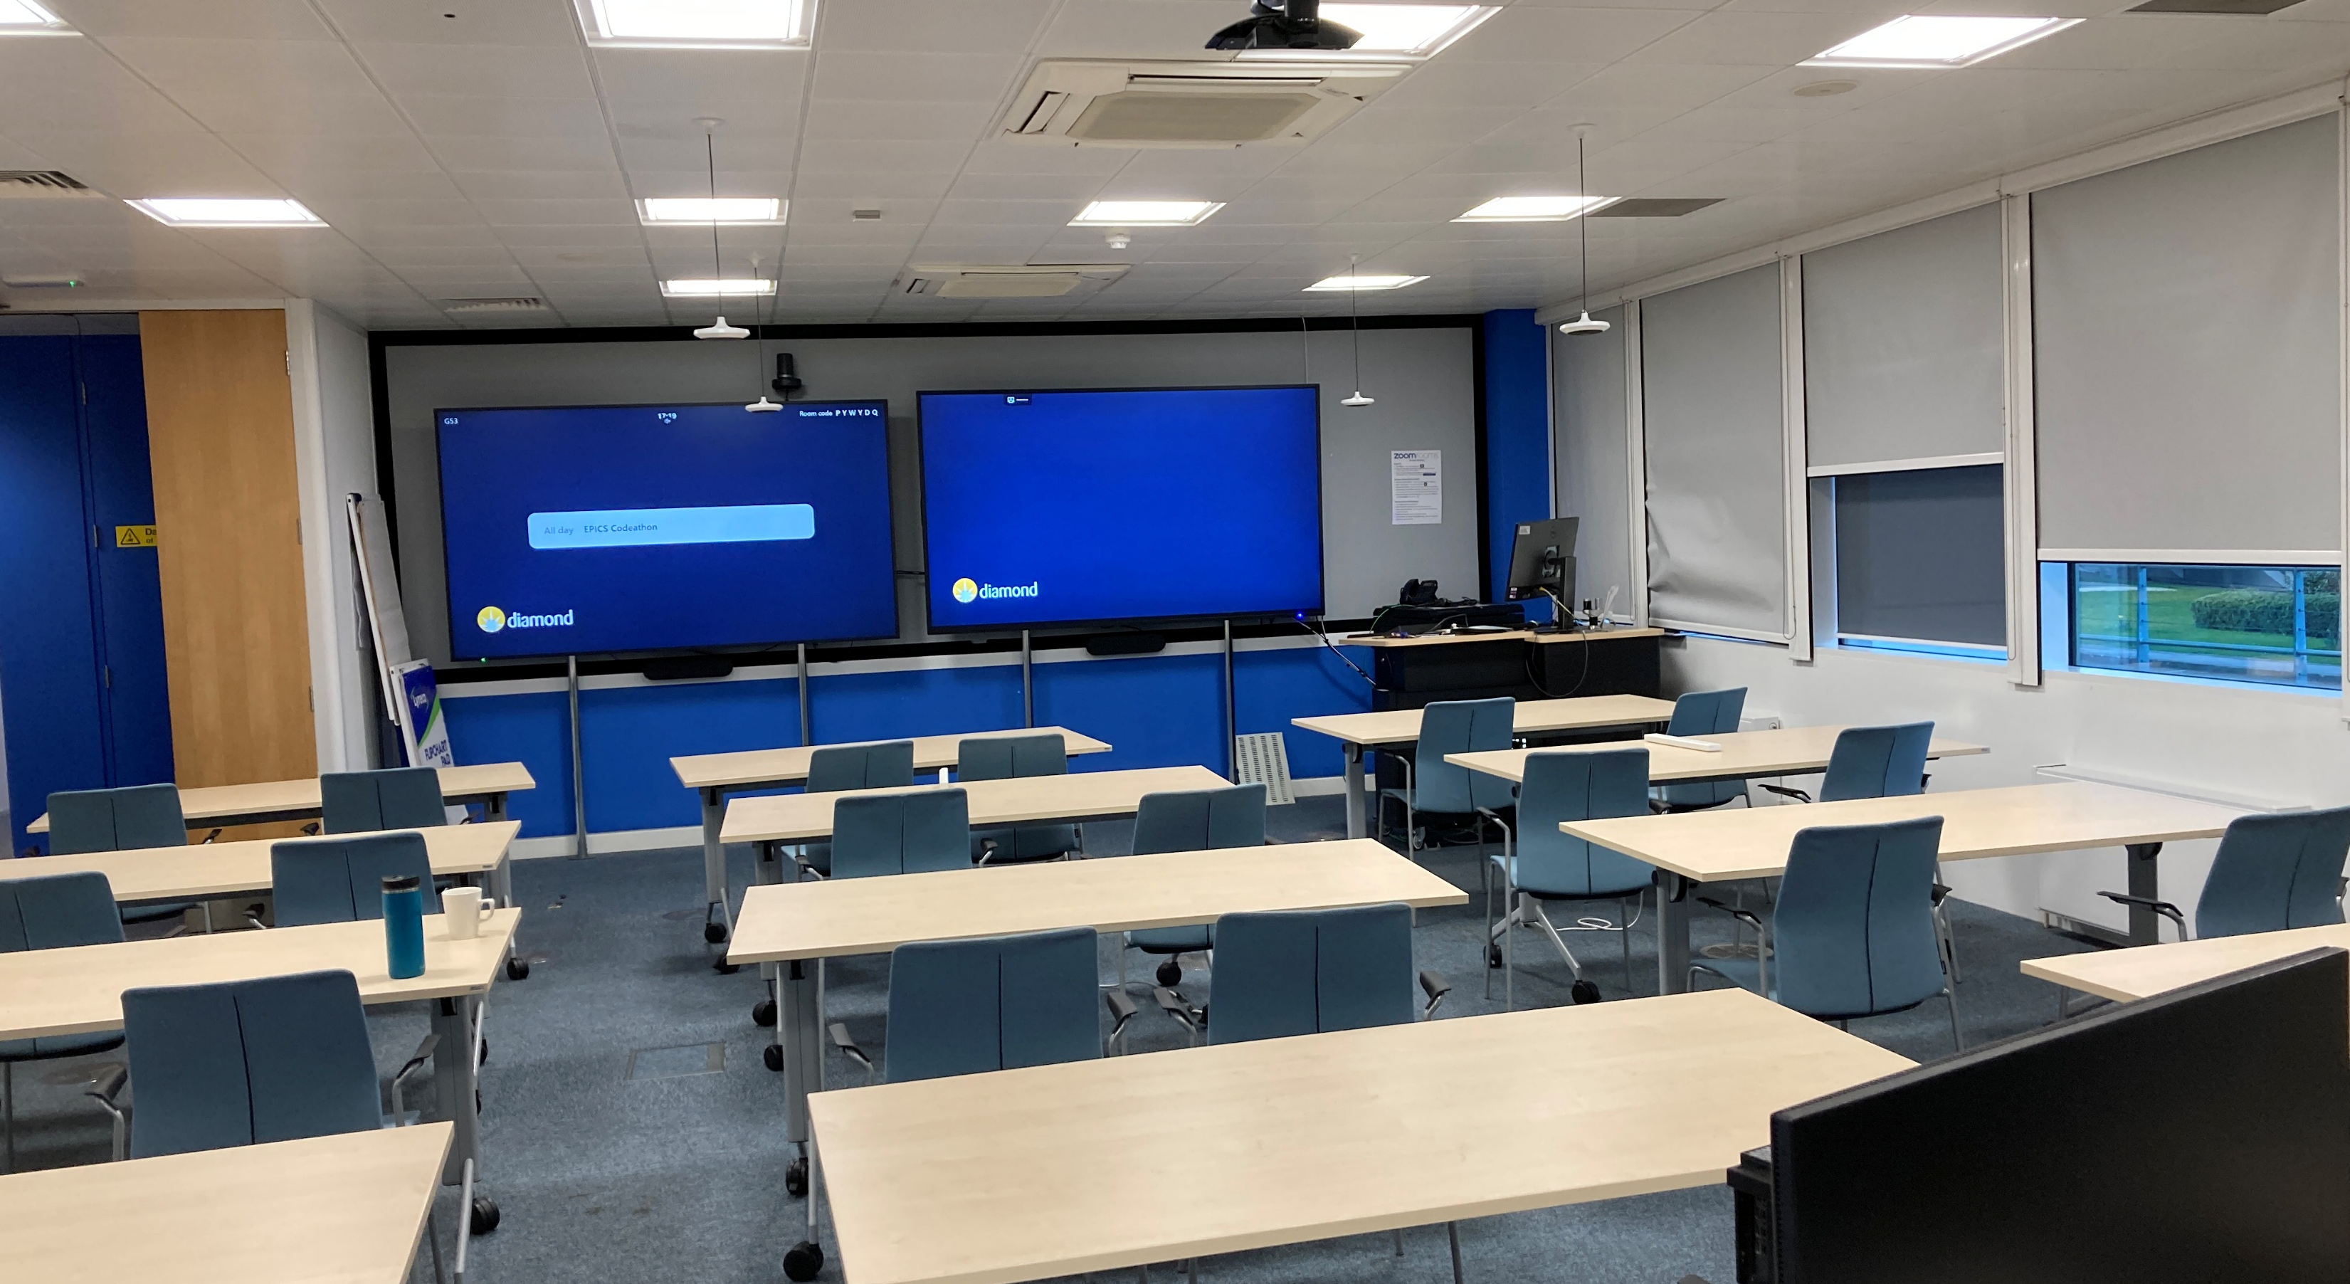
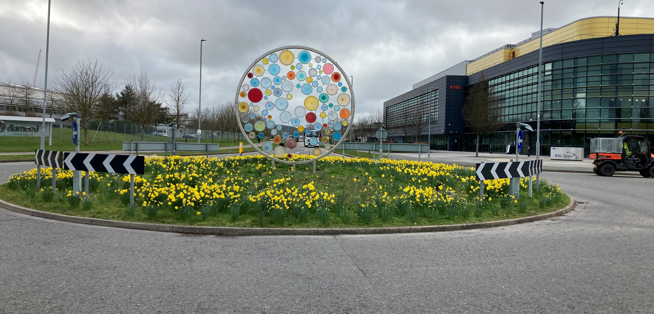
Codeathon week
Planning sessions
Core Developers’ meeting session on Monday
Phoebus session from Monday
Main event
Tuesday – introductions and project selection, also tours
Thursday – workshop photo + dinner
Friday – closing session
Coding all days
Refreshments AM/PM provided
Participation of colleagues from STFC on campus

Slide 9
Results
https://github.com/epics-base/epics-base/wiki/2026-Codeathon-Project-Results
Many Pull Requests were filed against these GitHub projects during the event, this is a rough count that is probably inaccurate:
epics-base - 20
epics-docs - 4
pvxs - 1
asyn - 1
areaDetector - 3
caPutLog - 1
CSS Phoebus – 10
Opportunity to discuss documentation and merging of documentation from epics-base and epics-docs

Slide 10
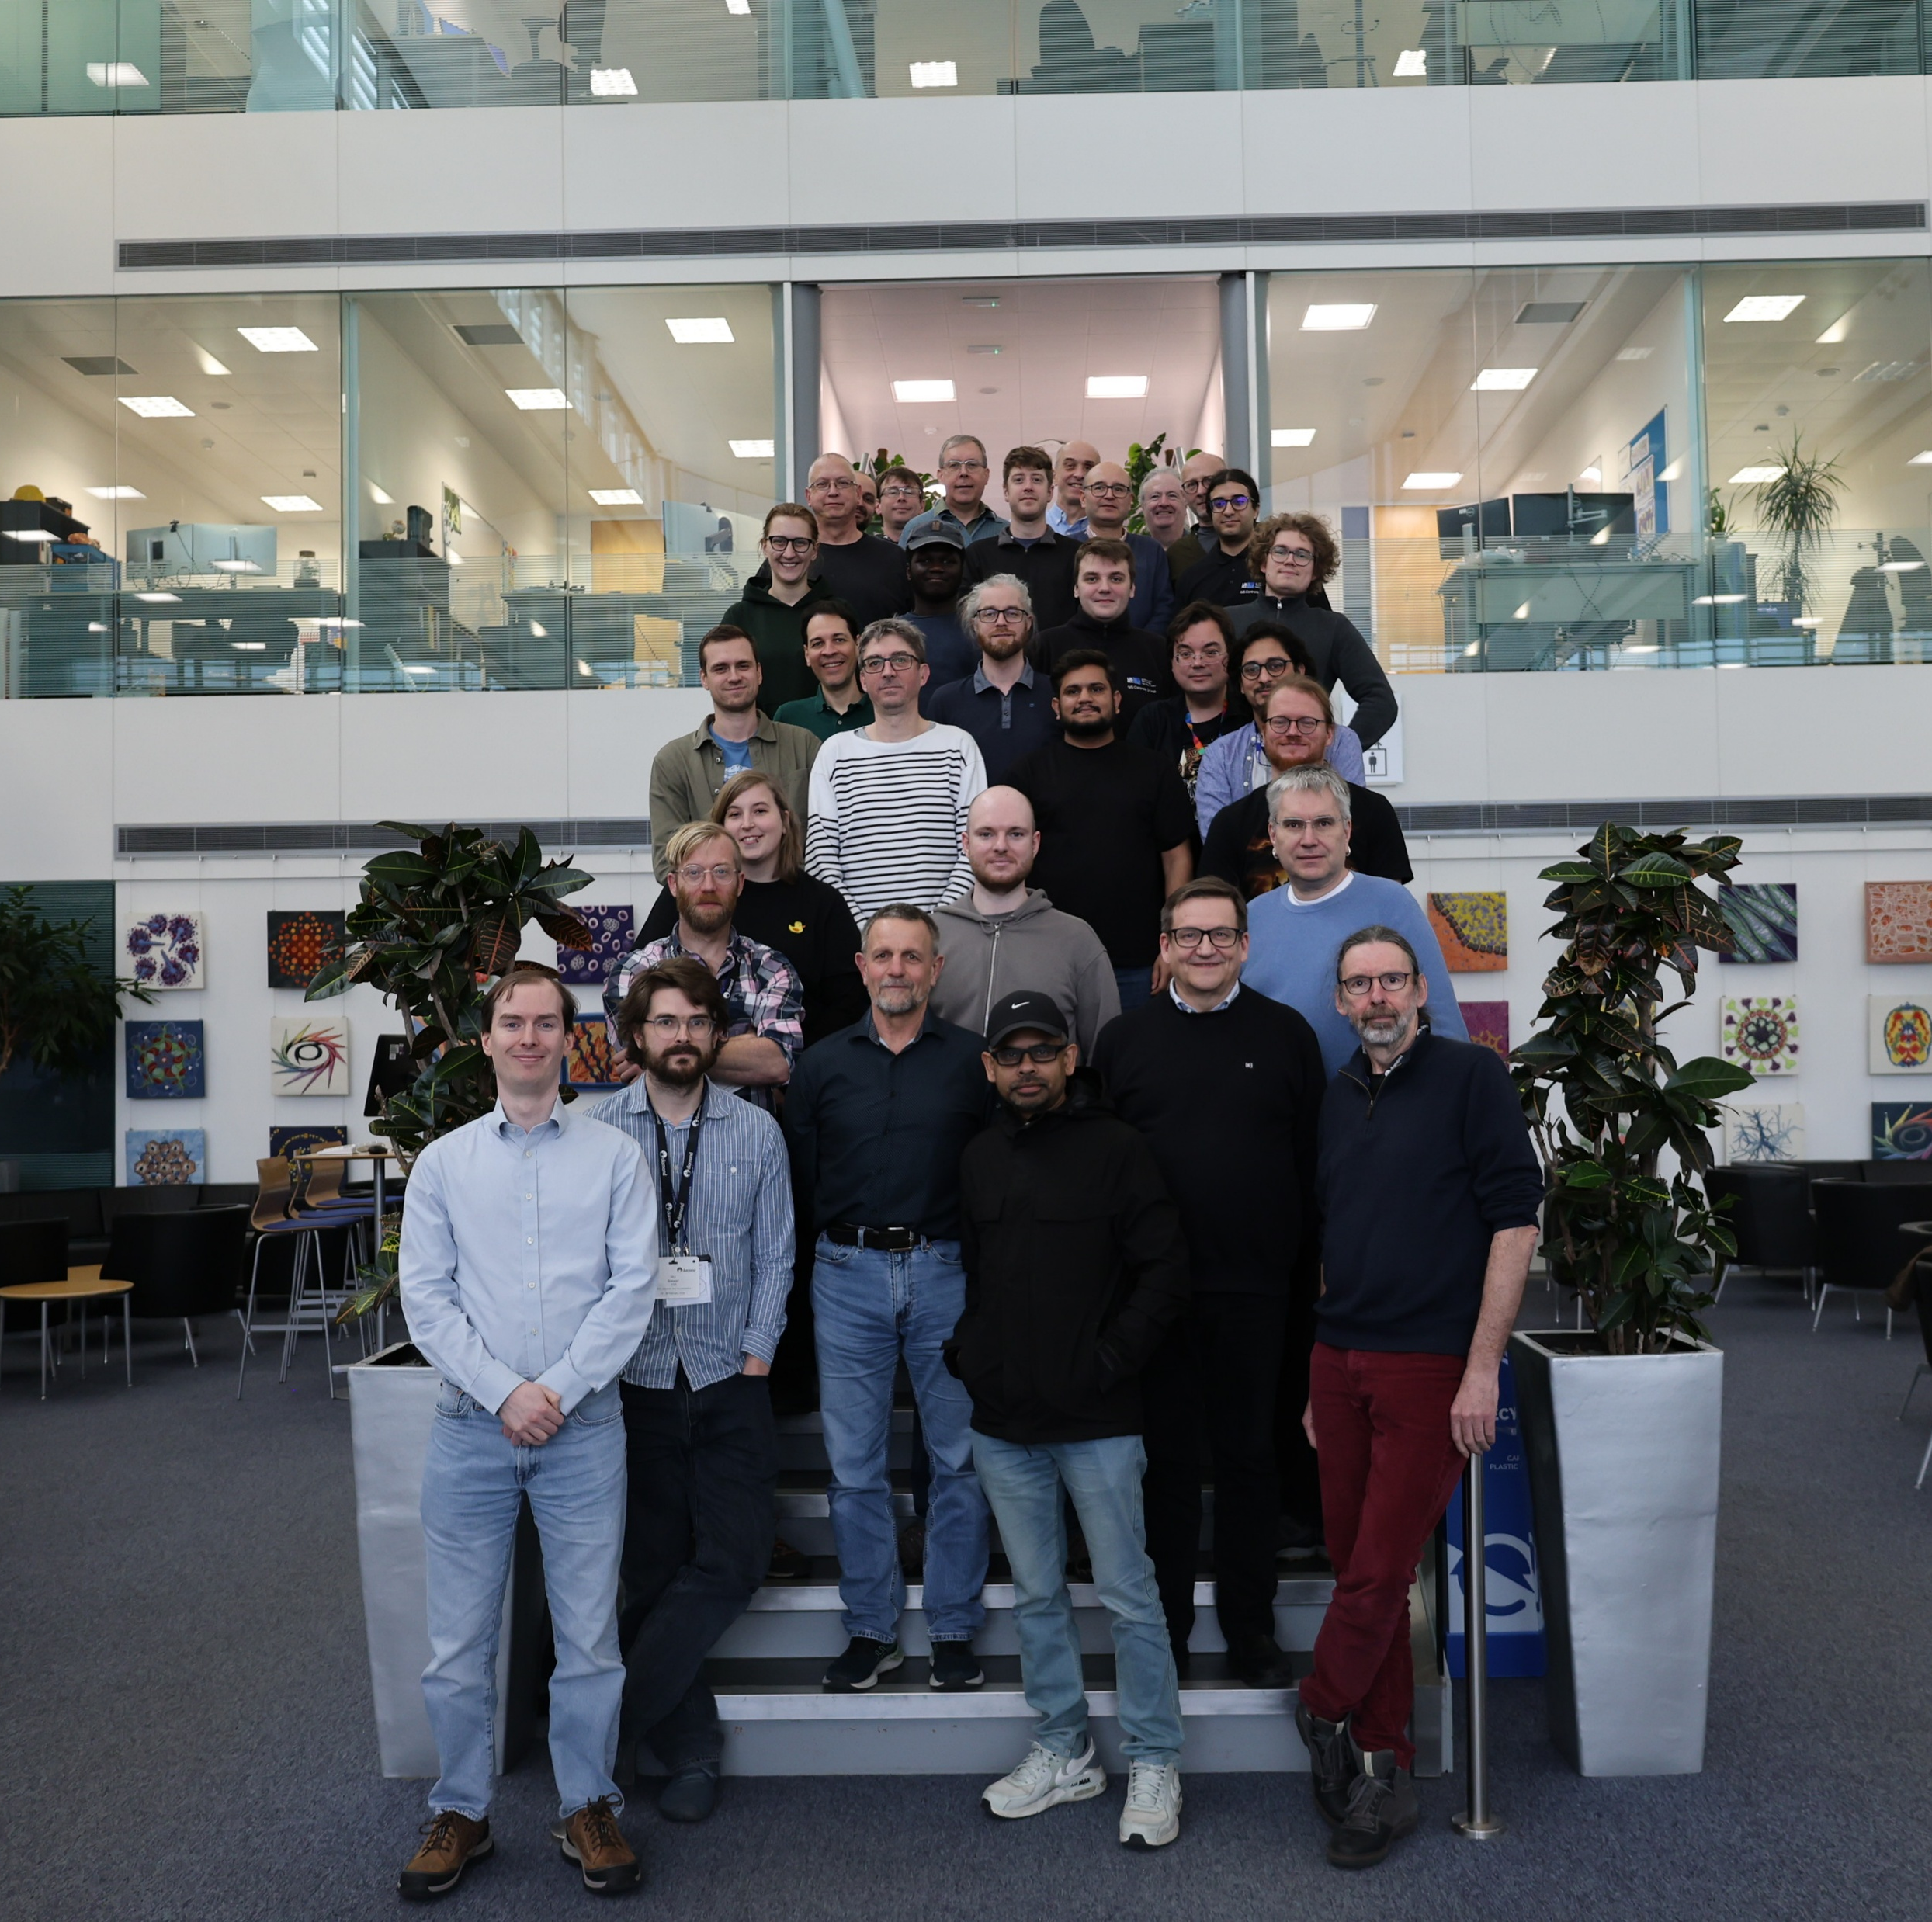
Thanks
Thanks to participants for attending
Thanks to Mark Heron and Diamond Management for sponsoring
Thanks to Events Team and Diamond Comms for support

Slide 11
Codeathon at Brookhaven National Laboratory
EPICS/Phoebus Codeathon & Documentathon @ BNL
When and Where: October 2026, Upton, NY
Who: Open to all skills levels, tasks and projects for everyone
Why:
Learn directly from experts and core contributors
Accelerate development through focused, in-person collaboration
Improve documentation and usability for the community
Strengthen the EPICS and Phoebus community through shared contributions
POC: Kunal Schroff
Notes:
In case of emergency follow instructions from an ORNL employee or PA announcements
Assembly points – Exit through the emergency exits near the stage or lobby front doors, assemble just past the flagpole
Your visitor badge allows you to be unescorted in this building (8600)
Please obey all safety postings – most relevant for the tours on Friday
While you are at ORNL, please do not take photographs of areas that indicate photography is forbidden
Our planned tour route allows photos at all locations

Slide 12
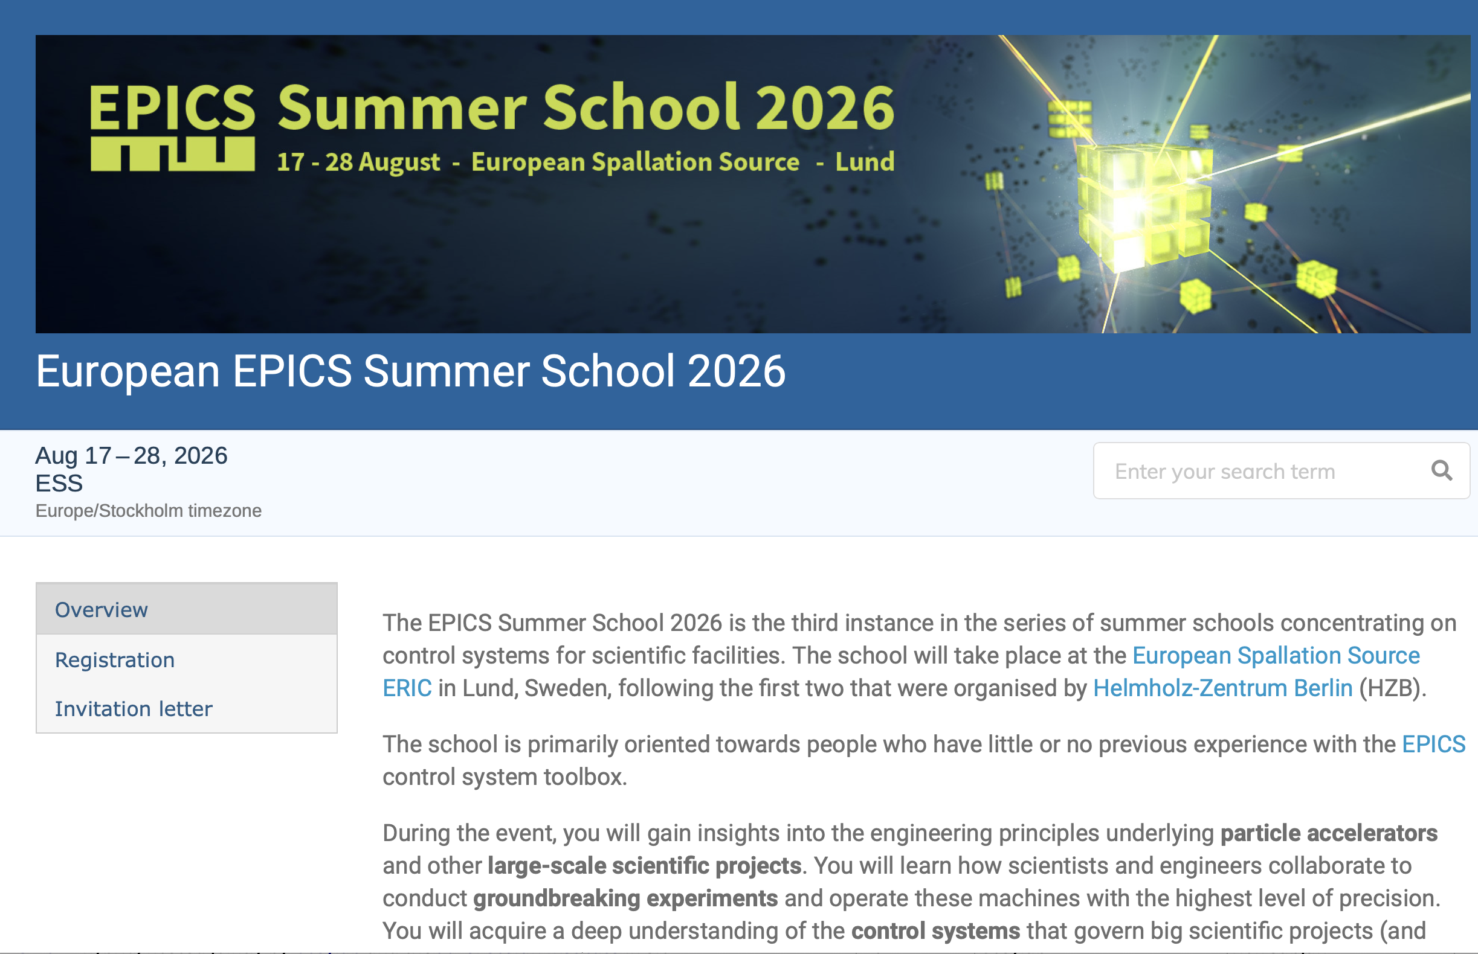
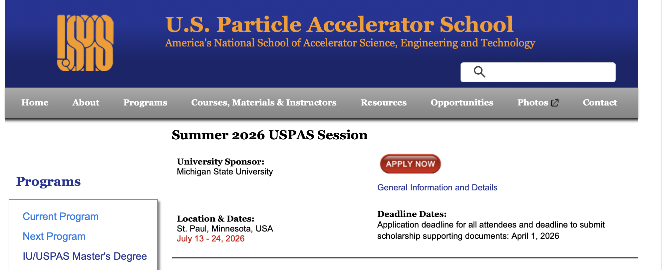
Training
EPICS Summer School
Hosted by ESS
August 17-28, 2026
https://indico.ess.eu/event/3921/
EPICS Control Systems at USPAS
US PAS Hosted by Michigan State University
July 13-17, 2026
Instructors Kay Kasemir/Brad Webb ORNL
EPICS Advanced Training
Under development
Goal
EPICS training is available twice a year on different continents
Notes:
In case of emergency follow instructions from an ORNL employee or PA announcements
Assembly points – Exit through the emergency exits near the stage or lobby front doors, assemble just past the flagpole
Your visitor badge allows you to be unescorted in this building (8600)
Please obey all safety postings – most relevant for the tours on Friday
While you are at ORNL, please do not take photographs of areas that indicate photography is forbidden
Our planned tour route allows photos at all locations

Slide 13

Need to move away from VxWorks? RTEMS
For laboratories who want to run production IOCs on VMEbus systems using RTEMS
The RTEMS support code in EPICS and some of the RTEMS BSPs have bit-rotted
The APS Controls group is hosting monthly Teams meetings of interested developers
Planning info is at https://github.com/epics-base/epics-base/discussions/851
Contact Andrew Johnson (anj@anl.gov) for an invitation to join meetings
Next meeting, 21:00 UTC on May 5th)
Notes:
In case of emergency follow instructions from an ORNL employee or PA announcements
Assembly points – Exit through the emergency exits near the stage or lobby front doors, assemble just past the flagpole
Your visitor badge allows you to be unescorted in this building (8600)
Please obey all safety postings – most relevant for the tours on Friday
While you are at ORNL, please do not take photographs of areas that indicate photography is forbidden
Our planned tour route allows photos at all locations

Slide 14

How do we pay for EPICS?
EPICS is open source but not free, but also not funded
The Collaboration does not receive any specific on-going funding to maintain/improve the software, but this is essential for sustainability
The collaboration relies on donated labor from organizations using EPICS software
The collaboration provides an incredible community of support (“free”, see tech-talk)

Slide 15
How can you get involved?
Opportunities to join working groups such as EPICS core, CS-Studio, more
Send someone to a code-a-thon or document-a-thon, great learning opportunities
You can work with international experts => develop more advanced skills that benefit your professional development and your effectiveness for your home organization
Leadership, host an EPICS Collaboration Meeting, code-a-thon, document-a-thon or developer’s meeting
There is no functional collaboration without active collaborators

Slide 16
EPICS Collaboration
Many thanks to everyone who is attending, presenting and contributing to the work discussed at this meeting
Many thanks to CEA Saclay for a well organized and productive meeting!
Notes:
In case of emergency follow instructions from an ORNL employee or PA announcements
Assembly points – Exit through the emergency exits near the stage or lobby front doors, assemble just past the flagpole
Your visitor badge allows you to be unescorted in this building (8600)
Please obey all safety postings – most relevant for the tours on Friday
While you are at ORNL, please do not take photographs of areas that indicate photography is forbidden
Our planned tour route allows photos at all locations

