Slide 1
Upgrading an Operational Control System to EPICS 7
April 20, 2026
EPICS Collaboration Meeting Spring 2026
Karen White, Alan Justice, Brad Webb
Oak Ridge National Laboratory

Slide 2
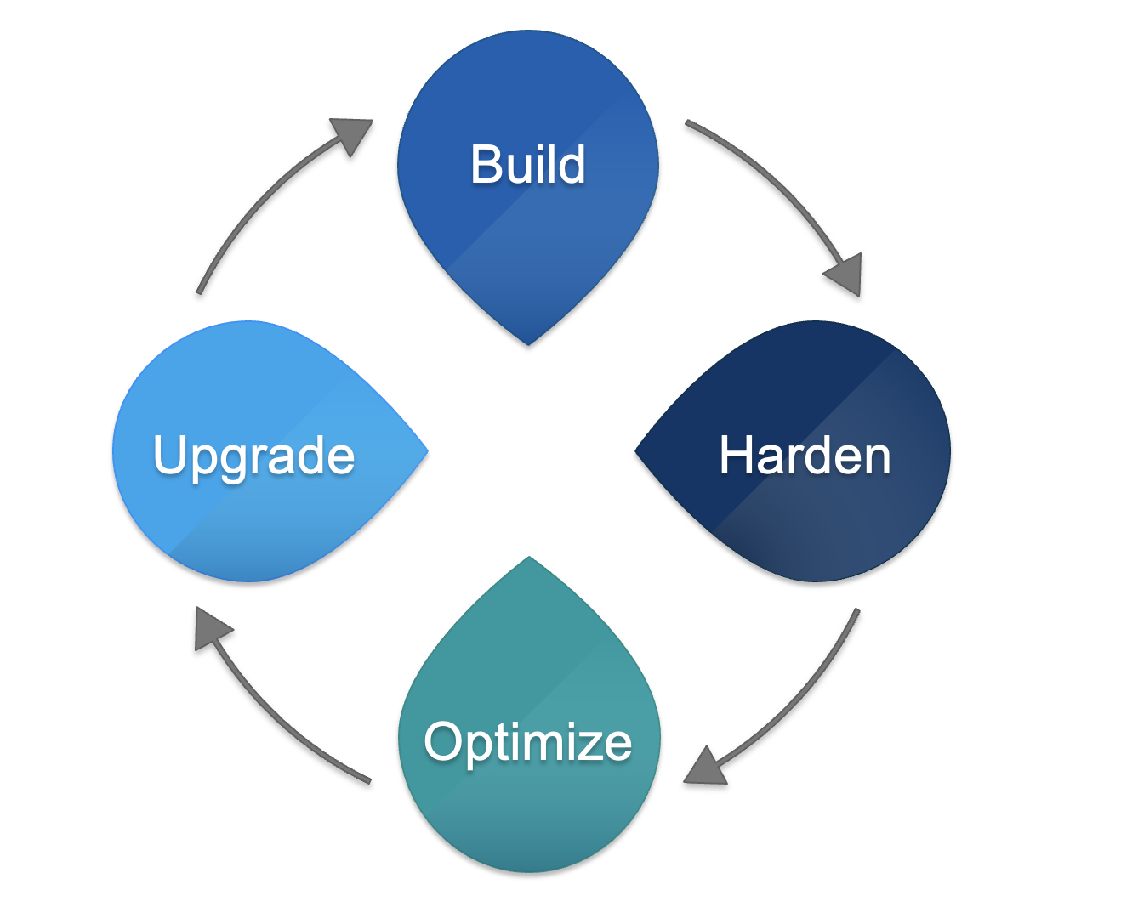
Sustaining Operations - lifecycle
Control system is built, but never finished
Some controls elements turnout to be unreliable
May need optimization
Emergent scope; customers want more diagnostics, new features, capacity may be challenged
Maintenance
Maintenance; parts of the control system start to become obsolete right away
Machine or facility upgrade projects
Notes:
Time for an overhaul, EPICS 3=>7 during operations

Slide 3

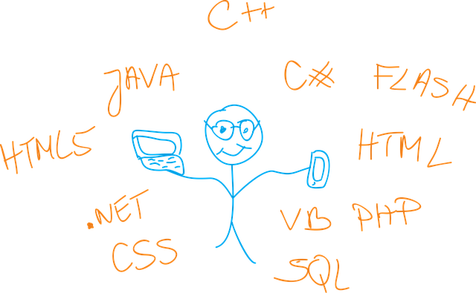
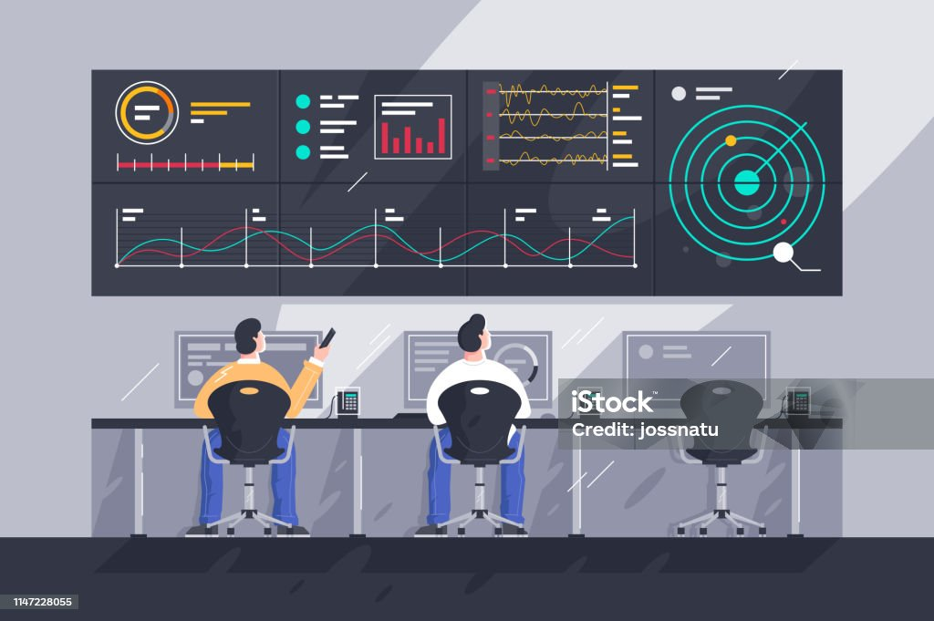

Software becomes obsolete
Support
Can software be supported?
Vendor
Staff
Contractor
Community
Affordably?
Incompatibilities
Can software keep working as other system factors change (hardware, OS, other software)
Hardware
Operating system
Other software
Network
Relevance
Can the software continue to meet customer needs?
Sustains performance
Performs needed functions
Can be adapted for emergent requirements
Integrity
Can software perform reliably, correctly, securely?
Produces correct results every execution
Operates without interruption, pauses, reboots, intervention
Protected from unauthorized access
Notes:
EPICS 3 is no longer supported – it gets harder to do everything yourself as systems get older
New pvAccess network protocol – can transport complex data types
Support for more diverse data structures (normative types, areaDetector, images)
Data structures transferred as a unit (matrices, images, waveforms)
Much faster data transfer
Will accommodate new EPICS security features, meet cyber regulations

Slide 4
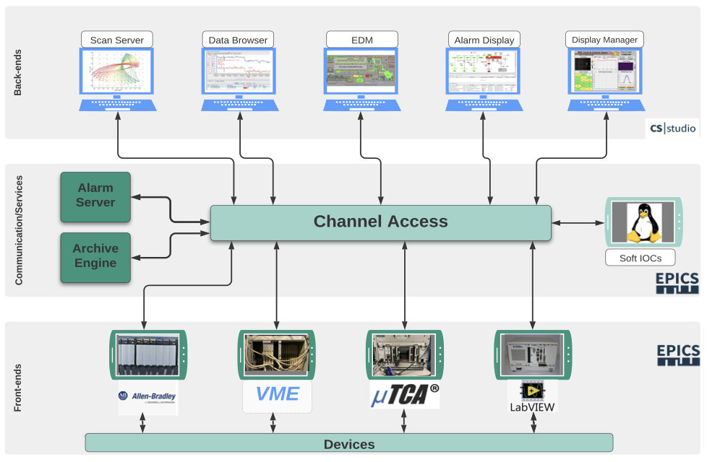
EPICS Architecture makes phased upgrades possible
Tools at the UI level can run in parallel or be replaced without disruption
Scripts at this level depend on function
PV Access peacefully coexists with CA
New services can run in parallel
Soft IOCs can be replaced one or more a time
Channel Access/PVAccess
IOCs performing control functions can be replaced one or more at a time during maintenance
Notes:
With large EPICS 3 operational system, upgrading to EPICS 7 can be a lot of work
The beauty of EPICS: Layered architecture of EPICS makes it possible to migrate without an extended shutdown period
EPICS 7 runs happily alongside EPICS 3 which makes a phased approach possible
Recommend first establishing a test environment where you can build and test EPICS 7
What needs to change?
All IOCs
Some clients
New network protocol

Slide 5
Start with a strong foundation
Migrate IOCs, clients, scripts, mix CA/PVA
Testing
Testing in operations
Test during maintenance days/outages, a few things
Lots of testing, written test plans, more tests
Testing in test environment
Easy rollback process in place
Solid save/restore in operations
You already have this (right?)
Include your hardware mix/devices
Create an EPICS 7 test environment
You already have this (right?)
Also see Managing IOCs with IOCM
B. Webb, 4/21/26, 13:50
Existing code is backed up and under configuration control
You already have this (right
Notes:
Not the time for automated test/build/deploy broadly
Many IOCs/clients transition smoothly, some need more work
Good code management tools and practices

Slide 6

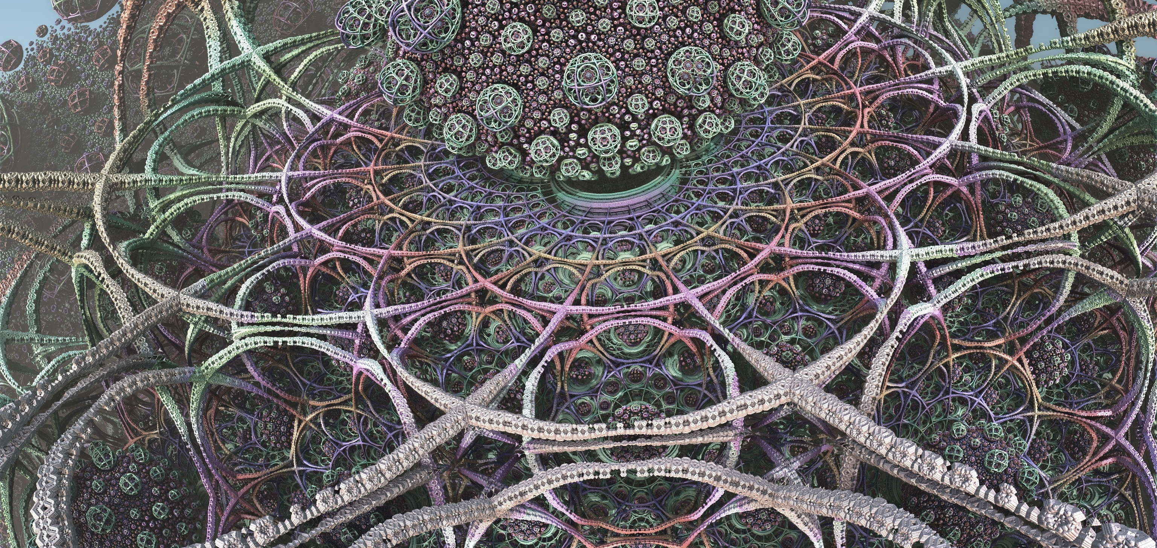

Goal: Seamlessly upgrade control system during normal operations cycle
It’s complicated
Prepare software changes
Make incremental upgrades on maintenance days or outages; return to working order at the end of each period
Plan the work, phase in, coordinated team effort
Soft IOCs
Hard IOCs
EPICS Clients – Phoebus is ready, EDM will not be not be supported
Other clients – User donated software (scripts) may need modifications
Communications, run both protocols, then phase out CA
Get ready for Secure EPICS
Test changes, rollback if issues are discovered while testing
Notes:
EDM does not support pvAccess, need to convert all screens to Phoebes and get people to stop adding more edm screens ☺
EPICS is flexible (more beauty of EPICS) so others can add clients, features (may not be under control group control),harder to corral
Donated Python scripts are everywhere (EPICS is flexible. Allowing users to add code and functionality), now try to get all these doners to update their code for any reason. (how many???)
Bridge software (bringing other data to EPICS PV (PLCs, LabView)
High Level Applications software (XAL, ..)
If you have hundreds or more IOCs and clients, this incremental approach will take many maintenance days and outages

Slide 7
Success!
EPICS 7 provides a strong foundation for our new reality
Staying cyber compliant/secure => Secure EPICS – time to manage all those certificates
Support endless undefined ML/AI experiments => Without additional infrastructure?
Automate everything or more
Thanks to all the developers who worked to make EPICS 7 a success without requiring huge code changes to migrate!

Slide 8

It takes a lot of people! SNS Control System Section is hiring
Controls Software Engineer
Protection Systems Engineer
Controls Infrastructure Engineer
AutoCad Designer
ksw@ornl.gov

Slide 9
