Slide 1

Spring EPICS collaboration meeting 2026
Information point
Paul Lotrus
20/04/26

Slide 2
Laboratory: LDISC
Localization: Saclay (France) on 2 buildings
Team: 22 technicians et engineers plus 2 fixed-term contract and 11 students (9 apprentices)
 | Permanent | Non permanent
Project manager | 4
PLC developer | 7 | 4
EPICS IOC developer | 5 | 2
Java and co developer | 3 | 1
LabVIEW | 1
FPGA | 1 | 1
System administrator |  | 2
Cybersecurity |  | 1
 | Permanent | Non permanent
Automation | 10 | 4
Software | 12 | 4
System administrator |  | 2
Cybersecurity |  | 1

Slide 3
Laboratory: LDISC
3 main software:
EPICS: accelerator control and more
Muscade: homemade SCADA for lightweight experiment
ASNET: homemade acquisition system for superconducting magnet
Working for 10 years to adapt EPICS for lightweight experiment, mainly providing tools for making PLC profile autonomous on EPICS
PLCParserTool: generates EPICS database from TIA Portal variables description for Modbus/TCP, S7 PLC, OPC UA, …
DFXTOOPI: generates Phoebus GUI from AutoCAD
Participation on codeathon: Have internal EPICS specialists (from IOC to GUI)
Participation on documentathon: Help beginners and non EPICS profiles to work with EPICS

Slide 4

Information
It is forbidden to smoke inside the ENS, even in the park inside
WIFI : ENS-GUEST
Connect with web browser
Your email address
Badge
Phone numbers
Red Point: You do not wish to appear in any official event media
Green ticket: You have chosen the vegetarian menu at the Gala diner
Visit : Name of the visit and color point
Give back the badge

Slide 5
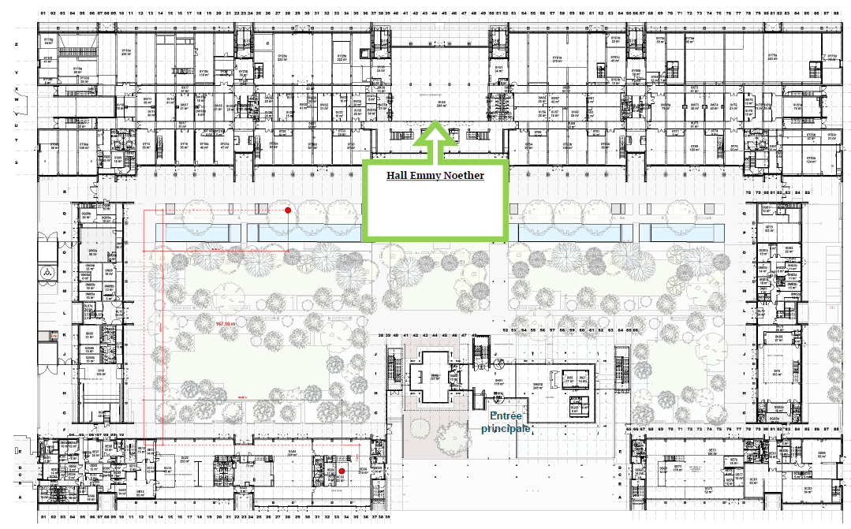
Entrance: Ground floor
Entrance
Support team

Slide 6
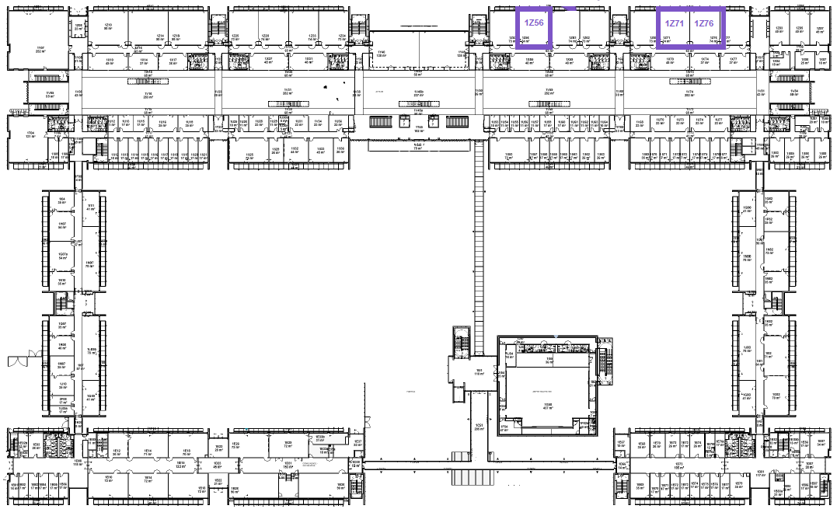
Talks: 1st floor
Auditorium Alain Aspect
Monday, Tuesday, Wednesday

Slide 7
Talks
Download your presentation on the website: https://indico.in2p3.fr/event/37441/contributions/mine
Meeting talks
15 minutes
5 minutes of questions
Lightning talks
5 minutes
No question
Please, be on time for the other presentation

Slide 8
Breaks: Ground floor
It is forbidden to open the doors on the street side
Hall Emmy Noether
Coffee break, Lunch, Tea break, Welcome drink
It is allowed to eat in the park
Support team

Slide 9
Workshops: 1st floor
Gradinée room (60 seats)
Thursday, Friday
Gradinée room (60 seats)
Thursday, Friday

Slide 10
Trainings and workshops
Depending on the workshop, you may need to download a Virtual Machine which will contains all the EPICS environment or configure a Github codespace
Please, go on the description of the workshop session in the Timetable – detailed view (https://indico.in2p3.fr/event/37441/timetable/#20260423.detailed)
Github code space for the session Introduction to EPICS
Same VM will be used for the sessions:
StreamDevice (Thursday 11h00)
EPICS 7 (Thursday 10h00)
OPC UA Security (Thursday 13h30)
oac-tree (Friday 9h00)
A VM for the session Phoebus GUI and services workshop (Thursday 13h30)

Slide 11

Social event: Welcome drink
Here at ENS after the meeting, ground floor in hall Emmy Noether at 17h45 (Diner on your side)
Hall Emmy Noether
Welcome drink

Slide 12
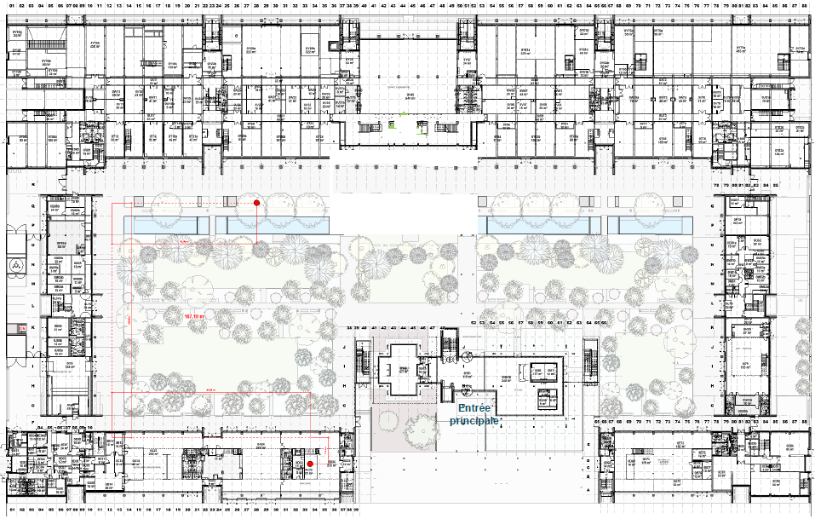
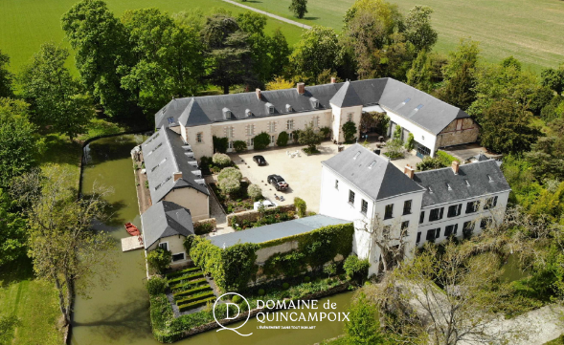
Social event: Gala diner on Wednesday
Bus departure
Ground floor
Registration are closed (full)
Domaine de Quincampoix
2 buses at 17h45 at the Hall Emmy Noether (ground floor)
Return by bus in 2 locations: One bus at ENS (here), one bus at Massy-Palaiseau train station
Vegetarian menu: You should have a green paper in your badge

Slide 13
Visit on Friday afternoon
Visit bus departure
Ground floor
Departure by bus at 13h50 from ENS (lunch exit) Return by bus at ENS
Synergium visit (full):
You MUST have your passport
You MUST stay with your group
2 groups of 10
Duration: 2h
SOLEIL (full):
Take your Id just in case
Duration 2h30
Maison de la simulation (Universe simulation):
Duration : 2h

Slide 14
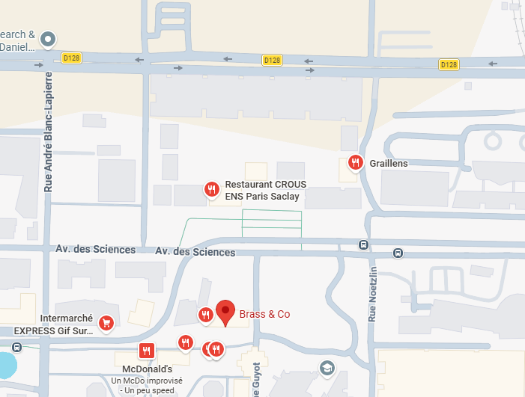

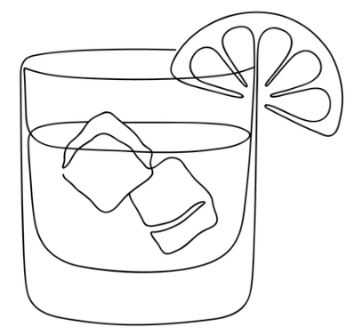
Social event: Farewell drink on Friday after visit
Farewell drink on Friday night at “Brass & Co” bar nearby (at your expense) at around 17h30

Slide 15
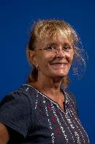
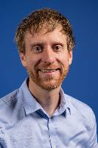
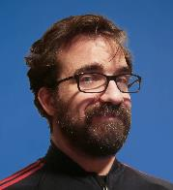
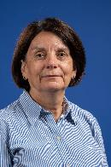
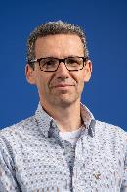
More information
Website of this meeting: https://indico.in2p3.fr/e/springepicsmeeting2026
Organization comity: Sophie DURAND, Natacha LOMET, Eva PROSZENUCK, Pierre MANIL
Scientific comity: Alexis GAGET, Françoise GOUGNAUD, Paul LOTRUS
Any person with a badge “CEA Paris-Saclay” can help you

Slide 16
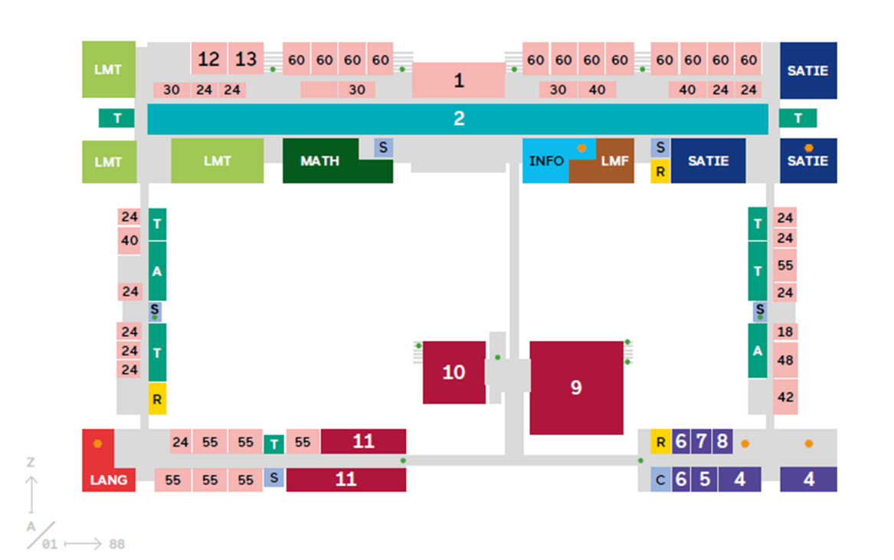

Photo
Group photo at 11h30 today on ground floor

Slide 17
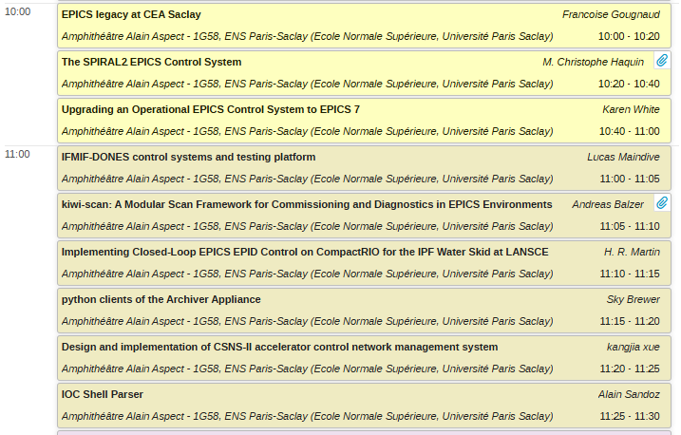
Morning program

