Slide 2

Following the two previous summer schools at Helmholtz Zentrum Berlin (BESSY II), I am pleased to announce that this year we will continue the series at the European Spallation Source.
The school is intended for people who are (relatively) new to EPICS:
Students interested in the field, professionals who are new to EPICS
The two-week school program consists of:
Presentations by expert scientists and engineers about how big (and small) experimental facilities work.
Training to introduce the fundamentals of EPICS
Work in on a challenging project using real hardware.
Site visit to the European Spallation Source guided by our scientists and engineers.

Slide 3
Registration for the summer school is open at https://indico.ess.eu/e/epics-school-2026
We can take 32 students. If there are more applicants than places, we will select the students based on their background, merits and interests.
The is no fee for the course, however the students must cover their travel and accommodation costs.
Easy access by train; closest airport is Copenhagen. Travel instructions are on the website.
For students with no institutional backing, we are preparing (a limited number of) grants to support them with accommodation in nearby hotels (ESS has no guest house facilities.)
Lunch and refreshments (Swedish ”fika”) will be provided during the school on-site.
An event dinner and other social activities are planned (TBD).

Slide 4
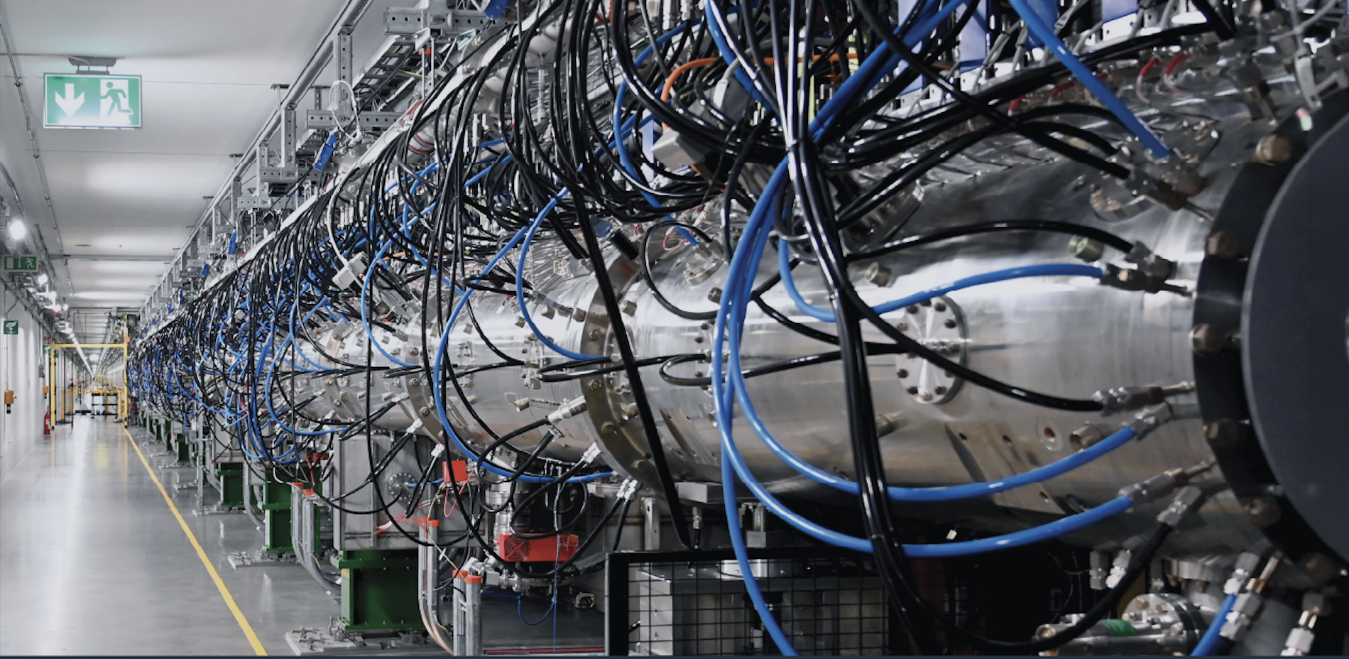
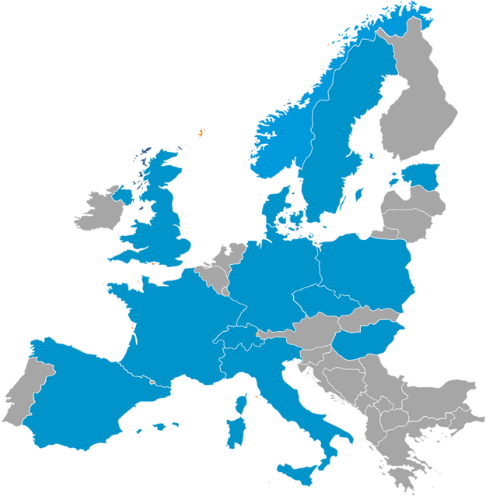
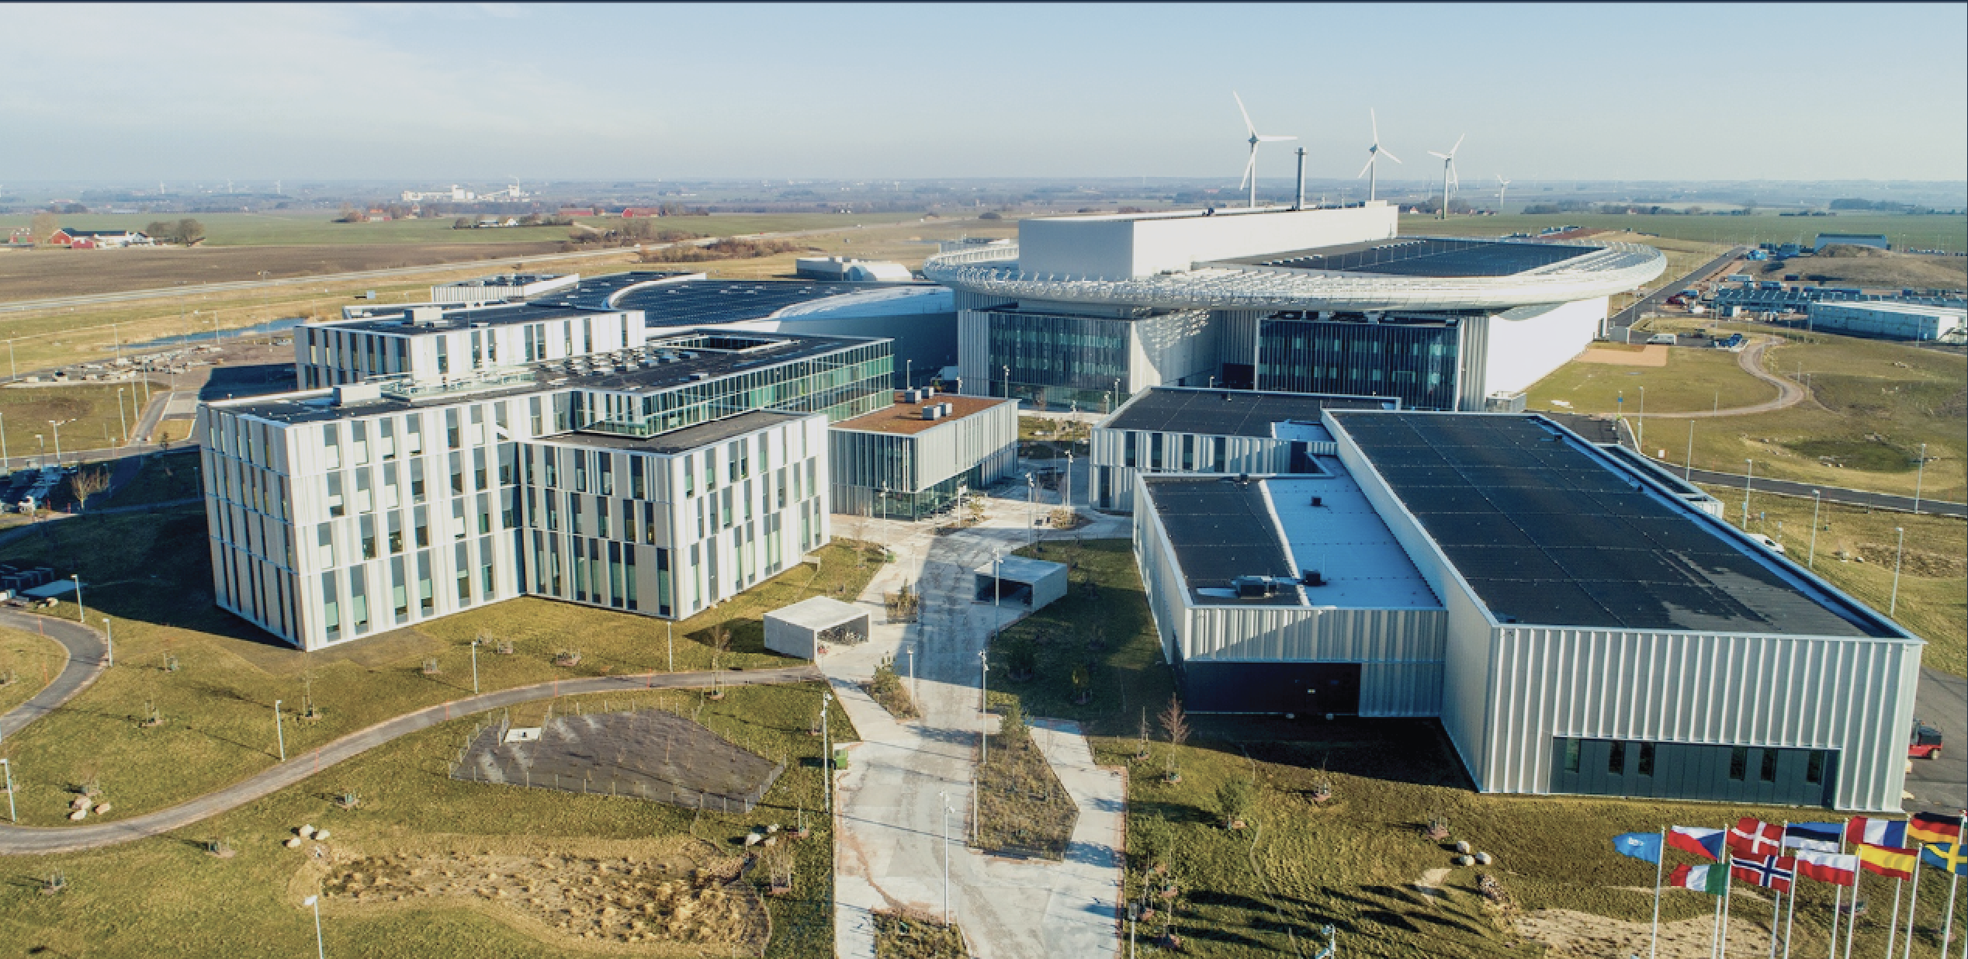
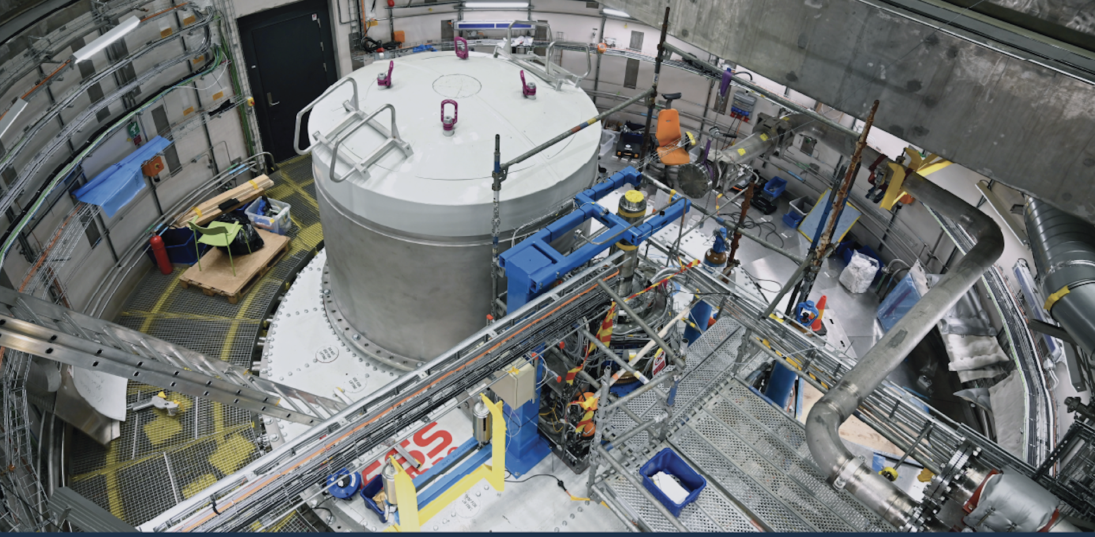
The European Spallation Source ERIC
An accelerator-based neutron source in Lund, southern Sweden and Data Management Center (DMSC) in Copenhagen, Denmark
Material and life sciences research
A collaboration of 13 European nations
Superconducting linac, rotating tungsten target
13 neutron instruments in construction

Slide 5
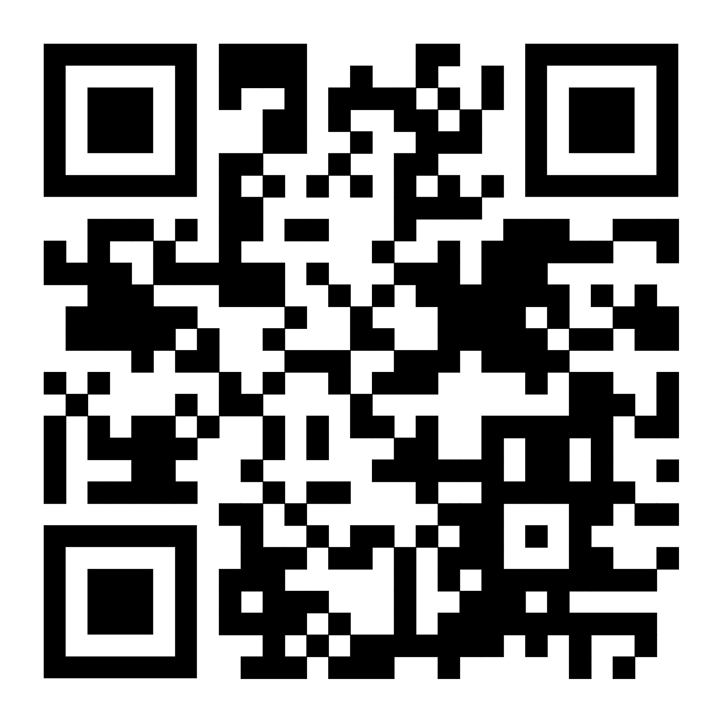
If this sounds interesting:
Consider applying if you think that the program would be suitable for you
Please spread the word at your school, university or workplace
We are looking forward to train a group of new talented control system engineers!
https://indico.ess.eu/e/epics-school-2026

Slide 6
Finish presentation

