Slide 1
Spring EPICS Collaboration Meeting Integration of non digital devices using modbus
Falk Rosenhahn
Fritz Haber Institute
PP&B and Elab Department
Paris-Saclay, 21.04.2026

Slide 2

Benefit
No coding and
no hardware development required

Slide 3
First Example

Slide 4
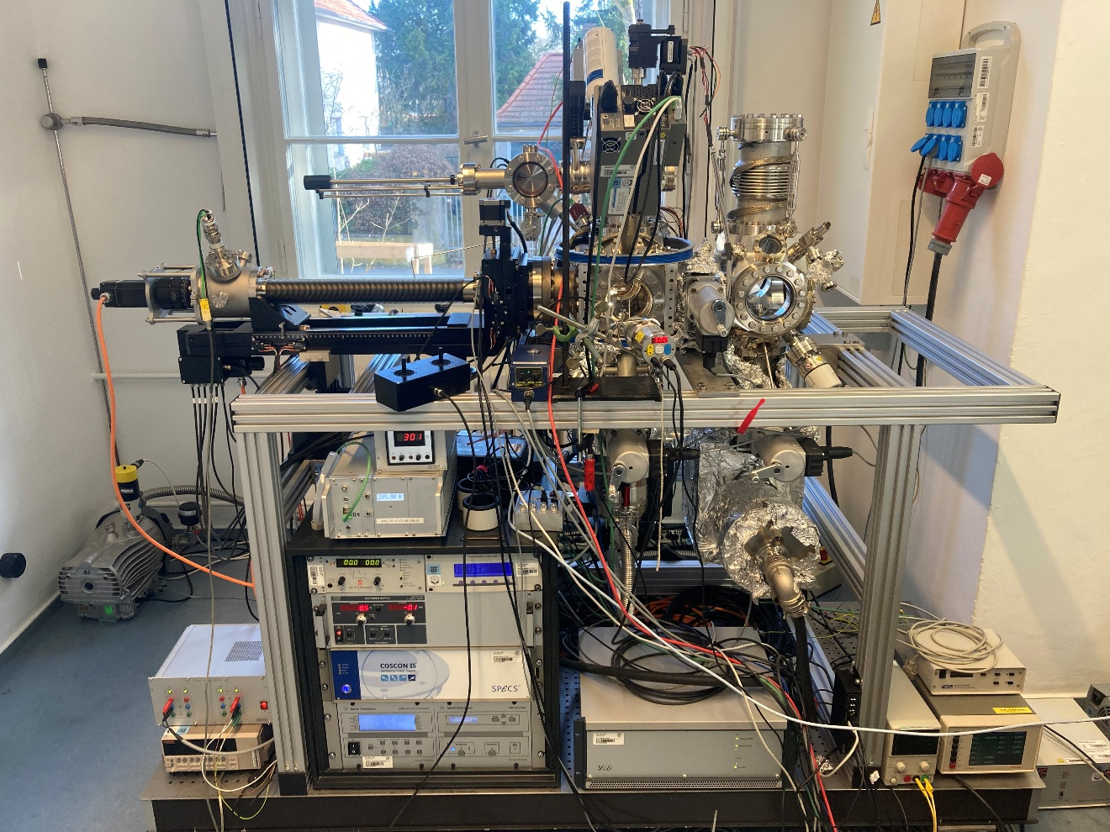
UHV system for surface science
LEED
SPUTTER
GARAGE
VALVE

Slide 5
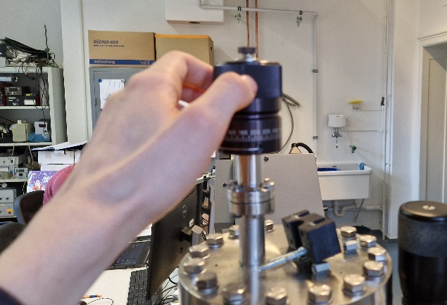
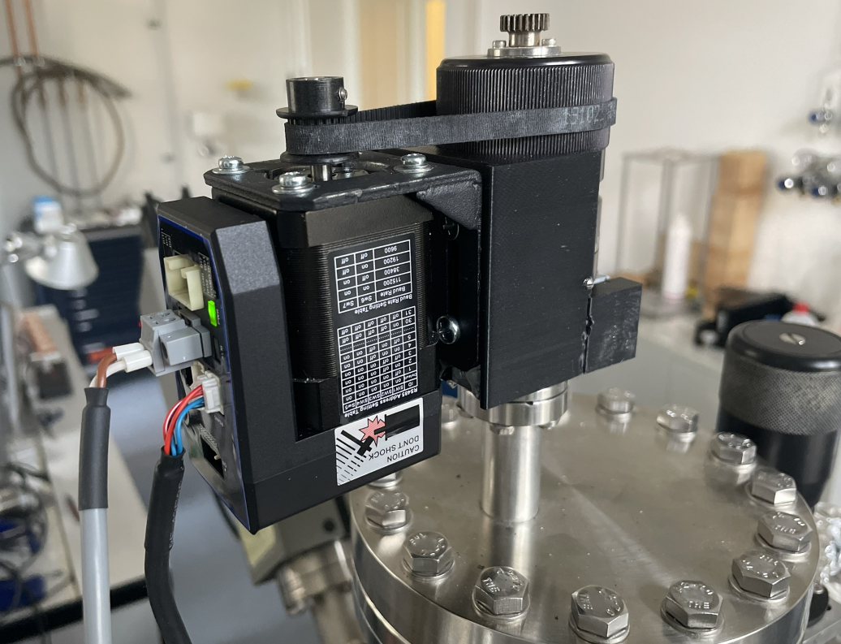
Automate linear motion

Slide 6
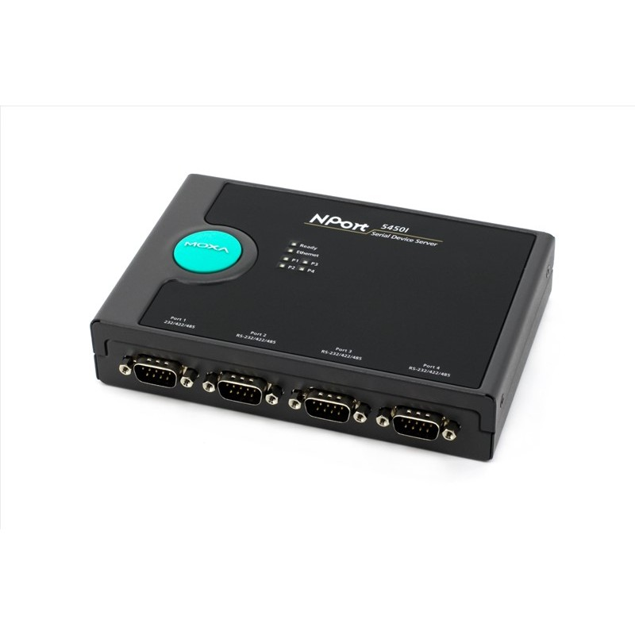
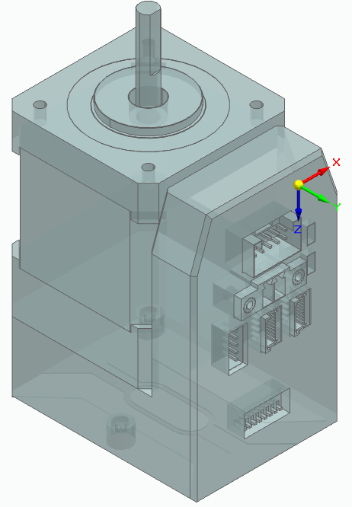
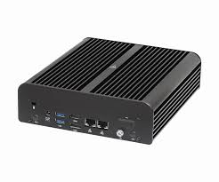
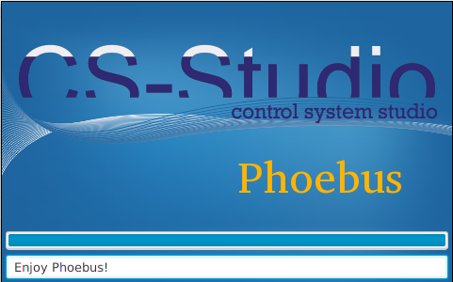
Integration
RS485
LAN
LAN
iCL42-RS06
Serial-Server
EPICS-Server
EPICS Client

Slide 7
st.cmd
epicsEnvSet("PORTT", "LAN")
epicsEnvSet("SM", "ICL42MOTOR")
drvAsynIPPortConfigure("$(PORTT)", "10.0.0.100:4005", 0, 0, 0)
modbusInterposeConfig("$(PORTT)", 1, 2000, 4)
drvModbusAsynConfigure("POS_SET$(PORTT)", "$(PORTT)", 1, 16, 0x6201, 2 , INT32_BE, 0 , "$(SM)")
drvModbusAsynConfigure("POS_START$(PORTT)", "$(PORTT)", 1, 16, 0x6002, 1 , INT16 , 0 , "$(SM)")
epicsEnvSet("ARG_LEED$(SM)", "PORTA=POS_SET$(PORTT), PORTB=POS_START$(PORTT)")
dbLoadRecords("db/StepperMotor.template","$(ARG_LEED$(SM))")

Slide 8
Steppermotor.template
record(longout, "$(P):$(M):Set_pos") {
field(DTYP, "asynInt32")
field(OUT, "@asyn($(PORTA) 0)")
field(EGU, "Steps")
field(FLNK, "$(P):$(M):Delay_start")
}
record(calcout, "$(P):$(M):Delay_start") {
field(SCAN, "Passive")
field(INPA, "$(P):$(M):Set_pos.VAL CP")
field(CALC, "A")
field(ODLY, "0.1") #Delay
field(OUT, "$(P):$(M):Start.PROC PP")
}
record(longout, "$(P):$(M):Start") {
field(DTYP, "asynInt32")
field(OUT, "@asyn($(PORTB) 0)")
field(VAL, "16")
}

Slide 9
Second Example

Slide 10
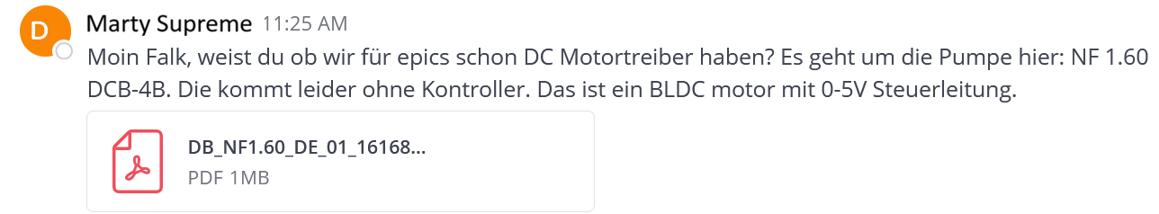
Ask for Automation

Slide 11
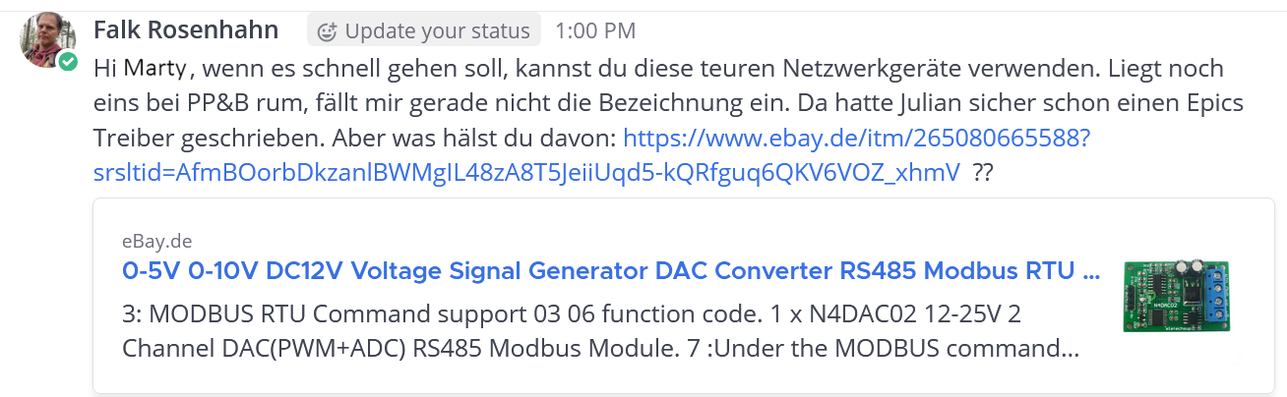
Ask for Automation

Slide 12
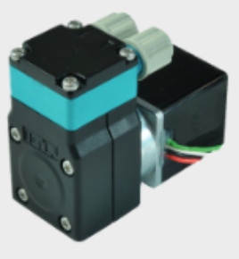
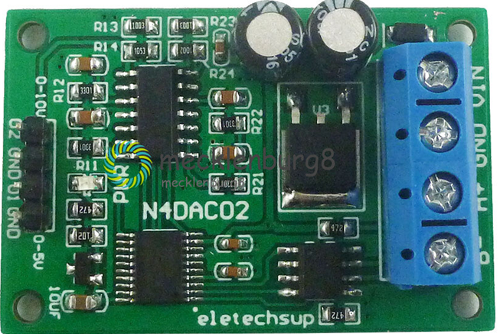
Integration
Analog
RS485
LAN
NF 1.60 DCB-4B
N4DAC2
EPICS-Server
EPICS Client

Slide 13
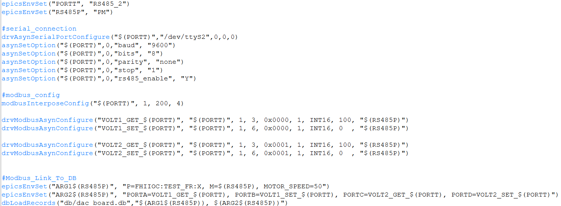
ST.CMD

Slide 14
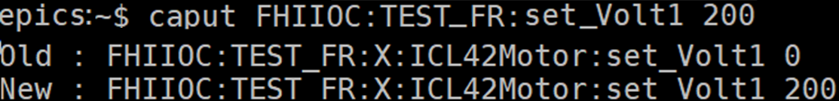
USE

Slide 15
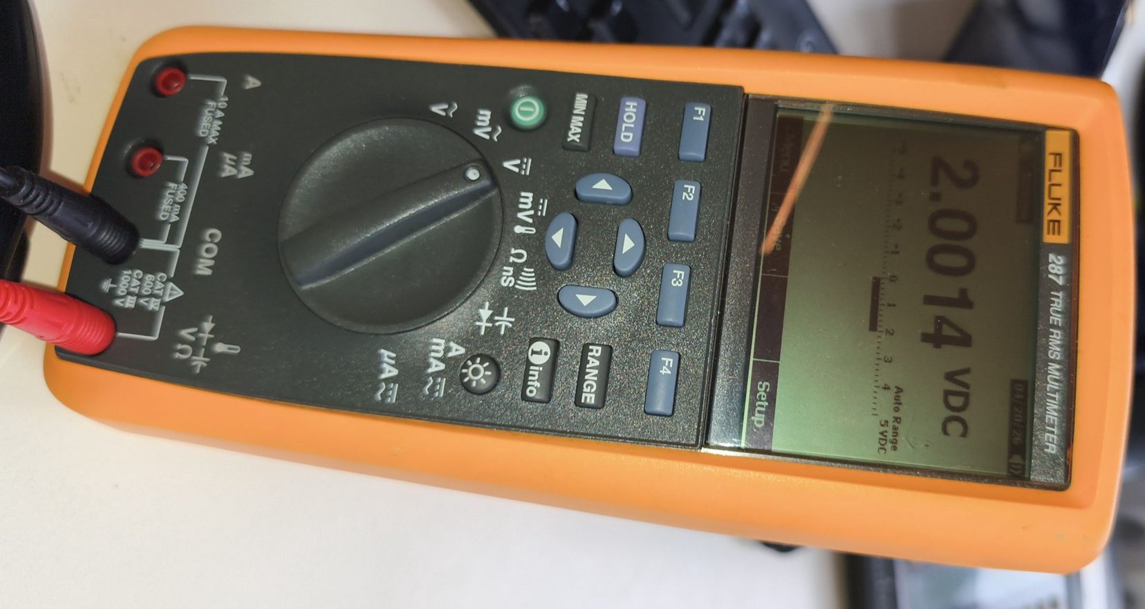
USE

Slide 16
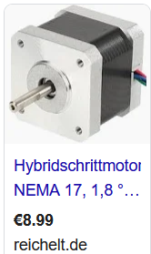
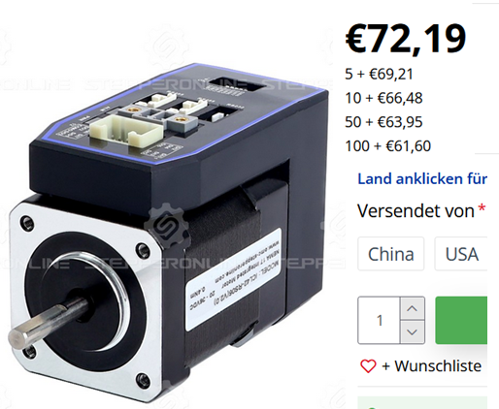
Conclusion
What will be cost more for our institude?

Slide 17
Thank you

