Slide 1
PVAccess for LabVIEW
Project Update
Ross Titmarsh – ISIS Accelerator Diagnostics
ENS Paris-Saclay, Paris
Tuesday 21 April 2026

Slide 2
The basic interface

Slide 3
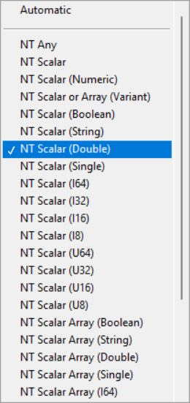
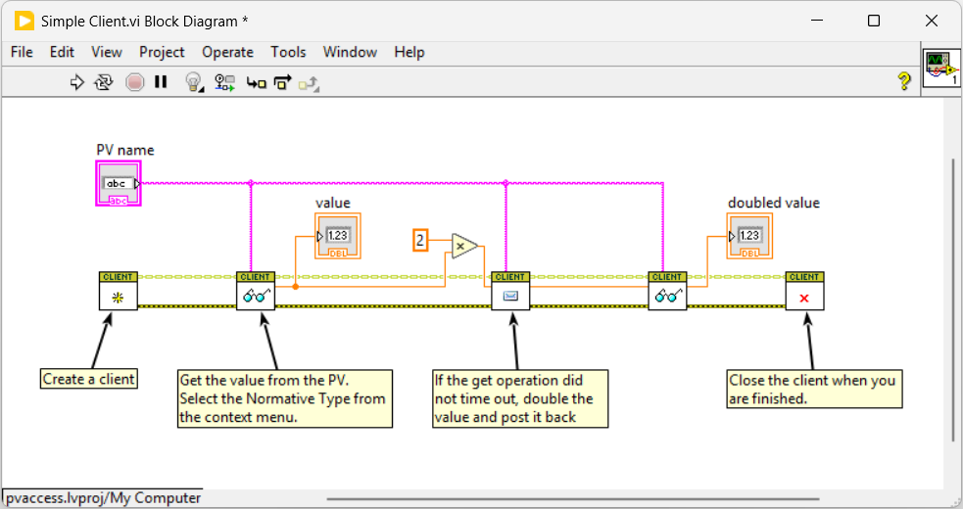
Notes:
Allows you to read the value and timestamps fields
Timestamp in and out terminals are on the bottoms of the Vis
Minimal serialisation, direct calls to PVXS get and post

Slide 4
Current deployments
Deployed in ISIS for 6 months on some non-critical systems for testing
Being used externally at INFN
It will replace our legacy XML over HTTP interface over the next year

Slide 5
Metadata!

Slide 6
A LabVIEW OOP
For reading and writing metadata, the PVData is encoded into LabVIEW classes
Two concrete classes are currently implemented
  NT Scalar (for booleans, strings and arrays of them)
  NT Scalar (Numeric) (for numerics and arrays of them)
Properties are accessed with property nodes

Slide 7
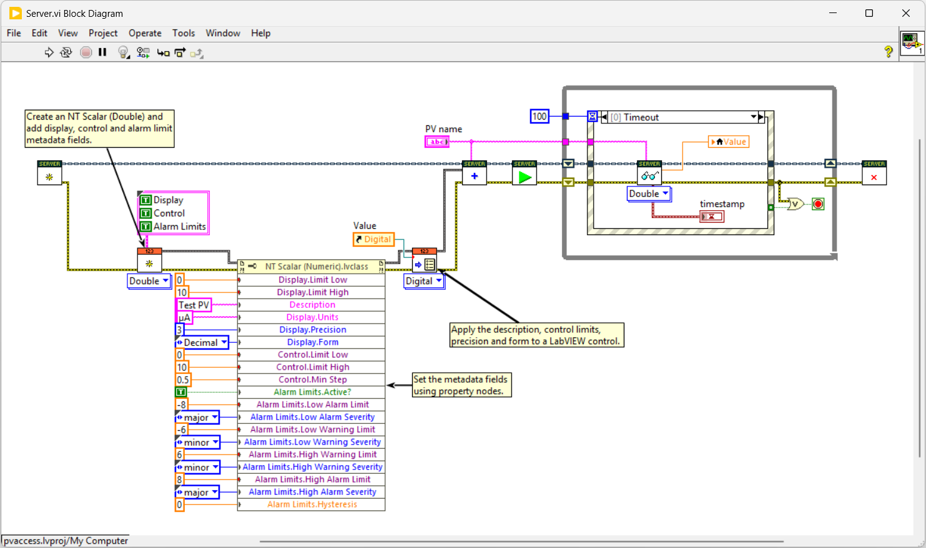


Slide 8
Roadmap
LabVIEW units
NTEnum support
NTTable support and custom data structures
Data persistence
Read only PVs
Alarm logic

Slide 9
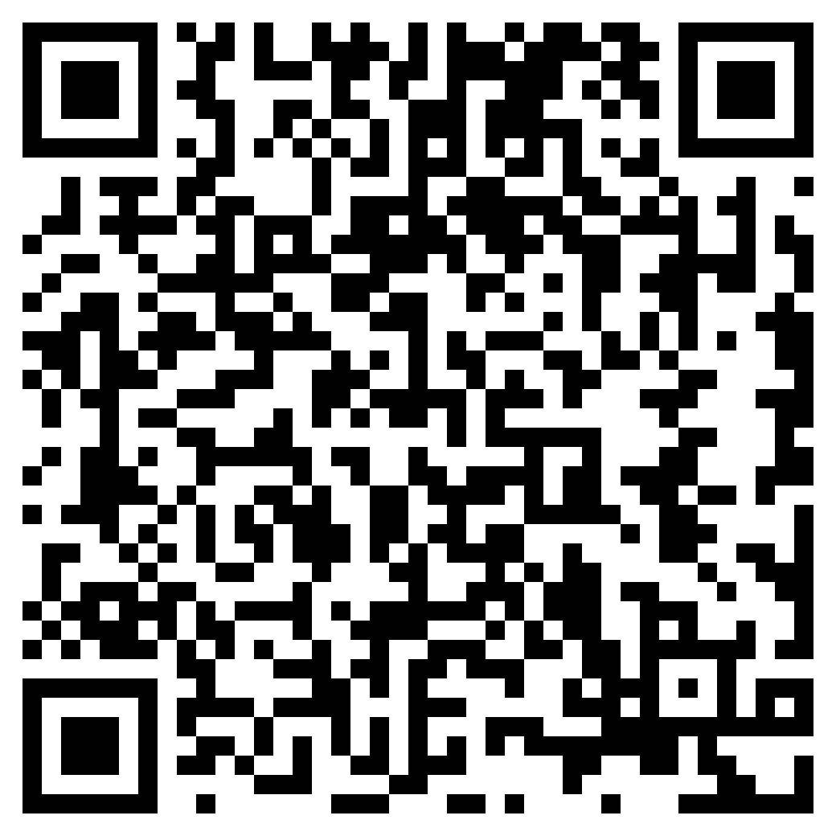
Thank you
Beta release now live! →
https://github.com/ISISNeutronMuon/pvaccess-labview

