Slide 1
Trace
PyDM Plotting Tool
Zach Domke
April 21st, 2026

Slide 2
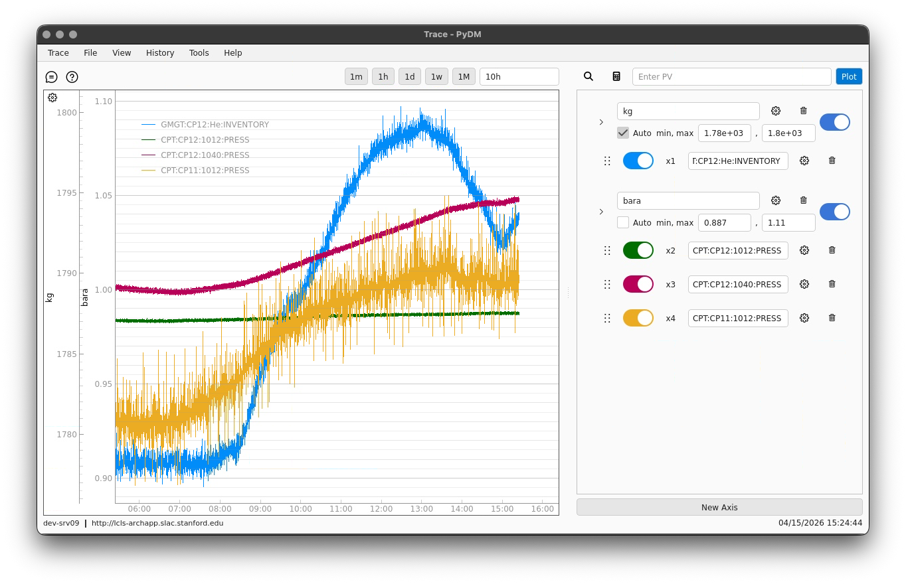
What is Trace?
PyDM Application
Bundle EPICS StripTool and ArchiveViewer
Plot live (CA / PVA) and archived data
Archive Appliance
Previously known as PyDM Archive Viewer
Presented in 2024

Slide 3
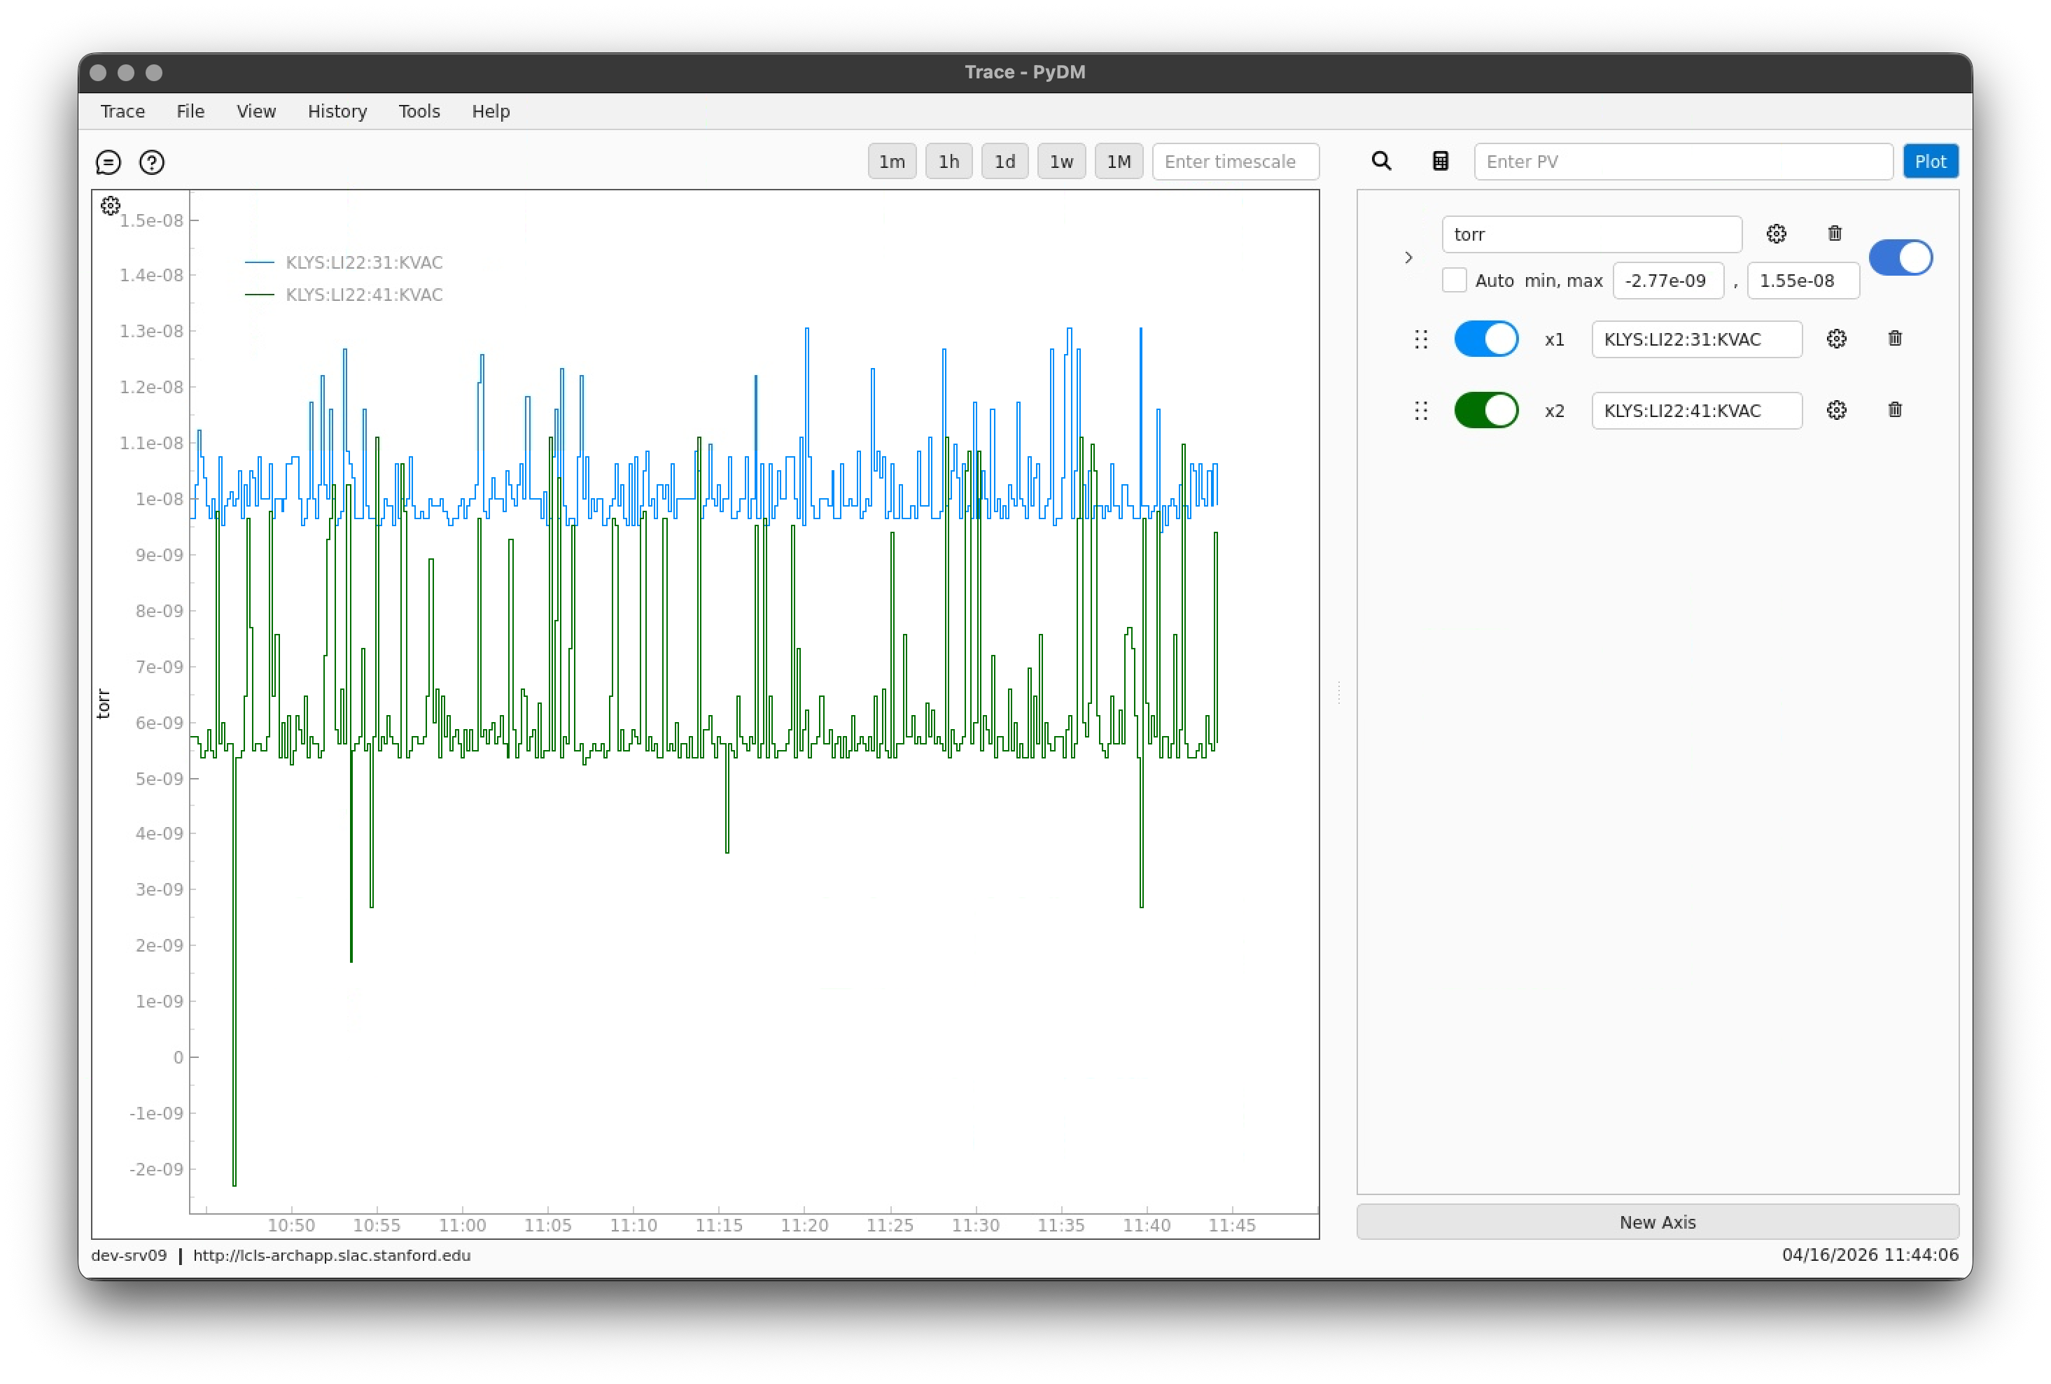
Interface Overview

Slide 4
Interface Overview
Plot Section
Mouse Controls
Zoom / Pan
Timescale options
Plot Settings
Legend & Crosshairs
Configuration Section
Add Traces
Add multiple Y-Axes
Customize both

Slide 5
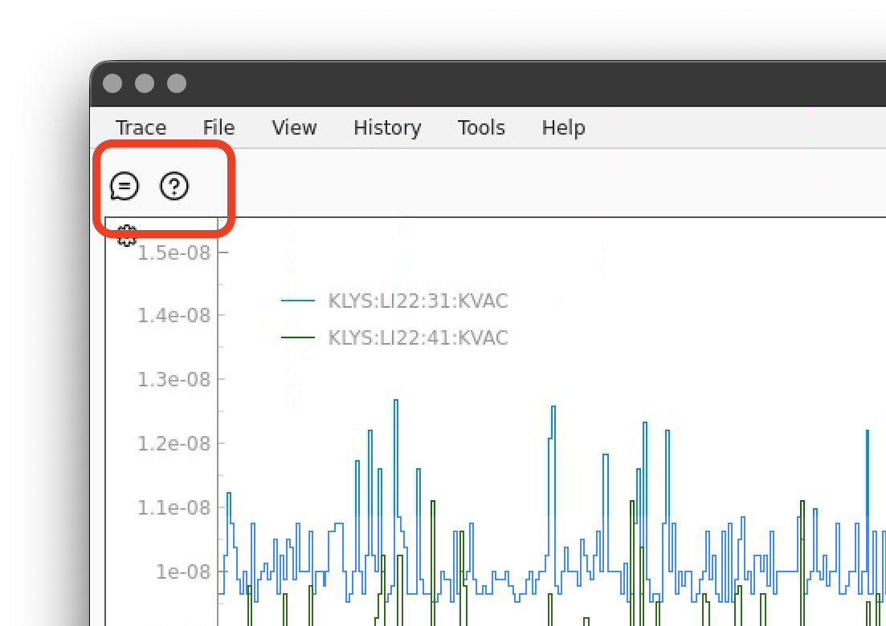
Interface Overview – Documentation & Feedback
Open default web browser
Feedback Form
Open Microsoft Form link
Documentation
Open GitHub hosted docs

Slide 6
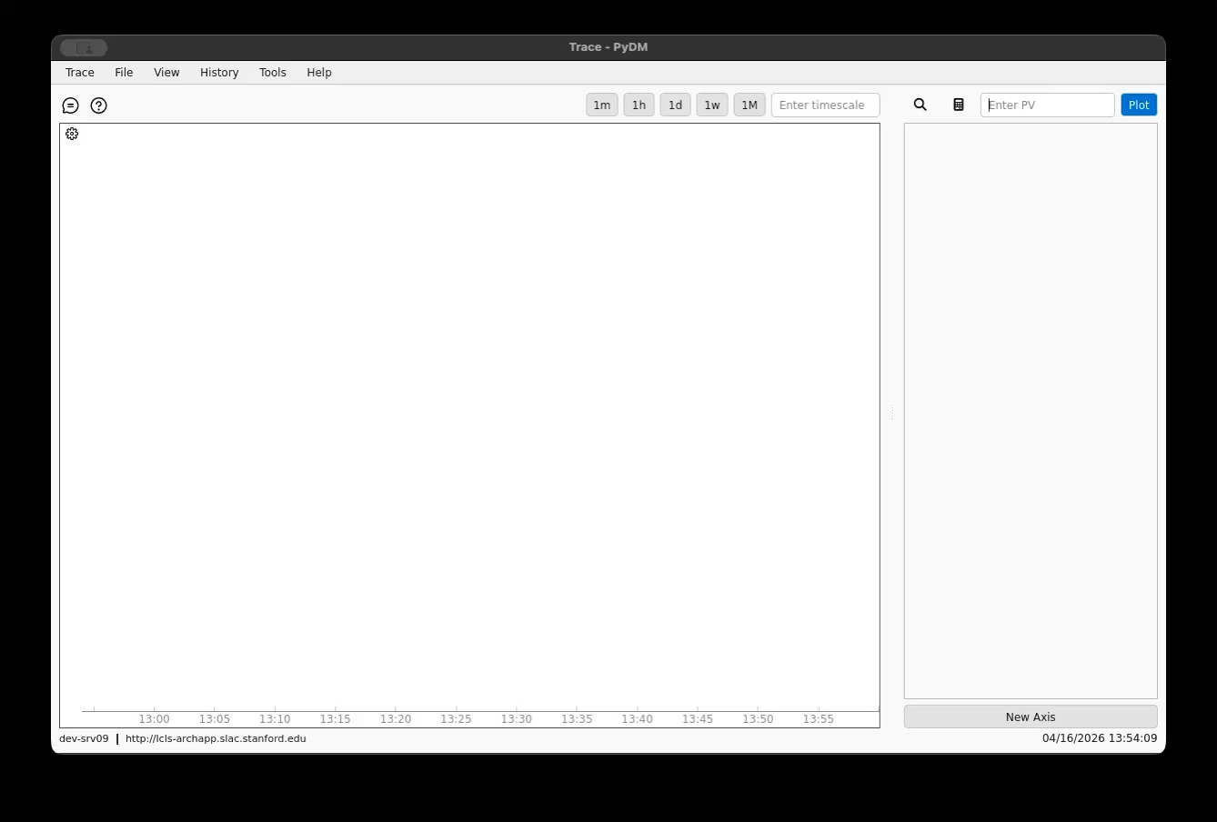
Core Workflow

Slide 7
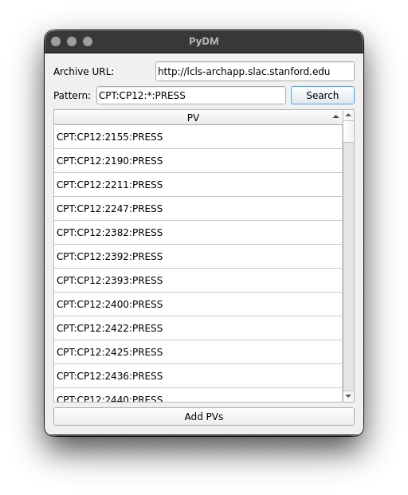
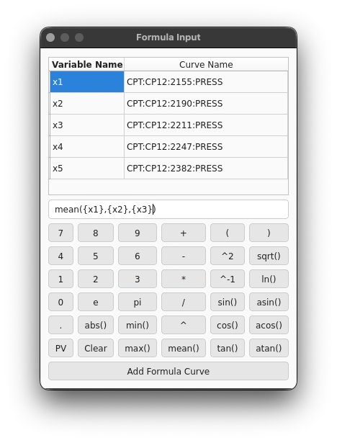
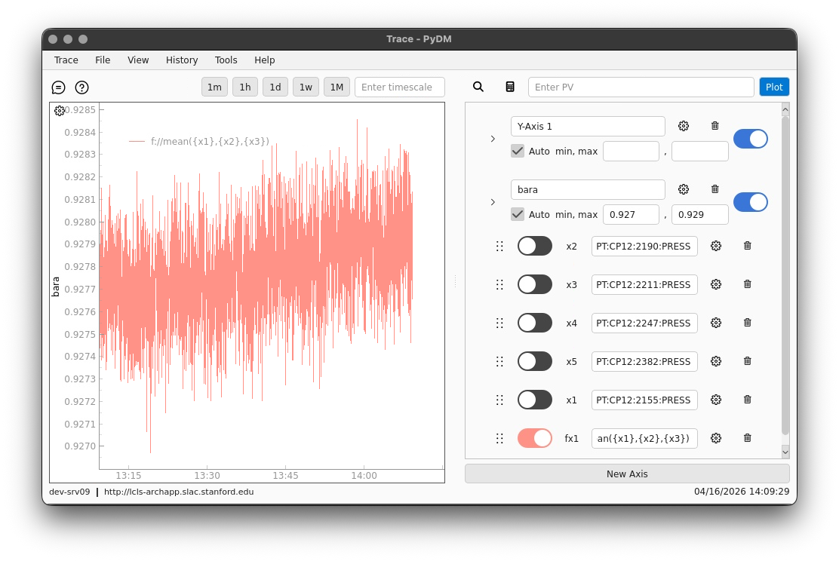
Key Features
Multiple Y-Axes
Per axis controls
Formula traces
PV Searching
Import & export
Import .stp, .xml, .trc
Only export .trc
Includes CLI converter
Dark mode

Slide 8
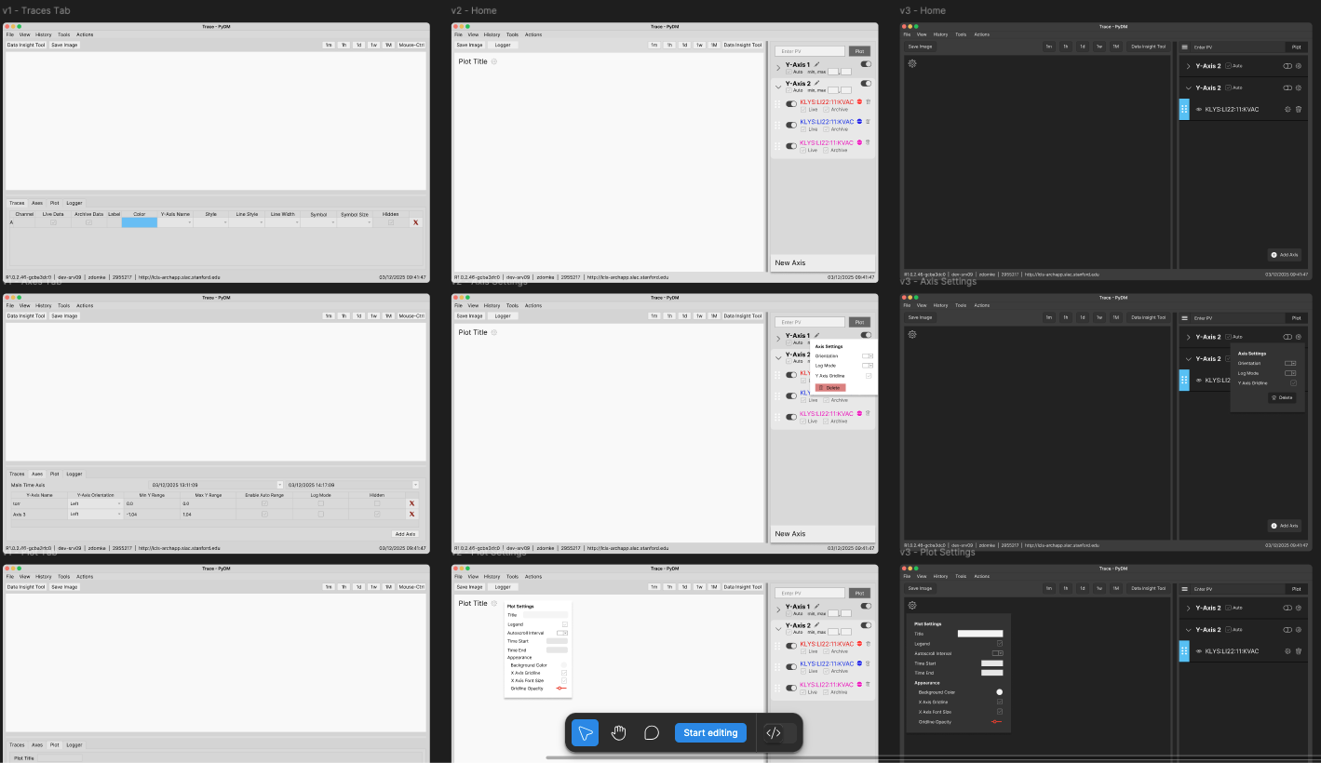
Design Process
Team includes UX Designer
Mockups with Figma
Iterate on designs
Future development
Constant feedback from users

Slide 9
Call to Action
Try out Trace for yourself
Request features & Report bugs & Make contributions
Public Repository
https://github.com/slaclab/trace
Documentation
https://slaclab.github.io/trace/
Contact
zdomke@slac.stanford.edu

