Slide 1
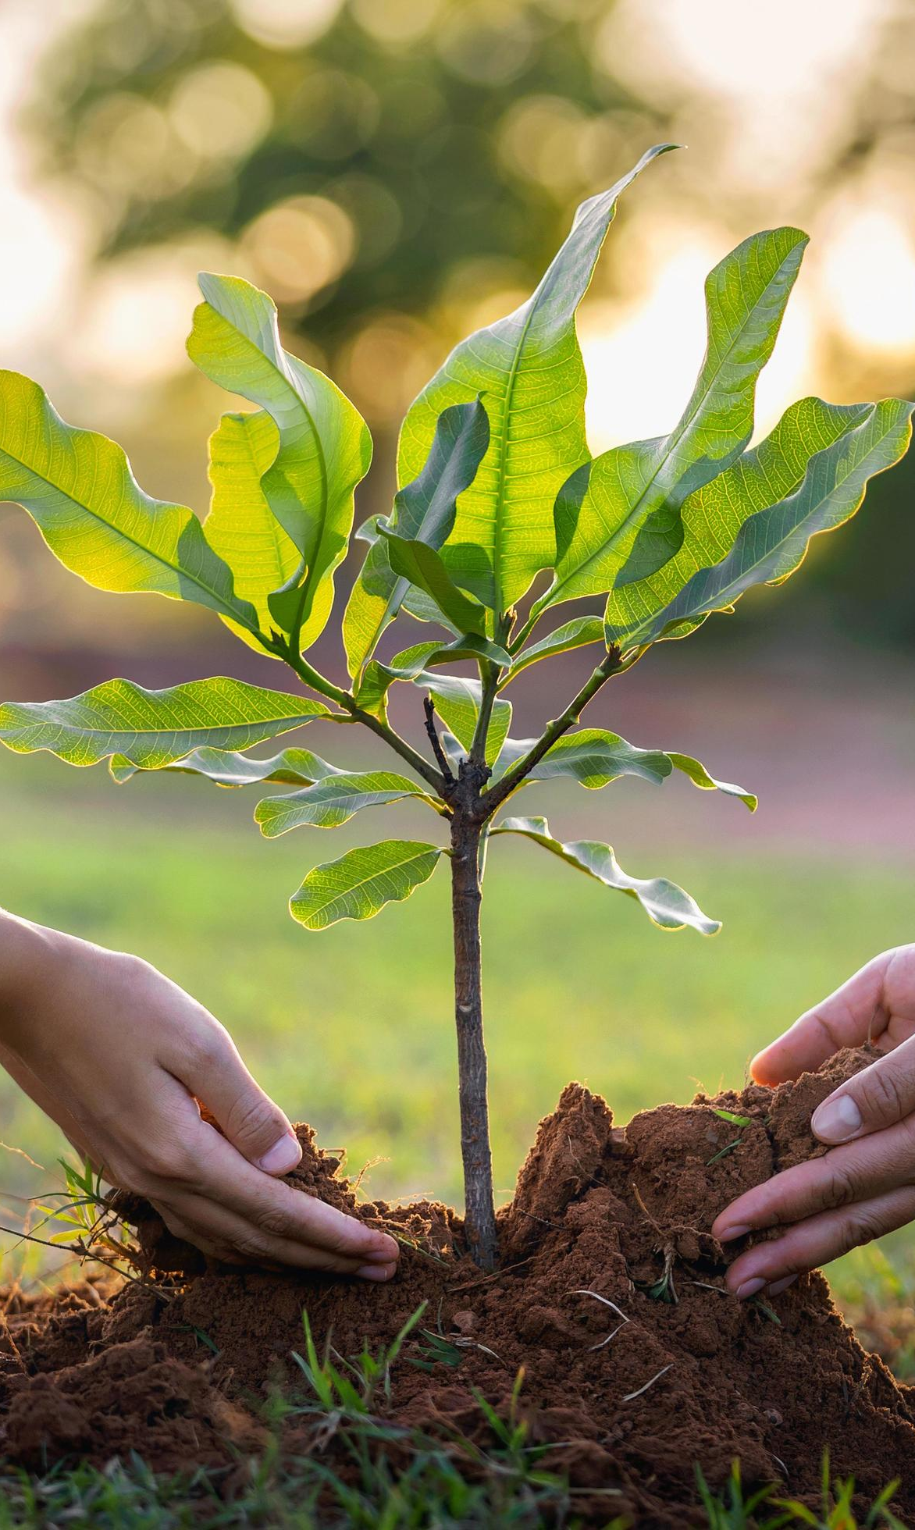

Planting the OACTree
Max Günther - Spring EPICS collaboration meeting 2026

Slide 2
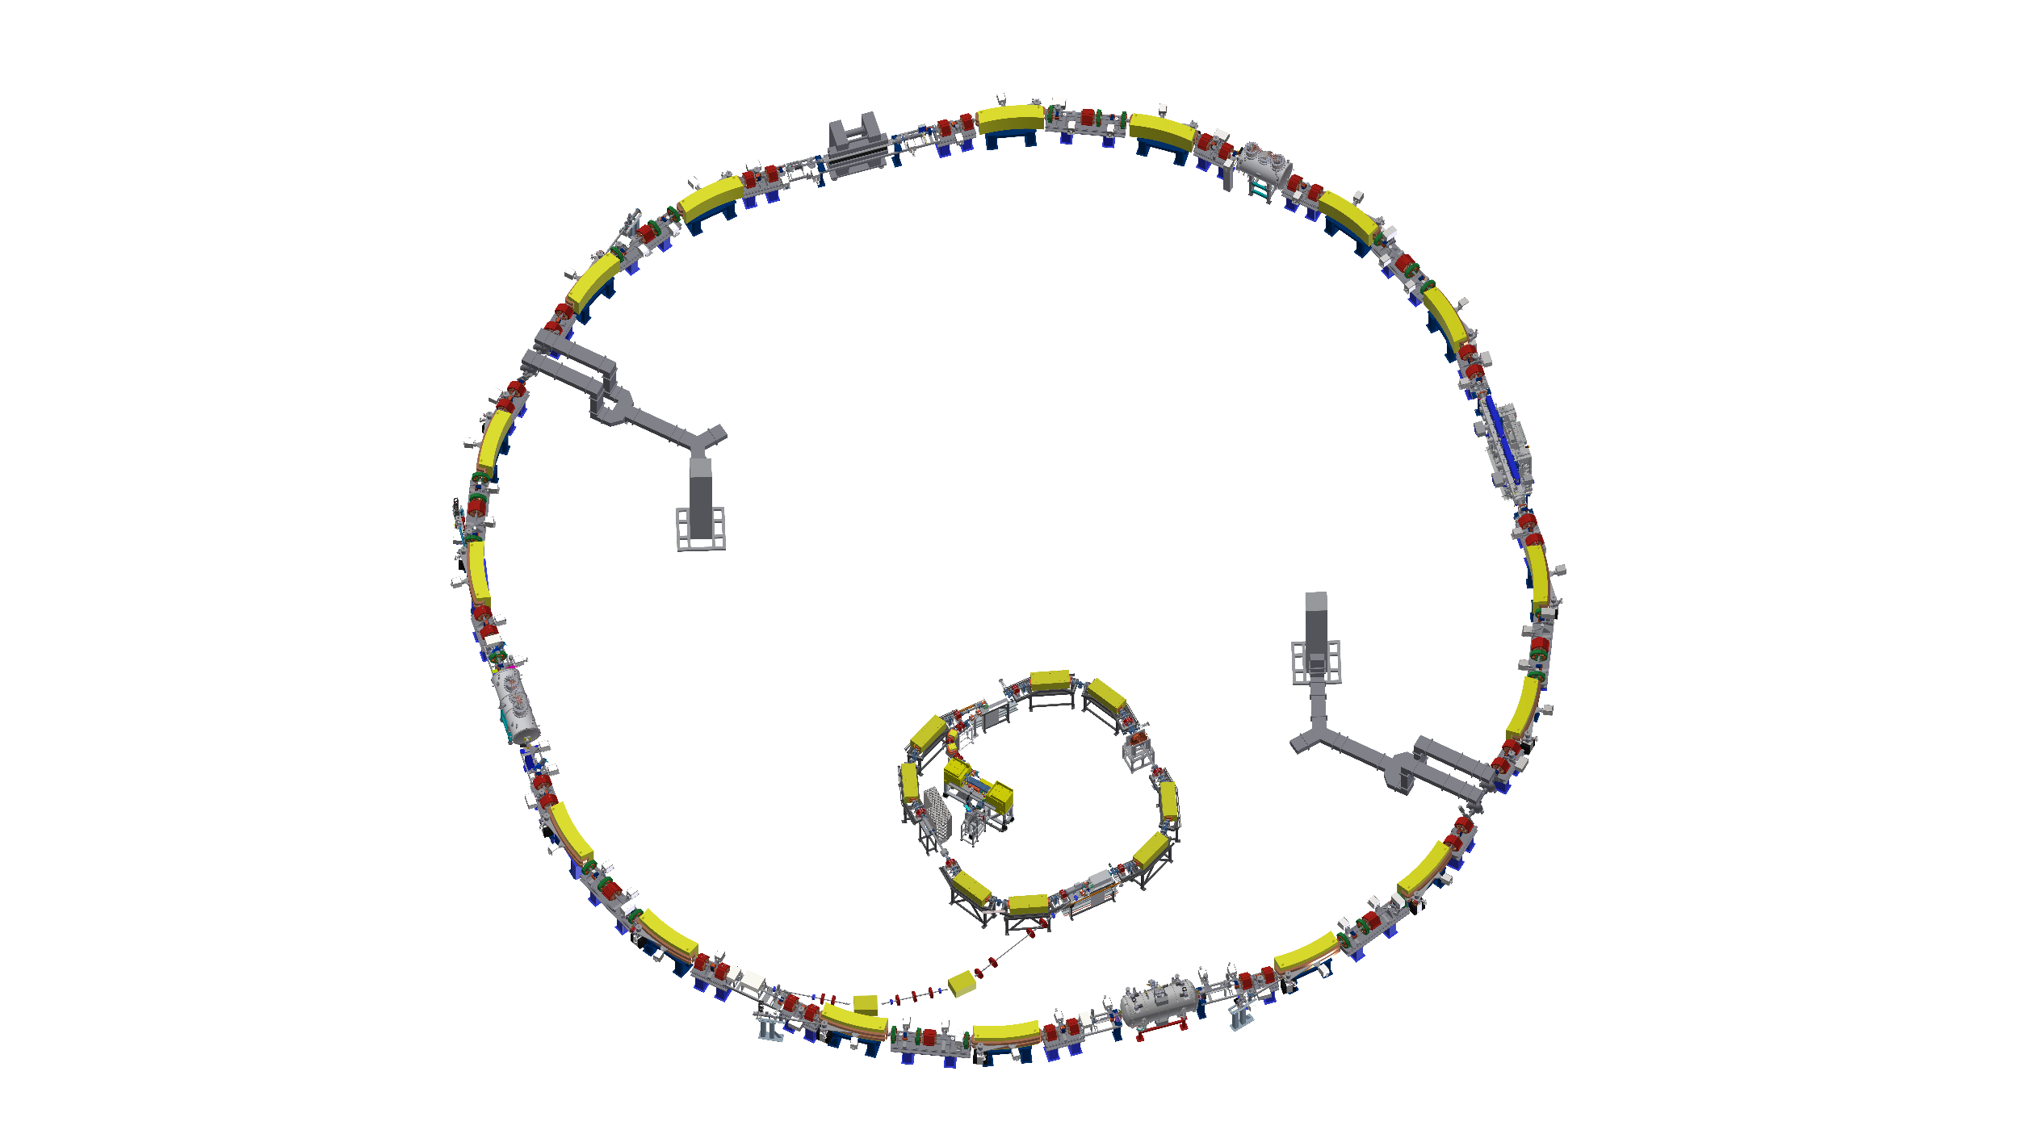
Current status of state machines
KARA Operations State Machine
KARA – Karlsruhe Research Accelerator
Automates key accelerator operations:
Dump beam & prepare injection
Cycle magnets, set RF, switch on EGun/Modulator
Timed actions (e.g. shutdown at 08:00 on Saturday)
Currently implemented in EPICS SNL
1 injection cycle/day (dump + re-inject): ~1 h
Automatic operation (no operator present): ~23 h
5-day operation – weekend: shutdown state

Slide 3

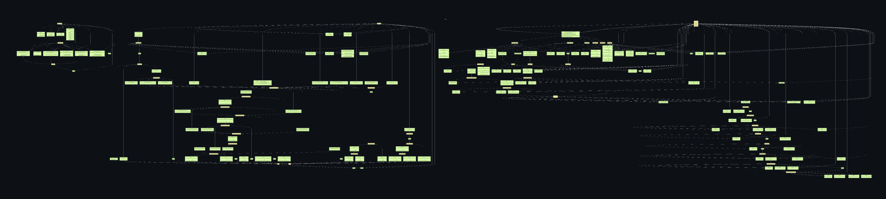
The problem: SNL is Hitting its Limits
Codebase Complexity
Operator Requests
> 2.000 lines of SNL code for the global state machine alone – and it keeps growing with every new feature request.
Testing all states and transitions is increasingly difficult.
New additions can silently break existing logic.
→ Decision: stop adding features to SNL implementation.
The state machine takes over manual operator steps – but operators have no way to influence it.
Temporary or permanent changes (e.g. new procedures, maintenance windows) always require a controls developer to modify the code.
No self-service for operators, no flexibility.
tree-sitter-epics + plasma (cea irfu)

Slide 4
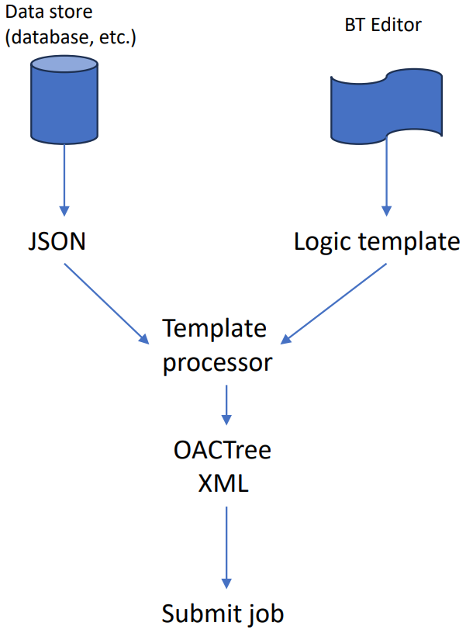

Why OACTree?
OACTree Sequencer
Workflow: Template-Based Generation
Operation, Automation & Control using Behavior Trees
Goal-based Behavior Trees: decompose operations into subtrees
XML-based sequences – no raw SNL code to maintain
GUI editor for building & monitoring trees
Operators can adjust sequences without developer involvement
Cross-device sequences supported natively
Notes:
① Data Store -> JSON config
② BT Editor -> Logic template
③ Template Processor merges both
④ Outputs OACTree XML
⑤ Submit as automated job

Slide 5
My User Story
Exploring OACTree
Next Steps
Dependency / Behavior Trees
Studied tree structure concepts as prerequisite for OACTree
vlinac as reference implementation
Explored vlinac – a simple linac sequencer built with OACTree from Timo Korhonen
Studied how sequences are structured in XML and how the tree is executed
Current status:
Framework running, BT concepts understood roughly
2 Weeks in – still early stage
Soon
Write first own OACTree sequences for simple KARA operations
The big goal
Migrate the global state machine to OACTree

