Slide 1
Embedded Linux EPICS IOC on a Xilinx UltraScale+ ZCU102 for mrfioc2
Sarah Dolan
April 21, 2026
LA-UR-26-23009

Slide 2
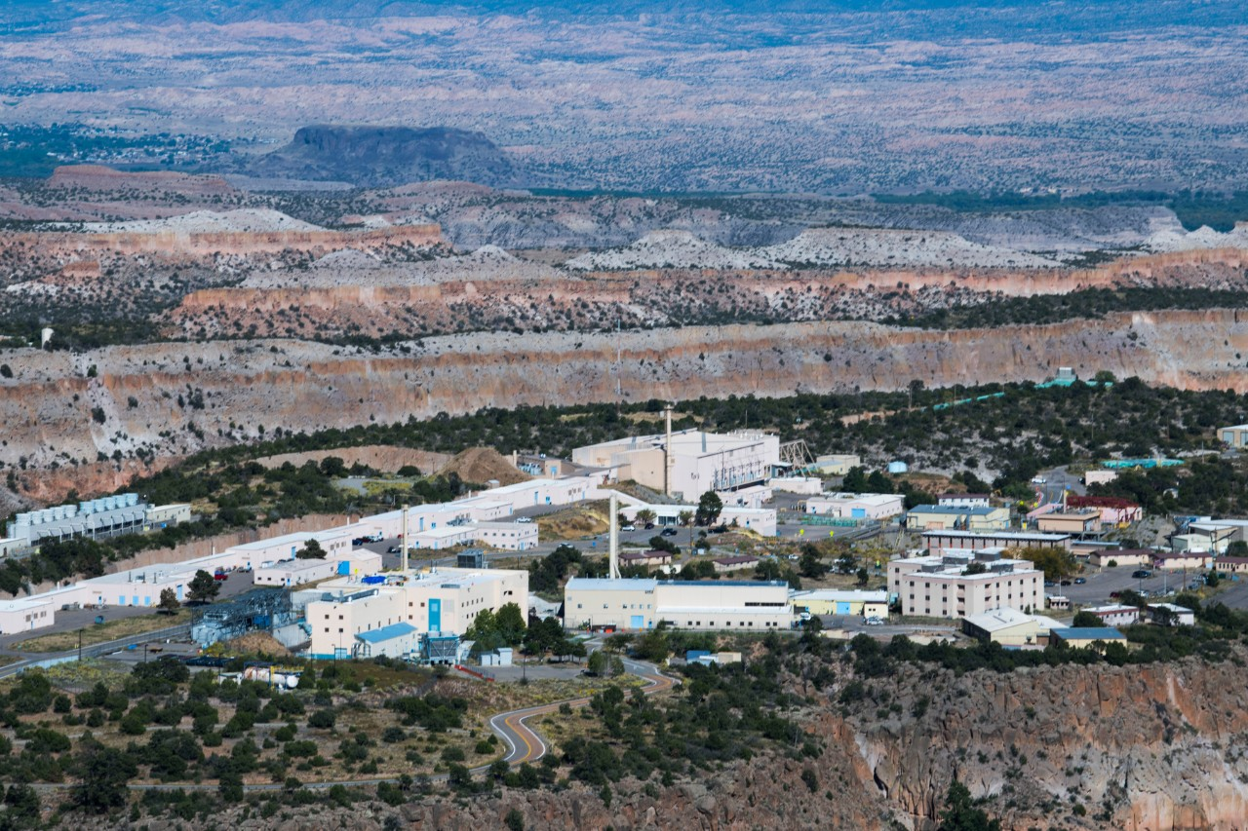

Introduction
Los Alamos Neutron Science Center (LANSCE) is modernizing old hardware. One focus is on timing and replacing our event receiver.

Slide 3
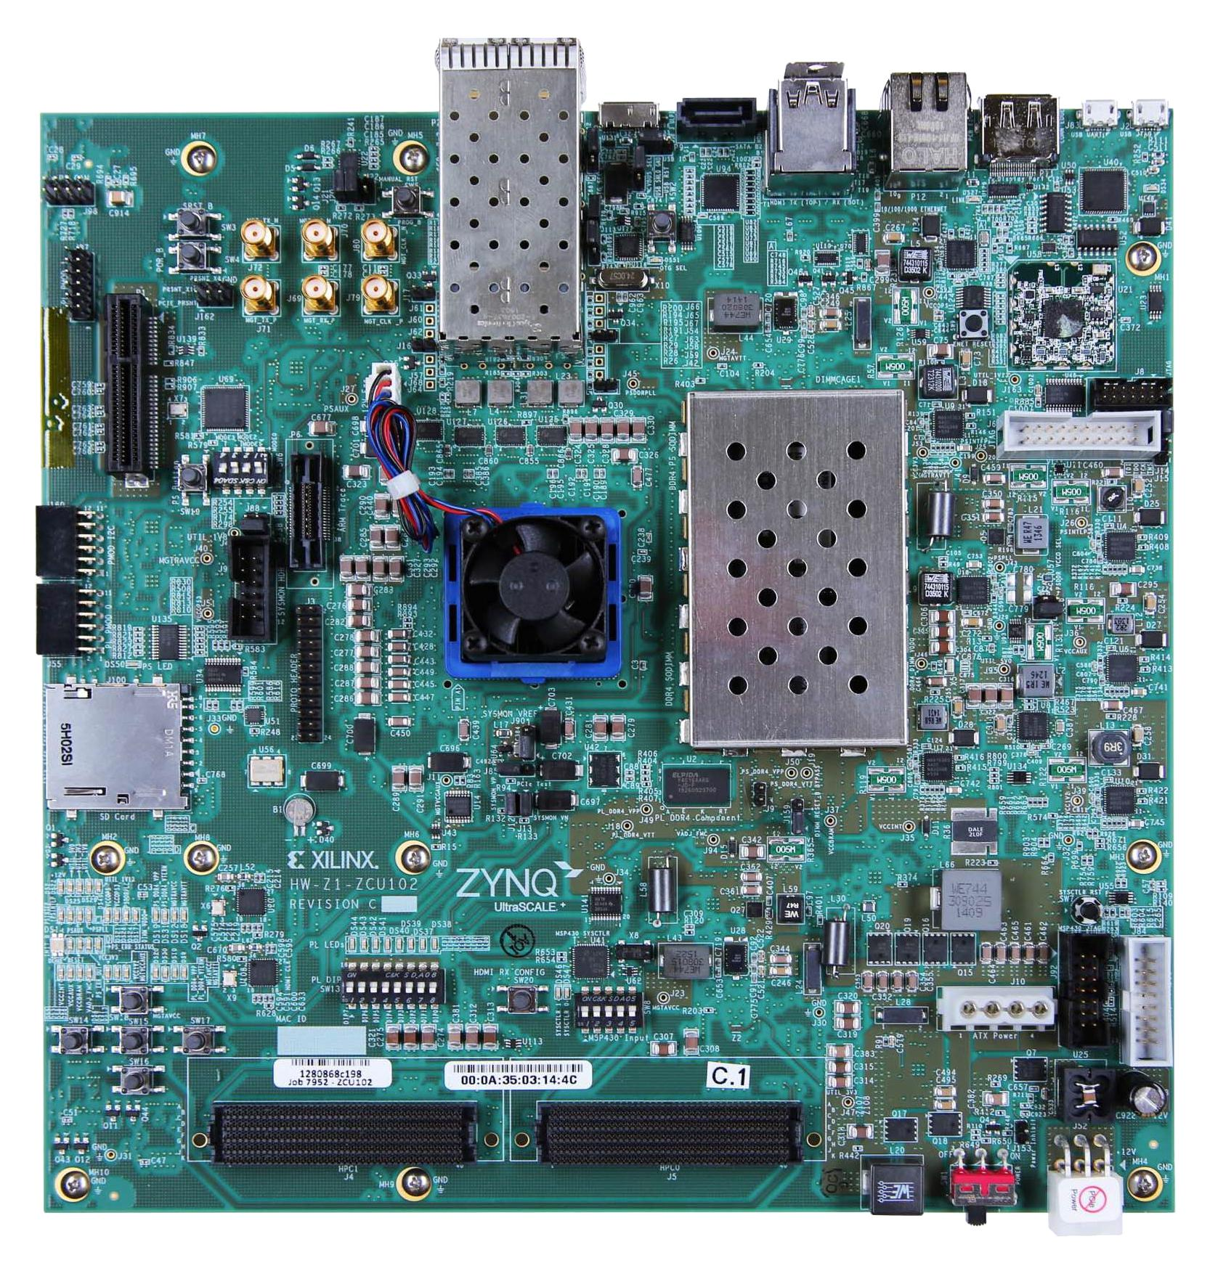
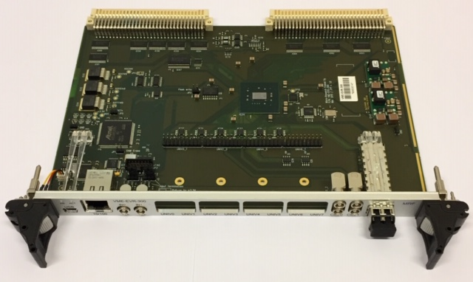
Event Receiver
VME-EVR-230
Xilinx UltraScale+ Eval Board (Prototype)
Notes:
System overview (big picture diagram)
We landed on the Xilinx Ultrascale + to have one board instead of the previous two board
System on chip architecture allows for ioc to be on ARM processor instead of the previous CR-12 and communication was via a backplane, now it will be using Xilinx IP, AXI
Will be taking the open evr project form mrf and mrfioc2 to make this possible on the zcu102
Note we do have the 230 version and open ever is the DC and until we update the master timer, we are stuck with this
Add either dates if possible or if we have any reslts

Slide 4
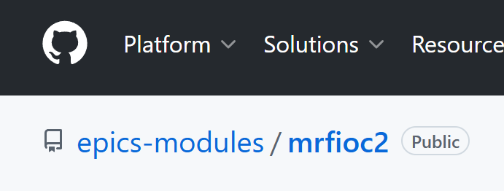

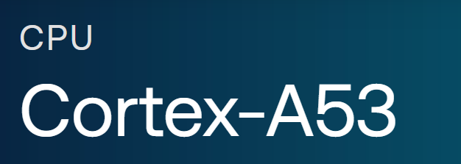
EPICS Integration
Open source mrfioc2, an EPICS module, runs on the ARM Cortex-A53
Embedded Linux + interrupt driven timing updates using yocto-based build
Modular kernel for future Xilinx SoC deployments across LANSCE
Notes:
EPICS IOC running on ARM Cortex A53
Using mrfioc2
Register level abstraction
Integrates EVR into EPICS records
What records look like and how the user interacts

Slide 5
Timing
LANSCE runs up to a rep rate of 120 Hz, so each machine cycle is about 8.3ms
Event handling is done in the FPGA
User updates are handled in processing system
Notes:
LANSCE runs up to a rep rate of 120, so each machine cycle runs in about 8.3 ms.
Event handling is done in hardware. Determinism stays in programmable logic side.
IOC handles Pulse Updates. User updates are handled in processing system.
Mrf evr handles event decoding and triggers
FPGA executes timing-critical logic
Linux-IOX updates registers
Interrupt handling connects FPGA to IOC
Determinism stays in hardware

Slide 6

Impact
Continued and future use of timing system
Open-source hardware and software for the community
Moving to Xilinx UltraScale+ guarantees chip support through 2045*
Embedded Linux allows for a standard, well-known interface
*AMD Supports Long Lifecycle FPGA Designs through 2040, 2045, and Beyond
Notes:
LANSCE’s effort to update the EVR will allow continued use and future improvement of our current timing system.
Using Xilinx products and embedded Linux will get us towards digitalizing old hardware and deploying modern, customizable hardware that is open source for the community.
Moving to Xilinx UltraScale+ guarantees chip support through 2045*.
Software simplification, having embedded Linux on same board as EVR reduces traffic in chassis. (no more backplane required)
Moving to embedded Linux allows users a standard and well-known interface.
Supports LASNCE timing requirements
Scalable to other facilities
Tighter latency bounds
More EPICS record support
Expanded timing features

Slide 7
Questions?

