Slide 1
IFMIF-DONES control systems testing platform
Lucas MAINDIVE
Spring EPICS Collaboration Meeting 2026 – CEA, Paris Saclay University, France
April 20th to 24th, 2026

Slide 2
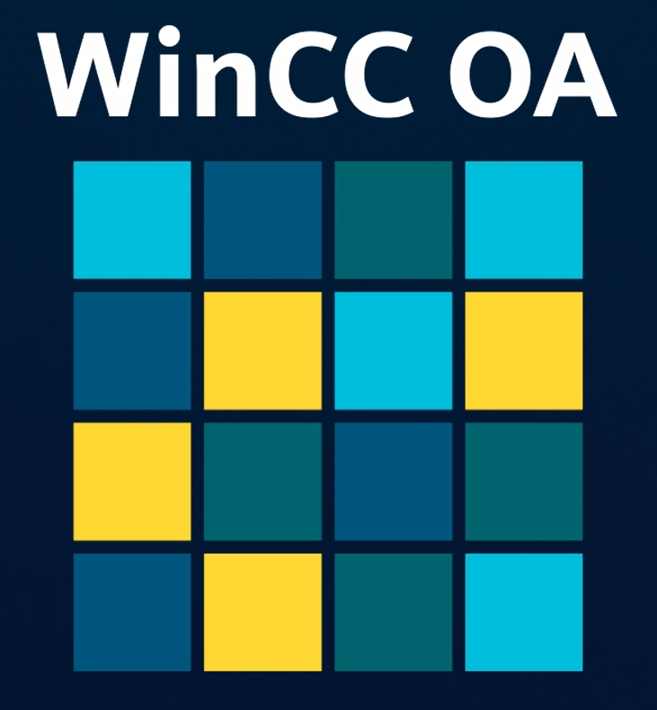
Context (see ICALEPCS 2025 - TUAG005)
IFMIF-DONES programme
  Local team near Grenade (Spain)
  In Kind Contributors
Controls Systems (CS) = Central CS + Local CS
  Segregated between:
    Control & Data Acquisition “CODAC”
    Machine Protection “MPS”
    Safety “SCS” (requires SIL 3)
  SW frameworks foreseen:
    EPICS (CODAC + MPS)
    WinCC OA (SCS)

Slide 3



How to harmonize all contributions and avoid chaos?
Our solution, distribute harmonized:
Guidelines
  Common architecture, software, catalogue, verification, cubicles, HMI, networks
Software Development Kit
  A common development environment for all
“miniCICS platform” for Verification phases
  Mimic of the Central CS (“CICS”)
  A common testing platform for development and testing phases (“FAT/SAT”)

Slide 4
miniCICS platform for system X
miniCICS for system X mimicking the Central CS “CICS”:
  Clients (e.g. operator workstations)
  Repositories (e.g. GitLab)
  Servers / services (containerized)
  PLCs
  Non-CICS systems interfacing with X (if any)
Factory & Site Acceptance Testing phases (FAT/SAT)
  Testing platform composed of:
    System X
    LICS of system X
    miniCICS for system X
  Difference between FAT and SAT:
    SAT: software built & deployment from the site repositories
Repository Common Software
GitLab
Scripts/Pipeline
OS
...
CICS Common Software:
SIMI-CICS Configuration
OS
Containers
EPICS
Phoebus servers
EPICS Archiver
...
miniCICS
DB CODAC
Server/PC
Server/PC
SW
repository
DB MPS
IOC
PLC
SW
System X
LICS Common Software:
IOC configuration
OS
Containers
EPICS
EPICS Archiver
...
Subsystem 1
LICS
SW
Subsystem 2
EPICS
IOC
PLC
FPGA
Subsystem n
Remote I/O
S
A
S
A
S
A
Acceptance Tests architecture

Slide 5



Reaching consistent miniCICS software
All the necessary is provided within the Software Development Kit (SDK).
Ansible playbooks to set up the containers and run their dockerfiles
Dockerfiles to build:
  Repositories of miniCICS
  EPICS base (EPICS 7.0.X, OPC UA device support module)
  Phoebus services
CI/CD pipelines for:
  Pre-compilation checks (e.g. linting)
  Build in GitLab runners
  Deployment in dedicated containers

Slide 6
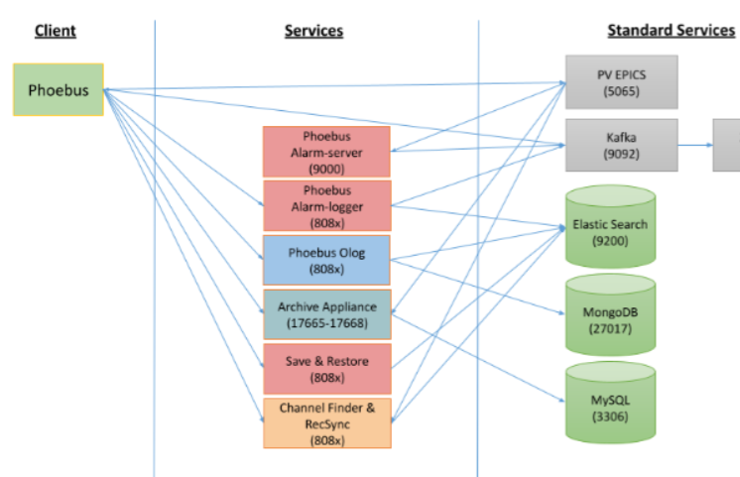
Progress and future work
✓= finished
~ = ongoing
· = to be started
Progress:
  Container base configuration
  GitLab repositories
  Phoebus services here →
Future work:
  Coordinate and collaborate with EPICS and Phoebus developers
  Complete our Ansible collection to cover the remaining services needed (see new documentation)
  Explore the web versions of the services
  Build a “site miniCICS instance” as a reference for every other instance
~
✓
✓
✓
~
✓
✓
✓
✓

Slide 7
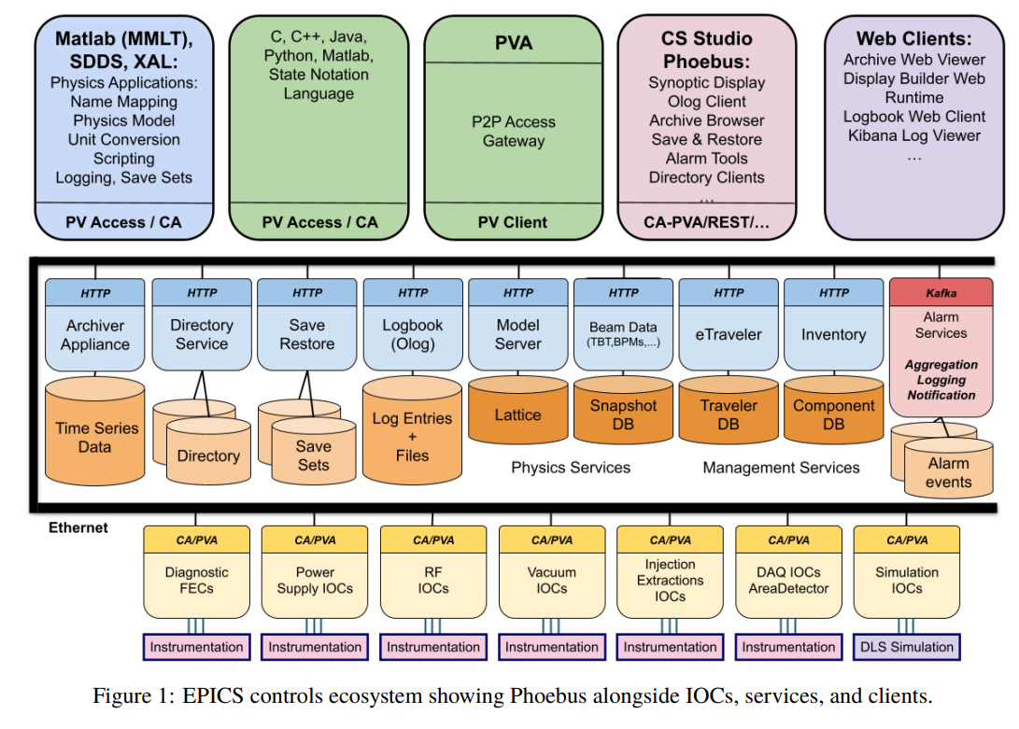
Annex: latest Phoebus framework architecture
More services, middleware services and clients to deploy
Decide first which to keep for our Central CS (see our test environment “CICStest” presentation by Manu J. Gutiérrez at IPAC 26)

Slide 8
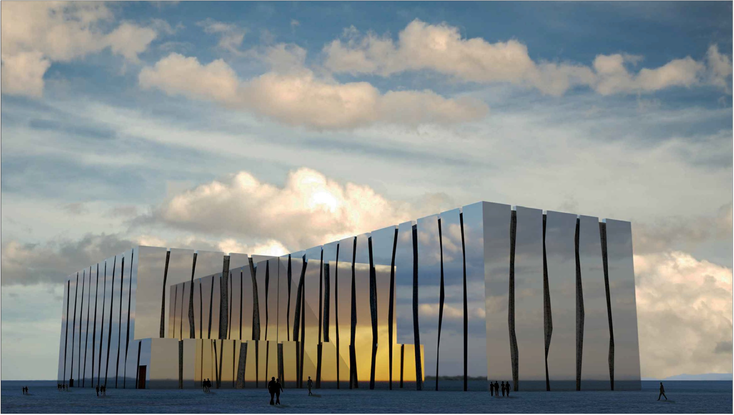







Thank you for your attention…
www.ifmif-dones.es

