Slide 1
Enhancing EPICS Service Resilience with VRRP and Round-Robin DNS
EPICS collaboration meeting
Paul Ray
with Ivan Finch and Mateusz Leputa
ENS Paris-Saclay, Paris
20th April 2026

Slide 2


Belt & Braces for Infrastructure
Started working with Infrastructure for EPICS ~ 2 years ago.
Round Robin DNS in place.
Opportunity to add additional resiliency with no material costs.

Slide 3
Round Robin DNS
When a device does a nameserver lookup DNS provides the answer with an IP address and a Time To Live (TTL).
The TTL determines how long this answer is good for.
DNS does not have to answer the same all the time.
By providing different answers to different devices it can provide
Rudimentary load balancing (Random Chance)
Depending on the TTL it can mitigate device failure

Slide 4
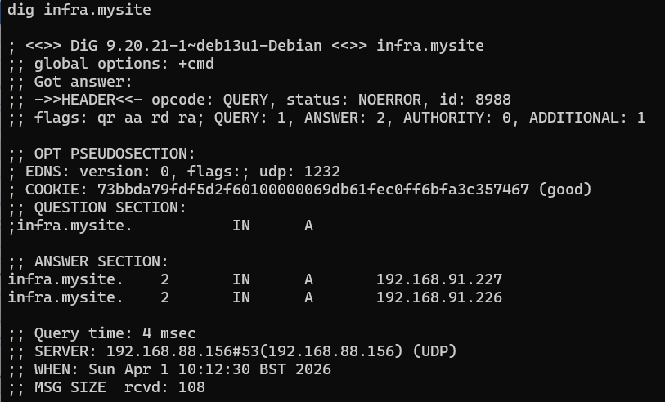
How we have been using it.
Load balancing HA Proxies with direct connections to Read Only PVAGateway for non-controls network access.
The TTL was set aggressively short.
Whilst adds resilience, failures still lead to 50% faults in initial looked up traffic.
Clients making persistent connection may hard code the IP of the connection after single lookup

Slide 5
Where VRRP comes in
VRRP is a vendor neutral implementation for IP level failover.
Standardized by IETF (RFC 2338, 1998)
keepalived initial release in 2001
2008 – 2013 started appearing beyond ISP and router services for the likes of HAProxy
Virtual IP: 192.168.91.226
Virtual IP: 192.168.91.227
Virtual IP: 192.168.91.227
Real IP: 192.168.91.26
Real IP: 192.168.91.27

Slide 6
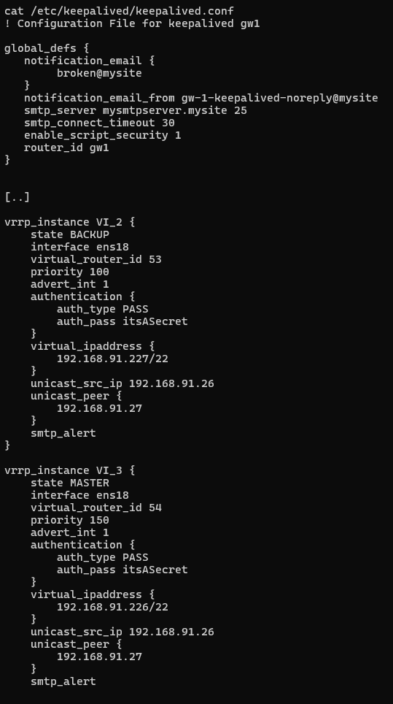
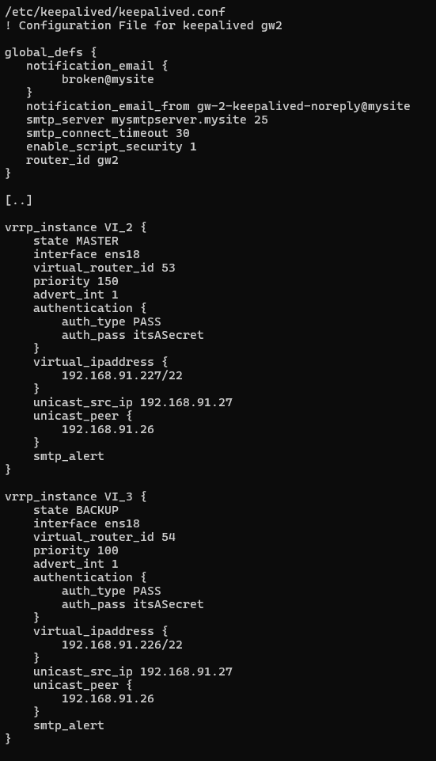
What a Config might look like
Virtual IP: 192.168.91.226
Virtual IP: 192.168.91.227
Real IP: 192.168.91.26
Real IP: 192.168.91.27

Slide 7
Where it works, and more importantly where it doesn’t
Reliable and predictable for network / equipment faults
VRRP itself doesn’t understand service fails, keepalived however can be told
Means full equipment failure is not necessary to trigger a VRRP response
Avoid degrading to 0 on service failures, a partially failed node may be better than nothing(!)
If you are using this, don’t collide your Virtual_Router_IDs, it’s just a mess.
Inspect packet from the IPv4 multicast (224.0.0.18) if you think you may have issues.
Virtual IP: 192.168.91.226
Virtual IP: 192.168.91.227
Real IP: 192.168.91.26
Real IP: 192.168.91.27

Slide 8
Summary
Round Robin DNS was the initial solution to increase the resilience of device connection
VRRP via keepalived has added belts to those braces, it is possible to take node points out of service and maintain them without affecting operations.
We’re still learning how far and wide we can functionally use this type of solution, but as with all infrastructure, coordinated management is one of the keys to smooth operation.

