Slide 1
AreaDetector Gaussian Fitting Plugin for Robust Beam Characterization and Alignment Support
Luca Porzio
EPICS Collaboration Meeting
ENS Paris-Saclay Spring 2026

Slide 2
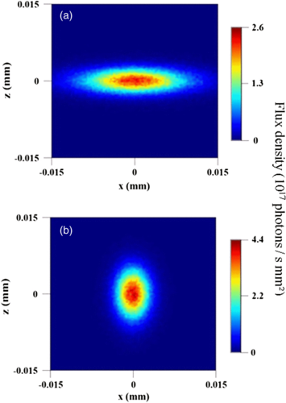
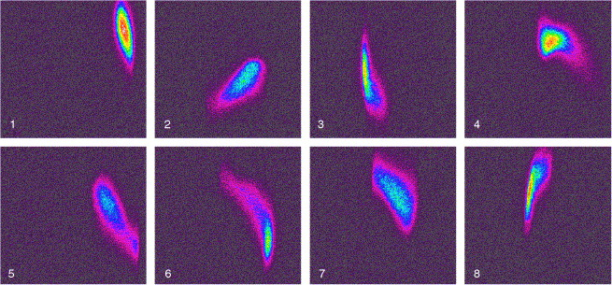
MOTIVATION
While areaDetector is the standard for DAQ, it currently lacks a robust, built-in way to perform true nonlinear curve fitting.
Doing the fit outside of EPICS introduces challenges on synchronization and timestamping as well as increasing the system complexity.

Slide 3


MOTIVATION
While areaDetector is the standard for DAQ, it currently lacks a robust, built-in way to perform true nonlinear curve fitting.
Doing the fit outside of EPICS introduces challenges on synchronization and timestamping as well as increasing the system complexity.
NDPluginGaussianFit

Slide 4
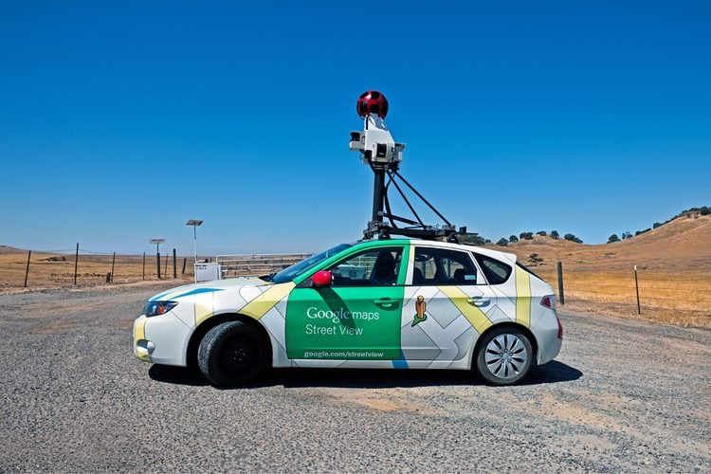
Architecture & core features
Ceres Solver (Google) – Used on Google Maps, Android Camera, Project Tango – Released under Apache 2.0 License .
Additional Features:
Data Sparsification (thresholding)
Robust Loss Function (resilience to outliers)
N-1 frame tracking (closed-loop)

Slide 5
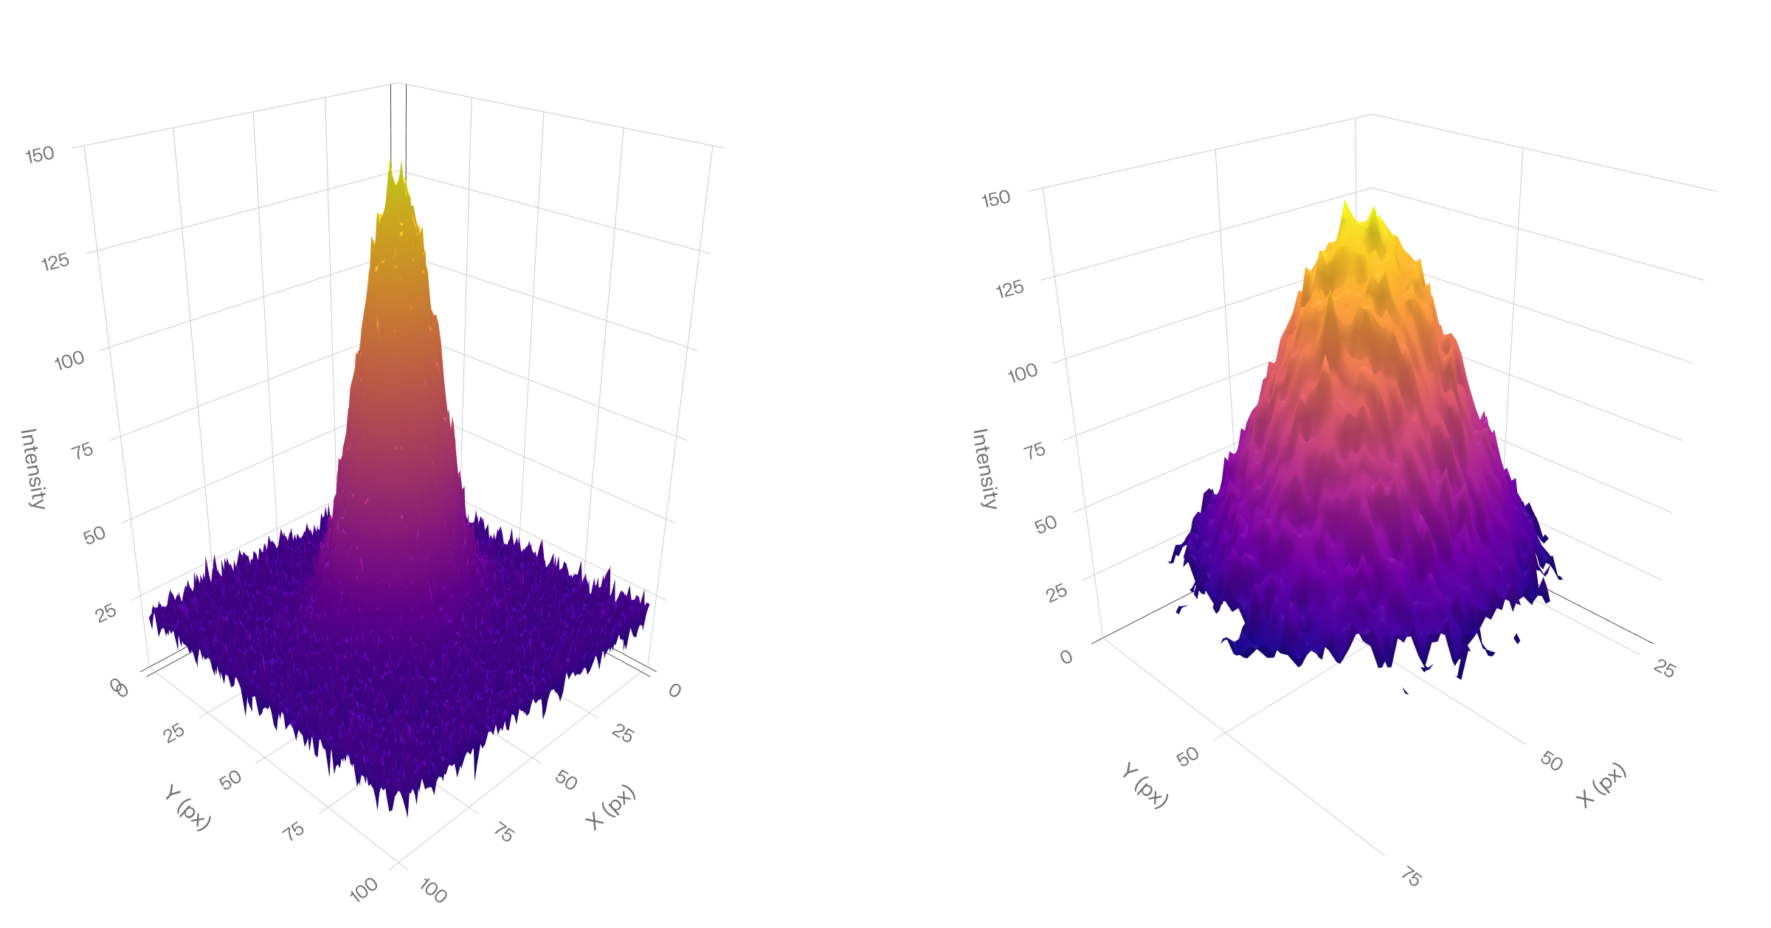
Architecture & core features
Ceres Solver (Google) – Used on Google Maps, Android Camera, Project Tango - Released under Apache 2.0 License
Additional Features:
Data Sparsification (thresholding)
Robust Loss Function (resilience to outliers)
N-1 frame tracking (closed-loop)
Dense
(40.000px)
Sparse
(5.000px)

Slide 6
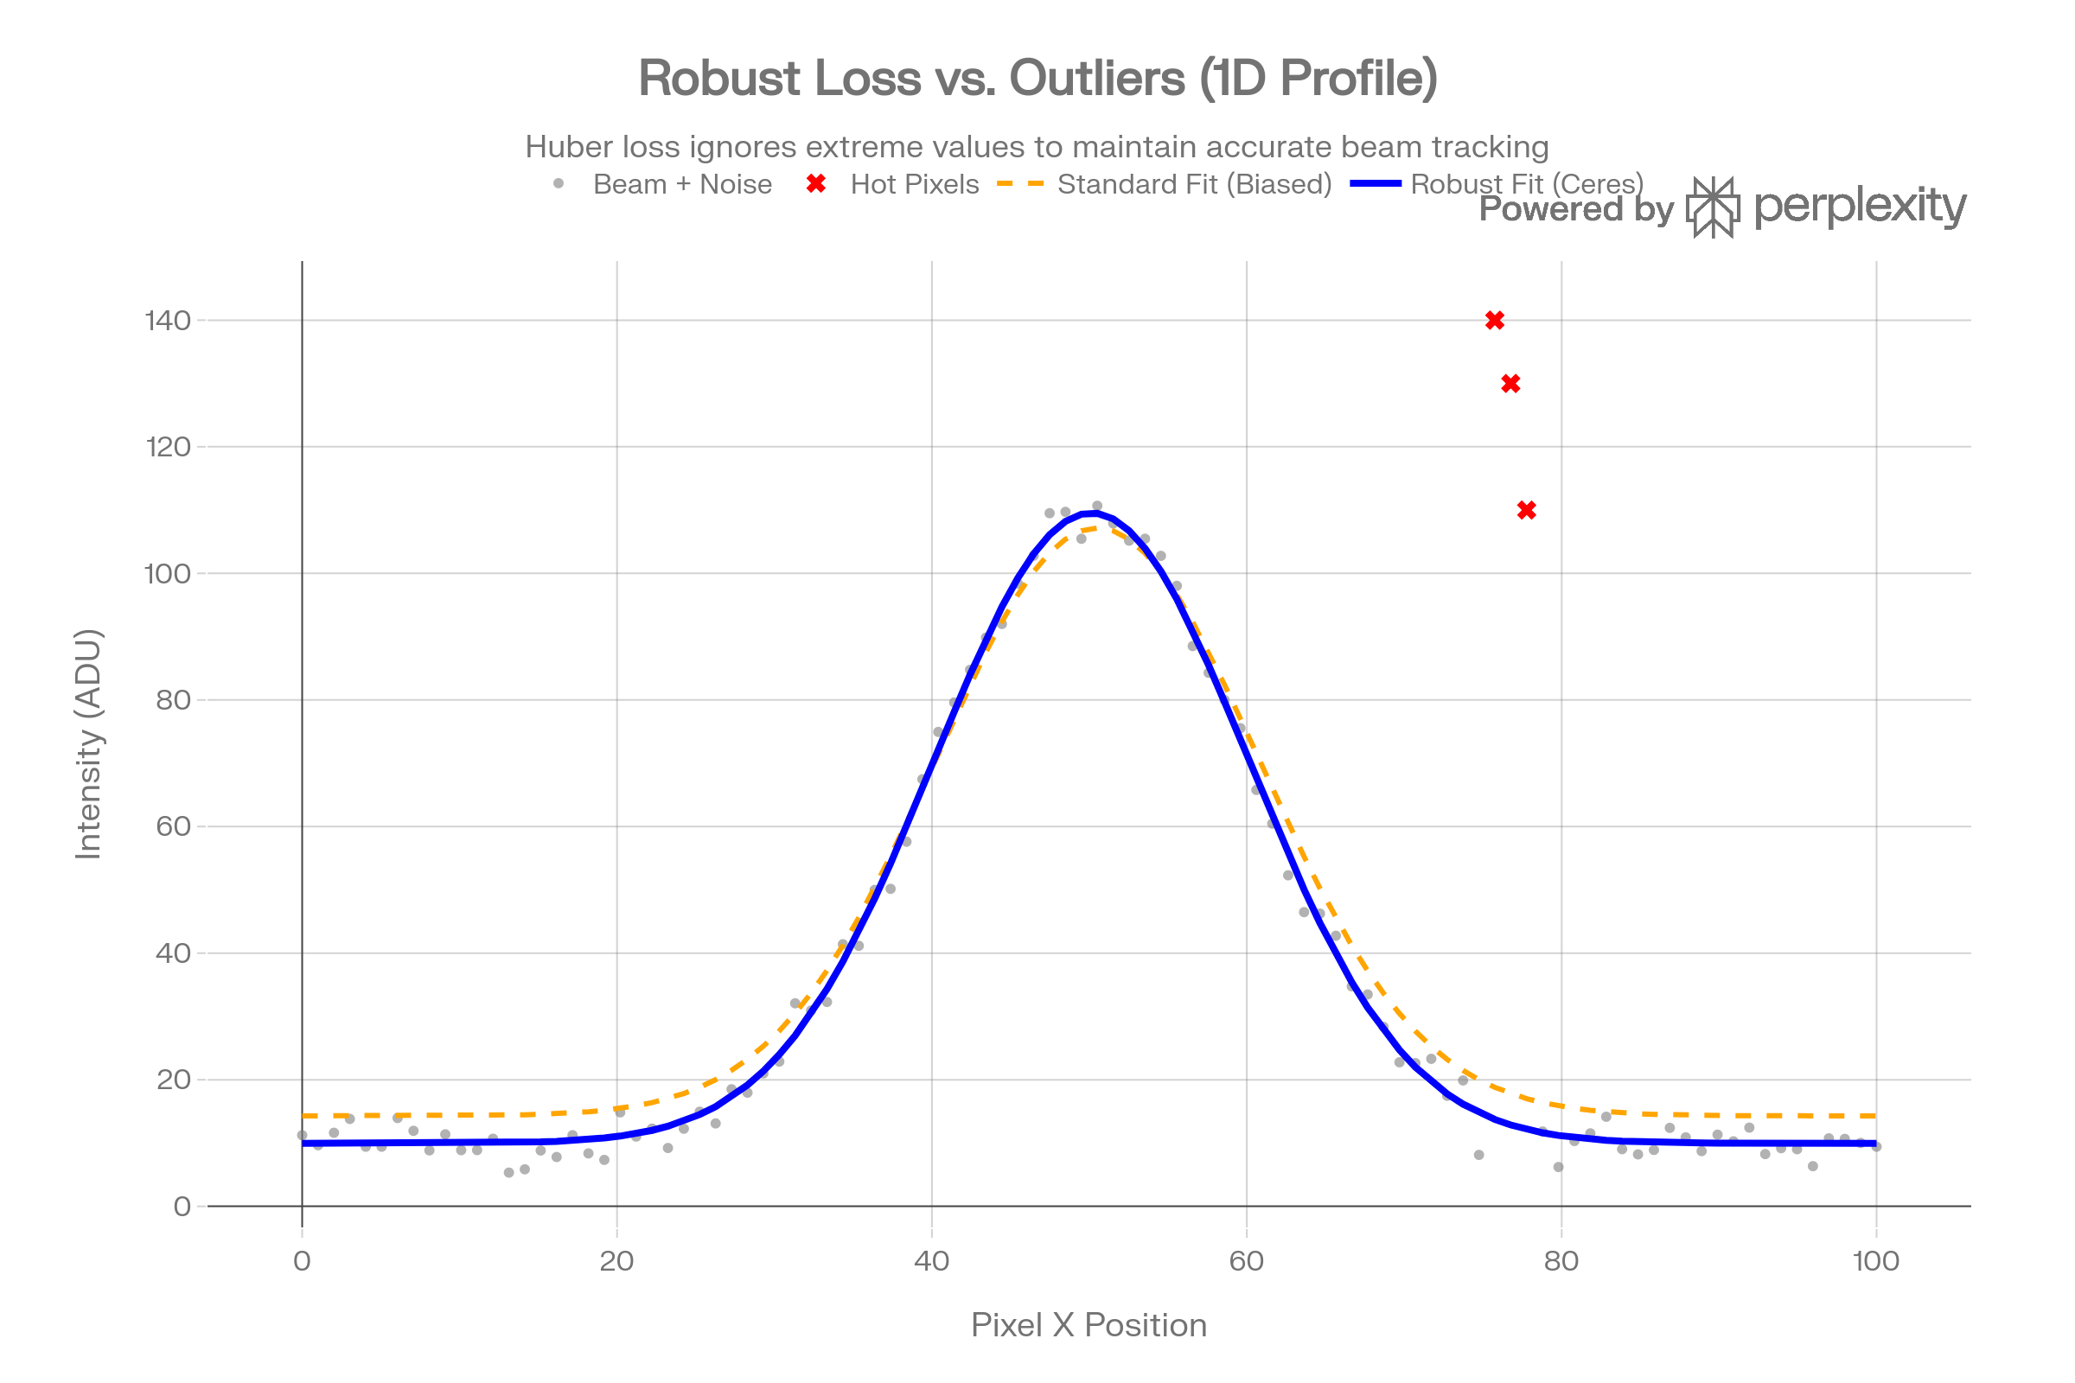
Architecture & core features
Ceres Solver (Google) – Used on Google Maps, Android Camera, Project Tango - Released under Apache 2.0 License
Additional Features:
Data Sparsification (thresholding)
Robust Loss Function (resilience to outliers)
N-1 frame tracking (closed-loop)

Slide 7
Architecture & core features
Ceres Solver (Google) – Used on Google Maps, Android Camera, Project Tango - Released under Apache 2.0 License
Additional Features:
Data Sparsification (thresholding)
Robust Loss Function (resilience to outliers)
N-1 frame tracking (closed-loop)
Performances:
300px x 200px uint8 - 40ms in closed-loop (total plugin execution time)
i9-12900K @ 5.2 GHz – 8 threads
At N = 0 you can use moments from NDPluginStats for Initial Guesses
Frame N
Apply Initial Guesses
Nonlinear Solver
Fitted Parameters

Slide 8
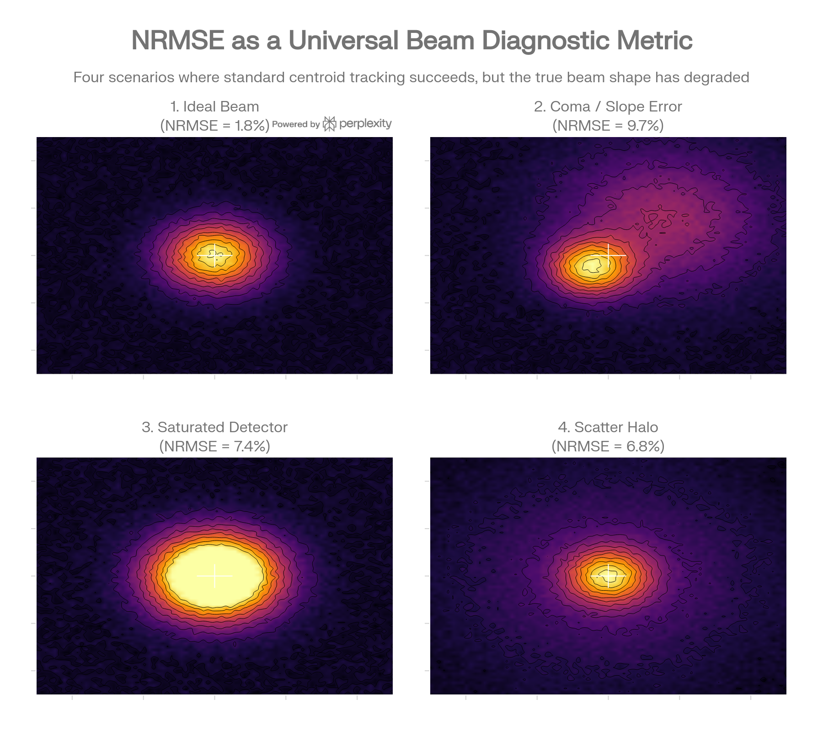

Use Cases – Beam/Optics characterization & alignment support
Moving from “where is the beam” to “how good is the beam”.
Goodness of fit (NRMSE): data drifts from the model, even if centroid/sigma don’t move.
Covariance matrix (from Hessian): 1σ uncertainties and correlations on $x_{0},y_{0},σ_{x},σ_{y},θ$, amplitude, and background in real time.

Slide 9
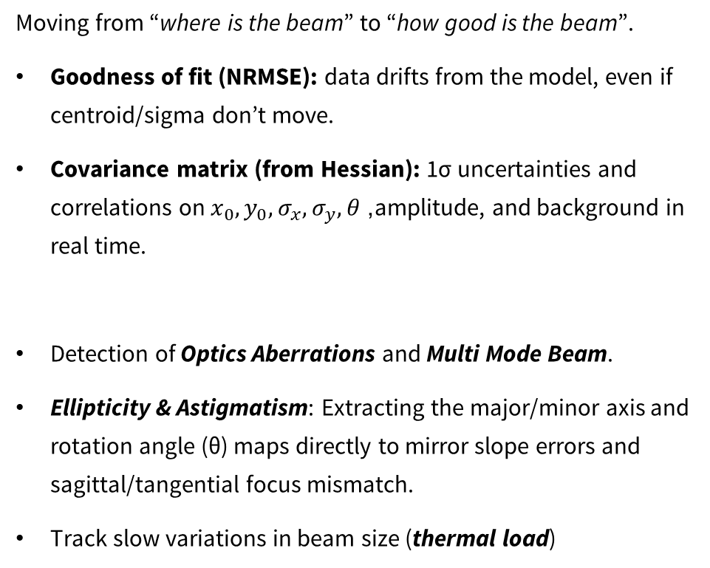
Use Cases – Beam/Optics characterization & alignment support
Moving from “where is the beam” to “how good is the beam”.
Goodness of fit (NRMSE): data drifts from the model, even if centroid/sigma don’t move.
Covariance matrix (from Hessian): 1σ uncertainties and correlations on $x_{0},y_{0},σ_{x},σ_{y},θ$, amplitude, and background in real time.
Detection of Optics Aberrations and Multi Mode Beam.
Ellipticity & Astigmatism: Extracting the major/minor axis and rotation angle (θ) maps directly to mirror slope errors and sagittal/tangential focus mismatch.
Track slow variations in beam size (thermal load)

Slide 10
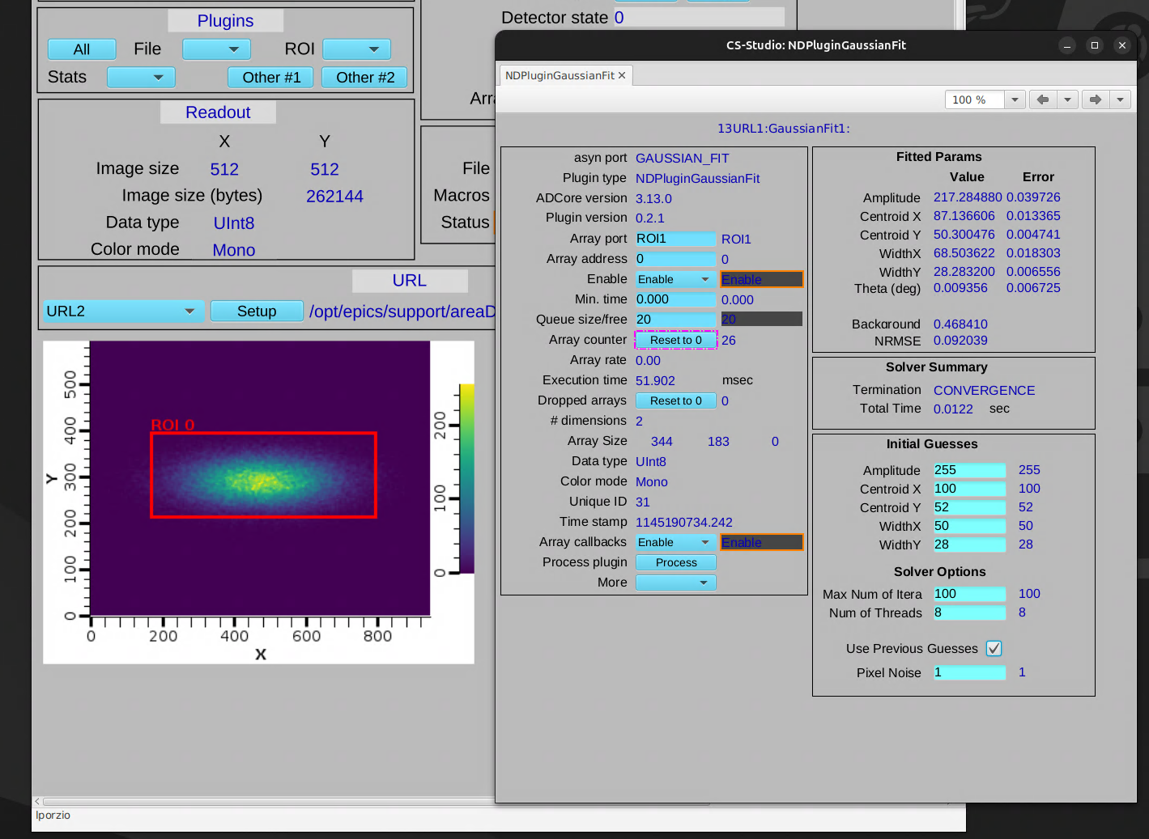
Future tests developments
Support to Voigt-like beams.
Kalman Filter Integration: Ceres provides per‑frame Gaussian fits and local curvature (Hessian), the Kalman filter turns those into a temporally consistent state with predictive priors and uncertainties.
AI & Flying Bayesian Optimization: Acting as the high-speed “reward function” evaluator. Autonomous agents can adjust mirror benders and pitch/roll, using the real-time σx,σy, and NRMSE from this plugin to optimize the beamline completely hands-free.

