Slide 1
Preparing EPICS Services for Operational Use at Fermilab
April 2026
Mariana González Velarde

Slide 2
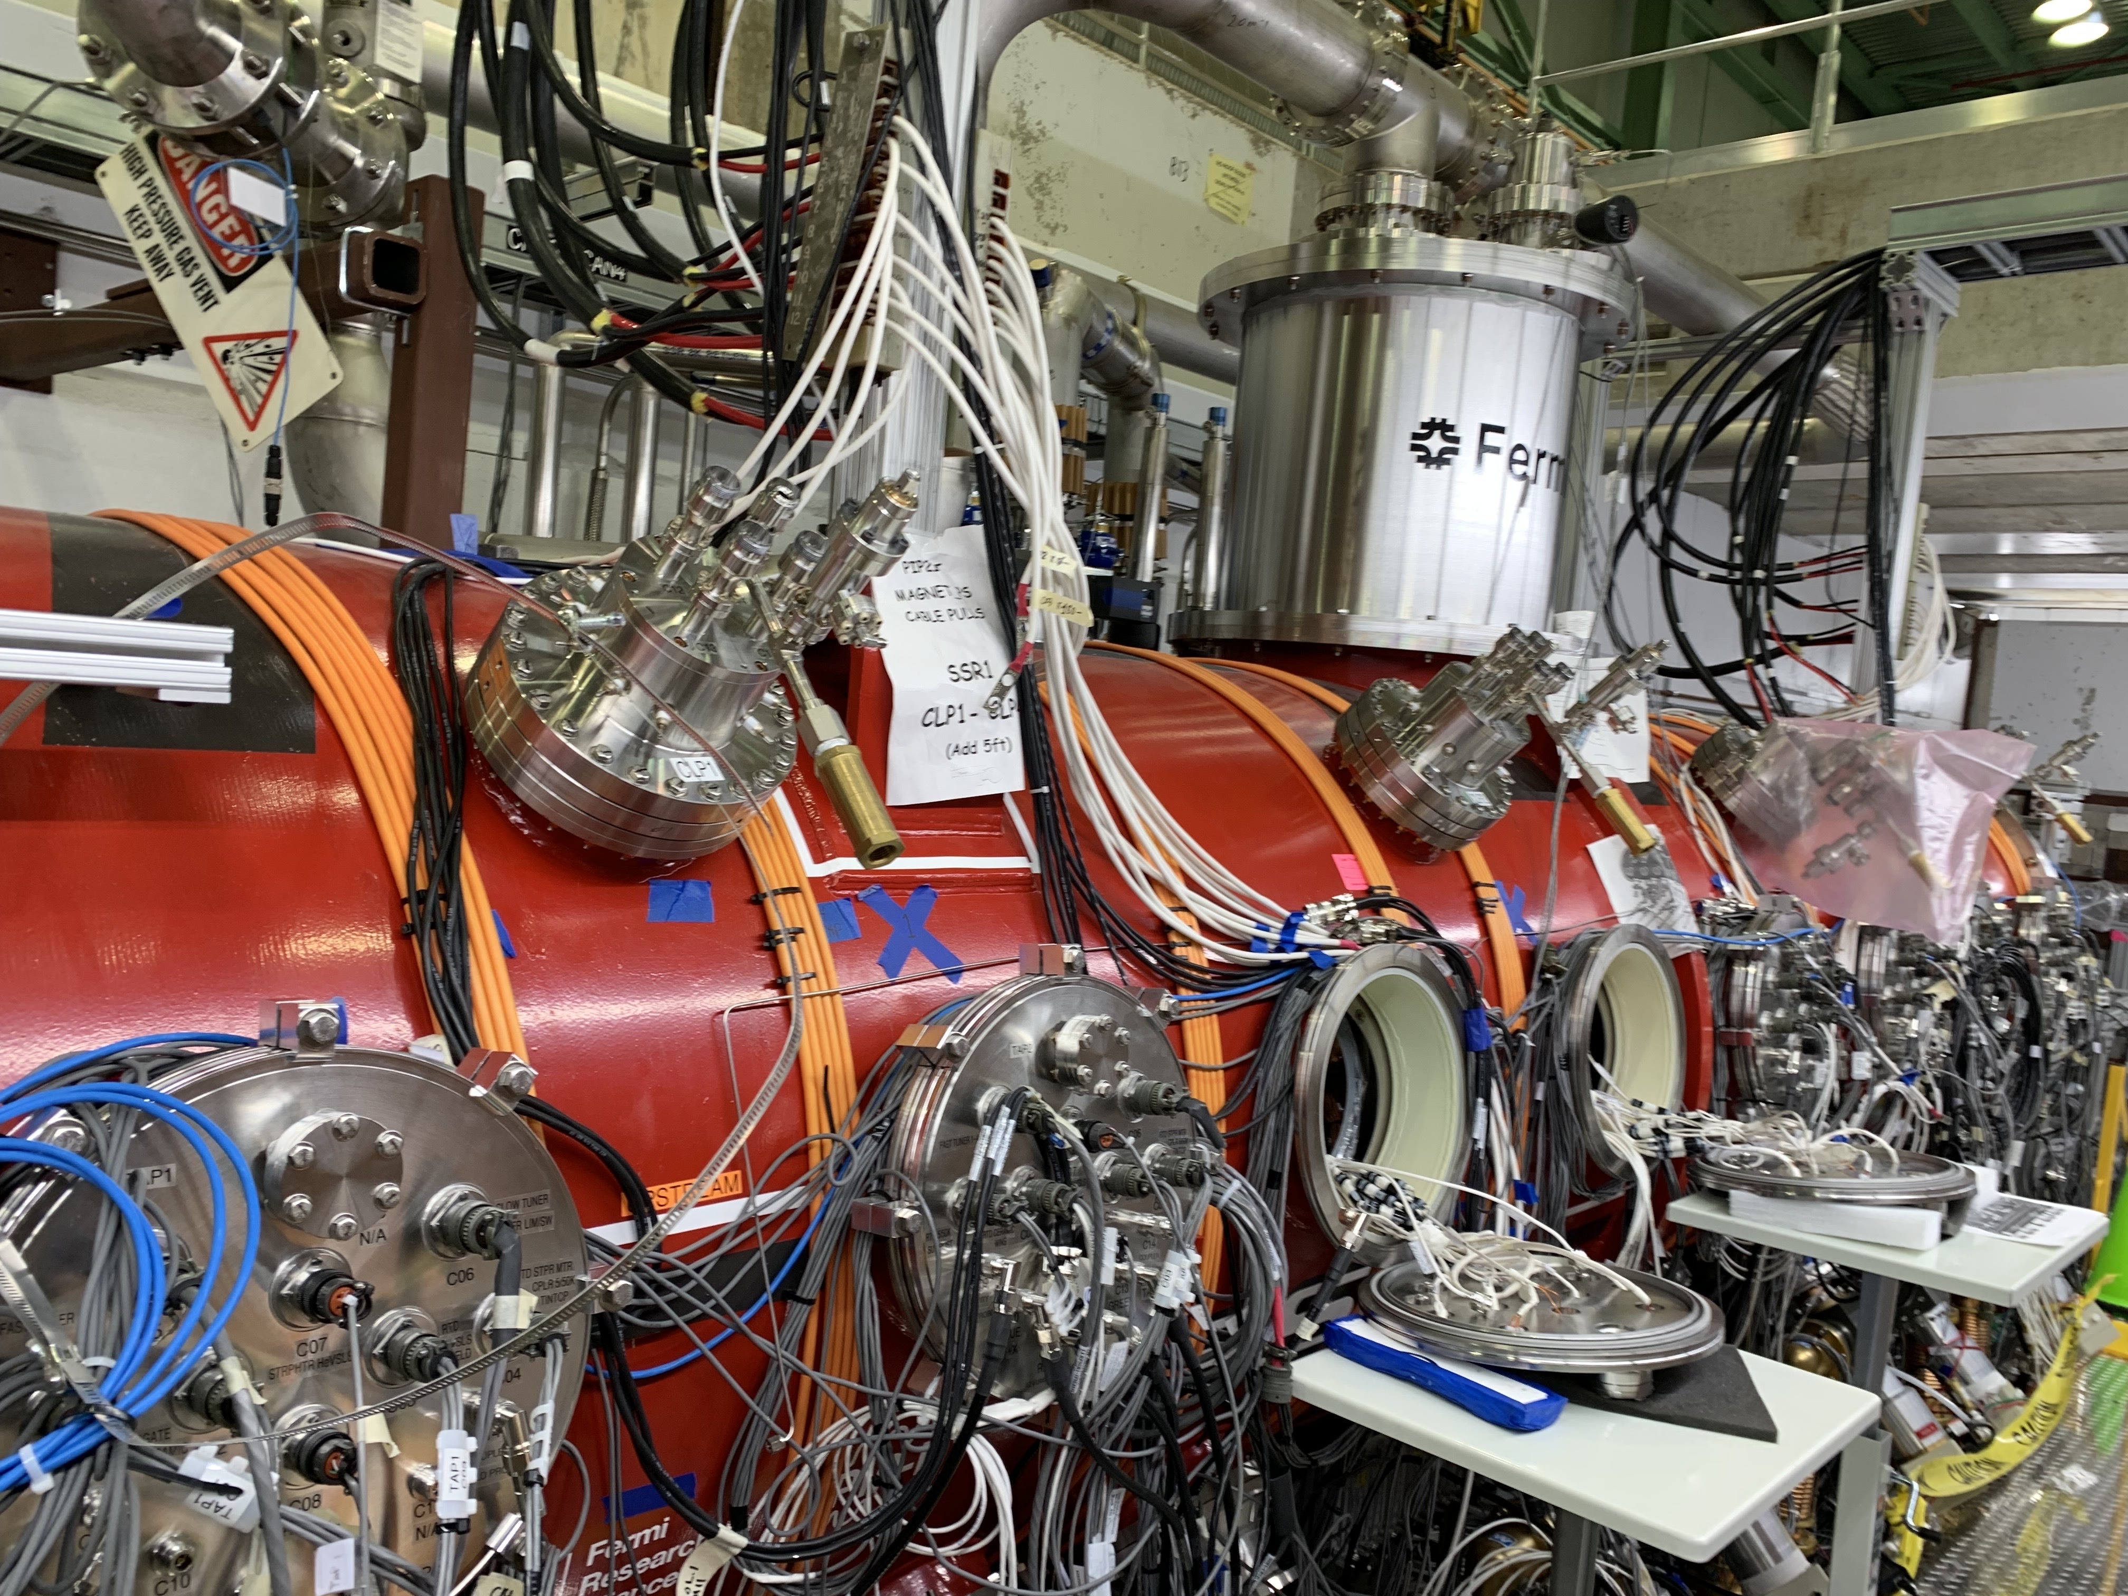
From functional to operational readiness
Our services work—but operating them at scale and over time requires additional discipline.
We had a functional stack of EPICS Services running for a while and tested during different test stands. So, what is next? Commissioning and operations require:
Reliability over time
Maintainability
Visibility into the system behavior
Operational Clarity
Cryomodule being installed for testing at PIP2IT at CMTF
Prototype HB650 "High beta 650 MHz"

Slide 3
The lightweight framework
🔧
⚙️
📊
🔒
Reproducible
Builds
Well-Defined
Config
Observability
Security
Practices
🔄
⚡
👥
✅
Recovery
Procedures
Performance &
Scalability
Operational
Ownership
Operator
Acceptance

Slide 4
Where we stand
✅ FOUNDATIONS IN PLACE
🔬 EPICS SERVICES STACK
☸️ Kubernetes
▸ Archiver
Container-orchestrated platform
▸ CSS Phoebus
🔀 GitOps Deployments
▸ Logger Service (caPutLog)
PR-controlled, declarative roll-outs
▸ Alarm Server
📁 Version-Controlled Config
All config under source control
▸ Alarm Logger
⚙️ CI/CD Pipelines
▸ Save & Restore Service
Automated build & deploy
▸ Channel Finder
📊 Observability Platform
▸ Scan Service
Nearly complete — logs, metrics
Tested across multiple test stands ✓

Slide 5
What we still need to validate
The stack works - but can it survive production conditions?
Performance & Scalability
High Availability
Failure Recovery
Behavior under peak IOC load
Number of concurrent clients
Redundant services
auto-restart behavior
Continuity of service during updates or restarts
Recovery time
Data continuity and reconnection to IOCs and clients
Data-loss scenarios
Security
Service status visibility
Least privileged containers
Automate vulnerability scans
Access control
Centralized logs for troubleshooting and correlation
Clear dashboards for service health

Slide 6

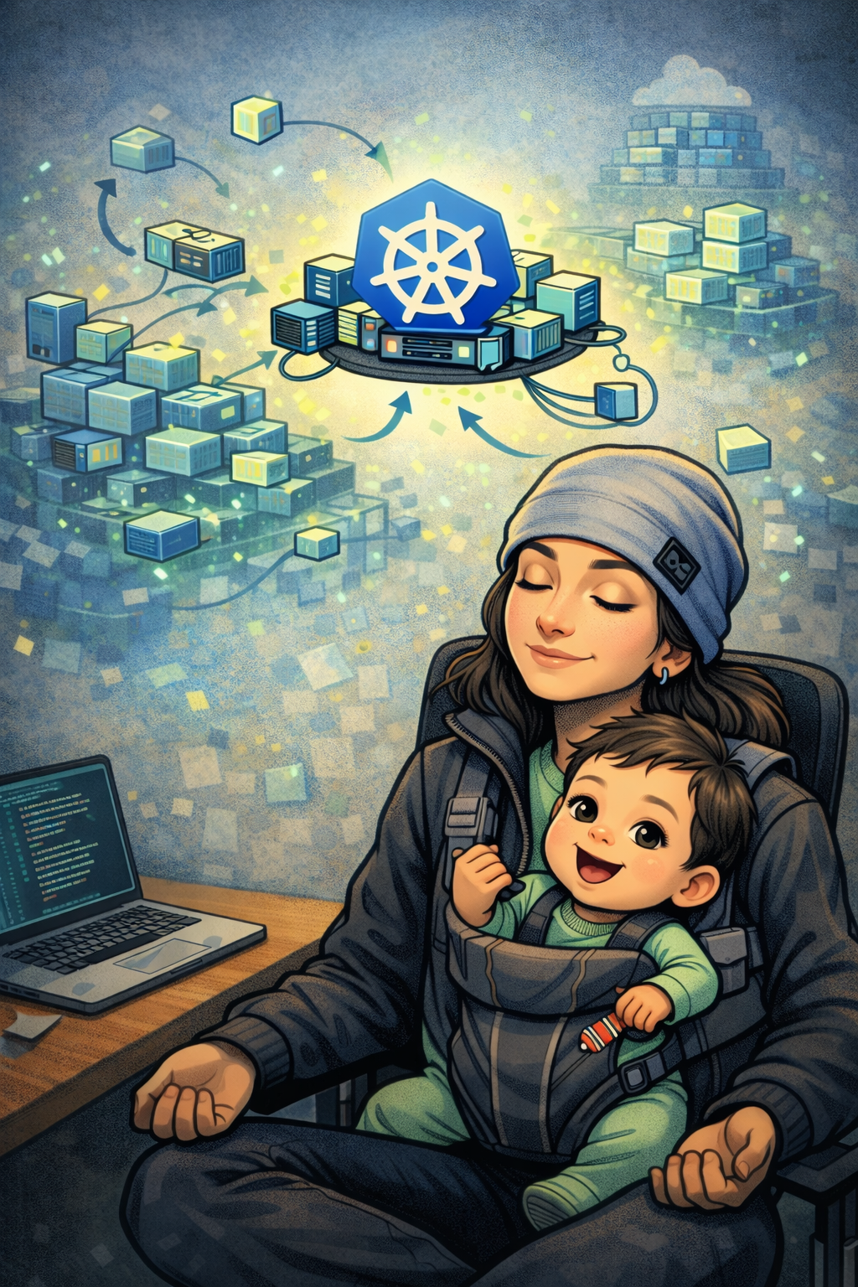
Merci à tous !

