Slide 1

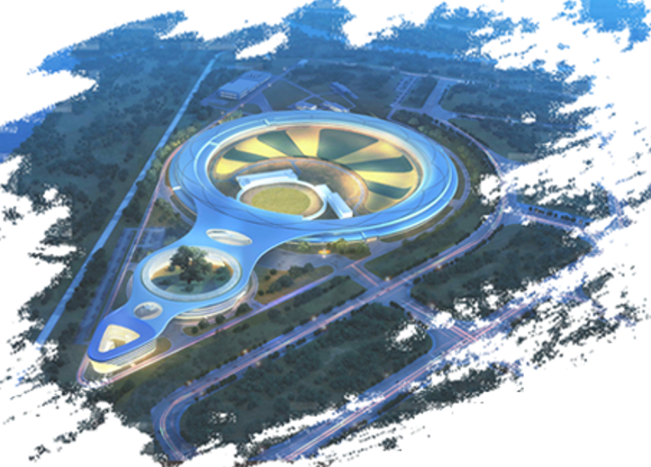
A Versatile Framework for Automated Attitude Tuning at Light Source Facilities
Pengcheng Li
Miao Zhang , Yu Liu , Yi Zhang
Experiment Software Group
Institute of High Energy Physics, HEPS
2026-04-21
Spring EPICS Collaboration Meeting 2026, Paris-Saclay
Notes:
“Hello, everyone.
I'm Pengcheng Li from the Institute of High Energy Physics, HEPS.
Today, I'll present our work: A Versatile Framework for Automated Attitude Tuning at Light Source Facilities.".

Slide 2


What is attitude tuning? Attitude tuning refers to essential preparation steps before beamline experiments, such as beam focusing, sample alignment, and detector positioning. These tasks typically involve multiple devices, including mirrors, lenses, gratings, sample stages, and monochromators.
The reality at modern light sources : These facilities produce smaller light spots and higher brightness, while beamline configurations become increasingly complex.
The consequence: Traditional scan-based methods are too slow. High brightness increases the risk of radiation damage. And manual tuning wastes valuable beamtime.
Background
&
Motivation
In short, most attitude tuning is peak finding in multi-dimensional spaces, which calls for a unified and automated framework.
Notes:
"So, what is attitude tuning? It includes tasks like beam focusing, sample alignment, and detector positioning — all essential before beamline experiments.
At modern light sources, we have smaller light spots, higher brightness, and increasingly complex beamlines.
Traditional scan-based methods are too slow.
High brightness risks radiation damage.
And manual tuning wastes valuable beamtime.
In short, most attitude tuning is peak finding in multi-dimensional spaces. We need a unified, automated framework."

Slide 3
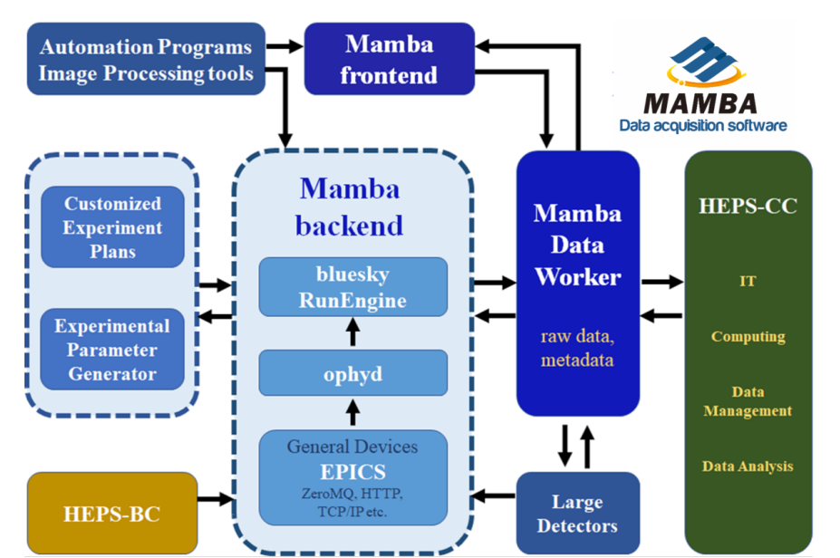
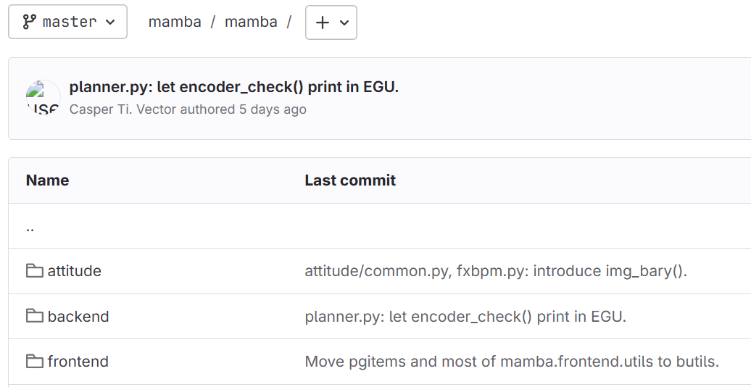
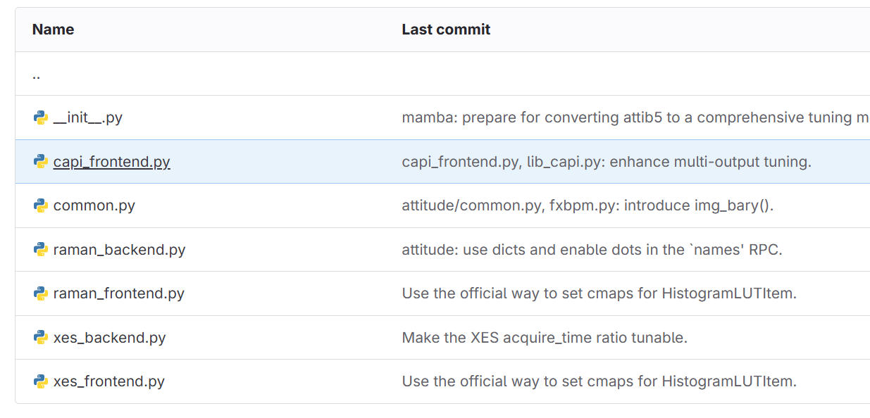
Mamba 2025
experimental control and data acquisition software framework（Mamba)
Notes:
Let me briefly introduce our experimental control and data acquisition framework — Mamba.
At HEPS, Mamba has already been deployed in 14 beamlines.
Among them, attitude-tuning-related functions are now available as an optional component installed within the Mamba system.
This framework serves as the foundation for our attitude tuning work."

Slide 4
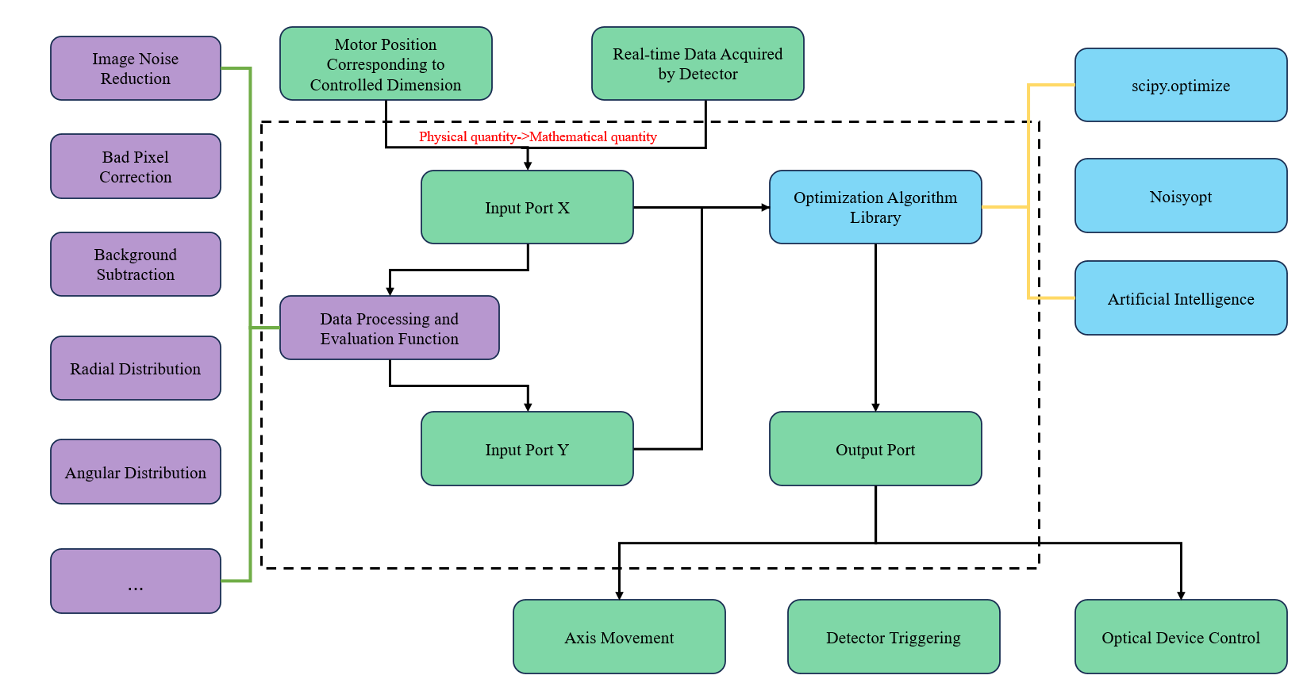
Our Solution – Framework Overview
A Mamba-based Numerical Optimization Approach
Core idea: Treat attitude tuning as a numerical optimization problem.
Core class: AttiOptim
Three key components:
Component | Function
I/O Ports | Convert physical devices (motors, detectors) to mathematical parameters
Data Processing and Evaluation Functions | Process raw data (ROI, image analysis, etc.) into objective values
Optimization Algorithms Library | Traditional (Nelder-Mead, genetic) + AI (reinforcement learning, Bayesian)
Architecture of the attitude-tuning framework
Integration Foundation :
EPICS + Bluesky(motors/detectors) + Algorithm Library
Notes:
"Our solution is a Mamba-based numerical optimization approach.
We treat attitude tuning as a numerical optimization problem.
The core class is called AttiOptim.
It has three key components: EPICS and Bluesky for integration, motors and detectors as I/O, and an algorithm library for optimization."

Slide 5
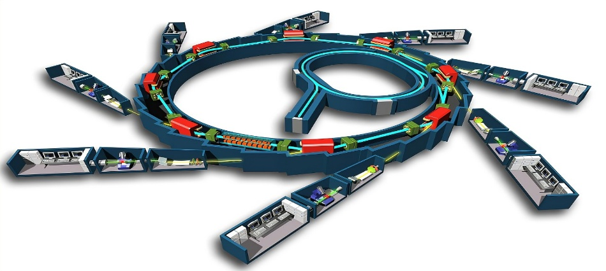
Architecture & Key Features
HOW AttiOptim Works?
Core Methods:
get_x()/put_x(): Read/control motors.
get_y(): Read detectors.
wrap(): Converts physical measurements into a mathematical function for optimizers.
Key Capabilities:
Flexible I/O: Works with any motor-like or detector-like device.
Custom Evaluation: Supports simple (e.g., photodiode current) to complex (e.g., image shape analysis) functions.
Multi-Objective Tuning: Handles multiple conflicting goals.
Human-in-the-Loop: Allows manual intervention (e.g., origin selection for XES).
ML/AI Ready: Bayesian optimization, deep learning pipelines easily integrated.
Notes:
"How does it work? We provide methods like get_x(), put_x() to read and control motors, and get_y() to read detectors.
The wrap() function converts physical measurements into a mathematical function for optimizers.
Key capabilities include: flexible I/O, custom evaluation from simple photodiode current to complex image analysis, multi-objective tuning, human-in-the-loop support, and it's ML/AI ready — Bayesian optimization and deep learning can be easily integrated."

Slide 6
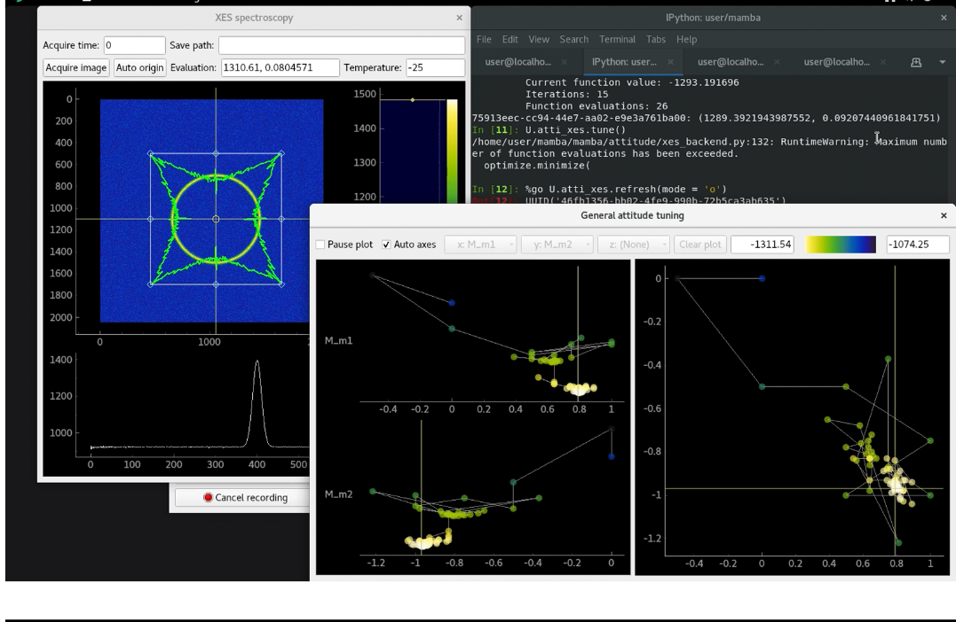
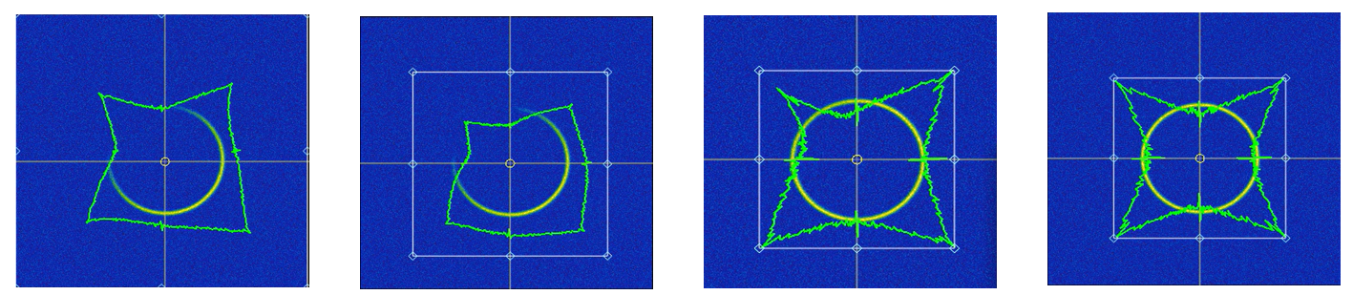
Example 1 – XES Spectrometer (Complex Evaluation)
von Hamos XES Spectrometer @ BSRF 4W1B
If the ring pattern center is inaccurate, the radial distribution will be distorted, and simple centroid algorithms fail under low SNR. We take (x,y) as optimization variables and use peak sharpness/intensity as the objective function to automatically refine the center via numerical optimization.
I/O Ports: Motorized pitch/yaw axes + area detector
Data Processing & Evaluation Function: Radial distribution calculation and mean intensity evaluation within the HM-ROI.
Optimization Algorithm Library: Local optimization algorithm to find the center position that maximizes the objective function.
Attitude tuning process of XES spectrometer
Notes:
"Here's a real example. At BSRF 4W1B, we tuned a von Hamos XES spectrometer.
We used motorized pitch and yaw axes and an area detector.
The evaluation function calculates radial distribution and mean intensity within a region of interest.
We treat the ring pattern center as optimization variables.
Even under low signal-to-noise ratio, our method finds the best center by maximizing peak sharpness and intensity."

Slide 7
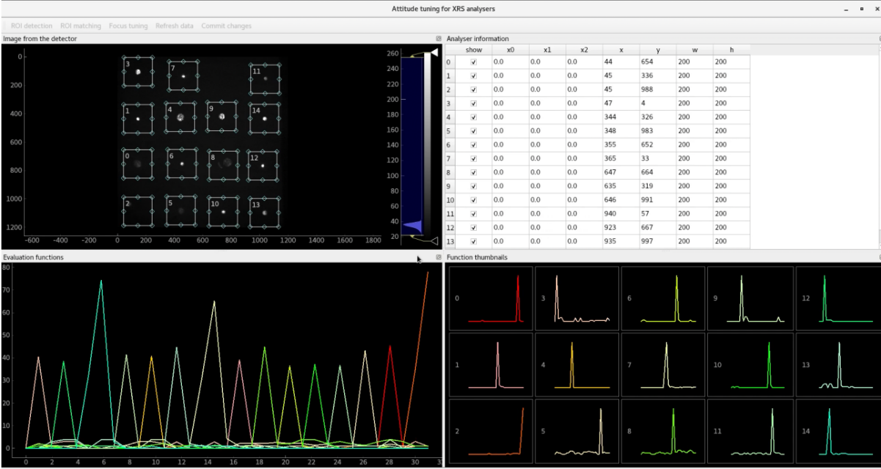
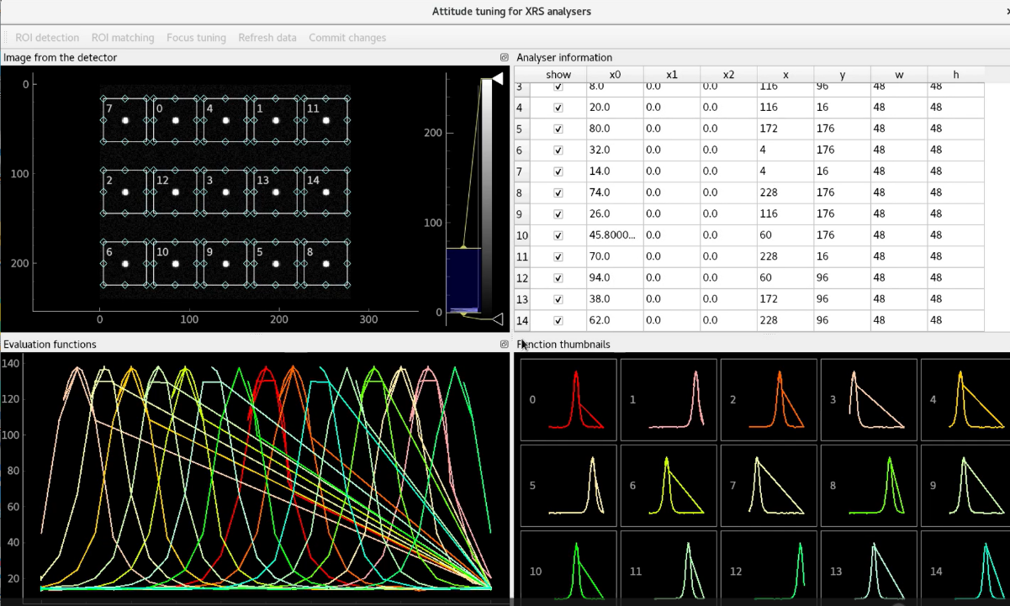
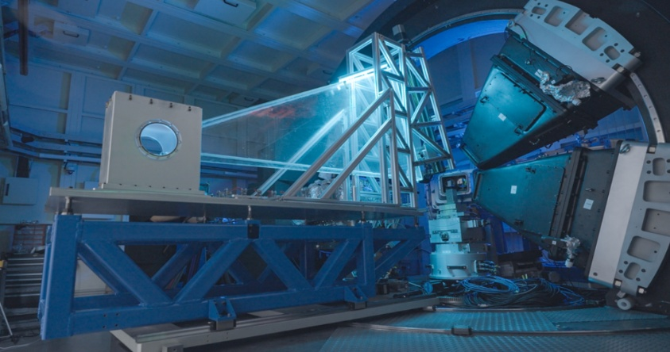
Example 2 – XRS Spectrometer (Custom Algorithms)
XRS on @ HEPS B5
I/O Ports: The X-ray Raman scattering (XRS) spectrometer includes 6 analyzer modules. Each module contains a detector and 9 analyzer arrays, with 3 motorized degrees of freedom per analyzer: one longitudinal shift and two latitudinal angles.
Evaluation Function: The optimization goal is to maximize the mean intensity within a 2D Half-Max Region of Interest (HM-ROI) on the detector.
Optimization Strategy: Custom algorithms (max_parascan(), perm_diffmax()) are implemented for parallel optimization and ROI matching.
Manual Initialization -> Automatic ROI Matching ->Parallel Focusing
Notes:
"Another example is the XRS spectrometer at HEPS B5.
It has 6 analyzer modules, each with 9 analyzers and 3 motorized degrees of freedom per analyzer.
Our evaluation maximizes mean intensity in a half-max region of interest on the detector.
We implemented custom algorithms like max_parascan() and perm_diffmax() for parallel optimization and ROI matching.
The workflow includes manual initialization, automatic ROI matching, and parallel focusing."

Slide 8
Conclusion & Impact
We have created a versatile, unified framework for attitude tuning.
It successfully handles:
Simple peak finding (Polycapillary lens).
Complex, image-based evaluation (XES spectrometer).
Custom, non-standard optimization tasks (XRS spectrometer).
Key Strengths:
Simple and maintainable code.
Works with CLI and friendly GUIs.
Easily integrates ML/AI.
Covers most attitude tuning needs at modern light sources.
Future Outlook: Apply to accelerator tuning, detector calibration, and collaborate with mathematicians on physics-aware algorithms.
Conclusion
& Future
Notes:
"In conclusion, we have created a versatile, unified framework for attitude tuning.
It handles simple peak finding, complex image-based evaluation, and custom optimization tasks.
Key strengths: simple and maintainable code, works with CLI and GUIs, easily integrates AI, and covers most attitude tuning needs at modern light sources.
In the future, we plan to apply it to accelerator tuning and detector calibration, and collaborate with mathematicians on physics-aware algorithms.

Slide 9
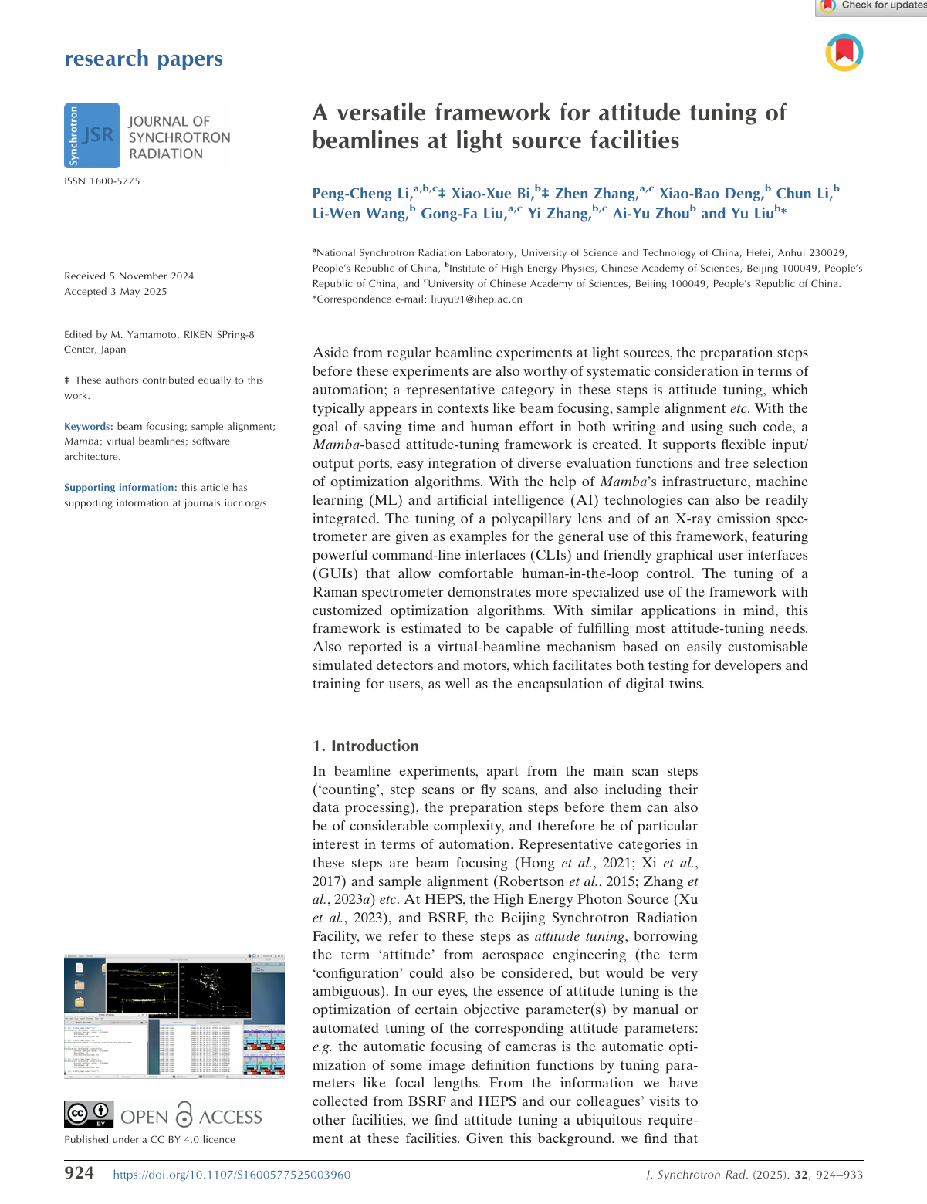

Thank you !
Pengcheng Li Email: lipc@ihep.ac.cn
Notes:
"Thank you!
[pause briefly]
If you are interested in this work, you can find a paper with the same title on JSR — the Journal of Synchrotron Radiation.
You can also reach us by email. Our contact information is on the screen.
Thank you again!"

