Slide 2
Python EPICS Archiver Clients
PRESENTED BY <Sky Brewer>

Slide 3
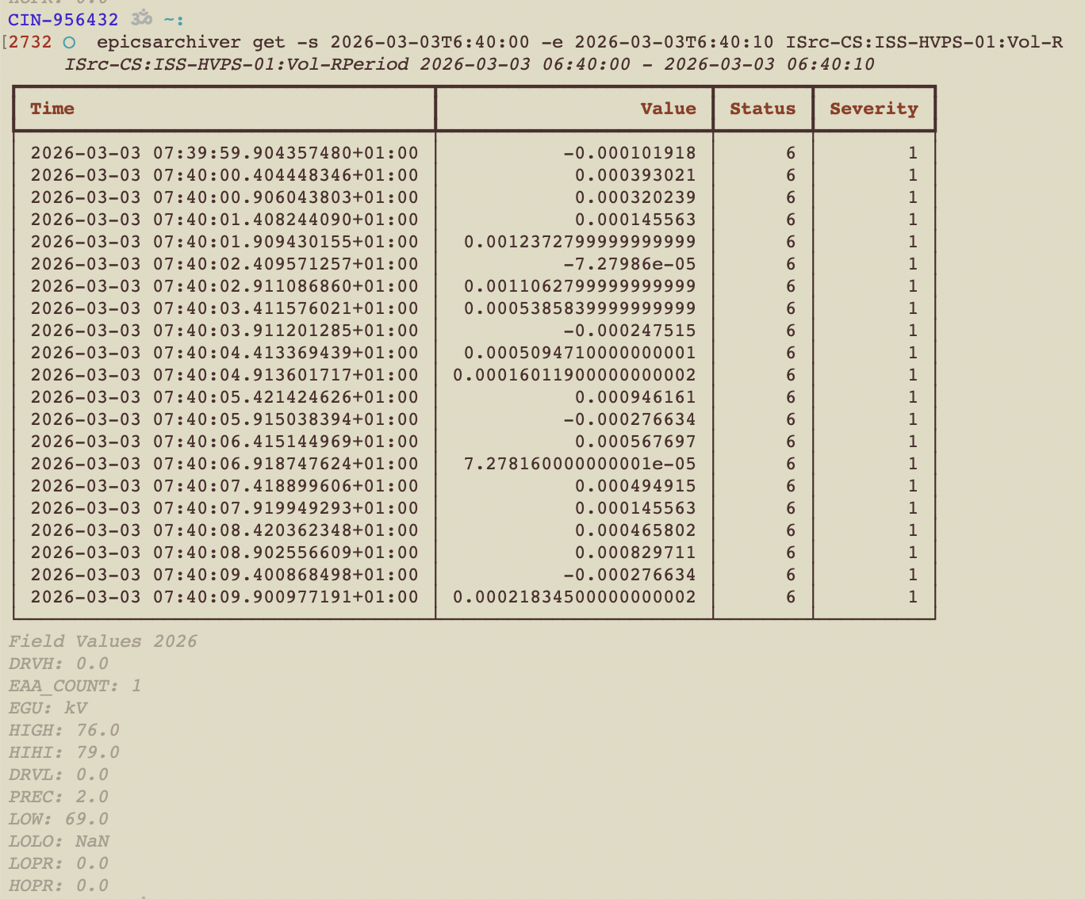
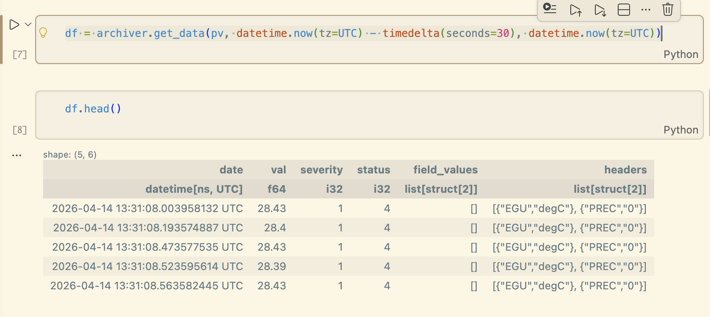
Epicsarchiver-retrieval
A python library and cli tool
  Download data into a list of events
  Download data into a pandas or polars dataframe
  Asynchronous support for fetching data
  Search for PVs
Present data in the command line

Slide 4
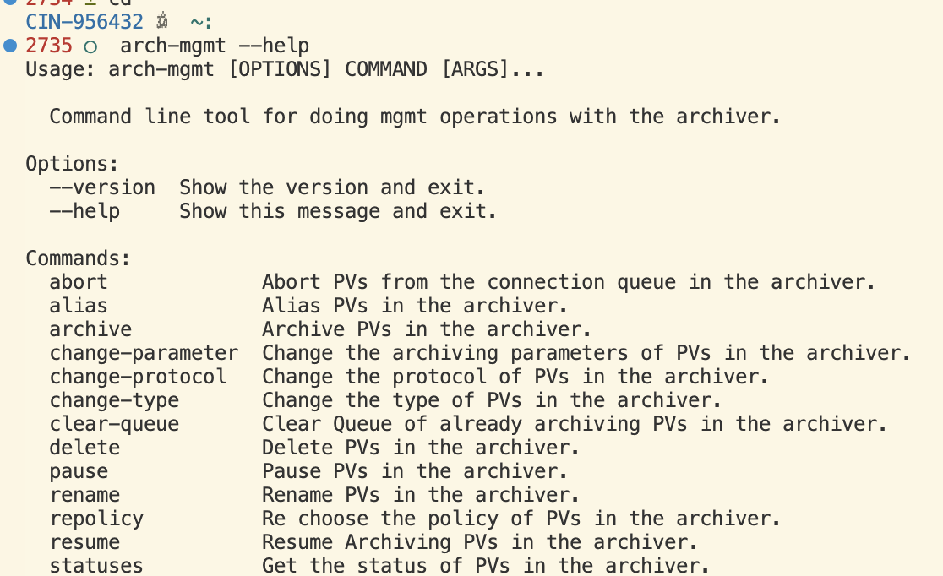
Epicsarchiver-mgmt
Command line tool for bulk mgmt operations in Archiver Appliance
Adds validation
- PVs are in correct status
- Not renaming to same name
- Type change is supported

Slide 5
Comparison to alternatives
 | Epicsarchiver-clients (ESS/Sky) | Aaclient (mdavidsaver) | Aapy (dls-controls) | PyArchAppl (zhangt58)
Supported return types | Polars, pandas, list | Hdf5, numpy | numpy | pandas
Retrieval Protocol | Protobuf | Protobuf | JSON, Protobuf | Protobuf
Async api | Yes | Yes | No | Yes
Mgmt support | pause, resume, archiver, change-type, and more | search | No | inspect

Slide 6
Coming Soon
Currently available at
https://gitlab.esss.lu.se/ics-software/py-epicsarchiver/
https://gitlab.esss.lu.se/ics-software/archiver-appliance/epicsarchiver-mgmt
I intend to make version 1.0 in the next month and move repositories to
https://github.com/archiver-appliance/epicsarchiver-client-retrieval
https://github.com/archiver-appliance/epicsarchiver-client-mgmt

