Slide 1
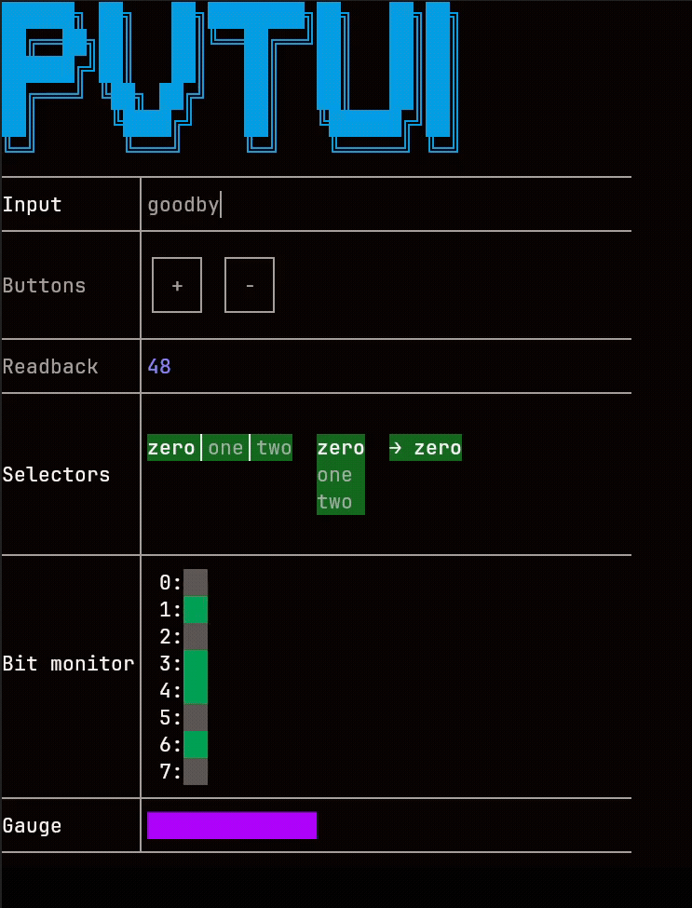
PVTUI – Terminal user interfaces for EPICS
April 24, 2026
Nick Marks
Control Systems Engineer
Beamline Controls & Data Acquisition Group

Slide 2
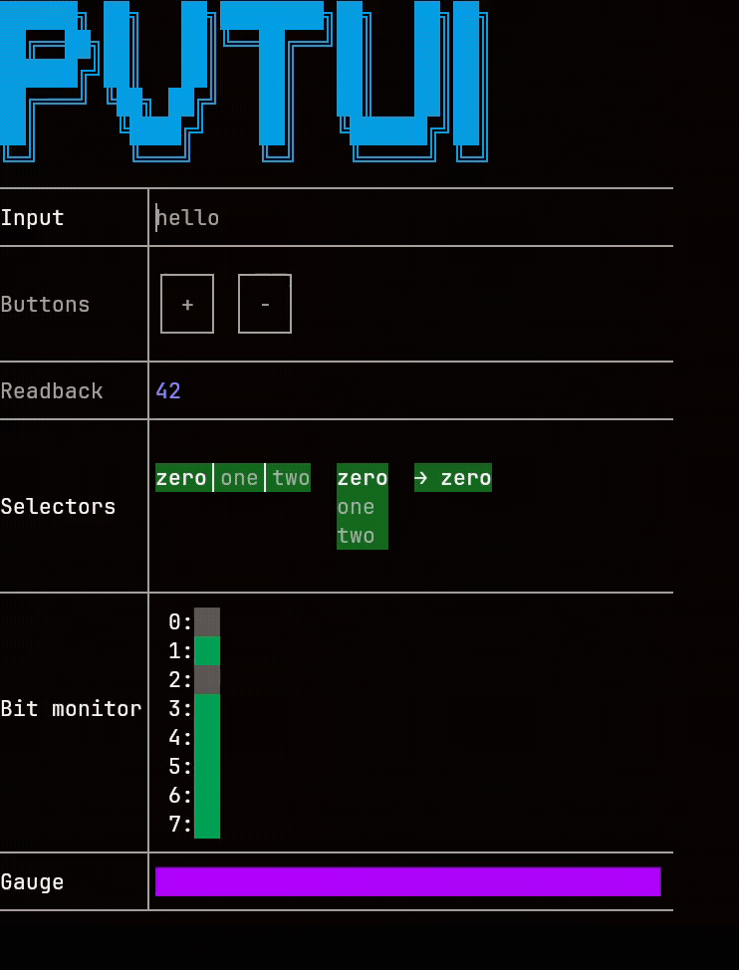
PVTUI
C++ library for creating text based user interfaces that run in your terminal emulator
Provides common UI widgets which abstract away EPICS communication details,
Supports both Channel Access and PVAccess
Includes set of ready-to-use applications
Great for working over SSH
Linux only (for now)
Limited testing on MacOS
Windows not tested

Slide 3
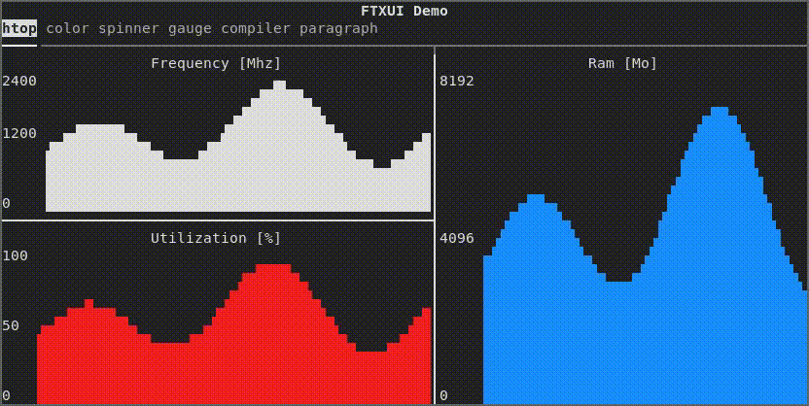
METHODS
FTXUI
PVTUI is a thin layer on top of FTXUI
Slight learning curve, but plenty of examples

Slide 4
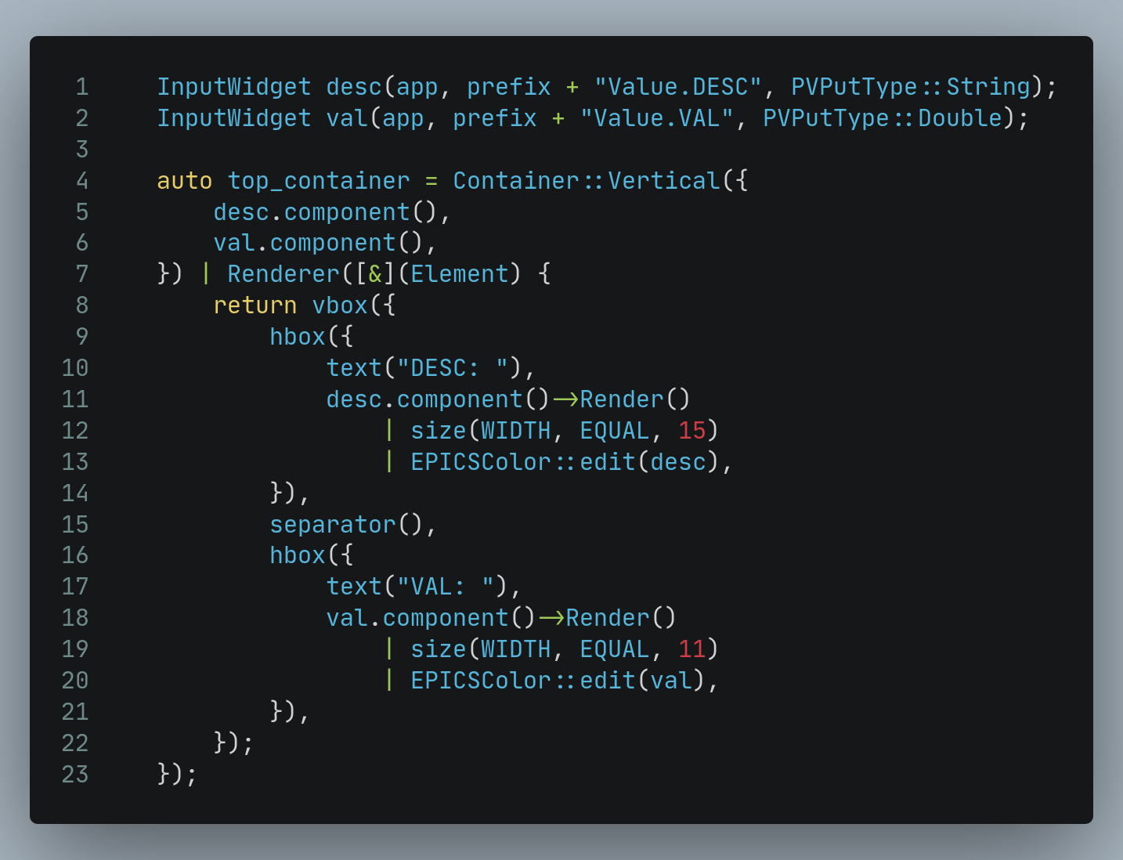
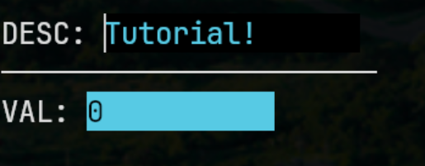
METHODS
Example

Slide 5
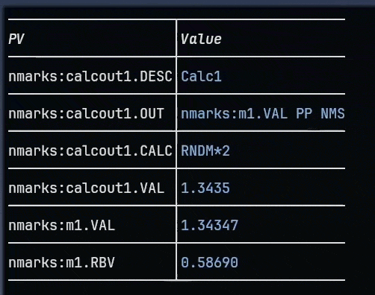
INCLUDED APPLICATIONS
monitor

Slide 6
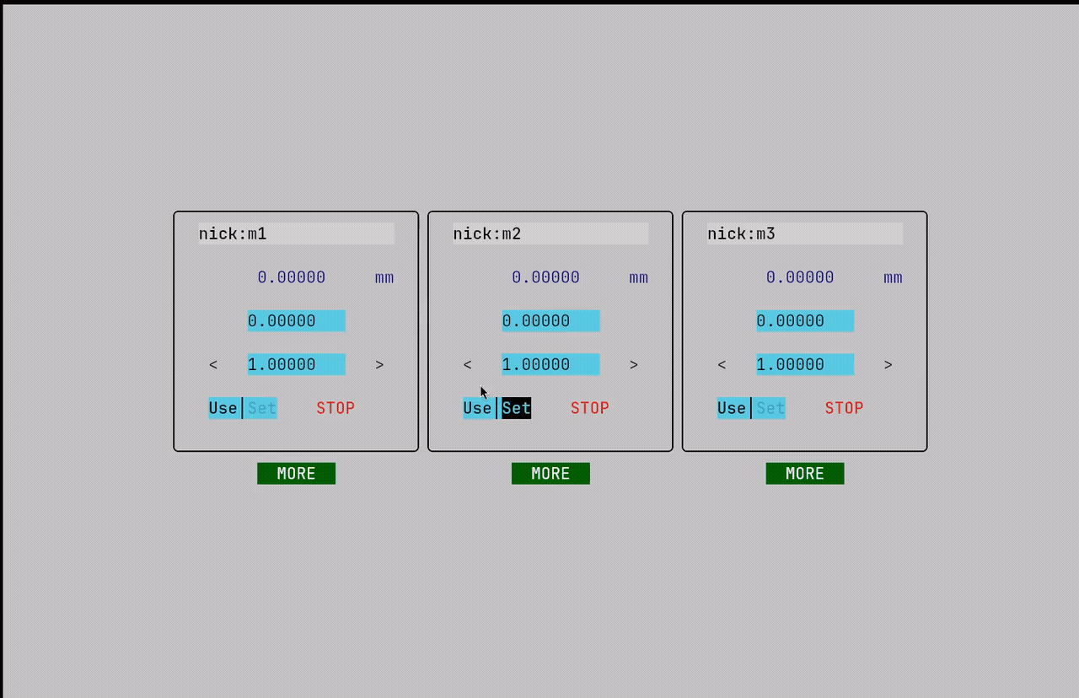
INCLUDED APPLICATIONS
motor

Slide 7
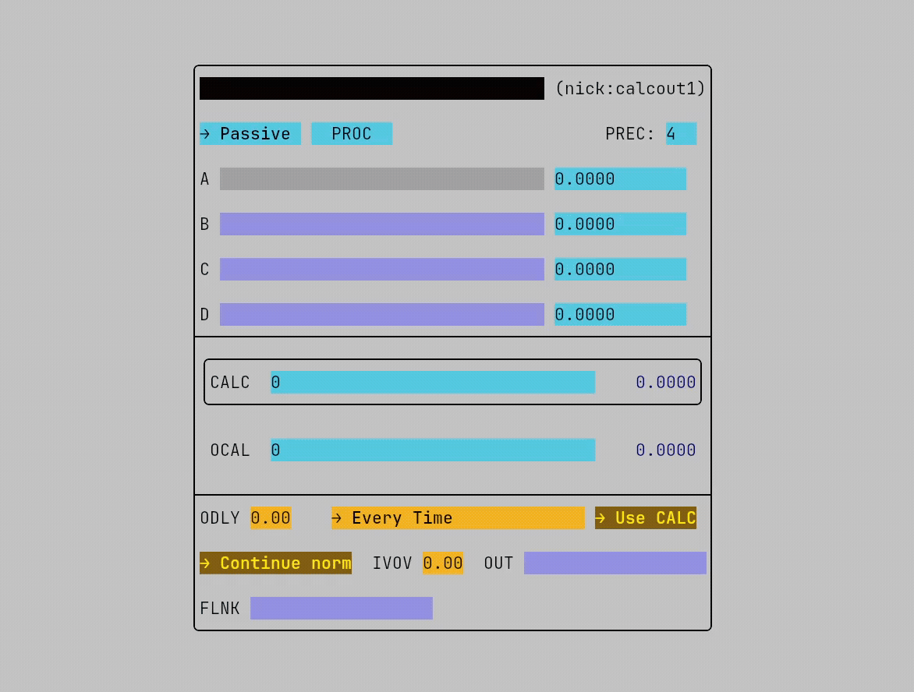
INCLUDED APPLICATIONS
calcout

Slide 8
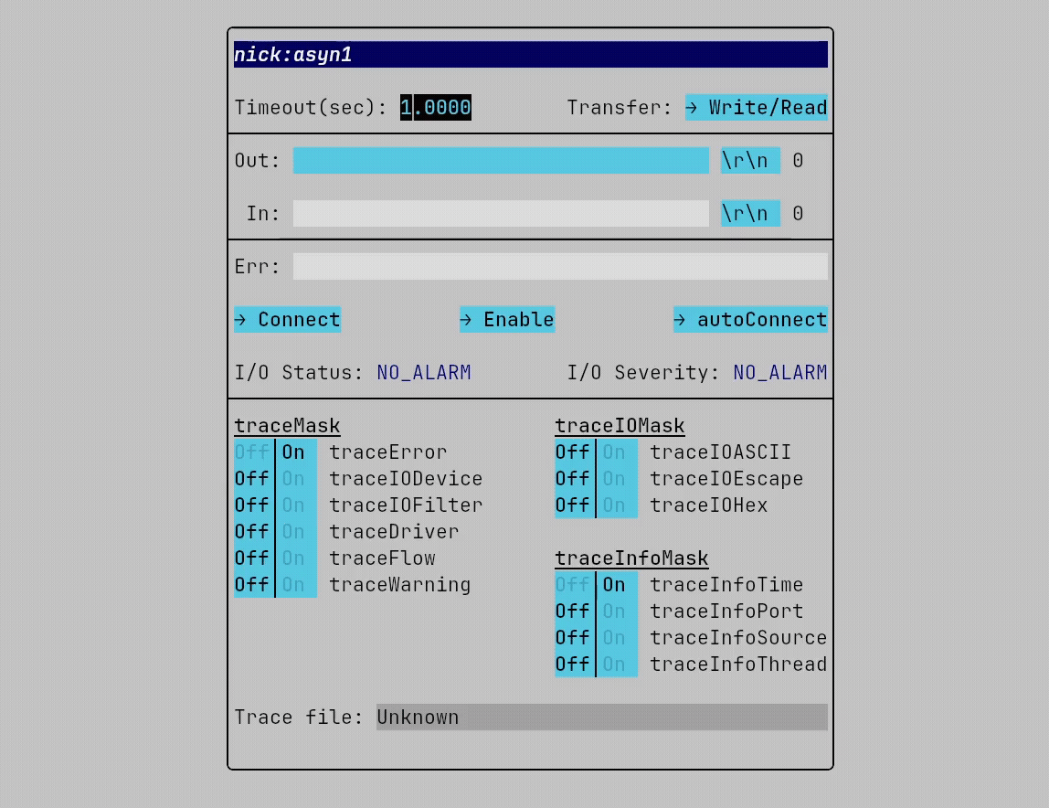
INCLUDED APPLICATIONS
asyn

Slide 9
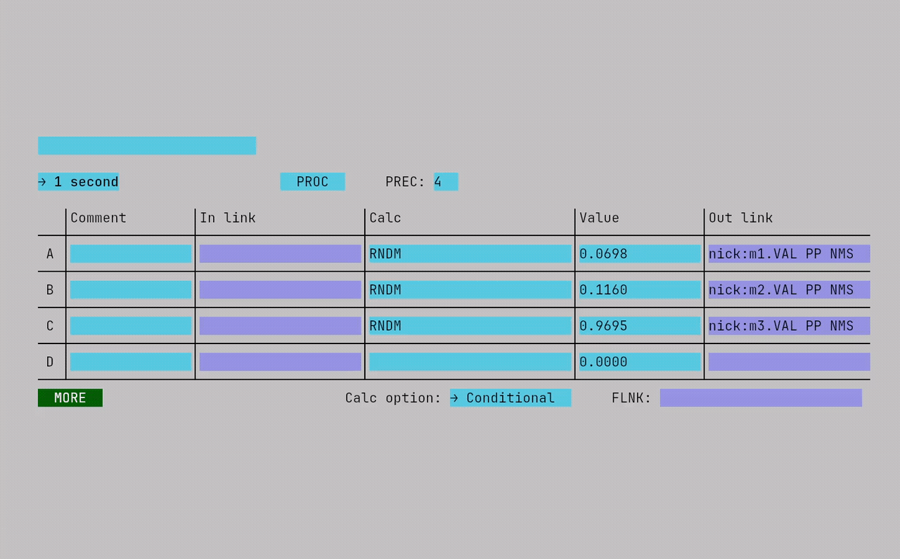
INCLUDED APPLICATIONS
transform

Slide 10
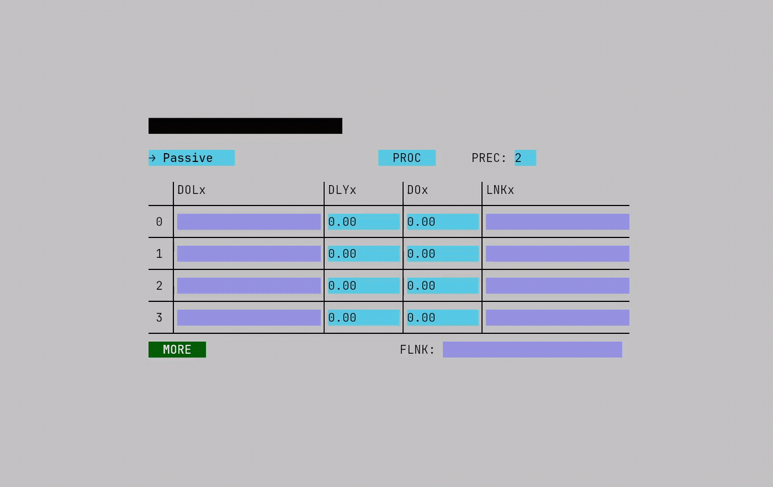
INCLUDED APPLICATIONS
sequence

Slide 11
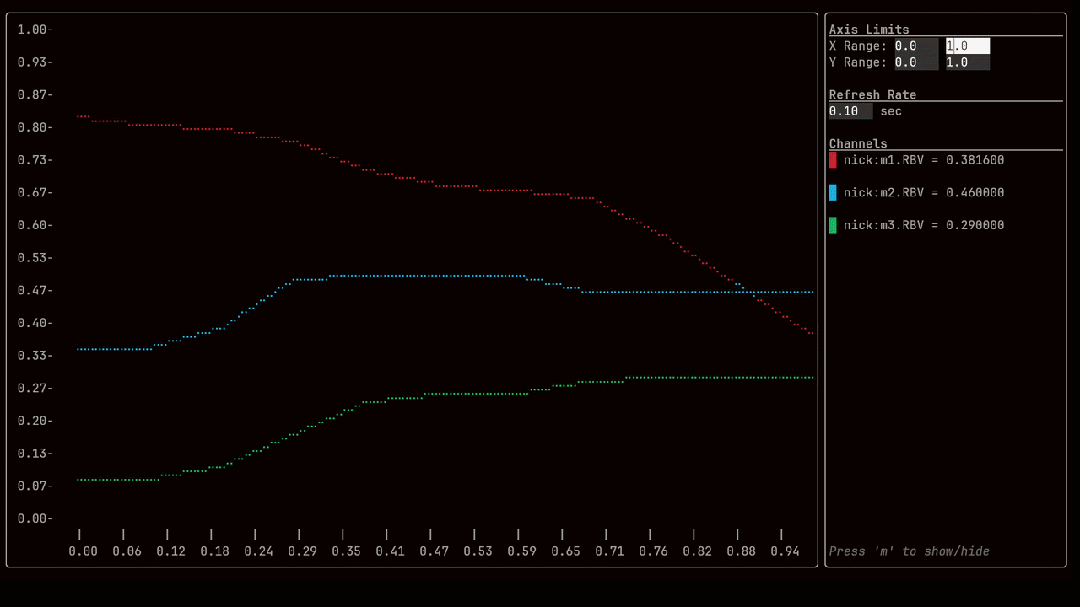
INCLUDED APPLICATIONS
striptool

Slide 12
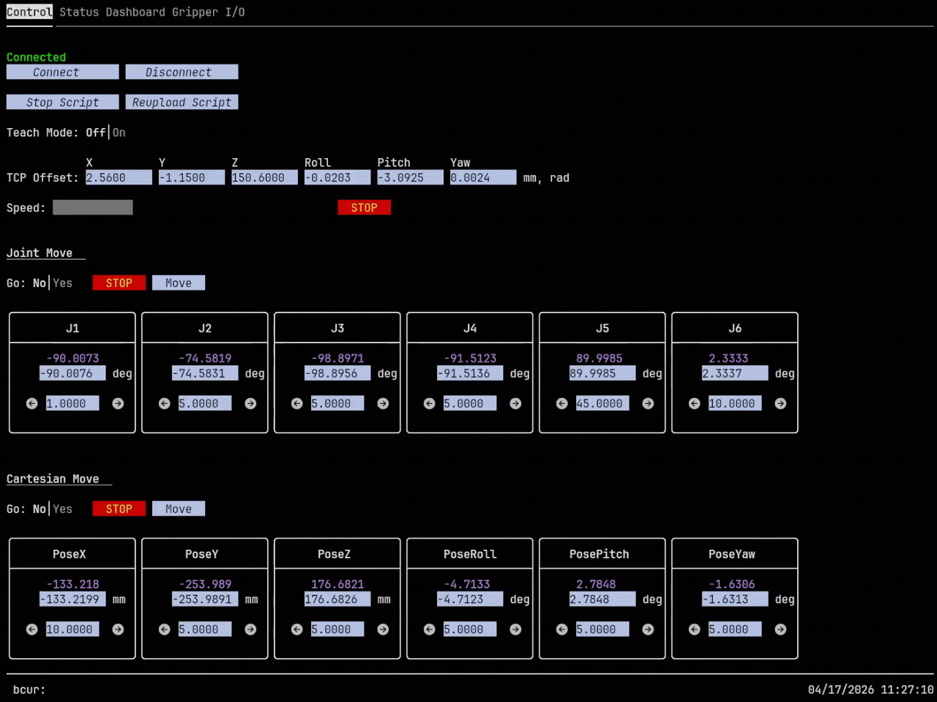
OTHER
Robot dashboard

Slide 13

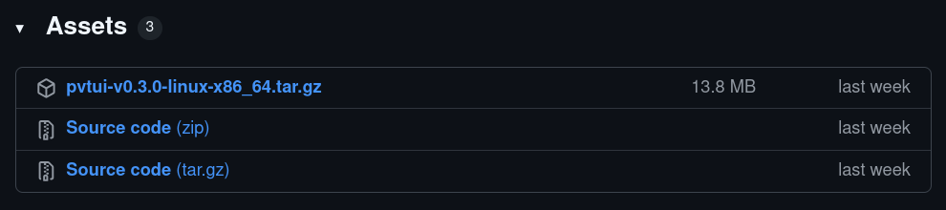
GITHUB
https://github.com/BCDA-APS/pvtui

