Slide 1
Design and Implementation of the Vacuum Control System for CSNS Spectrometers
Xuan Wu
Division of Accelerator Technology, CSNS
Institute Of High Energy Physics, CAS
EPICS Collaboration Meeting 20 – 24 April , 2026

Slide 2
Outline
Vacuum control system requirements
System design and implementation
Summary

Slide 3
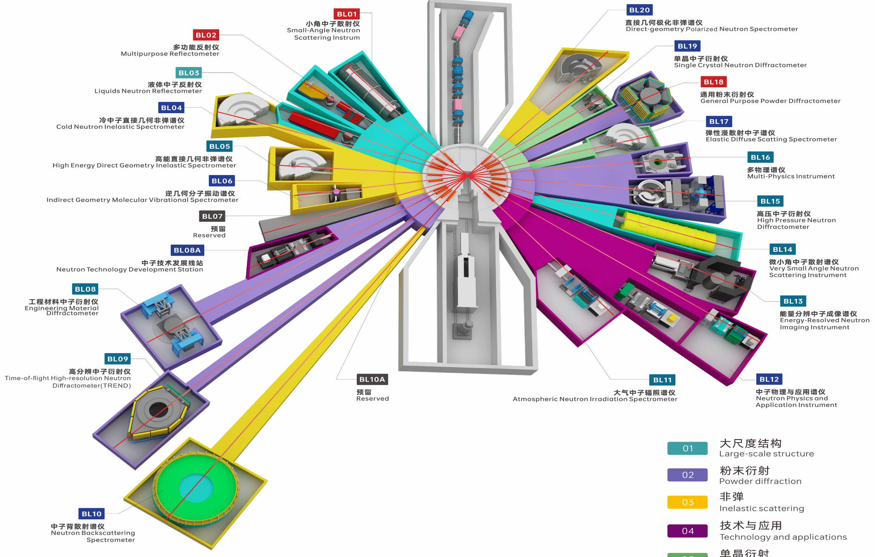
CSNS spectrometers
20 user spectrometers used to probe the microscopic structure and the dynamic behavior
Vacuum specification: Pa ~ 10⁻⁵ Pa

Slide 4
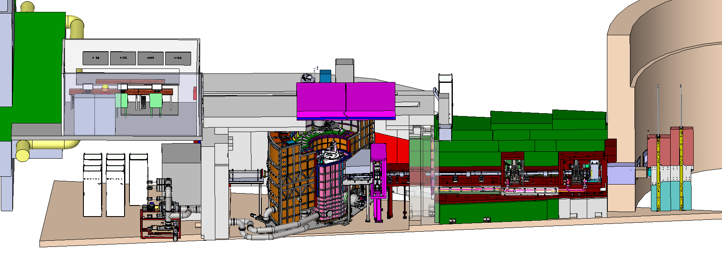
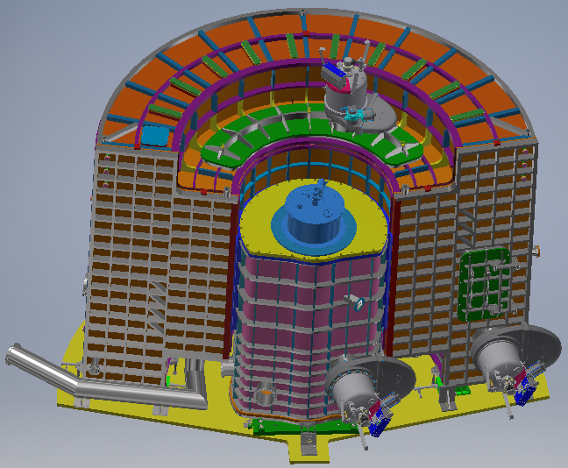
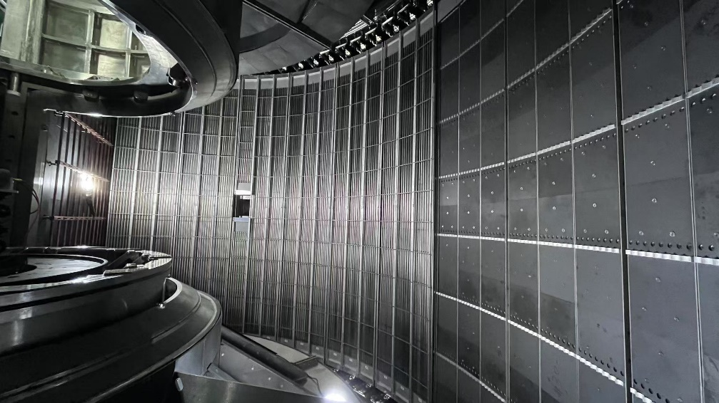
High energy direct geometry inelastic spectrometer(HEDG)
The scattering chamber has a volume of approximately 40 m³ and contains a large number of ³He tube detectors powered by a high voltage of around 2 kV.
This spectrometer operates under a vacuum of 5E-4Pa.
He³ tube
Scattering chamber
Sample chamber
Sample environment

Slide 5
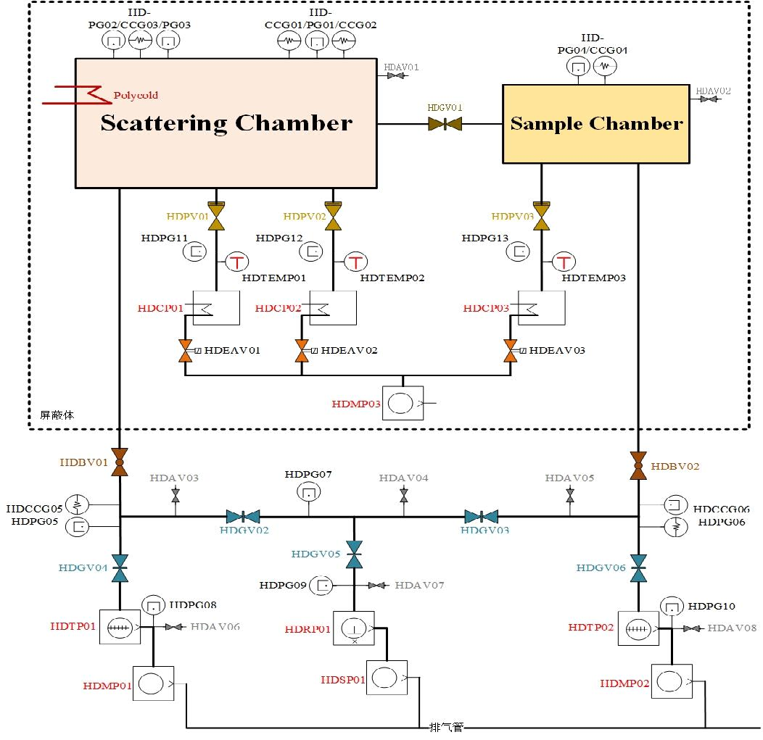
Layout of vacuum system
Device | Brand & Model | Quantity
Vacuum gauge | Pfeiffer IKR60/TPR018 | 16
Gauge controller | Pfeiffer TPG-500 | 6
 | Leybold CM51 | 3
Vacuum valve | VAT/CBVAC DN250/KF40 | 22
Roots pump | Pfeiffer Okta 4000 | 1
Dry screw pump | Pfeiffer HeptaDry 630P | 1
Mechanical pump | Pfeiffer ACP40 | 3
Cryopump | Leybold COOLVAC | 3
Compressor | Leybold COOLPARK | 3
Polycold | Brooks MaxCool 4000H | 1
Turbo pump | Pfeiffer HiPace 2300 | 2
Temperature controller | Lake Shore LS211 | 3
HV power supply | Wiener MPOD | 1

Slide 6
Vacuum control system requirements
Independent remote control for all vacuum equipment.
  Kinds of vacuum gauges, valves, pumps.
One‑key operation for chamber evacuation and venting.
  Frequent evacuation and venting of the chamber is time-consuming, with complicated procedures and operations.
Automatic interlock of vacuum valves and high-voltage power supply upon vacuum degradation.
  High-voltage arcing may cause damage to the detector or electronics when vacuum deteriorates

Slide 7
Scheme design
The PLC is used to control the switching, start/stop of various vacuum equipment, as well as the interlock of high-voltage power supplies. Status of some equipment is obtained via communication.
The core automated programs for complex operations run on the industrial PC.
OPI
Archiver
Alarm
Gigabit LAN
Yokogawa F3RP61(Embedded IOC)
Moxa MC1122(IOC)
Touch Panel PC
Yokogawa F3SP76(Sequence CPU)
Ethernet switch
NPort 5650
Cable
Cable
Cable
Cable
Cable
Interlock
Valves
Pumps
Gauges
AC contactor
HVPS
Gauges
Polycold
Gauges
Mechanical pump
Vacuum control system architecture

Slide 8
Main control logic
Manual mode: used during vacuum pumping/venting and equipment maintenance.
  Each equipment can be operated remotely.
Interlock mode: used after vacuum pumping down.
  Manual operation of any vacuum equipment is prohibited to prevent misoperation.
  Corresponding valves are interlocked when vacuum degrades.
Detector high-voltage PS interlock operates independently of control mode for safety.

Slide 9
Main control logic
Confirm from detector that the voltage is zero,
All the eight HDAV01/02/03/04/05/06/07/08 are closed,
Open HDGV01,
open HDBV01/02,
open HDGV02/03/05,
activate HDPG01/02/03/04/05/06/07/08/09/10
close HDGV04/06,
close HDPV01/02/03 simultaneously
Open HDMP03
Open HDCP01/02/03
When the isolate gate valve HDGV01 is open totally
open HDMP01/02
open HDRP01 simultaneously
If HDPG08/10 are lower than 5Pa,
start HDTP01/02
When HDPG01/02/03/04 are lower than 5Pa, and HDCP01/02/03 are ‘CRYO READY’,
open Polycold,
open HDPV01/02/03
When HDCP01/02/03 is ‘CRYO READY’,
close HDMP03,
When HDPG05/08 are lower than 1.0E-1 Pa, open HDGV04,
When HDPG06/10 are lower than 1.0E-1 Pa, open HDGV06
When HDPG07 is lower than 1.0E-1 Pa, and HDGV04/06 are open,
close HDGV02/05
One min later after the HDGV05 is closed, close HDRP01,
HDPG01/02/03/04/05/06 is lower than 1.0E-1Pa, activate HDCCG01/02/03/04/05/06
Four types of automated processes
  Evacuate the scattering chamber and sample chamber to restore vacuum from atmosphere.
  Vent the scattering chamber and sample chamber for long-term shutdown or maintenance.
  Venting the sample chamber is required for sample environment replacement.
  Sample chamber vacuum recovery
The process is complex and time-consuming.

Slide 10
Design of automation flow (One-key control )
Each step must be verified for successful execution via status readback.
Indicate process progress and provide error prompts.
Timeout mechanism
Manual abort available at any time
No conflicts shall occur when restarting the process after an abnormal exit.
Overall
pumping
Overall
venting
OP、No HV
Manual mode
OV、 No HV
Manual mode
Done/Fault
Done/Fault
Abort
Idle
Abort
Done/Fault
Done/Fault
Sample
chamber
pumping
Sample
chamber
venting
Abort
Abort
SP、 No HV
Manual mode
SV、 No HV
Manual mode
Automatic process state machine

Slide 11
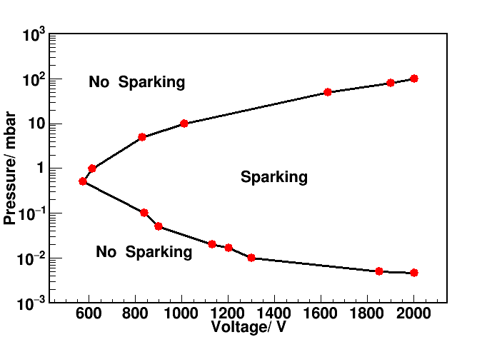
HV power supply interlock
Slowly ramp down high voltage through program when pressure exceeds 5E-3 Pa.
Ramp down high voltage quickly via TTL signal when pressure is above 8E-3 Pa.
Cut off 220VAC of the high-voltage chassis through the contactor when pressure is above 1E-2 Pa.
4
Alarm for hard shutdown
1×10⁻²
Pa
Cut off the electric connection immediately.
3
Alarm for soft shutdown
8×10⁻³Pa
Close valve for the pumps with problems, relive the voltage quickly
5×10⁻³Pa
2
Alarm for bad vacuum
embedded ramp down/up
1
Normal working area
5×10⁻⁴Pa
High-voltage arcing vs. vacuum pressure
Alarm severity

Slide 12
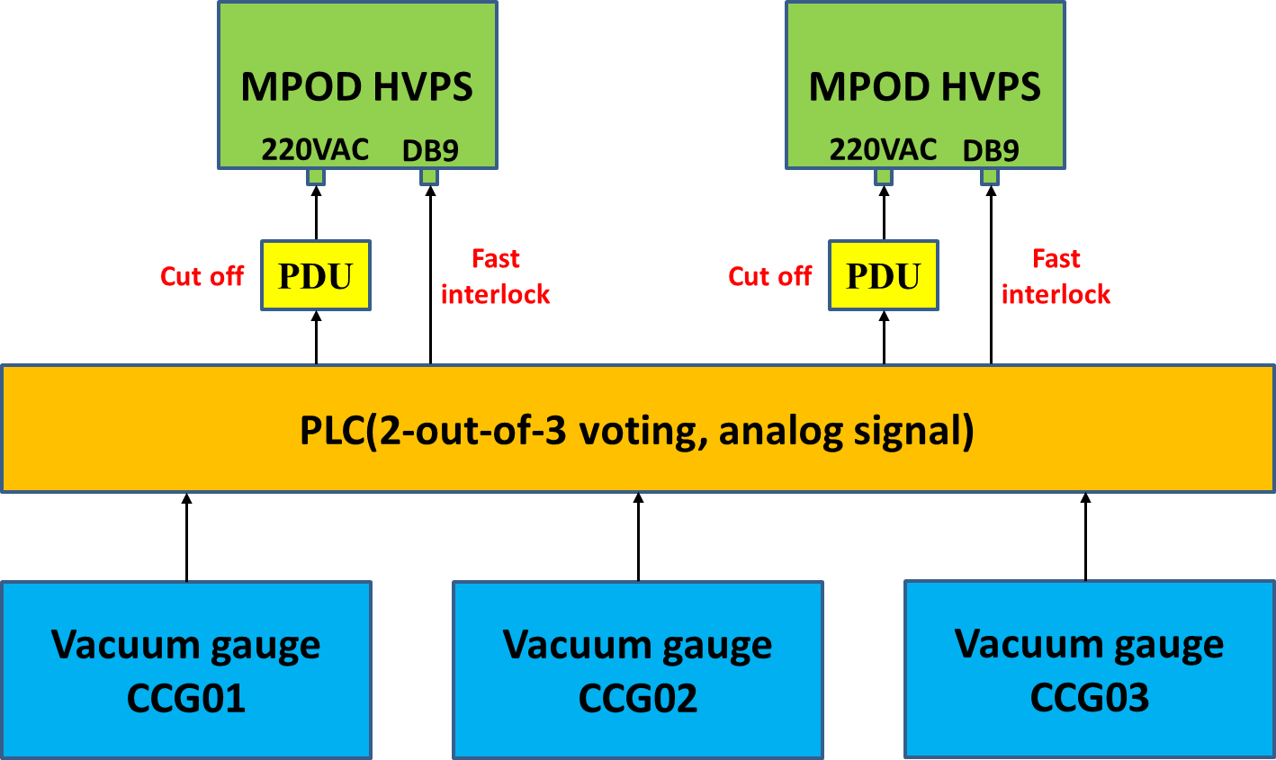
HV power supply interlock
Interlock when any two of CCG01, CCG02, CCG03 in the scattering chamber exceed the vacuum threshold at the same time.

Slide 13
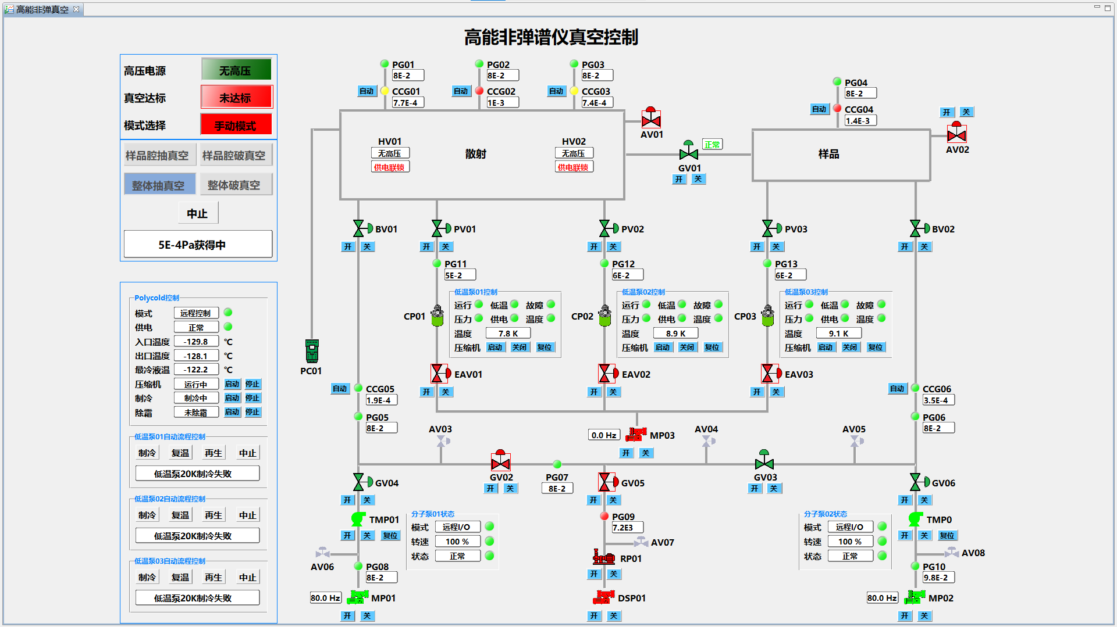
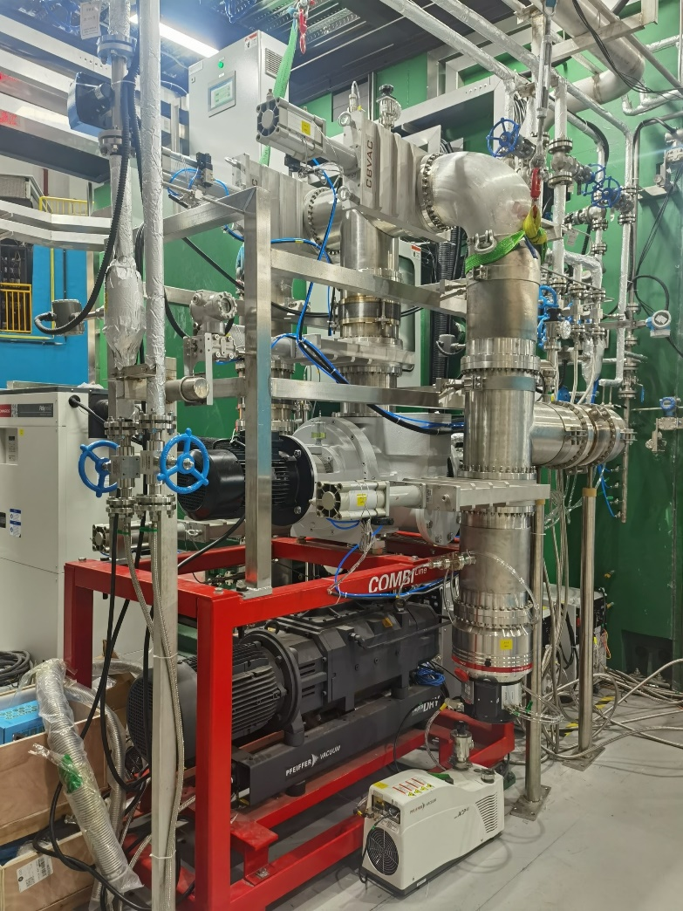
Operating status
The vacuum control system was developed over a period of one and a half years. It has been running reliably and provides solid support for spectrometer experiments.
In general, only these four buttons are required for operation.
Vacuum system

Slide 14
Summary
Remote and independent control of all vacuum equipment has been implemented.
One-key operation for complex workflows has been implemented.
The shift from fully manual to fully automated operation has greatly reduced the workload of experimenters.
Eliminating detector damage caused by vacuum issues.

Slide 15
Thanks for your attention！

