Slide 1
Second phase of beamline control system upgrades at SLS 2.0
Alvin Acerbo, Controls Integrator
Spring EPICS collaboration meeting 2026

Slide 2
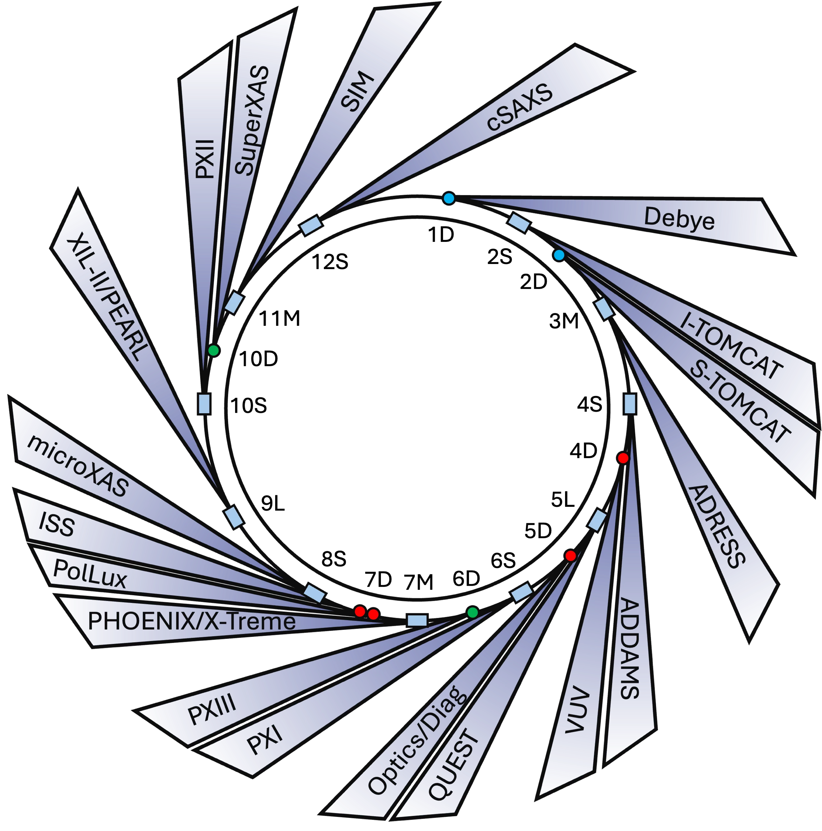
SLS 2.0 BEAMLINE UPGRADE PROJECT
Phase 0 (2023)
Phase 2 (2026/2027)
2 BL – 1st light
9 BL – Phase 2 Upgrade (2 pairs of beamlines share the ID)
Dark Time (2024)
SLS → SLS-2
More numbers
2 new beamlines
Phase 1 (2025)
3 beamlines move to another sector
10 BL – 1st light
8 BL – ready for experiments

Slide 3
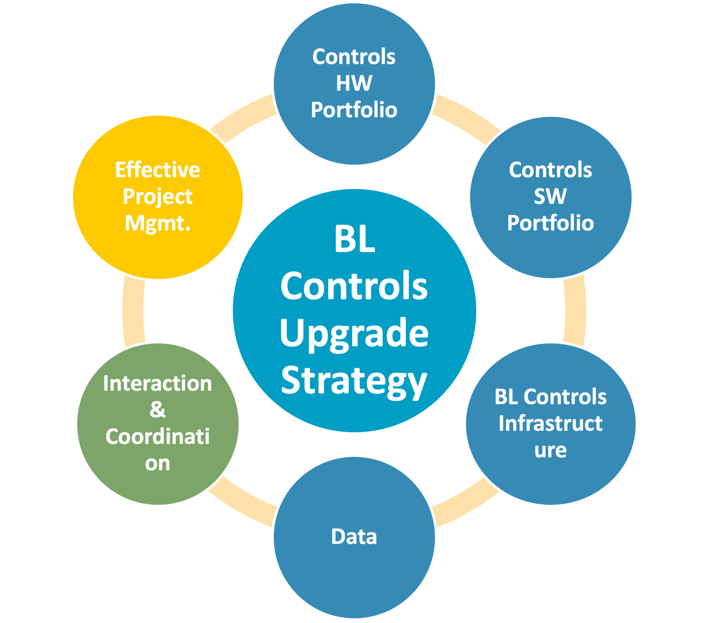
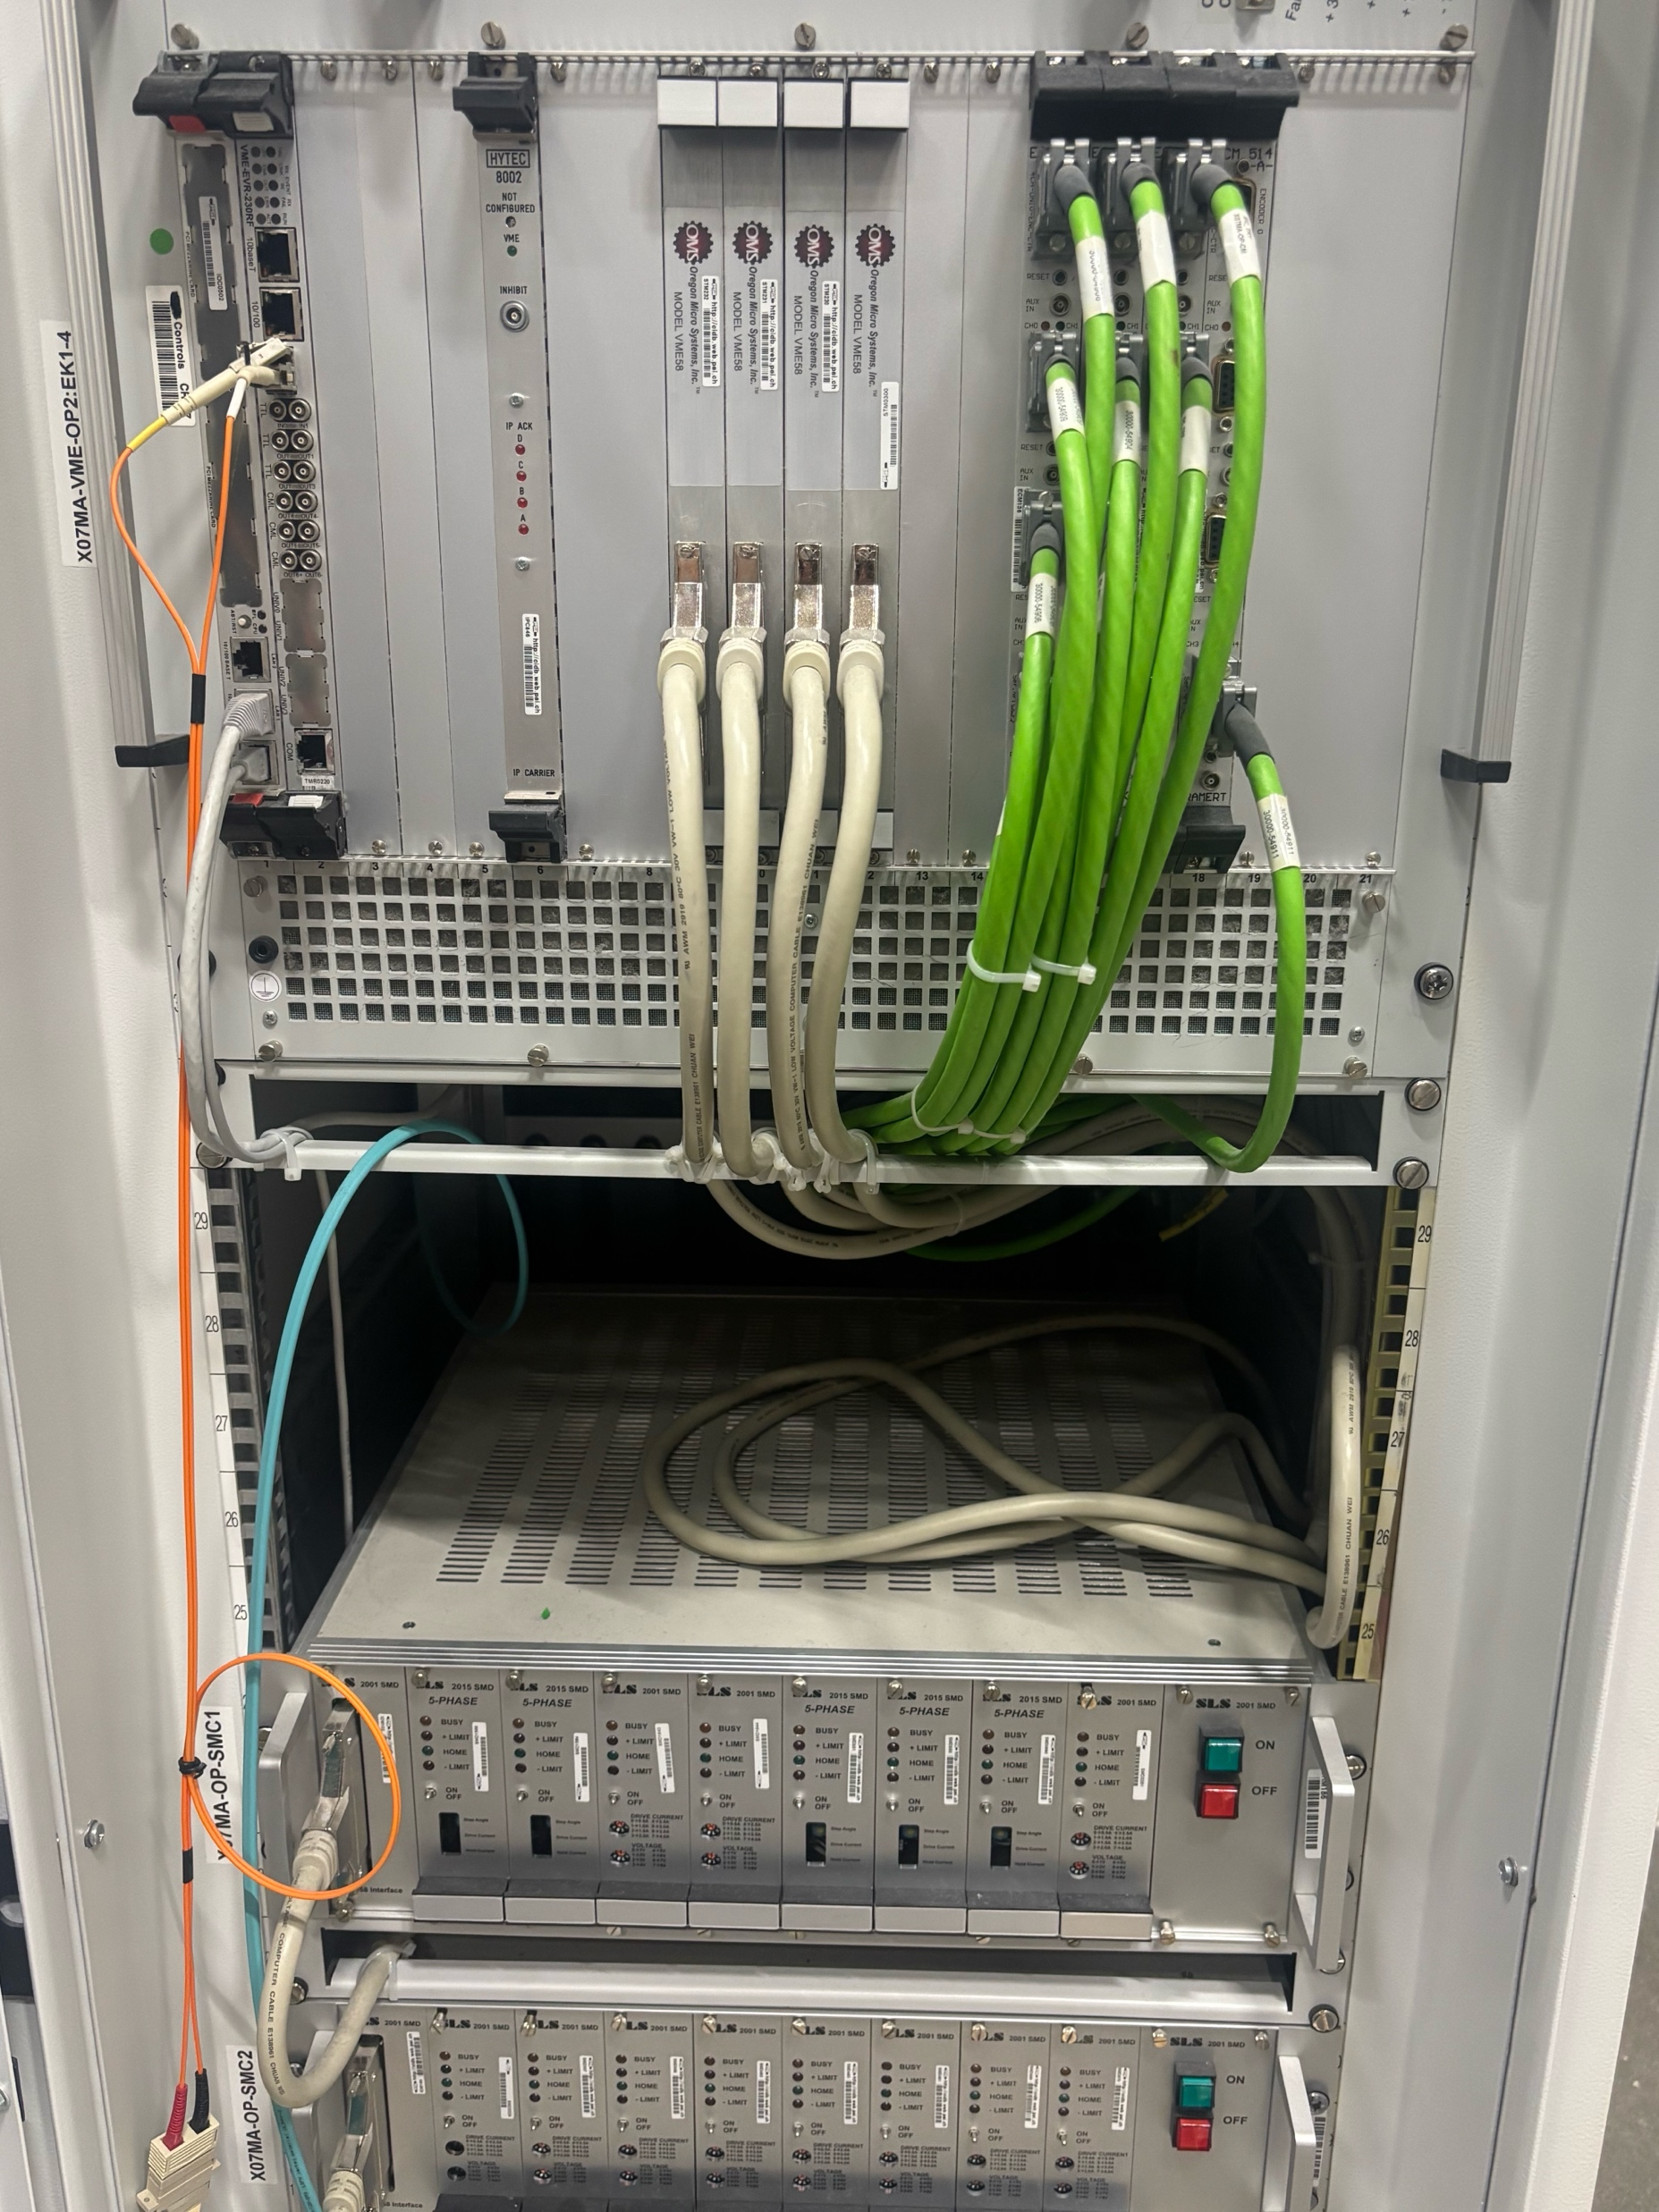
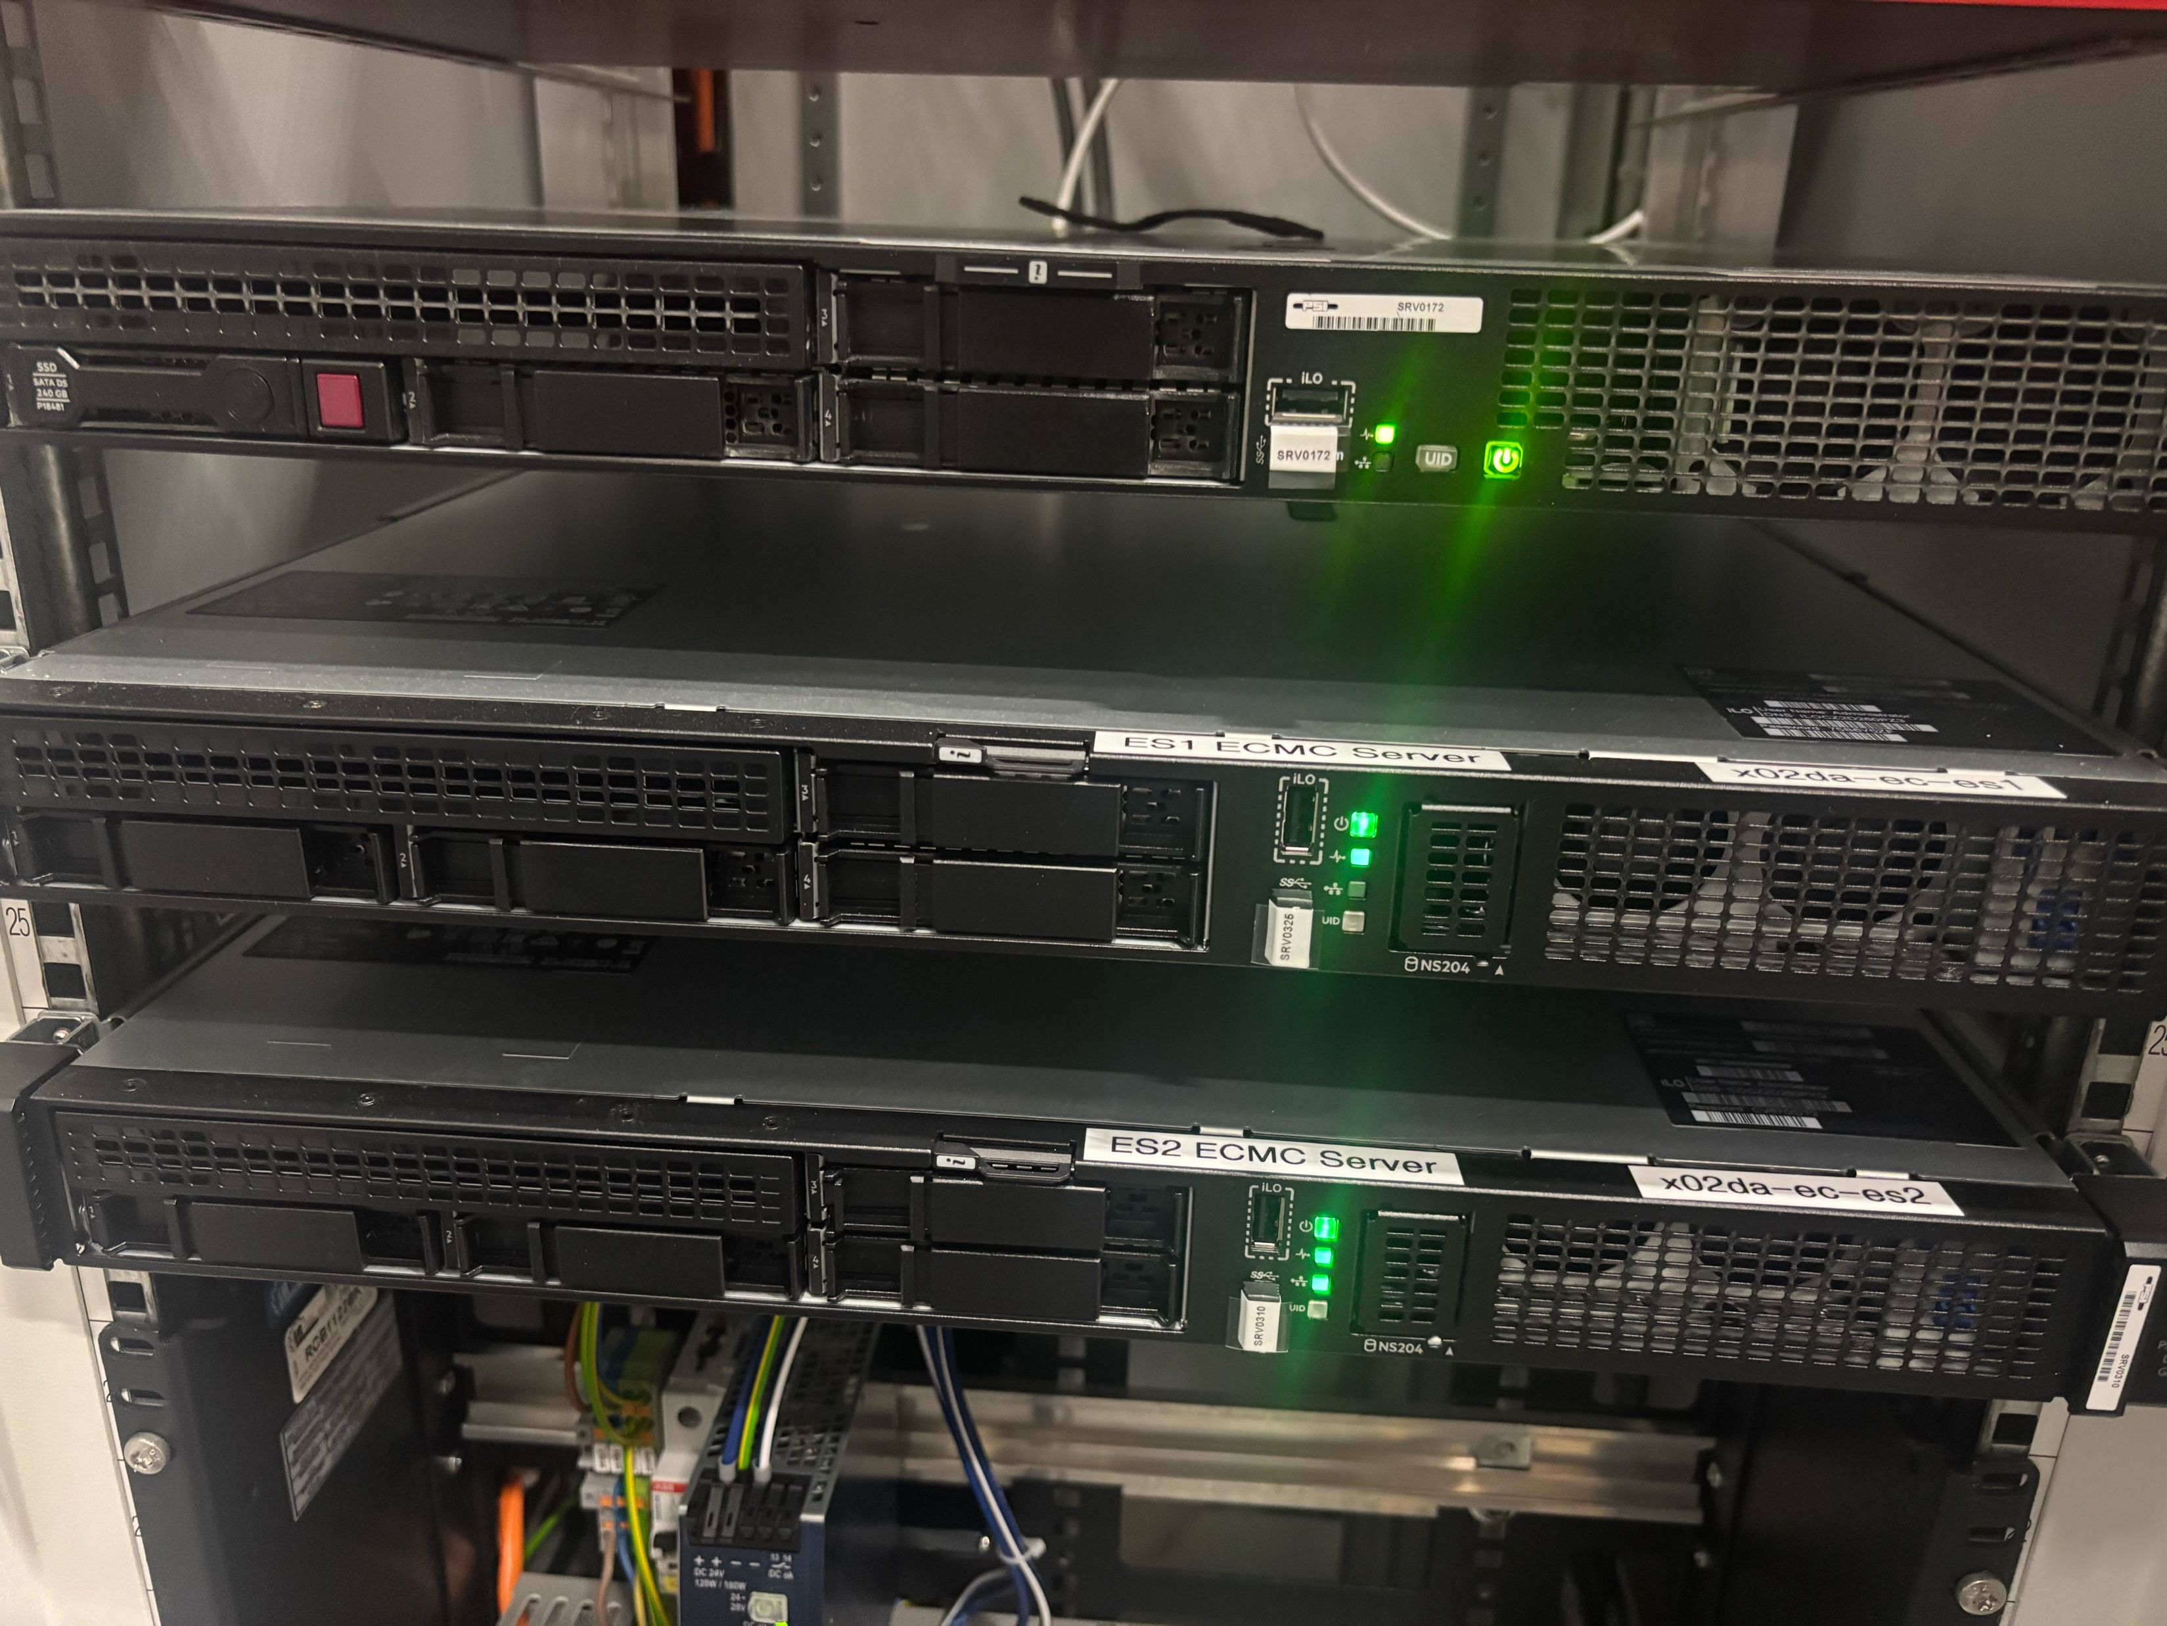
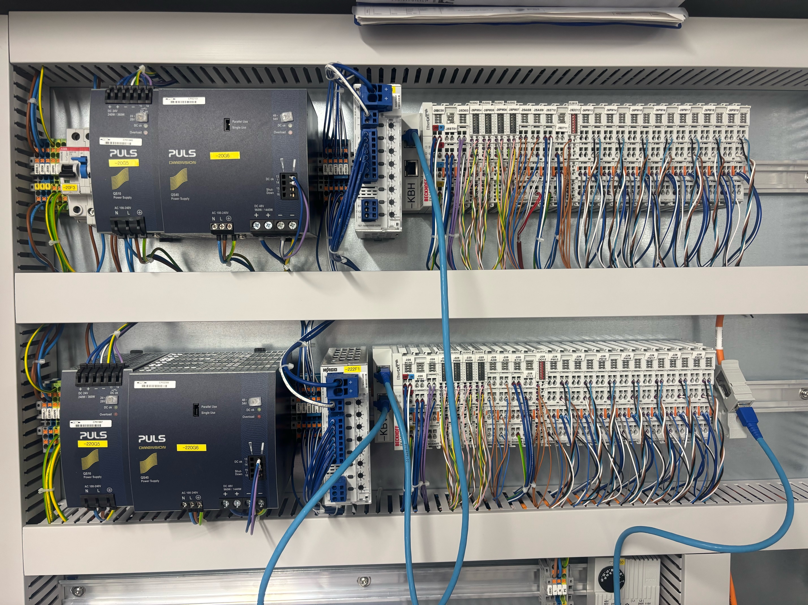
UPGRADE STRATEGY BRIEF
Migration to EPICS 7 before dark time
S7PLC replaced by OPC UA
Keep caQtDM as display manager
Developed new in-house channel access archiver
Experiment Orchestration based on Ophyd/BlueSky
Main Challenge: VME (vxWorks 6.9)
ECMC
ECAT
  Bonus:
  Timing systems by Romain, 14:30 today
MOTION + I/O

Slide 4
PHASE 0 BEAMLINES
Just 2 beamlines
  first light planned before dark time
  new control system, procedures, workflows, motion safety, naming conventions, …
  develop & test new tech stack – rebuild loss of knowledge
UI
UI
scan tools
ophyd
scan tools
basic scan logic
virtual axes / kinematics
SNL code
custom homing routines
EPICS
EPICS 7
ECMC
drivers
VME
EtherCAT

Slide 5
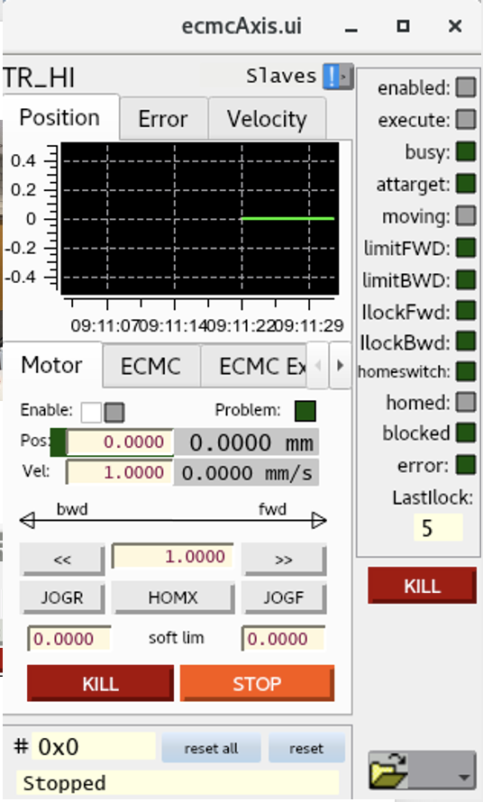
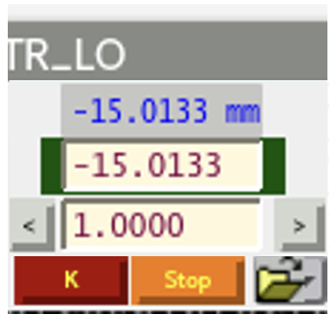
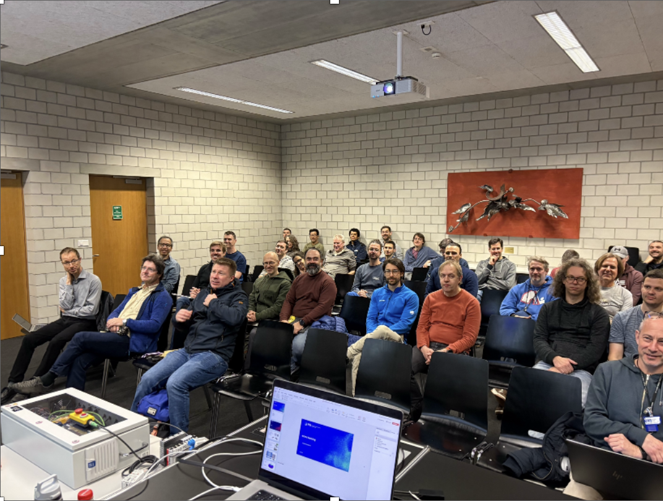
MOTION, I/O (ECMC) EXPERIENCES AFTER PHASE 1
ECMC is a mature system with major features available
  Simulated/virtual axes (kinematics), synchronization, PLC, C
  Focus now shifts to minor improvements, usability features
  Standardization of user/engineering panels
  New features improve commissioning efficiency & diagnostics
Close communication and short feedback loops with the users is critical
  Missing capabilities, unknown features
  Stuff that doesn’t work as expected
Knowledge transfer - Trainings & Documentation
EtherCAT workshop Thursday

Slide 6
ROAD TO COMMISSIONING
First light
hardware
I/O, usage
connectors
PV names
pinouts
wiring
cable names
network
electrical
motion cabinet
base IOC
I/O
motion
soft PLC
specifications
re-fine specs
re-tuning
bug fixes
Plan:
Device List
Schematics
Cabling/Infrastructure
Controls Integration
Commissioning
Reality:
Device List
Schematics
Cabling/Infrastructure
Controls Integration
Commissioning
Level | Contents | Delivery
1 | Basic motion and IO on real axes | Default
2 | ECMC safety, expert panels | Default
3 | Standard virtual motors, trivial bindings, basic Ophyd int. | Phase 2
4 | Custom demands, simple PLC, interfaces | Phase 3
5 | Overall integration, complex procedures, PLCs, sequencer, custom panels | Phase 3
Controls work at the tail end
Inherit delays from upstream groups
First light target dates remain
Loss of 2 integrators (5 to 3)
Smart Planning & MVP

Slide 7
CONTROLS COMMISSIONING READINESS
Early involvement of controls integrators
  Promote adherence to standards
  Help identify obvious issues early
  Joint "Commissioning Readiness" checklist (Controls + Beamlines)
Pre-commissioning with temporary motion hardware
Identify problems early on, before infrastructure is present
Creates overhead at first but pays off
Maybe even simulate hardware, applications
Notes:
Prozessablauf focuses mostly on infrastructure being ready
We add some checklist to guarantee that everything was done properly and everything is available for efficient commissioning
Pre-commissioning – basic stuff – single axis motion, we take the box as soon as we are done

Slide 8
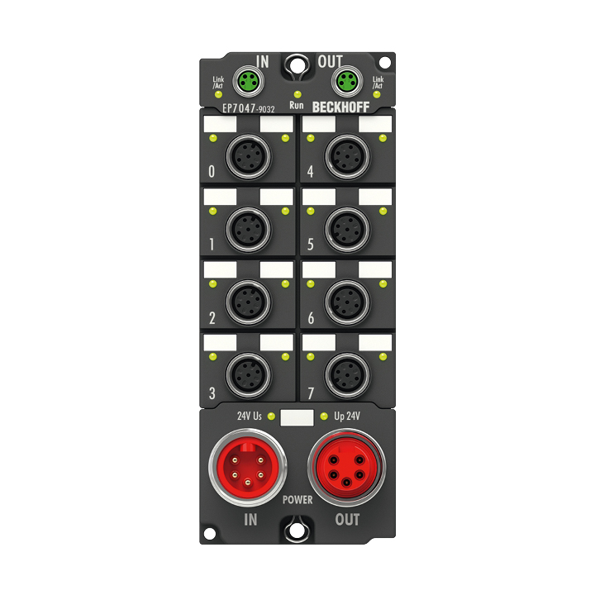
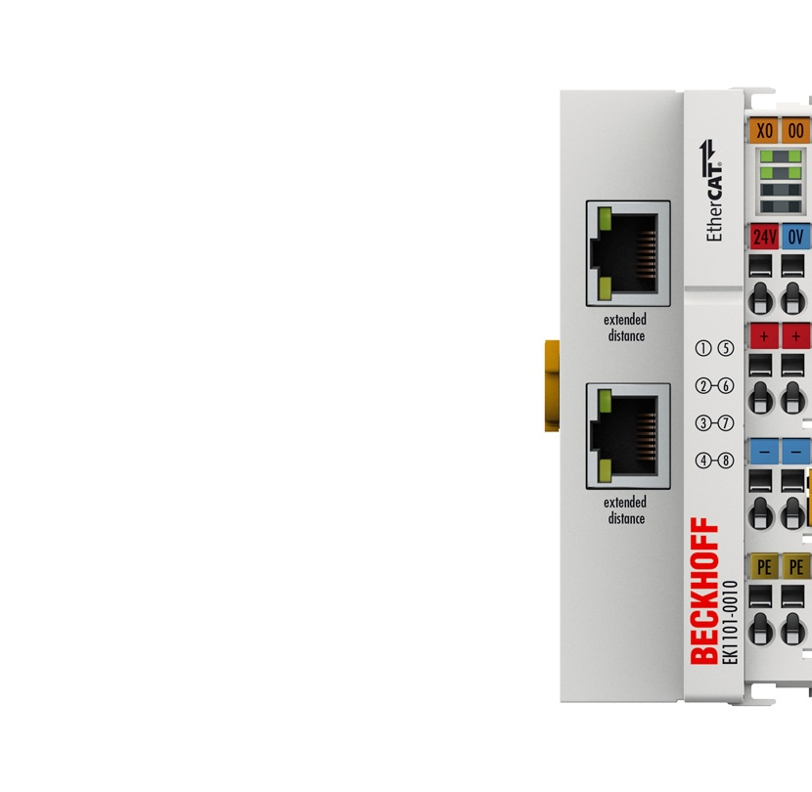
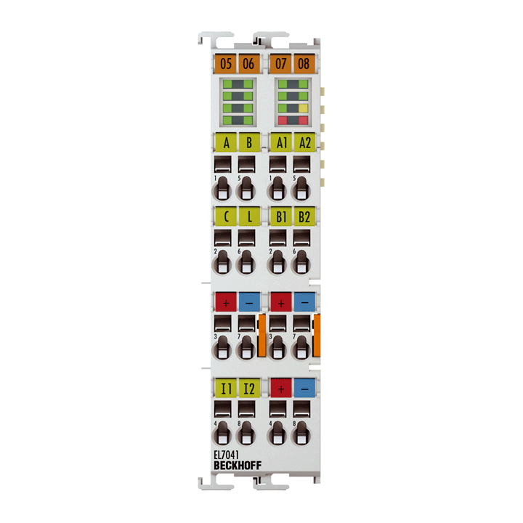
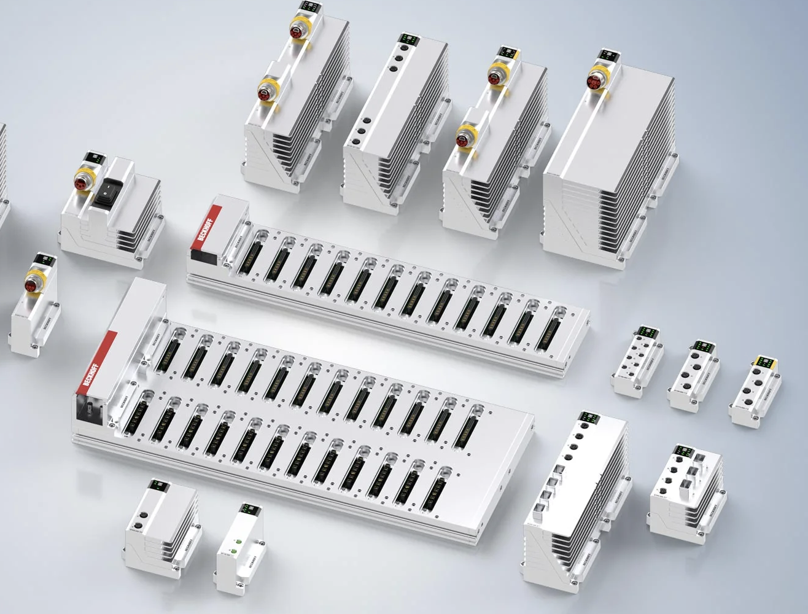
CURRENT CHALLENGES
New tech
Learn our new tech stack
Migrate to new file system
New operating system / infrastructure, new networking, subnets
CVS to Git migration, now Git to Gitea (no CI/CD)
Re-commissioning legacy axes
Lack of proper documentation, details need investigation
Old hardware, sub-optimal mechanics – tunning issues, closed/open loop
Modern controllers can expose previously hidden issues
Scope vs Resources
Per axis Time-to-Commission reduced from 0.5/day to 5/day
Manage work backlog and technical debt – where/when
Leverage AI tools as much as possible

Slide 9
LIFE AFTER PHASE 2
Planned upgrades
VxWorks license extension
Q
06/2027
VxWorks license termination
Phase 2 & consolidation
06/2030
2026
2027
2028
2029
2030
VME (VxWorks) legacy migration
Commissioned ECMC axes | Remaining VME axes today | New ECMC axes pending (new BLs) | Migrate to ECMC (Phase 2) | Remains legacy after SLS 2.0
~ 430 | ~ 1100 | ~ 90 | ~ 430 | ~ 650
* status March 2026 (estimate)
  Mostly actively in-use devices
  Timeline: end of 2029 (license end - June 2030)
  Planning should be finished in 2027

Slide 10
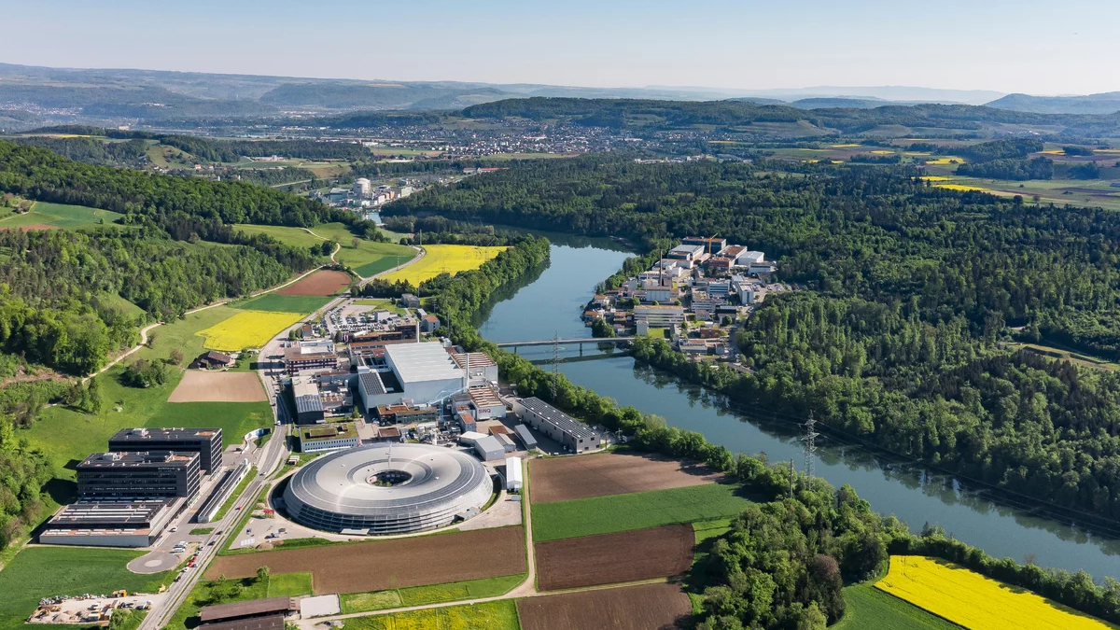
THANK YOU FOR YOUR ATTENTION!

