Slide 1
Dynamic HMIs and
Dynamic PVs
Ivan Finch
ENS Paris-Saclay, Paris
Monday 21 April 2026

Slide 2
Dynamic HMIs
CS-Studio / Phoebus

Slide 3
CS-Studio / Phoebus HMIs (files)
Phoebus HMI files
Phoebus uses XML files with the default file extension .bob
These are programmatically generated by the Phoebus Display Builder
Obviously, they may be generated programmatically by any system that can produce XML (i.e. basically anything!)
Sites already use this functionality to automatically generate “engineering” screens. Given a set of PVs and their types it is possible to create a file which displays them. This is useful for rapid prototyping and as an initial seed for user screens.

Slide 4
Phoebus HMIs (serving files)
A user’s copy of Phoebus must have access to the .bob files. There are a variety of ways to achieve this:
Local filesystem (HMIs in development, distributed through git, etc.)
Shared filesystem (e.g. NFS mounts, OneDrive, etc.)
Webserver (Phoebus can access files at HTTP endpoints)
At ISIS we use the webserver to deliver .bob files to our users. This allows us to update HMIs centrally. Potentially we can also log how often a HMI is access and who accesses it.
HTTP endpoints mean it is possible to dynamically generate the file in response to user action. A simple example is a 404 .bob file generated when a file that does not exist is requested.

Slide 5
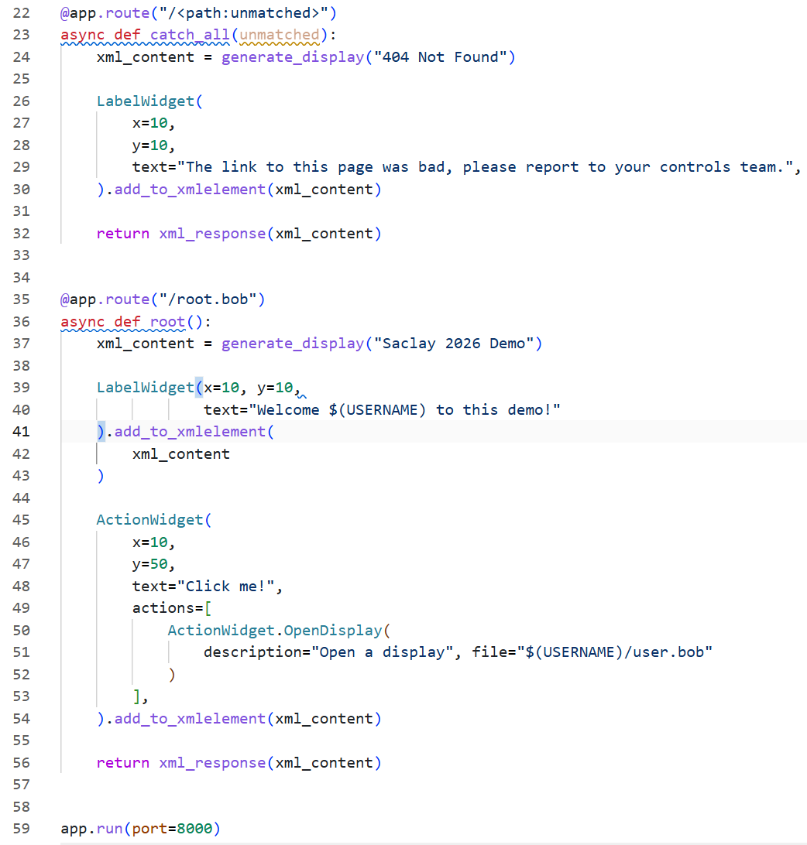
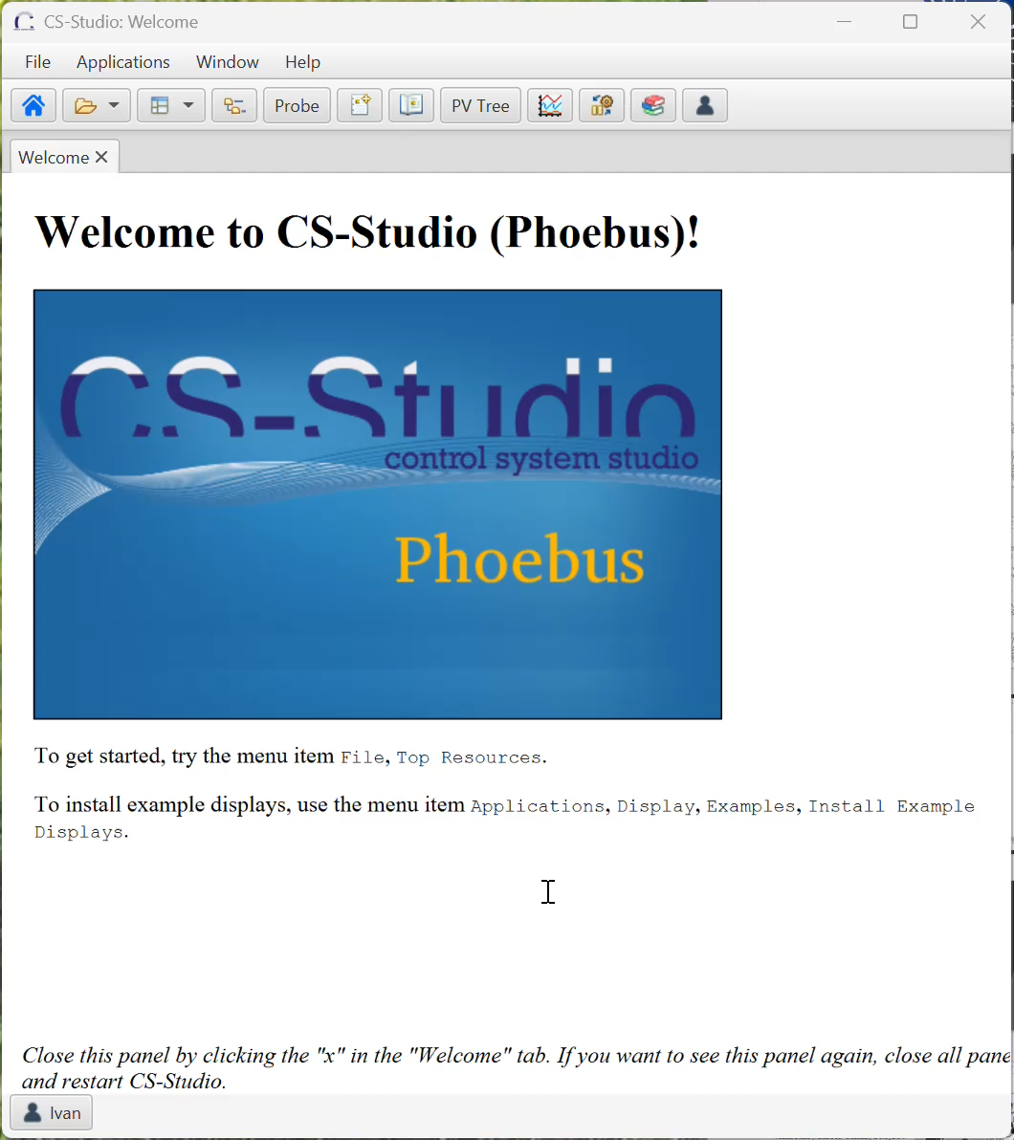
Example
Dynamically generated home screen, using Quart,
and
404 page

Slide 6
Dynamic PVs
Using Python

Slide 7

Dynamic PVs - pvAccess protocol searches
At ISIS we only use pvAccess (pva) not Channel Access (ca). This discussion will be about pva, but ca works in a similar manner.
To understand how dynamic PVs work we need to understand how ordinary PVs are discovered. In a conventional system, imagine an IOC with a PV called EXAMPLE:PV. If a client, such as Phoebus, requests a PV the process is roughly as follows:
Phoebus shouts (makes a UDP broadcast) to everyone in the same room (subnet) asking if they have EXAMPLE:PV.
All IOCs that do not have EXAMPLE:PV do not respond. An IOC that does have EXAMPLE:PV starts a personal conversation (via TCP) and a one-off get or continuing monitor is established. Phoebus almost always uses monitors.
Note that searches repeat (with a backoff) until a response is received or a timeout is exceeded.

Slide 8

Dynamic PVs – hijacking the search
To create a Dynamic PV, we hijack the search process. Assume no IOC has EXAMPLE:PV.
Phoebus shouts (makes a UDP broadcast) to everyone in the same room (subnet) asking if they have EXAMPLE:PV.
All IOCs do not have EXAMPLE:PV so do not respond. But our program responds “yes” anyway and then creates the PV in response to the search. It did not exist prior to the search.
It may not be immediately obvious, but this is how a PVA Gateway works. The PV exists in a subnet unreachable by the client (Phoebus). The client searches on its subnet, the gateway hears and passes the search on to its other subnet, if it gets a response, it creates the PV on the client subnet and passes values from one subnet to another. Importantly, it creates a PV on the client’s subnet in response to a successful search.
Analogy: gateway is like someone in the same room, but on a call with another room.

Slide 9
Dynamic PVs
The PVA Gateway is implemented using p4p, the Python wrapper for pxvs.
Dynamic Provider from the p4p documentation.
Code on the right will return a previously created PV when “blah” is searched for. Not quite dynamic!
class DynHandler(object):
def __init__(self):
self.pv = SharedPV()
def testChannel(self, name):
return name=="blah"
def makeChannel(self, name, peer):
assert name=="blah"
return self.pv
provider = DynamicProvider("arbitrary", DynHandler())
server = Server(providers=[provider])
Notes:
Note this can also be done with a conventional IOC if we have a way to spin one up on demand. It’s harder to know when to destroy it.

Slide 10
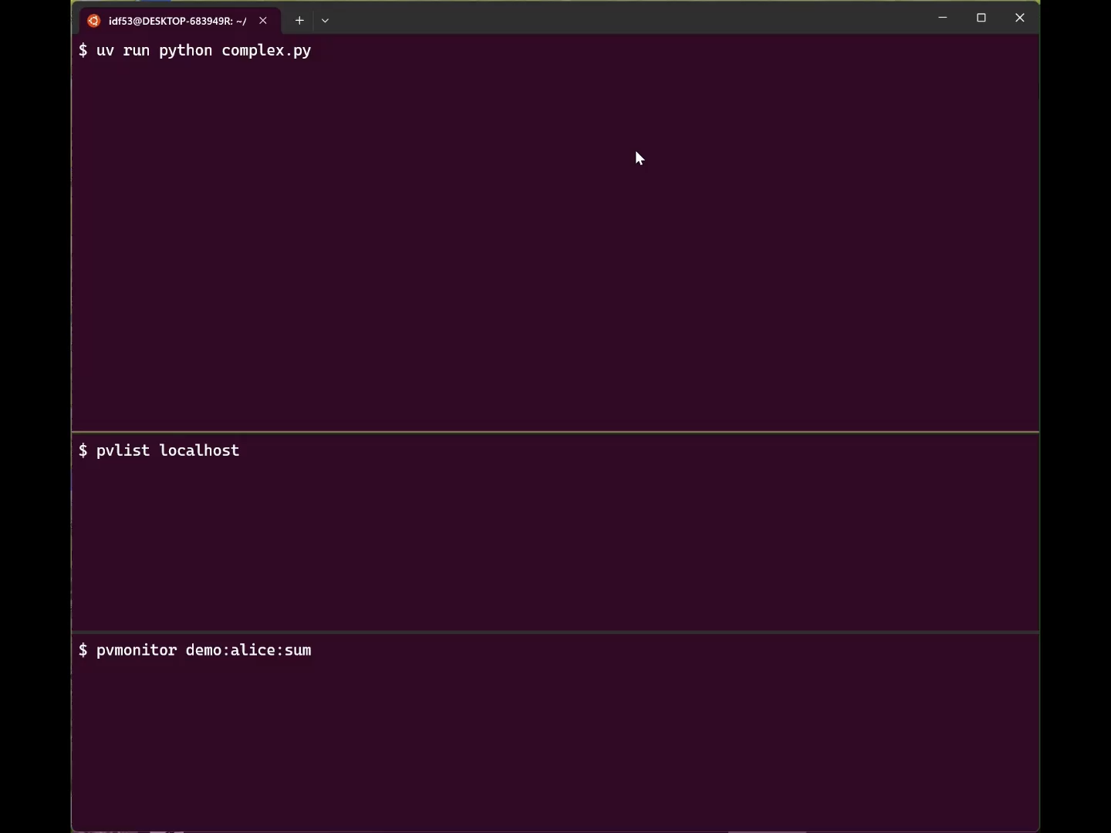
Demo of Dynamic PVs
We can dynamically create PVs using IOCs.
But can we dynamically destroy them when not in use?
Demo on the right shows PVs that only exist when you’re looking at them!

Slide 11
Combining Dynamic HMIs and Dynamic PVs
Sadly, not an impressive demo!

Slide 12
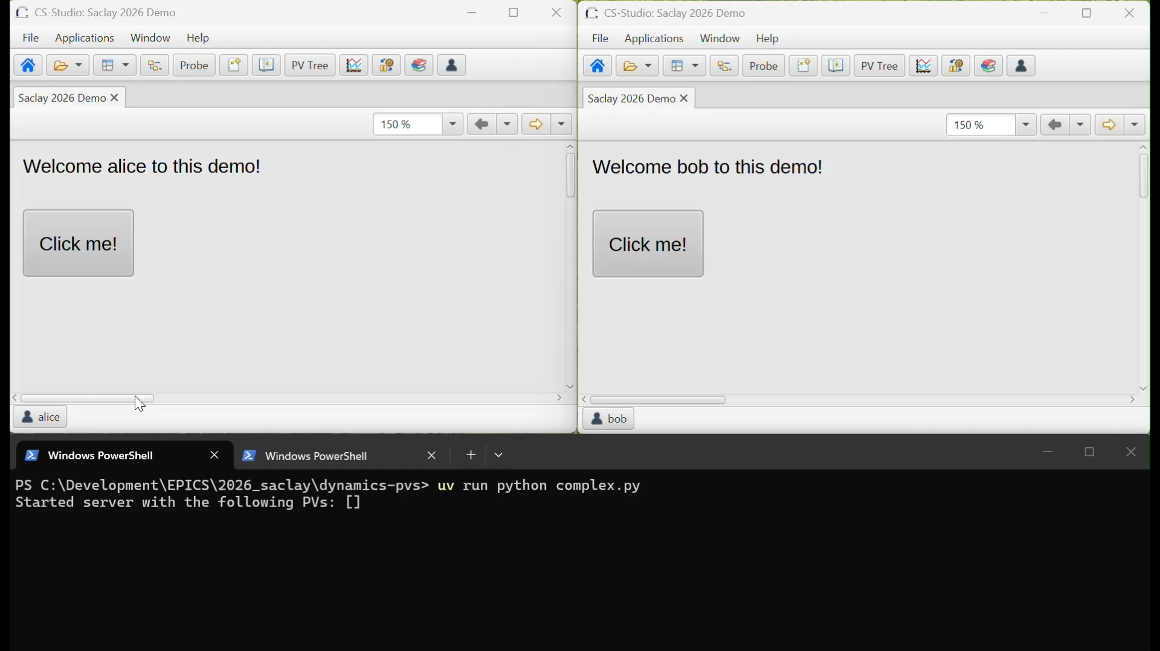
Dynamic PVs and HMIs in Phoebus
Here we start from the same screen but create a different
PVs are created when in use and destroyed when not in use.
Note: refreshing the screen will reset the value of PVs.

Slide 13
Conclusion
Dynamic HMIs:
Besides 404 pages, of limited use aside from per-user screens.
Dynamic PVs:
Don’t make sense connected to real equipment!
Can make sense for simulated equipment, models, machine learning, etc.
Use caution when using Python instead of an IOC. Concurrency and race issues need to be managed.

