Slide 1
Daedalus: A WebUI for EPICS
Ollie Copping
Software Systems Engineer
Notes:
For decades, Diamond Light Source (DLS) and other facilities have been reliant on GUI packages that were first developed in the 90s and 2000s (e.g. edm, medm). CS-Studio was an attempt to move away from this, but wasn't very popular at DLS because of its sluggish performance and dependencies on Eclipse RCP and SWT.
At DLS for our Diamond II upgrade, we are looking to modernise our whole software suite to replace outdated tools. Gone are the days of monolithic code bases of our GDA, and using tools such as iocxmlbuilder. As part of this upgrade, we have been developing "epics-containers" to allow us to take advantage of cloud computing infrastructure and all the benefits it provides. We also saw an opportunity to leverage this infrastructure to host screens in the Kubernetes cluster and render them in a web app. This includes using our IOC configuration files to automate screen generation/validation.
We decided as a basis of the screens to use Phoebus, and Python to automate process the screen generation and validation. We have also created a phoebus-equivalent web app, known as Daedalus, to render such screens. This was built using React and typescript.
As a result of these efforts, we have successfully deployed a set of screens on our I19 and VISR beamlines, and can access them through our web app through a browser.

Slide 2
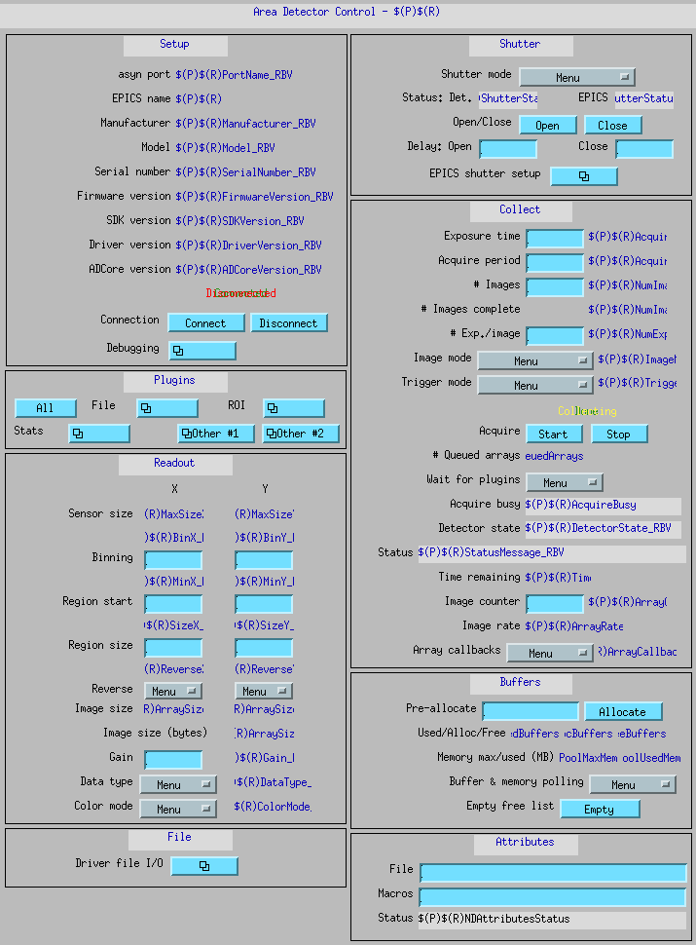
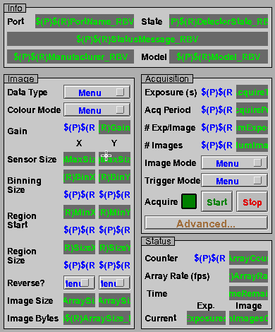
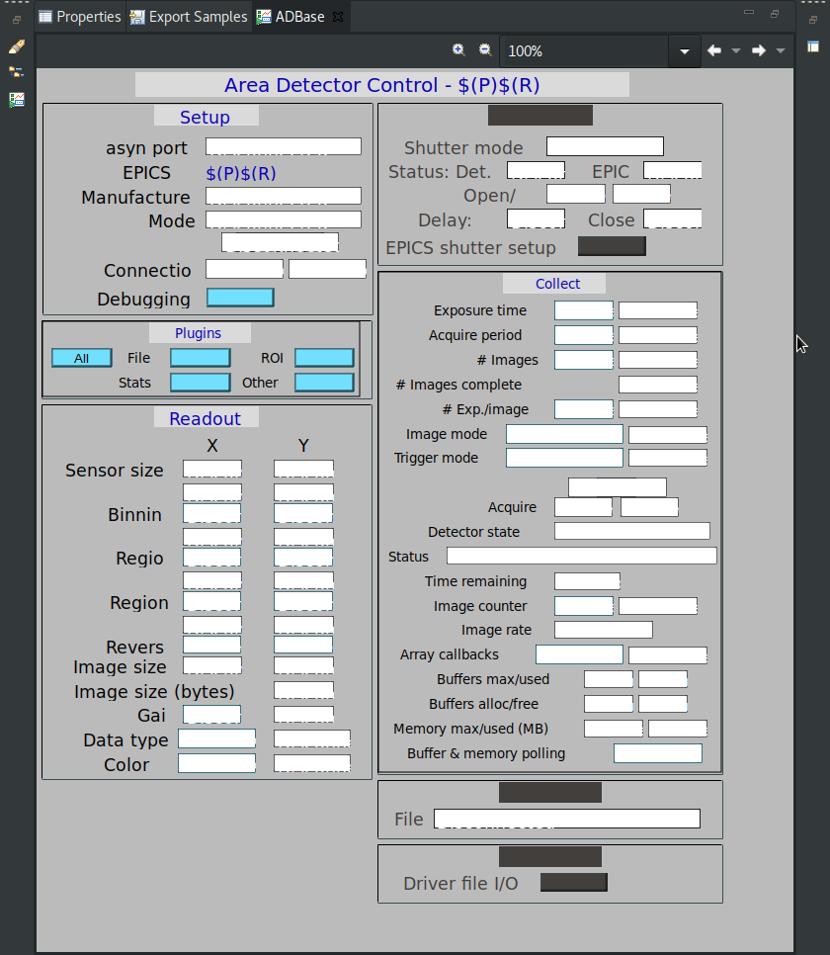
History Lesson
medm
edm
CS Studio

Slide 3


Diamond II
The CloudTM
Beamline Kubernetes clusters
Grafana, Prometheus
EPICS Containers
dev-c7
Ibek
ArgoCD
Phoebus, ...
Notes:
Monitoring
Debugging
Version control (tags, branches, …)

Slide 4
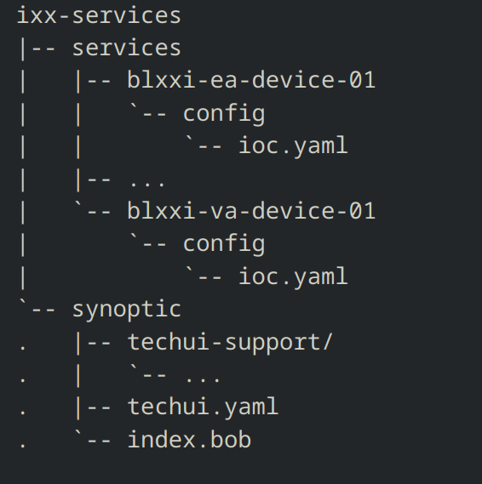

Slide 5
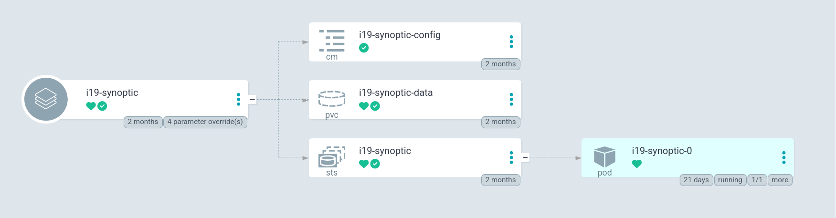

Slide 6
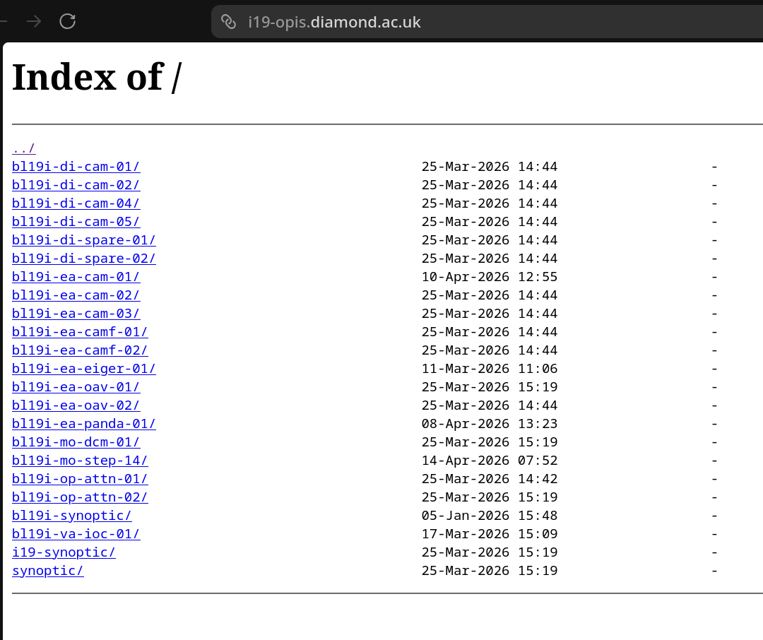
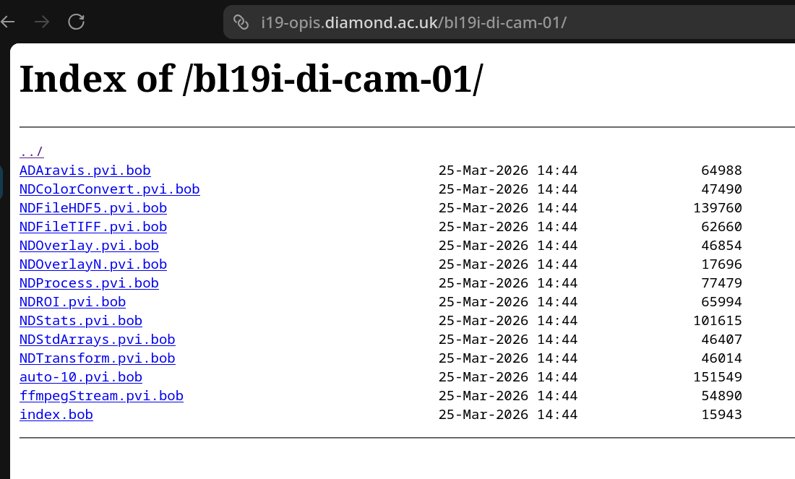
nginx
https://i19-opis.diamond.ac.uk

Slide 7
techui-builder
Takes advantage of k8s infrastructure
Ibek iocs
Screen generation/validation
Modern python (Python 3.12)
Phoebusgen (bob files), lxml
Generate JsonMap afterwards for breadcrumbs
uv support
Notes:
Gitlab CI

Slide 10
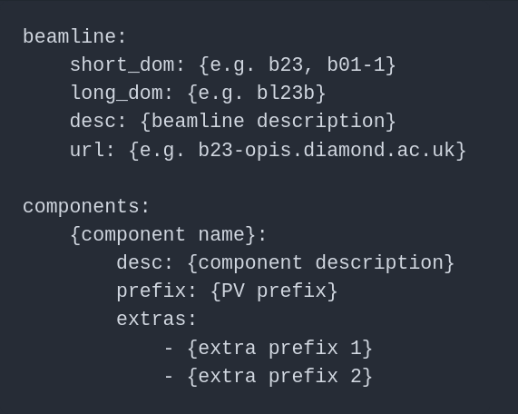

Slide 11
techui.yaml
beamline:
location: t01
domain: bl01t
desc: Test Beamline
url: t01-opis.diamond.ac.uk
components:
fshtr:
desc: Fast Shutter
prefix: BL01T-EA-FSHTR-01
d1:
desc: Diode 1
prefix: BL01T-DI-PHDGN-01
file: test.bob
motor:
desc: Motor Stage
prefix: BL01T-MO-MOTOR-01
extras:
- BL01T-MO-BRICK-01
Boilerplate config for every beamline
Component definitions for synoptic

Slide 12
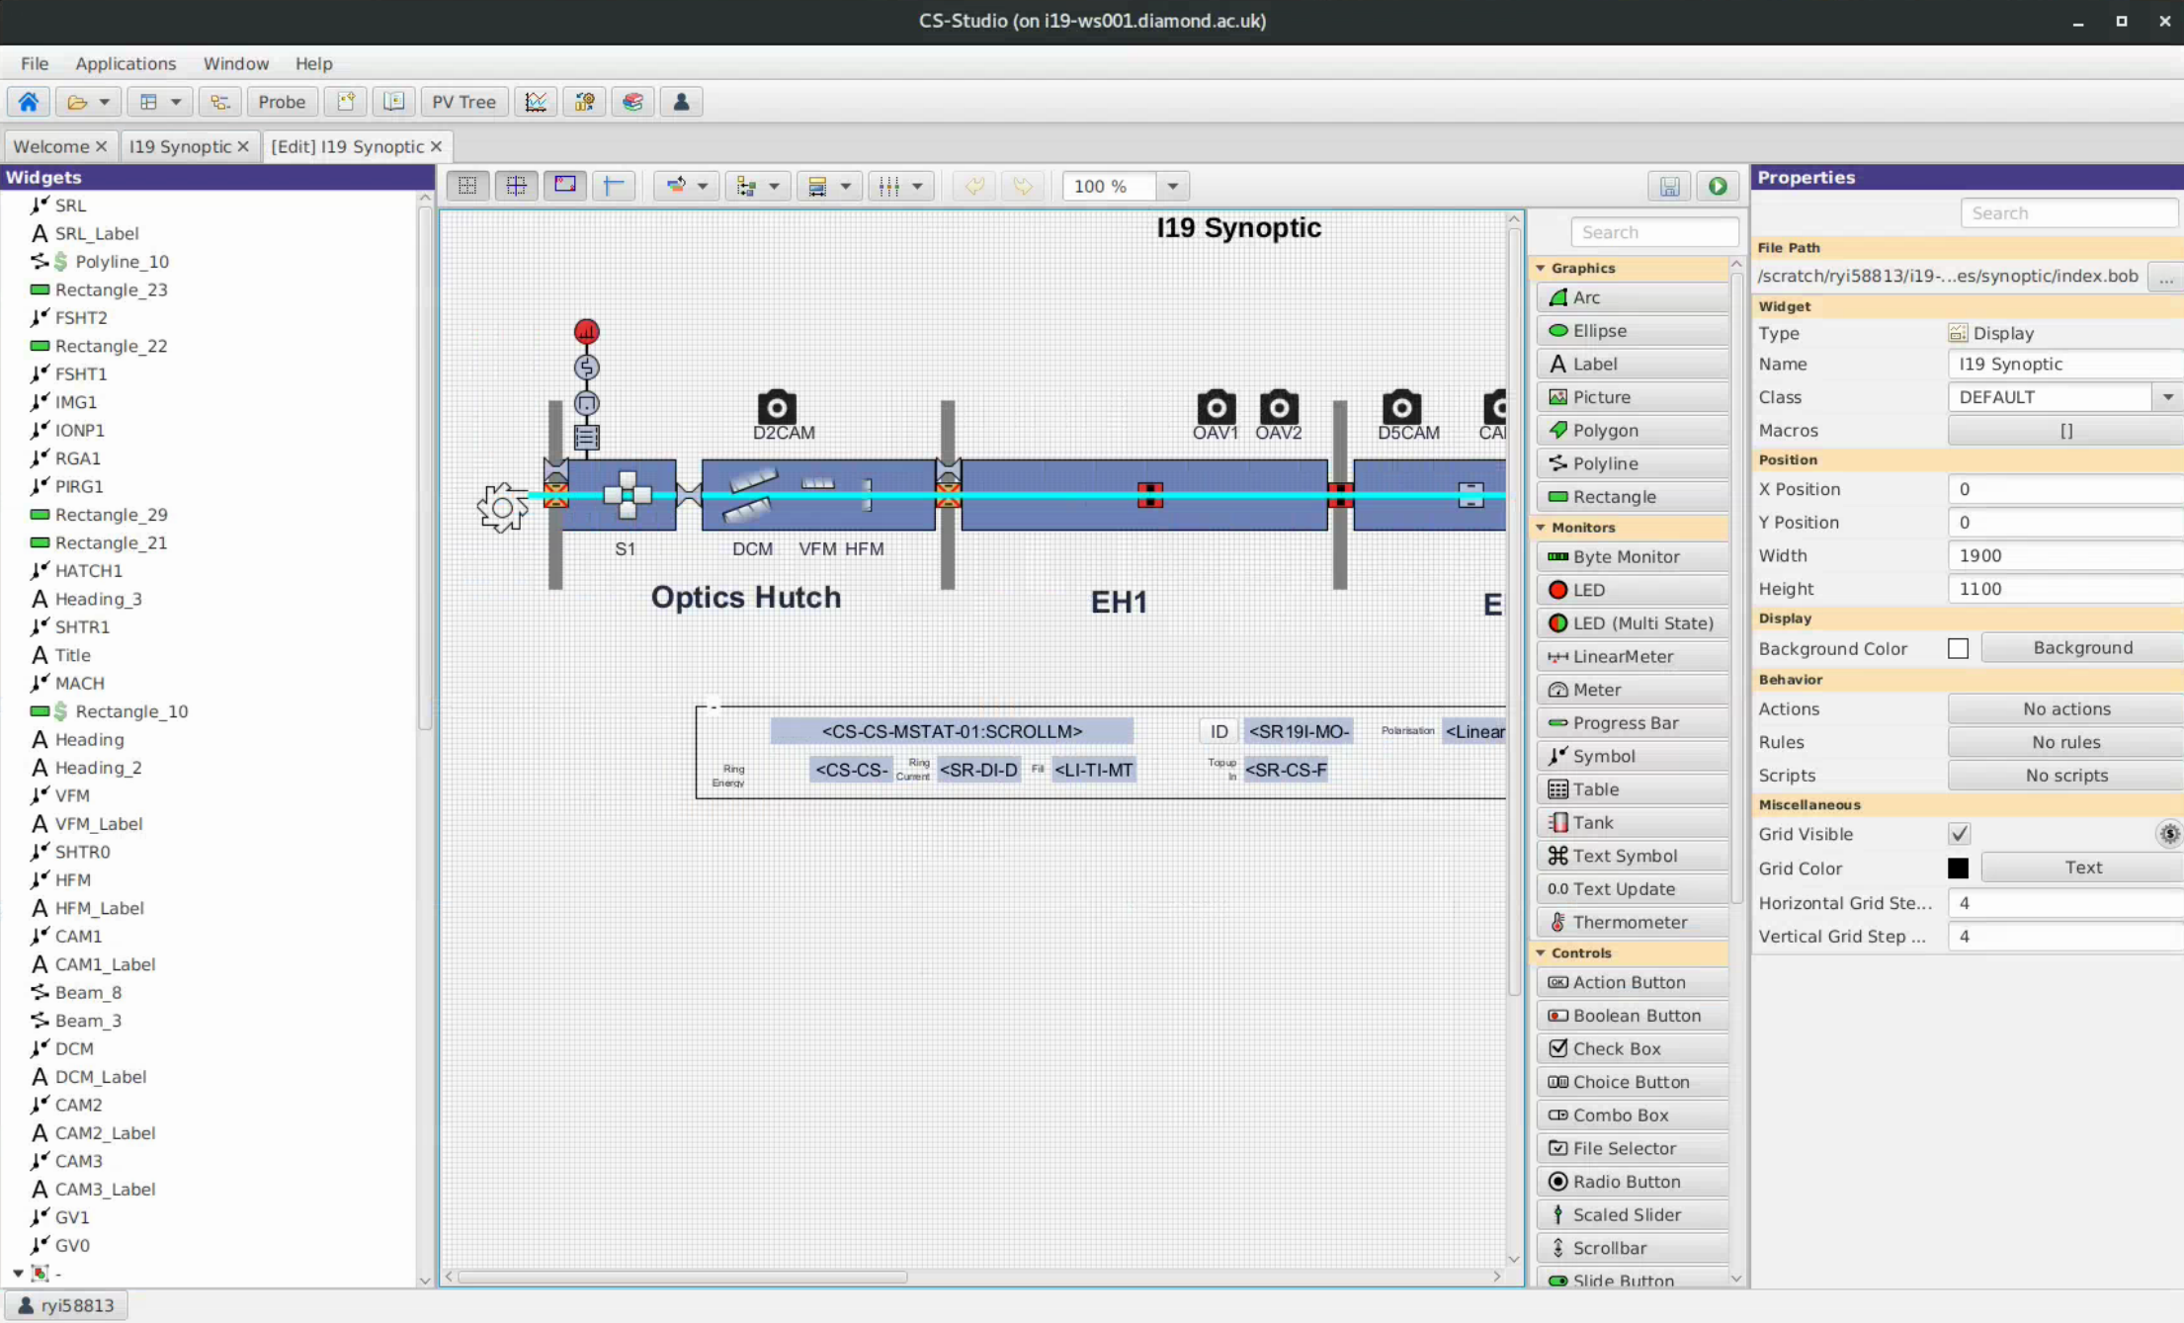
Phoebus
Bob files
Edit screens for “validation”
Local testing before pushing to cluster

Slide 13
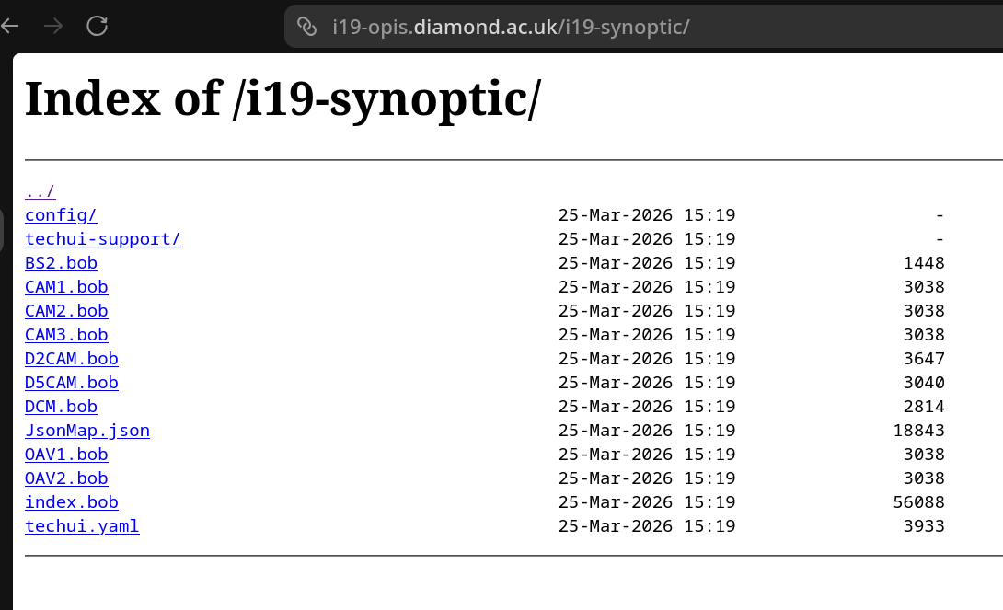

Slide 14
Daedalus
WebUI built on React
MUI, as close to Phoebus look and feel as possible
pvws
https://daedalus.diamond.ac.uk ​

Slide 15
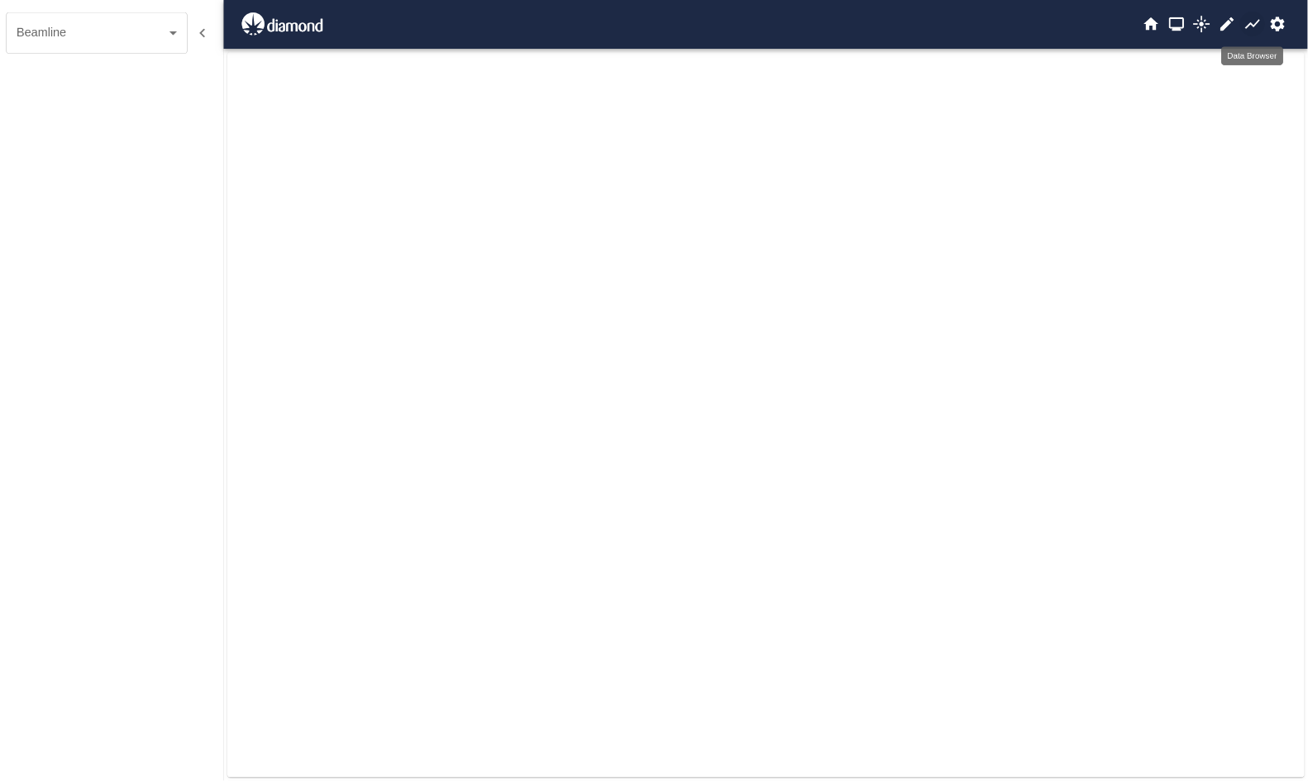

Slide 16
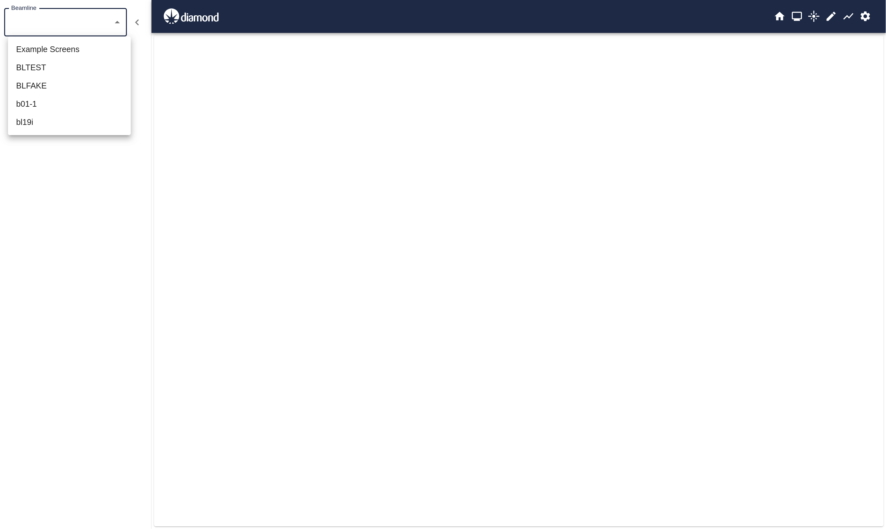

Slide 17
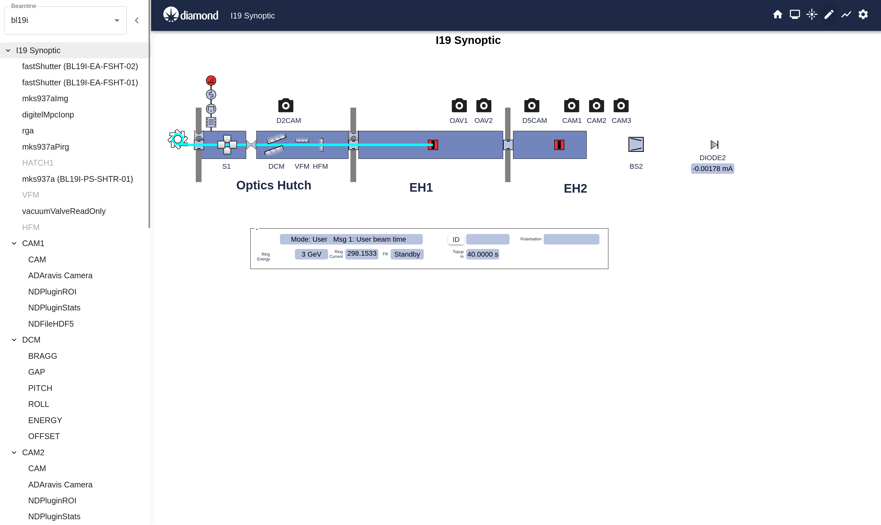

Slide 18
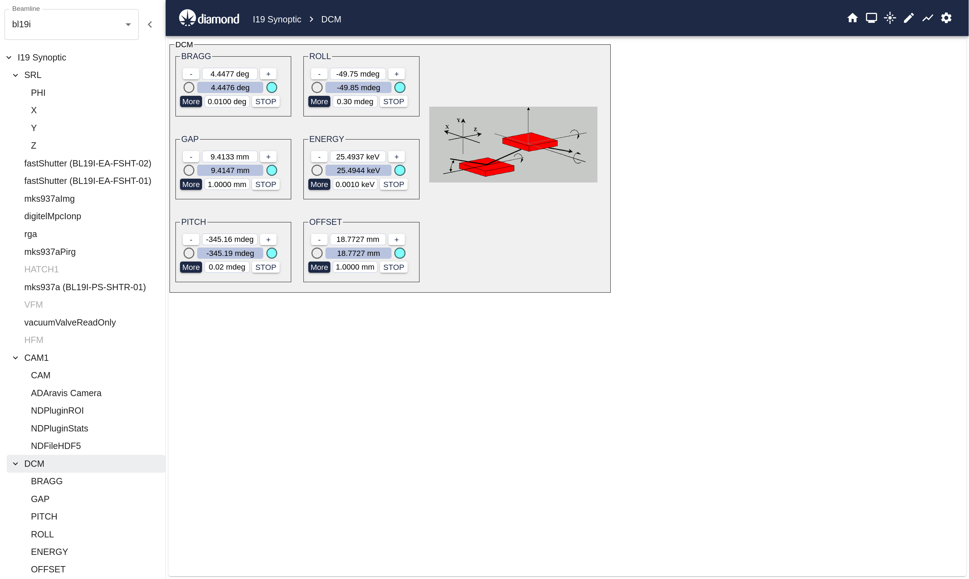

Slide 19
The Future
Deployed on SWIFT by 2027
Web Editor
Mobile browser support

Slide 20
Any Questions?

