Slide 1
Building Safe Experiments
A Tool for Configuring Interlocks Without Writing Code
Spring EPICS Collaboration Meeting 2026
Ernesto Paiser
Apr, 20 2026

Slide 2
Abstract
We will demonstrate a new tool developed at the Advanced Light Source (ALS) in collaboration with the European Synchrotron Radiation Facility (ESRF), supported through ALS funding, designed to help scientists and operators safely control lab equipment without needing to program PLCs.
The Wago Interlock System combines easy-to-use software with flexible WAGO hardware to let users set up interlocks—the safety rules that prevent hardware from operating in unsafe conditions. Using a graphical interface, users can create and edit configurations, connect inputs and outputs (like sensors, thermocouples, valves, or relays), and test them—all without writing code.
The system supports WAGO 750-series PLCs and a variety of modules, making it adaptable to different experimental setups. Built-in tools help track changes, manage user access, and ensure consistent operation across different lab areas. The hardware and a CLI software is already in use at all beamlines at ESRF (France) with BLISS control system and now with the new interface and EPICS driver this is ready to expand to other lab environments at Berkeley Lab.
Whether you're an operator, technician, or scientist, this tool makes interlock setup safer, faster, and more consistent—with minimal training and no need for PLC coding.

Slide 3
Outline
Introduction
Key Features
Use Cases
Current Status
Cost
Application Interface
Conclusion

Slide 4
Introduction

Slide 5
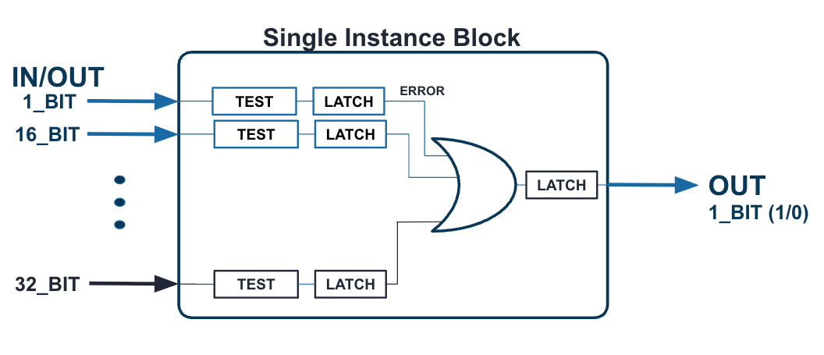
Concept: A Single Interlock Instance (max 30 inputs)

Slide 6
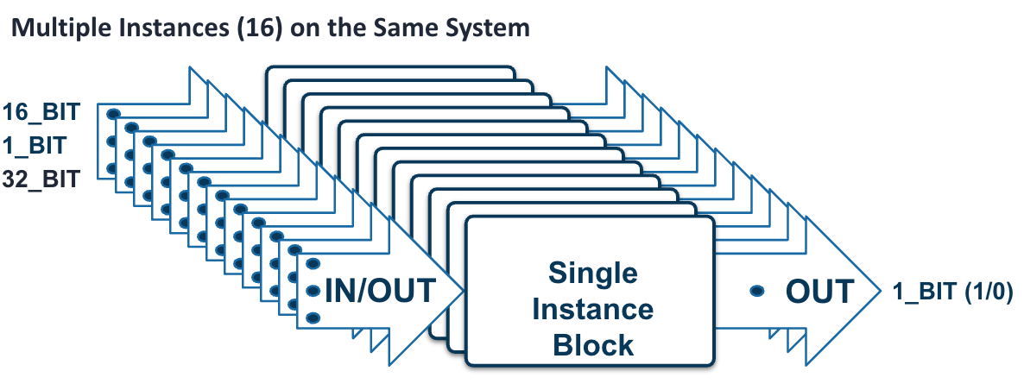
Concept: Multiple Interlock Instances

Slide 7
Concept: The Yaml Configuration File
Module Mapping
Interlocks
name: wcb15
description: System at Ernesto’s lab
main_module: 750-8001
modbustcp:
url: wc8001-test
mapping:
- type: 750-530
logical_names: do1,do2,do3,do4,do5,do6,do7,do8
- type: 750-517
logical_names: rl1,rl2
- type: 750-469
logical_names: tc1, tc2
- type: 750-469
logical_names: tc3, tc4
- type: 750-467
logical_names: ai1, ai2
interlocks:
- relay: do1
flags: STICKY
description: Bending Magnets
channels:
- logical_name: tc1
type: TC
min: 10
max: 90
- relay: rl1
flags: INVERTED
description: Water Flow
channels:
- logical_name: ai1
type: IV
min: 5.5
max: 7.5

Slide 8
Concept: The Yaml Configuration File
Module Mapping
Interlocks
Instance #1
name: wcb15
description: System at Ernesto’s lab
main_module: 750-8001
modbustcp:
url: wc8001-test
mapping:
- type: 750-530
logical_names: do1,do2,do3,do4,do5,do6,do7,do8
- type: 750-517
logical_names: rl1,rl2
- type: 750-469
logical_names: tc1, tc2
- type: 750-469
logical_names: tc3, tc4
- type: 750-467
logical_names: ai1, ai2
interlocks:
- relay: do1
flags: STICKY
description: Bending Magnets
channels:
- logical_name: tc1
type: TC
min: 10
max: 90
- relay: rl1
flags: INVERTED
description: Water Flow
channels:
- logical_name: ai1
type: IV
min: 5.5
max: 7.5
Mapping

Slide 9
The Hardware

Slide 10
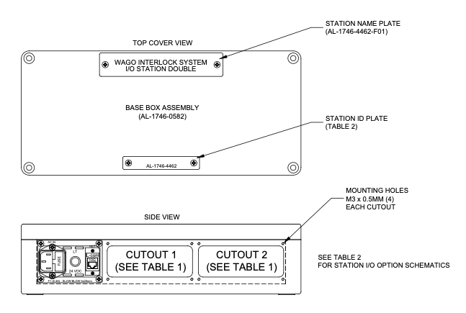
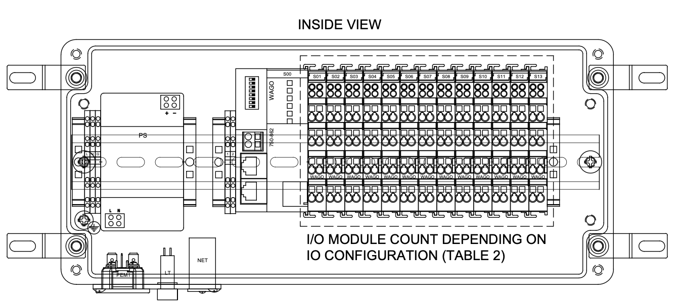
Concepts Hardware

Slide 11
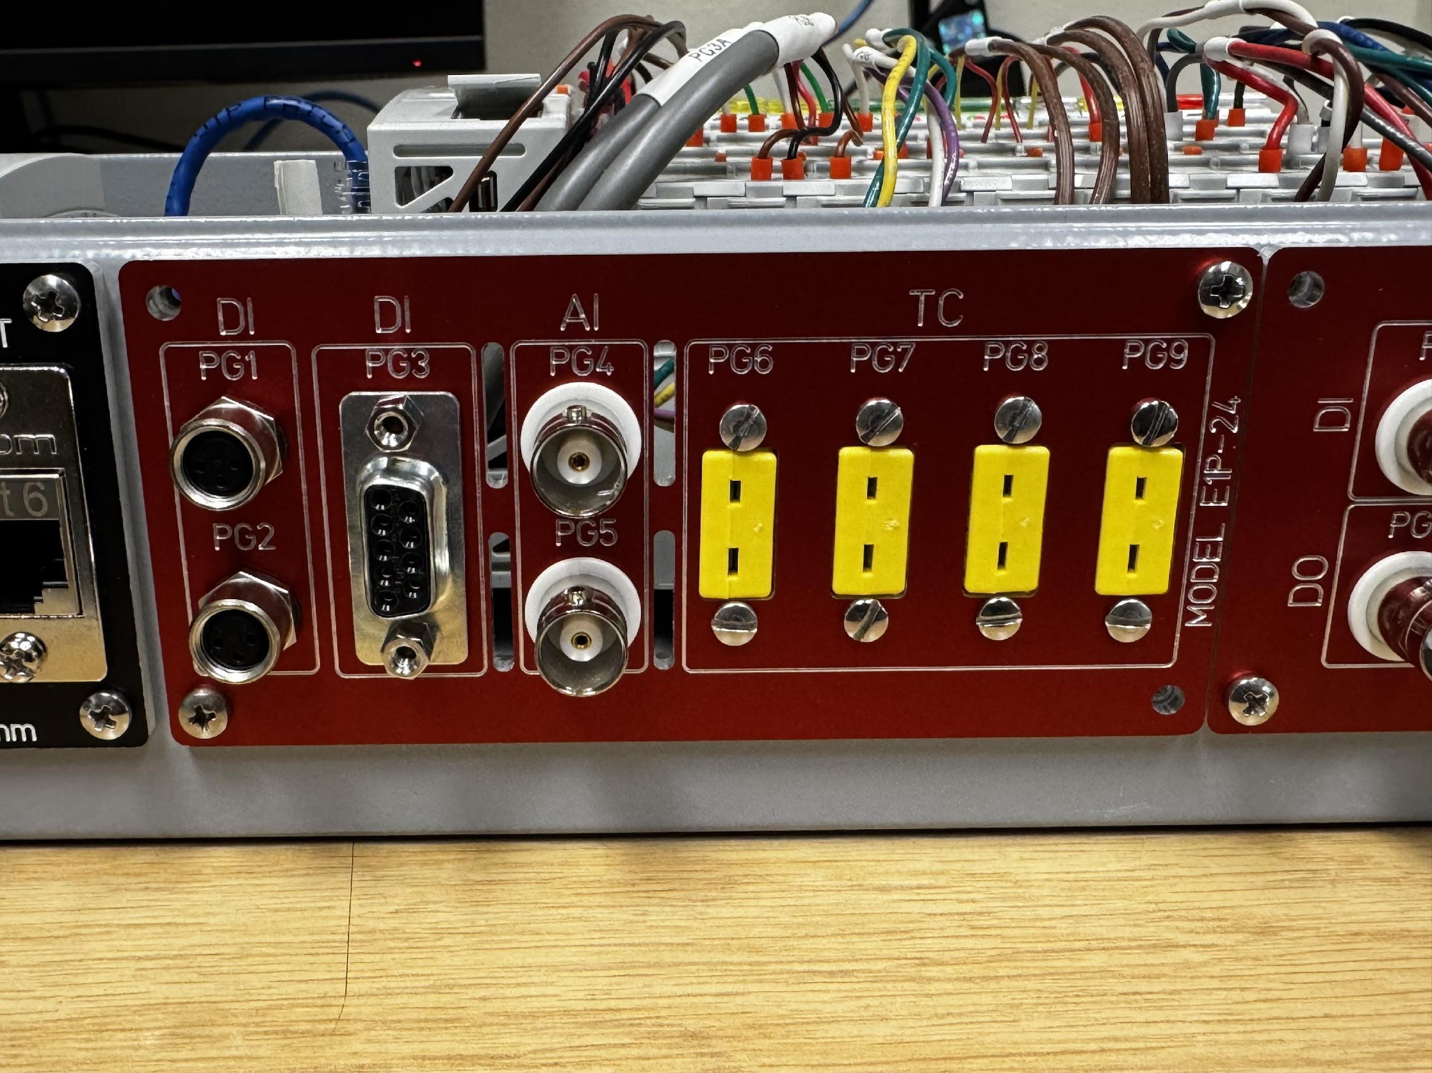
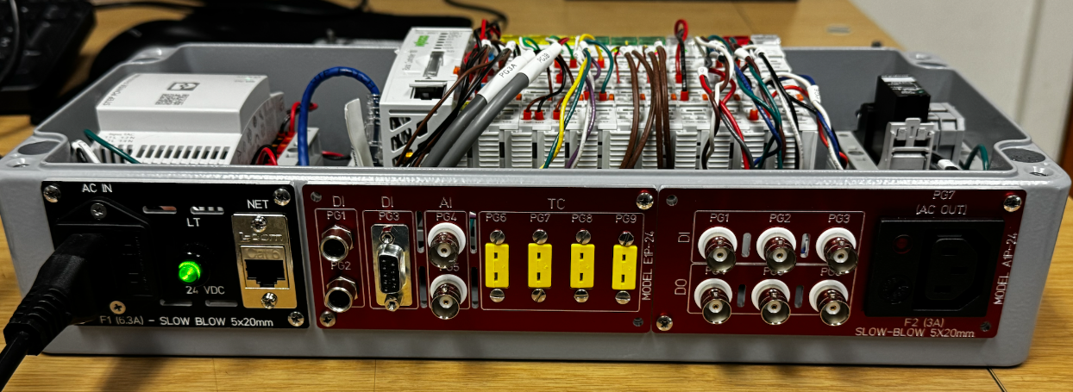
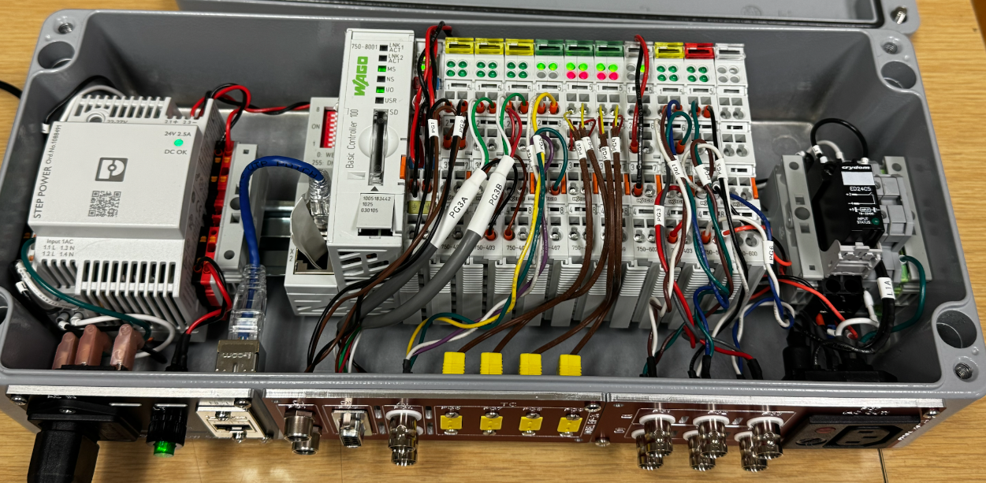
Concepts Hardware

Slide 12
Key Features

Slide 13
Key Features
Wago Interlock: Fast, Flexible, and Code-Free
Zero PLC Programming: No coding required—easy setup via intuitive software, reducing time and need for specialists.
Simple Integration: Modular design enables fast installation by beamline staff with minimal training.
Flexible & Scalable: Supports diverse I/O (analog, digital, thermocouples, encoders) and easily adapts to evolving experimental setups.

Slide 14
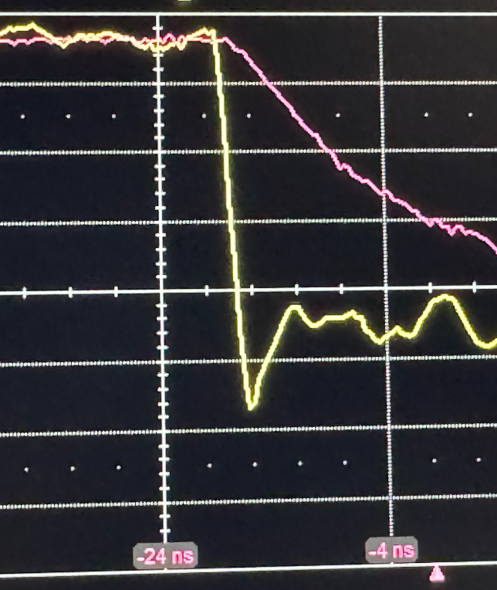
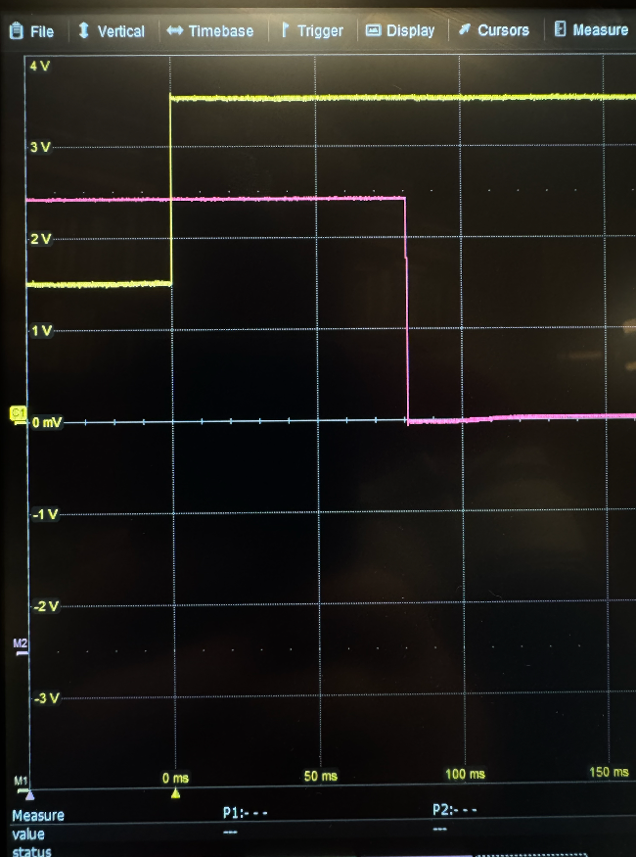
Time Response
Response time for Digital and Analog Input (3 interlock instances running)
Digital Input (Response time < 20ns)
  Just remove the grounded BNC from the DI
Analog Input (Response time ~ 80ms)
  Inserted a square wave from a signal generator
  with 1.25V and an offset of 1.5V
The Analog Input shows to be slow than the digital input but still less than 100ms.

Slide 15
Use Cases Examples

Slide 16
Some Use Cases Examples
Wago Interlock has been implemented in multiple applications from more than 20 years at ESRF, counting now more than 400 Wago boxes.
Lasers Safety:
  Disabling Laser electronics when a curtain is not fully closed.
Temperature:
  Protecting beamline slits and components from overheating.
Collision:
  Interfacing limit switches to prevent collisions on multiple moving parts.
Samples:
  Protecting vacuum and samples overheating during annealing process.

Slide 17
Current Status

Slide 18
Current Status
The system is currently 100% operational.
EPICS, Web, App, Container and Command line integrations ready.
Gattering for inputs from users to add/remove features.
20 units (10 big, 10 small) will be ready by July 2026 to be used at beamlines/labs at Berkeley (mainly at ALS).

Slide 19
Cost

Slide 20
Cost Comparison for DEMO Wago Interlock System
WAGO ($1,700)
ALLEN-BRADLEY (4,000)
Modules | Price
750-8001 | $787.64
750-403 | $40.95
750-403 | $40.95
750-504 | $52.32
750-469 | $240.00
750-469 | $240.00
750-467 | $275.00
750-600 | $27.31
Modules | Price
5069-L320ER | $2,782.00
5069-IB16F | $253.00
5069-OB16 | $299.00
5069-IY4 | $633.00
Excluded: Enclosure, connectors, wiring and resources (~4h 1 FTE) + (~500$)

Slide 21
Application Interface

Slide 22
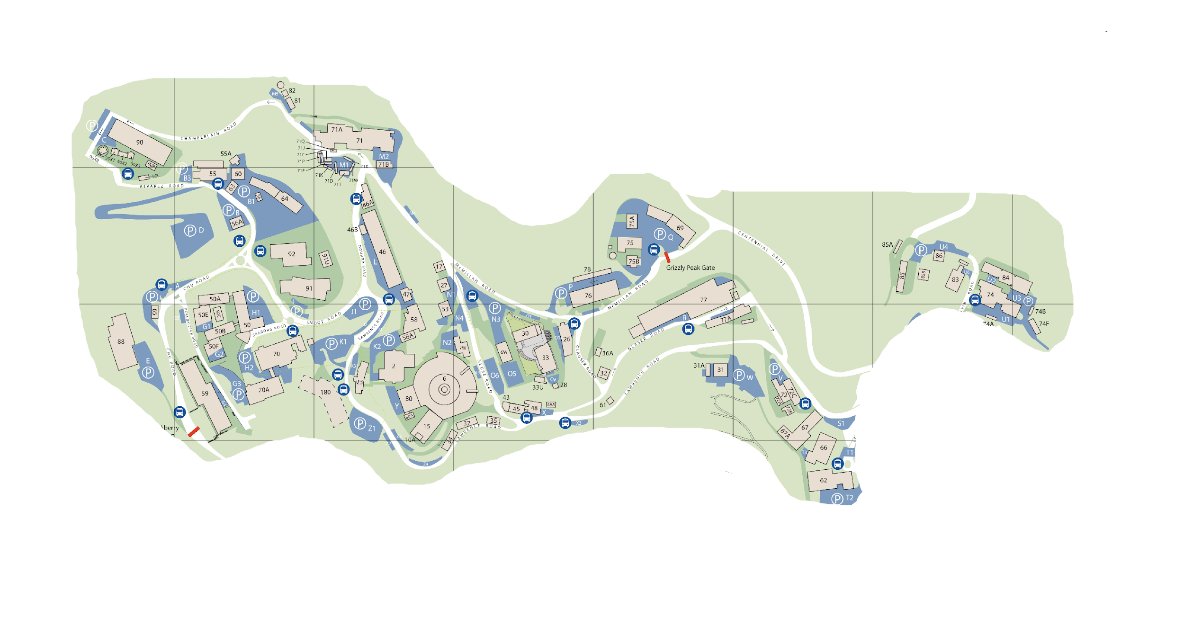
Berkeley Lab Facilities
Some Berkeley Lab Locations
AQT
BELLA
NCEM
JGI
ALS Beamlines
MMF
ALS Accelerator

Slide 23
Key Concepts (Locations and Wago Systems)
Berkeley Lab
Locations
Wago Systems
Permissions
Wago System
Berkeley Lab
Wago System
Locations
BELLA
Wago System
ALS Beamlines
Wago System
ALS Accelerator
Wago System
Master
MMF
Wago System
JGI
Wago System
Admin
NCEM
User
Wago System
AQT
Wago System

Slide 24
Permission Levels
Master
  Can manage all Locations and WagoSystems (superPower)
Admin
  Can manage a Location and all WagoSystem (superPower limited)
User
  Can limited manage its WagoSystem

Slide 25
Permissions
Permission Levels:
Master
Admin
User
There are rules
Wago Systems
User_3
User_1
User_1
User_1
User_2
Admin_3
Admin_1
User_2
Admin_2
User_1
User_3
User_2
Locations
User_4
User_3
User_1
Admin_4
User_2
Admin_5
Master

Slide 26

Wago Interlock Application
git clone git@gitlab.esrf.fr:deg-collab/wagotools.git

Slide 27
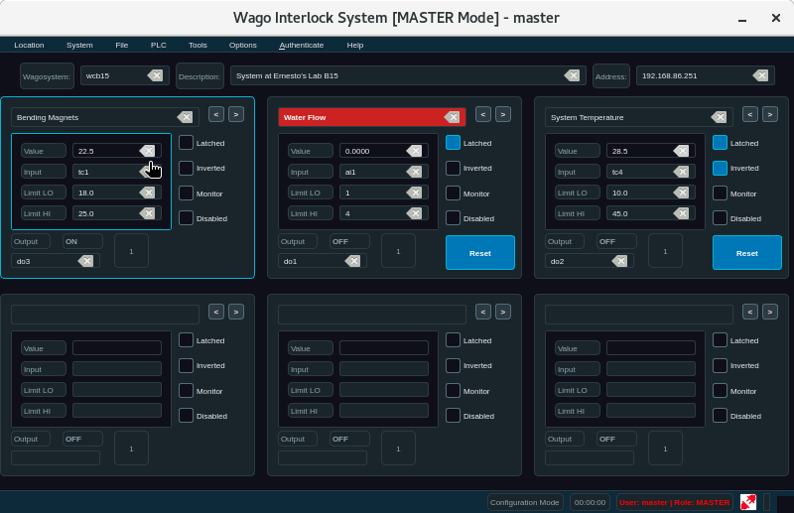
Wago Interlock Application – Main Screen

Slide 28
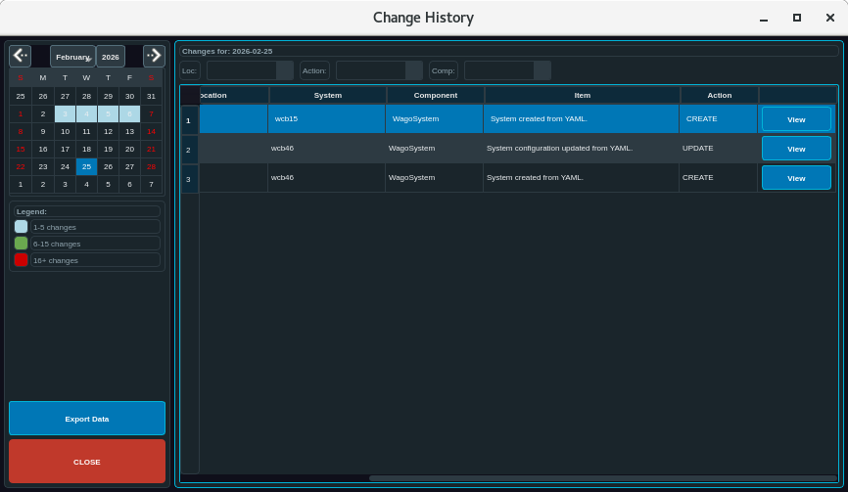
Wago Interlock Application – Changes Tracker

Slide 29
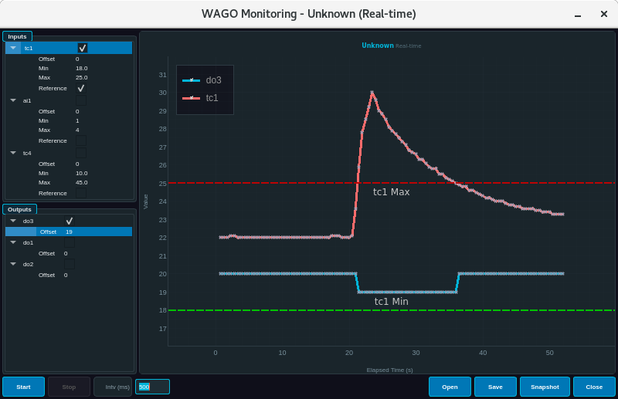
Wago Interlock Application – Plotting

Slide 30
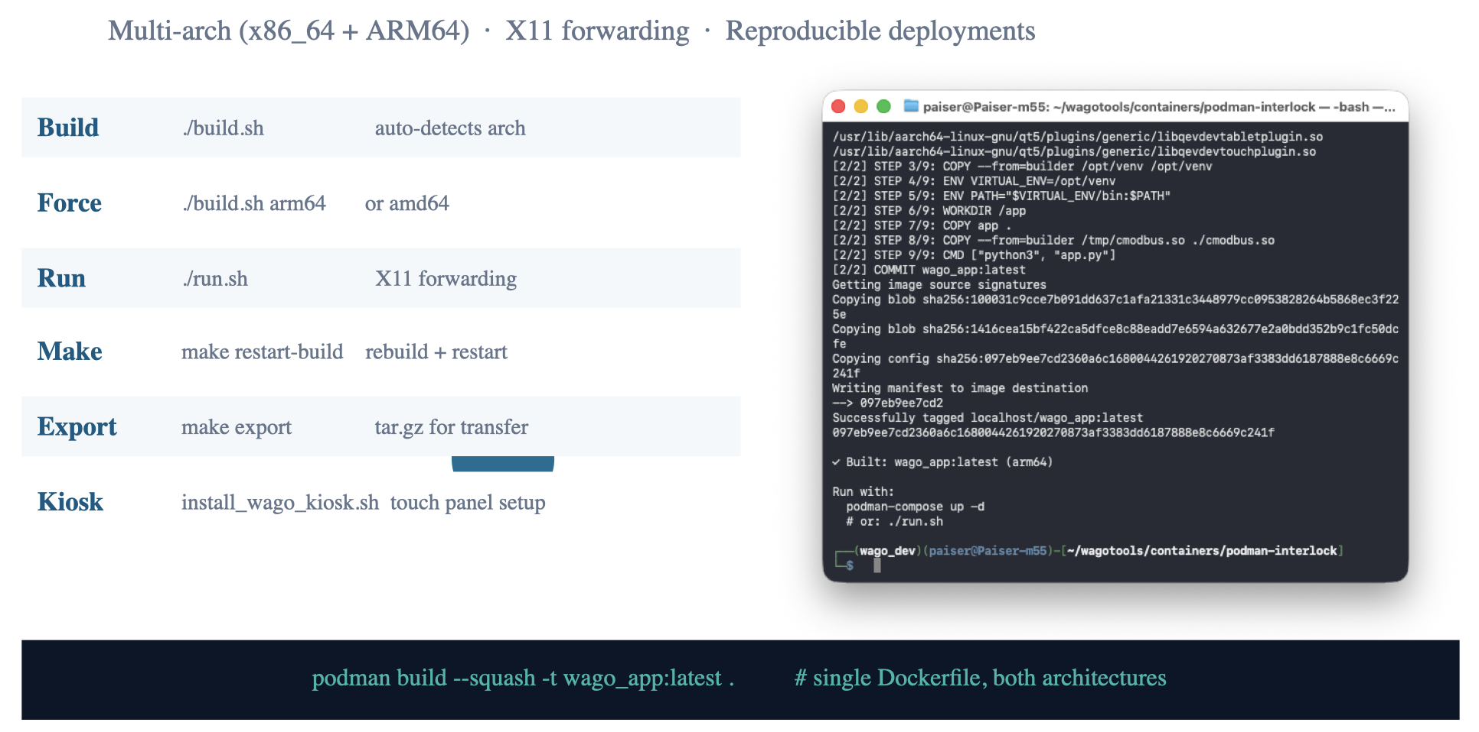
Control Software Container

Slide 31
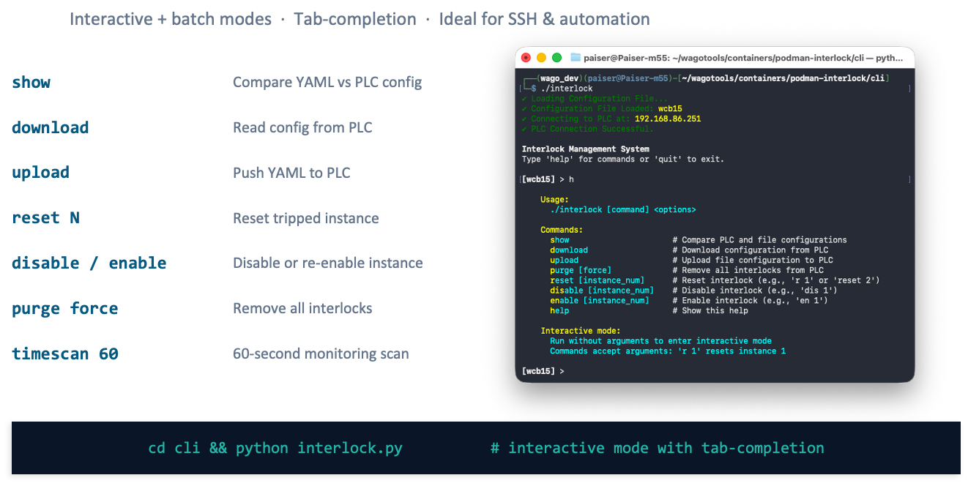
Control Software CLI

Slide 32
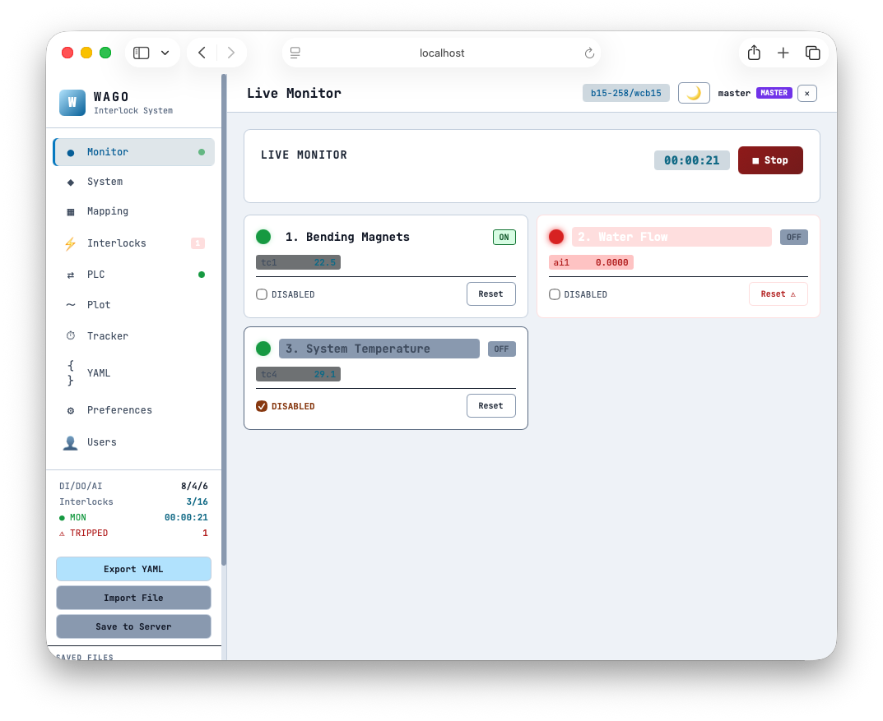
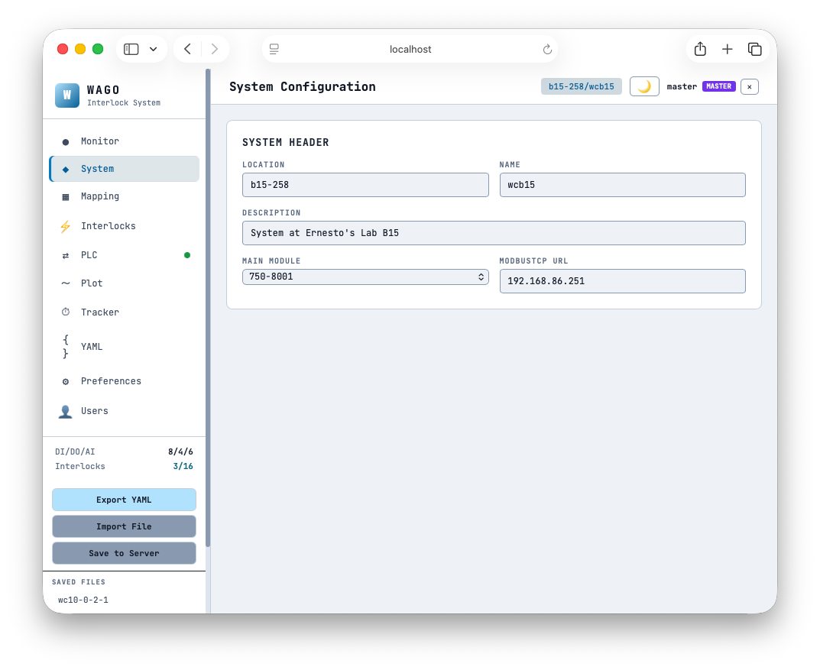
Control Software Web Interface

Slide 33
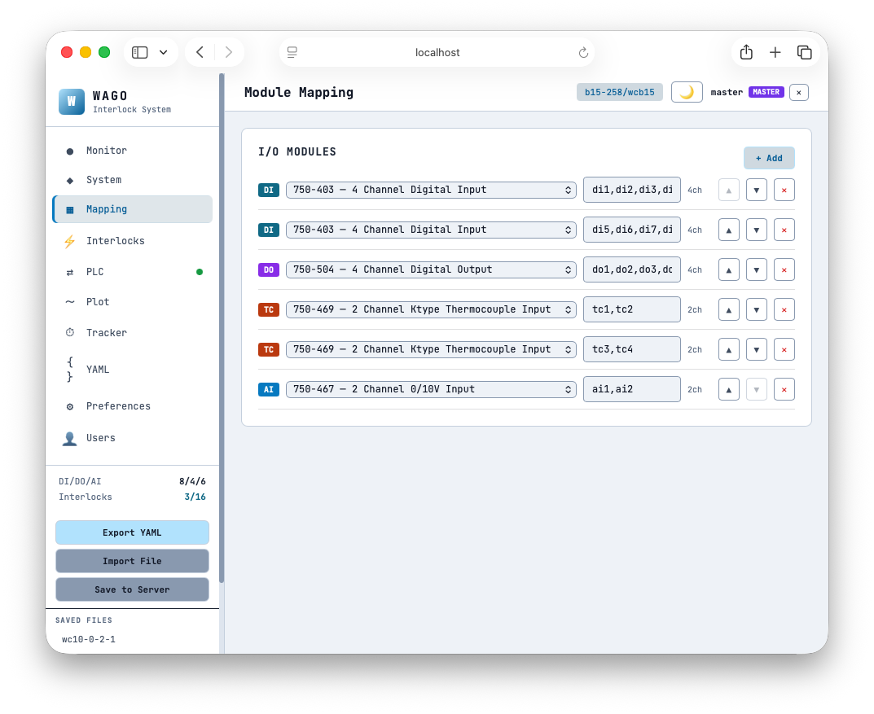
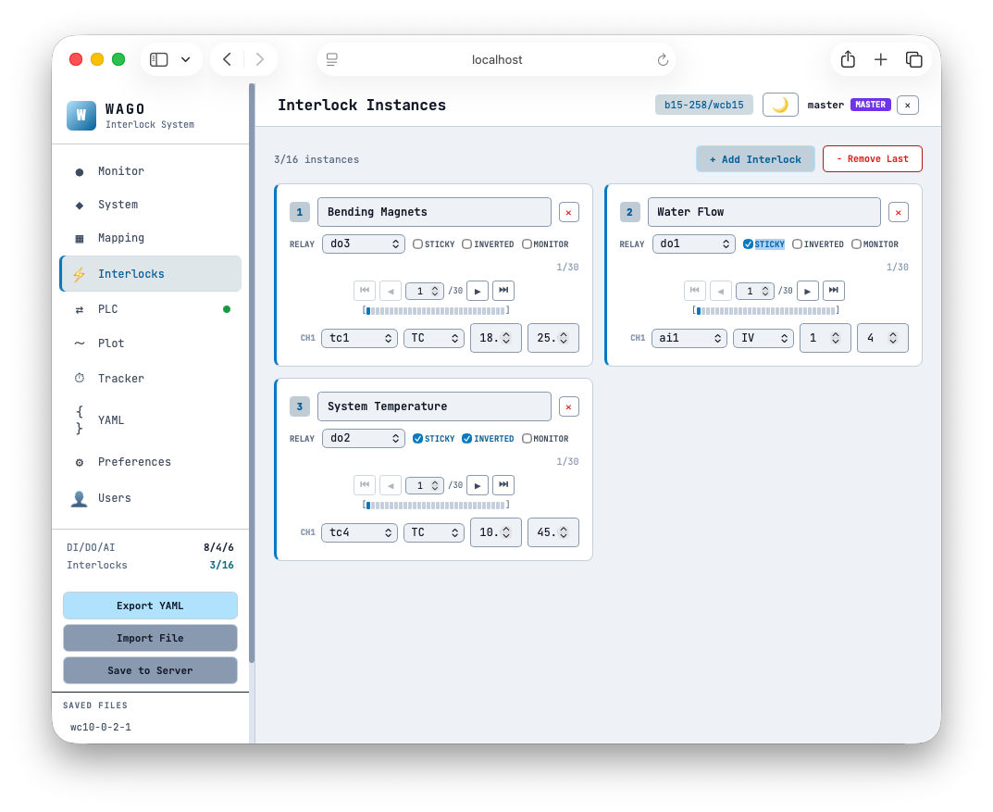
Control Software Web Interface

Slide 34
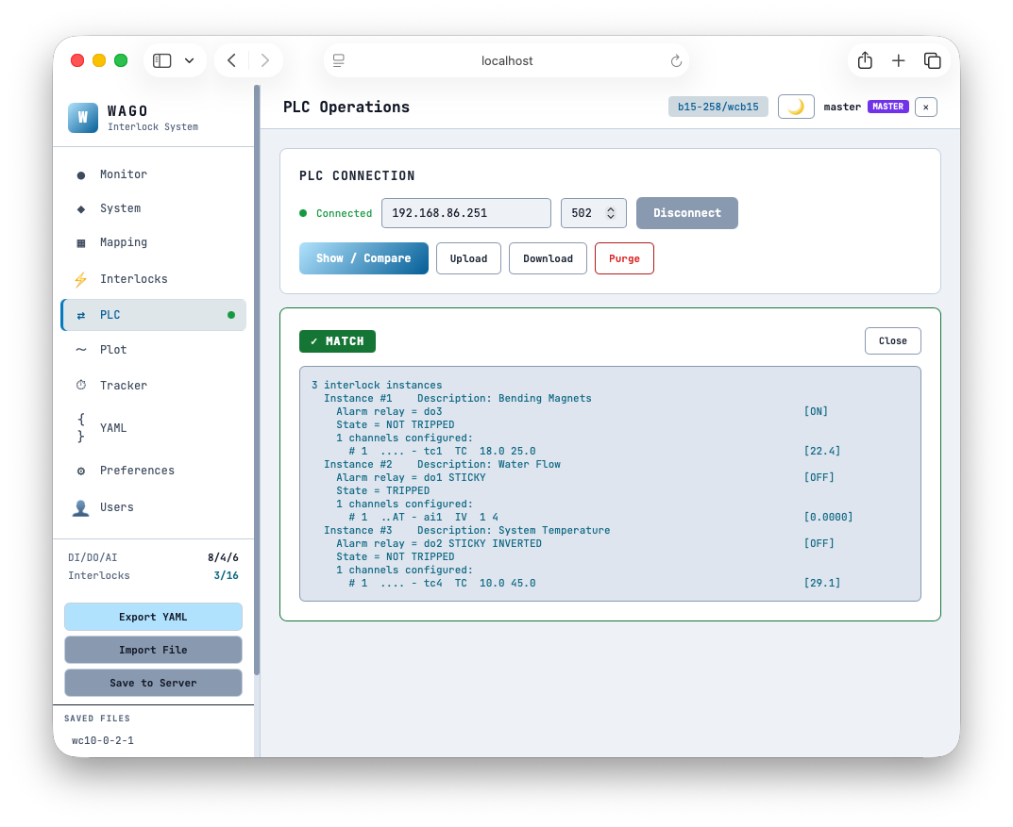
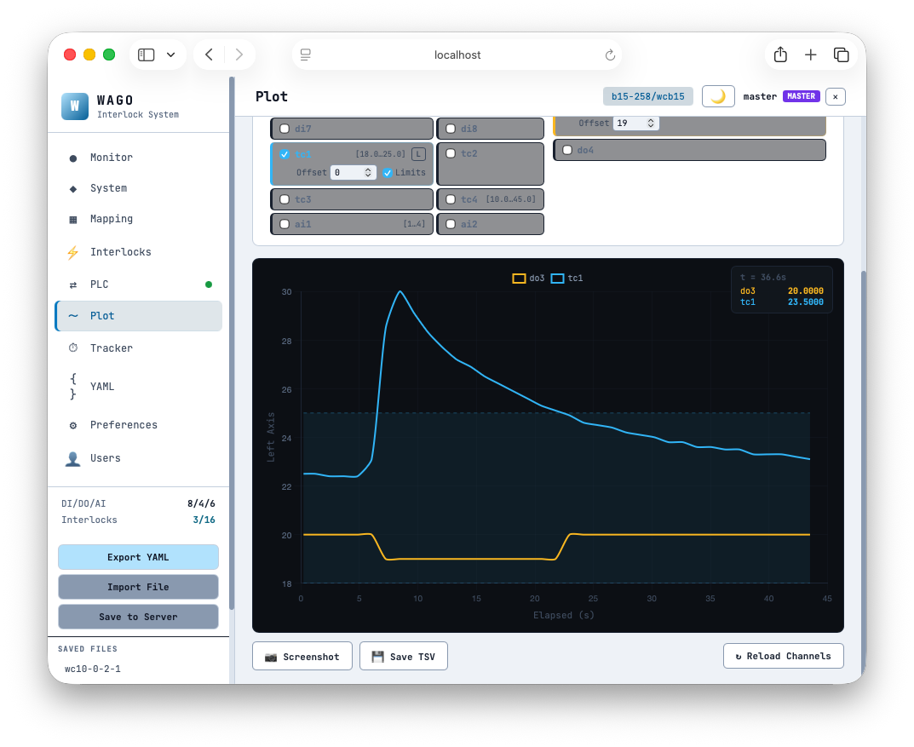
Control Software Web Interface

Slide 35
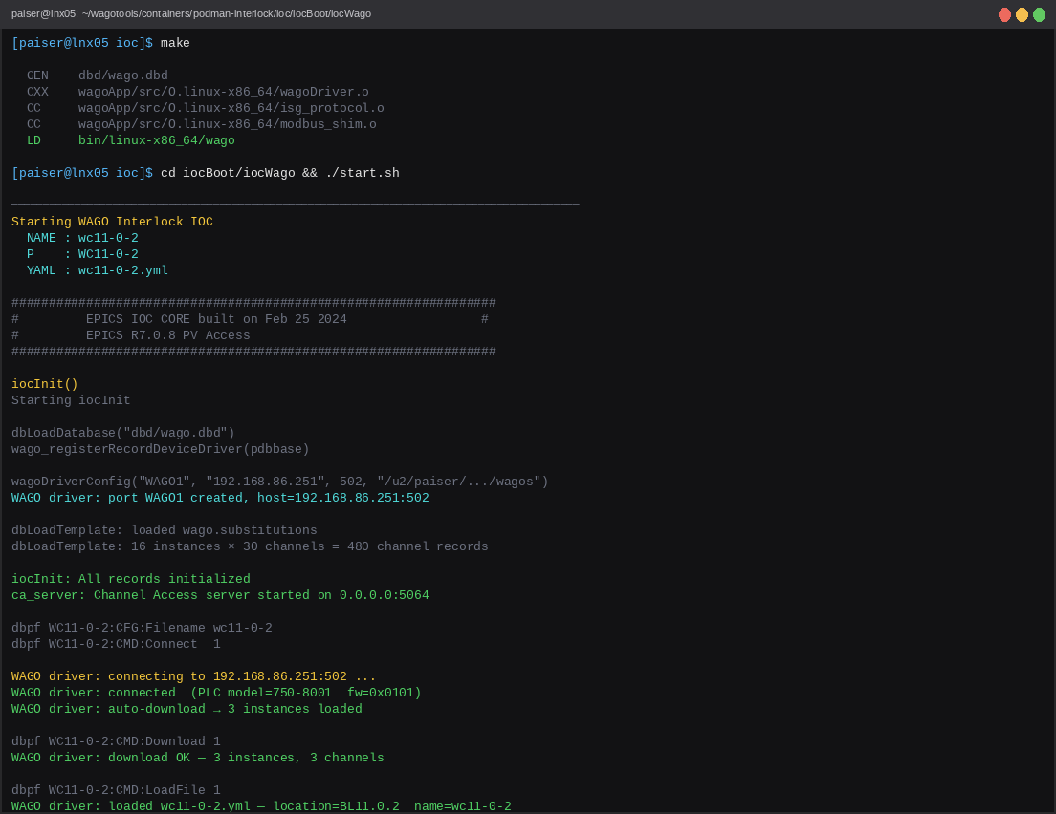
Control Software EPICS - IOC

Slide 36
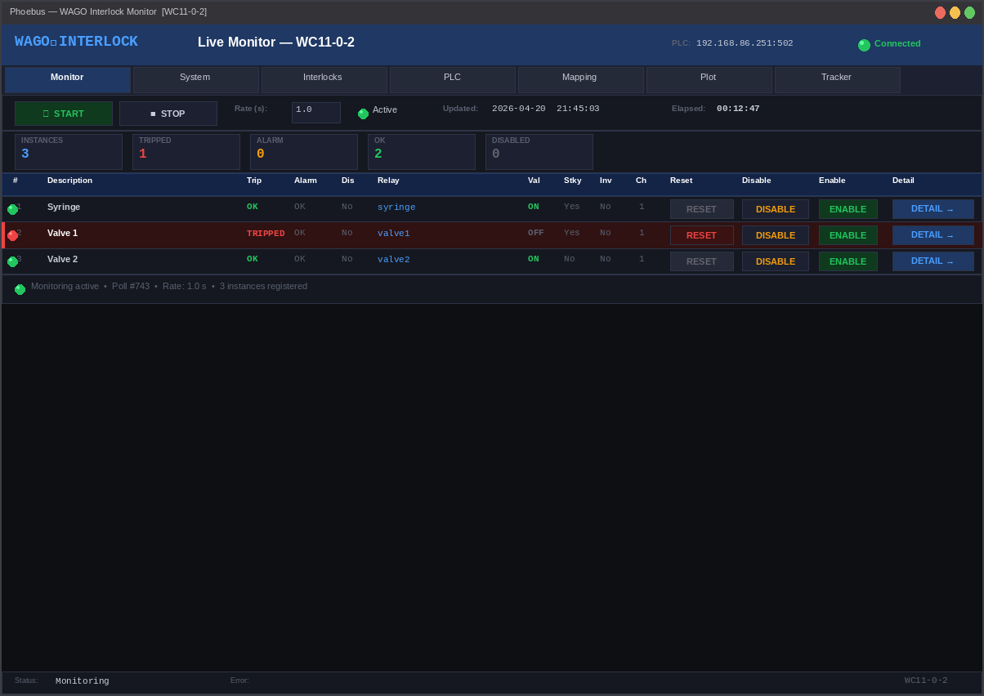
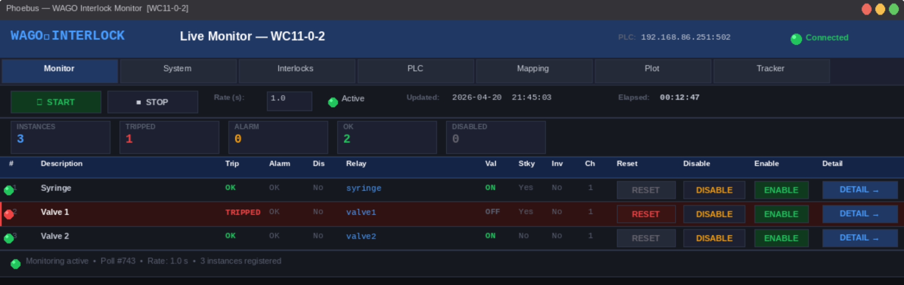
Control Software EPICS - Phoebus

Slide 37
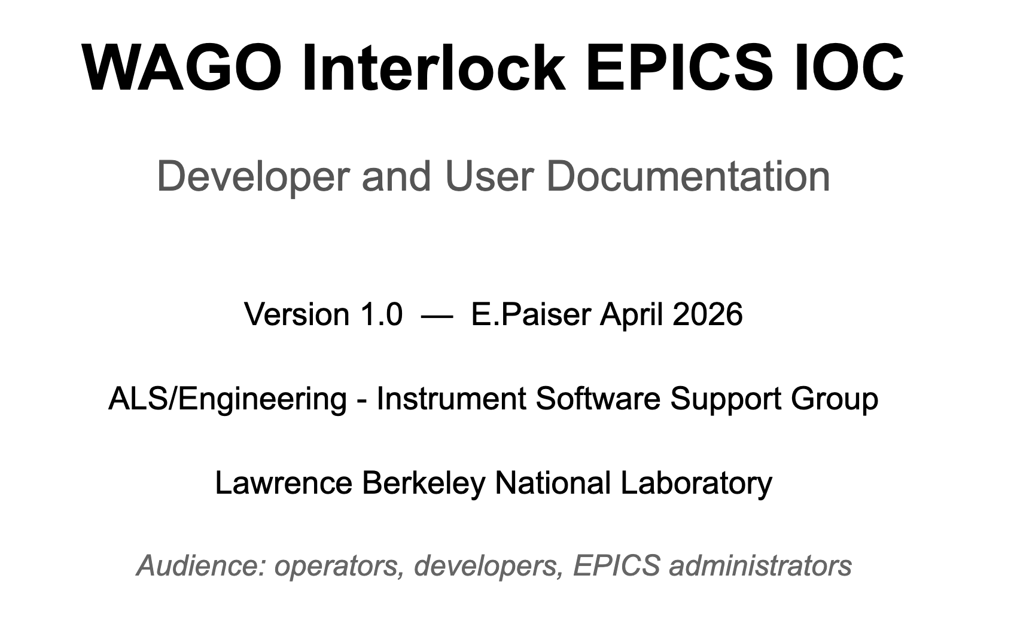
Control Software EPICS - Documentation
WAGO_IOC_Documentation_Latest (Ask me to download it)

Slide 38
Conclusion

Slide 39
Conclusion
Wago Interlock offers a significant improvement in interlock solutions for scientific experiments, end-stations, and lab-wide applications.
Engineered for zero-code implementation, its user-friendly design, flexibility, and reliability make it an ideal solution for improving safety and efficiency in research environments.

Slide 40
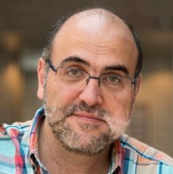



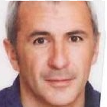

Acknowledgement
The development and implementation of Wago Interlock were made possible through the collaborative efforts of several individuals and institutions. We extend our sincere gratitude to the following individuals for their invaluable contributions
Pablo Fajardo(ESRF)
Ratana Biv (ESRF)
Damon English (LBL)
Christopher Toy (LBL)
Vicente Rey (ESRF)
Ricardo Hino (ESRF)

Slide 41
For a Practical Demonstration ask
Ernesto Paiser <paiser@lbl.gov>

