Slide 1
Generic Python Algorithm Plugin for Area Detector
NDPluginPython
EPICS Collaboration Meeting
Spring 2026
Jure Varlec
jure.varlec@cosylab.com

Slide 2
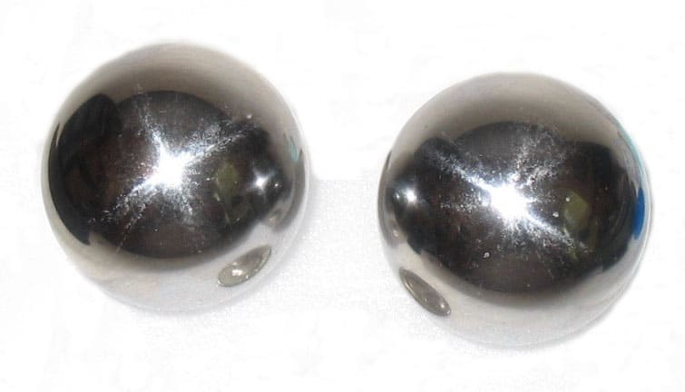
Live demo

Slide 3
Python algorithm base class
The processing function is wrapped in a class that provides information to the upper layers:
class Base:
parameters: List[UserParameter] = []
attributes: List[UserAttribute] = []
def process(self, image, params, attributes, metadata):
# Must be implemented in child class
raise NotImplementedError
Attribute list: optional, useful for checking consistency.
Parameter list: generates records and GUI elements.

Slide 4
Attributes
By default, all NDArray attributes are passed to Python.
Listing attributes filters them and is useful for ensuring they are present.
  Optional for input
  Mandatory for output
attributes = [
UserAttribute("ExpTime", "Exposure time", "Float64", AttrDirection.In),
UserAttribute("Quality", "Quality score", "Float64", AttrDirection.Out),
]

Slide 5
User parameters
parameters = [
UserParameter("Threshold", "Detection threshold", "float", ParamDirection.In, 0.5),
UserParameter("Mode", "Operating mode", "enum", ParamDirection.In, "Low",
choices=["Off", "Low", "High"]),
UserParameter("Count", "Detections found", "int", ParamDirection.Out, 0),
]
record(ao, "$(P)$(R)AlgoParamThreshold") {
field(DTYP, "asynFloat64")
field(DESC, "Detection threshold")
field(OUT, "@asyn($(PORT),$(ADDR=0),$(TIMEOUT=1))PYTHON_PARAM_THRESHOLD")
field(VAL, "0.5")
field(PINI, "YES")
info(autosaveFields, "VAL")
}

Slide 6
Processing function
def process(
self,
image: np.ndarray,
params: Dict[str, Any],
attributes: Dict[str, Any],
metadata: Dict[str, Any],
) -> Dict[str, Any]:
exp = attributes.get("ExpTime", 1.0)
score = float(image.mean()) / exp
return {
"status": AlgoStatus.Success,
"message": "",
"image": image,
"parameters": {"Count": image.size},
"attributes": {"Quality": score},
}

Slide 7
IPC Architecture
IOC Process
(Parent)
POSIX Shared Memory
Child Process
(Separate executable)
ImageMeta
NDArrayStruct
pack
zero-copy
ImageData
Pixel Buffer
NDPluginPython
algo.process()
Python (pybind11)
UserParams
IN / OUT Parameters
ResponseData
Status, Type, Message
unpack
zero-copy
ChildException
Error Info
POSIX Message Queues
Commands only
MsgQueueIn
parent → child
MsgQueueOut
child → parent

Slide 8
Architectural choices
The IOC is not linked to Python at all.
Python is called from a separate executable.
Allows full freedom to use any Python library and multiprocessing strategy.
  Separate plugin instances have separate interpreters
  You can use multiprocessing library freely
  GPU offload
Even use one Python in IOC and another for images!

Slide 9
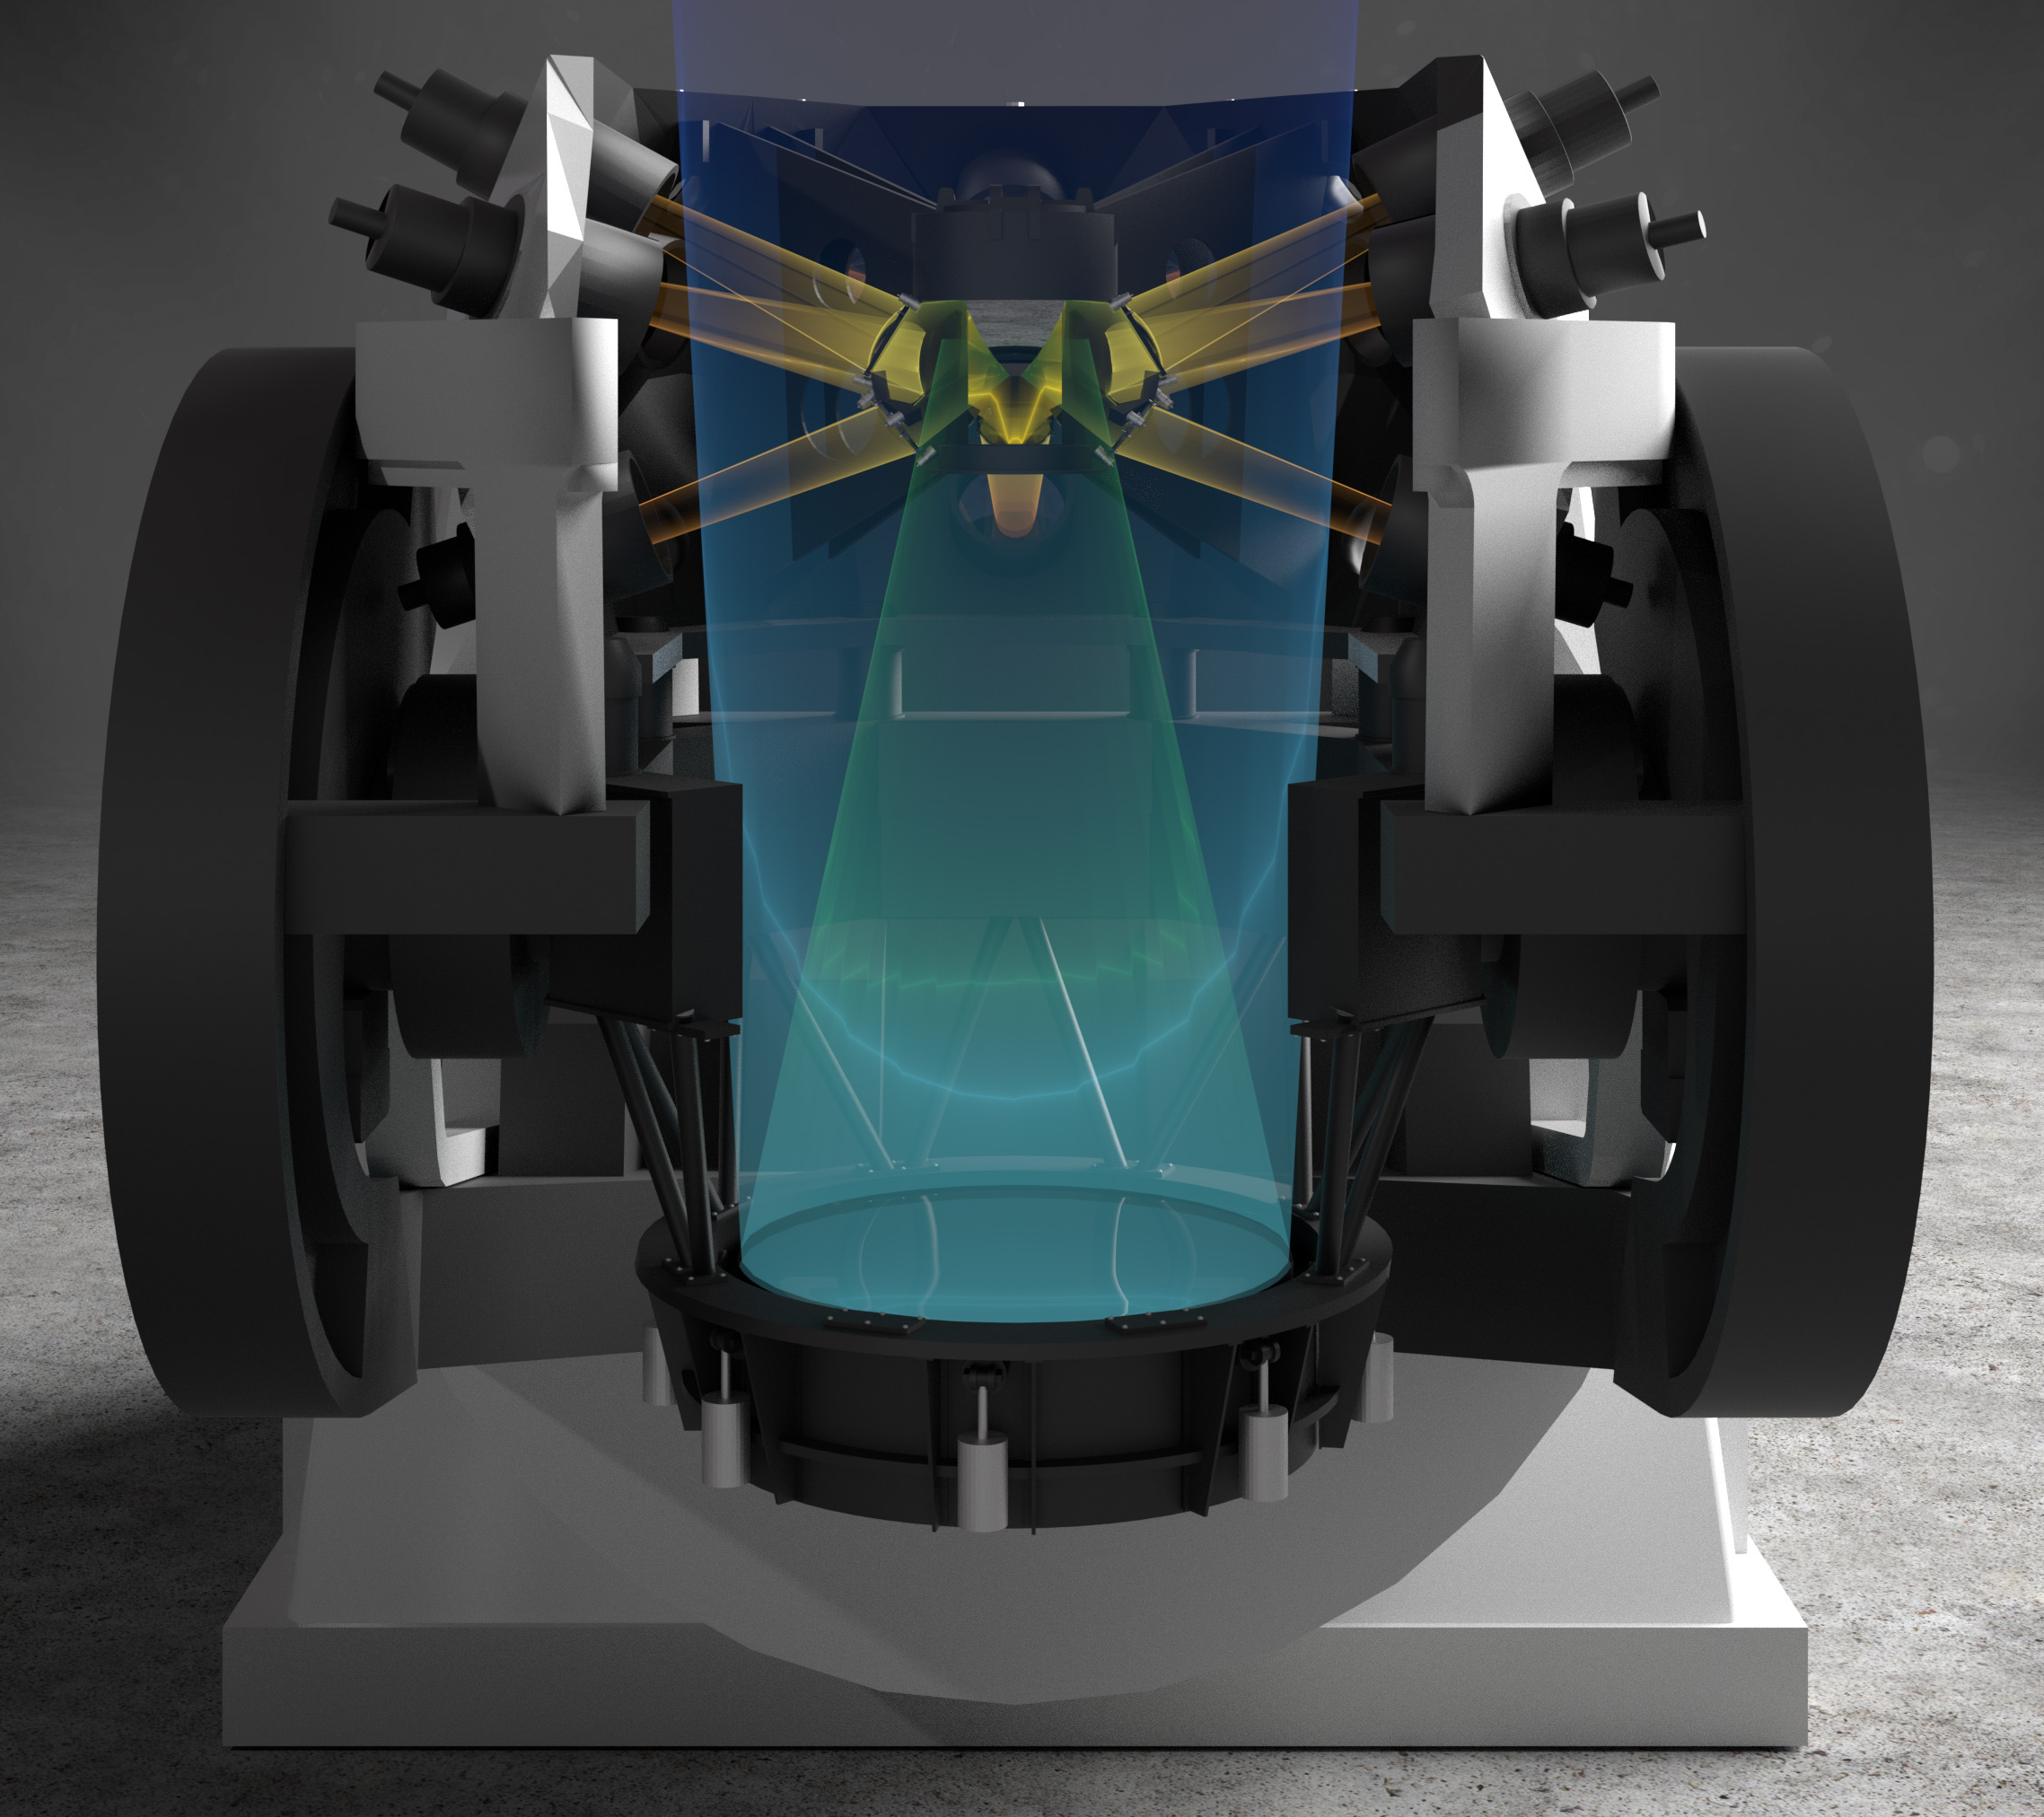
Flyeye
NEOSTEL: Near Earth Object Survey TELescope
  ESA Space Safety Programme
  Built by OHB Italia
EPICS controls
16 cameras, very wide FoV
Cameras are FTP clients
  Images go directly to ESA server
  Exception: autofocusing
Autofocusing is a slow process
  Python image analysis

Slide 10
Focus estimation
Only re-focus when needed, estimate focus on the fly.
NEOSTEL doesn't have this and needs to be upgraded.
Autofocusing is already a separate Python service: let's use the same approach!
But: another telescope is planned, and it will use Area Detector.
Do we want to integrate Python into AD?
An AD plugin would be useful for others: more valuable than a one-off solution!
For the existing telescope, create a plugin to read FITS images into AD.
Additionally, the ESA grant aims to produce a reusable piece of software.

Slide 11
Jure Varlec
jure.varlec@cosylab.com

