Slide 2
e3
Conda-Powered EPICS Environments at ESS
PRESENTED BY Anders Lindh Olsson

Slide 3

e3

Slide 4

1
EPICS IOCs

Slide 5
EPICS IOCs
What is an IOC?
Historically:
An Input/Output Controller: hardware + software, derived from VxWorks-era embedded systems.
In modern EPICS usage (and ESS' specifically):
A software process that acts as a server: it speaks Channel Access / PV Access, keeps a database of process variables, and (sometimes) interfaces with hardware I/O.
The shift from "IOC is a machine" to "IOC is a process" matters for how we think about packaging and deployment.

Slide 6
EPICS IOCs
Why it is painful
A compiled executable linking various (/EPICS) libraries at build time, for a specific platform.
The IOC is the lifecycle. Changing anything means rebuilding the IOC.
Everything is coupled. Library versions, site code, upstream source — tangled together, hard to change any piece in isolation.
Distribution is fragile. Modules compiled centrally, shipped via NFS, tied to a specific distro. Works until the distro is gone.

Slide 7

2
The require module

Slide 8
The require module
require — the IOC as a thin launcher
Developed at PSI by Dirk Zimoch. Rather than compiling each IOC as a custom executable, require turns the IOC into a generic process (iocsh) that dynamically loads functionality at startup.
In a startup script, require opcua loads the shared library, DBDs, and associated files into the running IOC. Modules are shared objects, resolved and loaded on demand — not linked in at build time.
Functionality has moved from compiled-in application code to runtime-loaded modules.

Slide 9
The require module
What require enables
No per-IOC compilation — one generic executable serves all IOCs.
Library reuse across IOCs.
Partial upgrades without IOC rebuilds.
IOC lifecycle decoupled from module lifecycle.

Slide 10
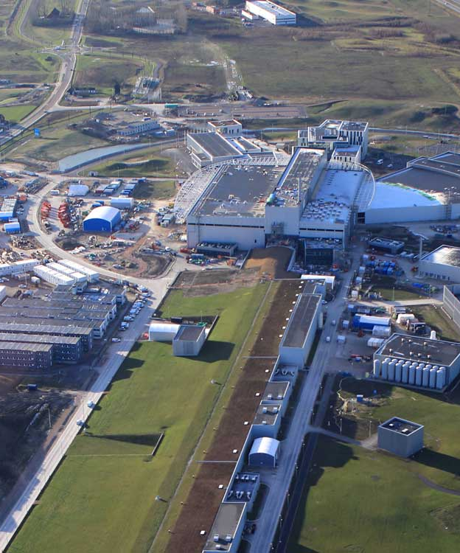
3
Module wrappers

Slide 11
Module wrappers
Separating Site from Source
ESS extended PSI's work with a wrapper concept: upstream module source and site-specific content live in separate repos.
In the wrapper repo:
Site-specific build configuration.
Data files: Database files, iocsh snippets, templates.
Patches, each linkable to an upstream PR.
No forks. Upstream stays upstream. Site additions are auditable and community-compatible.

Slide 12
4
Conda as a first-class package manager

Slide 13
Conda as a first-class package manager
What was still missing
Module compilation and distribution — still centrally built, still NFS-distributed, still tied to one specific distro.
No real dependency management — the e3 team was effectively the package manager.
No binary registry — packages were rebuilt per environment.
System libraries were implicit — the full dependency graph stopped at EPICS-level modules; deeper libs (readline, libxml2, hdf5, openssl) were whatever the host OS happened to provide.
And then... CentOS 7 reaching EOL turned a manageable constraint into a forcing function.

Slide 14
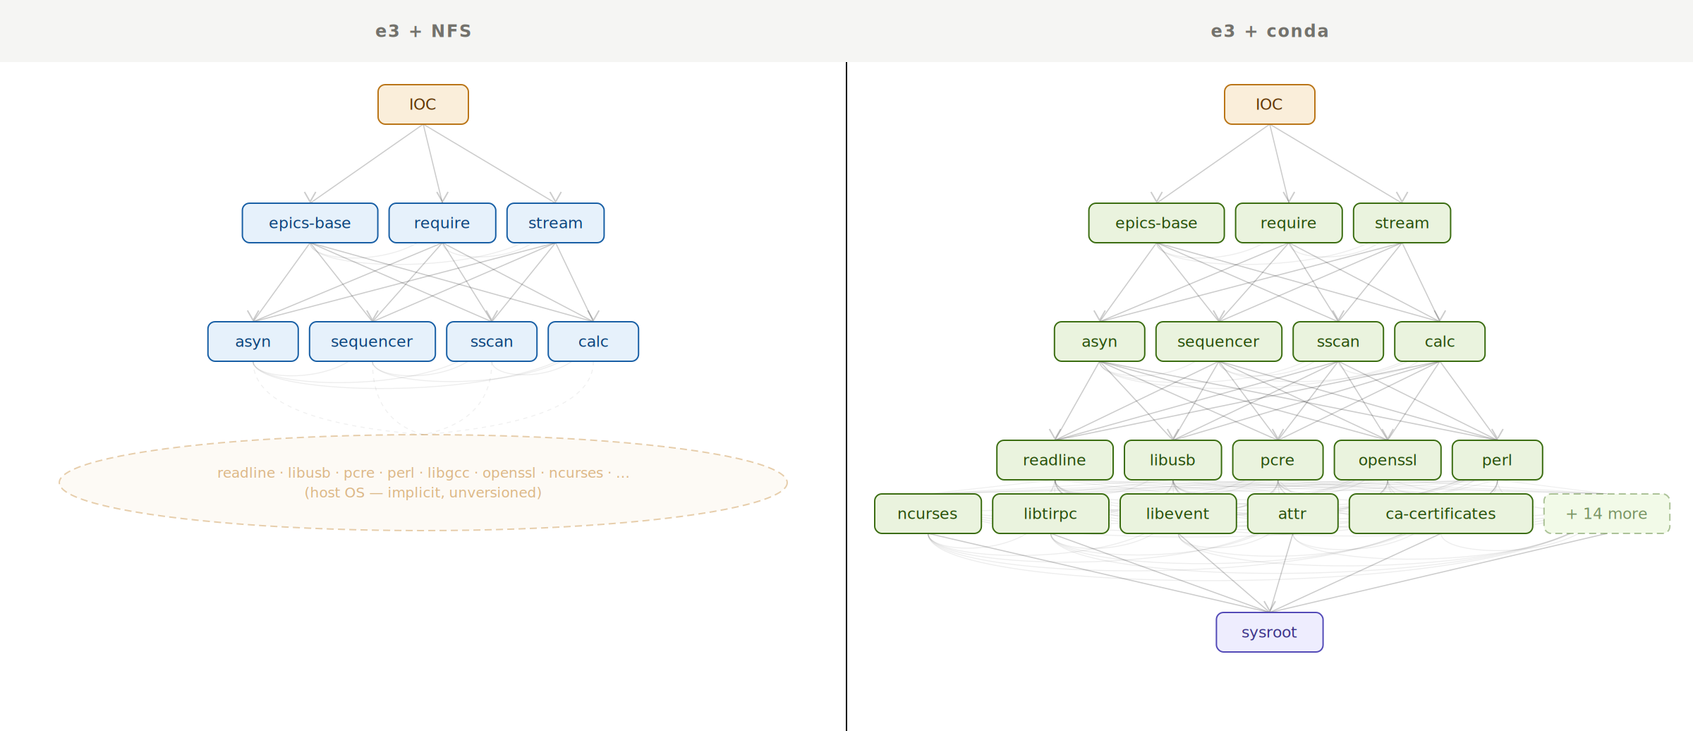
Conda as a first-class package manager
The dependency graph — before and after
Conda is an OS-agnostic, system-level binary package and environment manager. It encodes the full dependency graph; not just EPICS-level. Decouples the EPICS installation from the host platform.

Slide 15
Conda as a first-class package manager
Wrappers become recipes
Wrappers were already doing the job conceptually. Patches linked to Pull Requests, site-specific files separated from upstream source.
Recipes express the same concept in Conda's native format:
meta.yaml — metadata, upstream source reference, explicit dependency declarations (build / host / test).
build.sh — proper first-class build script with arbitrary pre/post hooks (wrappers needed custom affordances in require/the build system for this).
Patches and site-specific files alongside, as before.
Same collaboration surface, cleaner mechanism, broader capability.

Slide 16

5
e3

Slide 17
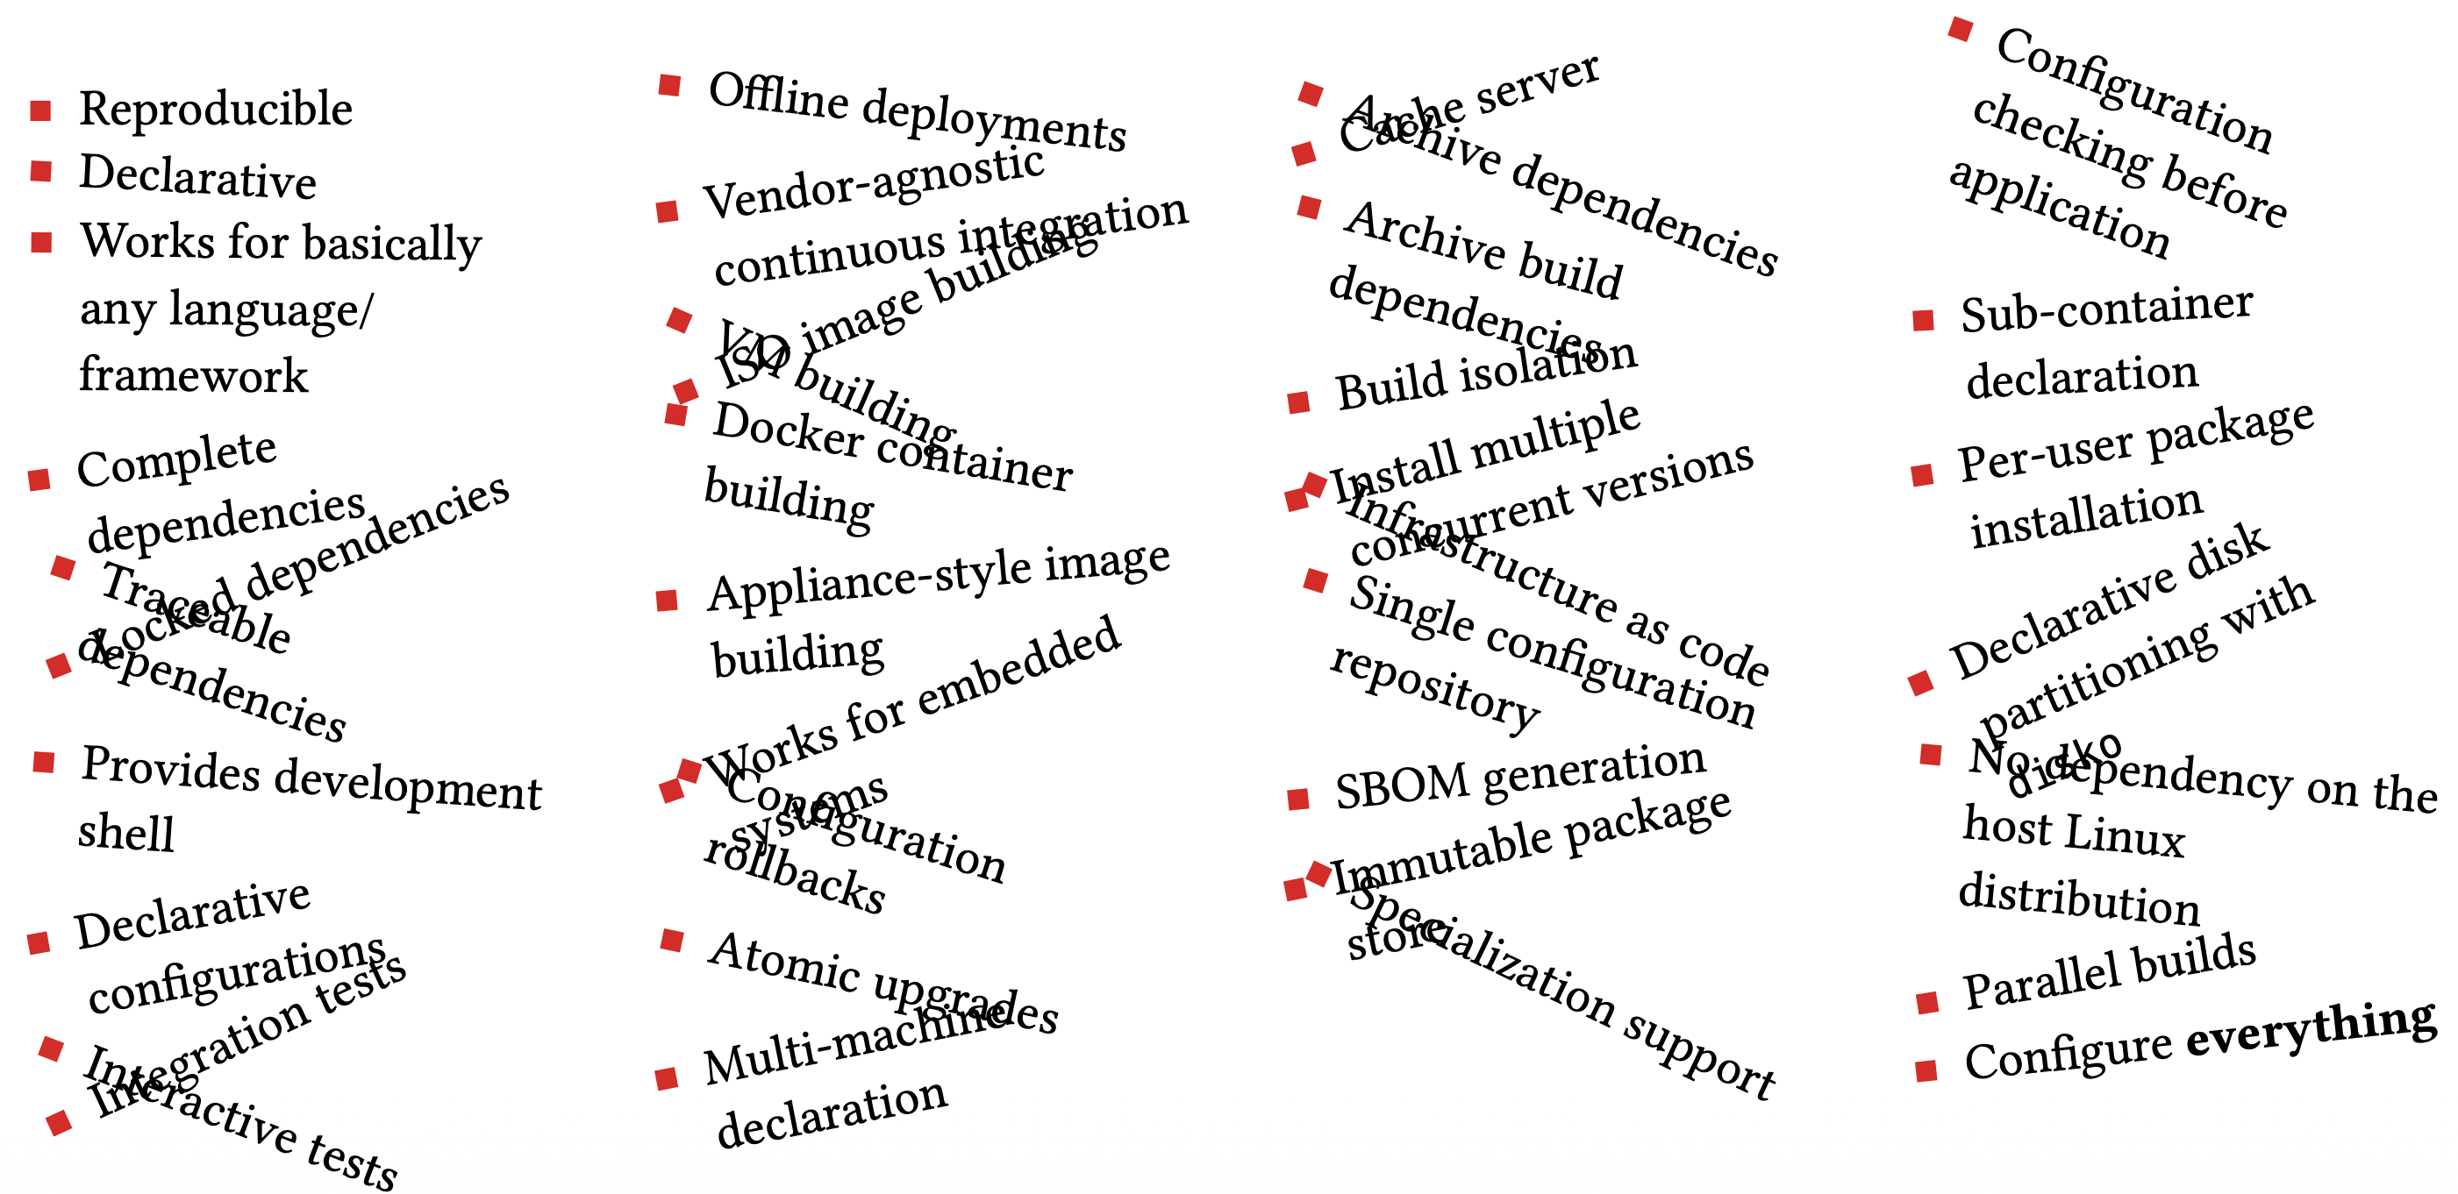
e3
Advantages

Slide 18
e3
How it works
Try it!
https://e3.pages.ess.eu

Slide 19

6
Where this fits, and what is next

Slide 20
Where this fits, and what is next
Can/should you use e3?
driver.makefile works. Its developer API is arguably better than upstream EPICS base's. But it is heavy to maintain, and it does not interoperate with upstream module build configs. A real cost for anyone considering adoption.
Conda and conda-forge as base works. But we have inherited conda-forge's sysroot and platform choices, which currently do not reach all targets we care about (looking at you, PPC big-endian...), and you may find yourselves in the same position.

Slide 21
Where this fits, and what is next
We are not alone
Others are attacking the same problem differently: epics-in-containers, EPNix, epicsdeb...
Same root problem. Different design choices on isolation, build model, runtime flexibility.

Slide 22
Where this fits, and what is next
Is the EPICS base build (and distribution) system the real problem?
Is EPICS base's build system the real problem? Every site past the simplest IOC grows its own tooling: e3, EPNix, epics-in-containers, site makefiles. Each solves a real pain point. None of them should have needed to exist at this scale.

