Slide 1
From Legacy to Modern: Next-Generation LANSCE controls Architecture with EPICS 7, Python, High-Speed Digitization, and Modern Timing System
Author: Dr. Tyagi Ramakrishnan
Co Authors: Dr. Abraham Flores, Anthony Braido, Christopher Hatch, Eric Westbrook, Greg DeLaTorre, Heath Watkins, Jesse Duran, Rocio Martin, Sarah Dolan, Dr. Scott Baily, Zane Sauer, Heather Leffler
LA-UR-26-22973

Slide 2
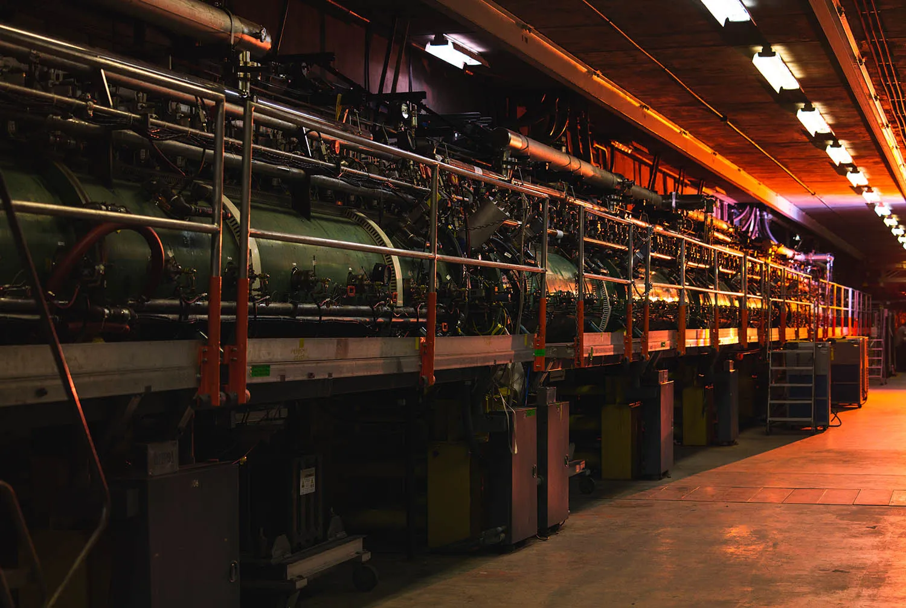
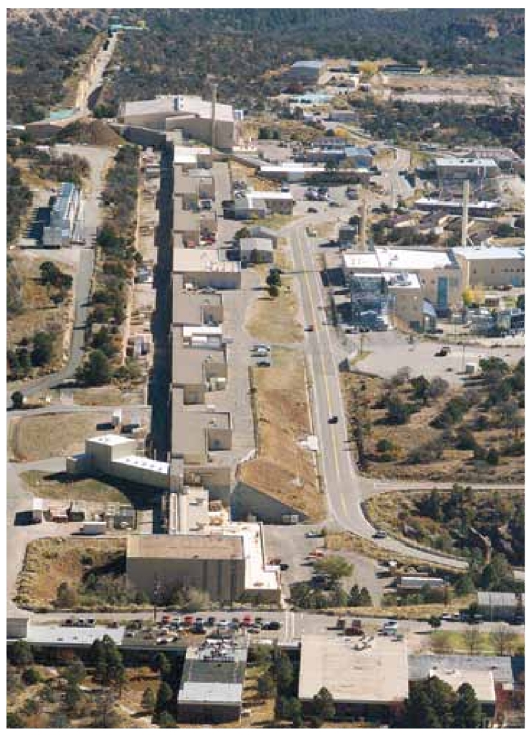

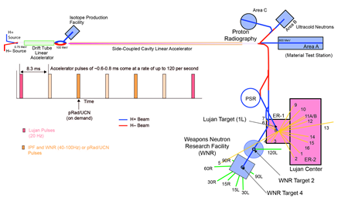
LANSCE
Birthplace of EPICS in the 90s
5 Target areas
Complex Timing
160K+ PVs
LA-UR-26-22973

Slide 3
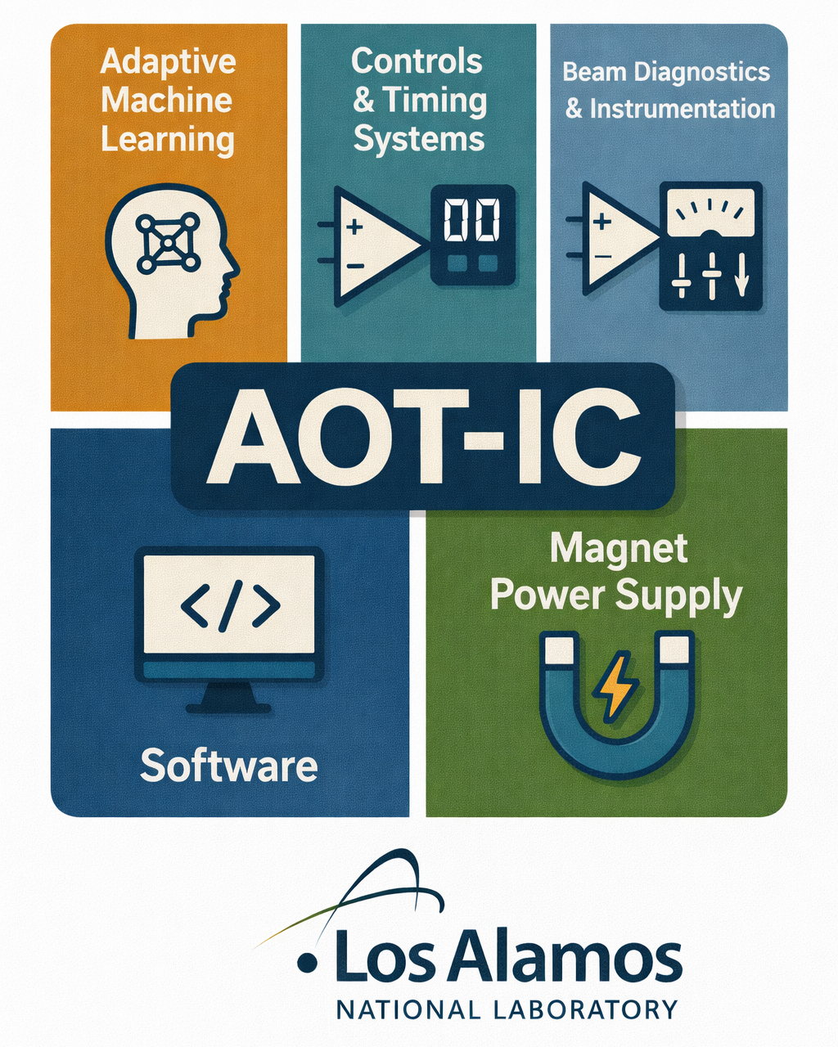
AOT-IC Controls Software Team
LA-UR-26-22973

Slide 4
LANSCE Infrastructure
LA-UR-26-22973

Slide 5
LA-UR-26-22973

Slide 6
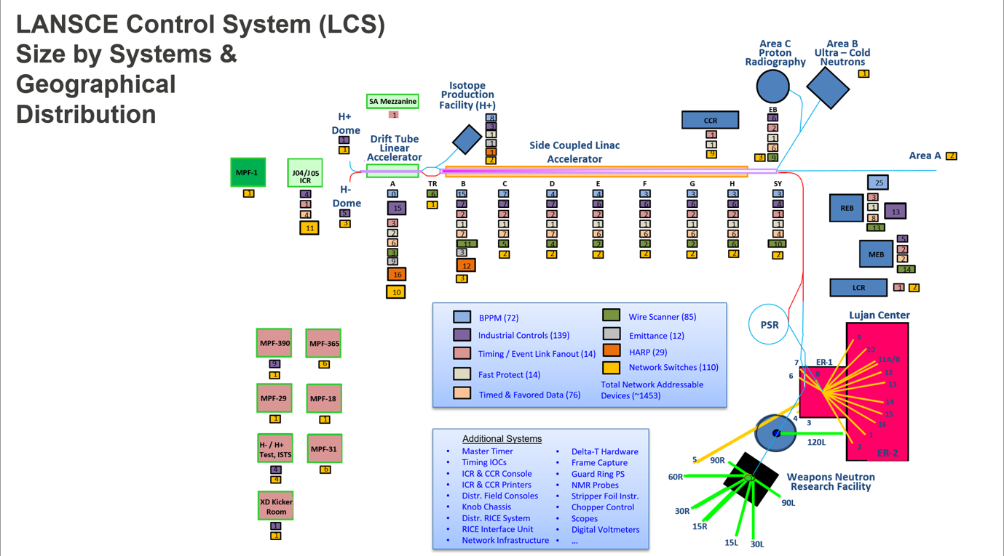
LA-UR-26-22973

Slide 7
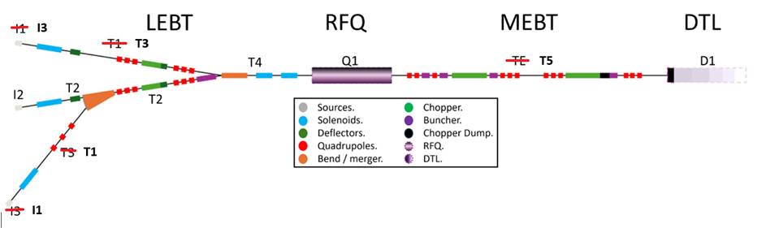









LA-UR-26-22973

Slide 8
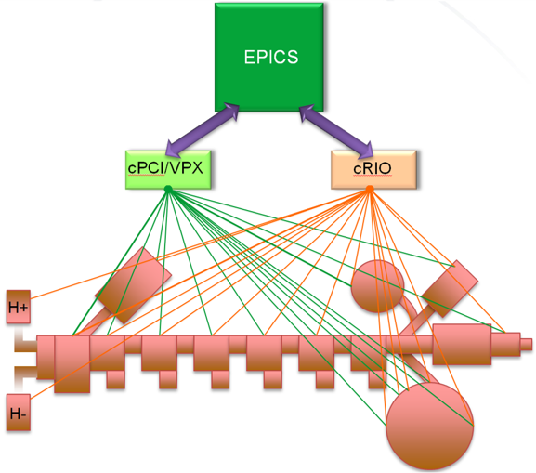
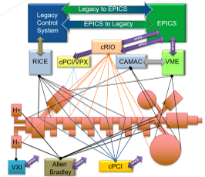




Move towards Modernization
PLC
PXIe
Open
Source
Today
Multiple Processor Types:
VME (68K, PowerPC), CR-12 (i7), NI 9024, NI 9075, NI 9038, NI 9048, NIOS
Types of Computer Hardware:
PLC, CAMAC, cRIO, VME, VME64, VPX, cPCI
Types of Operating system:
Real Time OS – VxWorks, RTEMS, LinuxRT
Other OS – Rocky 8, NI Linux RT
EPICS versions:
R3.15.9, R7.0.9, and DAR
Xilinx for cRIOs
Altera for FCM, BPPM, TDAQ
Future
Multiple Processor Types:
NI 9038, NI 9048
Types of Computer Hardware:
PLC, cRIO, VME64, VPX
Types of Operating system:
Real Time OS – LinuxRT
Other OS – Rocky 8, NI Linux RT
EPICS versions:
R7.0.9
Xilinx for cRIOs, PXIe, FCM, BPPM, TDAQ, Fast Protect, Fast DAQs
LA-UR-26-22973

Slide 9
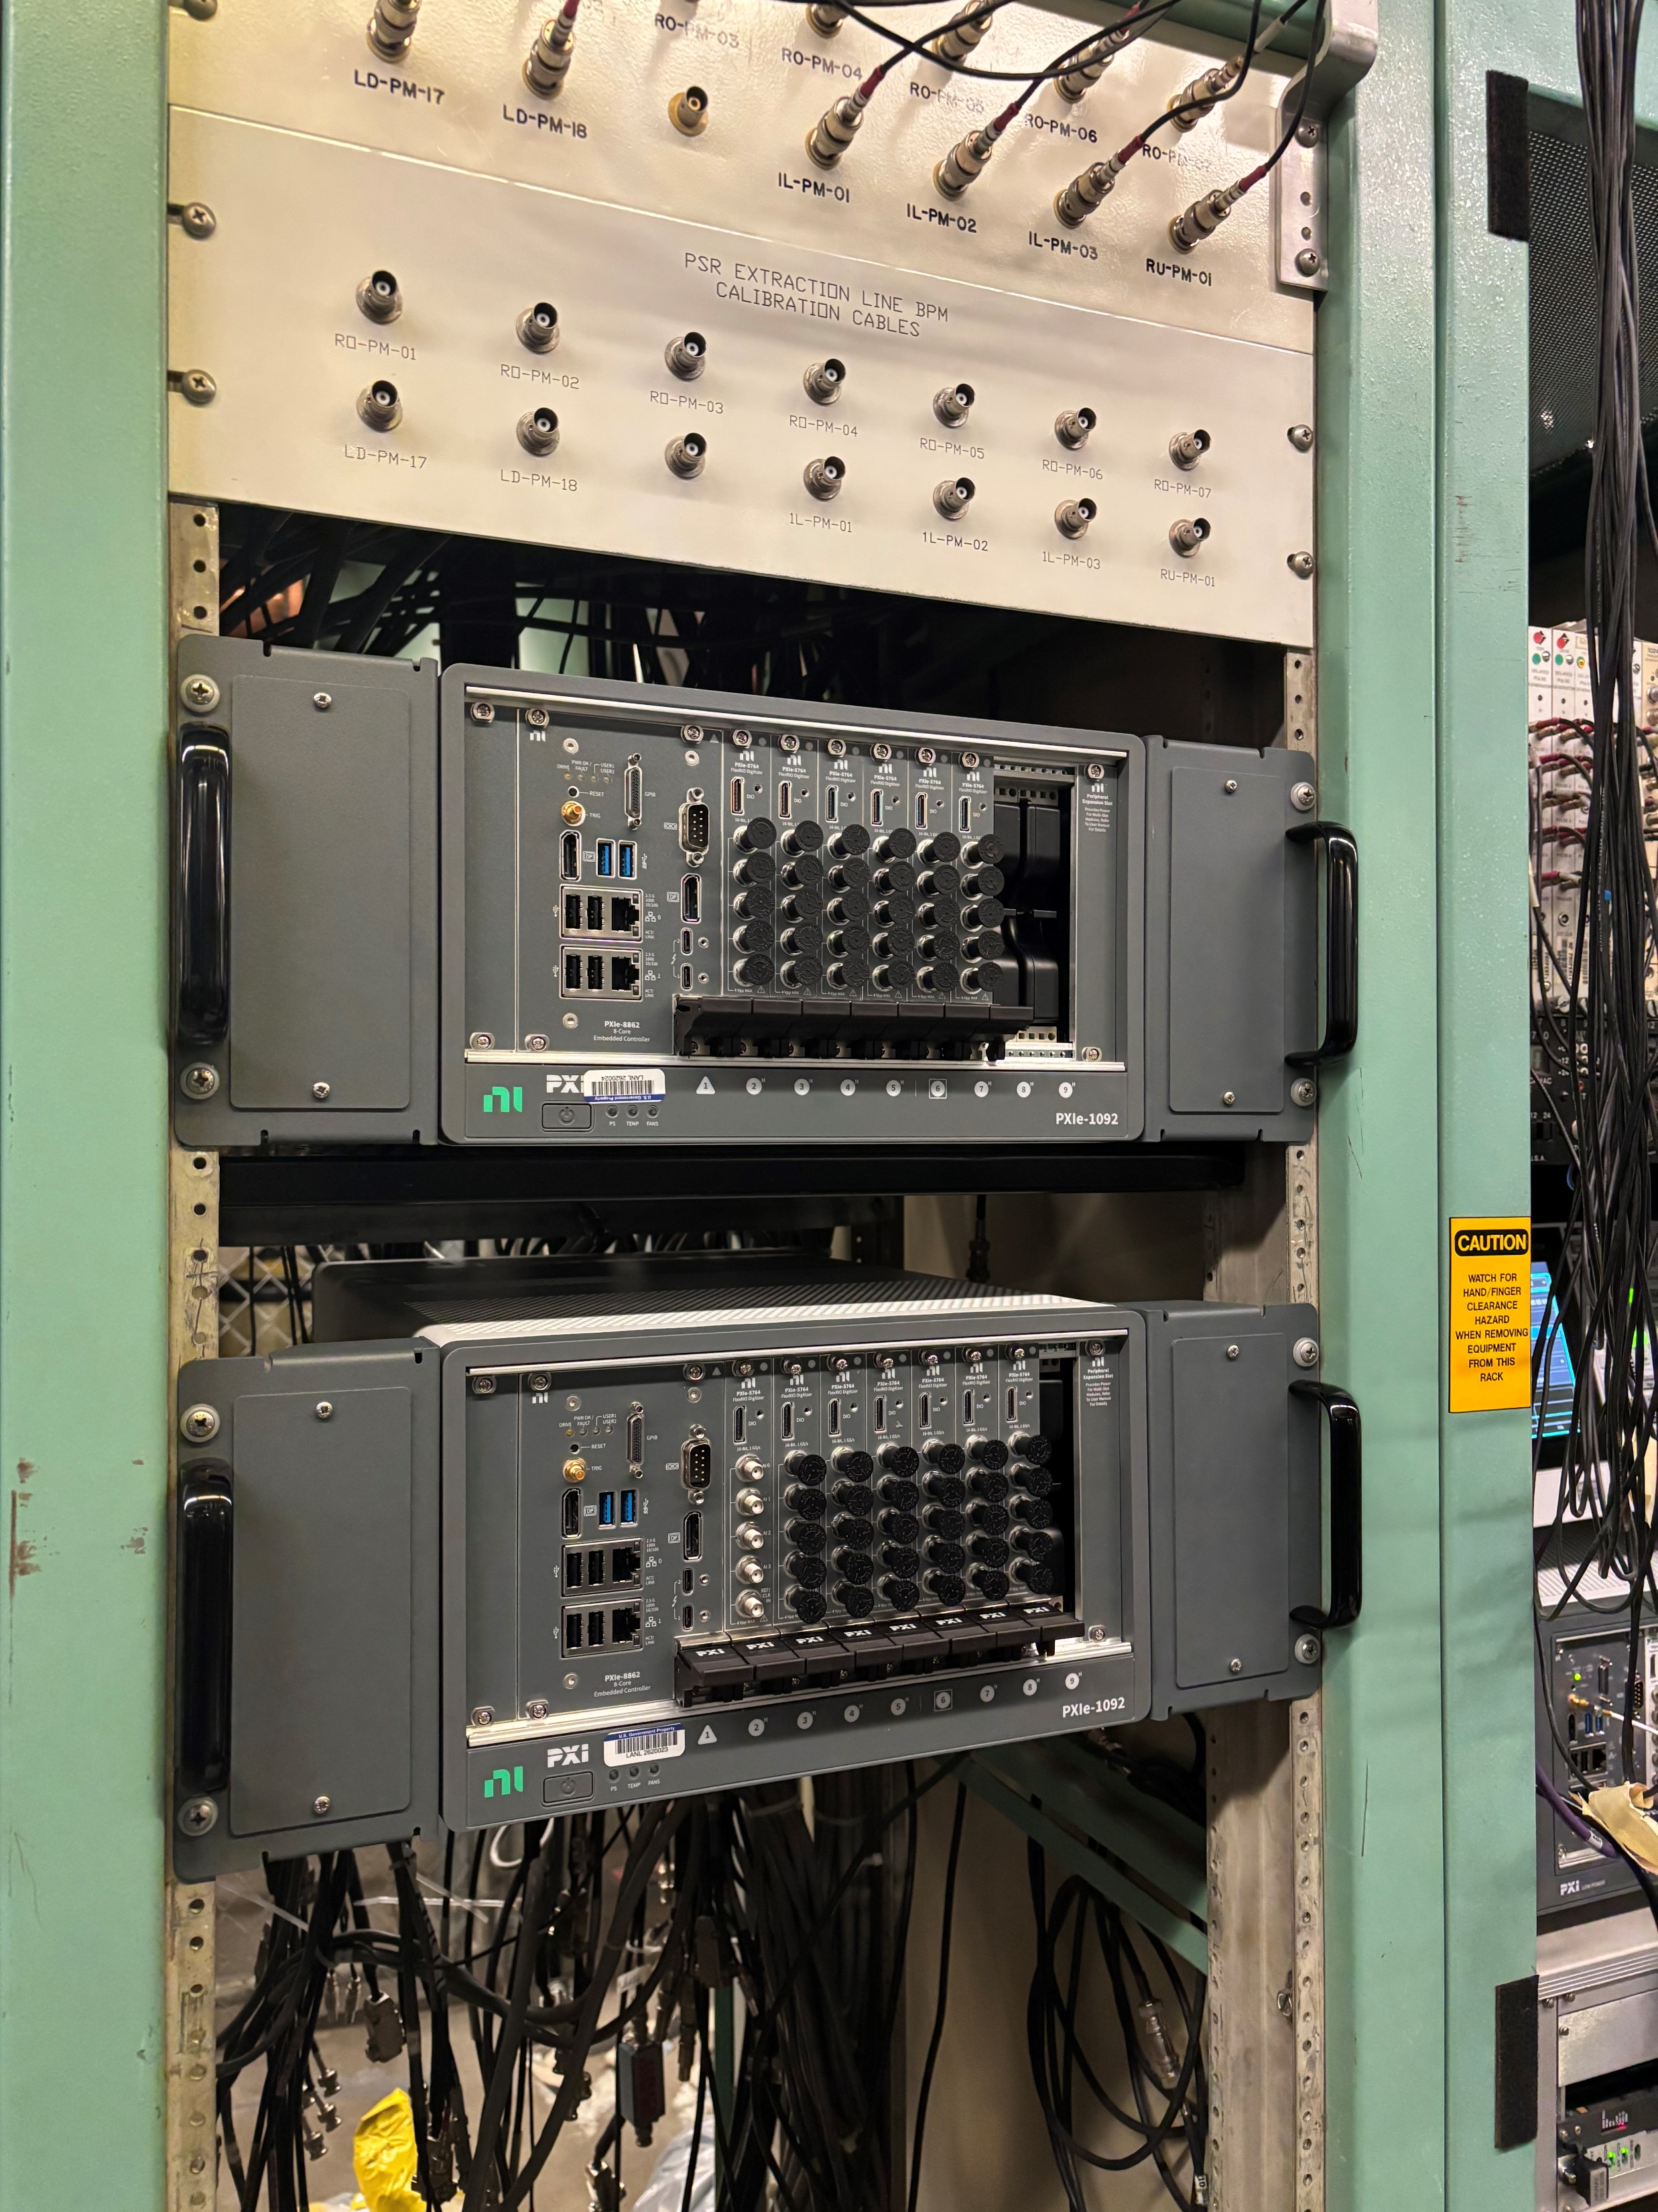
PXIe Implementation
Extraction BPMs
NI PXIe with LinuxRT
Use LvPortDriver and FPGA code
NI 5764 FlexRio cards compatibility
Lessons Learned-Don’t trust NI
Future implementation:
  TDAQ using COSYLAB EVR with Time and Flavor
  High speed DAQs of various flavors
LA-UR-26-22973

Slide 10
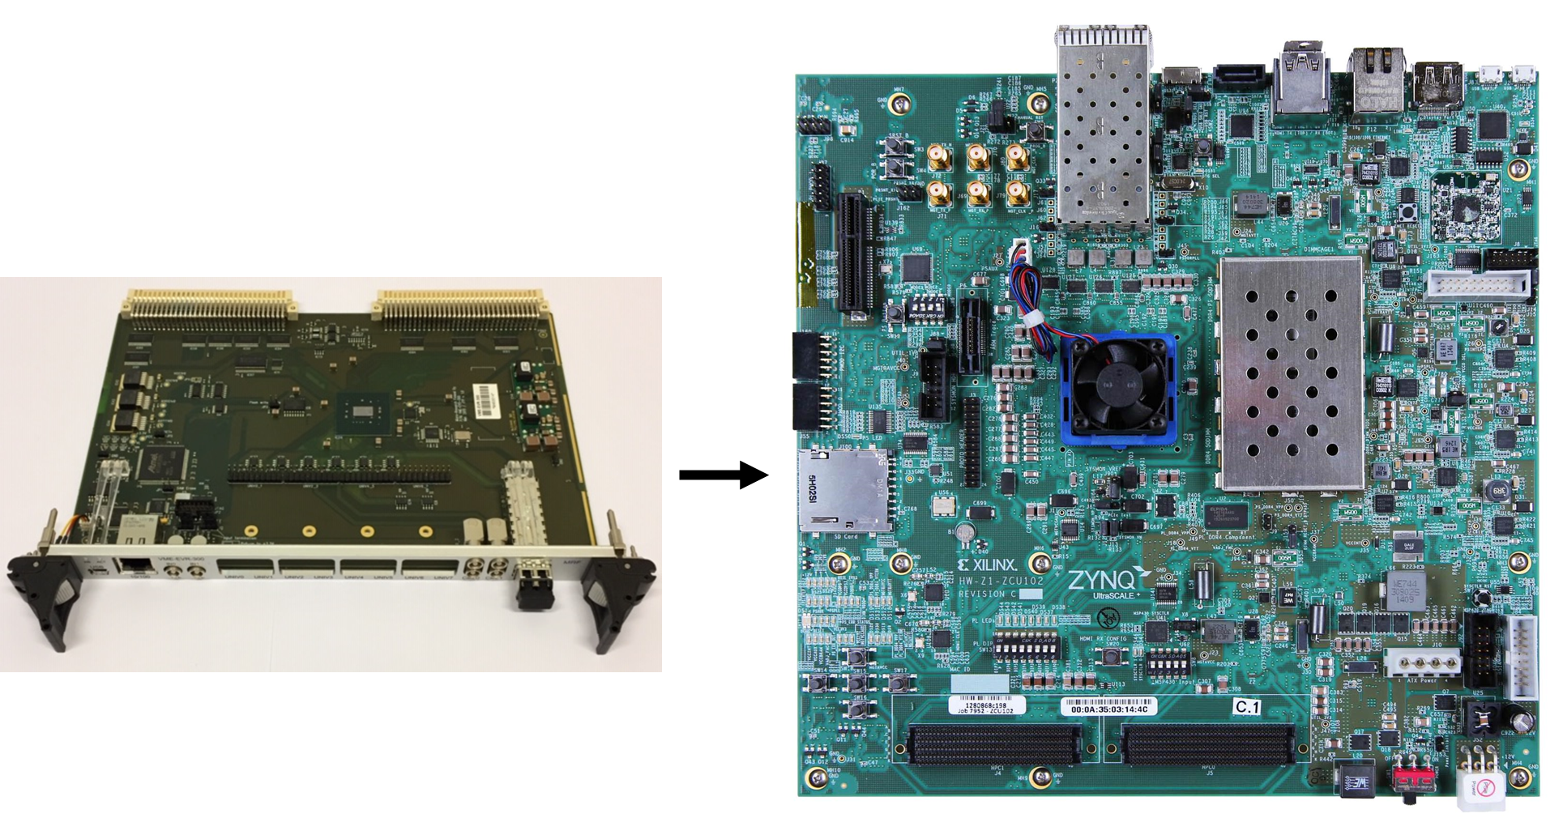
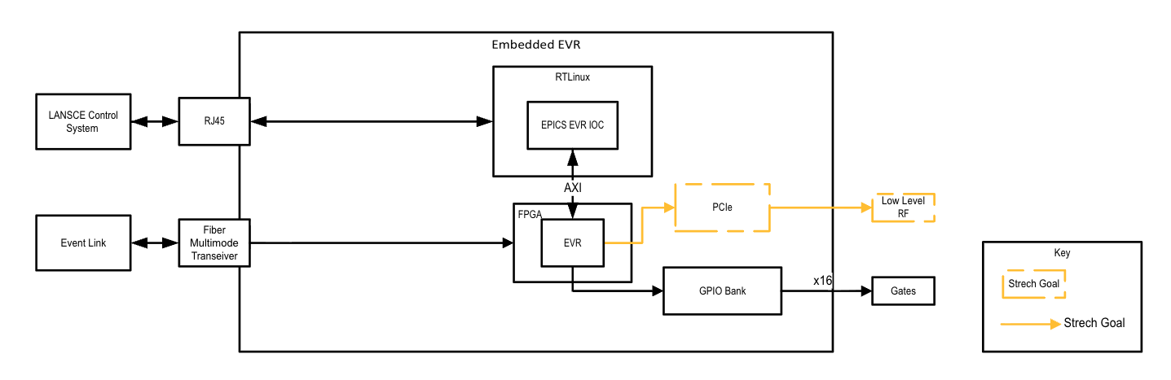
Open EVR development
To enhance inhouse FPGA dev.
Understand the flow of PCDB
Understand LANSCE timing behavior
LA-UR-26-22973
Notes:
MRF VME-EVR-230 replacement with Xilinx UltraScale+

Slide 11
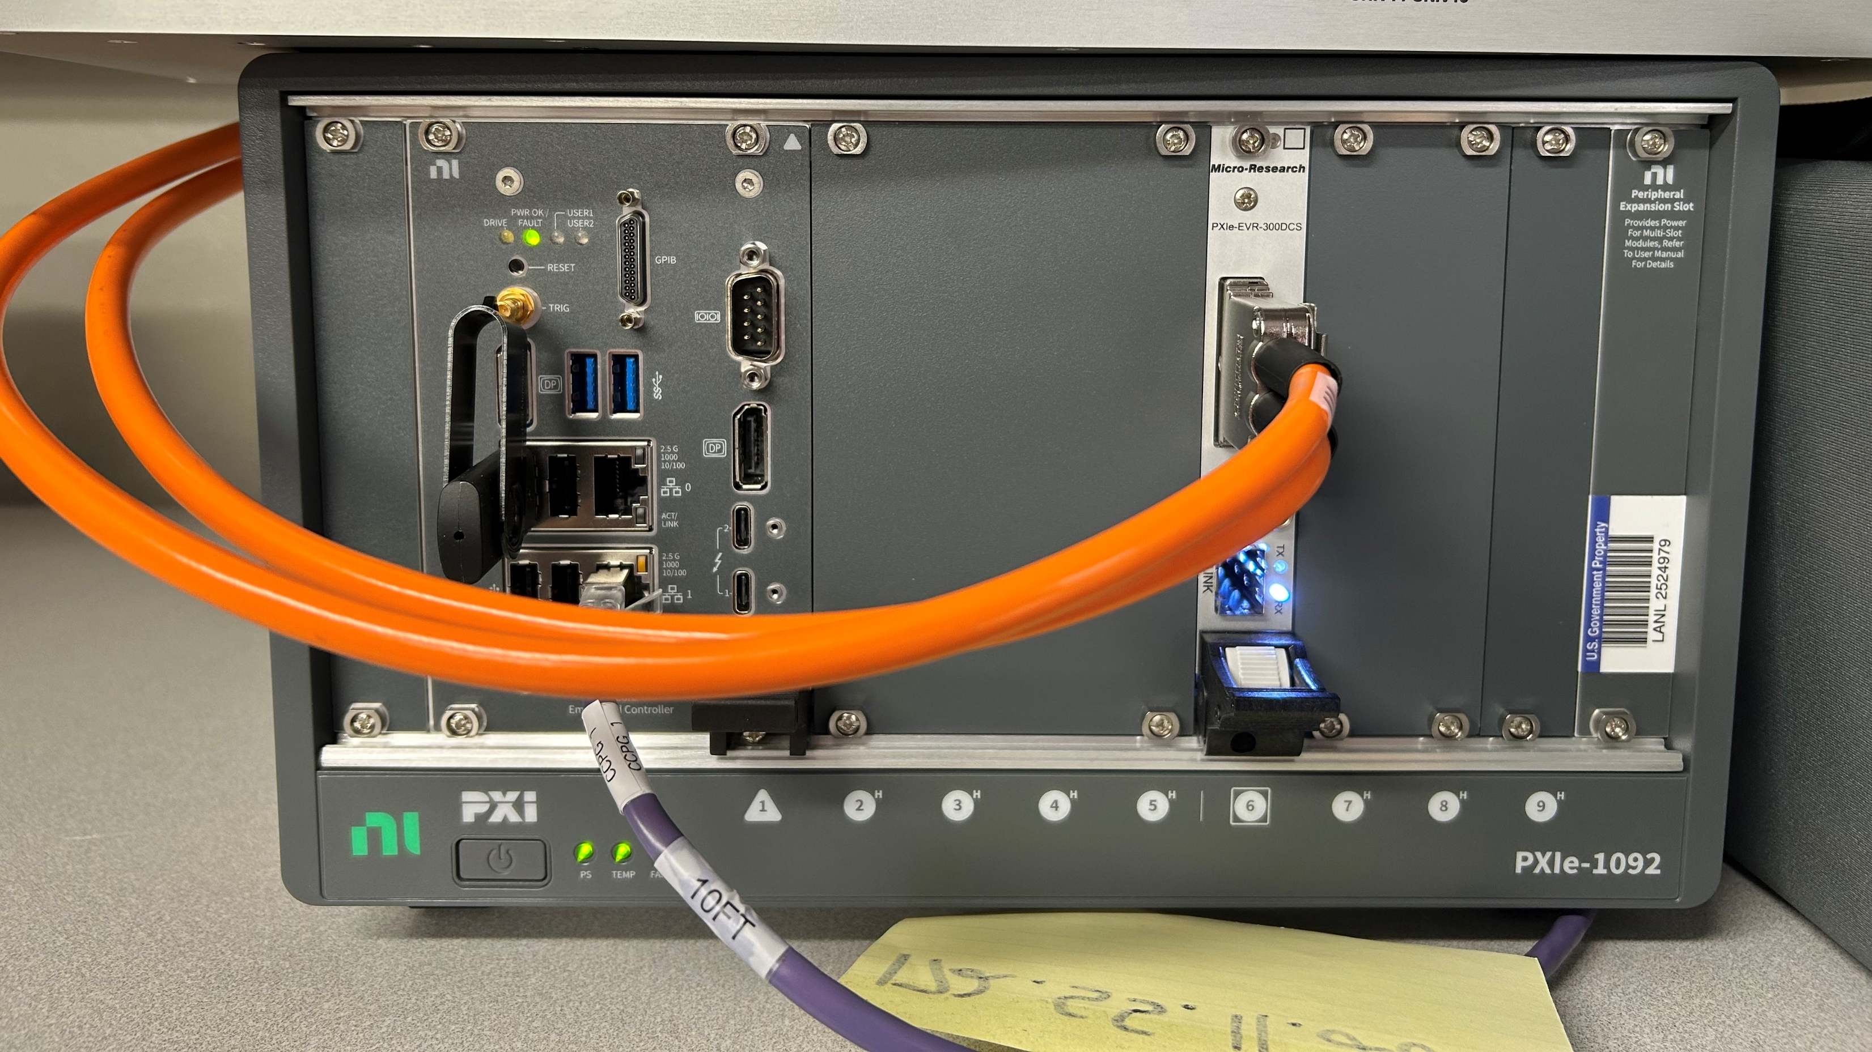


BPPM, TDAQ, FCM modernization
LA-UR-26-22973

Slide 12
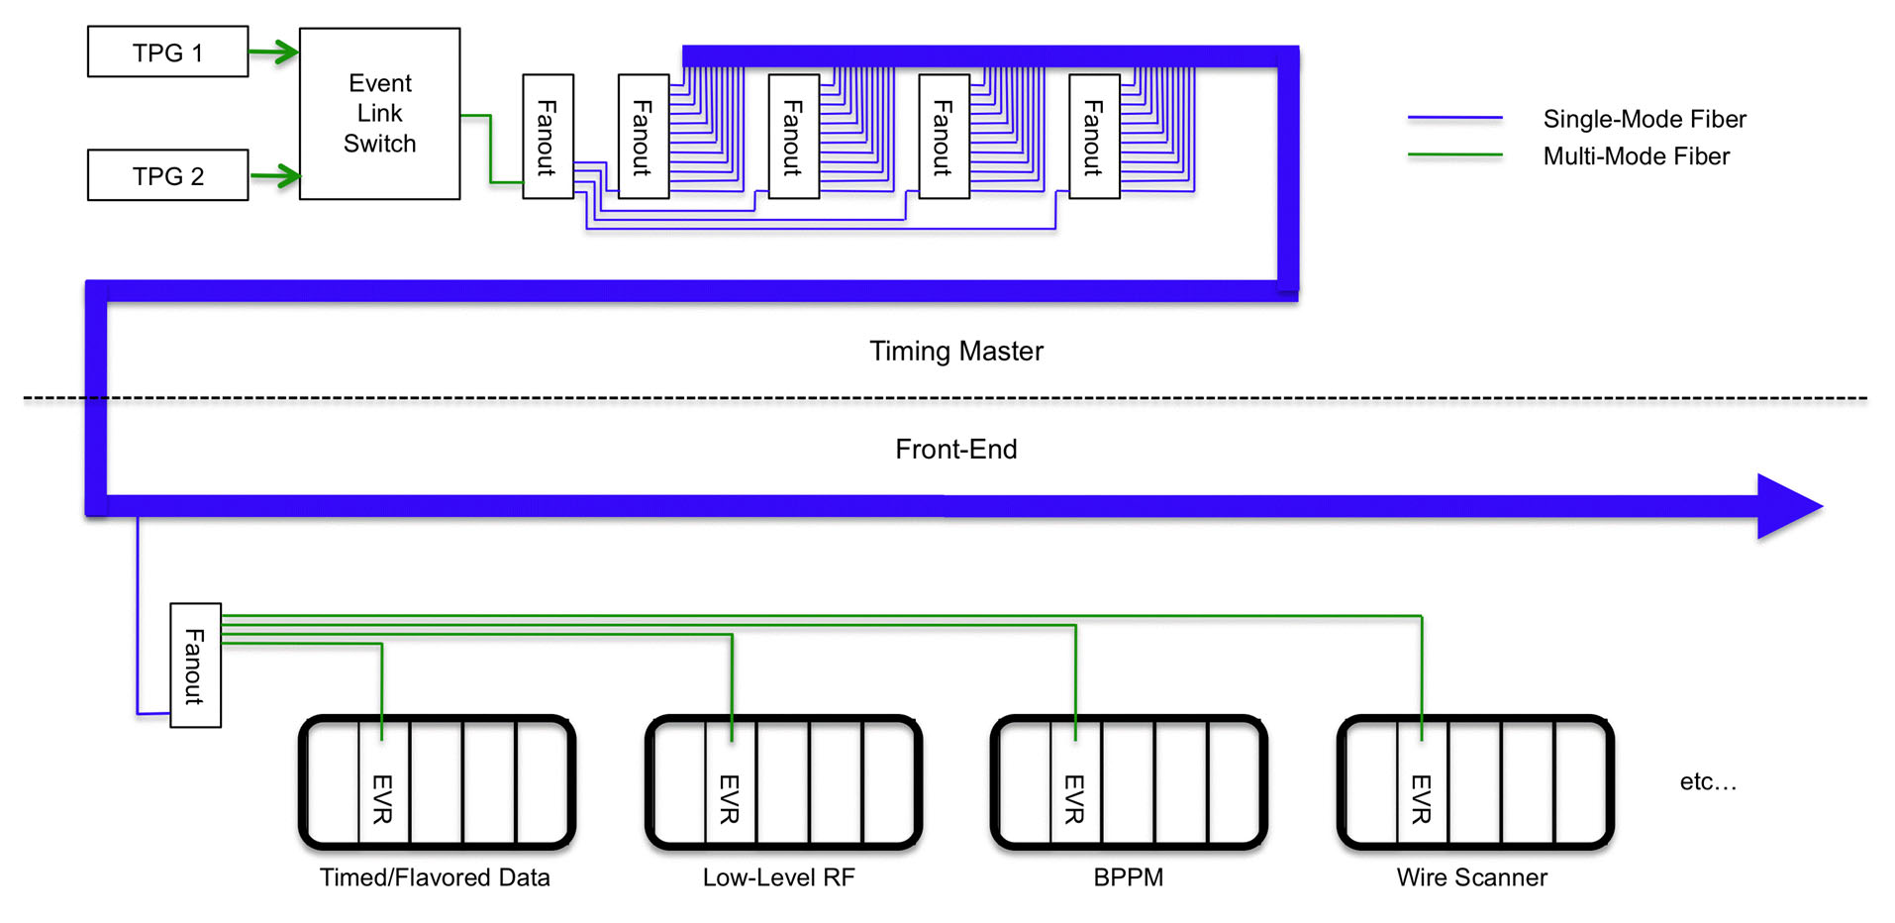
Master Timer Modernization
Current:
  VME64 Chassis
  MRF IOC
  TPGGUI
Future:
  Open EVG
LA-UR-26-22973

Slide 13
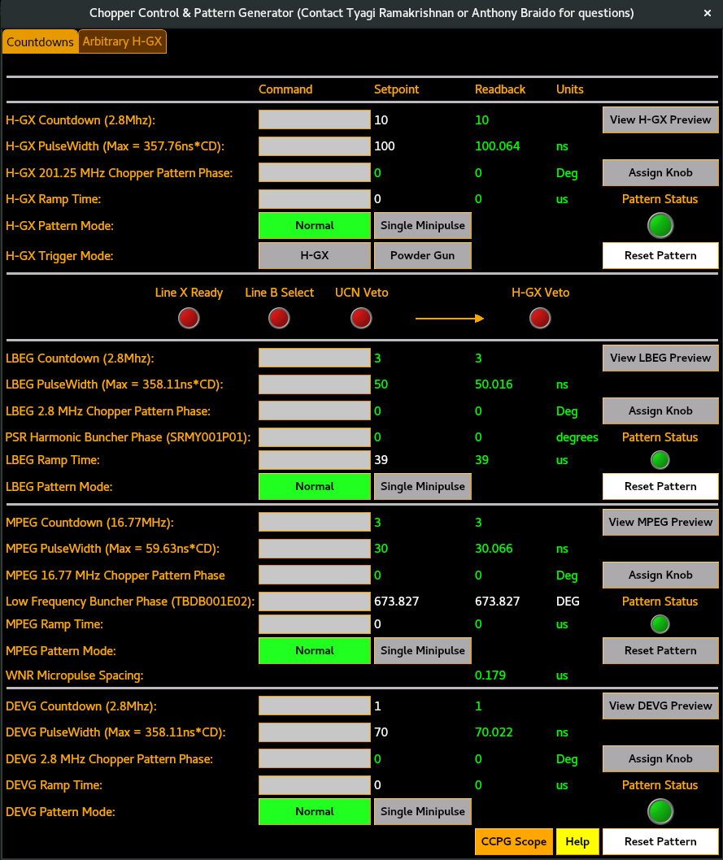
GUI development
Current:
  Java
  Tcl/Tk
  Python
  EDM
Future:
  Python
  Modern Display Manager
LA-UR-26-22973

Slide 14
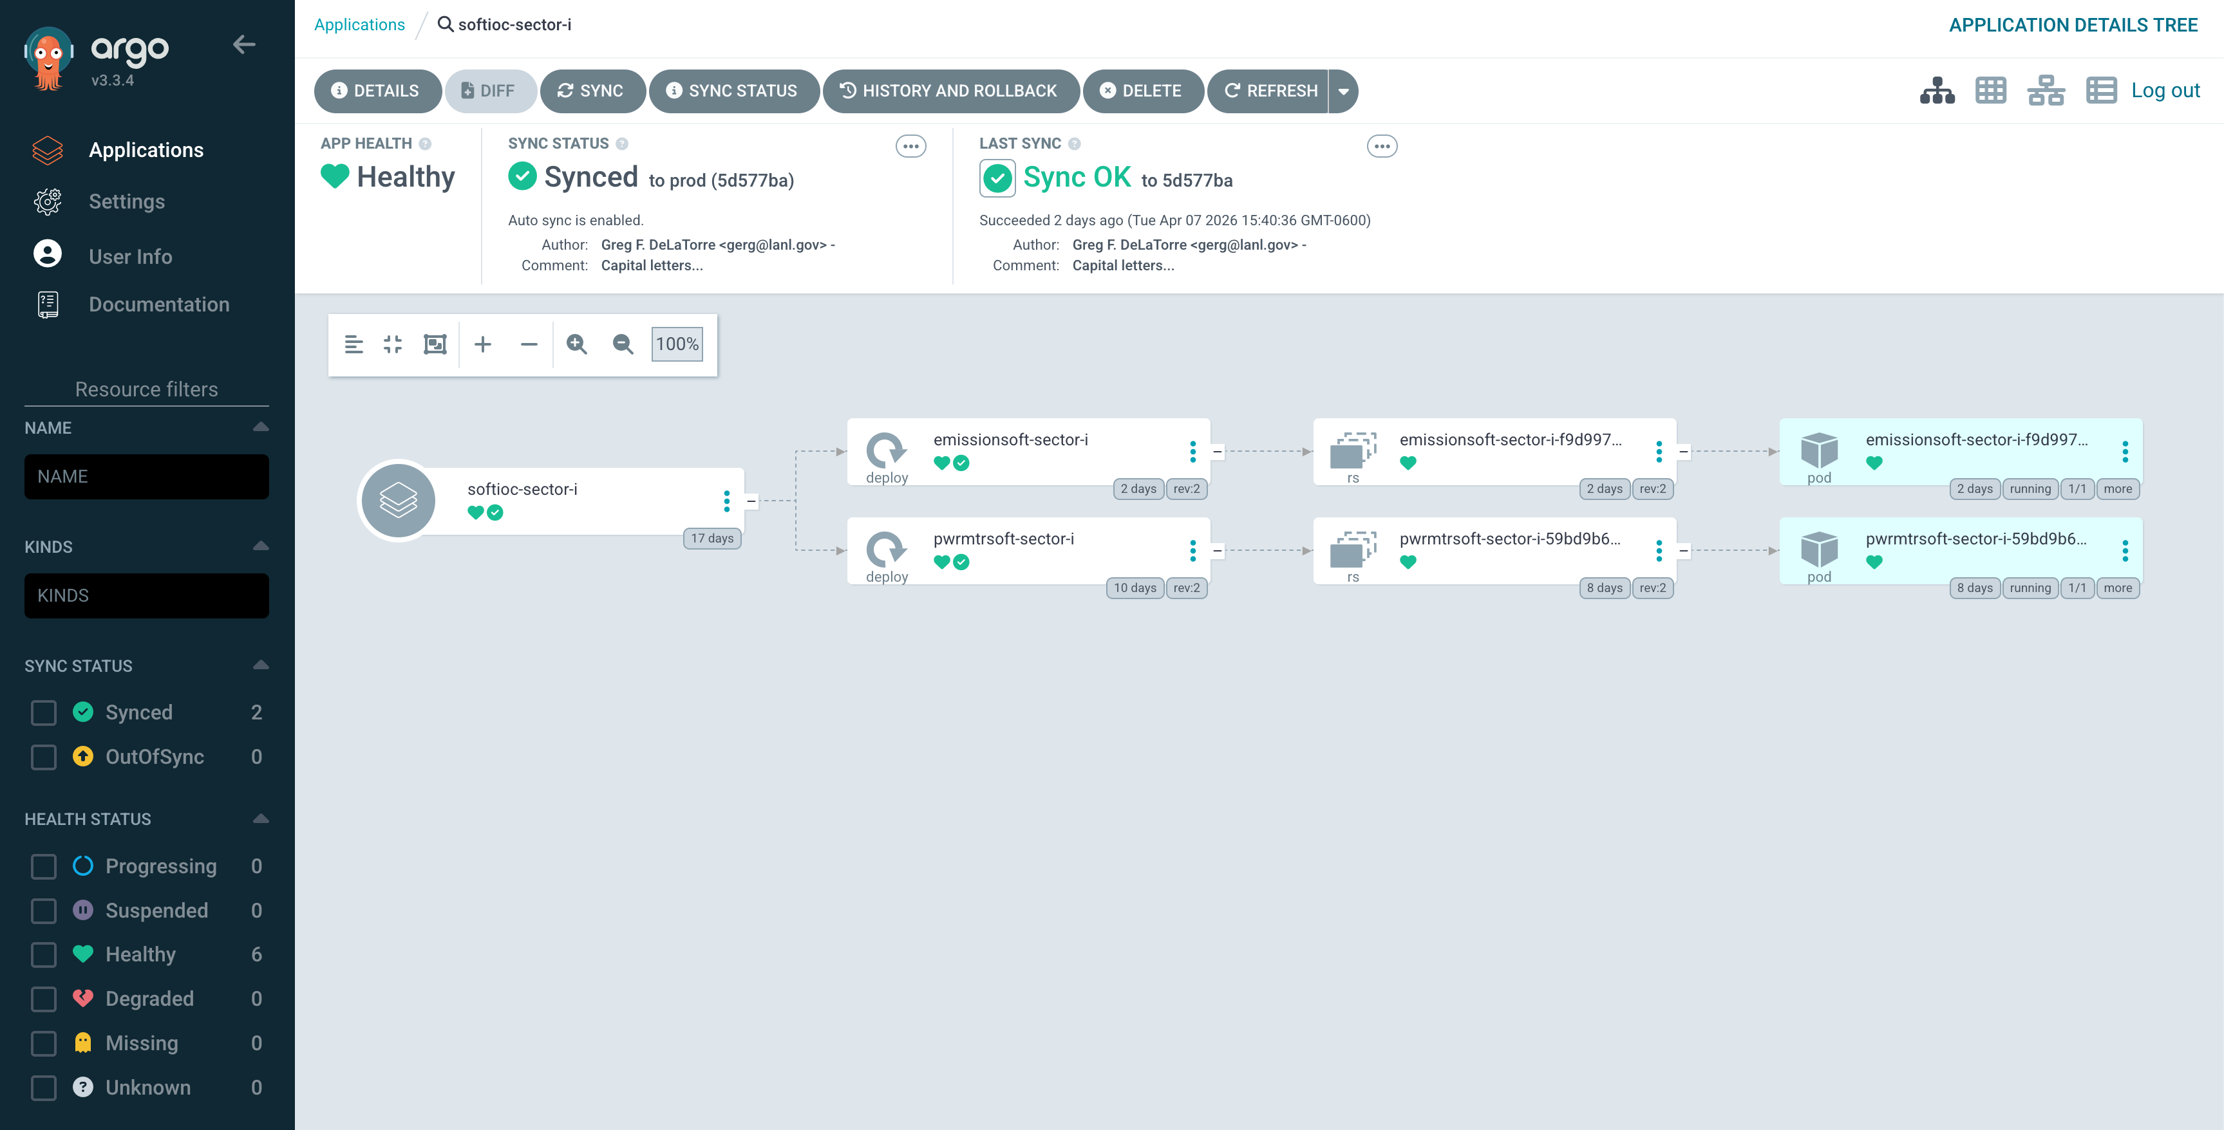
Soft IOCs on Containers
LA-UR-26-22973
Notes:
Currently have VMs on Hypervisors-Containers are incredibly lightweight and fast to deploy/re-deploy, with no dependency on the environment around them to be configured properly to run since they self contain all their dependency needs. The portability of containerization allows for easy expansion of a cluster and migration of any applications from one cluster to another is trivial. Updates that would affect all soft IOCs can now be made to the running image and pushed out to all soft IOCs at once, avoiding the need to individually update VMs or integrate something like ansible to push configuration changes. VMs and a hypervisor come with a lot of overhead and are slow to administrate (shut down/reboot/update). Each VM would need to have its environment configured to run a soft IOC. With containers, we are no longer limited to one soft IOC per VM and instead a worker node VM that is part of a Kubernetes cluster can host tens and tens of soft IOCs.
--- To containerize a soft IOC, we first begin with the container itself. We have created a generic docker image that facilitates all the environmental and dependency requirements for running a soft IOC, and all our soft IOC containers run using this image. These containers are then deployed to a pod in a locally hosted Kubernetes cluster leveraging ArgoCD for automated deployment. Utilizing yaml manifest files for configuration, we configure the soft IOC name, port, and source directory location as part of the entry point arguments so that the container itself runs the desired soft IOC using the corresponding source directory from our NFS (Network File Server). All NFS mounts are configured in yaml manifests and automatically deployed to the cluster via ArgoCD. Using the flannel CNI (Container Network Interface) alongside the multus CNI plugin, we’re also able to assign individual IP addresses to pods by assigning an additional network interface to each pod. All of this is configured in yaml manifests and automatically deployed by ArgoCD. This allows us to bypass needing to identify as the host’s IP with the ‘hostnetwork=true’ option for all our containerized soft IOCS, and give us a greater level of control while retaining the use of in-house developed IOC tools that require each soft IOC have its own IP address.

Slide 15
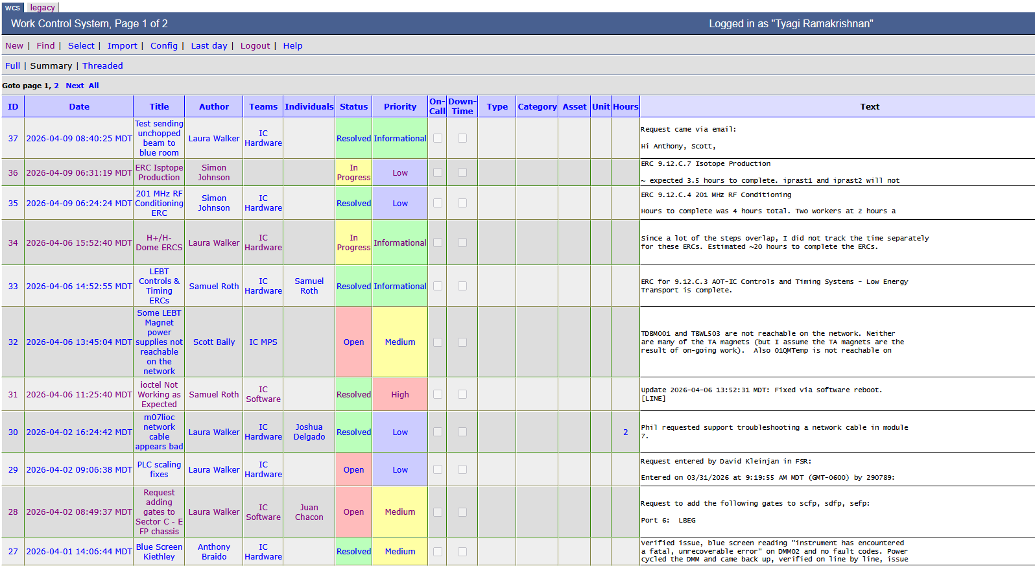
Asset Management and Work Control
Operations facility
Root cause analysis
In house development
REST api
Relational databases
LA-UR-26-22973

Slide 16
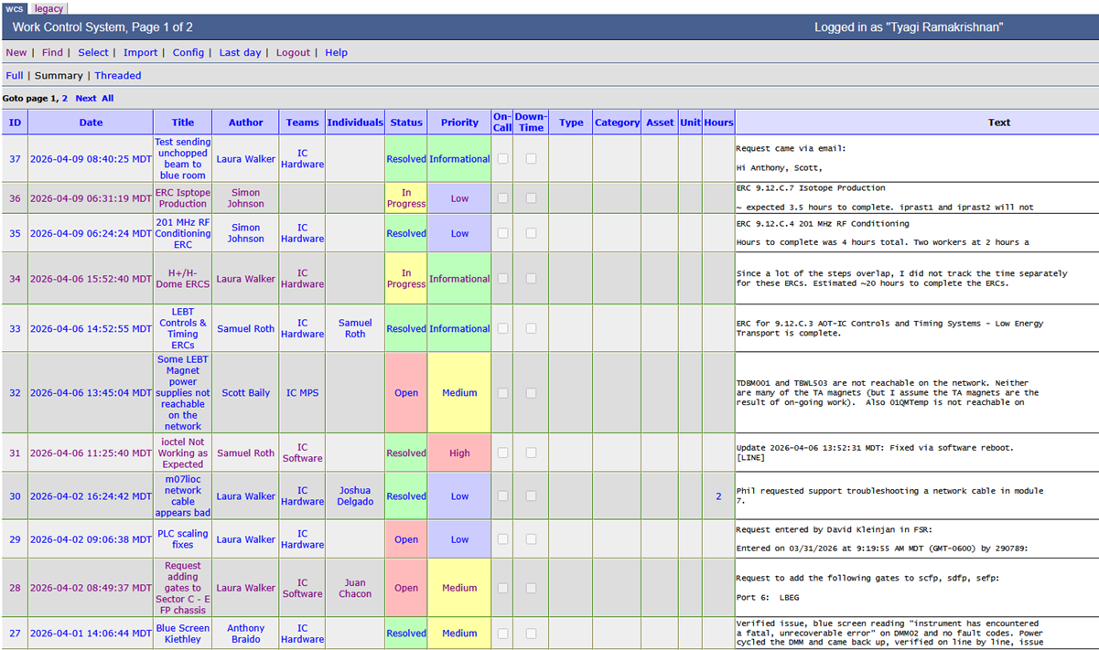
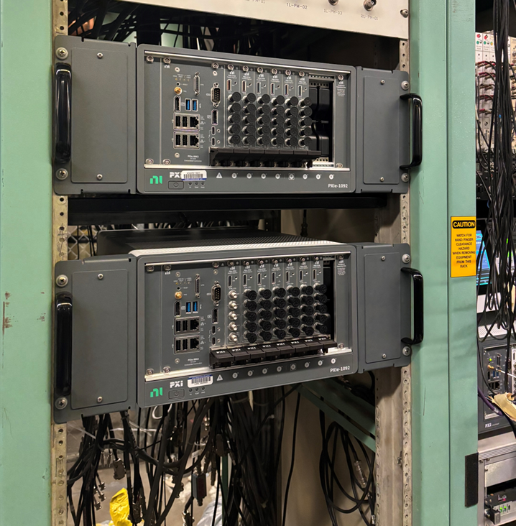







QUESTIONS?
LA-UR-26-22973

