Slide 1
caPutLog Integration with PVinfo
EPICS Collaboration Meeting Spring 2026
Conor Schofield - Controls Software Engineer
April 20-24, 2026

Slide 2
caPutLog Integration with PVinfo
Initial Implementation at LBNL
What is PVinfo?
Integration with PVinfo
Future Work
Demo

Slide 3
Initial Implementation of caPutLog

Slide 4
Initial caPutLog Implementation at LBNL
IOC configuration
  add caPutLog module to configure/RELEASE file
  Configure and start the caPutLogger after iocInit
  epicsEnvSet EPICS_AS_PUT_LOG_PV "${IOC}:caPutLatest"
  caPutLogInit "loghost:7011"
Data is outputted as JSON to a directory on a linux server
Integrate with Elasticsearch
Display Elasticsearch data with Kibana dashboards

Slide 5
caPutLog configuration with Elasticsearch
# logstash configuration for caPutLog
output {
file {
path => "/log/ioc/putlog-%{+YYYY-MM-dd}.json"
}
elasticsearch {
hosts => ["$(ELASTICSEARCH_HOST):$(PORT)"]
index => "putlog-%{+YYYY-MM-dd}"
cacert => "/etc/logstash/certs/ca.crt"
user => "logstash_user"
password => "password"
ssl => true
}
}

Slide 6
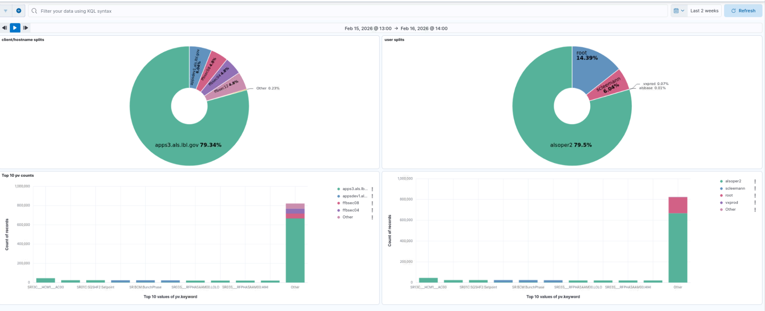
Problems with Kibana
Account creations/user privileges
Added more complexity than needed
Was not integrated with our current tools

Slide 7
What is PVinfo?

Slide 8
PVinfo Overview
PVinfo is an open source web application (React) developed at LBNL that provides a central place to look up information about any EPICS PV in your facility.
Built on top of the EPICS Channel Finder database, it gives operators and engineers a single interface to explore PV metadata, live values, alarm history, log entries, archived data, and now — caput history.
Designed to be modular: each integration is optional and configured via an environment file, so sites can adopt only the services they already run.
Github Repository

Slide 9
PVinfo Optional Integrations
PV Web Socket: used to show live PV data including the value, alarm status/severity, alarm limits, etc.
Phoebus OLOG: allows you to display any log entries that contain the specific PV name on the PV "details" page.
Phoebus Alarm Logger: displays the alarm history for a specific PV on its "details" page.
Archiver Appliance Web Viewer: used to show the archived history of PVs. Since this is simply an external link in PV Info to the archiver web viewer, other archive engines and their own web viewers can easily be used.
caPutLog (with Elasticsearch) displays the who/what/when/where history of caputs to a specific PV on the PV "details" page.

Slide 10
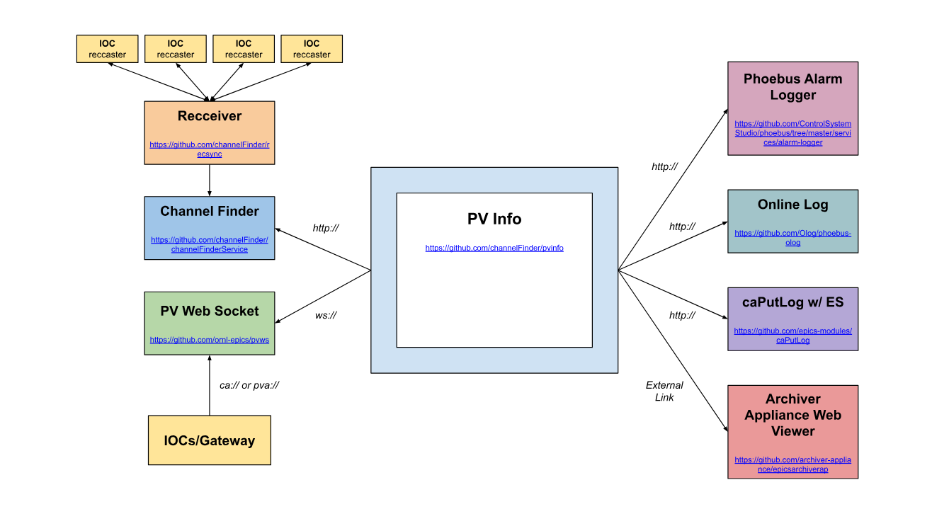
PVinfo Diagram

Slide 11
caPutLog integration with PVinfo

Slide 12
caPut Log Integration with PVinfo
IOCs/Gateway
Kibana
Logstash
Docker Container
Elasticsearch
NodeJS
PVInfo
ElasticSearchAPIConnector
APIProxyConnector
ElasticSearchAPIConnector
REACT_APP_USE_CAPUT_API_PROXY_CONNECTOR=false

Slide 13
caPutLog Node js backend
PVinfo runs in the browser, which means it cannot securely hold Elasticsearch credentials — a backend proxy is needed.
Node.js backend sits between PVinfo and Elasticsearch, keeping credentials server-side and providing a clean, controlled API surface.
Deployed as a Docker container, making it easy to run alongside your existing ELK stack — a Docker Compose file is included in the repository to bring up the Node.js backend together with PVinfo in a single command.

Slide 14
caPutLog Node js backend
Exposes 2 endpoints:
  /search: query caput log entries by PV, user, client, and date range
  /health: checks Elasticsearch connectivity for service monitoring
Authenticates to Elasticsearch using an API key (no username/password in the frontend).
For sites that are comfortable exposing Elasticsearch directly, PVinfo also supports connecting without the proxy backend by setting REACT_APP_USE_CAPUT_API_PROXY_CONNECTOR=false.

Slide 15
caPut Log Integration with PVinfo
REACT_APP_USE_CAPUTLOG=true
REACT_APP_USE_CAPUT_API_PROXY_CONNNECTOR=true
(optional if API PROXY CONNECTOR is true; will be set in node js backend)
REACT_APP_ELASTICSEARCH_INDEX_NAME=
REACT_APP_ELASTICSEARCH_API_KEY=
(will be elasticsearch host url if API PROXY CONNECTOR is false)
REACT_APP_CAPUTLOG_URL=http://localhost:8084

Slide 16
Future Work

Slide 17
Future Work
Explore adding caput history to the PVinfo plotting view as annotations on the time axis
Evaluate PV access puts — caPutLog currently only captures CA puts
Add caputlog node js code to github channelfinder project repo

Slide 18
Demo

Slide 19


