Slide 1
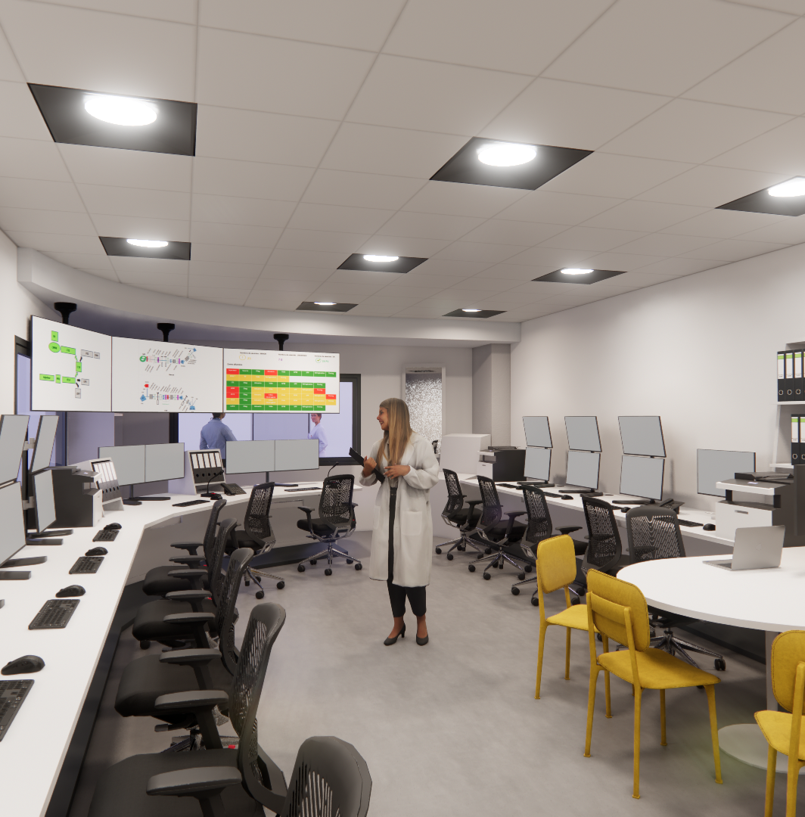

Machine Protection System for the Titan accelerator
Y. MARIETTE

Slide 2
  Outlines
  Architecture
  Technical solutions

Slide 3
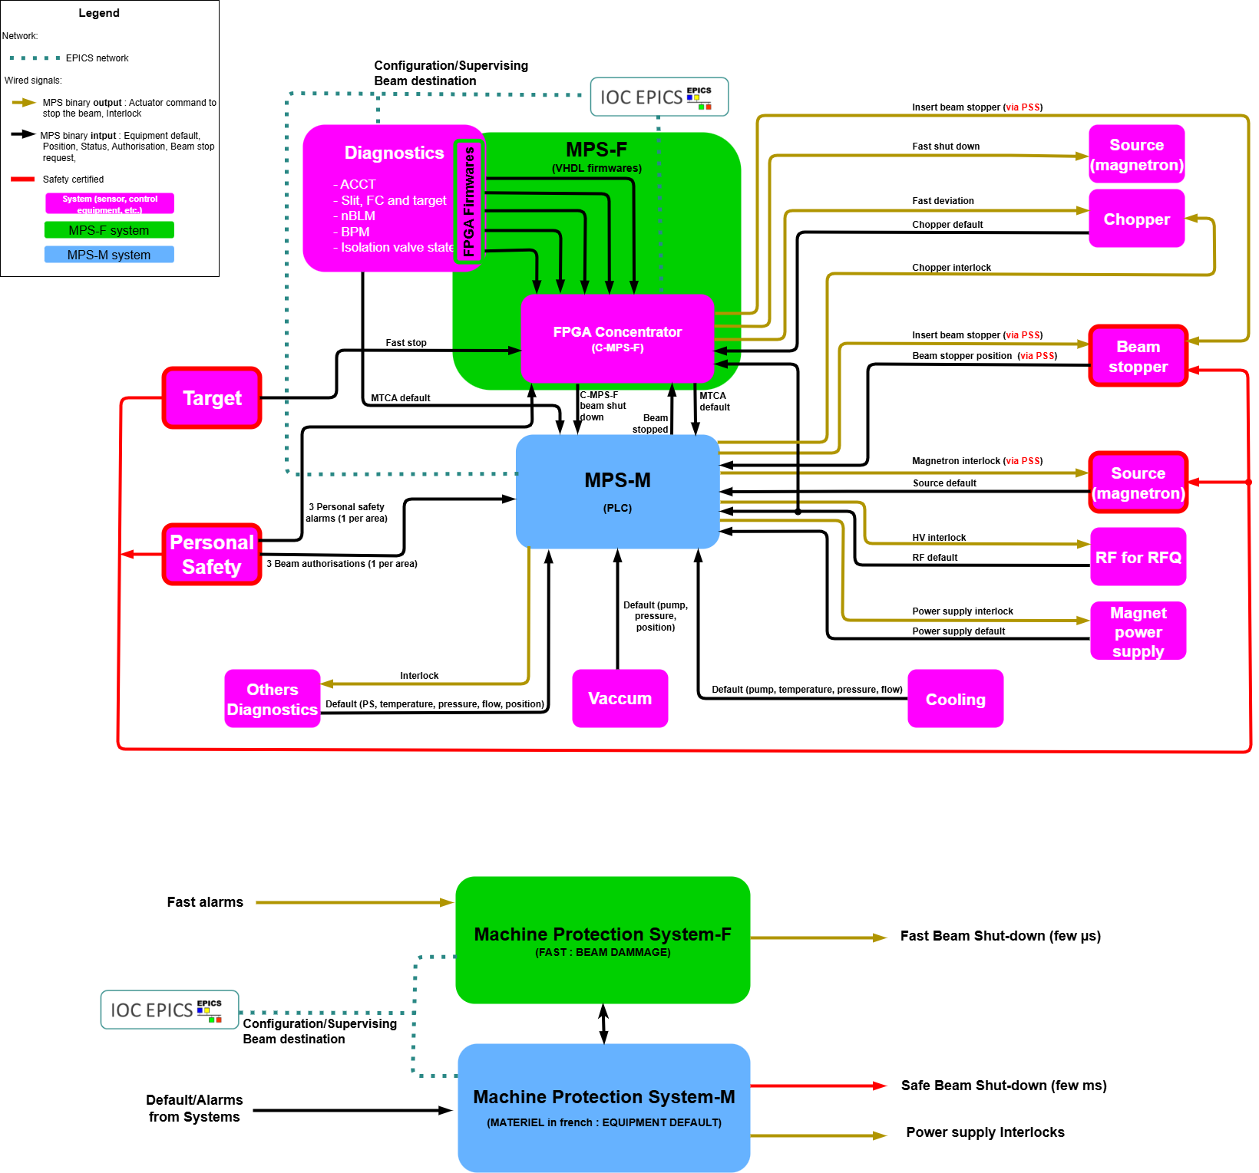
  MPS Architecture : Principle
  Protection against beam dammage => MPS-F for Fast
  Protection of equiment and possible consecutive dammage when default => MPS-M for « Matériel » = Equipment
Diagnostic fast alarms
3

Slide 4
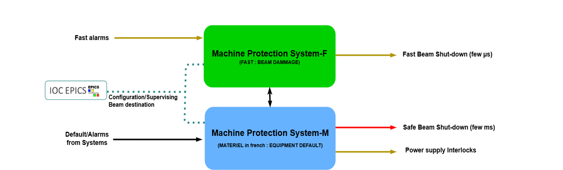

  MPS Architecture : Interface

Slide 5
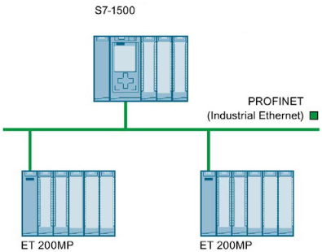



  MPS-M Technical solution
  Siemens PLC
  EPICS supervising using the OPC-UA communication
Sensors and actuators
(only MPS)
with Magnetron stopper and Beam stopper
PLC SPM-M
OPC-UA
CPU
PROFINET network for « MPS »
PROFINET « LCS Process »
+ Binary I/O
MPS-M island
+ Binary I/O
MPS-M island
4 x MPS-M remote islands
S7-1500 + I/O
OPC-UA
API « LCS Process »
Binary I/O
Sensors and actuators (only MPS)
Sensors and actuators
(MPS and for « LCS Process »)
Sensors and actuators
(only for « LCS Process »)
ANALOG
TELIS 915U1
5
Notes:
Ilot d’E/S déportées ou Système de périphérie décentralisée

Slide 6
  MPS-F Technical solution : fast alarm from diagnostic firmwares
  To have diagnostic fast alarms we must have fast detection => done by FPGA (VHDL)
  Different and many diagnostics, but only 3 firmwares
Diagnostic detection and alarm
  The Slits: exceeding a current threshold on the cheeks of the slits
  The Faraday Cup (FC) and Targets: exceeding a current threshold
  The ACCT: transmission fault alarm
  The nBLM: exceeding a neutron counting threshold
  The BPM: bad beam position
  Isolation valve fault detection and alarm :
  IV Positions : still totally or partially inserted while present beam
1. Section Beam Current Transmission firmware (SBCT)
2. nBLM firmware
3. BPM firmware
  To centralize fast alarms and make fast beam stop we must have a concentrator
  => done by FPGA (VHDL)
6

Slide 7
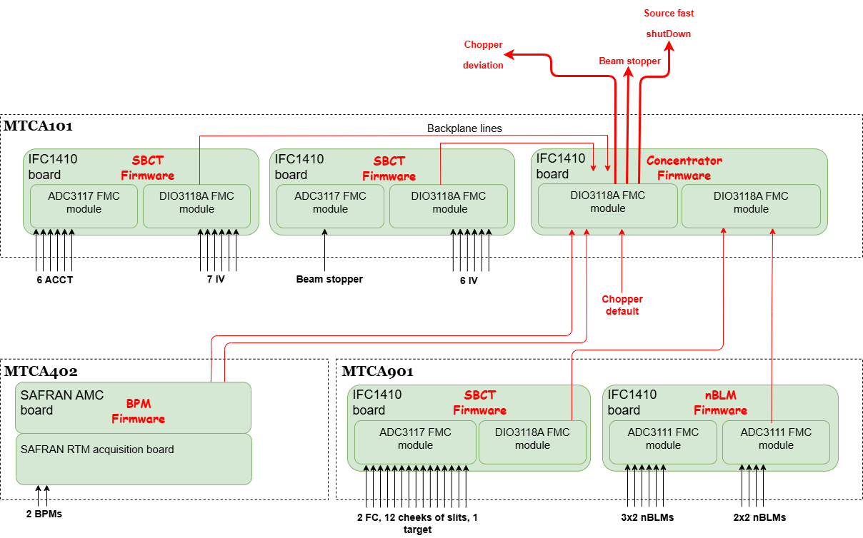
  MPS-F Technical solution : Implementation
  Use of MTCA crate which contains multiple boards
  The MTCA acquisition board used are IOxOS and SAFRAN brand (for BPM)
  On the FMC slot or in the rear slot, fast acquisition modules are used
  The concentrator is also in a MTCA and receives alarms from backplane lines and from front panel signals
  All these boards are monitored and configured with EPICS

Slide 8
Thanks for your attention

