Slide 1
Development of Virtual Beamline Software Platform for Advanced Light Sources Based on EPICS
Speaker：Miao Zhang
Co-authors: Pengcheng Li, Yu Li, Yi Zhang
Institute of High Energy Physics, HEPS | 2026.04
Email: zhangmiao@ihep.ac.cn
Spring EPICS Collaboration Meeting 2026, Paris-Saclay

Slide 2
Contents
Background
Platform Architecture
Core Design
Verification & Applications
Conclusion & Outlook

Slide 3
01 Background
Notes:
首先，让我们进入第一部分：引言与背景。在这一部分，我们将探讨以HEPS为代表的第四代同步辐射光源带来的新机遇，以及随之而来的软件系统挑战。

Slide 4
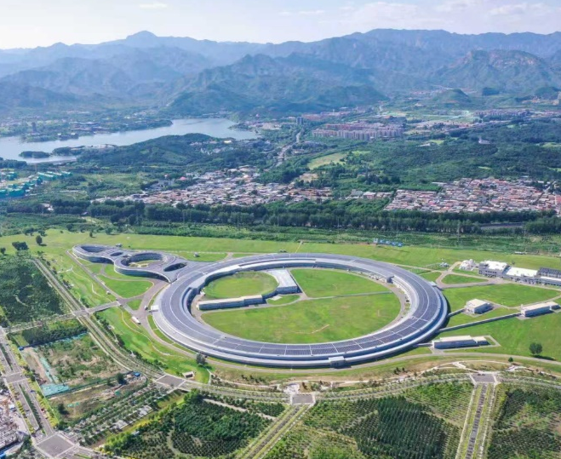
Background & Significance
▍ Four Major Challenges
Highly Complex System
Massive Data Throughput
Extreme Stability Requirement
Rapid Iteration & Extension
These requirements cannot be fully met by existing tools in the EPICS ecosystem.
海量数据吞吐

Slide 5
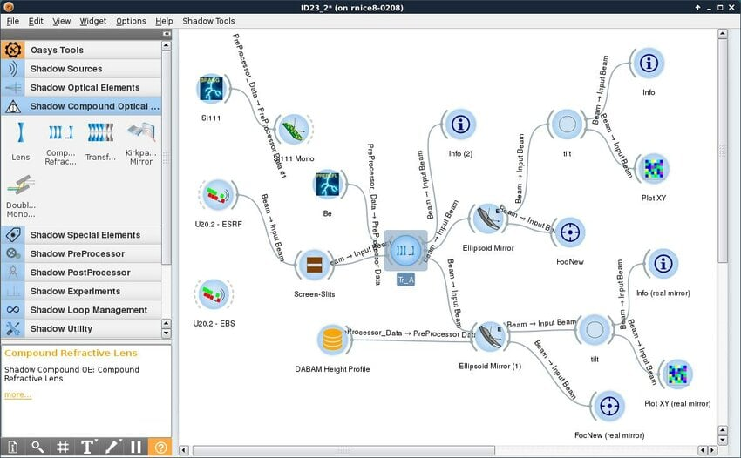
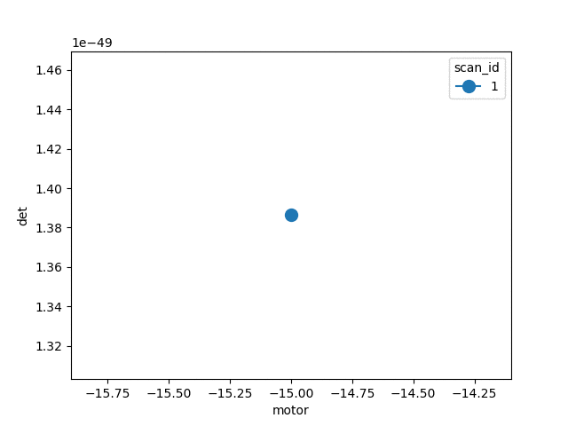
Background & Significance
Core Limitations of Current Technical Solutions
Virtual Beamline
Optical Design
Device Control
Experiment Orchestration
Core Tools: Bluesky, PyMCA
Core Tools: SHADOW, OASYS
Core Tools: EPICS IOC Simulator
User Interaction Layer
Core Function: Simulate PV variable response status of a single physical device
Virtual Device Layer
Key Limitation: Only single-device PV simulation;
Cannot reproduce multi-device timing
Data Management Layer
Key Limitation: No device virtualization capability
Key Limitation: No virtualization capability, high latency in loading historical data

Slide 6
02 Platform Architecture
Notes:
首先，让我们进入第一部分：引言与背景。在这一部分，我们将探讨以HEPS为代表的第四代同步辐射光源带来的新机遇，以及随之而来的软件系统挑战。

Slide 7
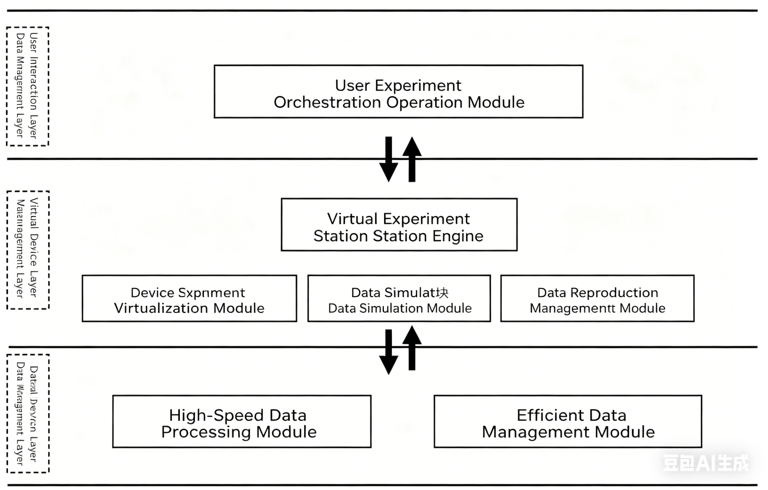
Platform Architecture
Core Design Concept: Bidirectional mapping and bridging mechanism based on Protocol–Data–Timing to achieve deep coupling and real-time interaction.
Top Layer: User Interaction Layer
Middle Layer: Virtual Device Layer
Bottom Layer: Data Management Layer

Slide 8
Platform Architecture
Core Design Concept: Three-Layer Architecture
User Interaction Layer
Virtual Device Layer
Data Management Layer
Based on Bluesky Framework
Core engine
Deeply optimized for HDF5/NeXus
Providing a graphical interface
Flexible programmatic experiment orchestration interface
Unifying heterogeneous physical devices into EPICS-standard virtual instances.
Providing high-speed reading, writing, and access for TB-Level massive data

Slide 9
Platform Architecture
Core Innovation: Dual-Mode Driving Architecture
Full Simulation Experiment Mode
Data Reproduction Mode
▌ Based on high-precision physical models
▌ Seamlessly load and high-fidelity replay historical experimental datasets
▌ Innovative design and pre-rehearsal of experimental schemes
▌ Accurate retrospective and verification of experimental processes

Slide 10
03 Core Design
Notes:
首先，让我们进入第一部分：引言与背景。在这一部分，我们将探讨以HEPS为代表的第四代同步辐射光源带来的新机遇，以及随之而来的软件系统挑战。

Slide 11
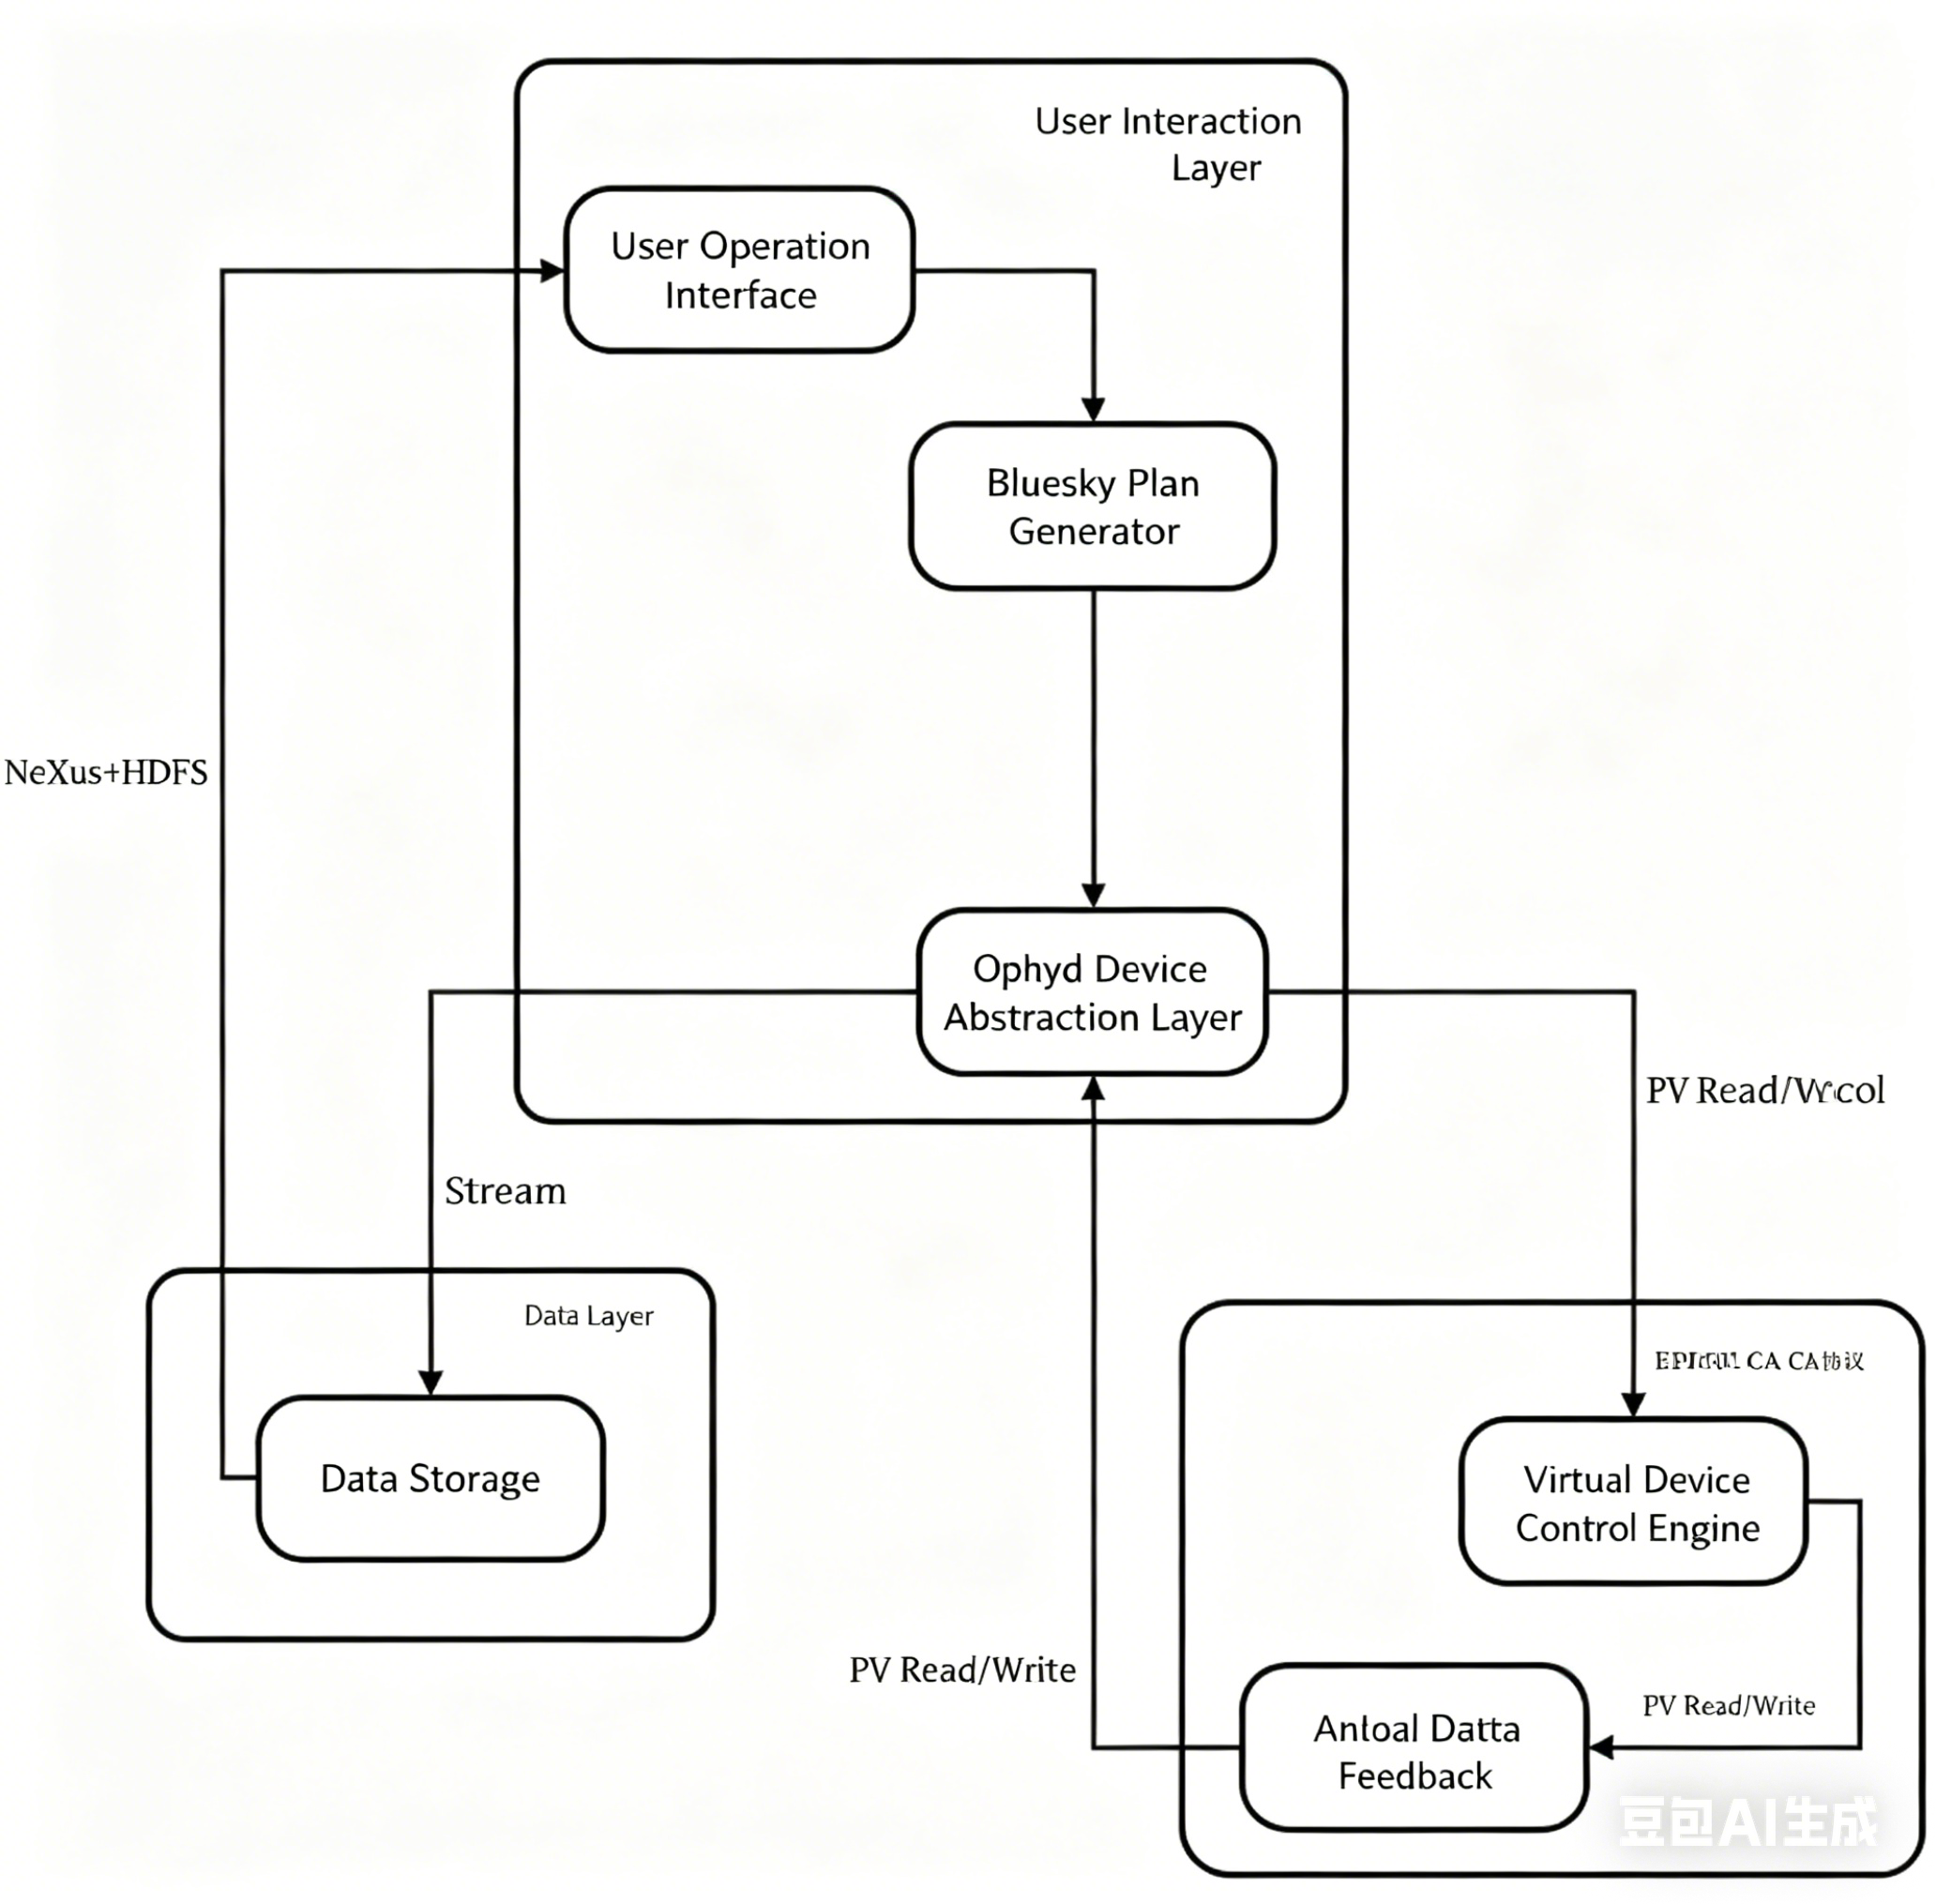
Core Design (I)
Three-Layer Architecture
Bluesky-Native Full-
Process Experiment Orchestration
Dual-Interface Design
① User Interaction Layer
Ophyd Native Encapsulation
② Virtual Device Layer
Intelligent Reverse Reconstruction
③ Data Management Layer
CA

Slide 12
Core Design (II)
Three-Layer Architecture
Virtual Experiment Station Engine
Beamline Virtual Device
Data Simulation
Data Reproduction
① User Interaction Layer
（1）Virtual Experiment Station Engine
② Virtual Device Layer
Core Scheduler of the Platform：
Intelligent Device Instance Scheduling
③ Data Management Layer
Unified Working Mode Scheduling
Precise Timing Collaborative Control

Slide 13
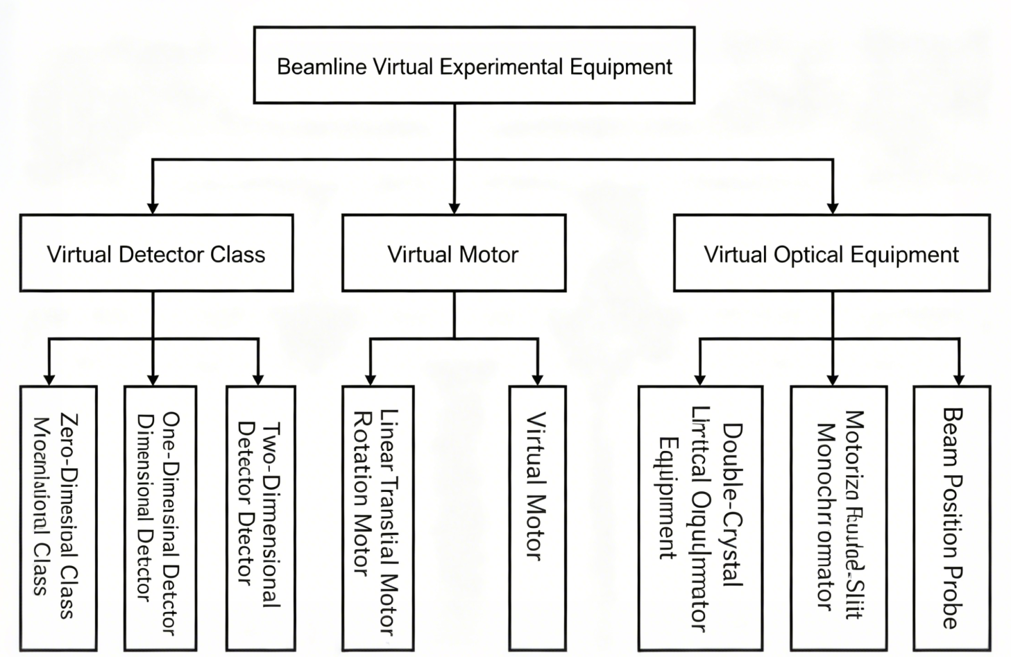
Core Design (III)
Three-Layer Architecture
（2）Beamline Virtual Device
① User Interaction Layer
② Virtual Device Layer
③ Data Management Layer
Virtual Detector Family
Virtual Motor Family
Special Optical Device for Beamline

Slide 14
Core Design: Virtual Detectors
0D Detector Simulation
1D/2D Detector Simulation
Typical Applications:
1D Detector
Photodiode, lon Chamber(Keithley 6485/6487), Counter
Ideal Intensity
+
Gaussian Noise
Linear Gradient /
Peak Distribution
Simulation Principle:
Baseline + Random Noise Model
Core PV Parameters:
ImageMode、Acquire、ArrayData、AcquireTime、NumImage、TriggerMode
Baseline
+
Random Noise
Configurable PV Parameters:
PV | Parameter Meaning | R/W
EGU | Engineering Unit | W
SCAN | Sample Cycle | W
RBV | Actual Reading | RO
NOISE | Noise Intensity | W
VAL | Baseline Setpoint | W
2D Detector
Full Simulation+ Data Reproduction
Core PV Parameters:
ImageMode、Size_X/Size_Y、AcquireTime、Acquire、ArrayData、NumImage、TriggerMode

Slide 15
Core Design: Virtual Motors
Overall Architecture: Trapezoidal Velocity Profile + Error Injection + EPICS PV Standard Control
Virtual Linear Translation Motor
Virtual Rotational Motor
Application Scenarios: Sample stage X/Y/Z axis positioning, motorized four-blade slit blade drive.
Application Scenarios: Sample stage attitude adjustment, CT experiment rotation axis, DCM Bragg angle control
Core Features: Trapezoidal velocity curve, backlash error injection (±0.001mm), soft limit protection
Core Features: Same trapezoidal velocity curve, angle drift error injection (±0.01°/min), 360° continuous rotation, unit: degree (°)
Core PV Parameters: VELO, ACCL, VMAX, DHLM, DLLM, VAL, RBV, Status
Core PV Parameters: Fully compatible with linear motor PV specifications

Slide 16

Core Design: Virtual Optical Device-DCM
Architecture:
Built-in Crystal Parameter Template (DCM)
Extended based on virtual rotational motor, realizing automatic linkage between energy and Bragg angle
Crystal Type | Si(111) | Si(311)
Crystal Plane Spacing（Å） | 3.135 | 1.637
Energy Resolution(ΔE/E) | 1e-4 | 5e-5
Thermal Expansion Coefficient(1/°C) | 2.6e-6 | 2.6e-6
Maximum Applicable Energy(keV) | 20 | 35
Core Formula(Bragg’s Law):
$$E(keV)=\frac{12.398}{2dsinθ}$$
(n = 1, d : crystal plane spacing (Å), θ : Bragg angle (°))
Core PV Parameters:
Standard:
SIM:DCM:Bragg(Bragg angle)
New:
Energy.VAL/RBV(Target Energy)

Slide 17

Core Design: Virtual Optical Device-Slit
Motorized Four-Blade Slit
▍Architecture
▍Core Innovation
▍Core Features:
4 independent virtual motors
One-Touch Aperture Control with Center Preservation
Dual-mode control:
Top, Bottom, Left, Right
independent blade adjustment / one-touch synchronous opening/closing
horizontal/vertical directions preform mirror-synchronized movement
Core Control Formula:
$$\left\{\begin{aligned}&Δ_{yTop}=+\frac{h}{2} \\ &Δ_{yBottom}=−\frac{h}{2} \\ &Δ_{xLeft}=−\frac{v}{2} \\ &Δ_{xRight}=+\frac{v}{2}\end{aligned}\right.$$
High-fidelity reproduction of real slit control logic
Motion Control Logic
Jog/relative move/absolute move
Zero beam center drift during aperture adjustment

Slide 18
Core Design: Virtual Optical Device-XBPM
Architecture
Core Technology
Core PV Parameters:
Dynamic Signal Reconstruction
SumSignal: Total Intensity
XPos / Ypos: Beam X Position
ChA ~ ChD: Four-Quadrant Electrode Signals
SCAN
Extended based on 0D detector, composed of 4 0D detectors forming a four-quadrant electrode array
Core Calculation Algorithms:
Sum Signal: Σ=(A+B+C+D)
Position: P=(A+D-B-C)/Σ
Core Application:
Hardware-independent beam orbit monitoring, supporting multi-device linkage simulation

Slide 19
Core Design (IV)
Three-Layer Model
（3）Data Simulation Module
High-precision physical models for synchrotron radiation:
- 2D Elliptical Gaussian Function Model:
① User Interaction Layer
- 3D Shepp-Logan Model + 3D Projection Integral Formula
Error Injection Capability:
- Inject Poisson noise into detector data to simulate dark current;
- Inject backlash/angle drift into virtual motors to restore real mechanical characteristics.
② Virtual Device Layer
③ Data Management Layer
（4）Data Reproduction Module
Efficient data stream playback
Intelligent parsing of experimental metadata from HDF5/NeXus files
Automatic generation of corresponding Bluesky acquisition scripts

Slide 20
Core Design (V)
Three-Layer Model
（1）Core Challenge
Traditional I/O loading delay >100ms for GB/TB-level HDF5/NeXus scientific data, hindering real-time reproduction and analysis.
①User Interaction Layer
（2）Core Technical Solutions
（3）Performance Improvement
Two Core Modules:
Efficient Data Management & High-Speed Data Processing
Reduce loading delay from >100ms to <10ms (10x+ improvement)
② Virtual Device Layer
<10ms
Block Index Pre-building
Memory-Mapped Zero-Copy
Double-Buffer Pipeline
Support EB-level high-throughput concurrent access
③Data Management Layer
EB
2:1 lossless compression ratio via LZ4 algorithm
2:1

Slide 21
04 Verification & Applications
Notes:
首先，让我们进入第一部分：引言与背景。在这一部分，我们将探讨以HEPS为代表的第四代同步辐射光源带来的新机遇，以及随之而来的软件系统挑战。

Slide 22
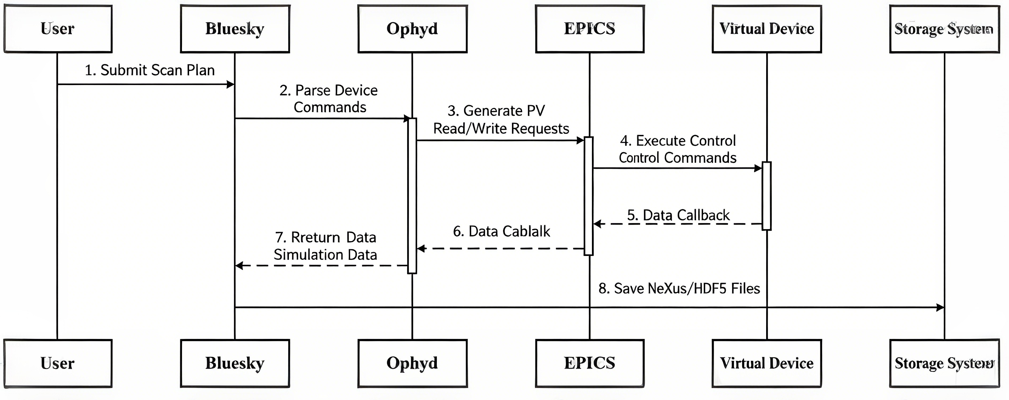
Function Verification Case 01:
CT Experiment
▌ Experimental
Workflow
01. Environment deployment
02. Optical system initialization
03. Experiment process orchestration
04. Virtual experiment execution
05. Data archiving
▌ Experimental Parameters:
Beam energy 10keV, scanning range 0°-180°, step 1°, exposure time 1s, detector output 1024×1024 2D projection
> 95%
Consistency between simulation data and real experimental data

Slide 23
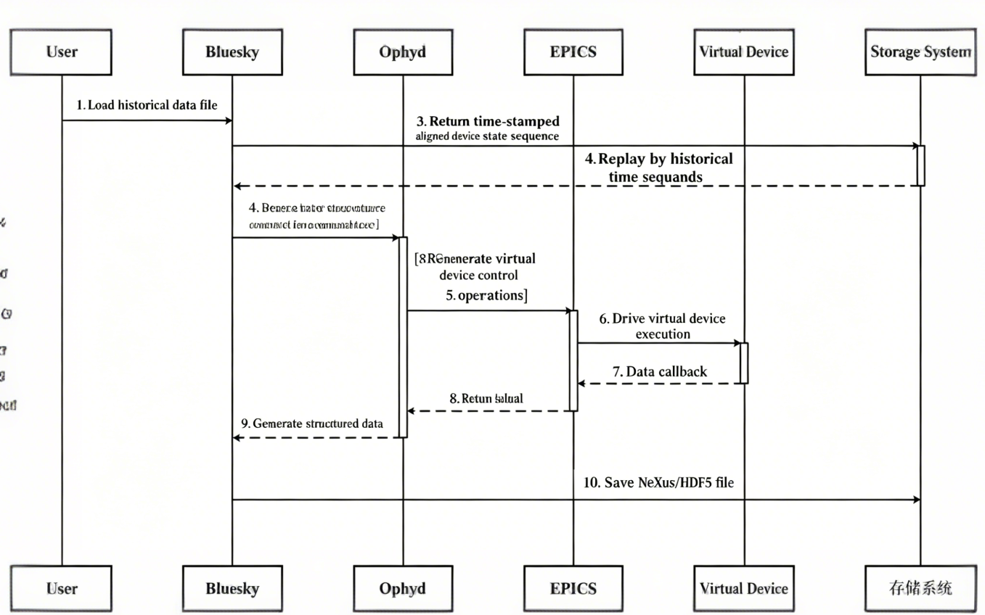

Function Verification Case 02:
XRD Reproduction
▌Experimental
Workflow
01. Environment deployment
02. Standardized data parsing
03. Zero-copy data loading
04. Automatic virtual device creation
05. Automatic process reproduction
Verification Result:
Device control logic and data acquisition timing are completely consistent with the original experiment.

Slide 24
05 Conclusion & Outlook
Notes:
首先，让我们进入第一部分：引言与背景。在这一部分，我们将探讨以HEPS为代表的第四代同步辐射光源带来的新机遇，以及随之而来的软件系统挑战。

Slide 25
Conclusion & Future Outlook
▍Core Conclusions:
▍Future Outlook
Continuously improve virtual device library, complete HEPS beamline adaptation, and on-site verification
Integrate AI/ML algorithms to realize intelligent beam tuning pre-training
Realize full-process closed-loop virtualization
Innovative dual-mode driving architecture
Deep native compatibility with EPICS/Bluesky ecosystem
Efficient massive data processing technology, solving the bottleneck of TB-level data access delay

Slide 26
Thank you for your attention!
zhangmiao@ihep.ac.cn

Slide 27
Q & A

