Slide 1




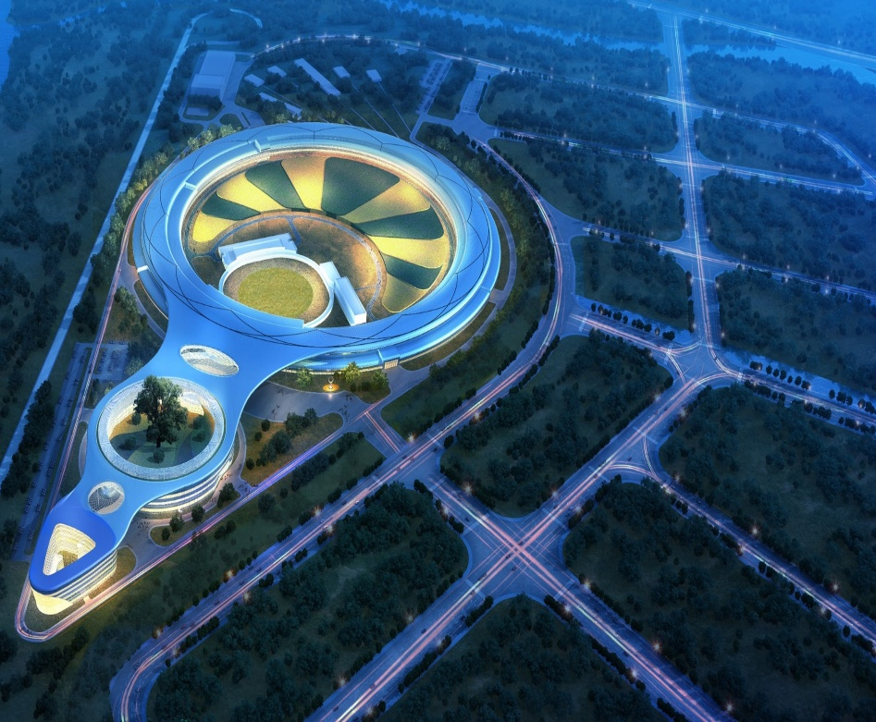
Spring EPICS Collaboration meeting 2026 ENS Paris-Saclay
EPICS-Integrated High-Level Application Development for HEPS
Xiaohan Lu (卢晓含)，IHEP
Apr. 21, 2026

Slide 2
Outline
HLA development requirements of HEPS
Pyapas for HLA development
HLAs development for HEPS
Conclusion

Slide 3
HLA development requirements of HEPS
Pyapas for HLA development
HLAs development for HEPS
Conclusion

Slide 4
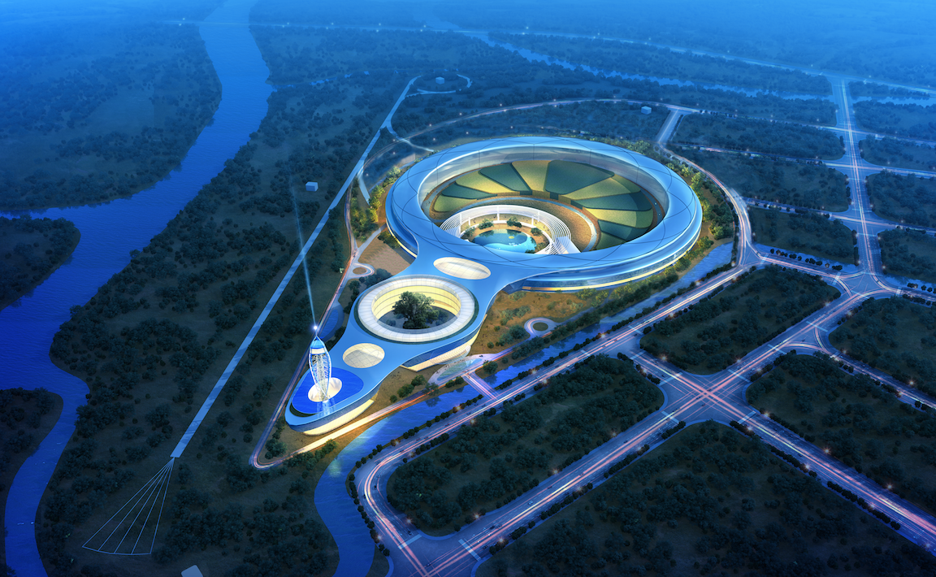
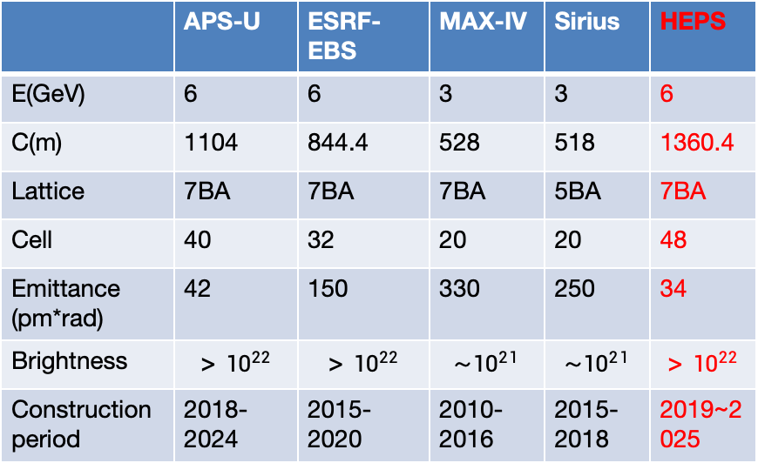
Introduction to HEPS
High Energy Photon Source
One of the world's brightest fourth-generation synchrotron light sources
 | APS-U | ESRF-EBS | MAX-IV | Sirius | HEPS
E(GeV) | 6 | 6 | 3 | 3 | 6
C(m) | 1104 | 844.4 | 528 | 518 | 1360.4
Lattice | 7BA | 7BA | 7BA | 5BA | 7BA
Cell | 40 | 32 | 20 | 20 | 48
Emittance (pm*rad) | 42 | 150 | 330 | 250 | 34
Brightness | $${>10}^{22}$$ | $${>10}^{22}$$ | $${\sim 10}^{21}$$ | $${\sim 10}^{21}$$ | $${>10}^{22}$$
Construction period | 2018-2024 | 2015-2020 | 2010-2016 | 2015-2018 | 2019~2025
Booster
Linac
Storage Ring &Experiment Hall
User Service Building
The facility has the capacity for more than 90 high-performance beamlines and can provide X-rays with energy up to 300 keV
The facility offers 10nm spatial resolution, 1MeV energy resolution, and picosecond time resolution for high-frequency dynamic detection

Slide 5

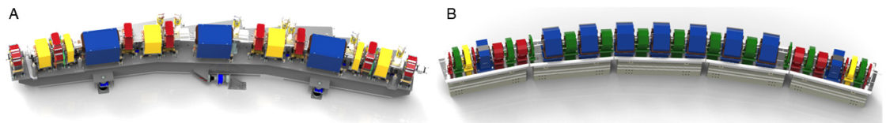
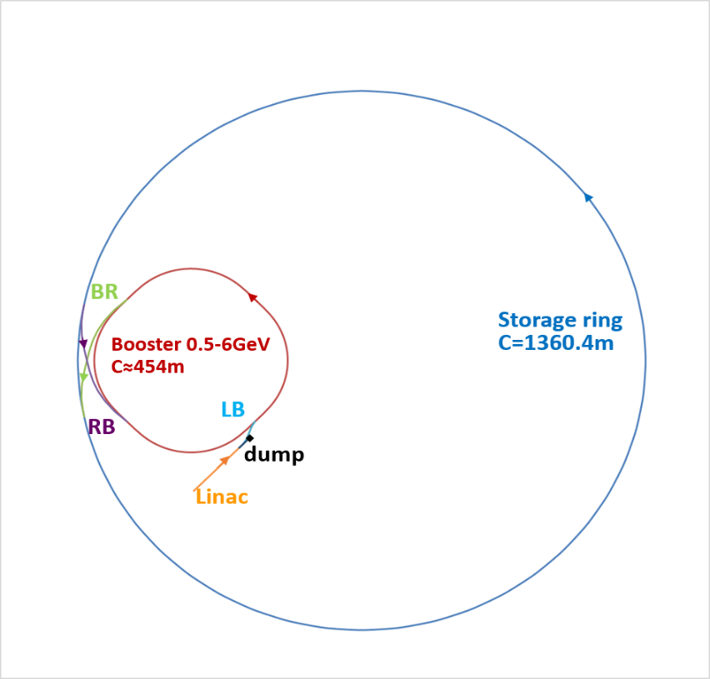
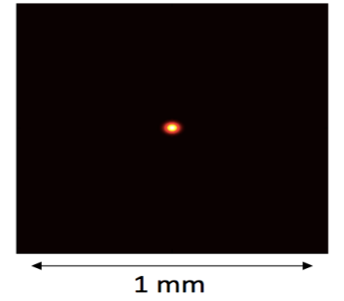
Introduction to HEPS
→The emittance is reduced by 1or 2 orders of magnitude, approaching the X-ray diffraction limit
→The number of magnets increases by an order of magnitude
HEPS is currently the largest accelerator facility in China.
High control complexity
Large scale of control variables
High precision control required
Large number of HLAs required
3rd generation
More than 2,000 power supplies.
4th generation
Layout
Beam Profile
Notes:
HEPS is the first 4-generation light source in china, compare to 3rd generation light source

Slide 6
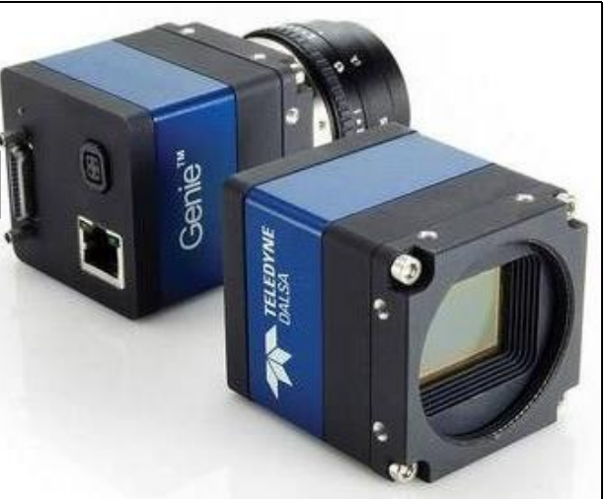
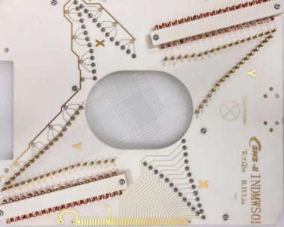
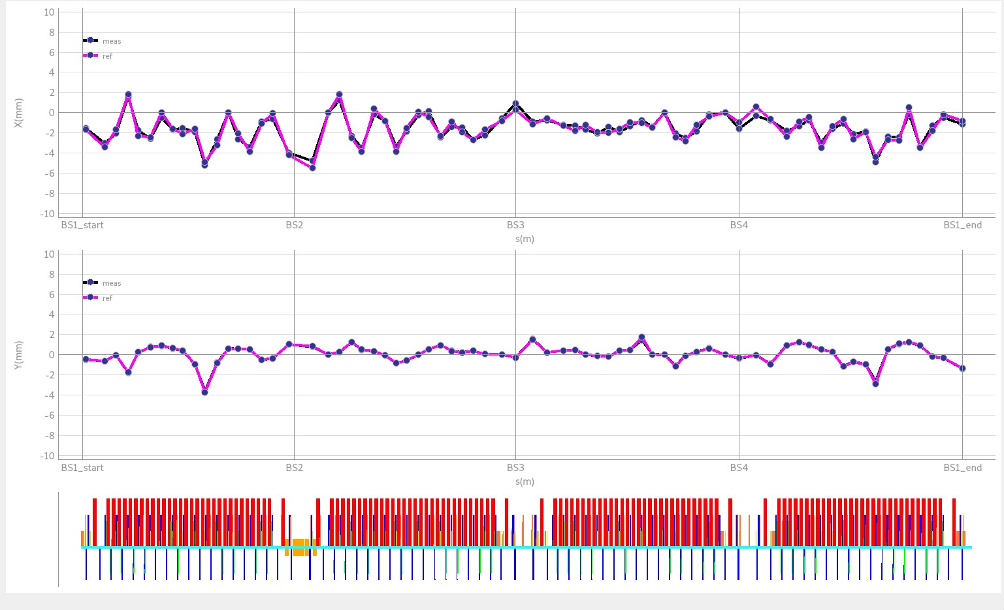
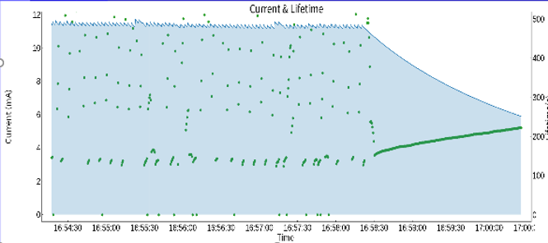
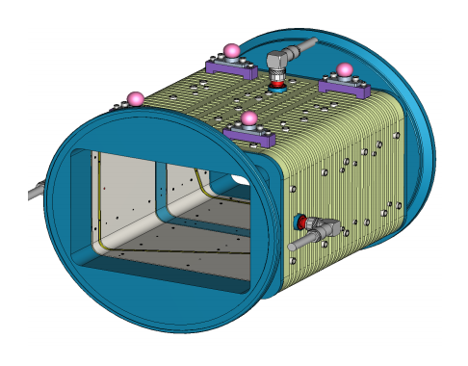
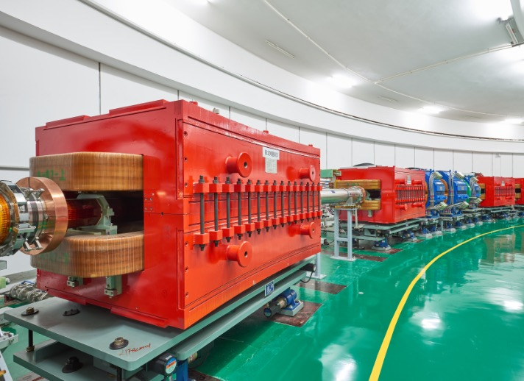
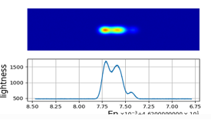
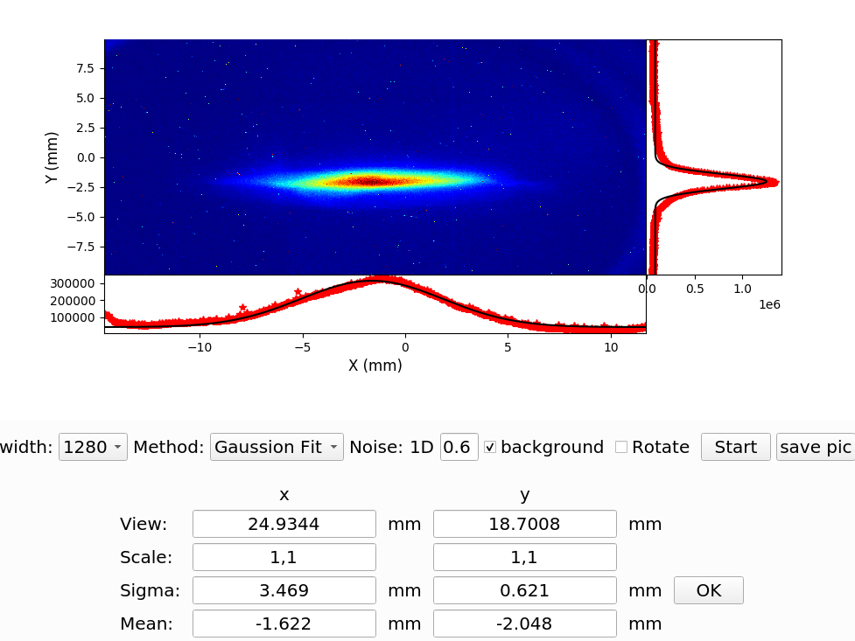
High Level Application
High-Level Application (HLA) is typically an integrated system that monitors, analyzes, and controls the accelerator’s operational status and beam parameters — serving as the accelerator’s “central nervous system”!
Low-Level Hardware
High-Level Application
WireScanner
Closed Orbit Correction
Lifetime calculation
Physical
Algorithm
BPM
Control
Communication
Energy / Energy Spread Analysis
Beam Emittance Measurement
Notes:
For physics developers, the following steps are overly complex. Independent development by each individual would be time-consuming

Slide 7
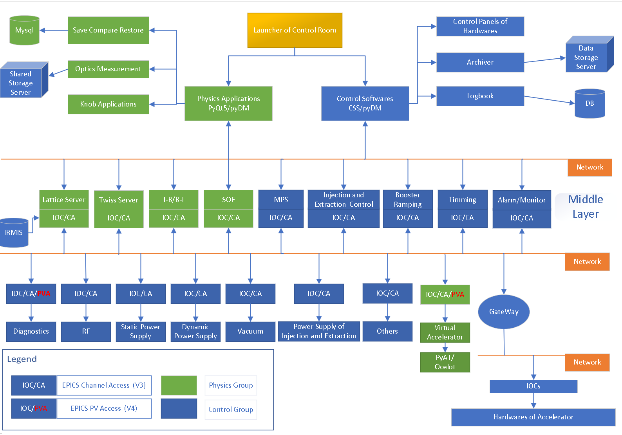
High Level Application
The overall structure of control system
Focus more on physical process:
optimization, simulation, feedback et.al.
High Level Application(HLA)
High control complexity
Large scale of control variables
High precision control required
Large number of HLAs required
Notes:
For physics developers, the following steps are overly complex. Independent development by each individual would be time-consuming

Slide 8
High Level Application
HLA Framework make the developer focus on the Algorithm Abstraction
Idea
Algorithm Abstraction
Software implementation
HLA Framework
Providing a Systematic Solution
Hardware and Beam Parameters
Real-time control and device communication
Hardware comminucation tools
Physics Model Calculation
Integration of physical models and online computation
Invoke physical models online
Human–Machine Interface
Development of visual,interactive interfaces
A user-friendly interface
High Availability and Long-Term Operation
server deployment and reliable runtime
Implement server development
Real-time database connection
Data Management and Archiving
Establishment of connected data storage systems
Notes:
For physics developers, the following steps are overly complex. Independent development by each individual would be time-consuming

Slide 9
HLA development requirements of HEPS
Pyapas for HLA development
HLAs development for HEPS
Conclusion

Slide 10
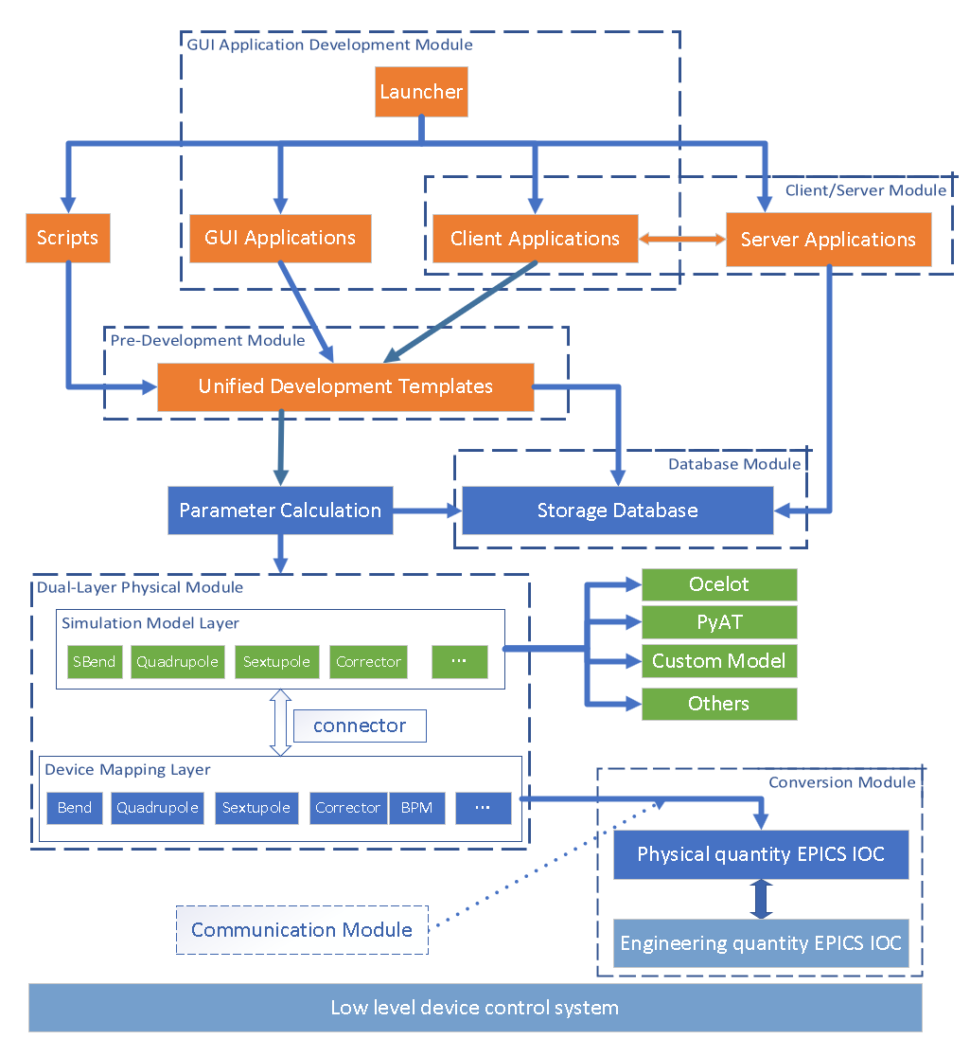
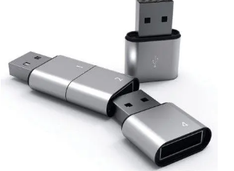
New HLA framework: Pyapas
A Pure Python Framework for High Level Application Development. Python-based Accelerator Physics Application Set (Pyapas)
Modular Design
Model-Based
Based on Physical Quantities
Pyapas framework
Dual-layer physical module
Friendly user interface module
Hardware communication module
Database connection module
Client-Server development module
Various phyiscal algorithm toolkits
Xiaohan Lu, et al, “A new modular framework for high-level application development at HEPS”, Journal of Synchrotron Radiation, 31: 385-393, 2024.
Notes:
It is worth mentioning that we developed a new modular framework for high-level application development, named Pyapas, based on which we developed the required high-level applications and adopted them in the HEPS commissioning

Slide 11
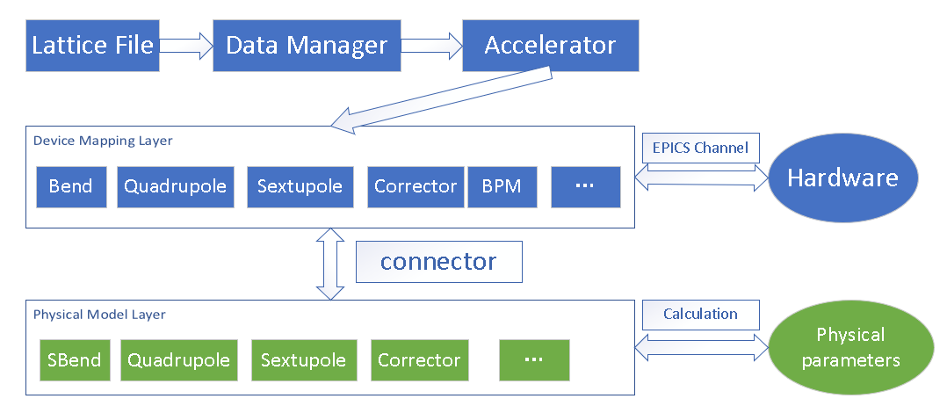
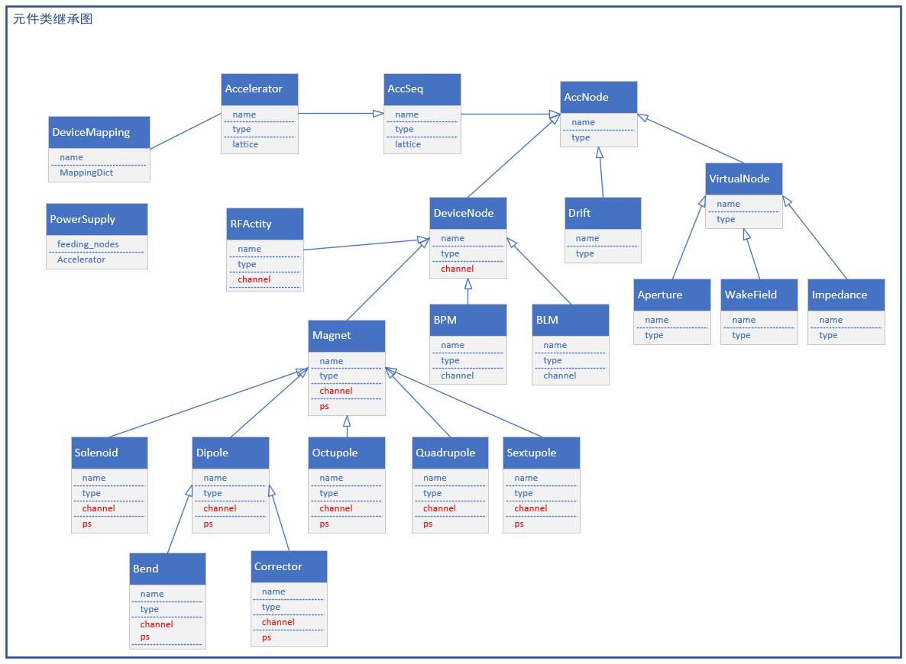
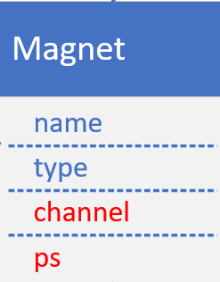
Low-coupling dual-layer physical module
Ocelot
PyAT
Custom model
The “Connector” is responsible for invoking simulation algorithms
Abstraction of the Hardware
Astract Object:
Name/Position/Length/ Field/Channel/Type/PS/ Physical parameter

Slide 12
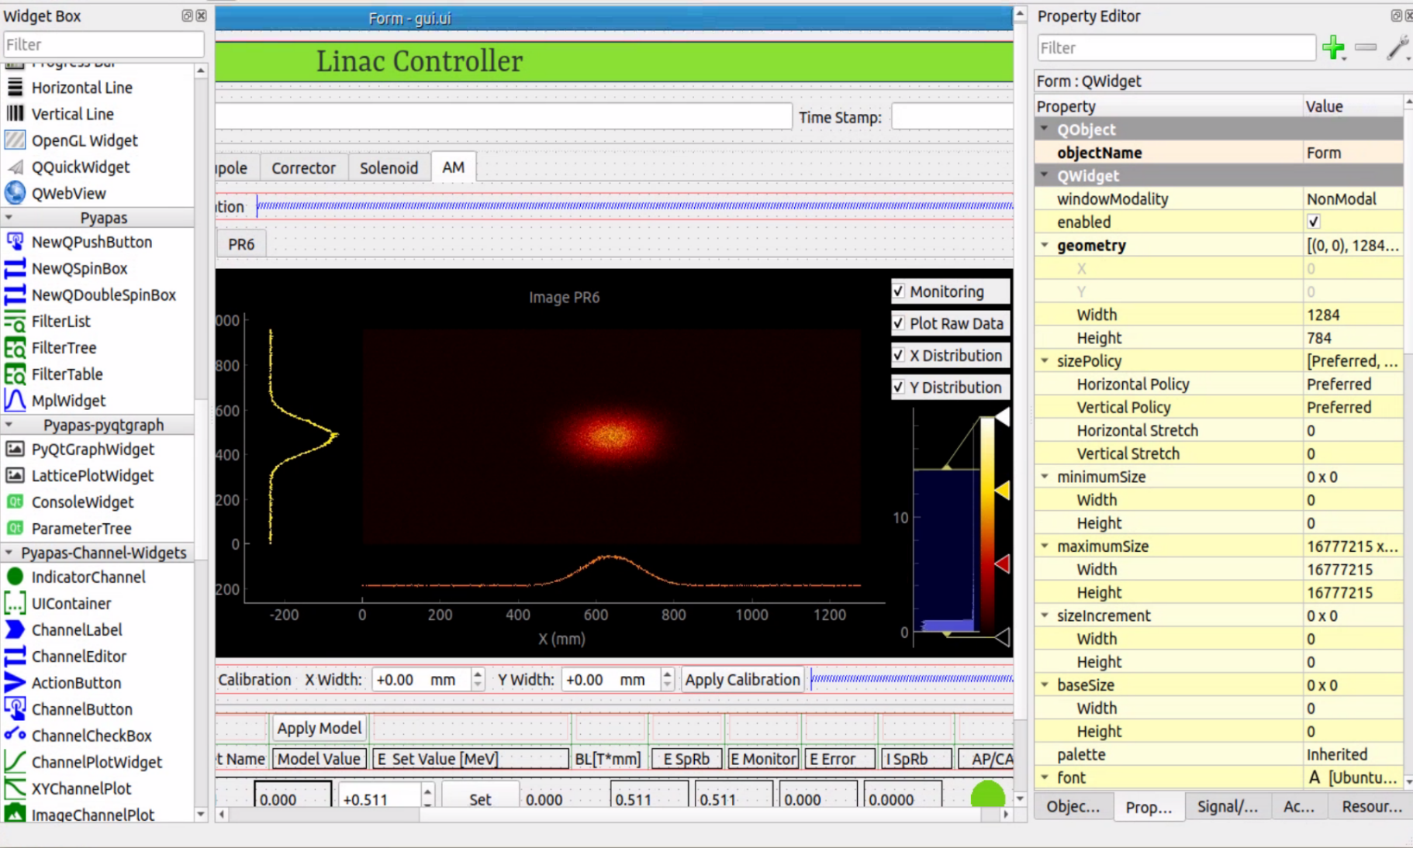
Low-Code development
Customize widgets for HLA development
“Drag and Drop”
More than 20 pre-built widgets for rapid development.
filterable list, table, tree
Plot widget for physical image, e.g. plot prameters with lattice
Widgets with channel property to interact with PV directly.
Notes:
for the user interface, we extend the Qtdesigner and customize lots of widgets for HLA development, such as plot widget with lattice, widgets with channel to interact with PV directly

Slide 13
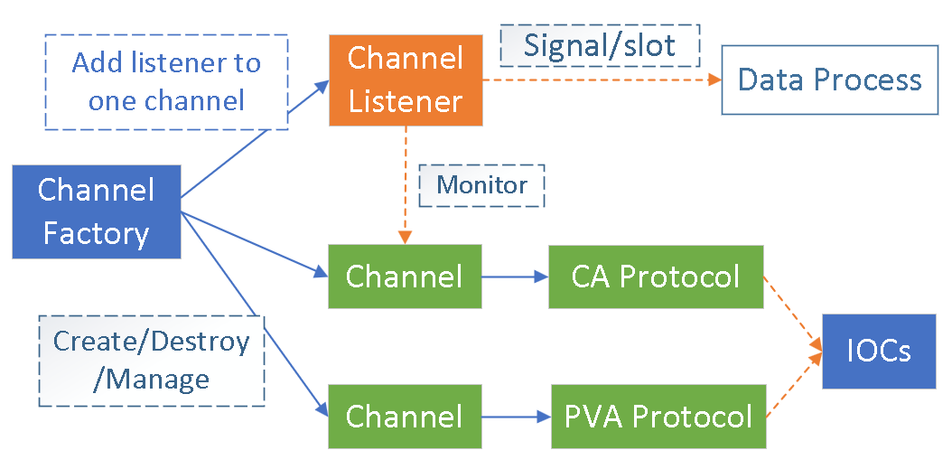
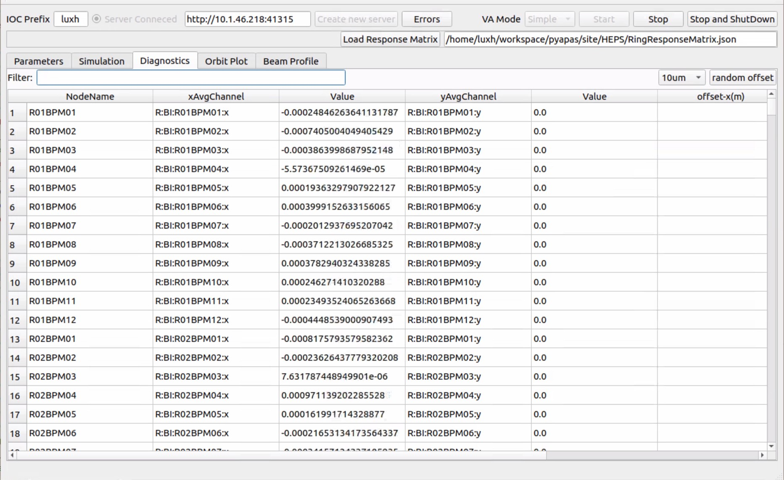
Real-time Data Interaction System
Design the communication structure (active and passive channel data acquisition) ）
The 'Singleton Factory Pattern' centrally manages interaction channels in the program, avoiding redundant creation and improving interaction efficiency.
The channel factory has namespace functionality
The Channel class contains the EPICS communication interface responsible for specific communication with the IOC
One application can smoothly run while monitoring 10,000 PVs
Notes:
Use the pyqt signal-slot feature and the ‘singleton factory pattern’, the interaction will be more efficient, a simple test was done to monitor 10K PVs in same application, it still run smoothly, meet the requirement of HEPS

Slide 14
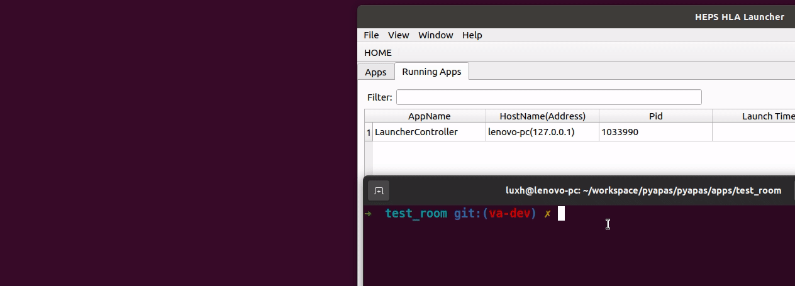
Client/Server Module
mDNS +XMLRPC
The system autonomously detects active Pyapas applications on the local area network and tracks their health and status.
These features are packaged into a full-featured Server class, allowing any subclass to instantly become a functional server.
Luncher
Terminal

Slide 15
Multithreading-based scanner
Python's GIL locks up the UI during single-threaded scans, as the loop cannot be paused. This requires a forced close of the program, which is impractical and risky in a live machine setting.
A universal scanner was designed to address this limitation
Main Thread
scan Thread
DAQ Thread
Add scan information
Add Monitored Channel
Signal/Slot
Signal/Slot
Periodic Monitoring
Scan Control/ Start /Stop
Signal for Data Acquisition
Send data step by step
Send data upon completion of all scan commissions

Slide 16
HLA development requirements of HEPS
Pyapas for HLA development
HLAs development for HEPS
Conclusion

Slide 17
HLA Development for HEPS
Transfer Line
Booster
Storage Ring
LINAC
Linac Virtual Accelerator
Transimission Efficiency
Emittance Measurement
Orbit Correction
Phase Scan
Energy Spread Measurement
Beam-based Alignment
Linac Control
LB Virtual Accelerator
Emittance Measurement
Orbit Correction
Beam-based Alignment
Local Orbit Correction 
Lattice Preparation
Booster Virtual Accelerator
First Turn Measurement
Dispersion Measurement 
Chromaticity Measurement
Tune adjustor
Global Orbit Correction
Local Orbit Correction
Beam Lifetime
Lattice Preparation
Booster Virtual Accelerator
First Turn Measurement
Dispersion Measurement 
Chromaticity Measurement
Global Orbit Correction
Local Orbit Correction
Beam Lifetime 
Orbit Display 
Slow Orbit Feedback 
K-Value adjustor 
Fast BBA 
All HLAs are developed based on Pyapas
More than 40

Slide 18
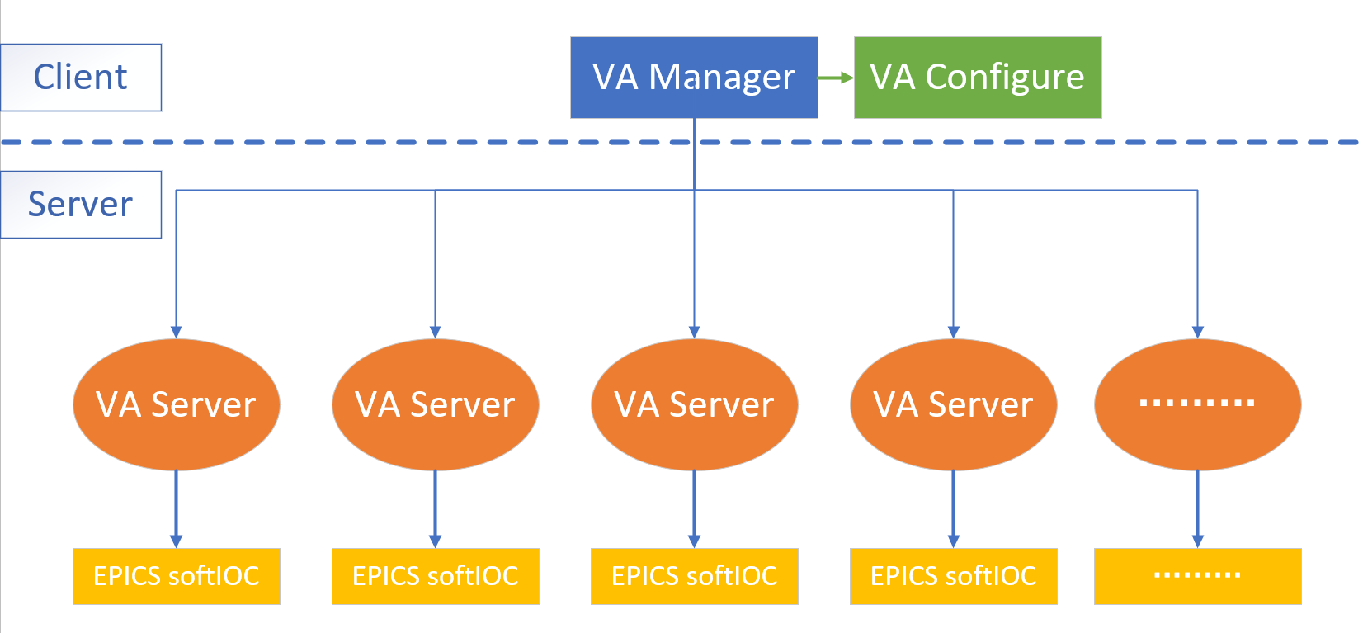
Design of A Multi-User Virtual Accelerator
Create virtual hardware to simulate real machines, providing corresponding PV channels and beam information
C/S Architecture
Multiple tasks running concurrently
Multiple users operating simultaneously
Unified management with one-click start and stop
Within the same network environment or on the same server, any number of virtual accelerators can be launched without conflicting with each other

Slide 19
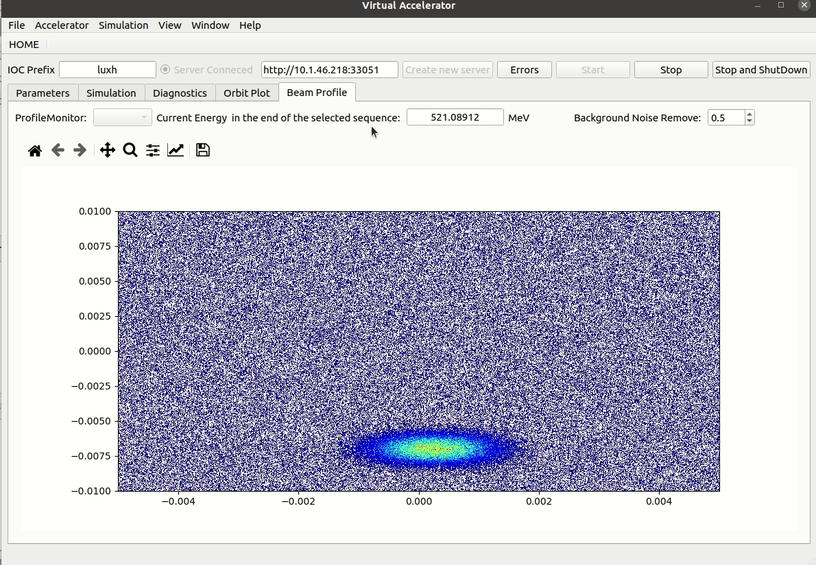
Virtual Accelerator of HEPS
Generate 'real-time' data for testing HLAs
Single Particle Tracking
Multi-Particle Tracking
Vritual PR
Full feature IOC
Errors included
All applications are initially tested via VA, which significantly reduces the overall time

Slide 20
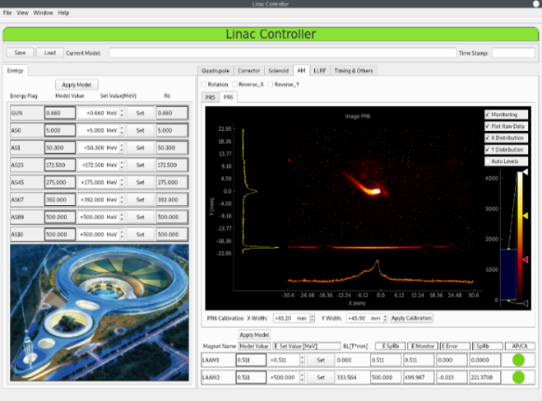
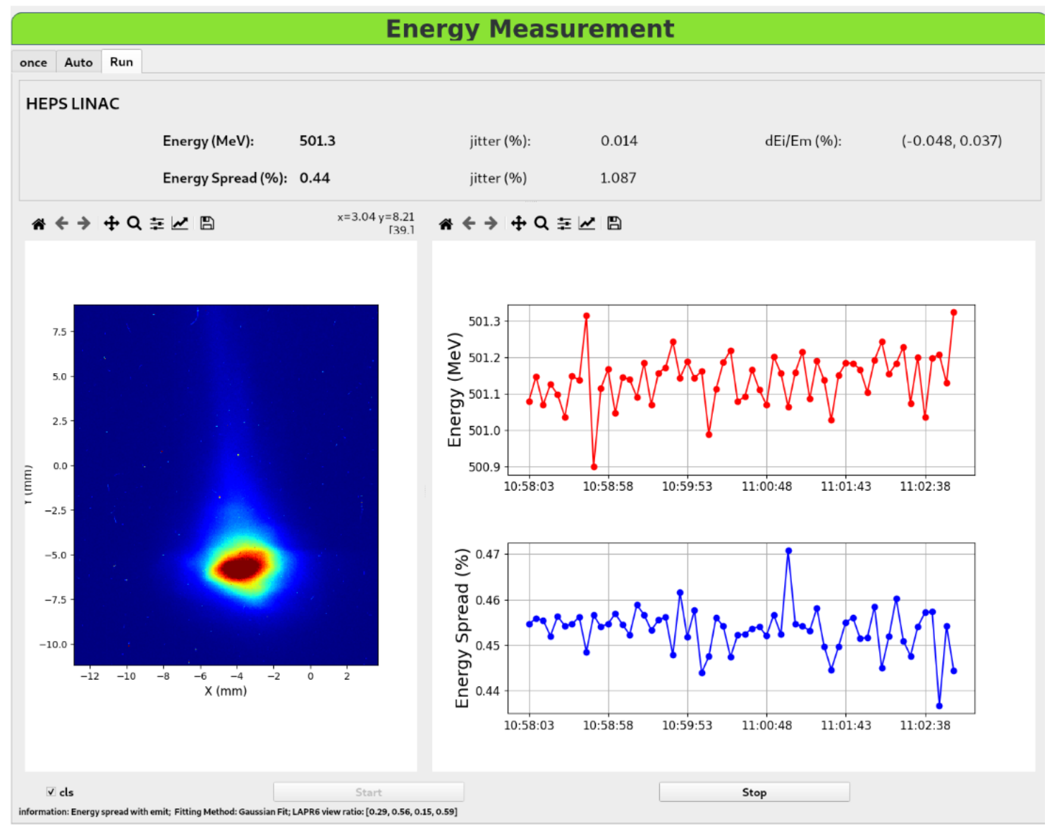
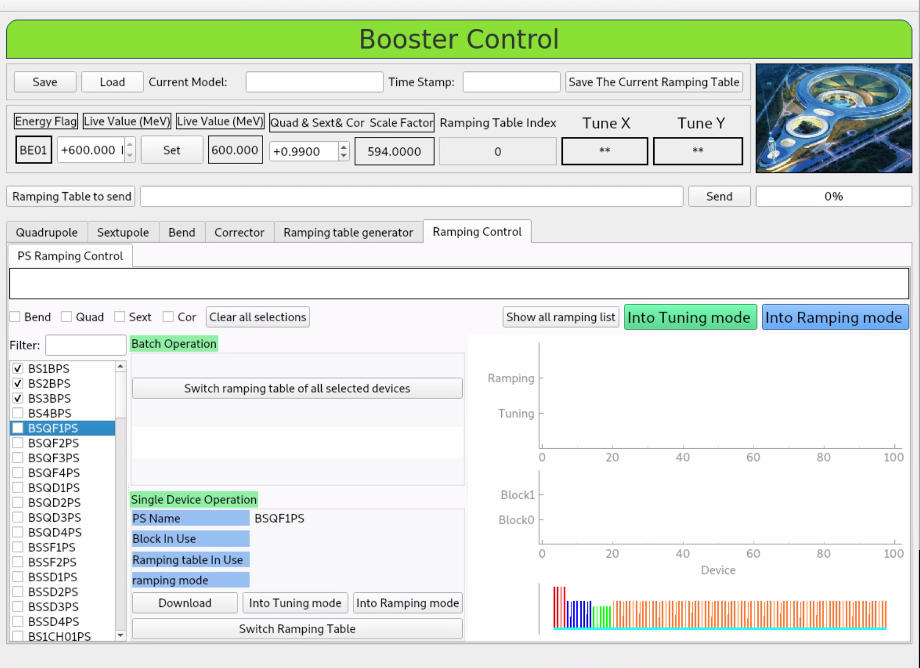
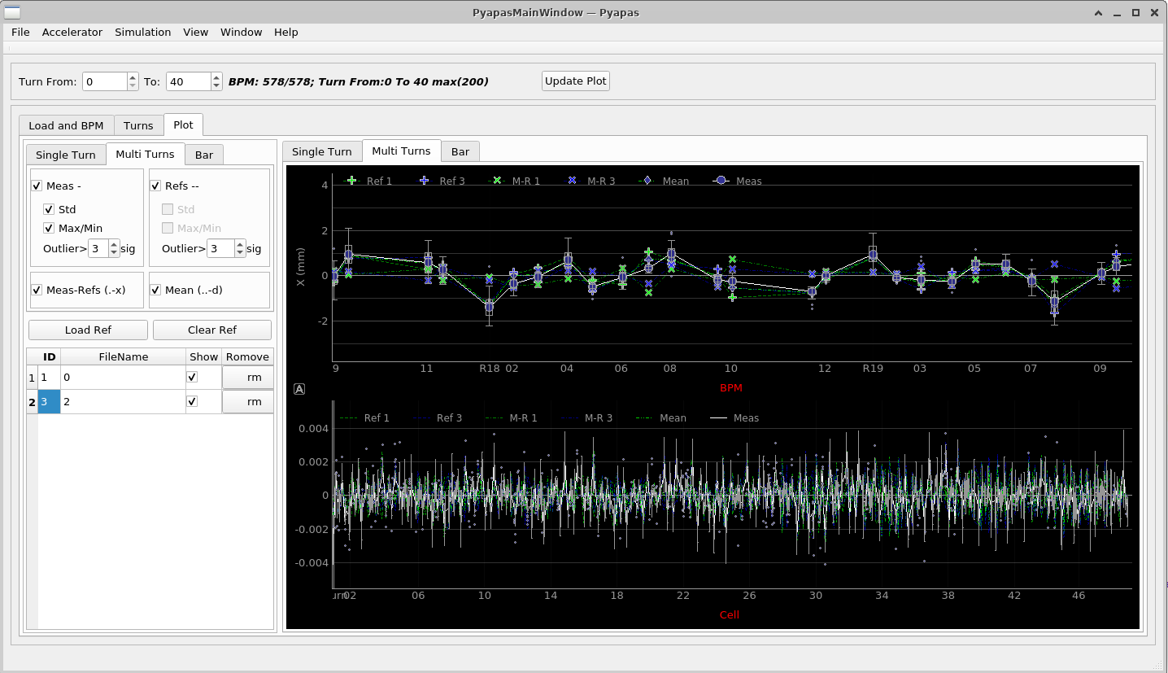
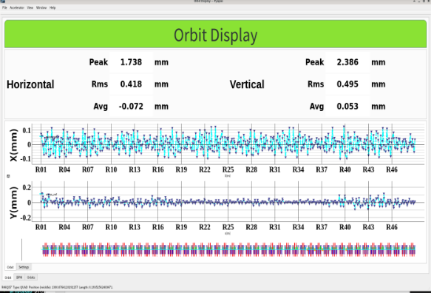
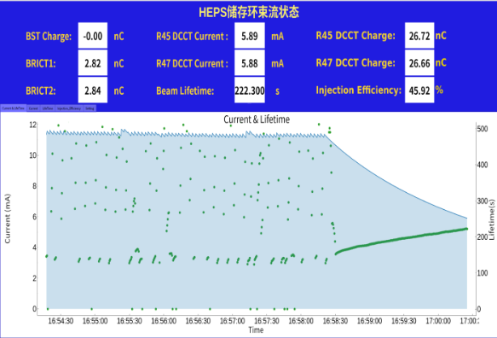
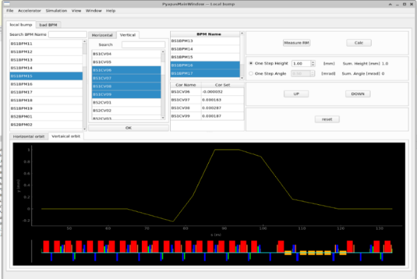
Pyapas-based HLAs for HEPS
All the HLAs are developed based on Pyapas
Linac Control
Energy Measurement
Booster Control
Virtual Accelerator
Fist Turn Analysis
Orbit Display
SR Status Monitor
Local Orbit Correction
Y.L. Zhao et al., Journal of Instrumentation, 2023; Y.M. Peng et al., Journal of Instrumentation, 2023;

Slide 21
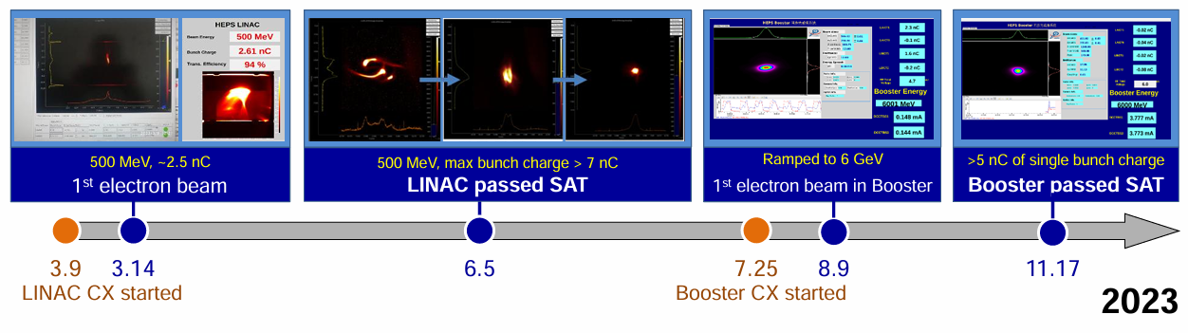
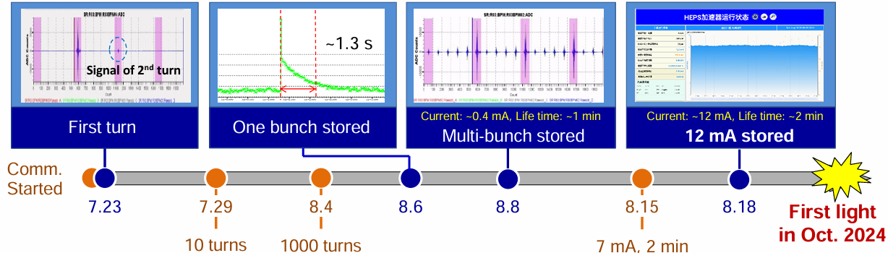
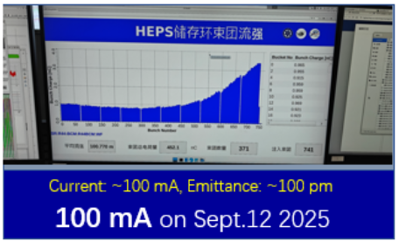
Beam Commissioning Milestones of HEPS
2025.10
passed the process
qualification and acceptance

Slide 22
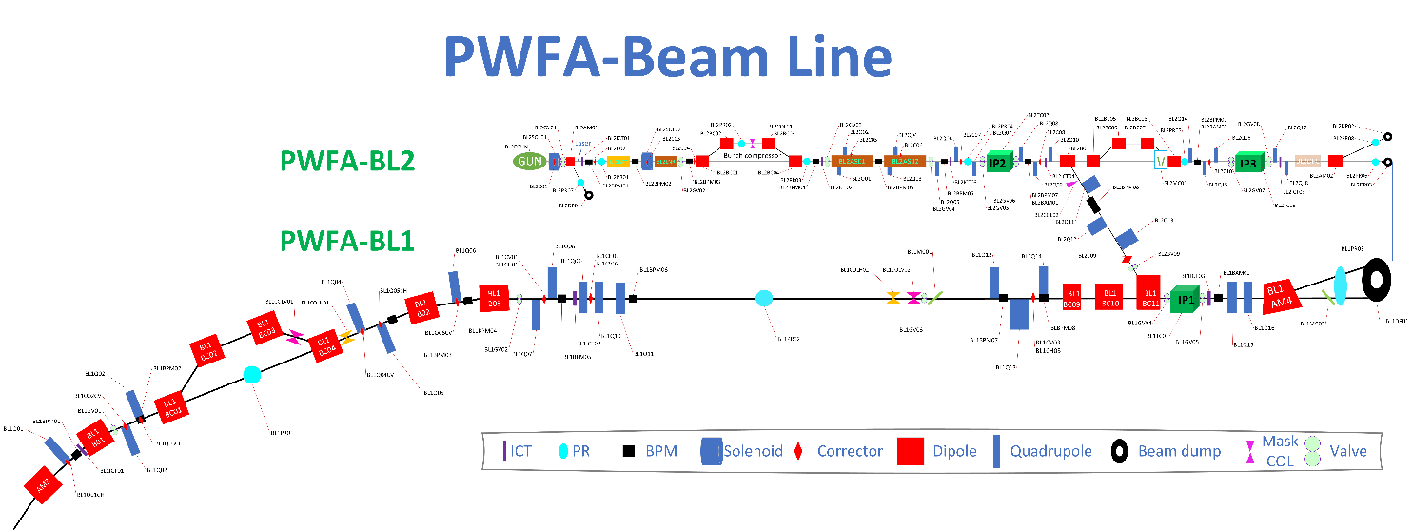
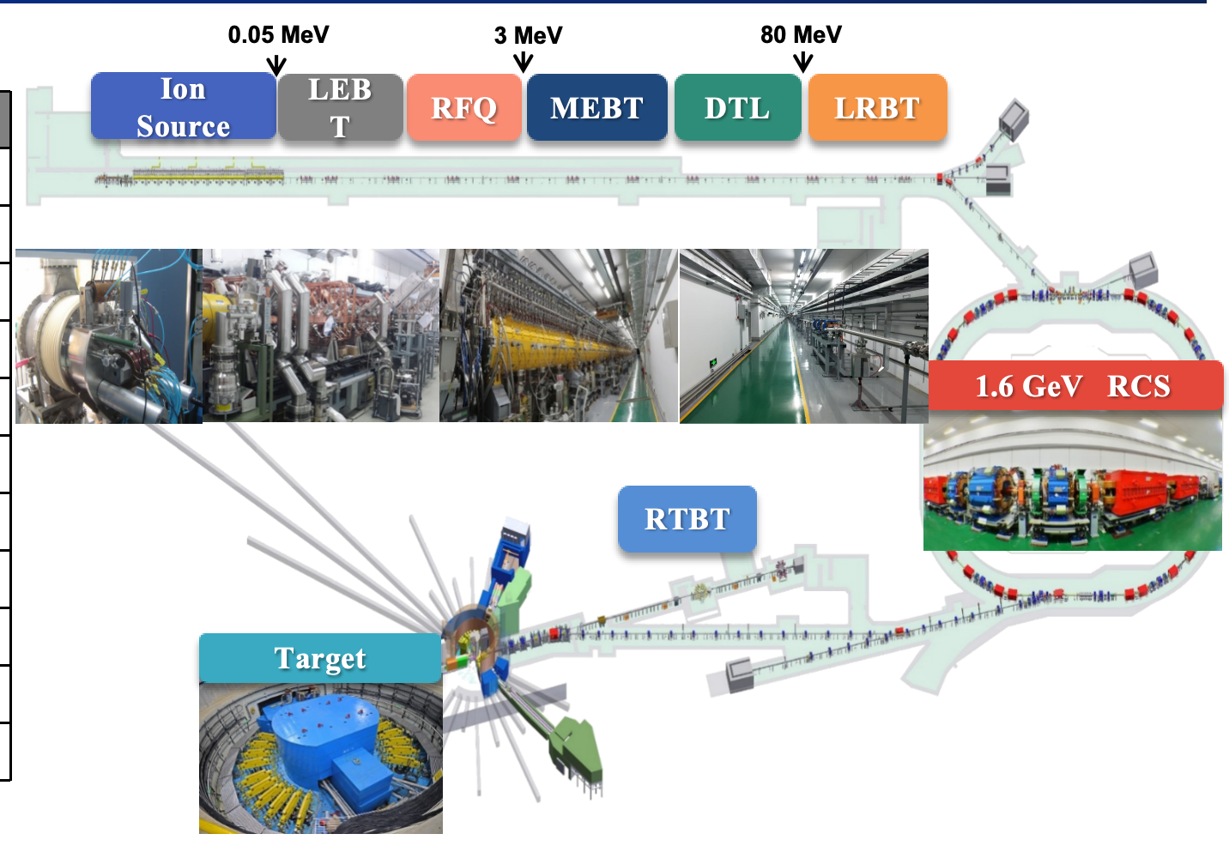
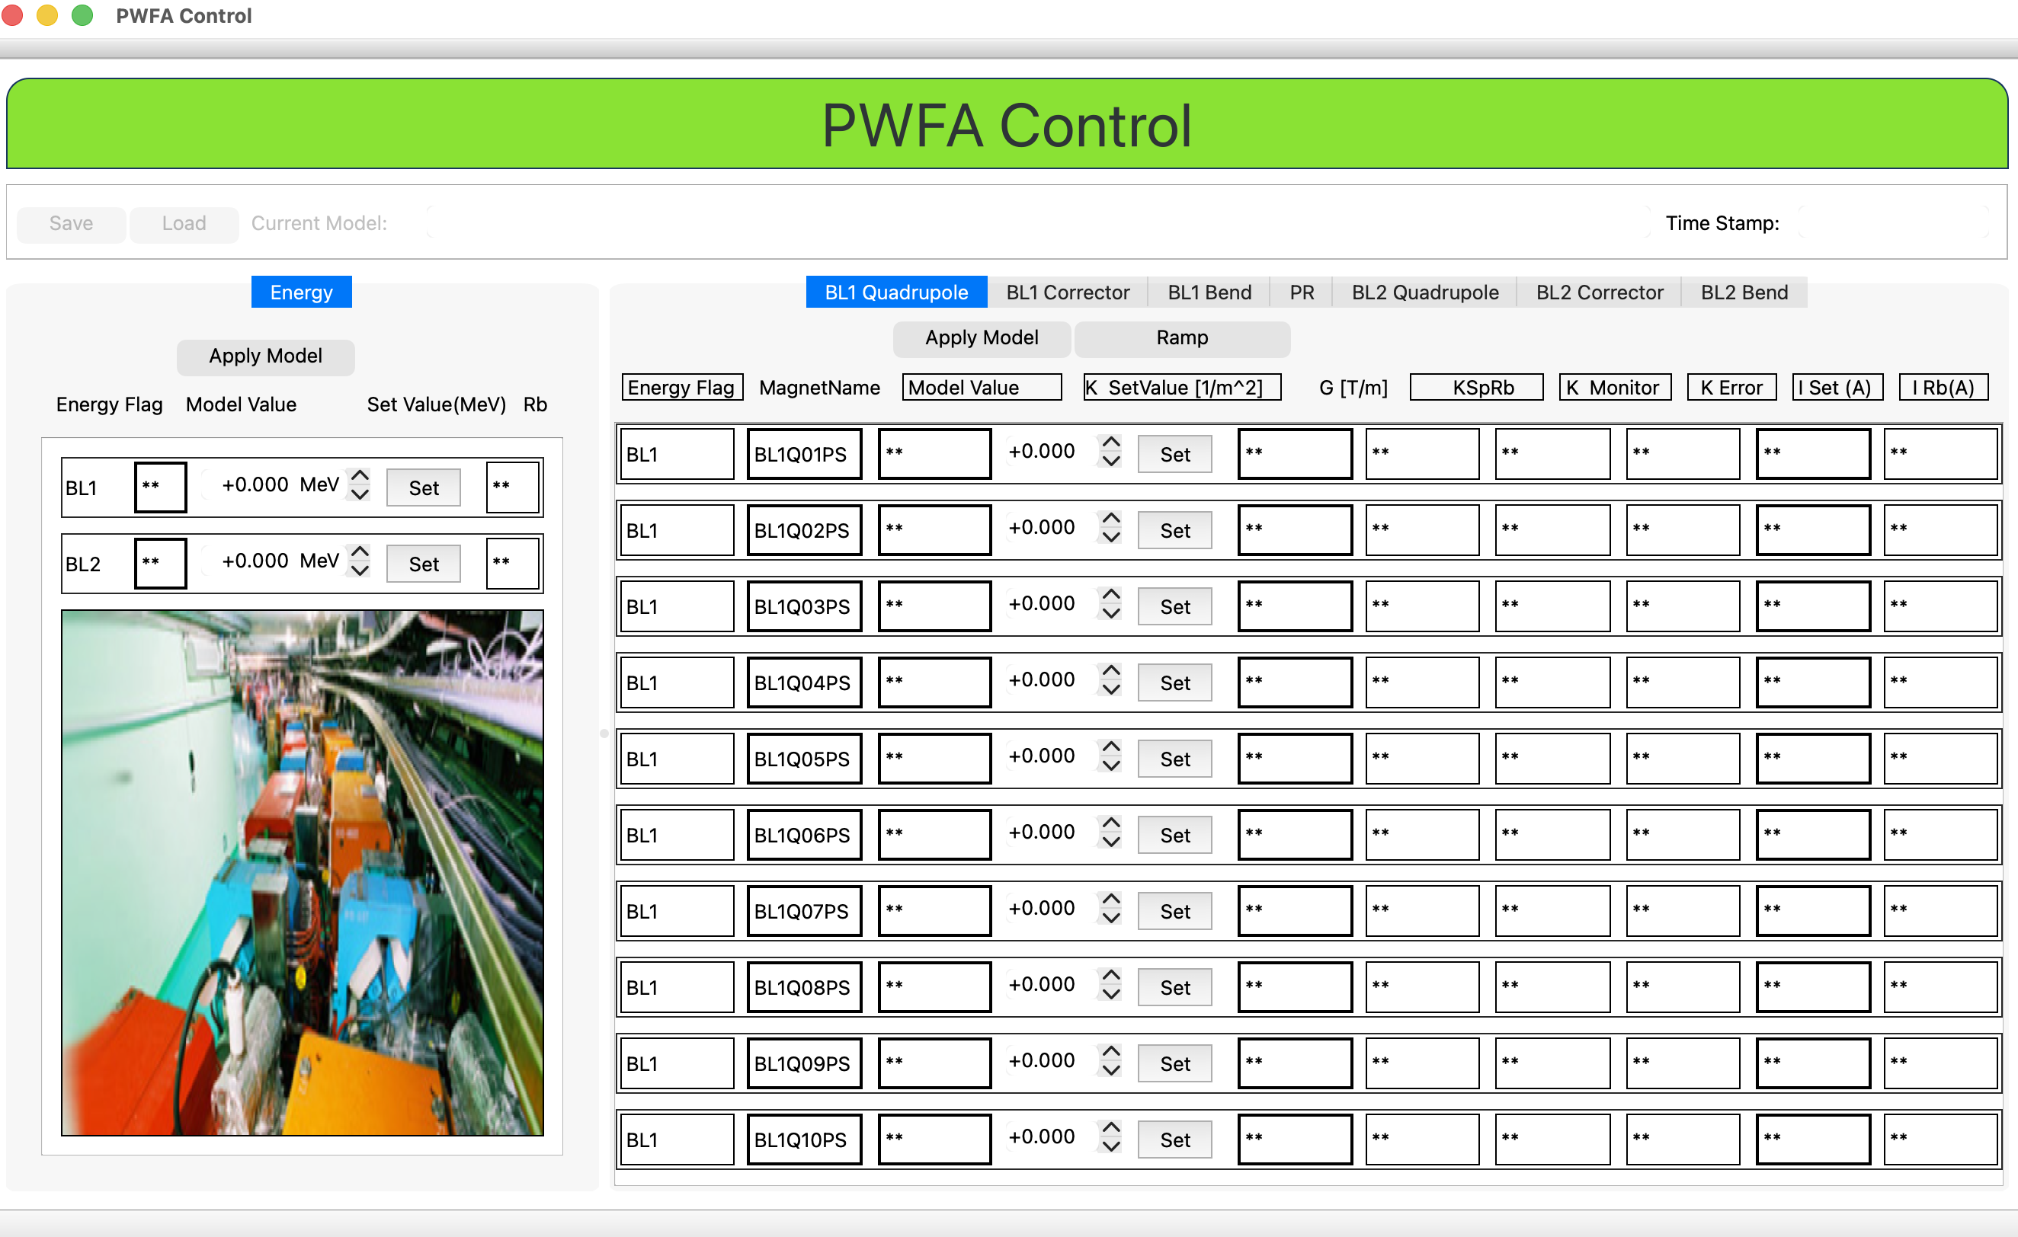
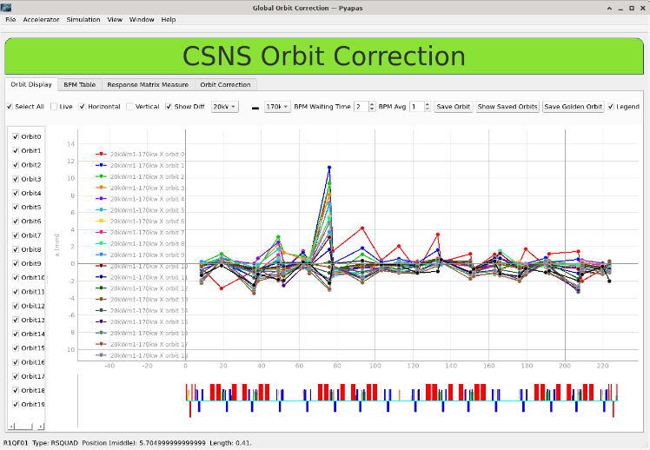
Deployment of Pyapas in Other Facilities
Pyapas architecture has been successfully applied to various accelerator facilities, including light sources, neutron sources, and novel accelerator concepts.
PWFA(electron& positron)
CSNS(Proton)
https://github.com/luxiaohan/pyapas.git

Slide 23
Two more EPICS-based solutions to share......

Slide 24
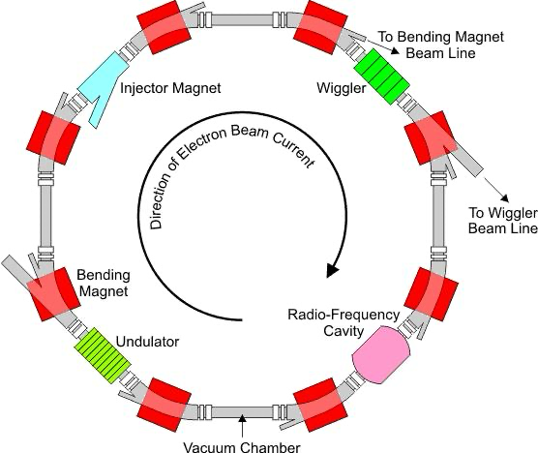
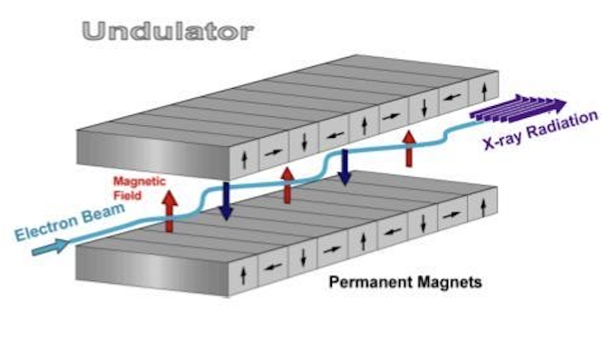
EPICS-Based Interlock System for HEPS Insertion Devices
Objective:
Coordinate insert control, feedforward, and long-coil power supplies for real-time compensation and interlock control during gap operation
GAP
Single Insert Structure
Interlock table
Interlock table
Long Coil
Interlock table
Feedforward PS x4
Interlock table
Phase Shifter
Interlock table
Interlock table
GAP
GAP
Interlock table
Interlock table
Interlock table
Interlock table
Dual Insert Structure
Long Coil
Long Coil
Feedforward PS x4
Interlock table
Interlock table

Slide 25
EPICS-Based Interlock System for HEPS Insertion Devices
Challenges:
Multi-mode interlock (operation/calibration mode )
The interlock table should be updated online
Strict response time requirement (<10ms)
GAP
Interlock table
Interlock table
Long Coil
Interlock table
Feedforward PS x4
Interlock table
Phase Shifter
Interlock table
Interlock table
GAP
GAP
Interlock table
Interlock table
Interlock table
Interlock table
Long Coil
Long Coil
Feedforward PS x4
Interlock table
Interlock table

Slide 26
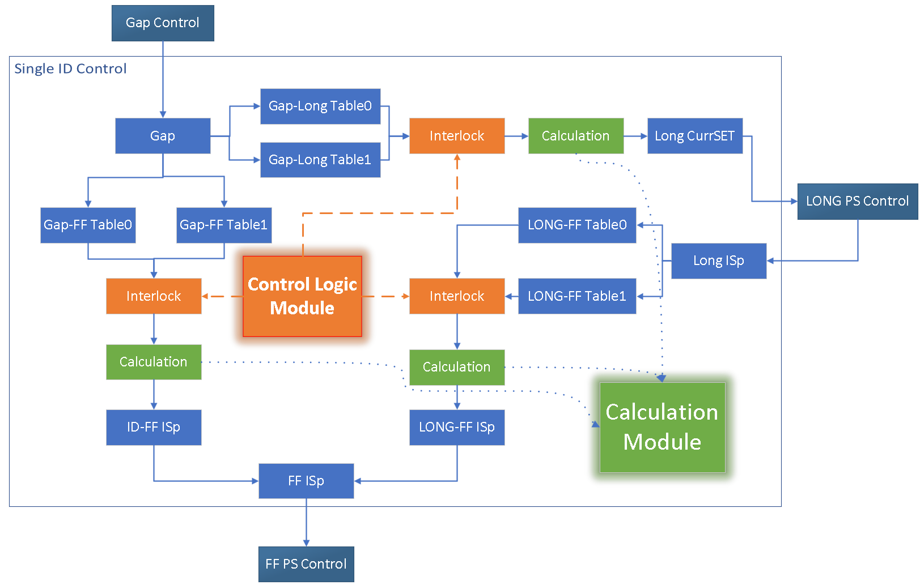
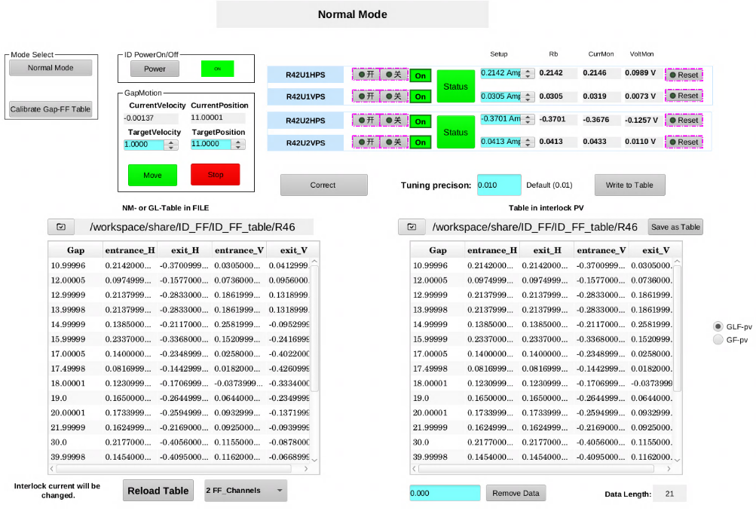
EPICS-Based Interlock System for HEPS Insertion Devices
Limitations of the current EPICS system in interlock control, particularly in:
Fast switching among >8 modes with condition-dependent logic
Dynamic reconstruction of interlock tables
Solution: C-based interlock & computation modules in EPICS with “aSub”:
* One-click mode switching (>8 configurations)
* Reconfigurable interlock logic
* Response time < 5 ms
GUI with Phoebus

Slide 27
EPICS-Based Orbit Feedback
Motivation: Low-frequency orbit noise (~3 Hz) was observed before FOFB (~ 22k Hz) was ready Python-based SOFB ( <1Hz ) cannot meet the required response speed
Proposed Solution: Develop an EPICS-based Medium-Frequency Orbit Feedback System (MOFB : 30Hz~ 100Hz )
Challenges: 1. ~2000 PVs interactions ( 1152 correctors and 1156 BPMs )
2. Lack of support for large-scale matrix computation
The aSub record supports up to 21 inputs, and therefore cannot be used directly.
aSub
Load 2000 PV Names
Global Variables
The system can operate above 100 Hz,
But is limited to 40 Hz due to the BPM SA data refresh rate
aSub
Load Matrix and Golden orbit
SVD calculation
aSub
Perform calcualtion
Feedback

Slide 28
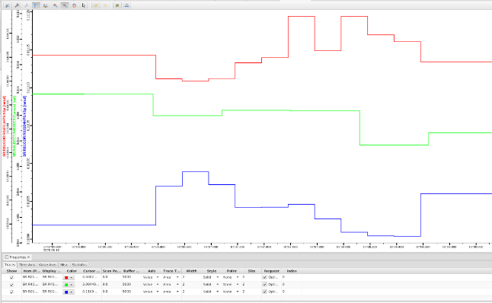
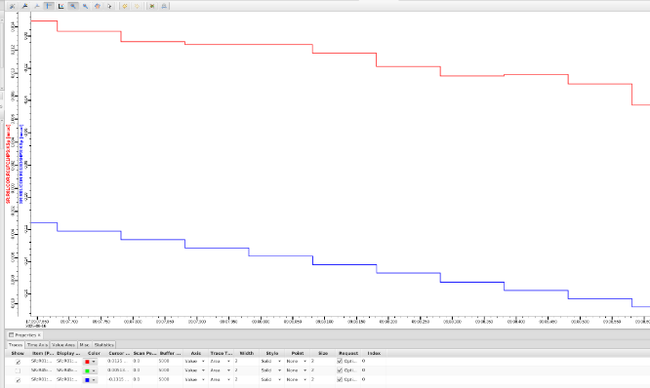
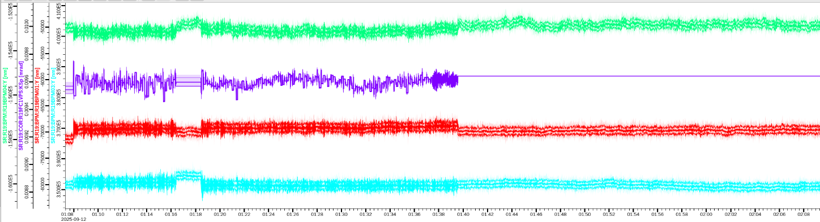
EPICS-Based Orbit Feedback
Motivation: Low-frequency orbit noise (~3 Hz) was observed before FOFB (~ 22k Hz) was ready Python-based SOFB ( <1Hz ) cannot meet the required response speed
Proposed Solution: Develop an EPICS-based Medium-Frequency Orbit Feedback System (MOFB : 30Hz~ 100Hz )
Challenges: 1. ~2000 PVs interactions ( 1152 correctors and 1156 BPMs )
2. Lack of support for large-scale matrix computation
40Hz Operation
PS
ON
OFF
5Hz Operation
10Hz Operation
Orbit

Slide 29


HLA development requirements
Pyapas for HLA development
HLAs development for HEPS based on Pyapas
HLAs development for CSNSII based on Pyapas
Conclusion

Slide 30
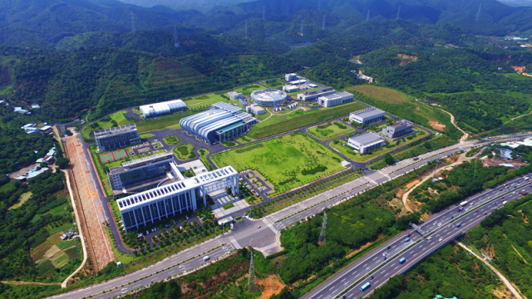
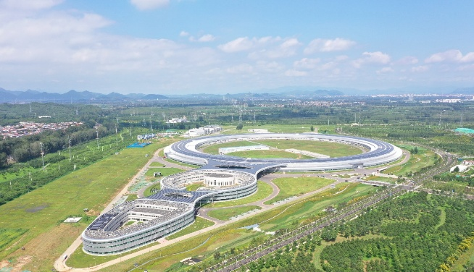
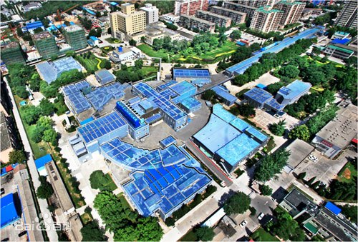
Conclusion
An EPICS-Based framework, Pyapas, was developed to enhance the efficiency of HLA development.
Pyapas has been successfully applied to the development of HLAs HEPS greatly improving development efficiency.
Pyapas is one of the very few frameworks applied to HLAs development for proton, electron, and pwfa. https://github.com/luxiaohan/pyapas.git
CSNS
HEPS
BEPCII (PWFA)

Slide 31

Thank you for your attention!

